Slide 1


Slide 2
STAY calm AND STAY Grounded
• Feeling stressed weakens the immune system
• Focus on what you can do
• Keep bodies strong and healthy
(you and your household)

Slide 3
LEADING DOCTORS ARE
Recommending THE SAME THINGS

Slide 4
Exposure
*Avoid contact with face, eyes, nose, mouth, ears
SOURCES
  Public environment
    Money, grocery carts, door handles, gas pumps, shared condiments
  Touching, shaking hands (e.g. after sneezing)
LIFE-SPAN
  Sneezing – about 10 feet to drop to the ground and no longer airborne
  Metal surfaces – can live at least 12 hours
  Fabric surfaces – can remain active for 6-12 hours
  Hands – 5-10 mins
    A lot can happen in this amount of time
    Rubbing nose or eyes unwittingly thereafter

Slide 5



TOP OIL Chemistry
Limonene (all citrus oils)
Linalool (Lavender, Petitgrain, Cilantro, Coriander, Basil, Clary Sage)
Alpha-pinene (Frankincense)
Beta-caryophyllene (Copaiba, Black Pepper)
1.8 Cineole (Rosemary, Eucalyptus, Cardamom)
Spices: Cinnamon, Clove, Cassia, Oregano, Thyme
Melissa, Litsea, Lemongrass

Slide 6




ON GUARD Everything
THE ULTIMATE SOLUTION’S PROVIDER
Wild Orange
Cinnamon
Clove
Eucalyptus
Rosemary

Slide 7

HAND Health
TIPS
  Prevent Public Exposure
    Wash or sanitize hands before you eat
    Use a napkin to touch or pick up public shared items
    Wash hands as soon as you come home
    Clean off your cell phone frequently
Sanitize hands frequently
(especially when out in public)
Wash hands frequently
(especially as an at-home practice)

Slide 8
DIY HAND Mist
INGREDIENTS
¾ full alcohol – at least 60%
(Everclear, Isopropyl, Vodka (e.g. 130 proof → 65%)
10 drops On Guard Blend
Aloe Vera Gel
In a 2oz spray bottle, add alcohol and essential oil. Fill remainder with Aloe Vera gel.

Slide 9
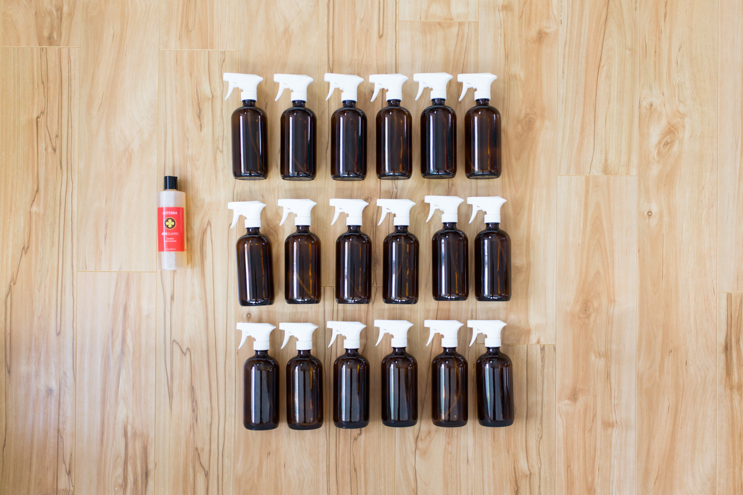
ALL PURPOSE Cleaner

Slide 10

Aromatic
DIFFUSE A MINIMUM OF 2 HOURS PER DAY (e.g. home, car, office, caregiving)
  Inhale from palms frequently (dual benefits – hand cleansing too)
  Wear like perfume/cologne (sustained inhalation and protection)
  Under nostrils (sustained inhalation and protection)

Slide 11

Topical
  Hands/palms
  Bottom of feet
  Spine
  Back of neck
  Ears
  Chest
  *Reflex points

Slide 12
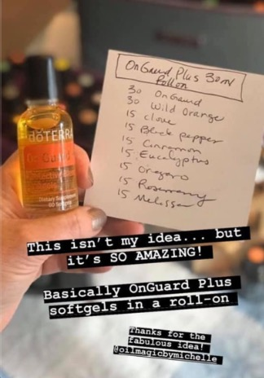
Topical On Guard+
30 On Guard
30 Wild Orange
15 Clove
15 Black Pepper
15 Cinnamon
15 Eucalyptus
15 Oregano
15 Rosemary
15 Melissa
Add ingredients to a 30mL bottle,
gently shake, and apply as needed.

Slide 13

Internal
  Drink in water (respiratory support)
  In a capsule (promote gut health)
  Under tongue (rapid systemic delivery)
GARGLE WITH ESSENTIAL OILS
  Keep throat area clear
  Minimize and eliminate exposure
  Stop invasion “at the door” before entry into lungs

Slide 14
Hydration
Get 20 drops of citrus oils, high in limonene, in body daily
Drink plenty of water daily
  Half body weight in ozs.
Consider drinking hot water
  Especially during cold weather
  Good for the body
  Effective
  Avoid ice water
Add Essential Oils
  Purify to improve quality
  Boost for added benefits

Slide 15



Slide 16


ON GUARD + SOFTGEL Replacements

Slide 17

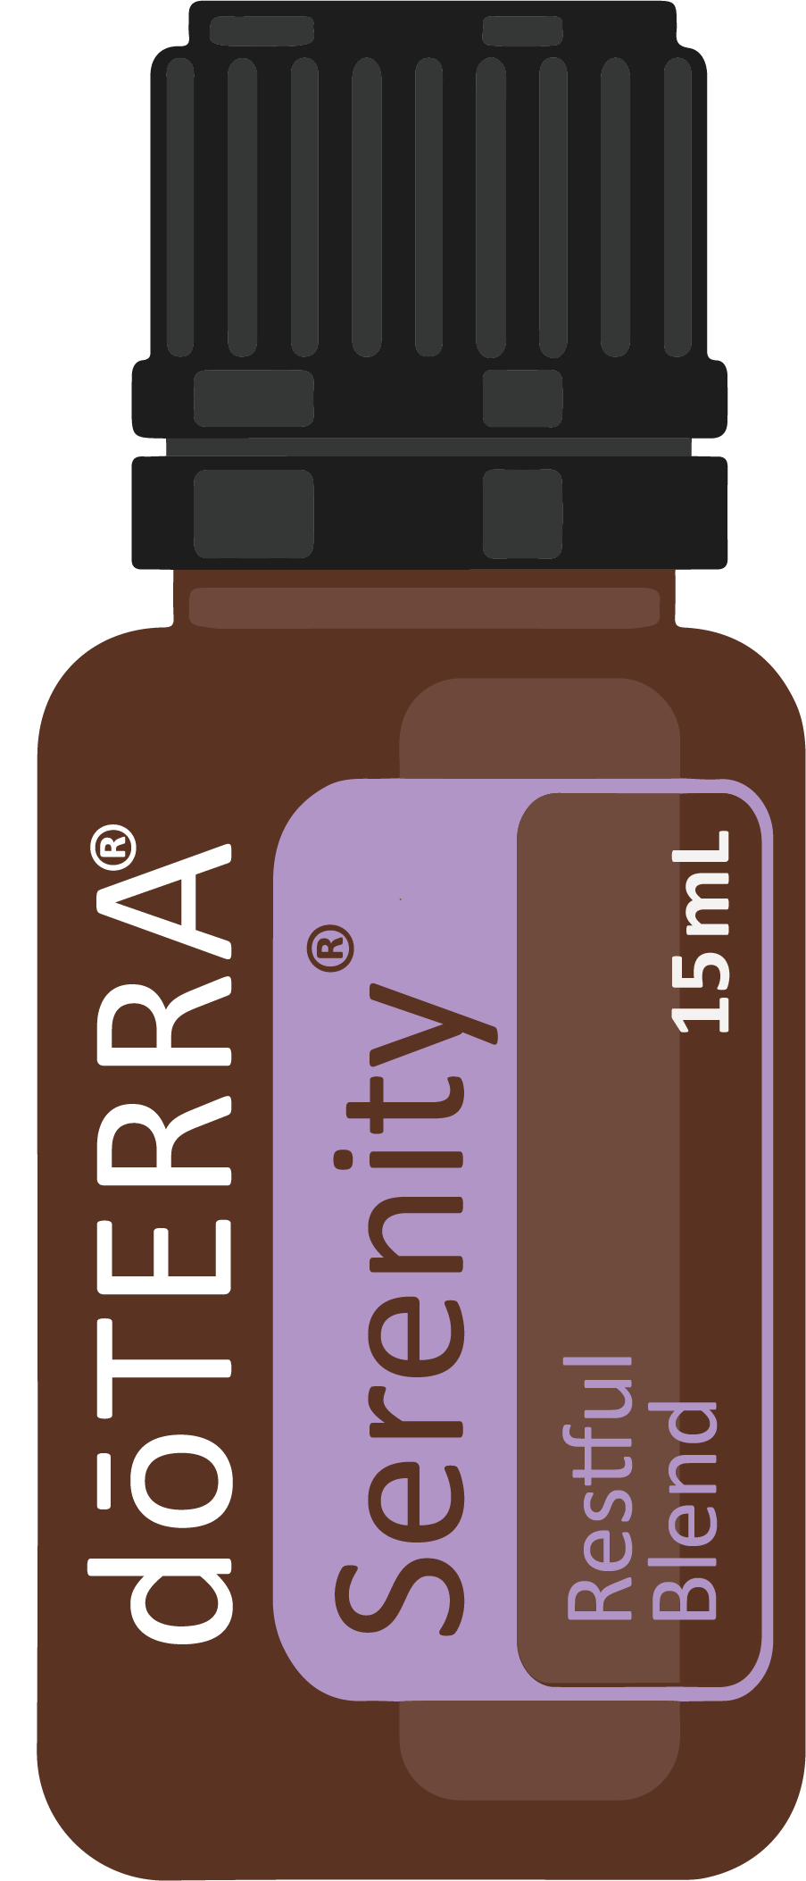
STAY Calm AND GET ADEQUATE Rest
  Balance
  Serenity
  Peace
  Adpativ

Slide 18
WASH YOUR Clothes
  Use OnGuard Laundry soap
  Boost laundry benefits with On Guard, Purify, Lemon
  Put clothes in sunshine (not heat resistant)

Slide 19

INCREASE Nutrition
  FUEL YOUR BODY
  Avoid sugar consumption and other compromising food choices
  Avoid artificial sweeteners (maintain healthy pH)
  SUPPLEMENTATION:
  LLV
  Mito2Max
  Vitamin C, D, Zinc, Magnesium

Slide 20
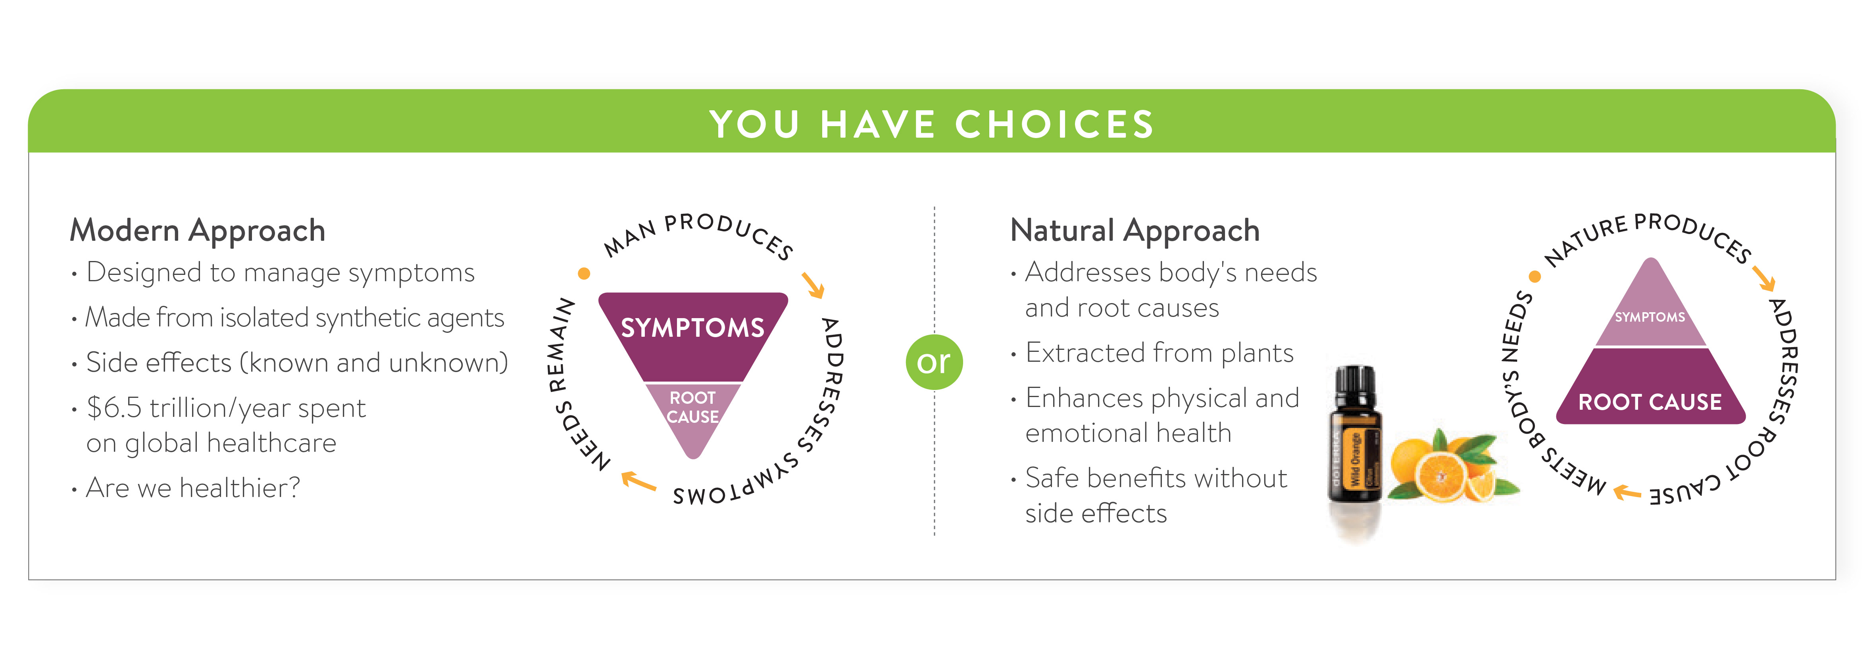

Slide 21


Slide 23


Slide 24


Slide 25
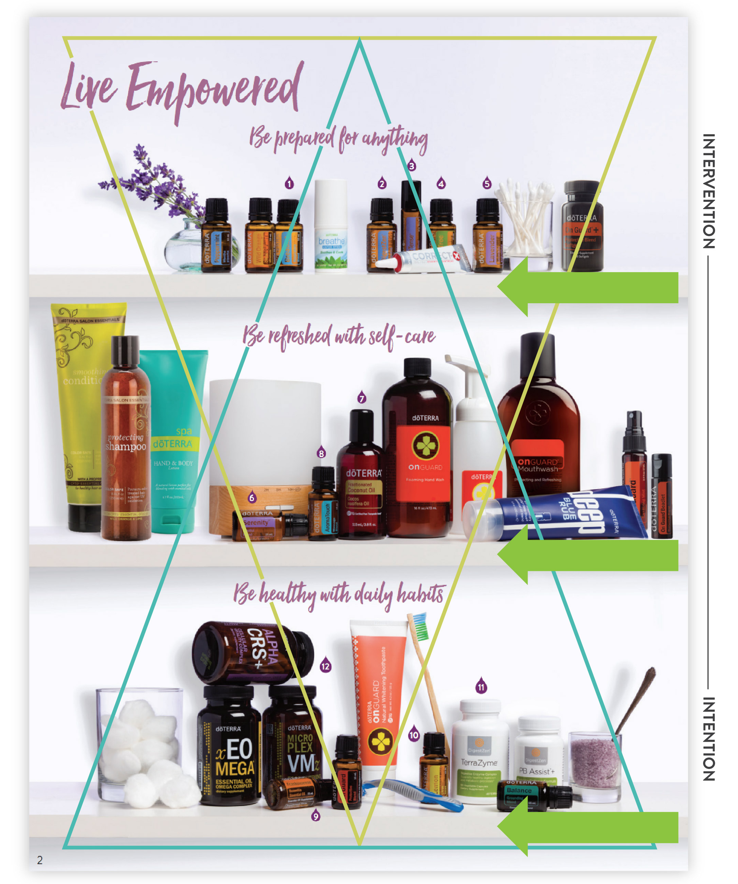

Slide 26
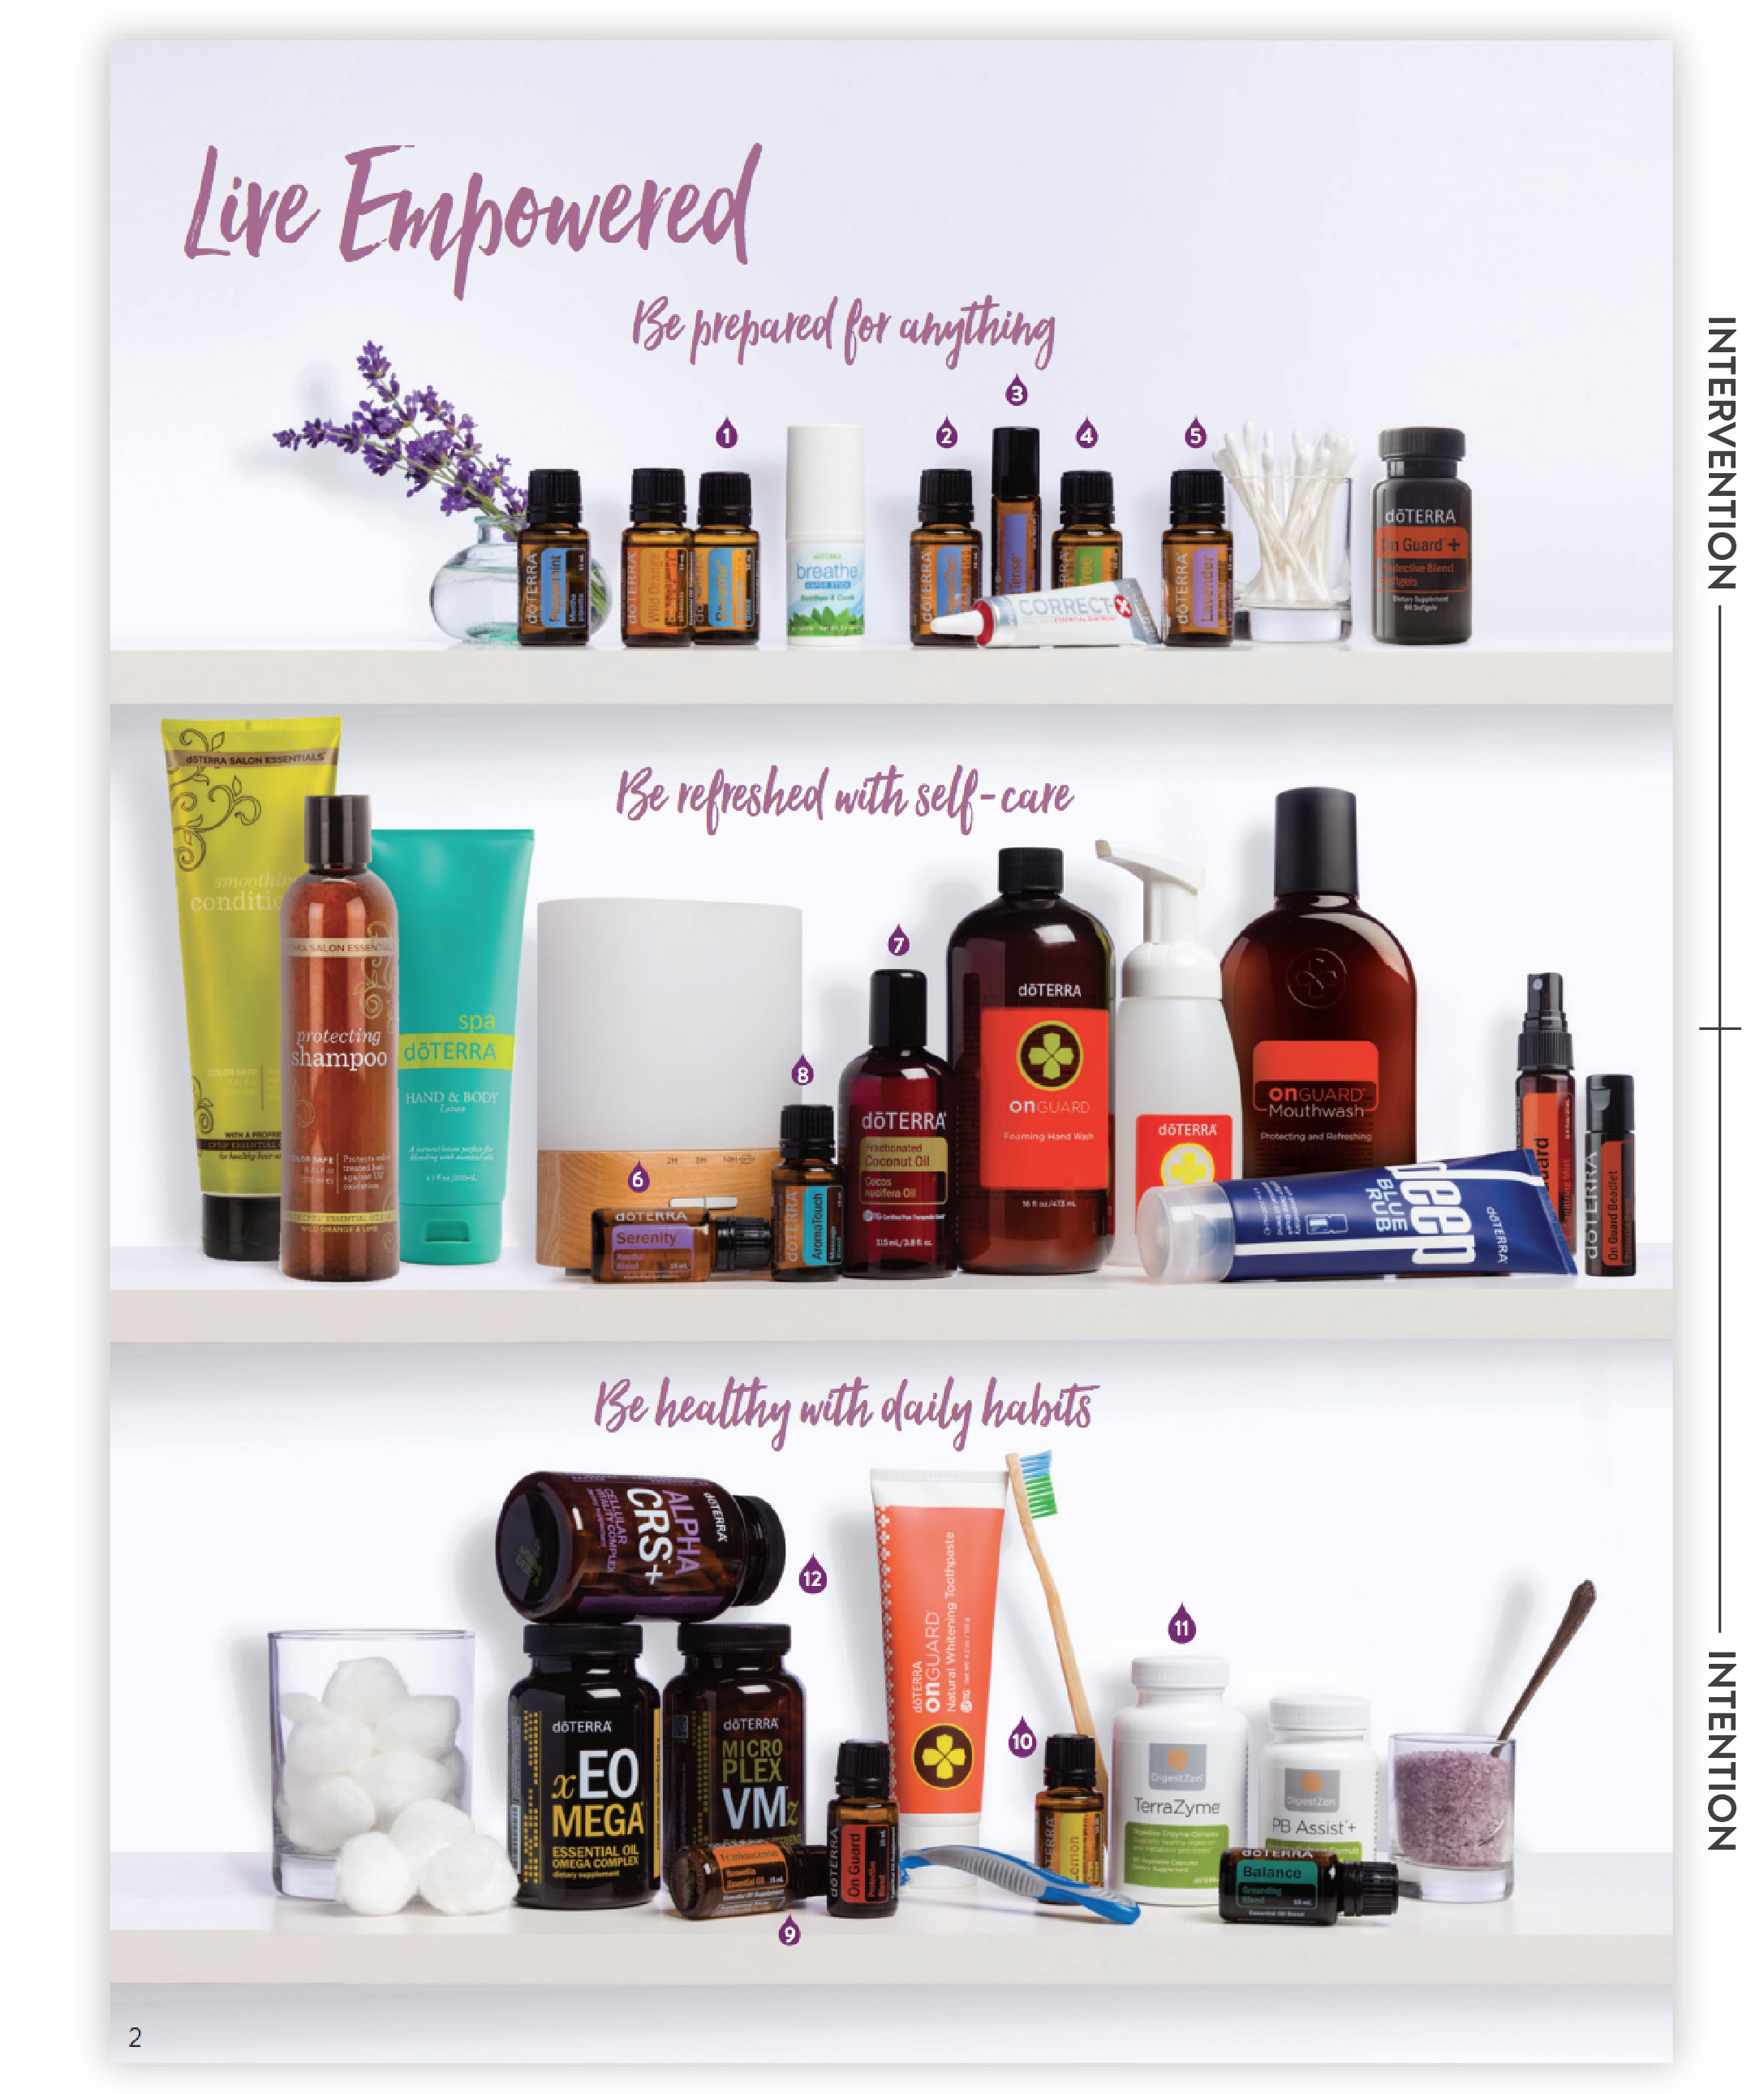

Slide 27
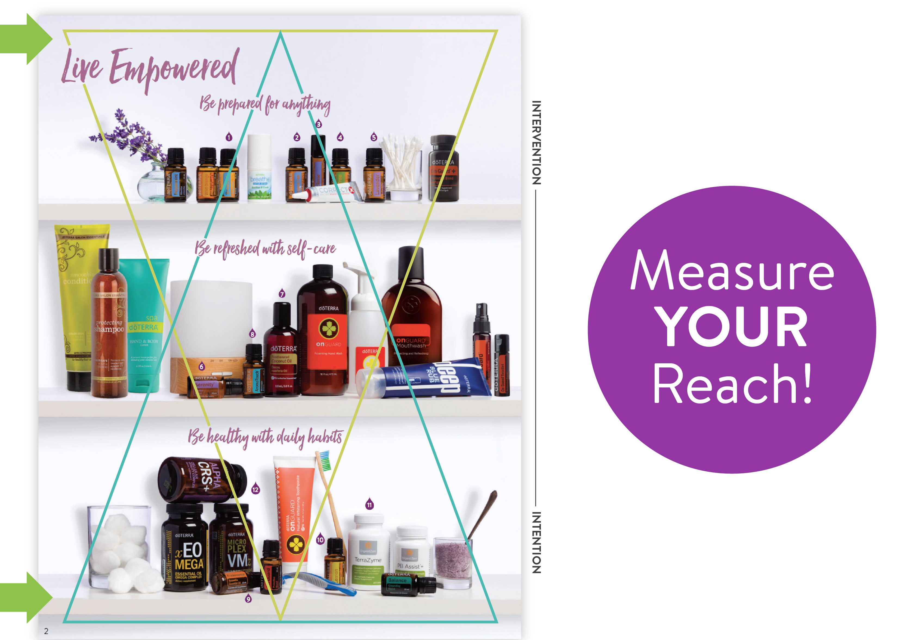

Slide 28



HEALTHY Cells
  DDR
  Turmeric
  Frankincense
  Copaiba
  Siberian Fir

Slide 29



DR. HILL’S
Recommendations
• Applied to bottoms of feet
• Add to veggie capsule
• Add to drinking water
• Diffuse

Slide 30



MAINTAIN A Healthy Gut
  PB Assist+®
  TerraZyme®
  GX Assist®

Slide 31

IMMUNE Support

Slide 32

SEASONAL Threats

Slide 33
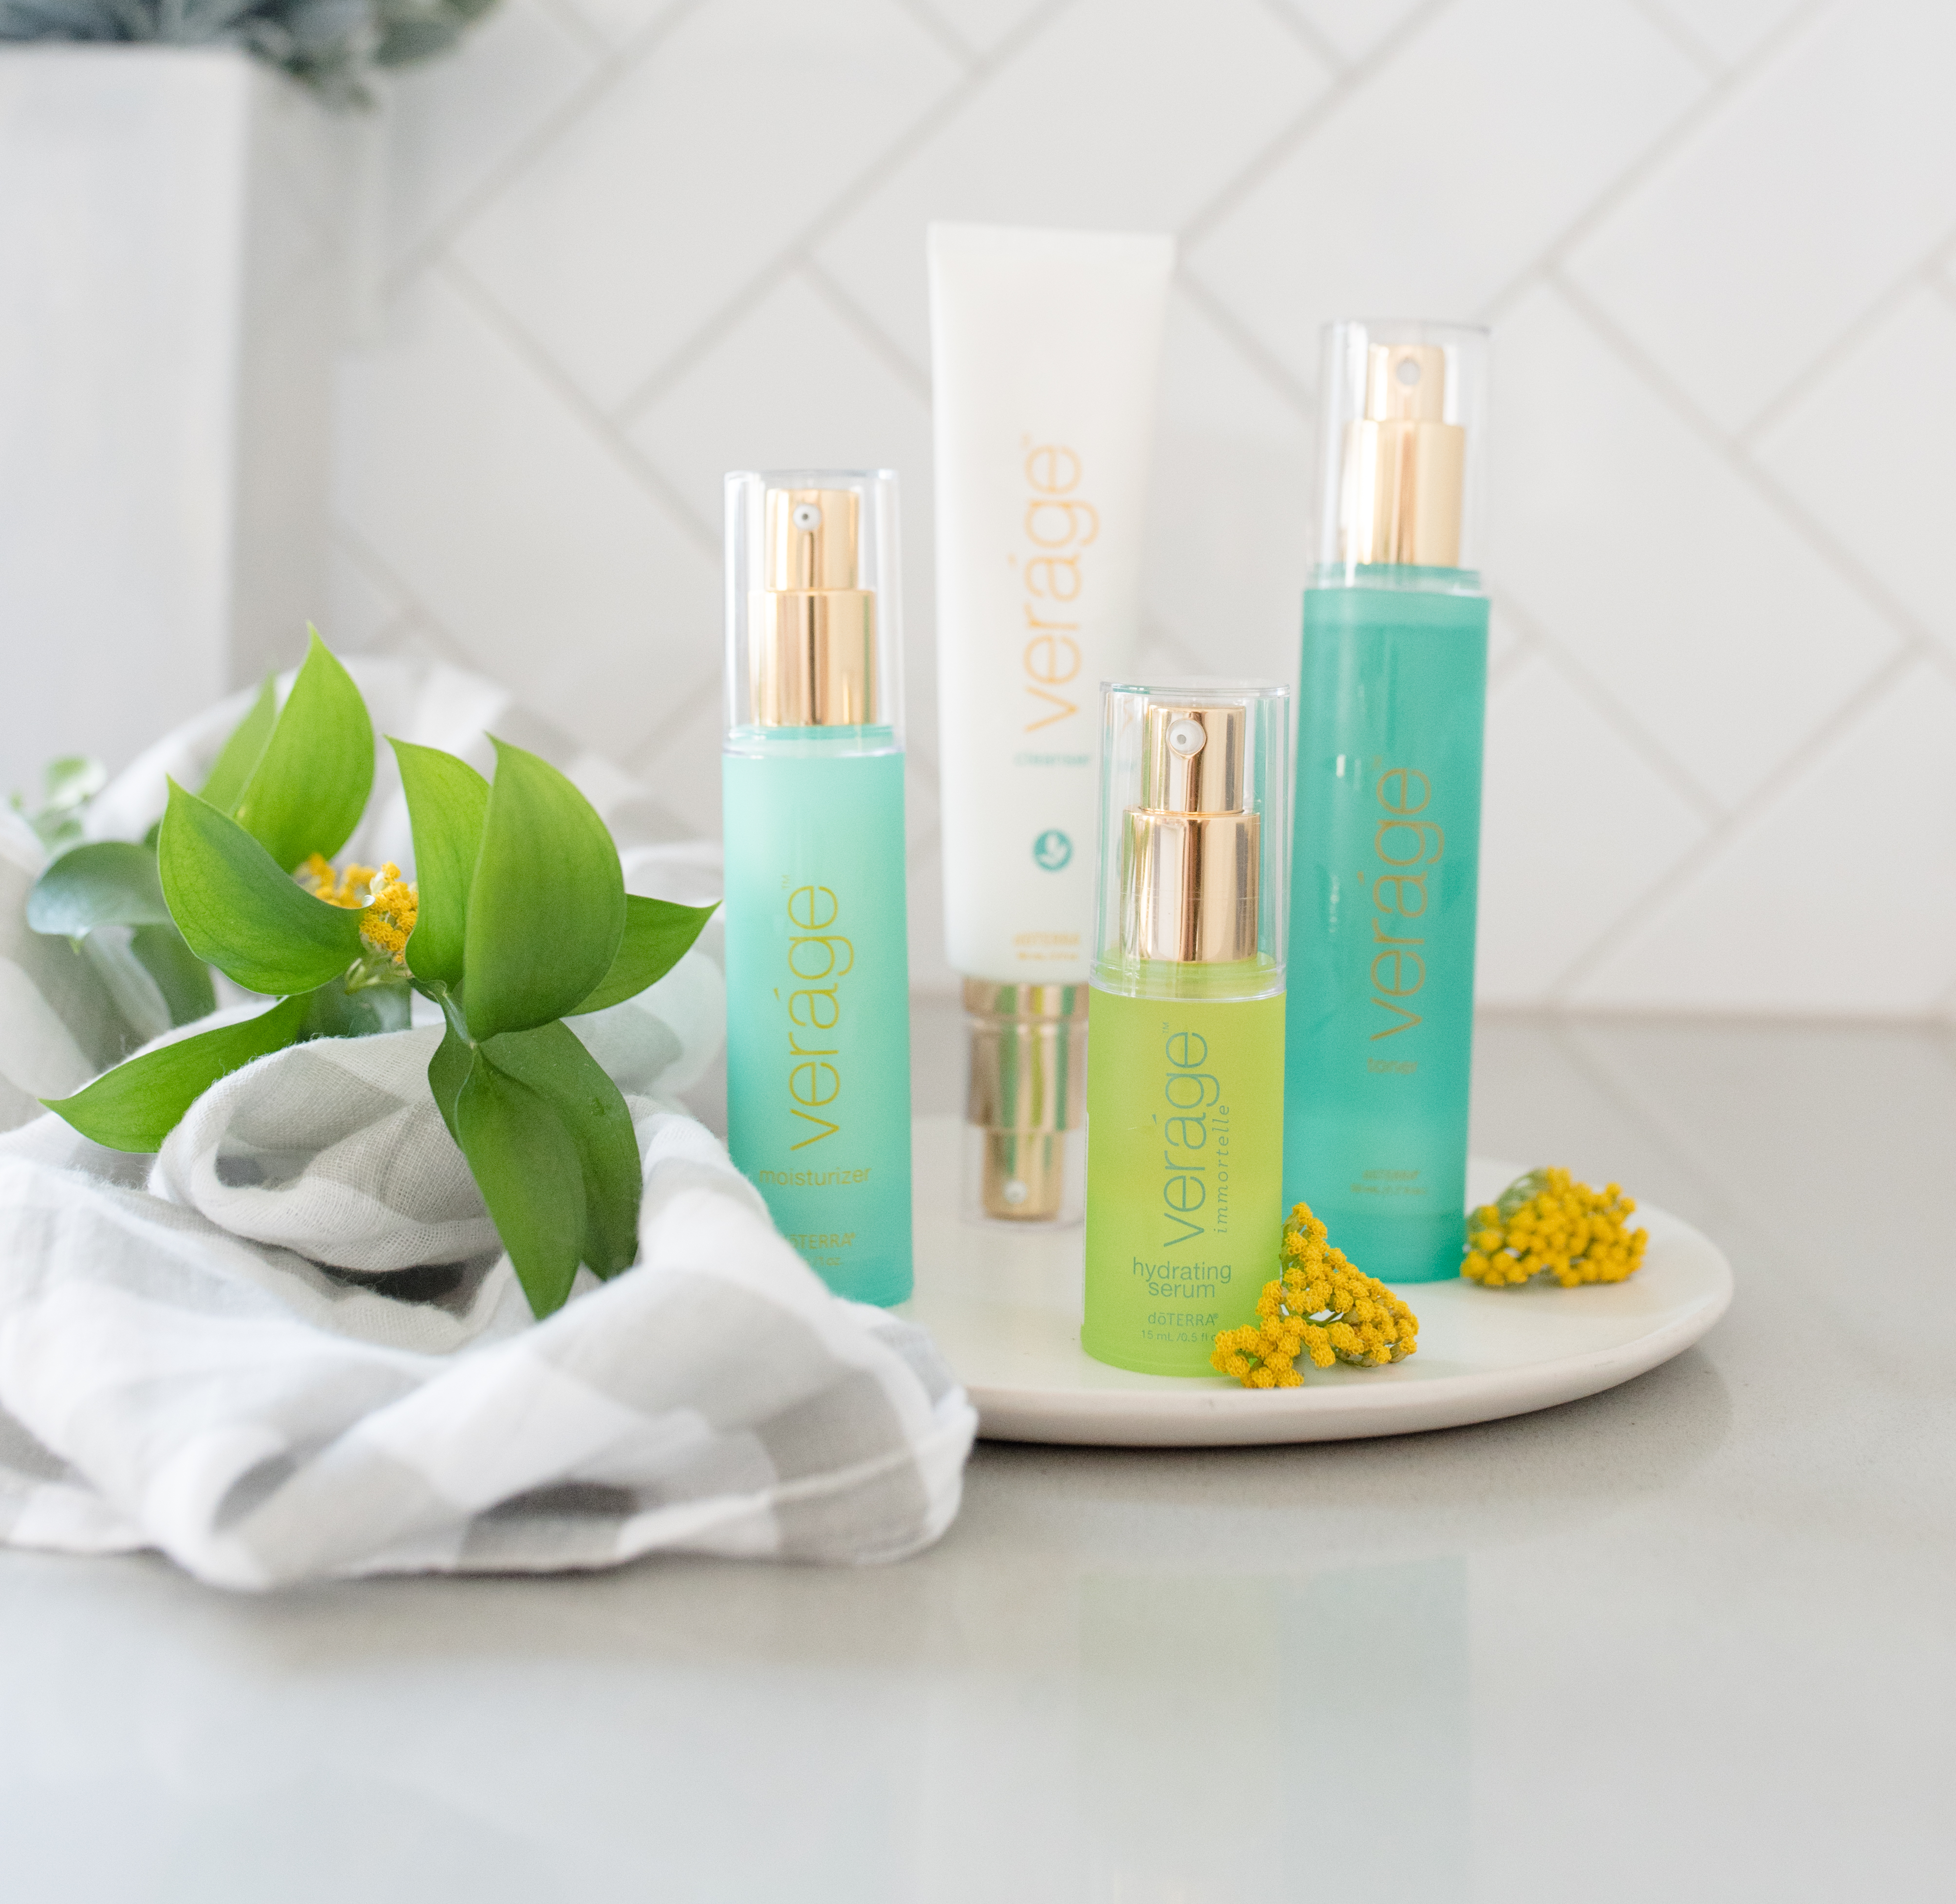
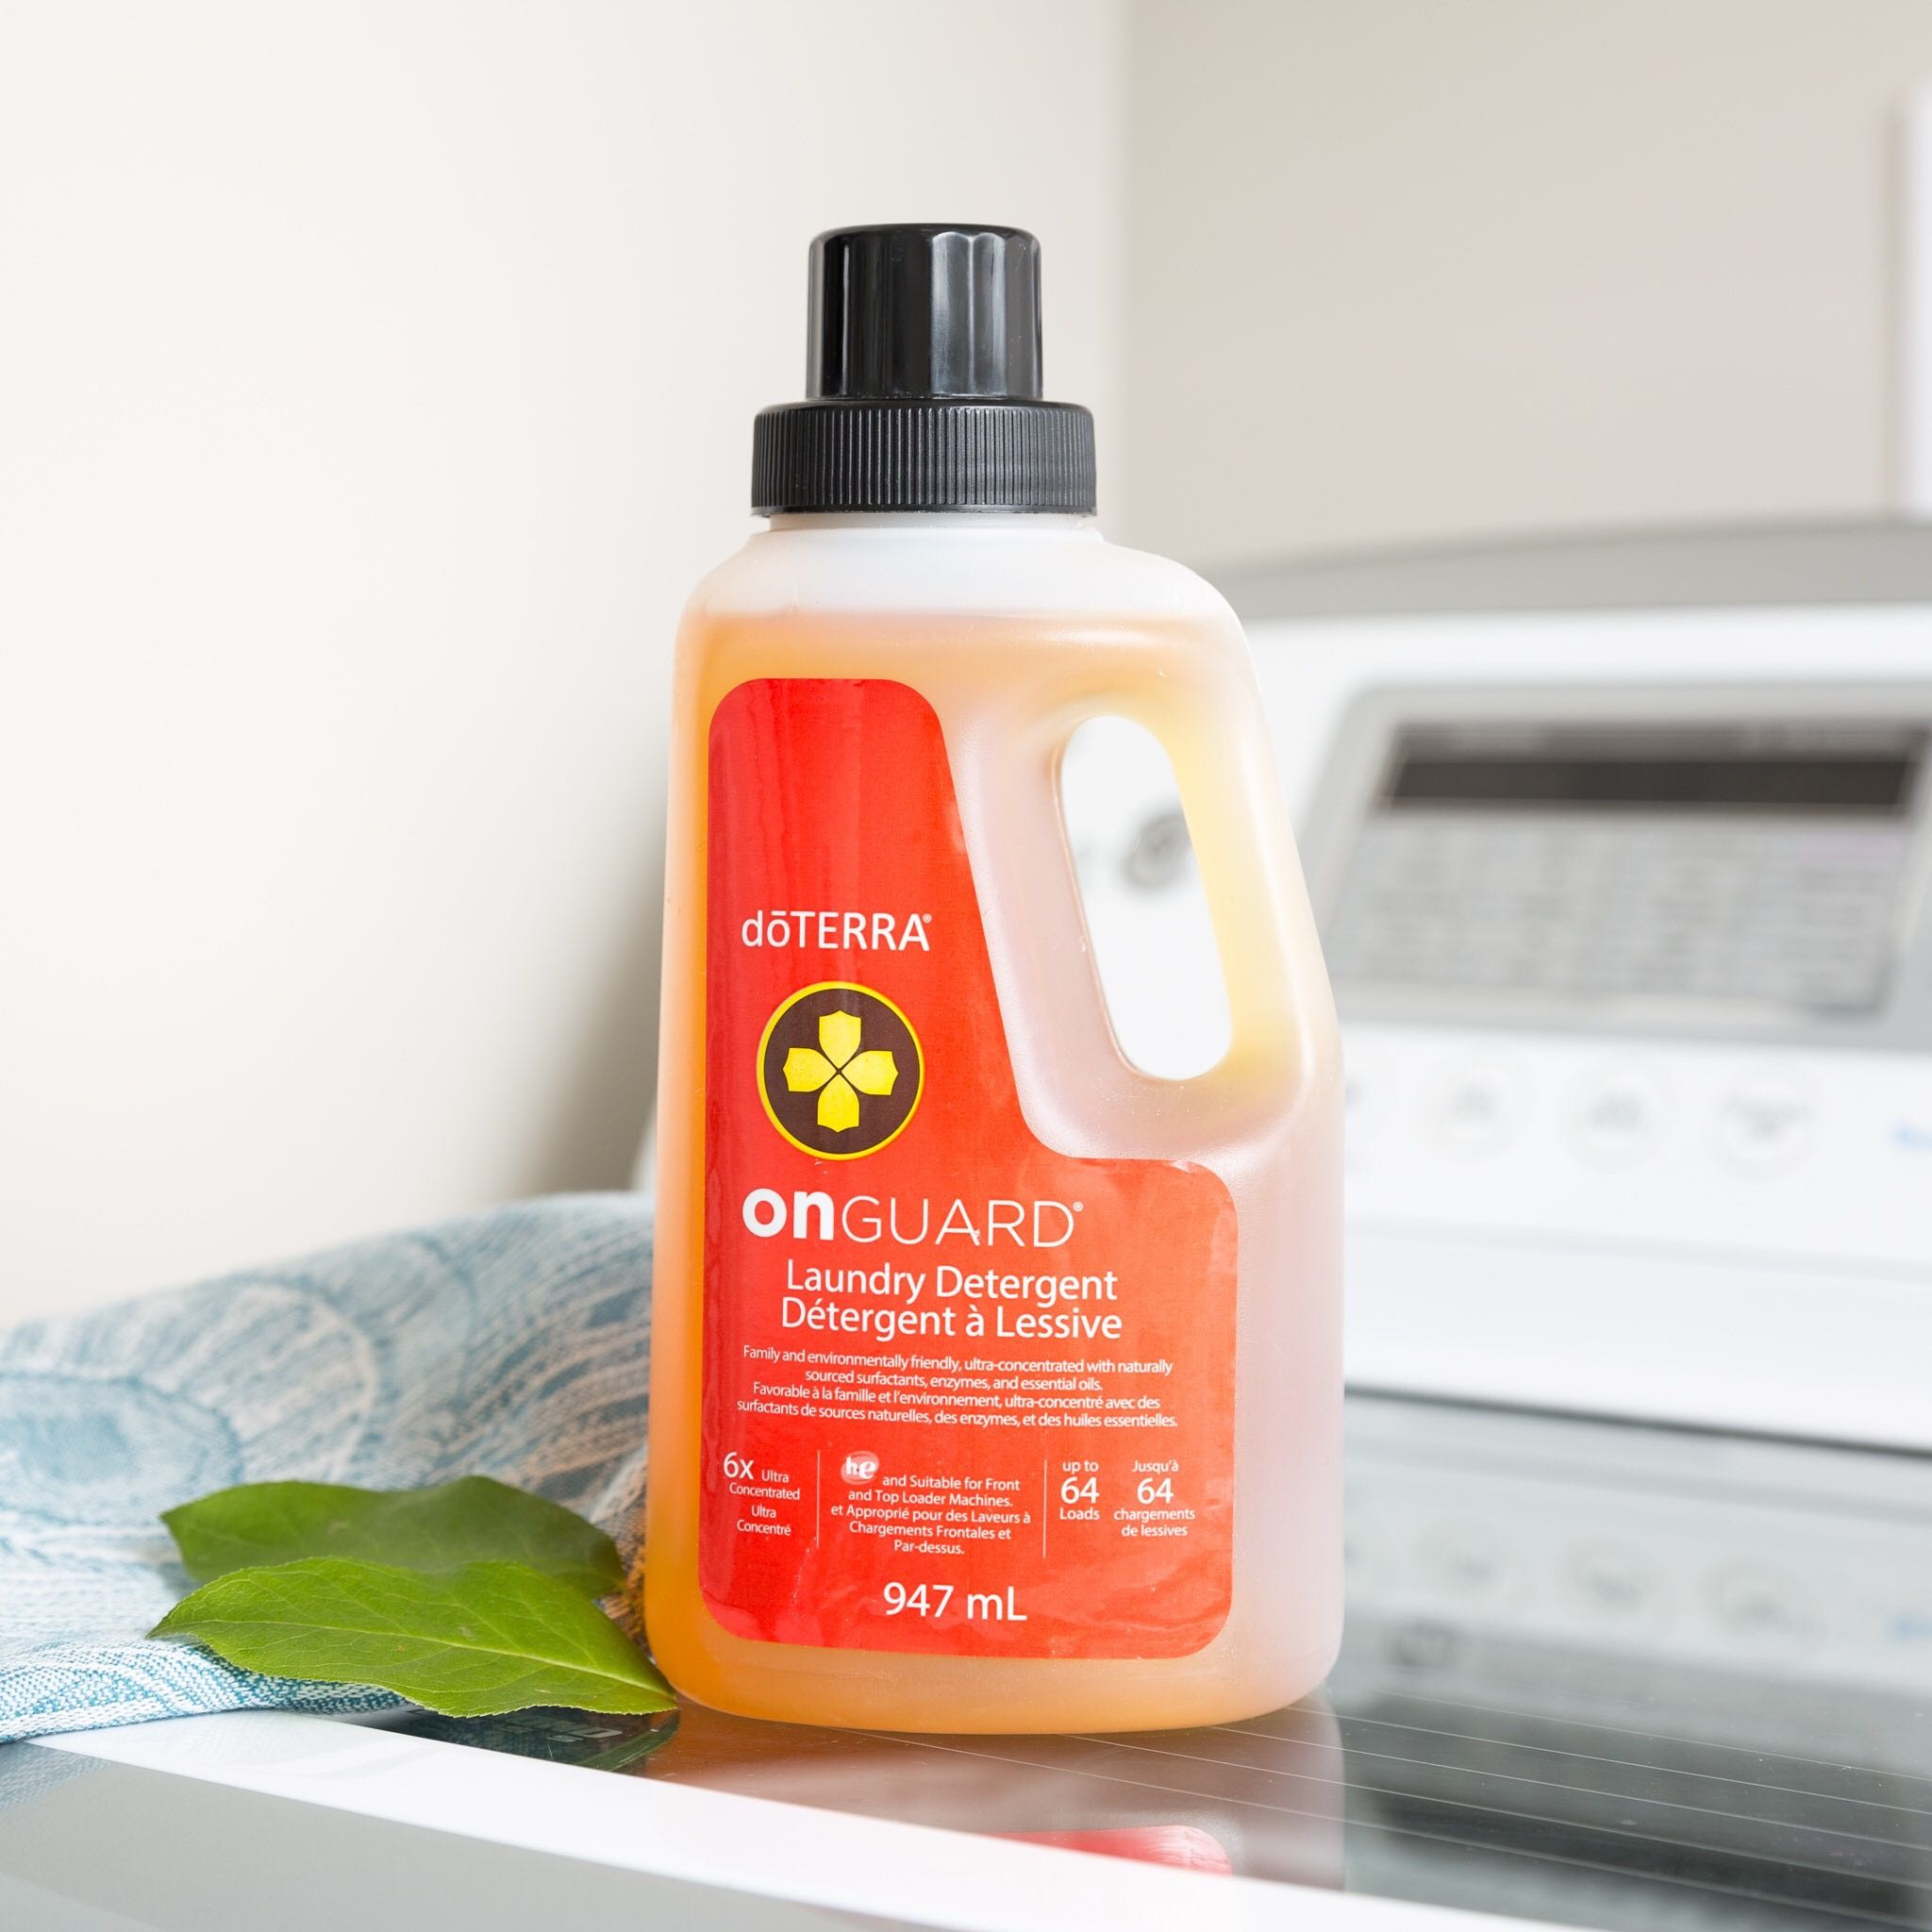
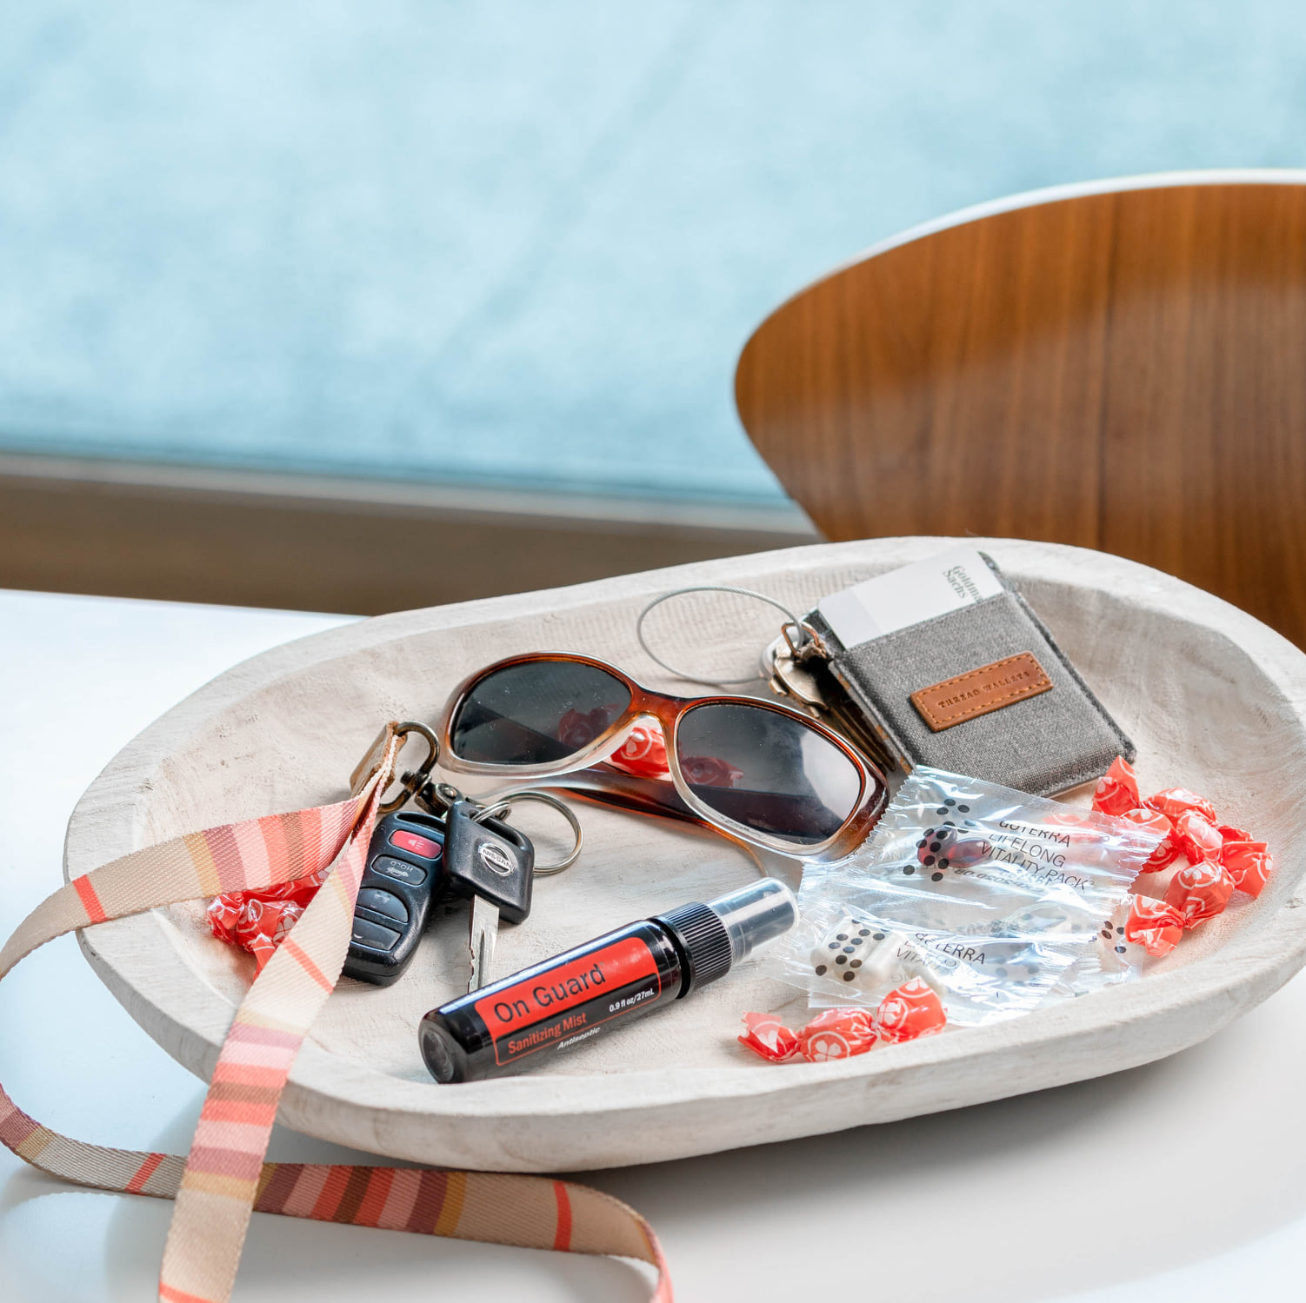
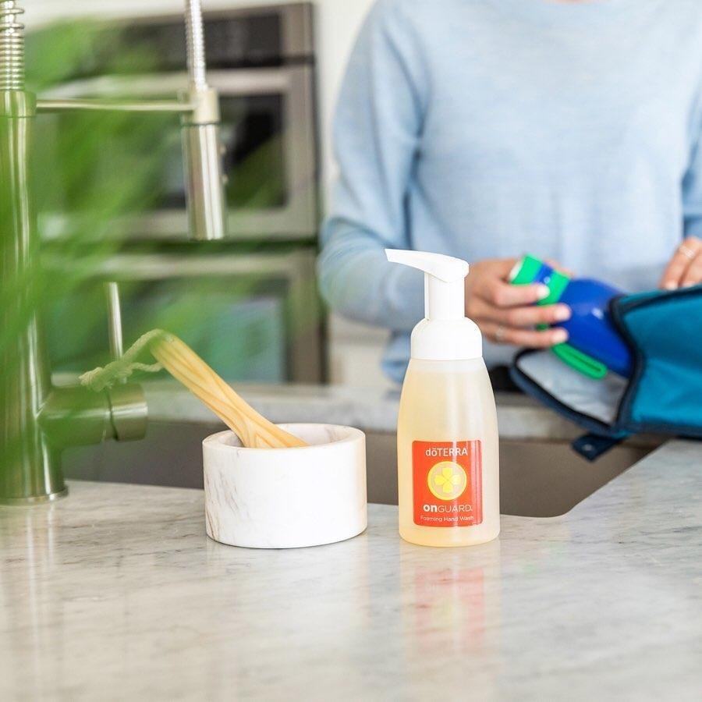
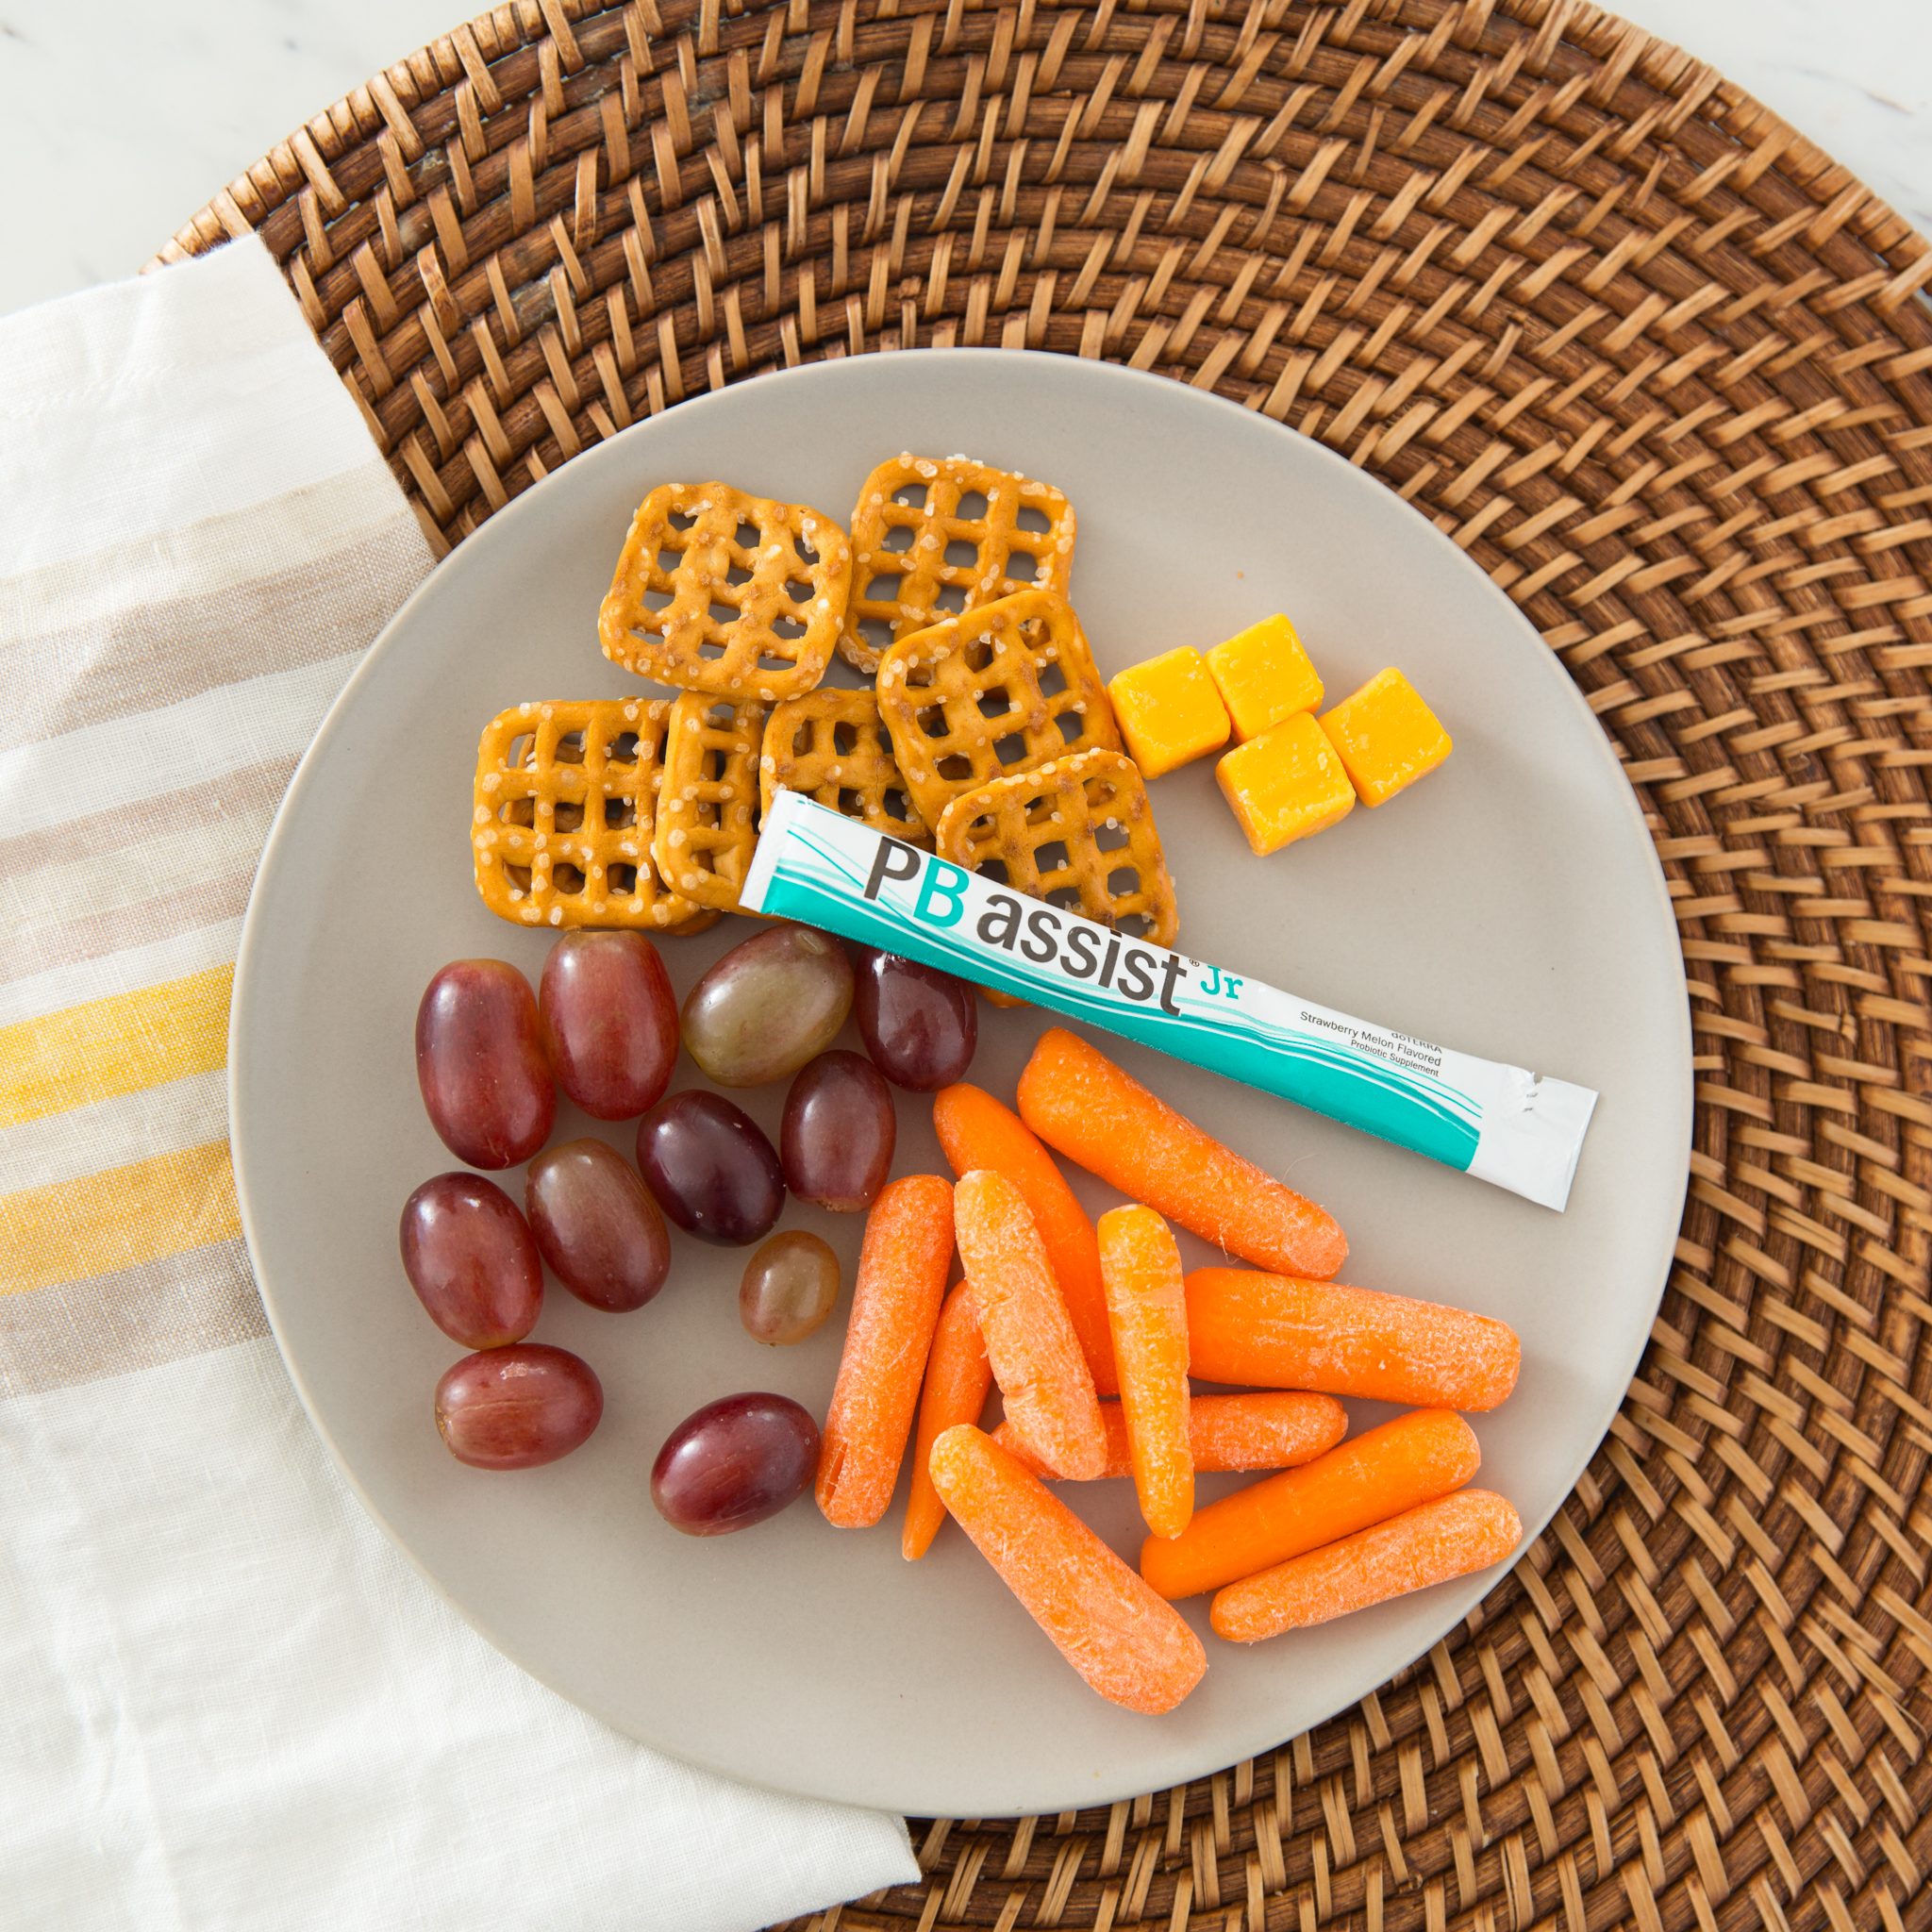
DAILY Routine

Slide 34
STAY Informed
  SYMPTOMS OF PNEUMONIA CAUSED BY CORONAVIRUS:
  1st – throat infection - dry sore throat - lasts for 3 to 4 days
  2nd – virus blends into nasal fluid; drips into trachea, enters lungs = pneumonia; process takes 5 to 6 days
  3rd - with pneumonia comes high fever, difficulty in breathing, uncommon nasal congestion – feels like drowning; seek immediate medical attention

Slide 35
KEEP STAPLES ON Hand
  HAVE FOOD, WATER, STAPLE, SUPPLIES ON HAND
  Just in case:
  Lock down
  Quarantine for household members
  WHAT DOTERRA PRODUCTS WOULD YOU NOT WANT TO RUN OUT OF?
  Have a Plan B, Plan C - DIY

Slide 36
Online Classes
Do-It-Yourself
Continued Ed
Daily Routine
Mailing Samples

Slide 37
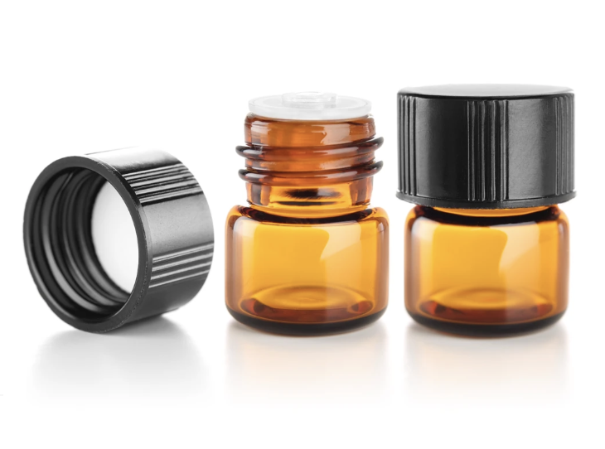
Samples

Slide 38
DO-IT-YOURSELF Classes
TEACH HOW TO MAKE EASY DIYs
Hand Sanitizer
1 TBSP rubbing alcohol
1/2 tsp vegetable glycerin (optional)
1/4 cup Aloe Vera gel
10 drops cinnamon essential oil
10 drops tea tree essential oil
Add ingredients to a 4oz bottle, fill with distilled water or colloidal silver/ionic silver for added antibacterial power.
Other essential oils (just for scent)

