Slide 1

Women’s Health and Hormones
with doTERRA CPTG Essential Oils

Slide 2

Can Anyone Relate?

Slide 3


Slide 4


6.5 trillion per year spent on healthcare.
Are we healthier?

Slide 5
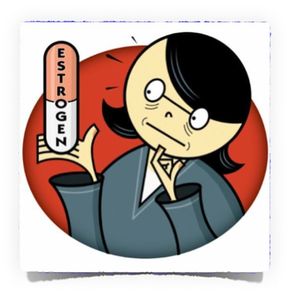
Hormone Replacement Therapy (HRT)
Increased risk of breast cancer and other types of cancer
Increased risk of stroke
Increased risk of cardiovascular disease

Slide 6
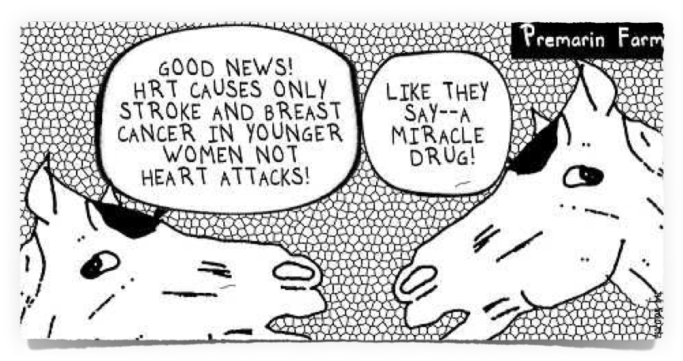
Is there another way?

Slide 7
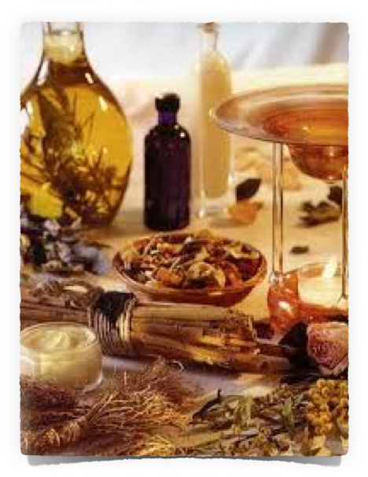
Essential Oils are natural aromatic compounds found in plants. They can be found in the roots, seeds, stems, bark, leaves, and flowers and are distilled and extracted for their health benefits.

Slide 8
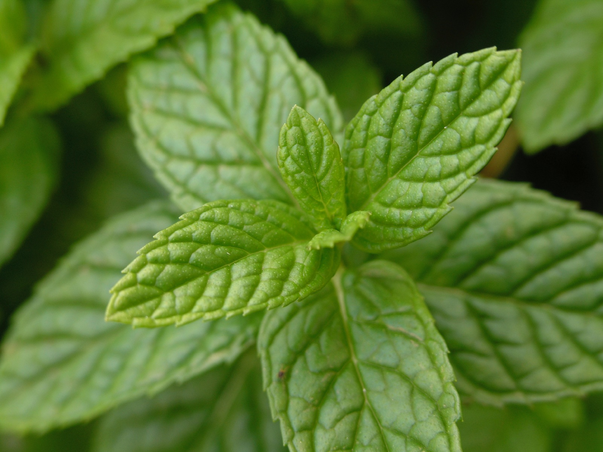
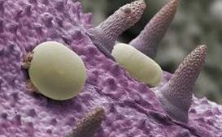

Slide 9
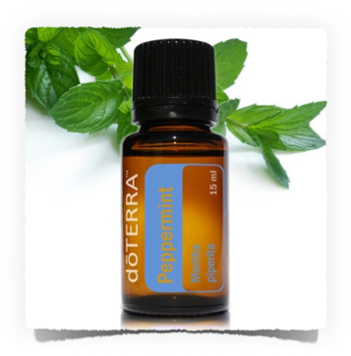
Peppermint
Headaches
Hot flashes
Energy
Fevers
Breath freshener
Nausea

Slide 10
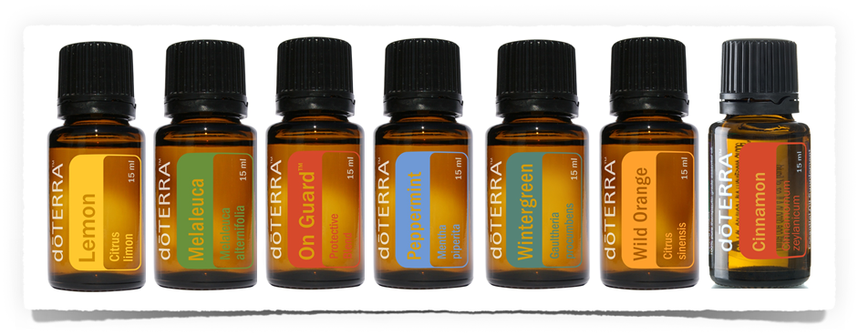
50-70 times more powerful than dried herbs
Contain dozens of unique compounds
Our bodies do not develop a resistance
Work at the cellular level

Slide 11
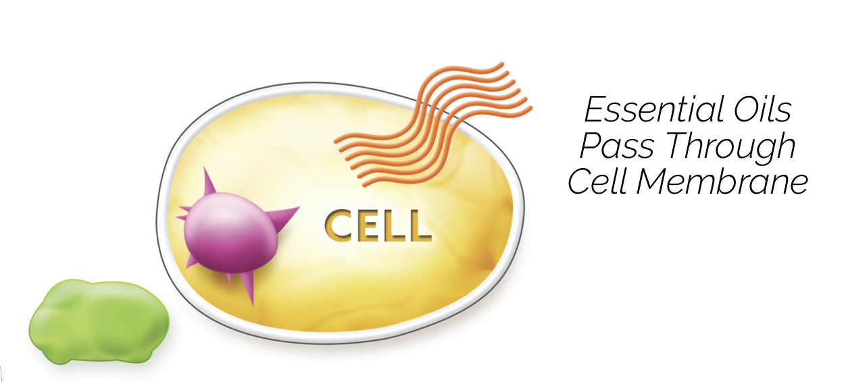

Slide 12
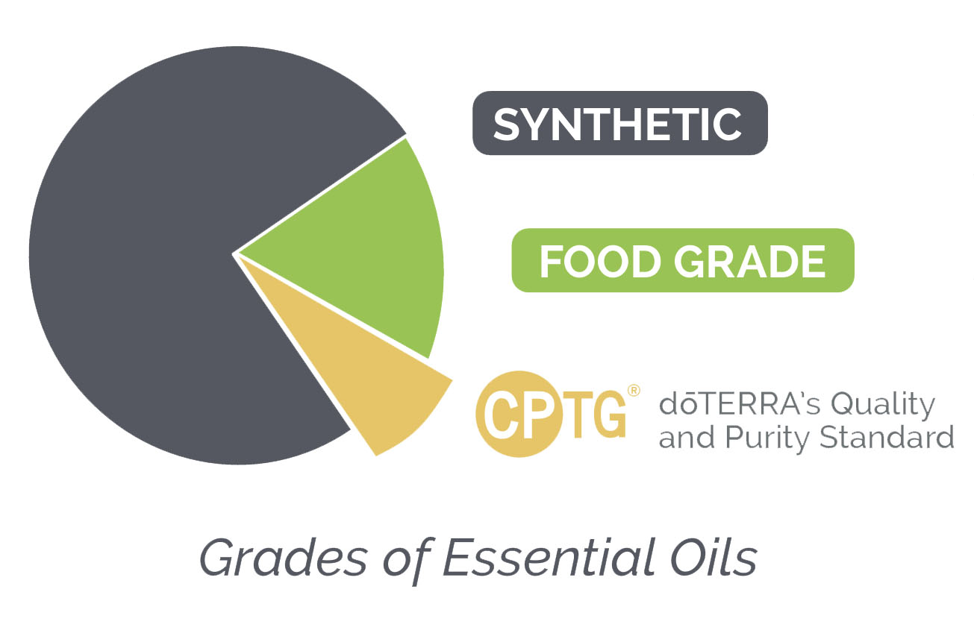

Slide 13

Certified Pure Tested Grade®
CPTG is:
Verified Pure
Beyond Organic
Free of Pesticides and contaminants
Plant material sourced from native origins
3rd Party Testing is used to certify purity and potency

Slide 14
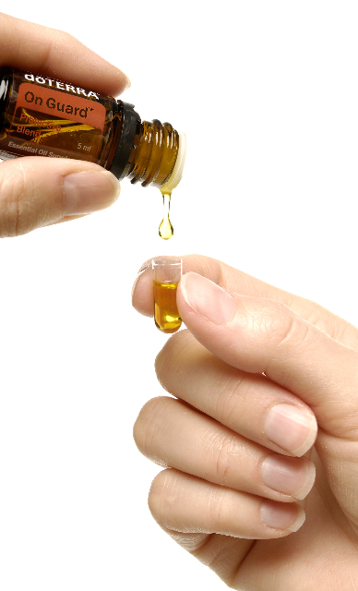
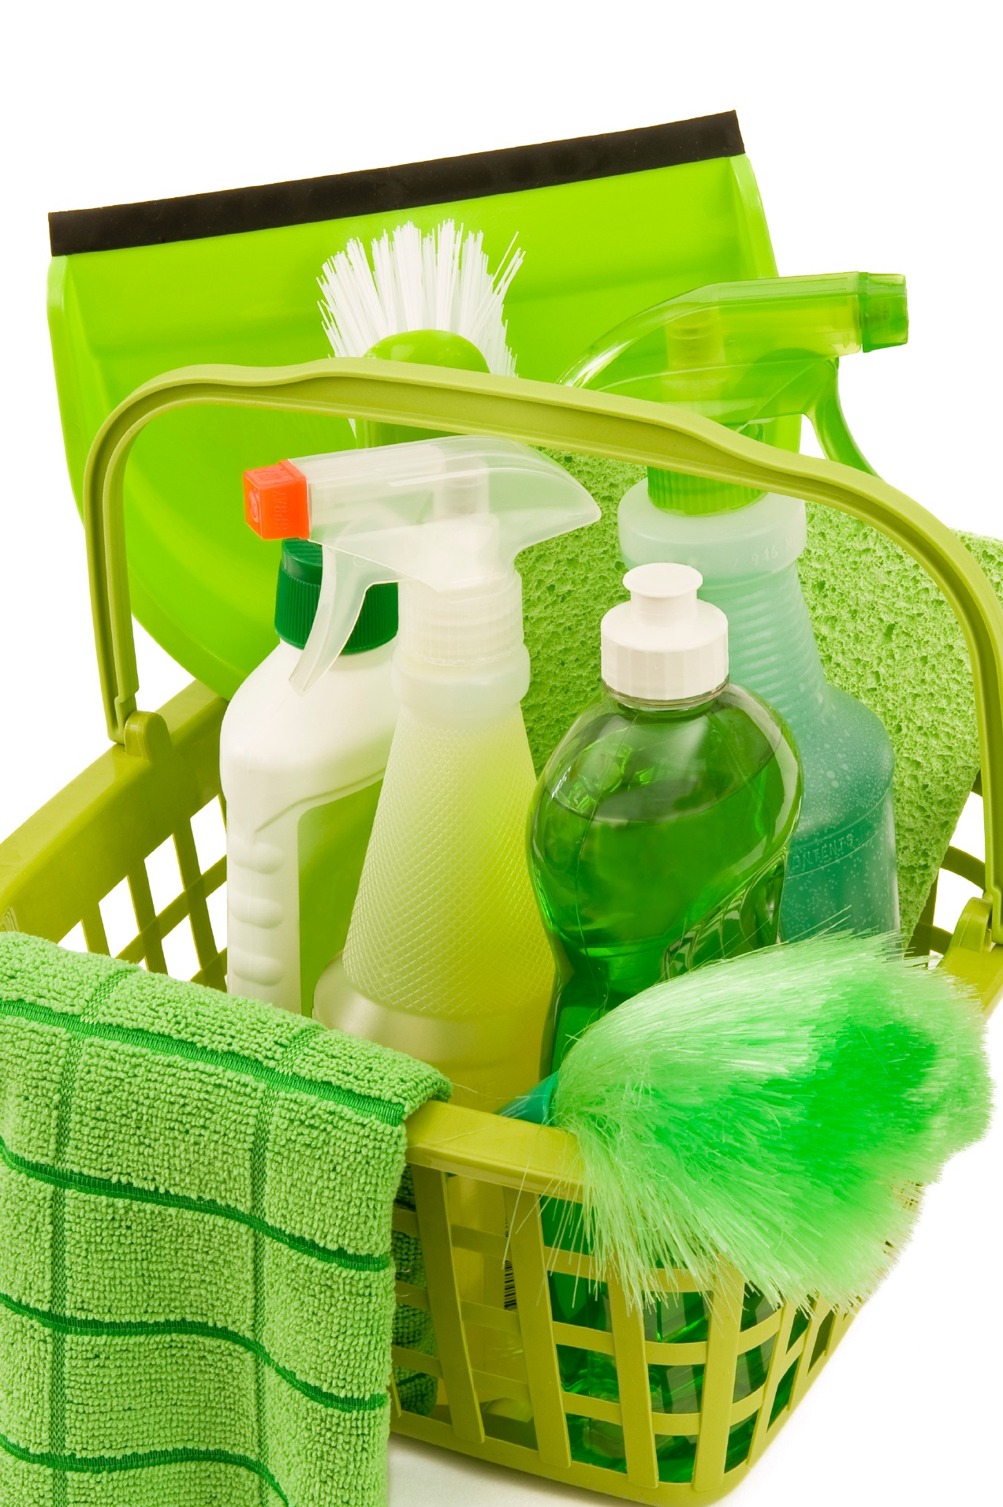

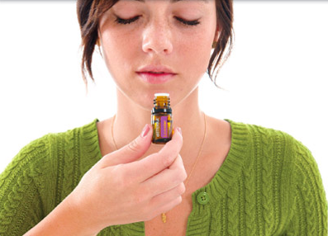

How we use oils

Slide 15
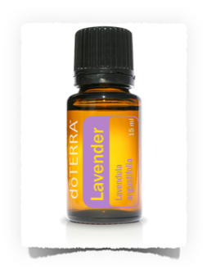
Lavender
All things calming
Soothing to the skin, causes healthy regeneration of skin cells.
Supports normal hormone levels
Promotes a restful sleep
Relaxes the mind and decreases feelings of anxiety and stress.

Slide 16
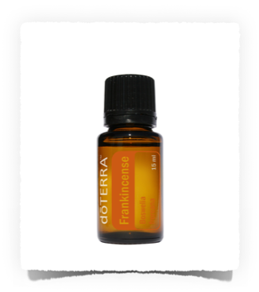
Frankincense
Promotes healthy cellular activity and response
Stimulating and elevating to the mind. Great for diffusing to instill feelings of calmness.
Combats inflammation
Balancing to the whole endocrine system!

Slide 17
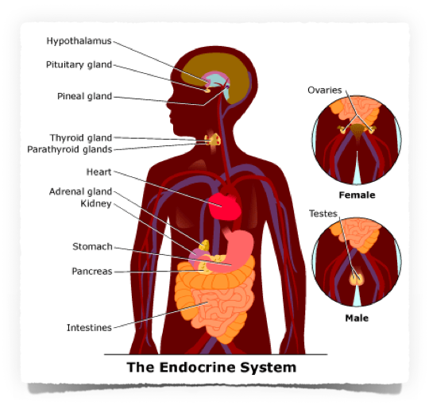
Approx. 50 hormones in the human body!

Slide 18

Signs of Hormone Imbalance
Depression/Irritability/Anxiety/Moodiness
Digestive Problems
Excessive Sweating
Food Cravings
Fatigue
Loss of Muscle Mass
Weight Gain
Low Libido

Slide 19
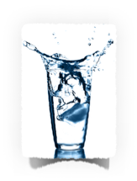
Minimize hormone imbalance 5 ways…
Proper hydration is a MUST!
Reduce or eliminate caffeine
Eat 3 balanced meals and 2 snacks daily
Diffuse essential oils throughout the day
Utilize the Aromatouch Technique regularly

Slide 20
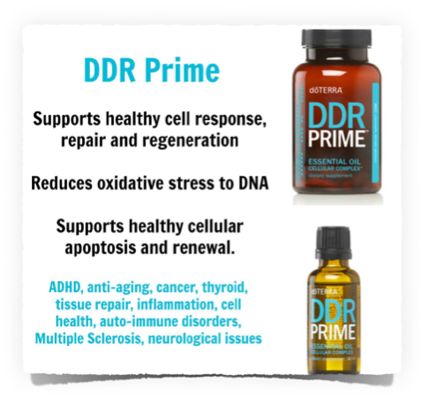
DDR Prime
Use daily to assist with hormone balance!
Supportive of healthy response of all body systems

Slide 21
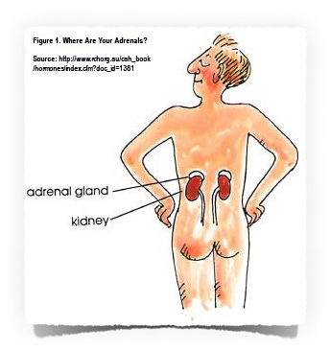
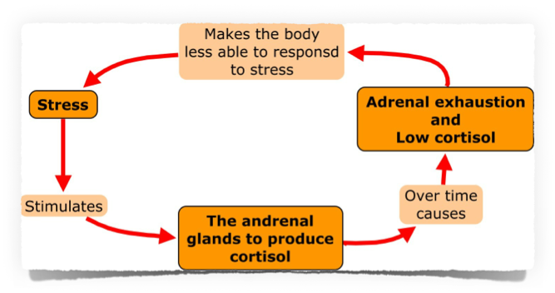
Adrenals
Releases cortisol, hormone responsible for “fight or flight” response

Slide 22

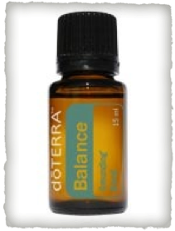
Balance
Great to use EVERY DAY! Apply to the bottoms of the feet morning and evening
Contains oils geared toward the CNS. For those who suffer mood swings, anxiety, temper problems, etc.
Relieves nervousness and aids in emotional release.
Creates a sense of calm and well-being

Slide 23
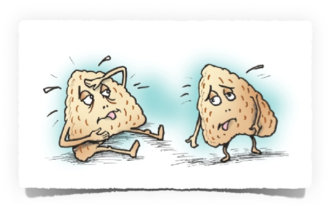
Adrenals
Use calming oils! Serenity, Balance, etc.
Layer Lemongrass, Basil and Frankincense across lower back (kidneys) daily

Slide 24
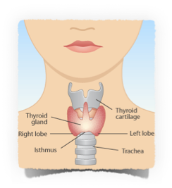
Thyroid
Essential Oil Blend
10 drops Clove
10 drops Myrrh
8 drops Frankincense
8 drops Lemongrass
Place oils in roll-on bottle and fill remainder of bottle with fractionated coconut oil.
Apply topically to thyroid area and bottom of feet 3 times per day.

Slide 25

Estrogen and Progesterone

Slide 26
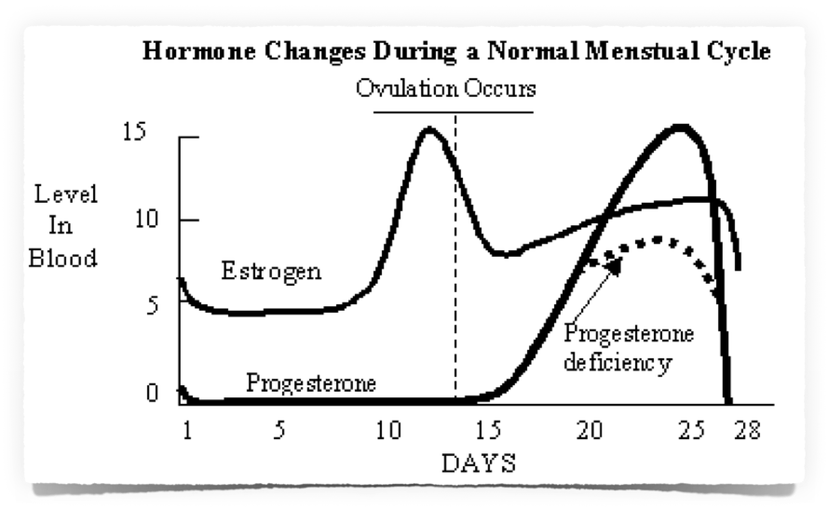

Slide 27

Estrogen and Progesterone
affect:
Energy Levels
Sleep Cycle
Brain Function
Bone Health
Heart Health
Weight Management
and much more!

Slide 28
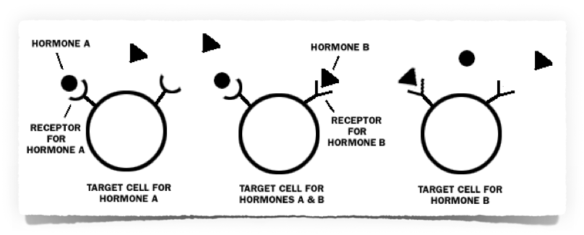

Slide 29

What are Xenoestrogens?
Man-made, potent endocrine disruptors that act like estrogen in our bodies
Found in makeup, lotions, plastic containers and water bottles, processed foods, contraceptives, cleaners, and more!
100-1000x more potent than our own natural estrogen

Slide 30
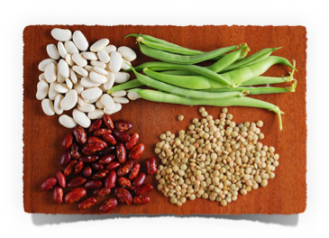
What are Phytoestrogens?
Supportive of normal hormonal functions in women.
Contain NO actual estrogen
Protect tissues from the effects of xenoestrogens and other hormonal pollutants.
Set up precursors so that the body can produce what is needed in the proper order
Many essential oils
contain phytoestrogens!

Slide 31

PMS/Monthly cycle
PMS is caused by hormone imbalance
Generally too much estrogen (estrogen dominance)
Sugar, poor diet, caffeine, alcohol, stress, and lack of exercise all contribute to worsening symptoms.

Slide 32
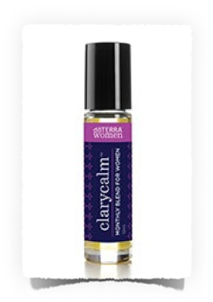
Clary Calm
A blend of the following oils, which contain phytoestrogens,
and support normal endocrine health in the body.
• Clary Sage - releases muscle tension, helps to elevate mood, hormone balancing.
• Lavender - calming and soothing, stress reducing.
• Bergamot - eases muscle tension.
• Roman Chamomile
• Cedarwood
• Ylang Ylang
• Geranium - hormone balancing
• Fennel - support normal endocrine health
• Carrot Seed
• Palmarosa
• Vitex (Chaste berry).

Slide 33
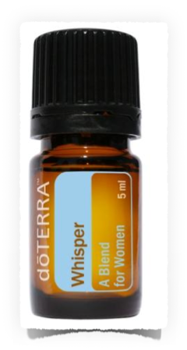
Whisper
Protects organs and tissues, soothes PMS, works as a natural perfume, soothes headaches, improves general well-being
Apply to bones behind ears and below ankles

Slide 34
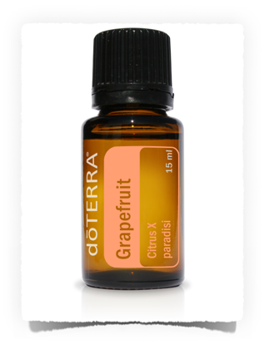
Grapefruit
Boosts progesterone!
When we are under stress, cortisol blocks progesterone production. Grapefruit inhibits the cortisol from doing that.
Take several drops in a capsule, in water or under the tongue daily.

Slide 35
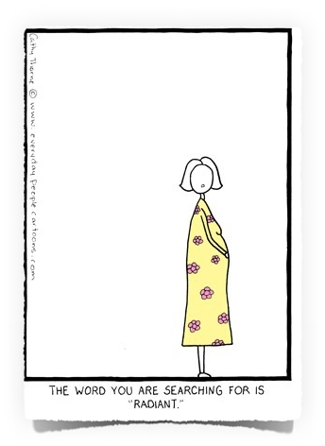
Pregnancy/Postpartum
Essential oils are a fantastic benefit during this time
Quality/purity of utmost importance!
Read “Essential Oils for Pregnancy, Birth and Babies by Stephanie Fritz

Slide 36


Healthy Lifestyle Essential!
Eat Right
Exercise
Rest and manage stress
Reduce toxic load

Slide 37
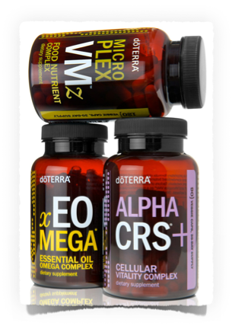

Lifelong Vitality Supplements
• Whole food supplement
• Fights inflammation
• Boosts energy by supporting healthy mitochondria
• Supports healthy cellular immune function
• Supports mental clarity and a healthy brain
• Supports bone health with calcium, magnesium, zinc and Vitamin D
• Provides systemic benefits of vitality and wellness associated with optimal intake of nutrients

Slide 38

Menopause

Slide 39
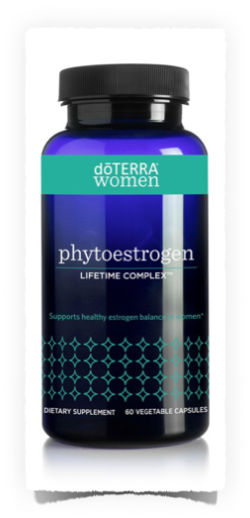
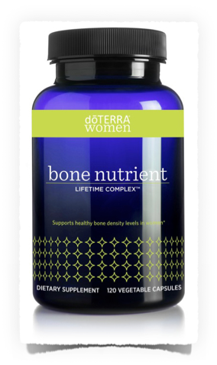
Phytoestrogen Lifetime Complex
and
Bone Nutrient Complex
A blend of standardized plant phytoestrogens that support hormone balance gently and naturally.
- Use with LLV and Bone Nutrient to help you stay younger from the inside out!
Vitamins C, D2 and D3, plus 1000 mg of calcium, 400 mg of magnesium, and other trace minerals

Slide 40
Testimonials from post-menopausal women
“I can’t believe I have energy!”
“I have moisture where I was dry!”
These things are
happening because
we are feeding the
body what it needs.

Slide 41
References for You

Slide 42

Essentials of the Earth
Great reference guide for anyone wanting to know more about essential oils and how to use them.
It's "Essential" for using essential oils.

Slide 43

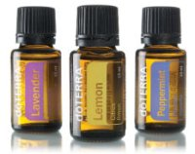
How to order
Retail
Wholesale
$35 membership fee
25% off ALL products
Earn Loyalty Reward Points
Free Products every month!

Slide 44
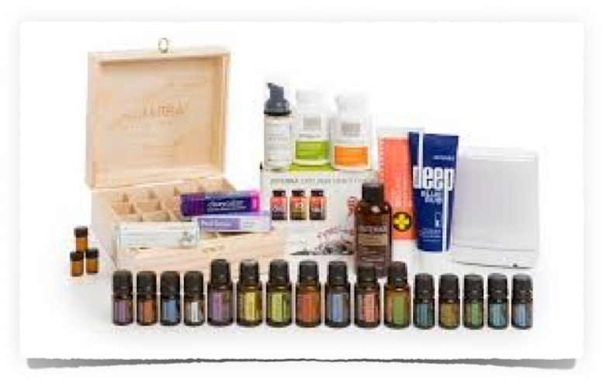
NATURAL SOLUTIONS KIT
+ 100 product
credits
Start at 15% rewards!

Slide 45
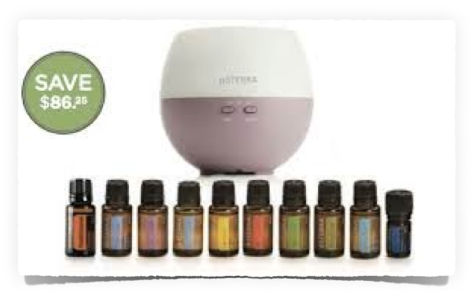
Home Essentials Kit

Slide 46
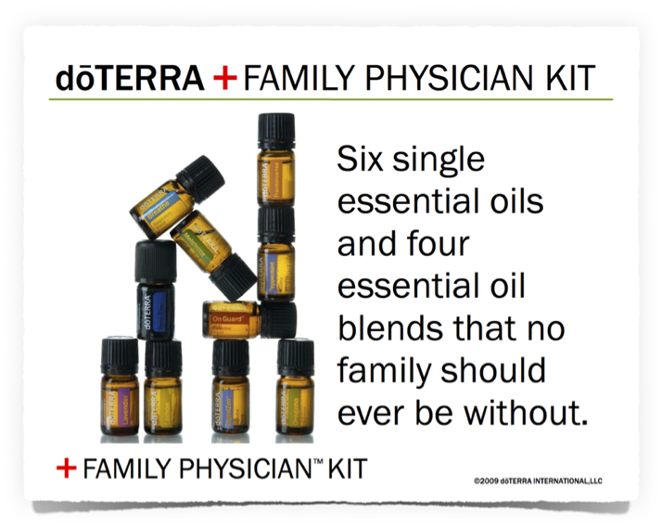

Slide 47
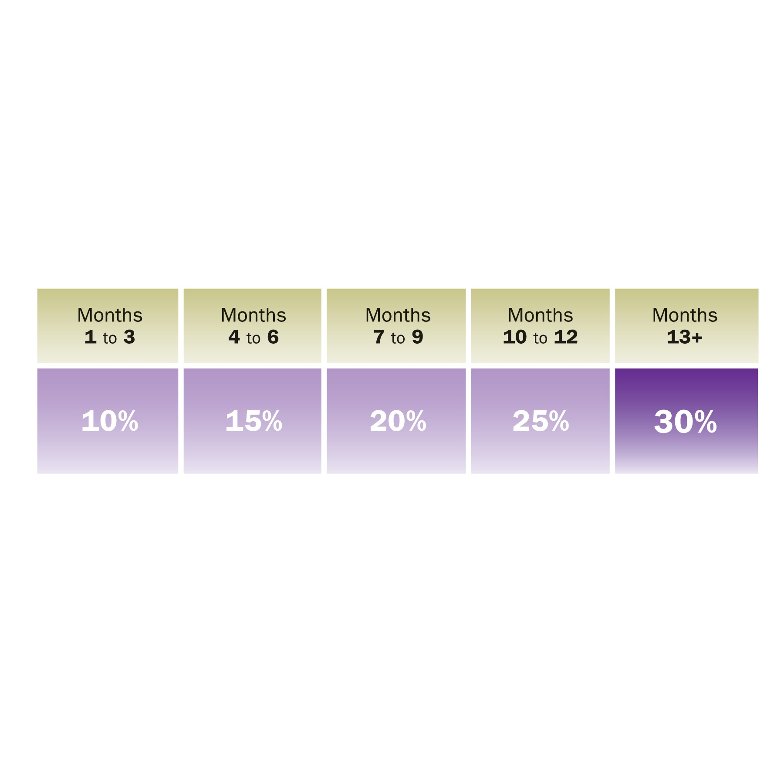
dōTERRA Loyalty Rewards Program = FREE PRODUCTS!
The most intelligent way to buy
Receive free product credits
Choose any products, anytime
Can cancel anytime
Minimum of 100 PV to receive compensation
Minimum of 50 PV to receive product credits

Slide 48


