Slide 1
Notes:
Introduce yourself and welcome guests.
Here’s a few things about how this workshop will go.
It’s helpful to have pen and paper ready to take notes and write down questions.
This will be about an hour long. You’ll want to stay on until the end because there will be a giveaway.
We will be using the chat feature throughout this workshop. Let’s warm it up by clicking on the chat button and telling us where you are from.

Slide 2
What would you like to address for your health?
Notes:
We always want our workshops to be personal and helpful for you. So let’s start with a personal assessment for you and/or your family.
What areas of your health would you like help with?
Comment in the chat the numbers representing the areas you or someone in your household struggles with.
#1 digestive issues
#2 Headaches, pain and inflammation
#3 Immunity issues
#4 Stress and Anxiety
#5 Energy and Stamina
#6 Sleep Issues
#7 Blood Sugar Regulation
I think you’ll be excited at the many options you have to take care of ROOT issues for your health.

Slide 3
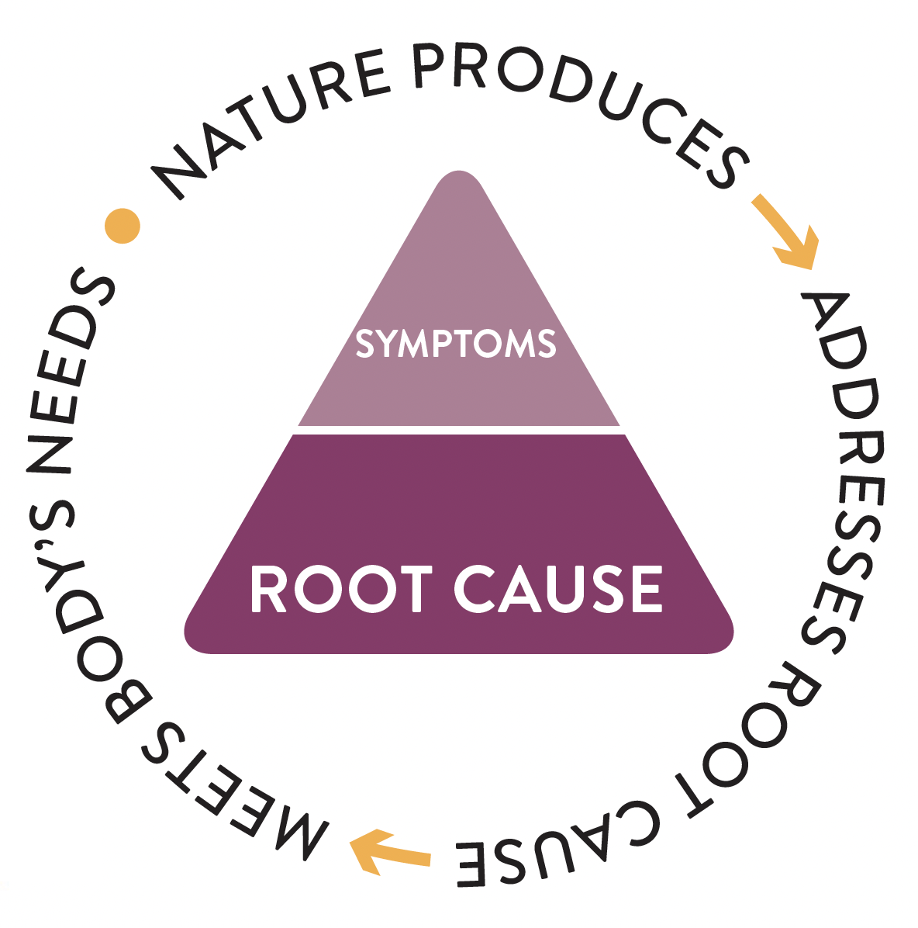
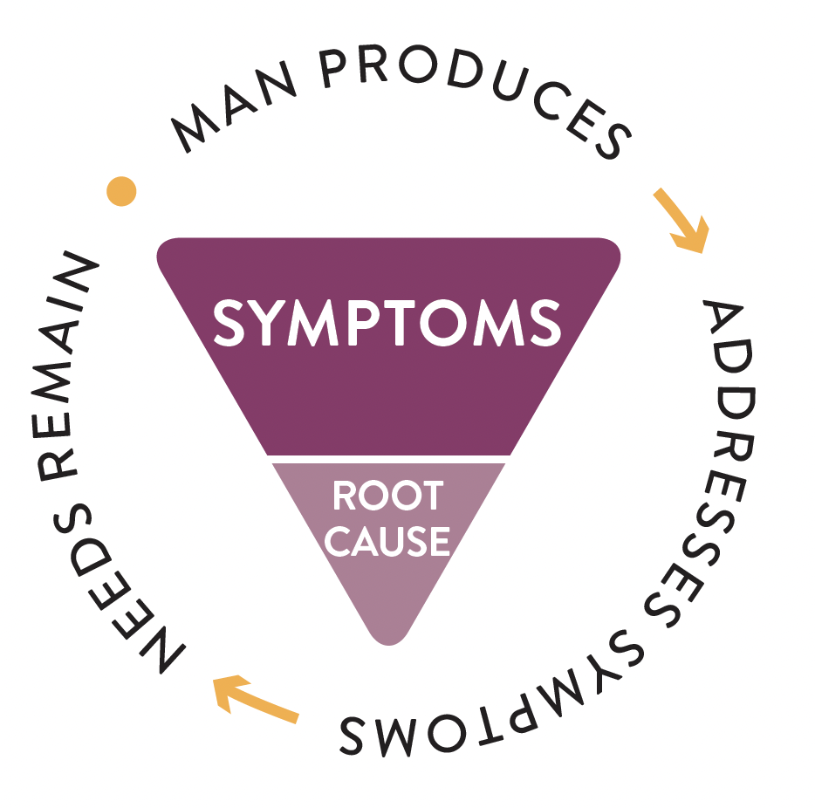
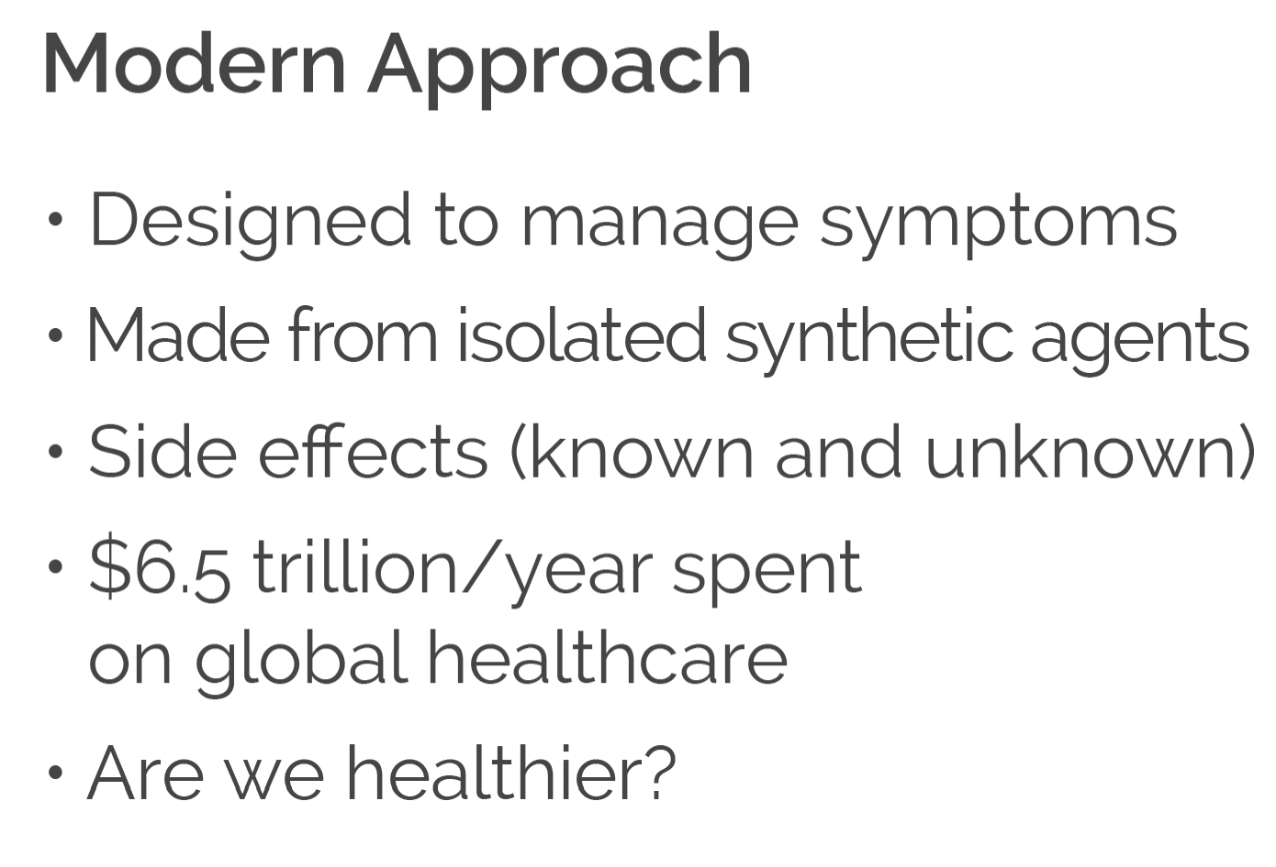
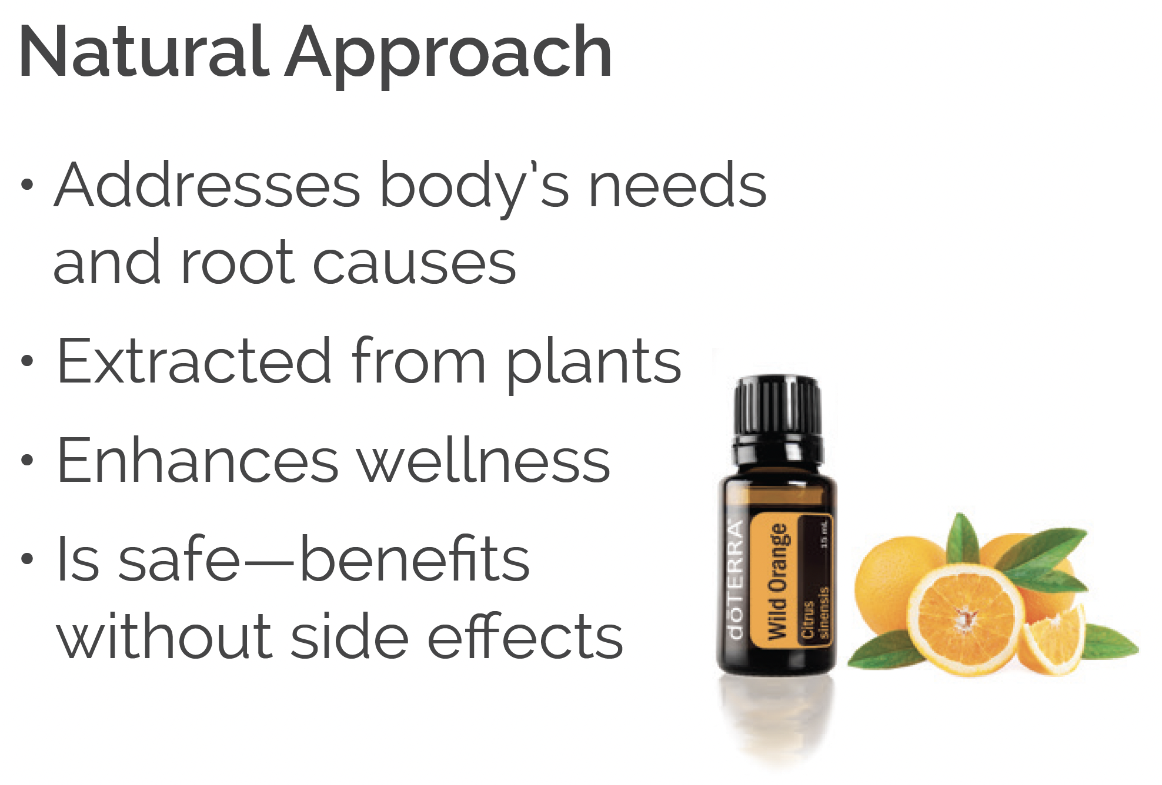
Modern Approach vs Natural Approach
Notes:
Modern Approach vs Natural Approach
We’re going to look at two different approaches to health as we begin this workshop. Before we do, I want to share a few studies with you. The FDA estimates that 200,000 Americans are hospitalized every year because of overdoses and side effects of NSAIDs (Nonsteroidal Anti-inflammatory drugs such as Advil, ibuprofen, and aspirin). They are also the cause of THOUSANDS of deaths per year. Even Tylenol (acetaminophen) is known to cause liver damage if used to excess. https://www.google.com/amp/s/abcnews.go.com/amp/Health/PainManagement/story%3fid=2739177&page=1
I share this info because it reflects our modern approach to medicine. In the modern approach, we turn to pills and prescriptions as a primary solution to address physical problems and symptoms. These can have dangerous side effects and even risk of addiction. Because this approach often focuses on symptoms, root causes can often get overlooked.
In addition, we’re looking at $6.5 trillion spent each year on global health care. Are we healthier?
Check out the natural approach. In that approach, we focus on the root causes and use a plant-based approach because our body RECOGNIZES plant sources.

Slide 4
What creates disease in the body
What creates disease in the body?
Notes:
What Creates Disease in the Body?
Now let’s shift gears and look at disease.
There are 3 main factors that cause disease in the body:
Nutrient Deficiency
Inflammation
Toxic Overload

Slide 5
What creates disease in the body
Notes:
Nutrition
Nutrition is at the core of our immune function. When our nutrition buckets in our body are filled, we function optimally with energy, clarity of thinking, good mood, great sleep, and little to no inflammation.
According to the Environmental Working Group: (Share chart)
95% of US adults are deficient in Vitamin D
94% are deficient in Vitamin E
61% are deficient in Magnesium
The nutrition buckets in our body are not full, which means most of us do not have a great baseline health. The results of nutrient deficiency varies by body, but I’ll list a few for you:
Inflammation
Headaches
Lack of sleep
Foggy thinking
Lack of energy
Digestive issues
Poor nutrition is the #1 cause of poor health.

Slide 6
What creates disease in the body
Notes:
Inflammation
What causes inflammation? The biggest contributors are:
Sugar. It’s in nearly everything we consume now!
Stress and lack of sleep.
Toxins in our environment
Chronic inflammation is linked to diseases like:
Autoimmune diseases like rheumatoid arthritis
Cardiovascular diseases like high blood pressure and heart disease
Gastrointestinal disorders like inflammatory bowel disease
Headaches
Metabolic diseases like Type 2 diabetes
Lung diseases like asthma
Mental illnesses like depression
Joint Pain

Slide 7
LifeLong Vitality
Toxic Load to the Body
Notes:
Toxic Load
Toxic load is the third area we are looking at as a source for disease and refers to the chemicals in our body that build up from our environment, processed foods, pesticide use, and personal care products.
The Product Safety Commission tested and found 150 cleaning chemicals that are linked to ADD, asthma, Cancer, reproductive problems, respiratory problems and more.
We can’t always control what we come into contact with outside the home, but we can make smarter choices in our homes.
So what do we do with all of this?

Slide 8
What’s in that supplement?
Sometimes more than you bargain for.
Notes:
Research from Harvard Medical School:
We’re just about ready to see our first health solution. However, we’re going to take a quick look at the supplement industry. Let’s go to the chat feature first. Who here uses a supplement? Think vitamin D, C, B…maybe you take a multivitamin or an omega. If you take any kind of supplement, put “yes” in the chat box.
Now let’s take a quick peek at the supplement industry:
A study by the FDA from 2007 to 2016 detected contaminants in 776 dietary supplements, produced by 146 companies. (https://www.health.harvard.edu/staying-healthy/whats-in-that-supplement-sometimes-more-than-you-bargain-for)
A study of 3 leading memory supplements found that 2 of them didn’t contain the active ingredient listed on the label.
The Supplement industry is not heavily regulated. They can contain lots of fillers and not much of the actual ingredient.
However, because our standard American diet is deficient in most vitamins and nutrients, it is necessary to supplement to make sure our bodies get what they need to function properly at a baseline level.

Slide 9
LifeLong Vitality
Lifelong Vitality
Less pain & inflammation
More energy
More balanced mood
All whole food ingredients - no synthetics
Bioavailable - your body know how to use it!
Ingredient levels make an impact on the body
Notes:
Lifelong Vitality Supplements
So let’s move to solutions! The Lifelong Vitality is doTERRA’s best selling product. It addresses all three areas we just mentioned: nutrient deficiency, inflammation and toxic overload. Think of this line as the foundation of your health house. It has the necessary foundation to build your health on. This line helps support the cleansing and filtering out of toxins. *There are three supplements in this line: A food nutrient, cellular repair and your omegas.*
This line is your micro-nutrients:
Lifelong Vitality fills the nutrient buckets in your body
Contains powerful antioxidants to help protect our DNA
Made with whole food ingredients.
95% bioavailable for your body. The average supplement is 20-30% bioavailable.
This product has gotten more people off their over the counter and prescription drugs more than any other product doTERRA sells.
SHARE A TESTIMONIAL or TWO!

Slide 10
Notes:
Clinical Trials
Clinical trial results are based on bloodwork that was taken before and after. Subjects took the doTERRA Lifelong Vitality Supplements for 2 months and continued with their normal diet and exercise.
Statistically significant improvement with:
Blood lipids
Fasting insulin
Cardiovascular biomarkers (example: CBC, blood lipids, blood sugar, electrocardiogram (ECG), echocardiogram or ultrasound of the heart muscle)
Reduce triglycerides levels in the blood
Cellular inflammation
Positive effects on:
Biochemical indicators of cardiovascular health
Antioxidants
Inflammation
Blood glucose regulation
Overall improvement with:
Mental clarity
Energy
Motivation
Control
Balance
Happiness
I consider LLV as part of my food budget. It runs about $28 per bottle. If you purchase it through our customer rewards program, you’ll get points back on every order to use to get product for free!

Slide 11
Healthy Gut Biome
Notes:
If you want to focus on gut health specifically, Lifelong Vitality paired with PB Assist and Terrazyme is our highest recommendation. The gut plays a vital role in our overall health and well-being. Your gut is often called your second brain.
It is vital in everything from our weight, to our immune function, to our mental wellness.
doTERRA’s PB Assist is our dual capsule time release pre and probiotic. With this unique dual-encapsulation delivery system, it protects the sensitive probiotic cultures from stomach acid delivering it safely and effectively to your gut.
Balances bacteria for optimal health
Promotes positive balance and proliferation of GOOD bacteria
Maintains healthy intestinal microflora balance
Supports healthy digestive and immune system function
Supports GI tract health; especially intestines and colon
Supports optimal metabolism and food absorption
TerraZyme is doTERRA’s digestive enzyme.
Includes a variety of whole-food enzymes that help with digestion
Can be taken with every meal
Supports healthy digestion and metabolism
Supports conversion of food nutrients to cellular energy
Promotes gastrointestinal comfort and food tolerance
10 active whole food enzymes

Slide 12
Diabetes and Sugar
1. What percentage has diabetes cases increased in America since 1960?
2. How long does it take the average American to
consume the same amount of sugar that our ancestors
from 200 years ago would consume in a year?
Notes:
Diabetes and Sugar in the Body
Time for a little interaction! We’re heading into the second section of our workshop and I want to make sure you’re with me! So find the chat feature now!
ASK: What % has diabetes increased since the 1960s?? Answer: Almost 700% ASK: How long does it take the average American to consume the same amount of sugar that our ancestors from 200 years ago would consume in a year. Answer: 2 weeks

Slide 13
6.8%
ONLY
OF THE U.S. ADULT POPULATION HAS
OPTIMAL CARDIOMETABOLIC HEALTH
National Health and Nutrition Examination Survey n = 55,081 people aged 20+ years
Notes:
Cardiometabolic Health
ONLY 6.8% of the population have optimal cardiometabolic health.
That means that 93% of Americans DO NOT have optimal cardiometabolic health.

Slide 14
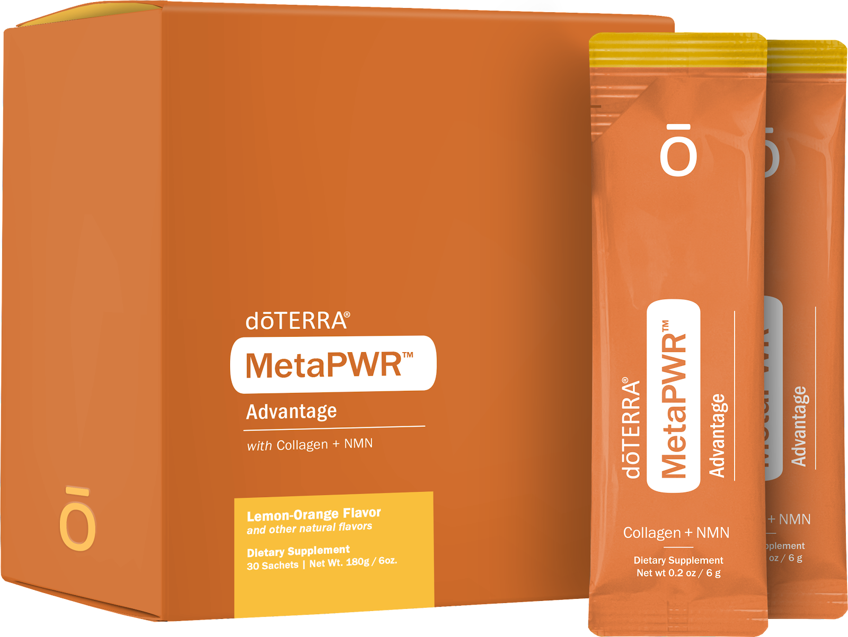
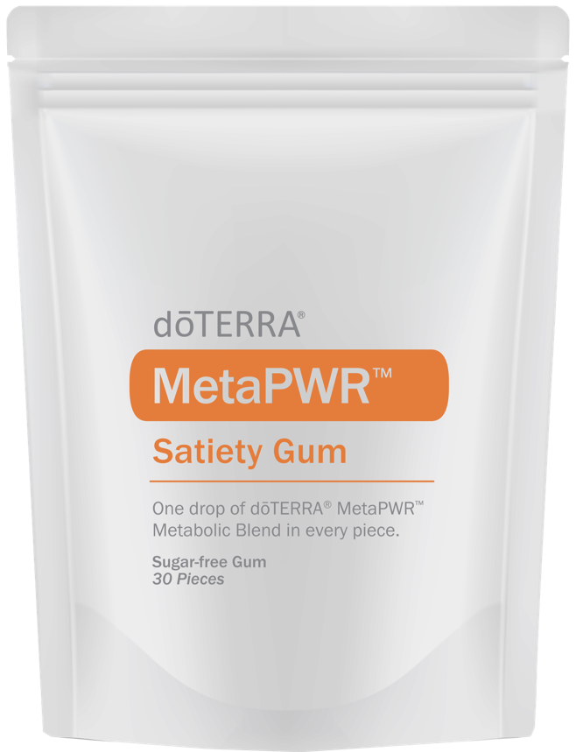
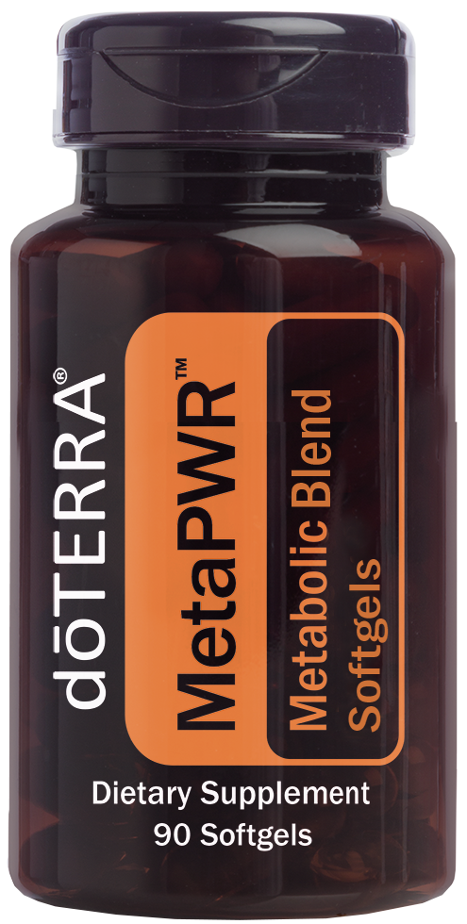
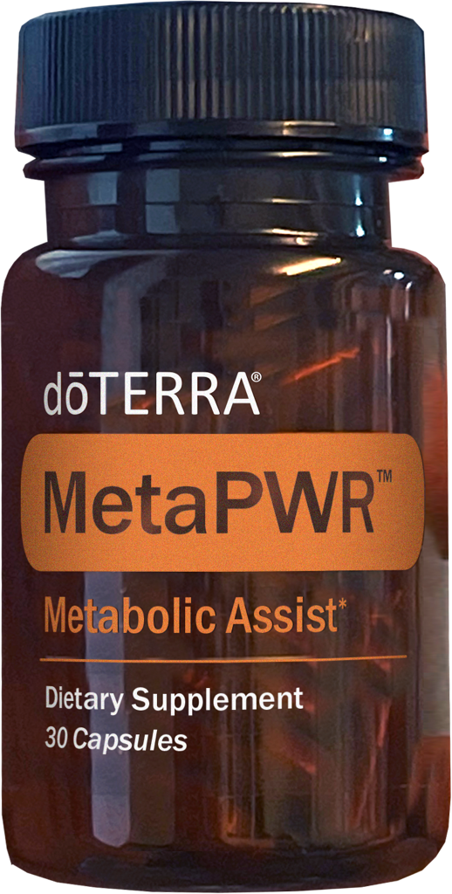
MetaPWR
Metabolic System
Notes:
MetaPWR – Metabolic System
The MetaPWR system was specifically designed to tackle poor cardiometabolic health. This is your macronutrient line! It pairs beautifully with Lifelong Vitality, our micro nutrient line. The MetaPWR line does three things: Addresses cellular repair that leads to aging, addresses blood sugar regulation and supports the inhibiting of fat absorption into cells.
The average American spends the last 14 years in a state of declining health and difficulty completing everyday tasks. The MetaPWR System is the first and only system that synergistically supports a healthy metabolism, curbs cravings, sustains normal-range glycemic and insulin response evenly throughout the day, and naturally promotes cellular energy.
Those using this line have reported improvements in:
Eyesight
Energy
Pain
Neuropathy
Sleep
Skin
hair growth
Mood
Mobility
strength (causes the body to build muscle)

Slide 15
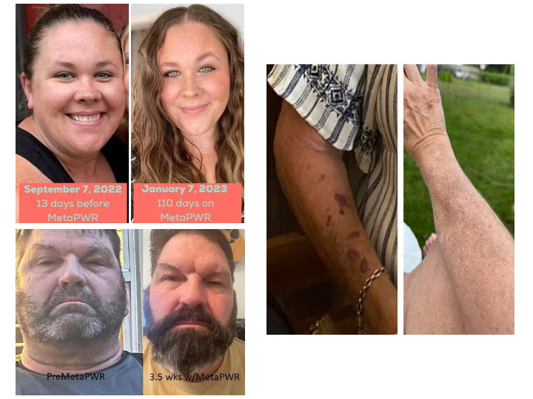
Notes:
Benefits of MetaPWR
Before we get into too many details with the MetaPWR, let’s look at a few before and afters.
The young lady on the top has been using MetaPWR for 4 months. She’s had amazing results, specifically with improvements on her face, eyes and hair.
The gentleman on the bottom left experienced:
improved skin elasticity
darker hair growth
He got his blood work taken after three weeks on the MetaPWR and this is what it showed:
40-point decrease in cholesterol
25-point decrease in LDL
57-point decrease in Triglycerides
On the right side you see a 58 year old lady who had red spots on her arms. Anytime she bumped herself they would appear. Doctors biopsied & said it’s just what happens when you get older. After using MetaPWR for just 3 months, the spots are totally gone. She has seen other changes too, weight loss (60lbs), thicker hair, nails growing, and lower A1C.

Slide 16
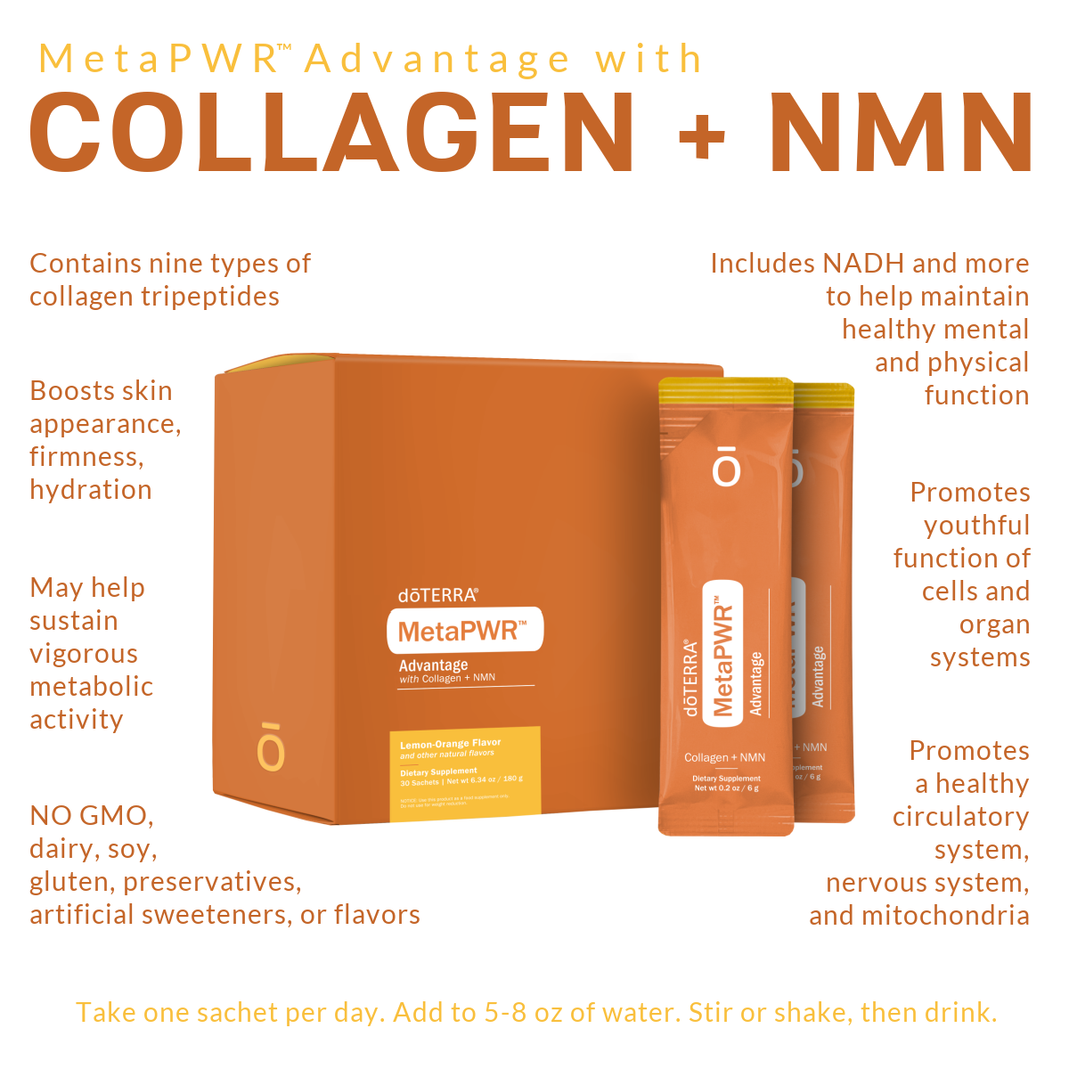
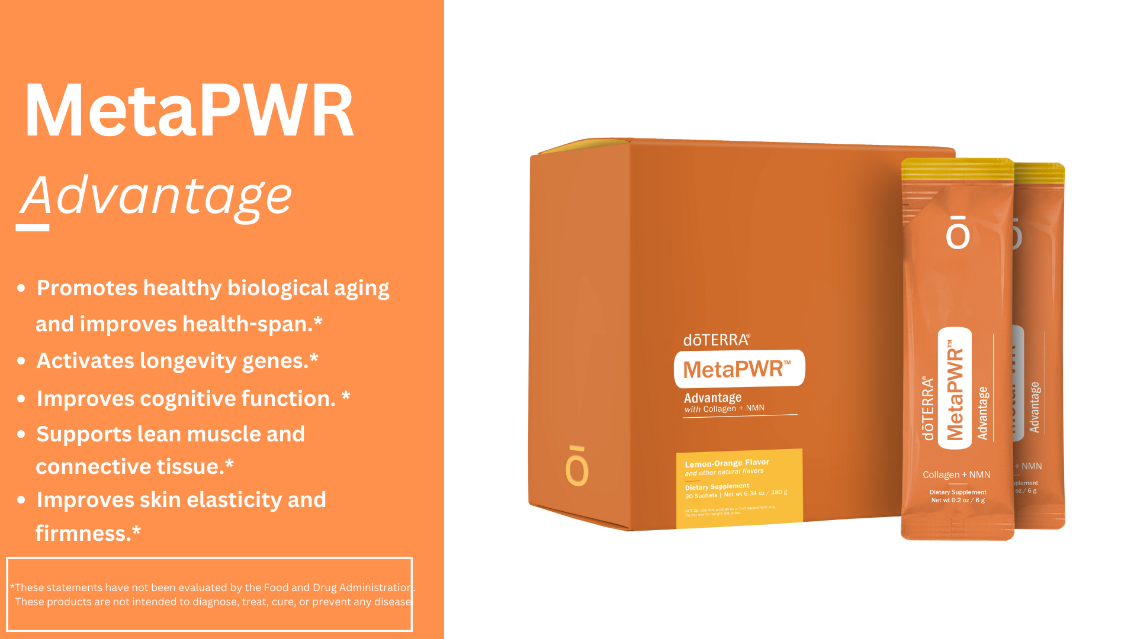
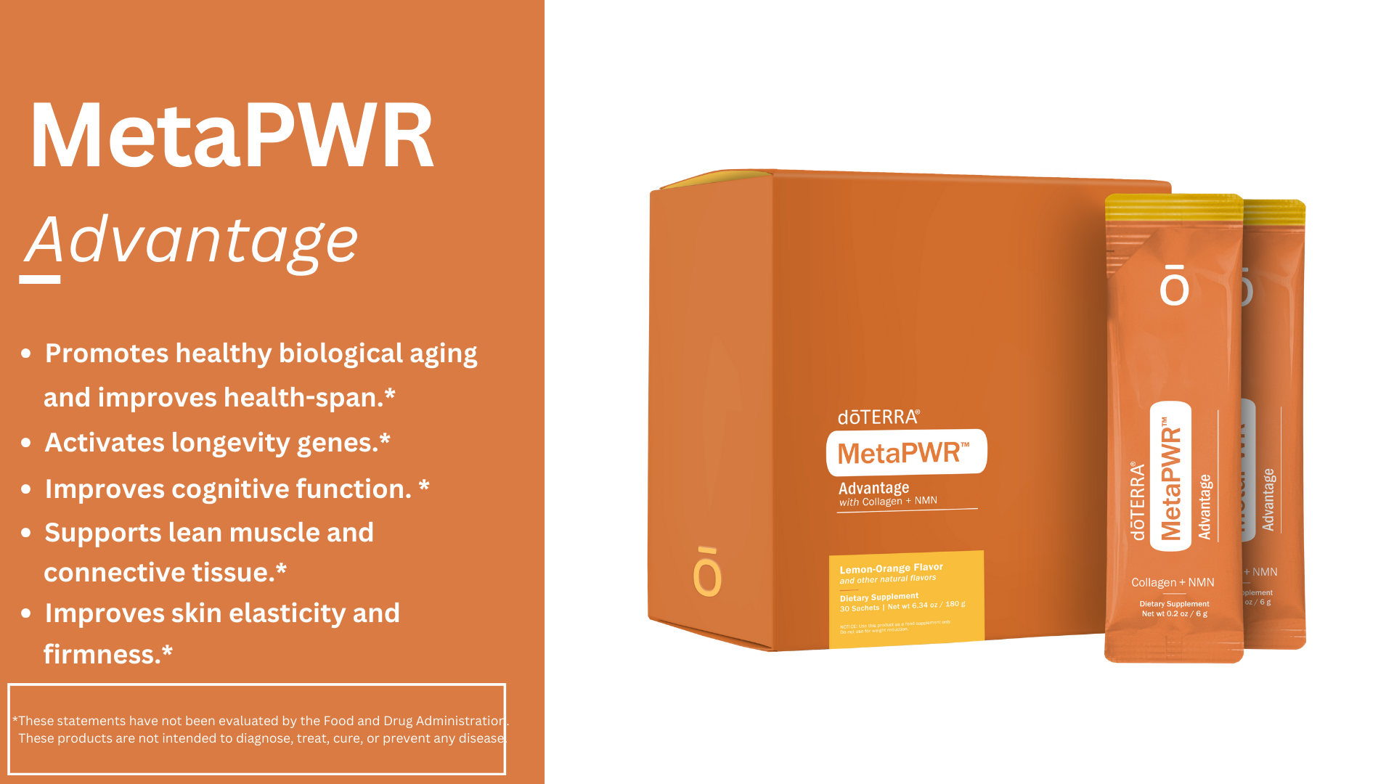
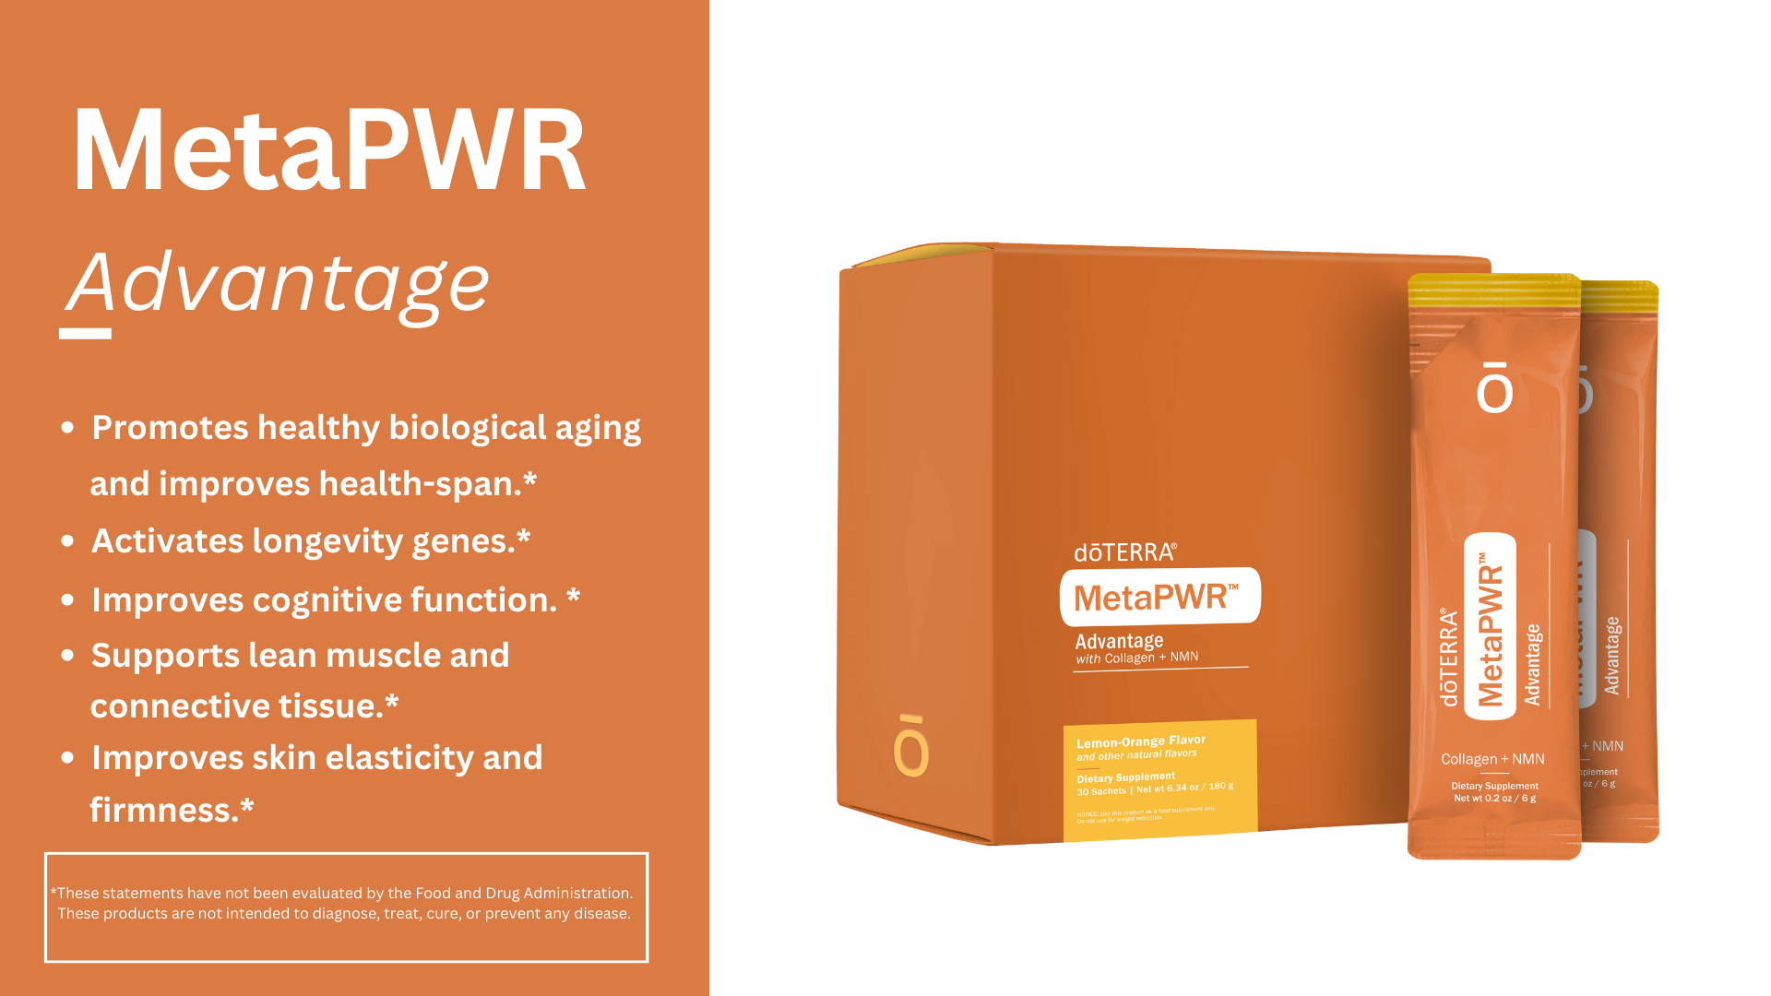
MetaPWR
Advantage
Notes:
MetaPWR – Metabolic System
I want to highlight my favorite MetaPWR product, the MetaPWR Advantage. This is doTERRA’s collagen product which includes:
9 types of collagen
Over 70% tripeptides so your body absorbs it 12 times more than other collagens.
It comes in small packets with freeze dried collagen and other nutrients to mix with water.
MetaPWR Advantage:
Promotes healthy biological aging and improves health span by helping aging cells
Activates longevity genes
Improves cognitive function
Supports lean muscle and connective tissue
Improves skin density, elasticity and firmness
We have a deep dive class recording on the Lifelong Vitality and the MetaPWR lines. If you love science and knowing how and why these products work, ask your wellness advocate to send it your way!
MetaPWR TESTIMONIALS Here
Ok, we’re changing direction now and heading down the road to oils. doTERRA is mostly known for their essential oils. So we need to look at why they lead the world in this area.

Slide 17
Notes:
Research: Roseman University of Health Sciences
In this independent study, doTERRA oils were found to be:
therapeutically-relevant in cell growth and rejuvenation
metabolic health
and healthy inflammatory responses
Essential oils from different competitors had minimal effects. They concluded that the therapeutic potential of essential oils is highly dependent on the complete composition of the oil. Sourcing, processing and characterization are critical.

Slide 18
Notes:
doTERRA Difference?
Oil is pure – No fillers, no synthetic ingredients, & no dilution.
Independent lab tests show that the majority of brands available to consumers aren't pure. I can post the link to that study at the end of this class.
We source from plants grown in their ideal environments- this makes all the difference in the chemical profile and therapeutic effectiveness of the oil.
Every batch of oil is tested for ideal chemistry and consistency
Over 54 tests done on each batch of doTERRA oils – from the farmer to the consumer.
doTERRA oils can be used topically, aromatically, and internally
People turn to doTERRA because they want safe, affordable and effective solutions for their family’s health. Let’s look at what that means exactly.

Slide 19
Notes:
Safe
Many look for safe and effective solutions that don’t have dangerous side effects or the risk of addiction.
We just mentioned Independent lab tests show that 80-90% of oils on the market have contaminants and synthetic markers- We suggest never ingesting another brand.
DoTERRA recognized that the essential oil industry didn’t have a standard for purity the ensured safety. So they created the CPTG standard that can be used throughout the essential oils industry. This standard is beyond organic and includes significant testing that isn’t cheap. DoTERRA will invest to ensure you have the most effective, safest product because that is best for YOU. Many doTERRA oils are safe to ingest – if it can be ingested it will have a food grade label on the bottle.
Girl with Burns on Chest
These 2 sisters were spending the night at their grandma’s house. They were used to putting doTERRA Lavender oil on their chests just before bed to help them relax and go to sleep. Grandma was out of doTERRA lavender. She used a backup from another company in her cabinet that she bought at a health food store and figured, “It’s just lavender. So it should work.” The girls ended up with chemical burns with scars almost a year later. I’m not saying this will be your reaction with other essential oils. However, it is important that you understand the risks.
doTERRA oils are safe to use at any age from newborn babies to great grandma. Brand matters for SAFETY!

Slide 20
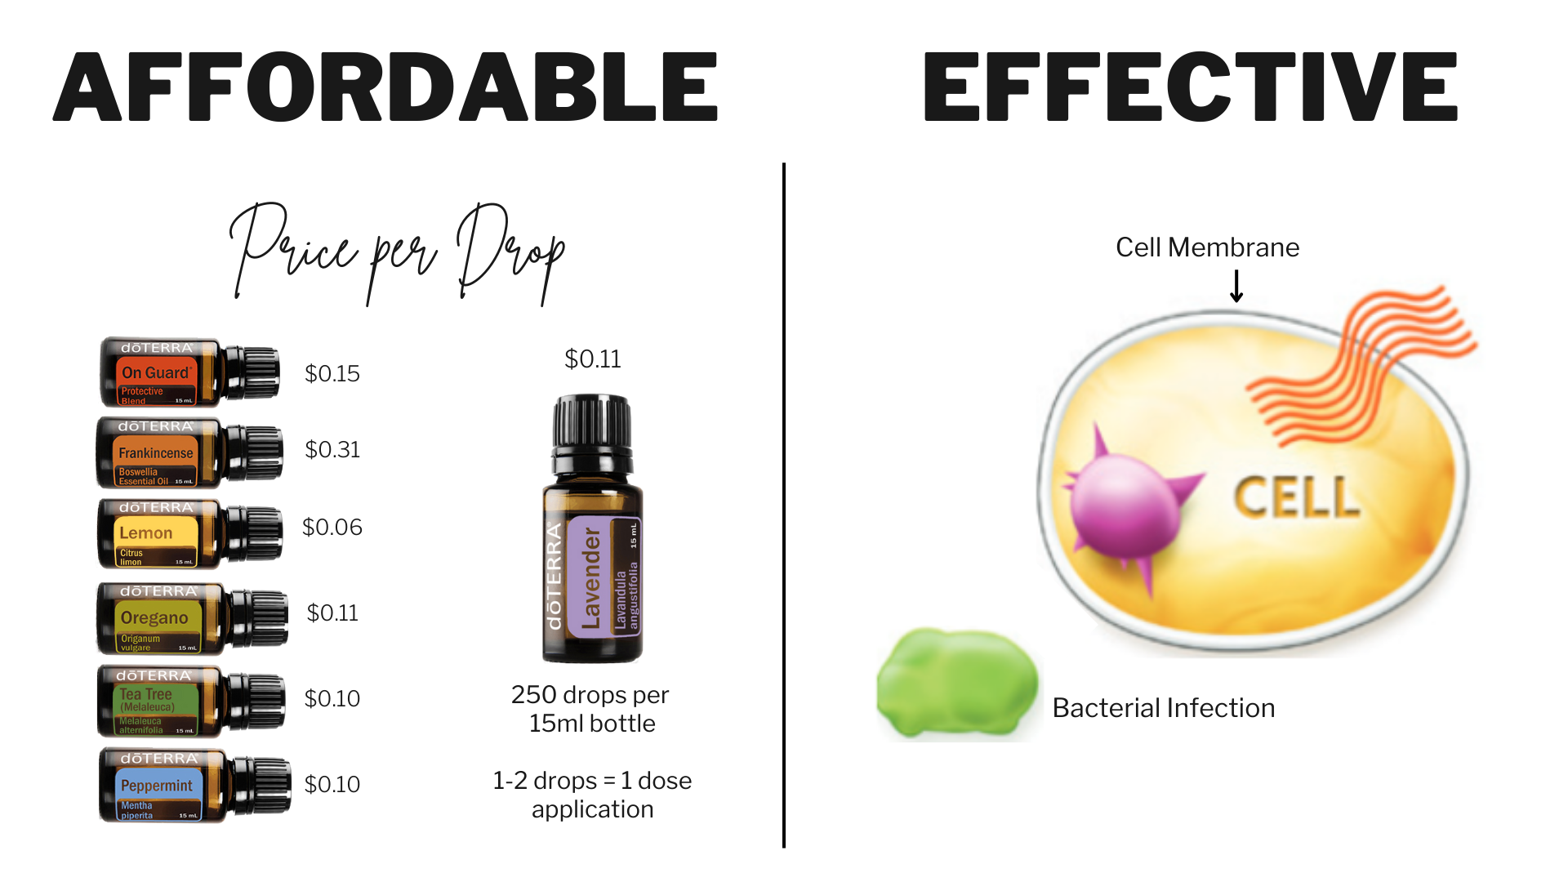
Notes:
Affordable
Let’s look at affordability and effectiveness next. Believe it or not, affordability is one reason people turn to doTERRA.
Oils are 50-70 times more potent than herbs. This means a little goes a LONG way! Let’s illustrate this.
Using the chat feature, I want you to make a guess. A recent test of Costco peppermint oil showed that it was not 100% peppermint oil. How much peppermint is in the Costco Peppermint oil bottle? (ANSWER: 10%).
When you use a DoTERRA oil, you get 100% of the oil making it much cheaper comparatively to other company’s oils where it is diluted.
Each 15ml bottle has 250 drops of essential oil in it
1 dose = 1 -2 drops
On average, it’s about $1 or less for treatment
Here’s an essential oil tip…When you are treating any kind of infection, disease or ailment, it is always better to use less oil more frequently throughout the day. Using 8 drops of oil on a wound at one time will not be more effective than using 1 drop of oil on a wound every 2-3 hours throughout the day. Use less more frequently.
Effective
This is one of my favorite micro-biology lessons! For our scientists in this workshop, we do know this is a very simplified lesson. So here we go! Our body is made up of cells. Each cell is surrounded by an oily membrane intended to protect it. It keeps the good in and the bad out. When you have a bacterial-infection (see that green blob?), you can get an antibiotic to help you because the bacteria grows on the outside of the cell. Viruses are different and proliferate on the inside of a cell. Essential oils, unlike most modern medicine, can penetrate the cell membrane & help stop the duplication of a virus and support your immune system to heal faster. When you have essential oils on hand, you can begin to support the healing of your body immediately instead of paying a copay and waiting to see a doctor.

Slide 21
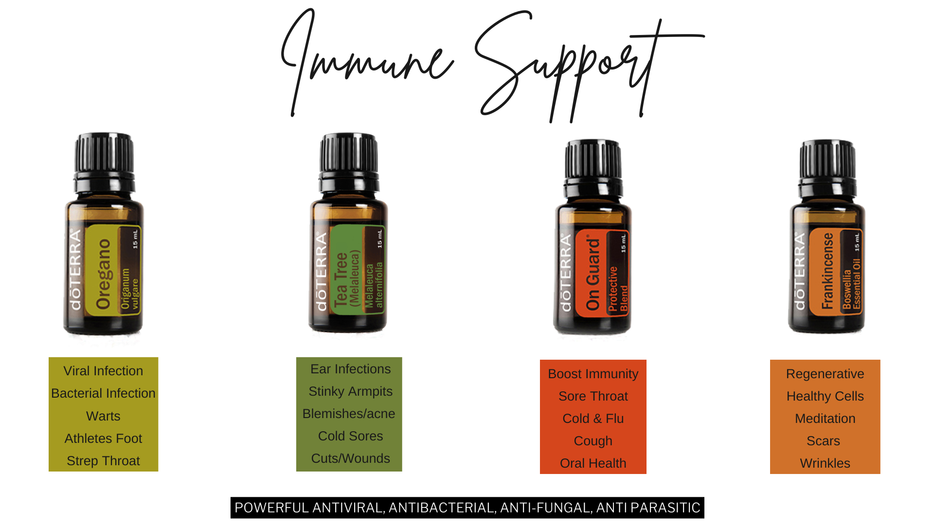
Immune support oils
Notes:
Immune Support
Use your keychain as you talk about the oils.
Oregano - A powerhouse antibacterial
Use for skin tags and warts
Canker sores
Tea Tree - Great for all things fungal or any kind of infection.
great for acne
Use after you shave to prevent razor burn
Good for cold sores
Use for wounds/cuts
Amazing if you struggle with smelly armpits even when using deodorant
OnGuard - (show in keychain) The protector. Natural immune defense. Everyone should have On Guard.
Stops the growth of viruses and bacteria.
Diffused it cleans the air of airborne pathogens.
Soothes sore throats and can help knock it out.
The key is to use it frequently right away. So worth it to avoid getting sick for a week!
Frankincense - Considered the KING of oils - When in doubt use Frankincense. Renewing, beautifying, rejuvenating, grounding.
Reduces inflammation
Relieves headaches (wonderful with peppermint and lavender)
Supports immune function
Apply topically to help reduce the appearance of skin imperfections
Strengthens the effects of other oils when used together
Diffuse during meditation for a sense of relaxation and balance

Slide 22
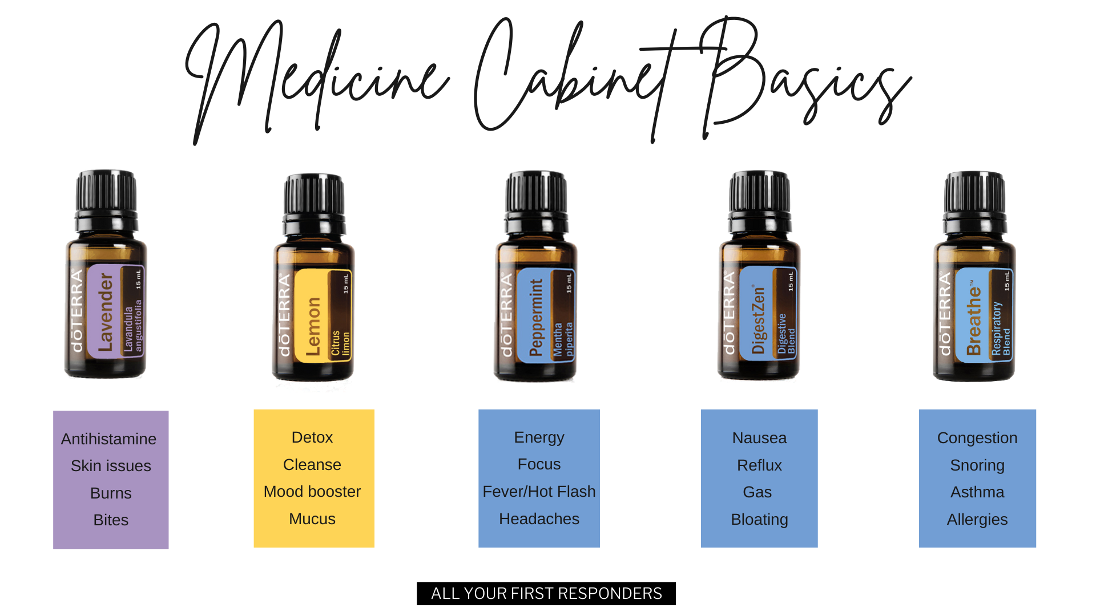
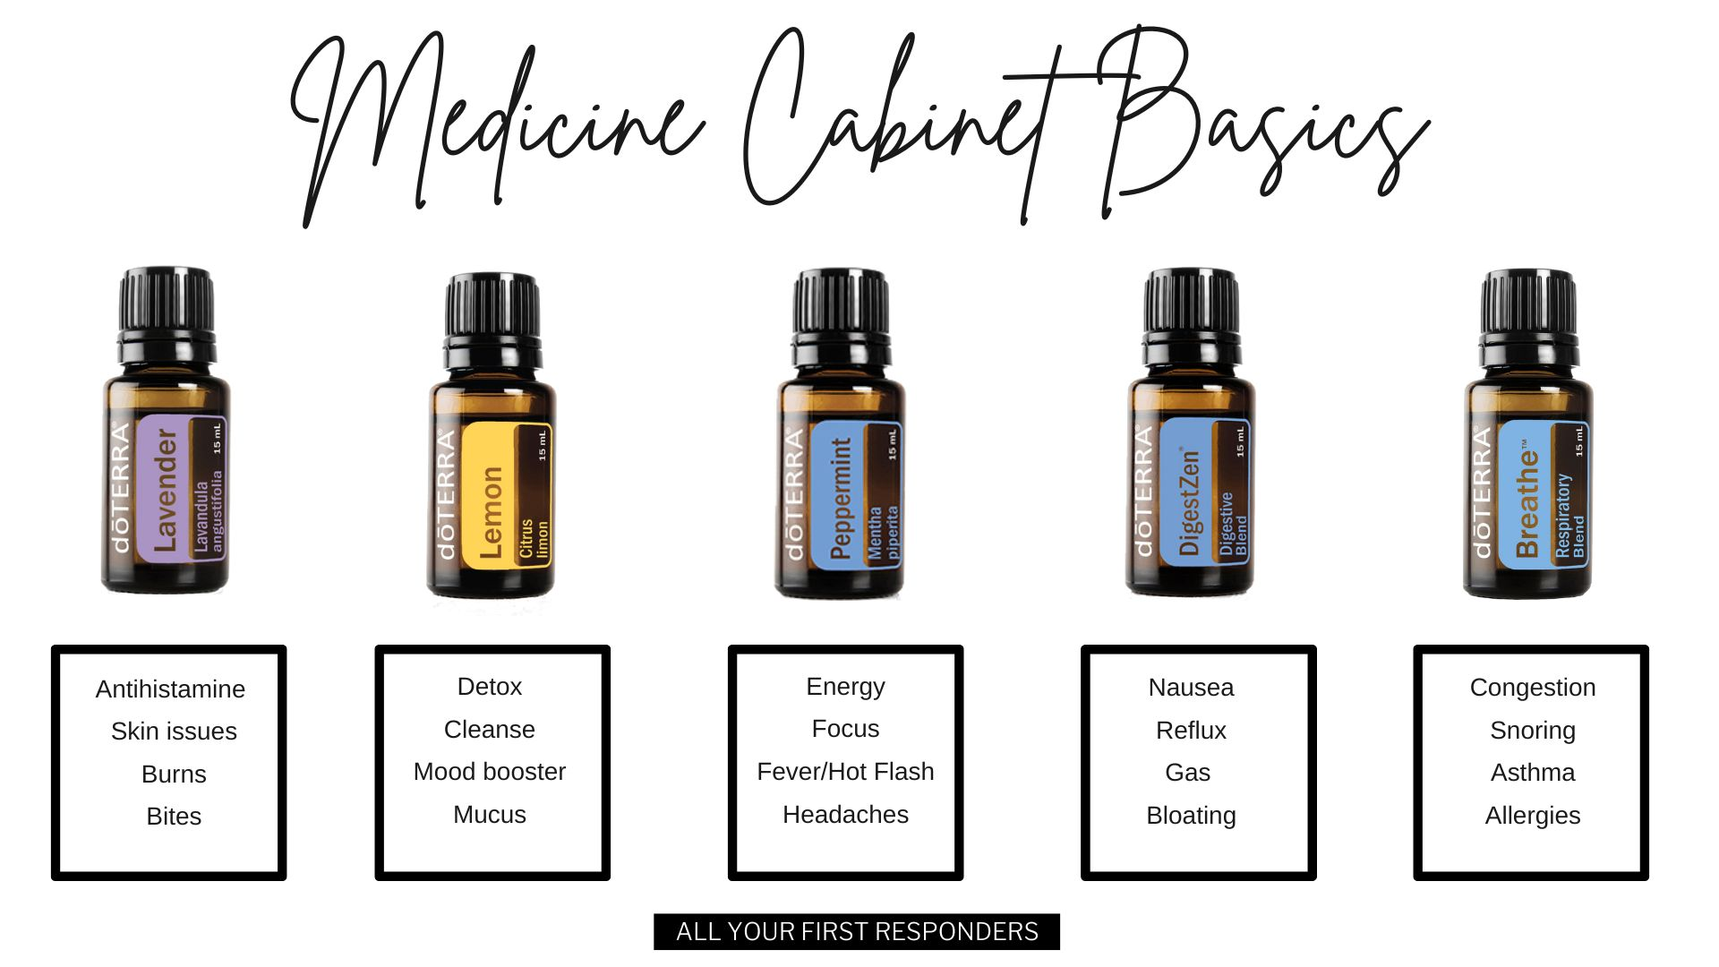
Medicine Cabinet Basics
Notes:
Medicine Cabinet Basics
PICK 1-2 TO HIGHLIGHT ON THIS SLIDE
Lavender: (show keychain) the Swiss army knife of oils! Every first aid kit needs lavender in it!
Good for calming the mind and skin
Great for bug bites and bee stings. Pain goes away almost immediately and the itching stops right away.
Soothes and heals burns and skin irritations. Takes burning away immediately and doesn’t scar.
Good if you struggle with sleep or just unwinding
Relieves stress and anxiety
Are you an allergy sufferer? If so, this is a must have. It’s a natural antihistamine. Increases the body's serotonin levels.
Lemon: (show keychain) cleansing. A drop or two in water is amazing for escorting toxins out of your body
The clean fresh scent uplifts your mood.
Use it to clean your fruits and vegetables
Awesome with anything sticky like residue and chewing gum
ASK: How many lemons does it take to make a bottle of doTERRA’s Lemon Oil? 60
Peppermint: (show keychain) everything cooling and energizing
Increase energy. In the afternoon when you need to wake up and focus. It oxygenates your cells.
Great to diffuse when studying or working where you need to be alert
Use this when your sinuses are stuffed up and you need to open your airways
Wonderful relief for tension headaches - can knock it out before it really sets in
When you eat something spicy or eat too late at night - peppermint can help prevent acid reflux
When overheating on a summer day or kids have a fever, you’ll be glad you have oils to cool down. Can cool your body 1 degree. Also great for hot flashes.
TRIVIA: Let’s go back to the chat feature! Take a wild guess. How many cups of peppermint tea would be equal to one drop of doTERRA peppermint oil?
DigestZen: (show keychain) might not use this one every single day, but it’s going to be one you are glad you have on hand when you need it. We call this the oil of repentance. It’s definitely a “purse oil”. You’ll never want to be without it (even when traveling).
Useful for acid reflux, bloating, gas, indigestion, bloating, diarrhea.
Can be used for nausea - settles your stomach
Can even be used for food poisoning
Breathe: (show keychain) you will use this for everything respiratory
sinus infections, asthma, snoring, congestion
with that nagging cough and difficulty breathing it will help clear the congestion so you can breathe better
those with asthma find it’s a must have
diffuse at night for a more restful sleep and to help reduce snoring
use before a workout to open airways and increase your stamina

Slide 23
Notes:
Pain and Inflammation
Deep Blue - must have for muscle and joint health
Not only does it relieve pain and tension, the amazing oils in it support muscle, joint and bone healing.
Alleviates back pain
When you have a nasty bruise forming, grab your deep blue to stop it in its tracks.
Stick has copaiba in it and is easy to apply without it getting on your hands.
Copaiba – another oil used for pain and inflammation; a super anti-inflammatory
Layered with another oil, it increases the effectiveness
When you really need to boost pain relief, this is what you’re going to use with your Deep Blue.
If you ever suffer from any emotional strain such as anxiety or depression, this oil can calm and soothe.
Supports all major body systems: heart, nerves, respiratory, immune and skin
Can really be helpful for ADD or ADHD
A CBD replacement

Slide 24
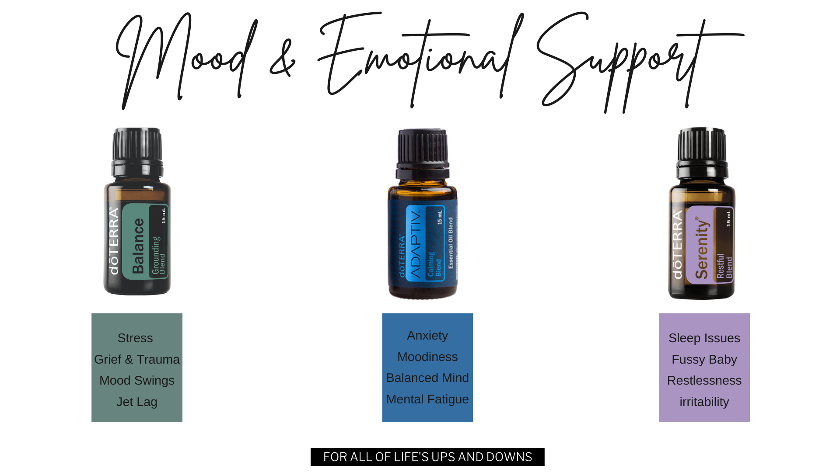
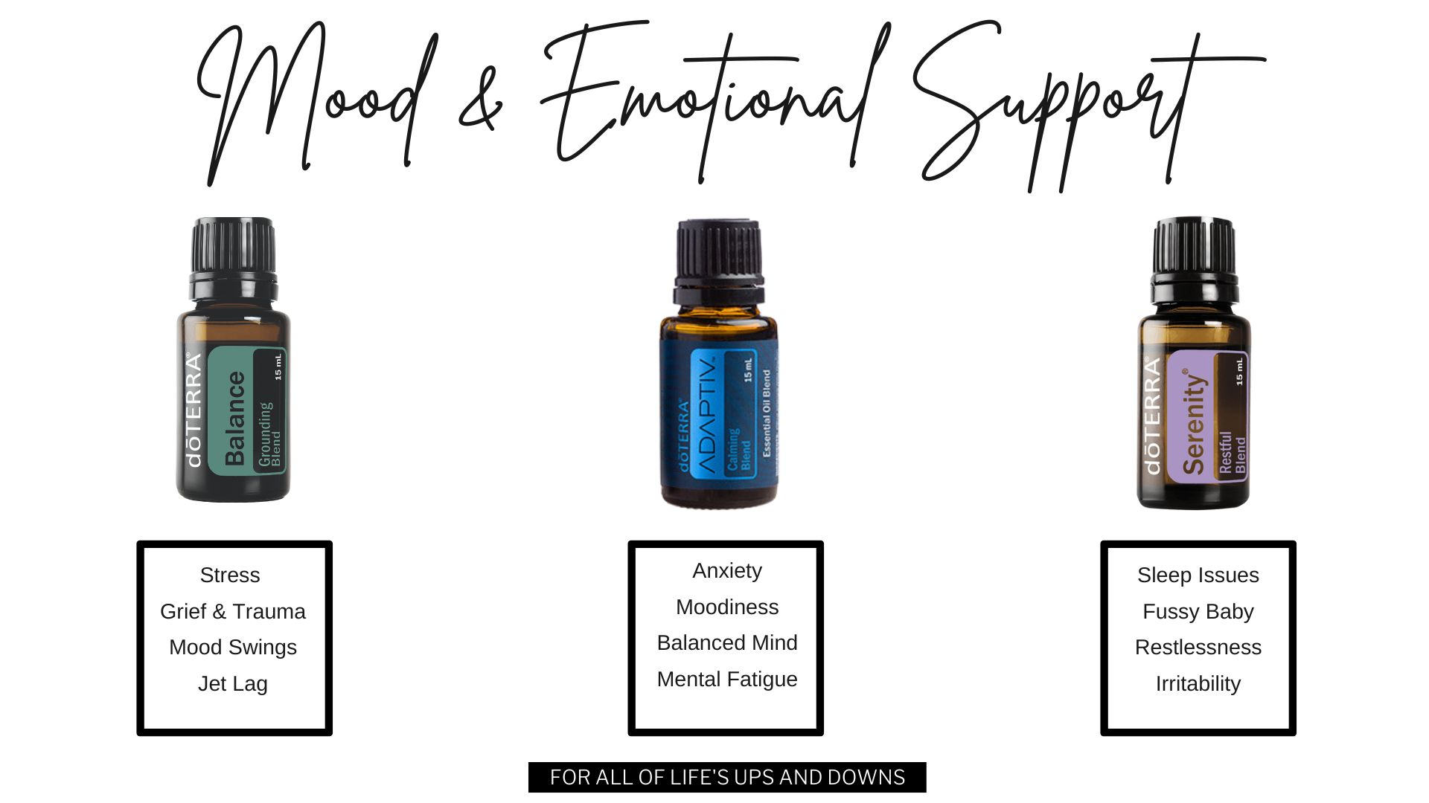
Mood & Emotional Support
Notes:
Mood and Emotional Support
Let’s wrap up our oils section with mood and emotional support oils. Talk with your wellness advocate about additional oil options available for wellness!
PICK 1 TO HIGHLIGHT ON THIS SLIDE
Lastly – let’s talk about our mood and emotional support blends. For those of you who indicated you or someone in your family deals with anxiety, these are great options to consider.
These oils are 3 of the powerful blends for emotional & mood support
Adaptive –
Helps the brain stay in executive functioning in the frontal cortex instead of going into fight or flight
Brings a calming effect over your body
Diffuse it in a room or use it topically
Balance - smells like a forest
wonderful to diffuse
very grounding emotionally and helpful with grief, sadness, overwhelm, heaviness, or just getting through the day feeling more emotionally strong and grounded
Serenity - calming and helpful for sleep
May help you fall asleep more easily and sleep more deeply
So many people swear by it
Also, helpful for anxiety and stress

Slide 25
100 PV:
Free Shipping
Free Citrus Bliss
150 PV:
Free Pebble Diffuser
200PV
Free Adaptive Touch
Free 5 ML Frankincense
FREE 15 ML Adaptive Oil (Oct only)
FREE Adaptive Bath Oil (Oct only)

Slide 26
Notes:
30 Second Commercial
Share your gratitude of how doTERRA has blessed your life and touch on these topics
I never imagined myself doing something like this
Making a difference and impacting people's lives in a significant way
Time flexibility- I get to work when it's convenient for me and my family
Friends

Slide 27
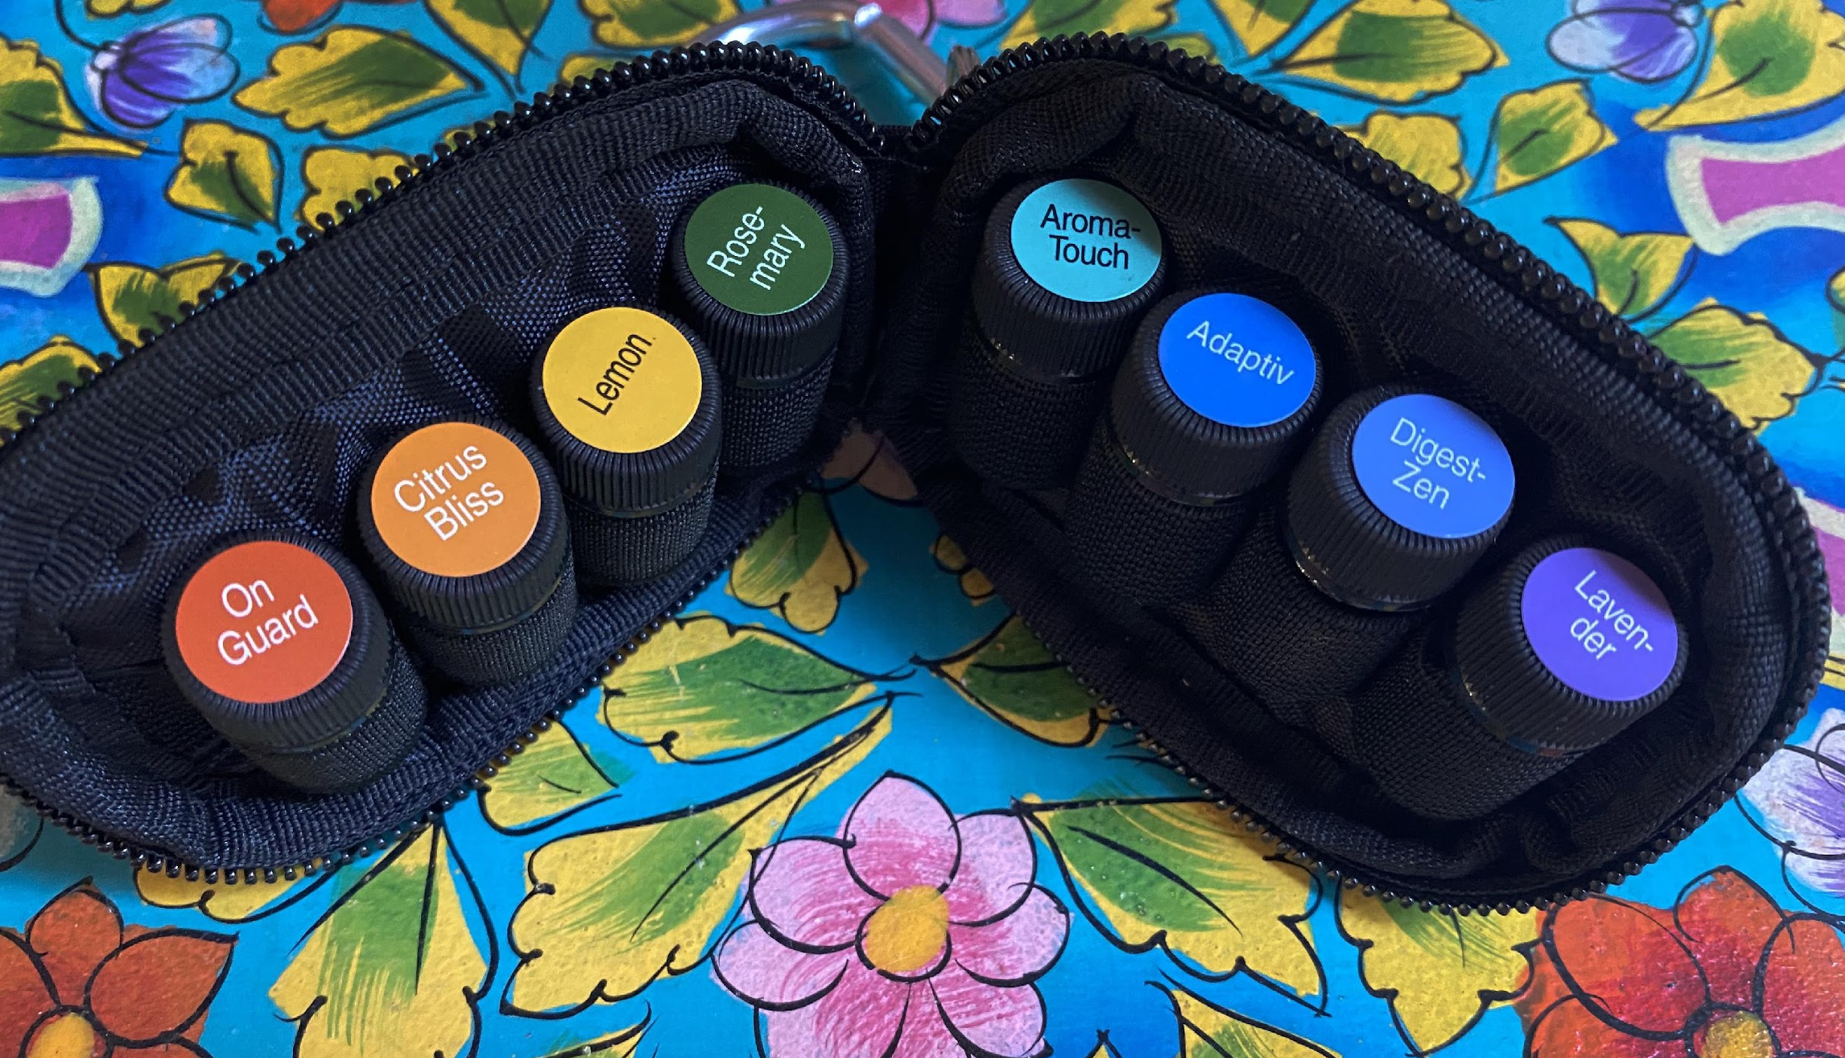
Want this?
Notes:
Host a Workshop/Class Online
This has been one of the most valuable items to have with me on the go! There is a way you can get it for free. We host a workshop every week that you can join in on at any time. However, if you have thought of your own friends or family who might enjoy a workshop geared specifically to them, you will get this as a gift when you host.
When you schedule your wellness workshop, you will receive this keychain! This is the only way to get one!
You can invite your friends that live outside your community or even in a different country. The ideal workshop size is 5 people. That’s doable, yes? You will get 5 oils for hosting. For every guest you have there up to 5, I will add another free oil to your keychain as a gift!
Talk to your wellness advocate about that option if you’re interested.

Slide 28
Notes:
Join FB Community
POST LINK TO THE FB GROUP IN THE CHAT https://www.facebook.com/groups/livewell.livefree.livenaturally
We have an awesome customer FB group where we help you maximize your products, share before and afters, testimonials as well as keeping you in the loop on all things with your health journey.
It’s a great way for you to get support you need and check out how others are using their products.
We put the link in the chat. Click that to join and answer the 3 questions so we know you are not a bot. Then we will get you approved.

Slide 29
GIVEAWAY
TIME
Notes:
Google Form and Giveaway
POST LINK TO GOOGLE FORM IN THE CHAT: https://docs.google.com/forms/d/e/1FAIpQLSeCWzoIh-aTc892wrOje9YBqQN6MQTQKaSgCXiiMk3gRsf4Wg/viewform
Okay we are going to do a giveaway at this time. I am posting the link to a very quick Google Form. Take a couple of minutes to fill that out.
Then we are going to do a giveaway.
PICK A WINNER FOR A PRIZE
Thank you all for joining us. The wellness advocate that invited you will be reaching out in the next day or 2 to help you find solutions for your health.
Between now and then, be sure to jot down anything else that pops in your head so you can share with your wellness advocate when you connect with them.

Slide 30
EXTRA SLIDES
Notes:
.

Slide 31
Notes:
Marine Collagen

Slide 32
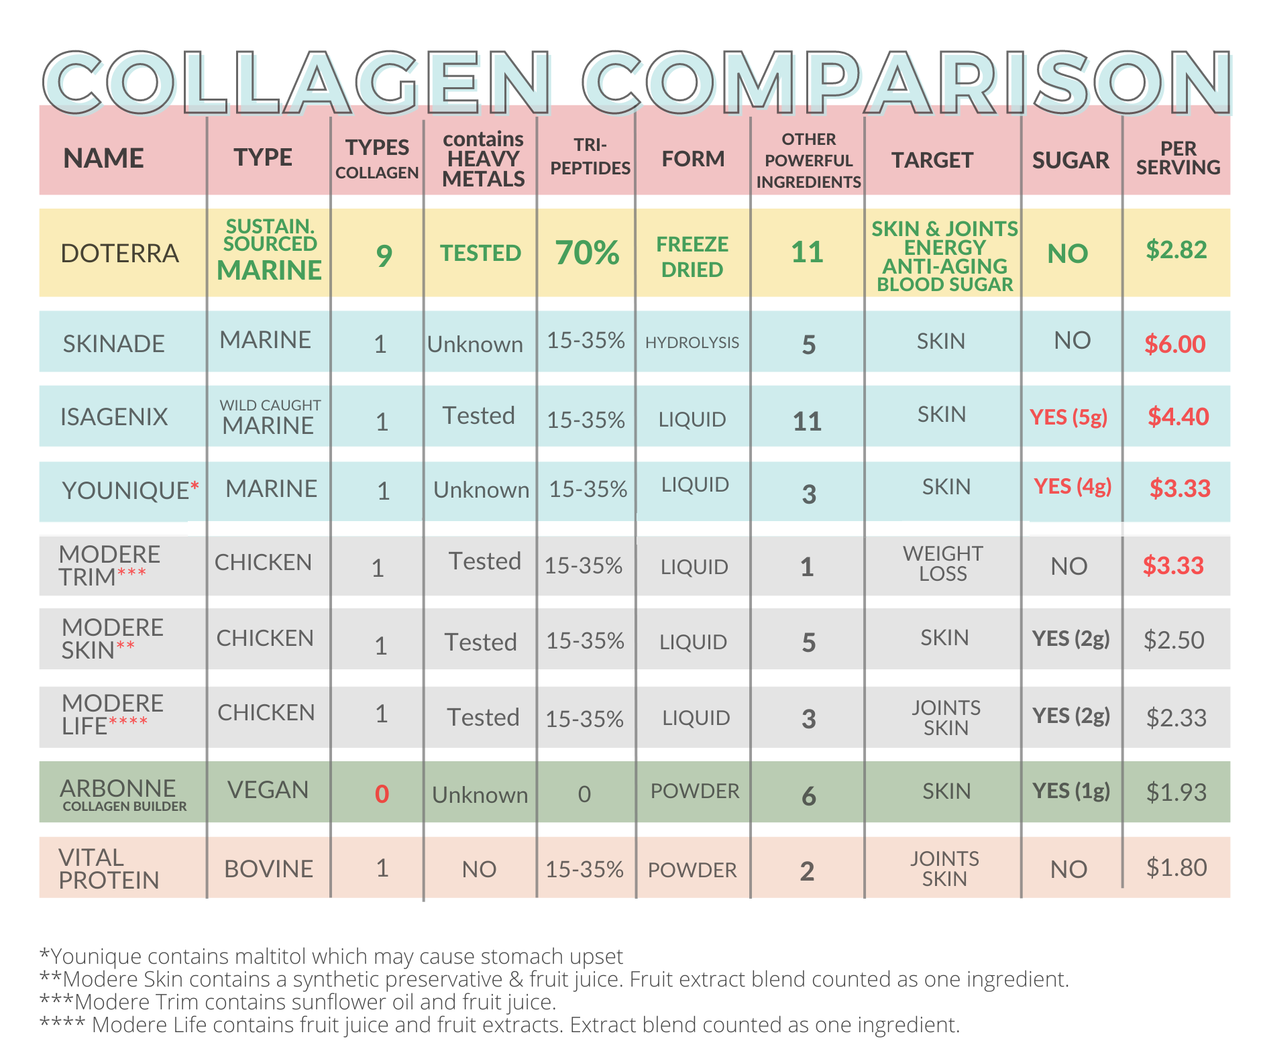
Notes:
Collagen Comparison Chart

Slide 33
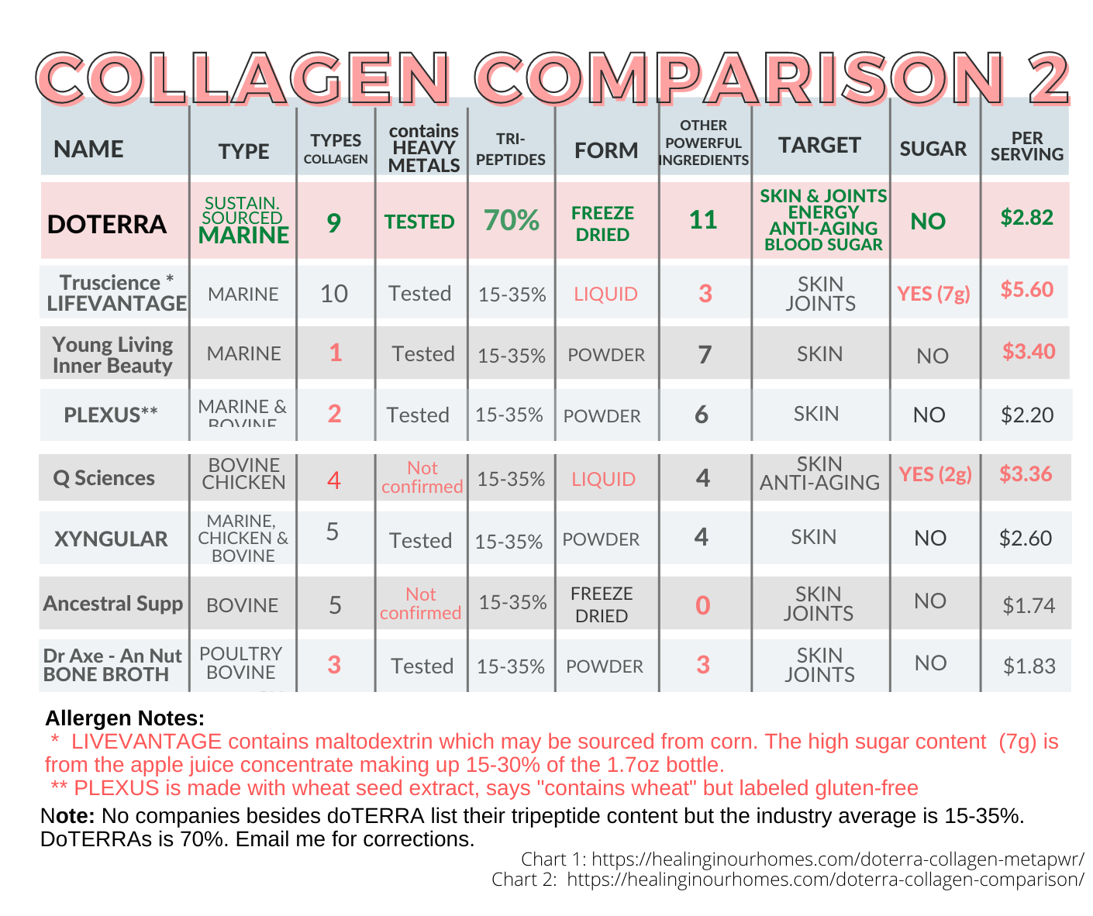
Notes:
Collagen Comparison Chart

Slide 36
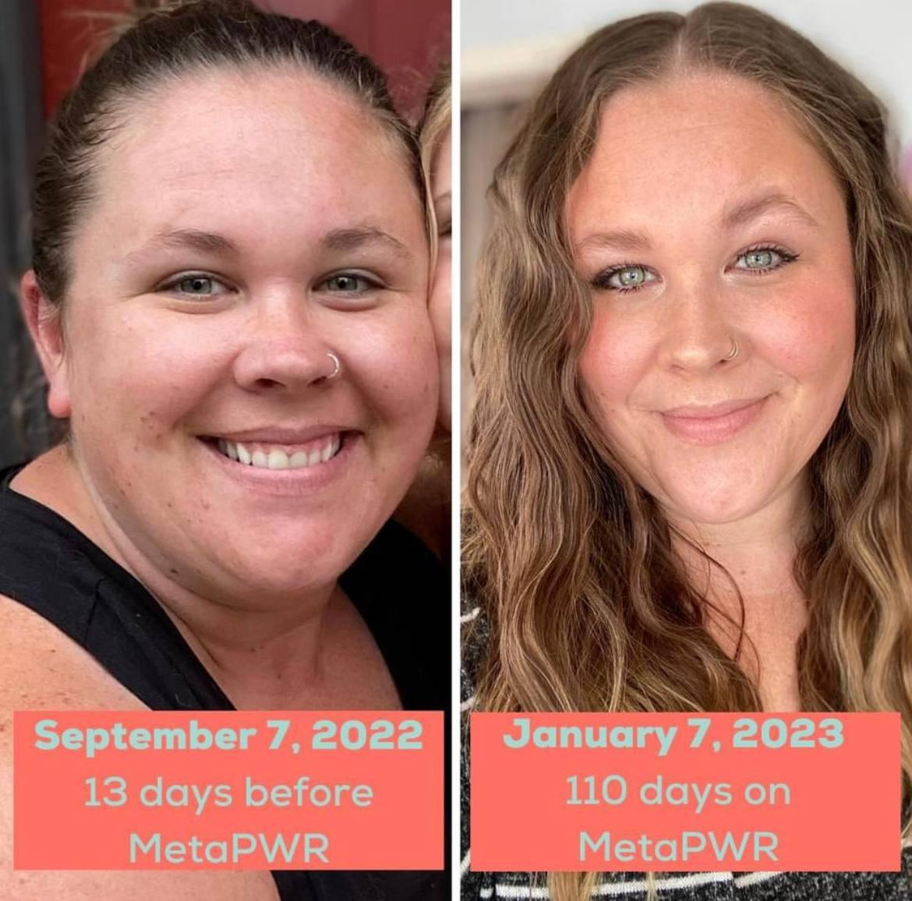
MetaPWR Results
healthy metabolism
curbing cravings
sustaining normal-range glycemic and insulin response evenly throughout the day
naturally promoting cellular energy
Notes:
Benefits of MetaPWR
Before we get into too many details with the MetaPWR, let’s look at a few before and afters.
The lady on the right has been using MetaPWR for 4 months. She’s had amazing results. Look at the improvements on her face, eyes and hair. You’ll see this same lady on the upper-left. She rubbed MetaPWR oil on her legs and knees. These are her results in 2 weeks.
The gentleman on the bottom left experienced:
improved skin elasticity
darker hair growth
He got his blood work taken after three weeks on the MetaPWR and this is what it showed:
40-point decrease in cholesterol
5-point decrease in HDL
25-point decrease in LDL
57-point decrease in Triglycerides

