Slide 2
INTENTION

Slide 3
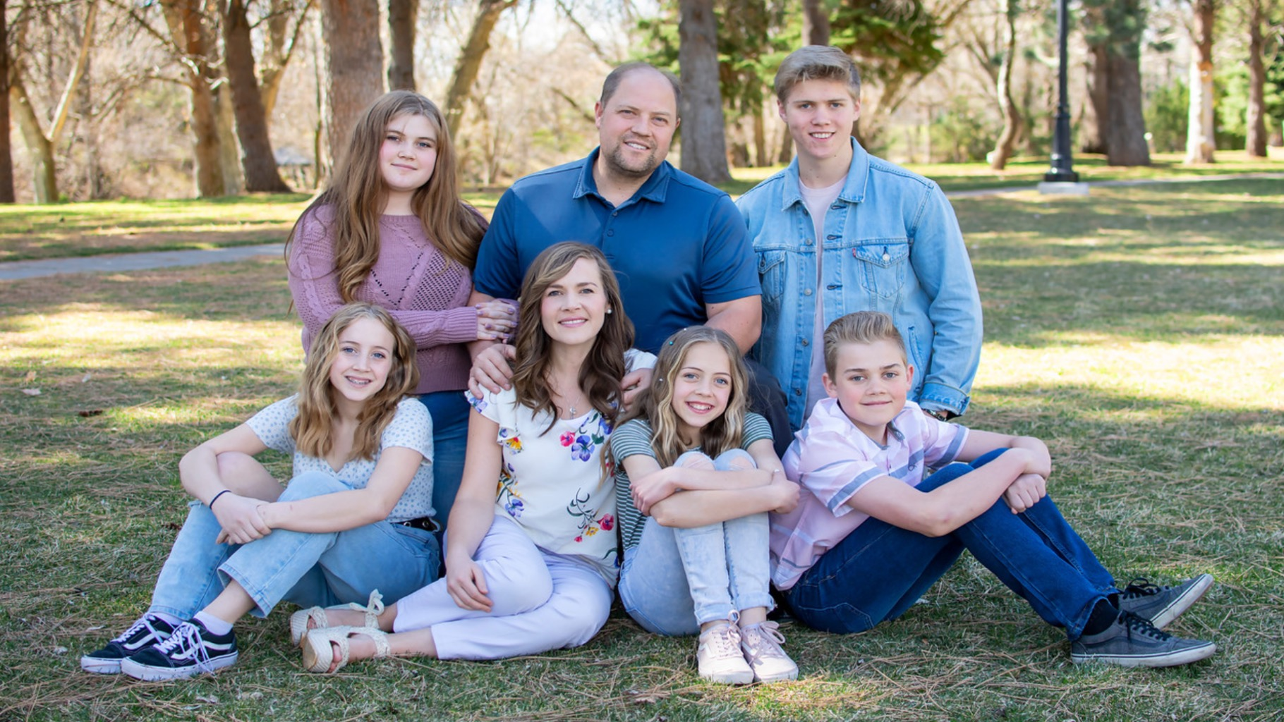
Amy & Rich Fullmer
Blue Diamond & US Founder 2.0

Slide 4
400k volume/mo 2 Blue Diamonds 4 Diamonds 9 Platinums 12 Golds 40 Silvers 45 Premiers 183 Elites 90% of team in Utah
Amy & Rich Fullmer
Blue Diamond & US Founder 2.0

Slide 5
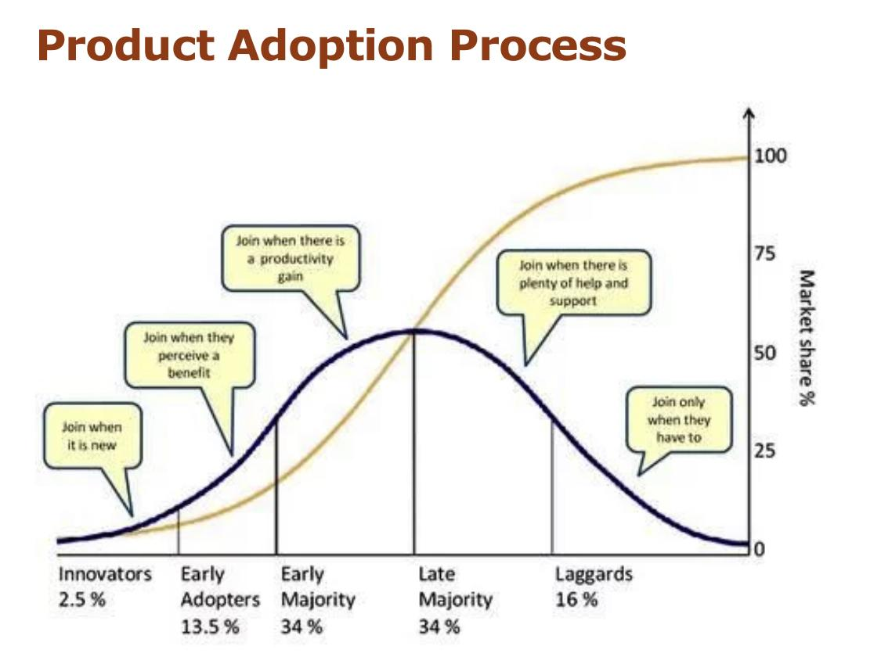

Slide 6
What speaks to the Early Majority
Evidence of efficacy outside of you- Research (especially on why DoTERRA is better- Roseman study- have handouts or links available), before and after photos, testimonials
Having their own experience
Emphasize time saving benefit
Emphasize money saving benefit
Address how doTERRA compares to pharmaceuticals
Know your market!

Slide 7
What speaks to the Late Majority
Safety- $ back guarantee
Support- clarify what you have to offer and follow through- one on one (wellness consult), continuing ed classes, fb group, customer appreciation events
Be sure to start the class with identifying their needs and make the presentation about THEM! Practice the way you speak
Know your market!

Slide 8
Notes:
Research: Roseman University of Health Sciences
In this independent study, doTERRA oils were found to be:
therapeutically-relevant in cell growth and rejuvenation
metabolic health
and healthy inflammatory responses
Essential oils from different competitors had minimal effects. They concluded that the therapeutic potential of essential oils is highly dependent on the complete composition of the oil. Sourcing, processing and characterization are critical.

Slide 9
Notes:
Research: Roseman University of Health Sciences
In this independent study, doTERRA oils were found to be:
therapeutically-relevant in cell growth and rejuvenation
metabolic health
and healthy inflammatory responses
Essential oils from different competitors had minimal effects. They concluded that the therapeutic potential of essential oils is highly dependent on the complete composition of the oil. Sourcing, processing and characterization are critical.

Slide 10
62 Presidential Diamonds 187 Blue Diamonds 644 Diamonds

Slide 11
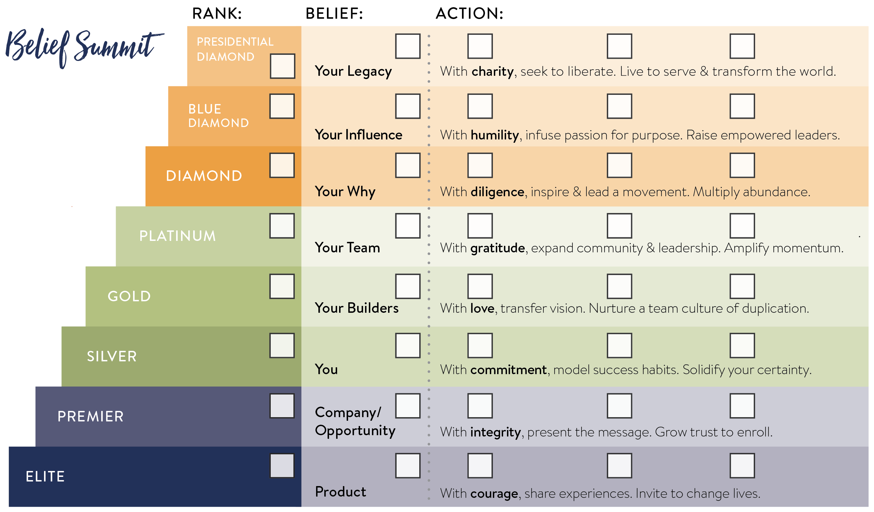

Slide 12
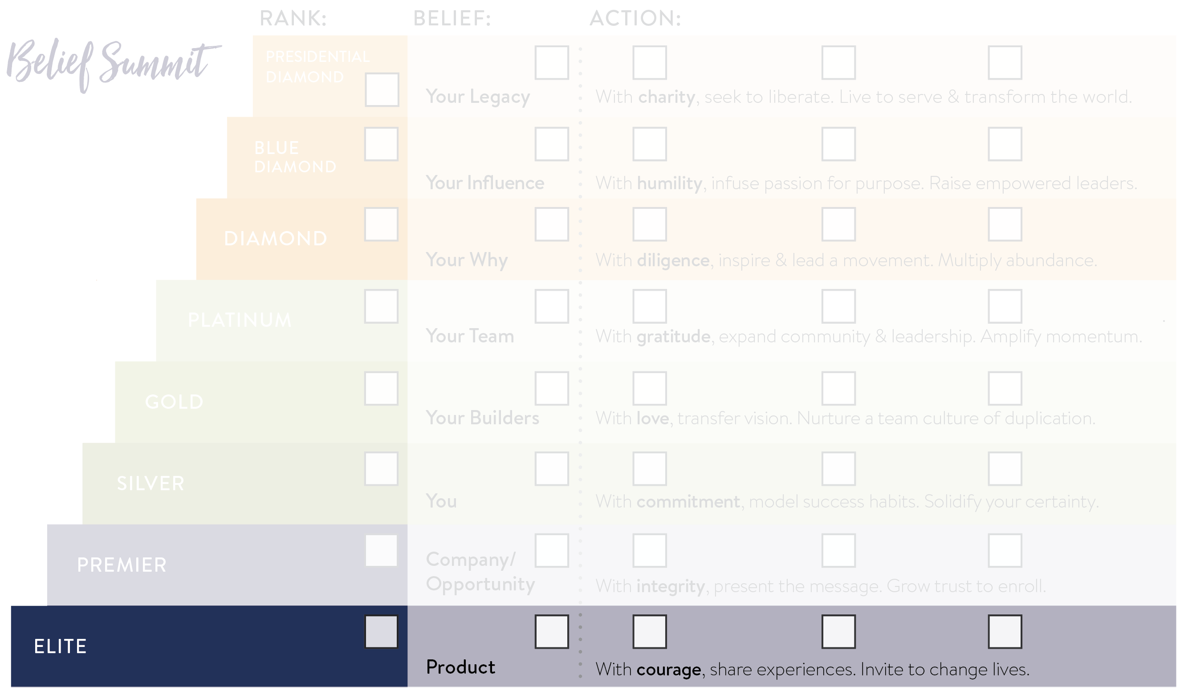

Slide 13
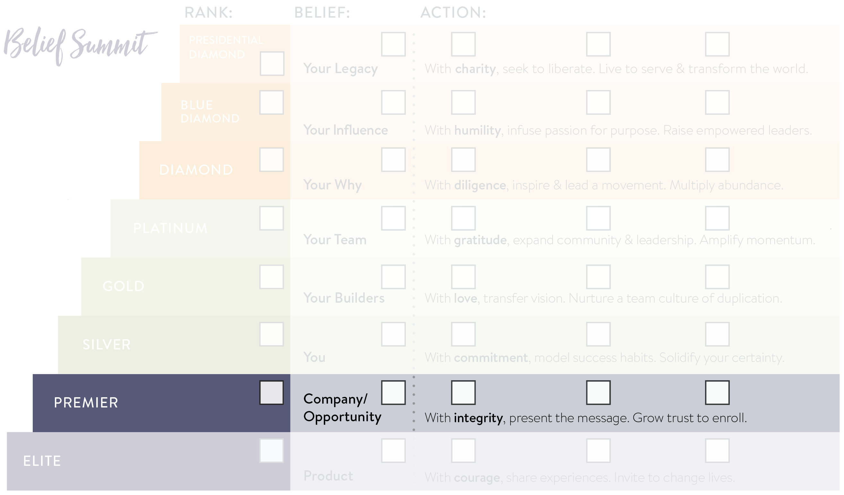
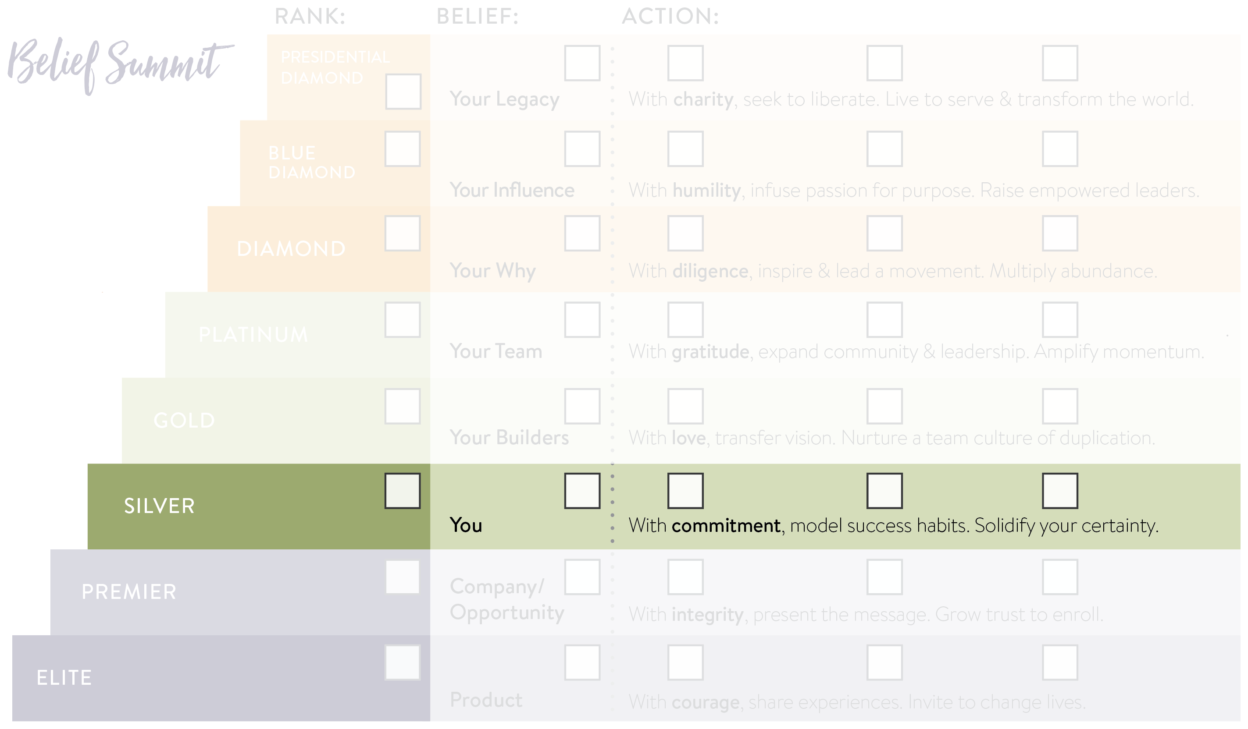

Slide 15
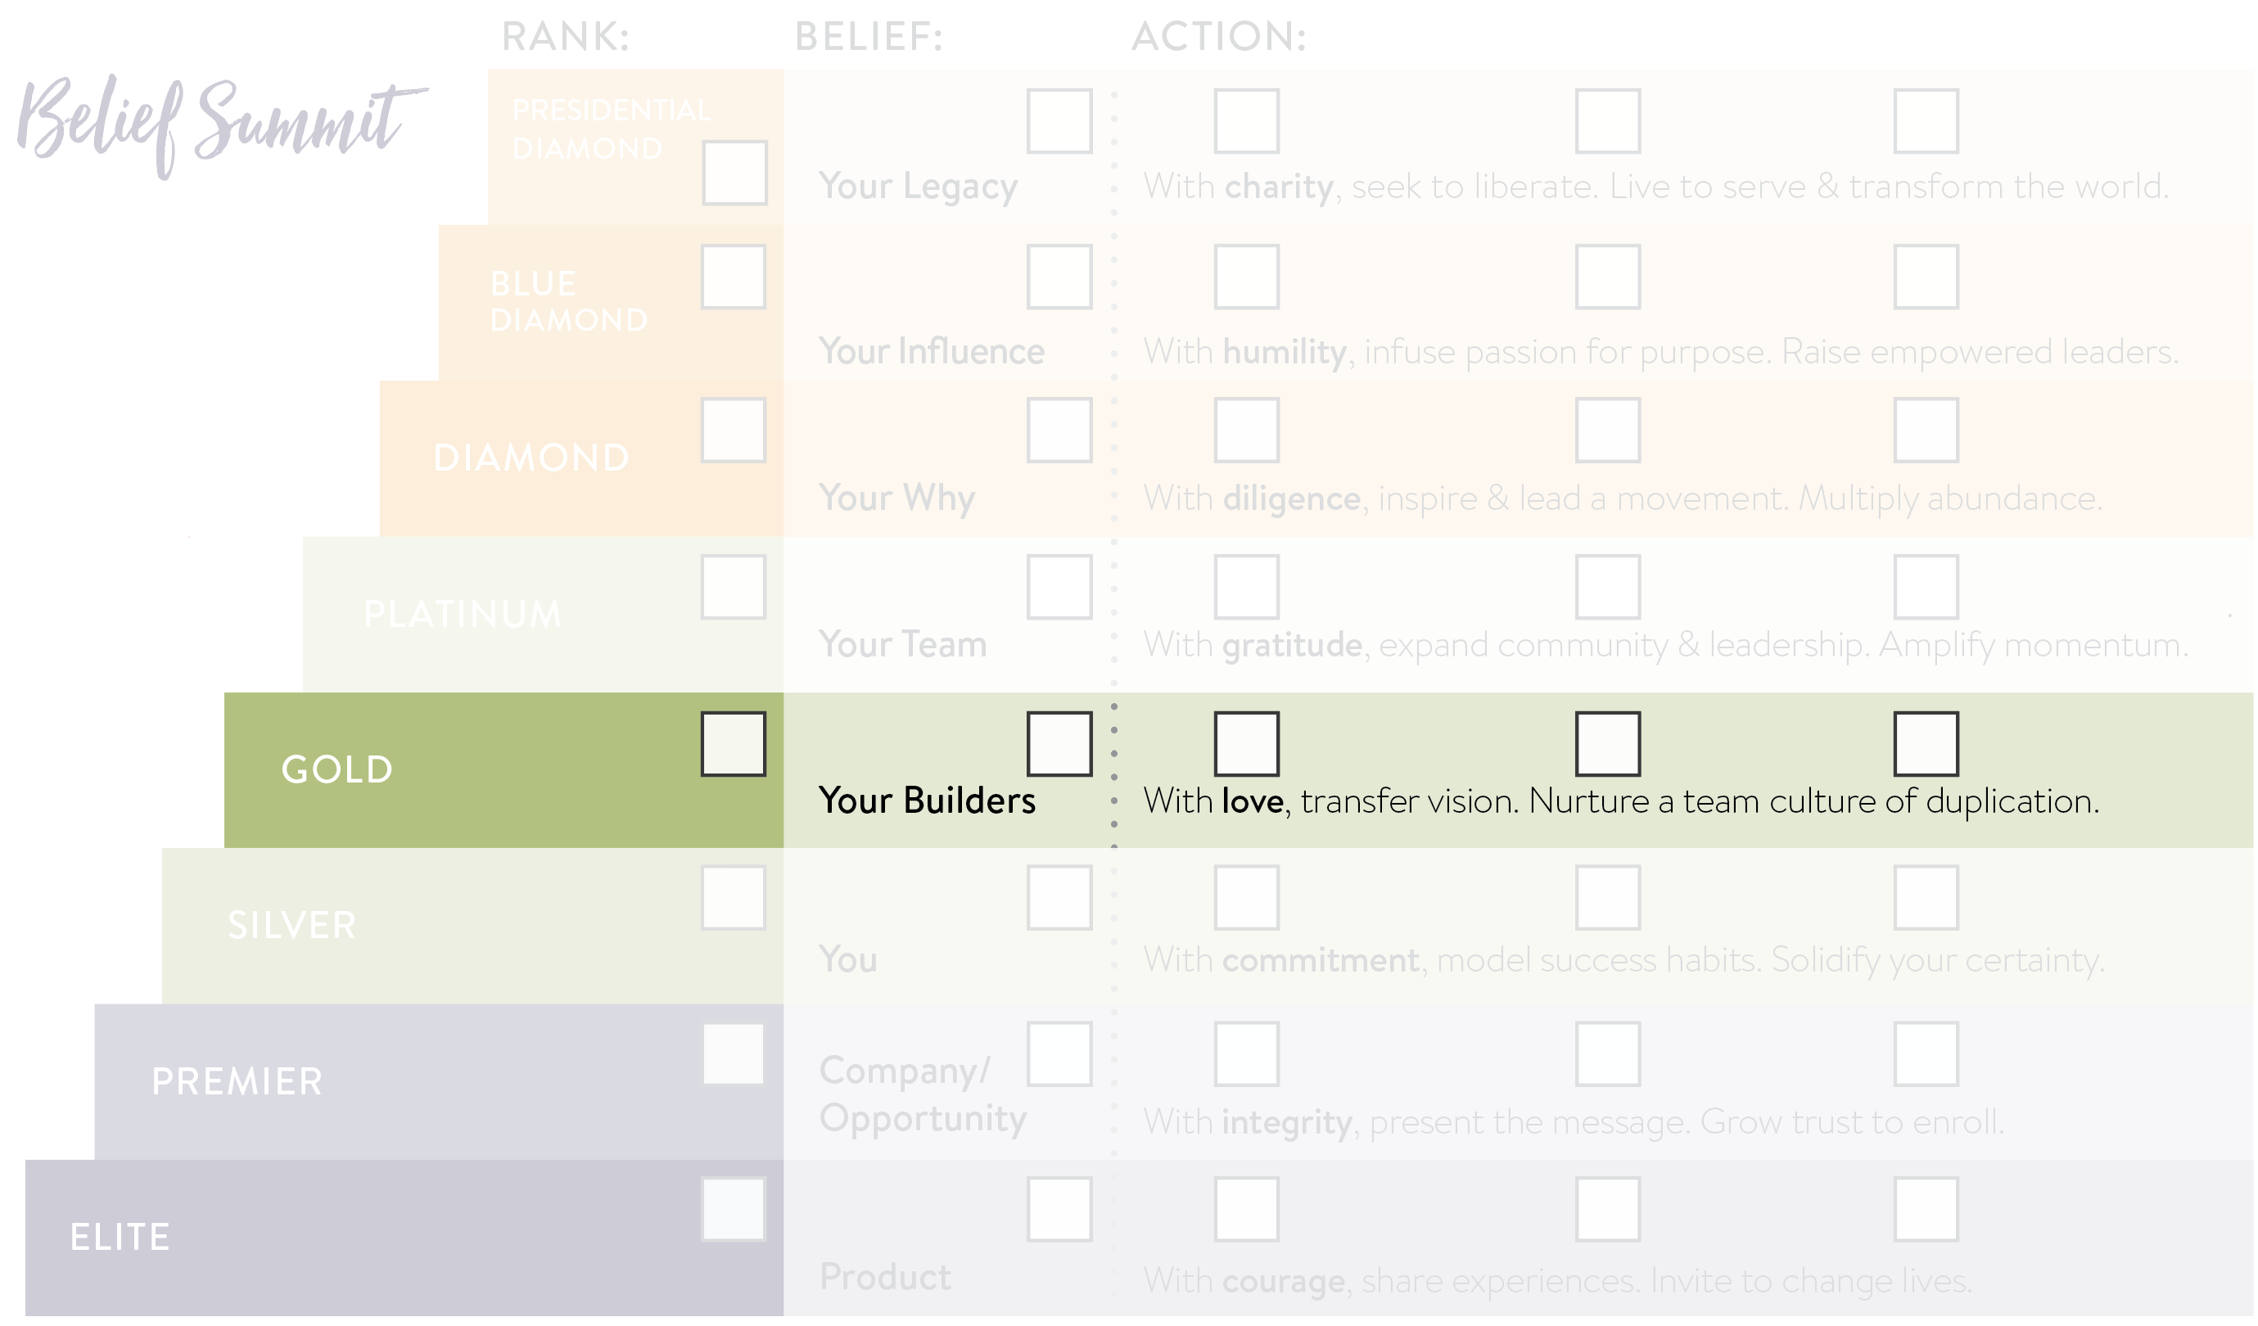

Slide 17
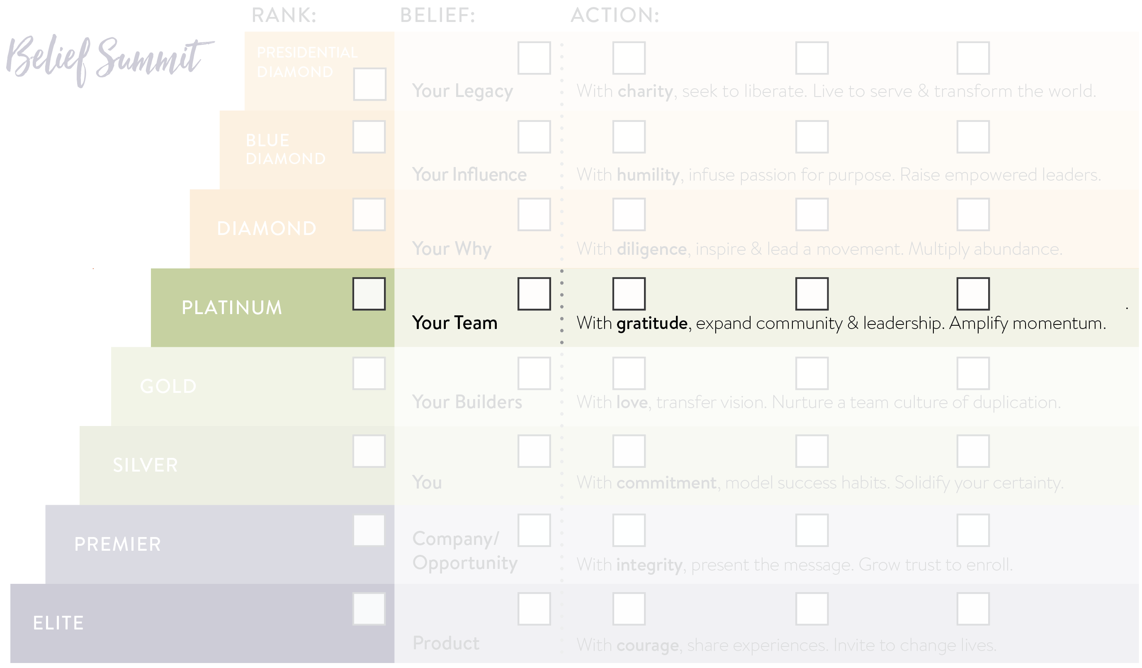

Slide 18
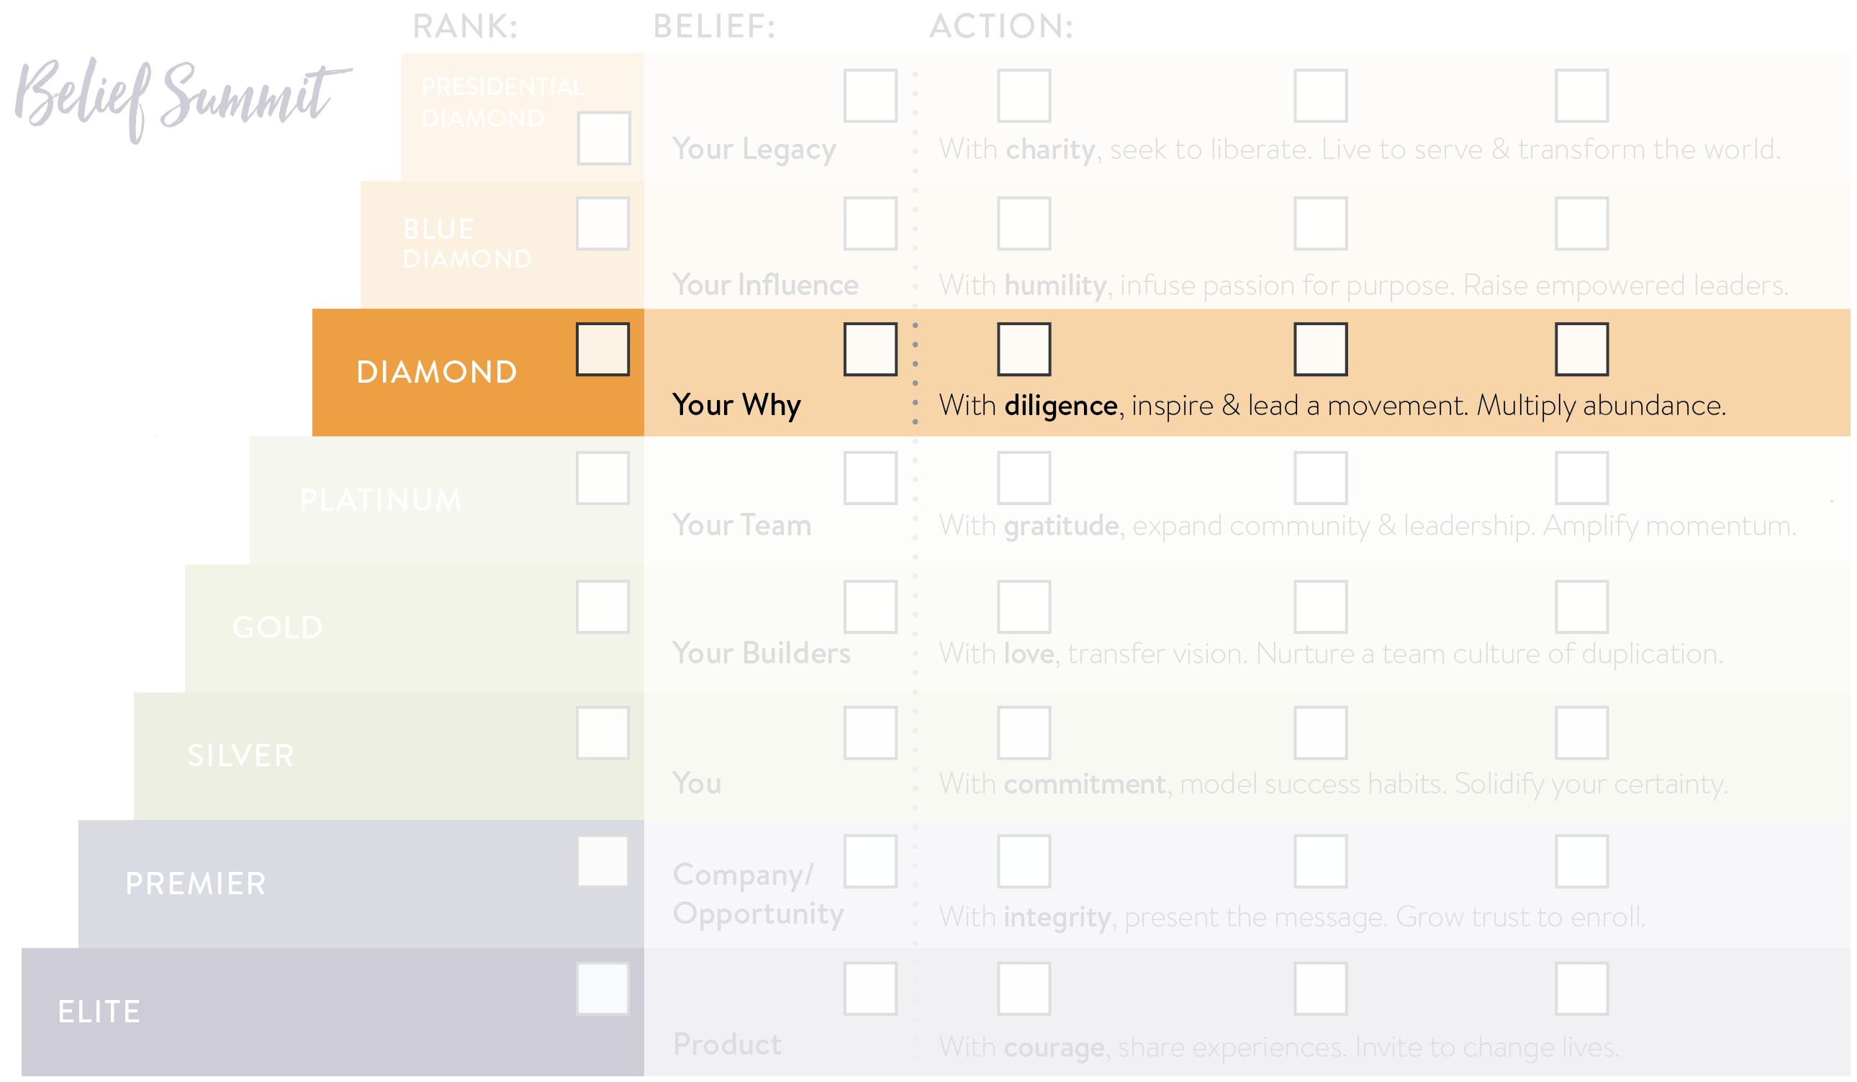

Slide 19
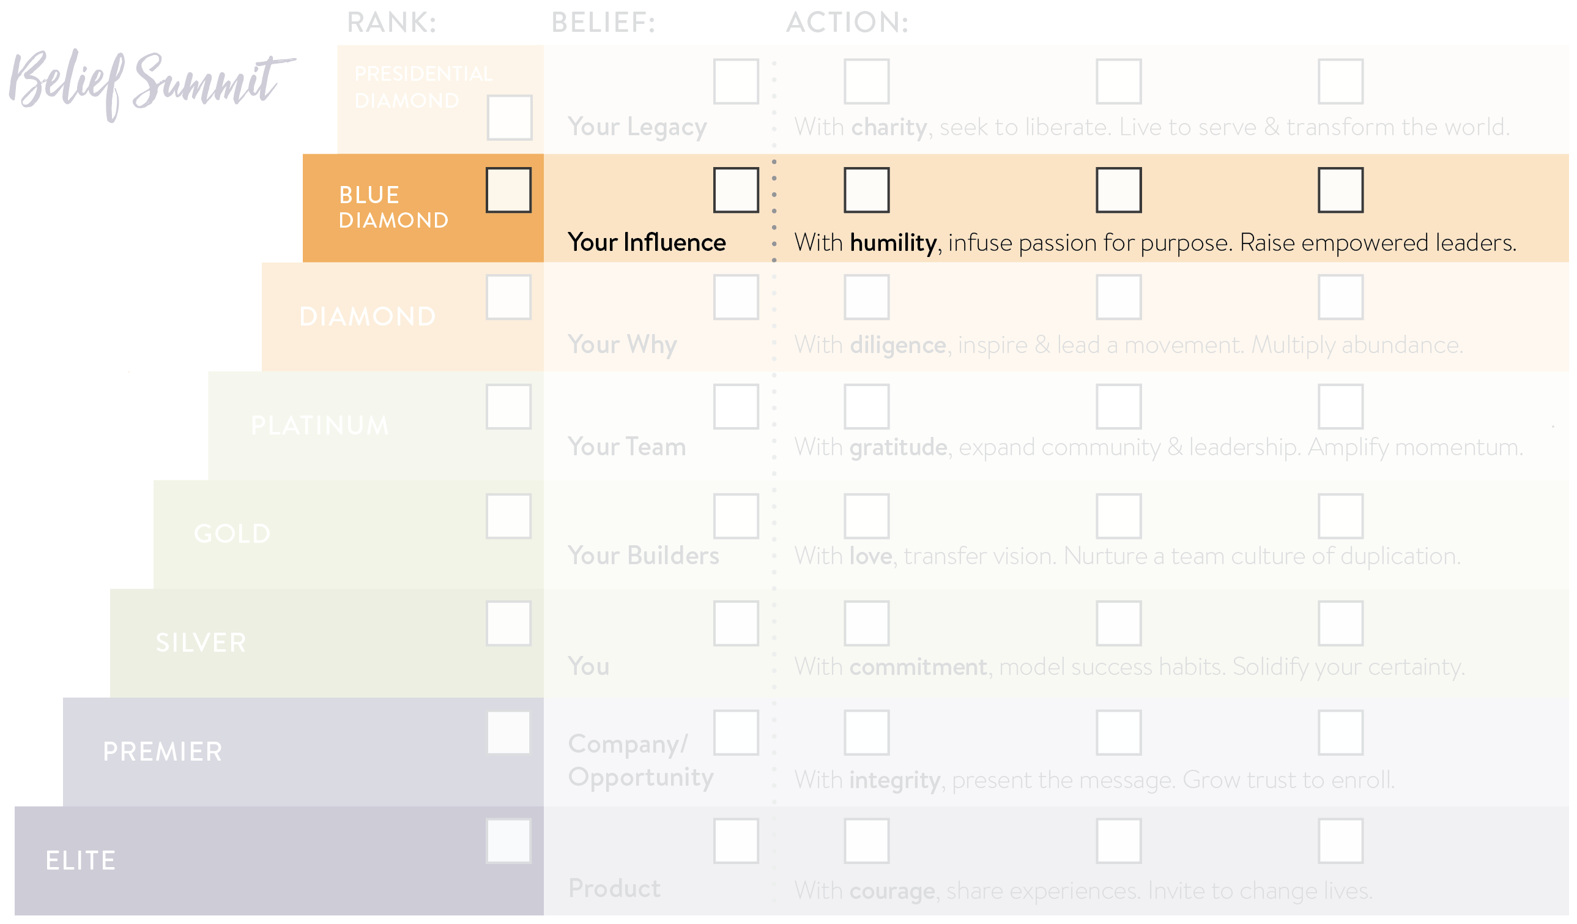

Slide 20
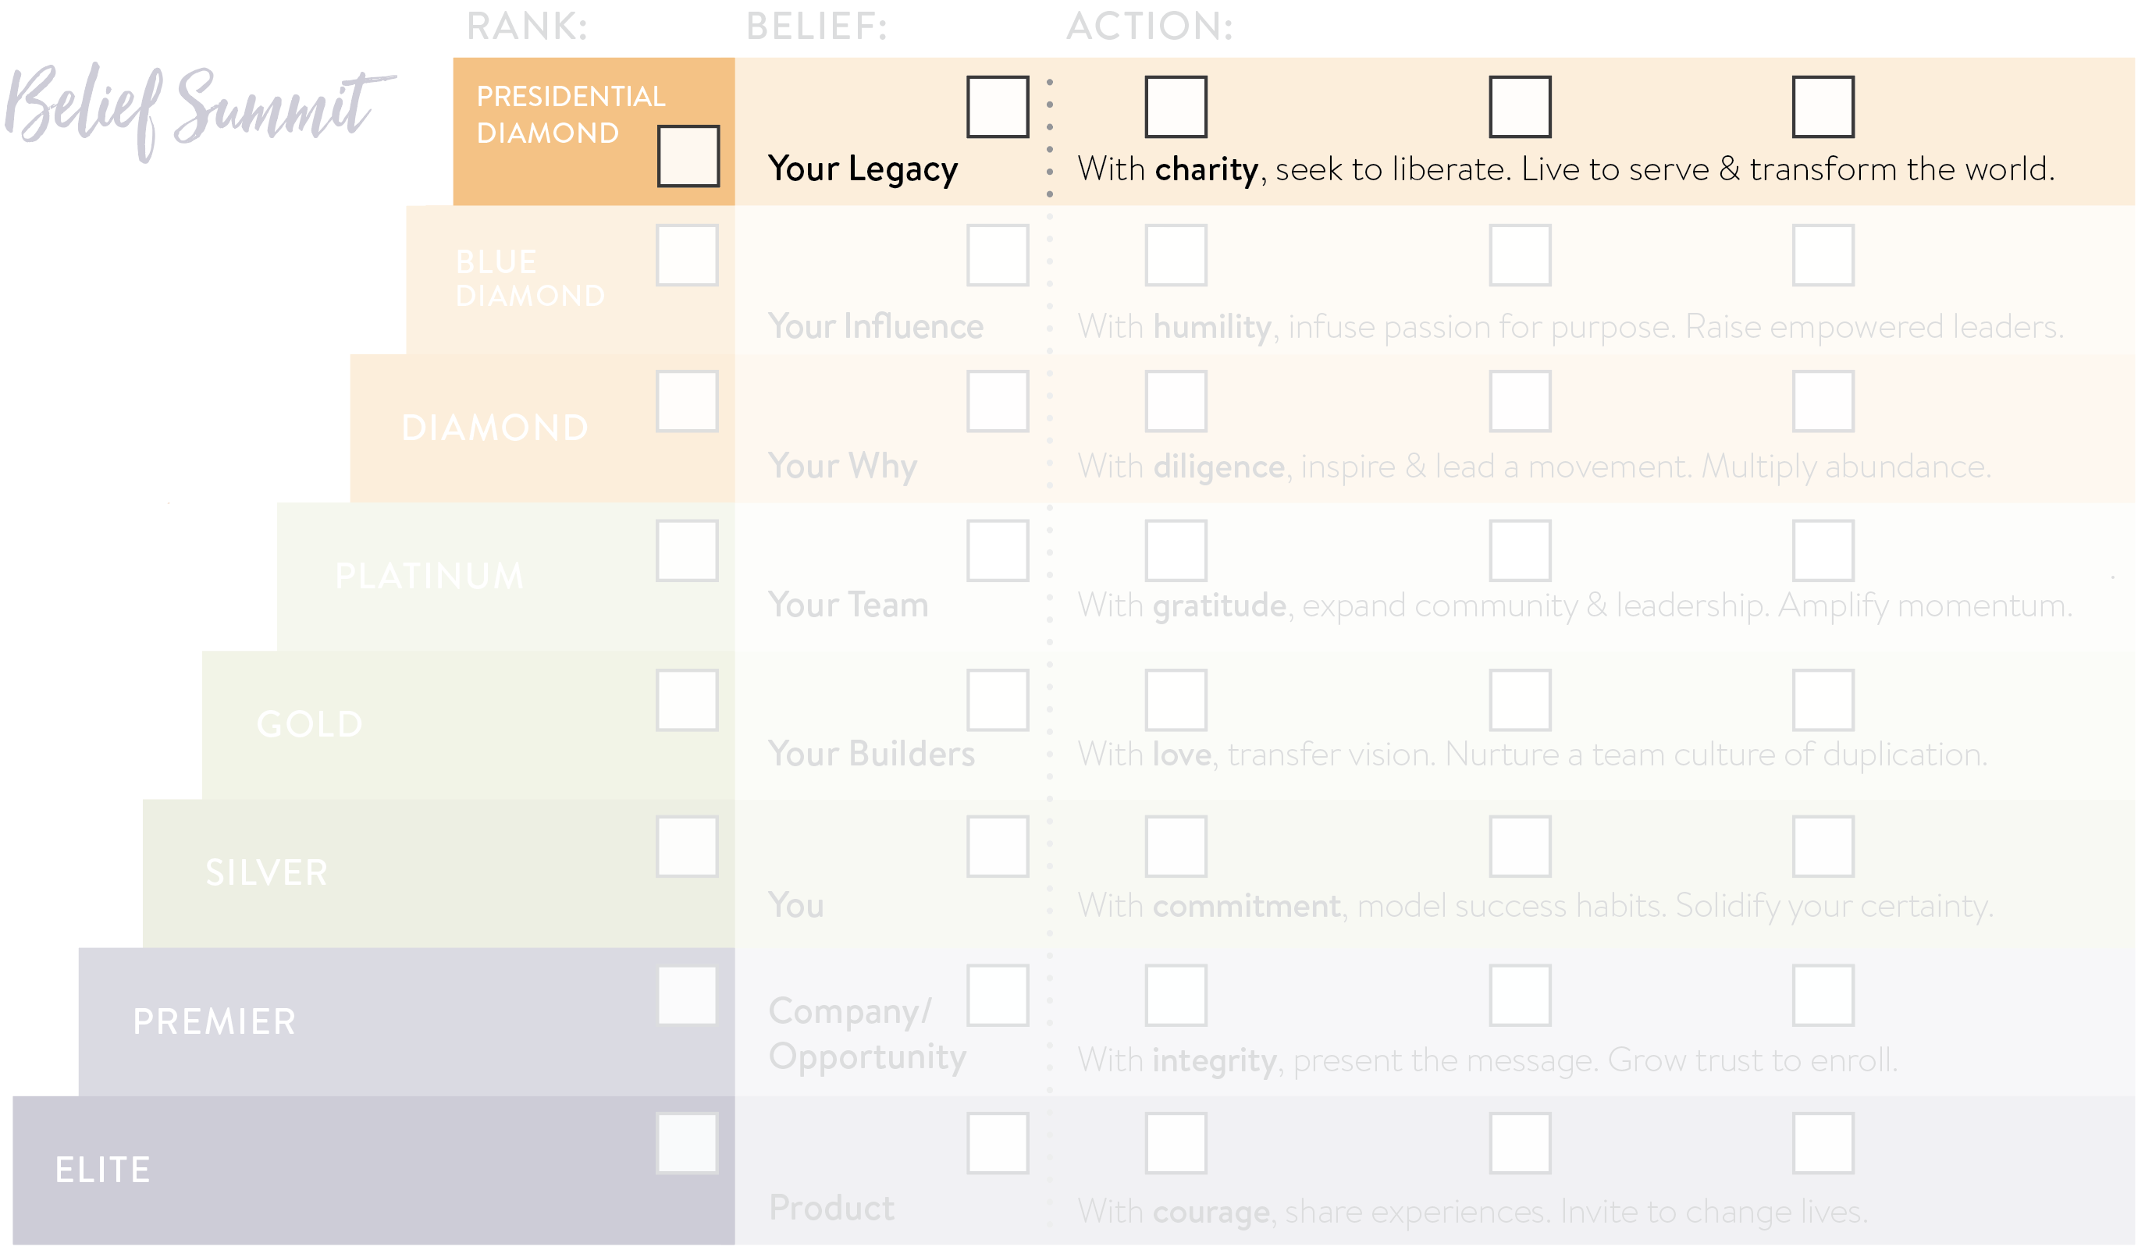

Slide 21
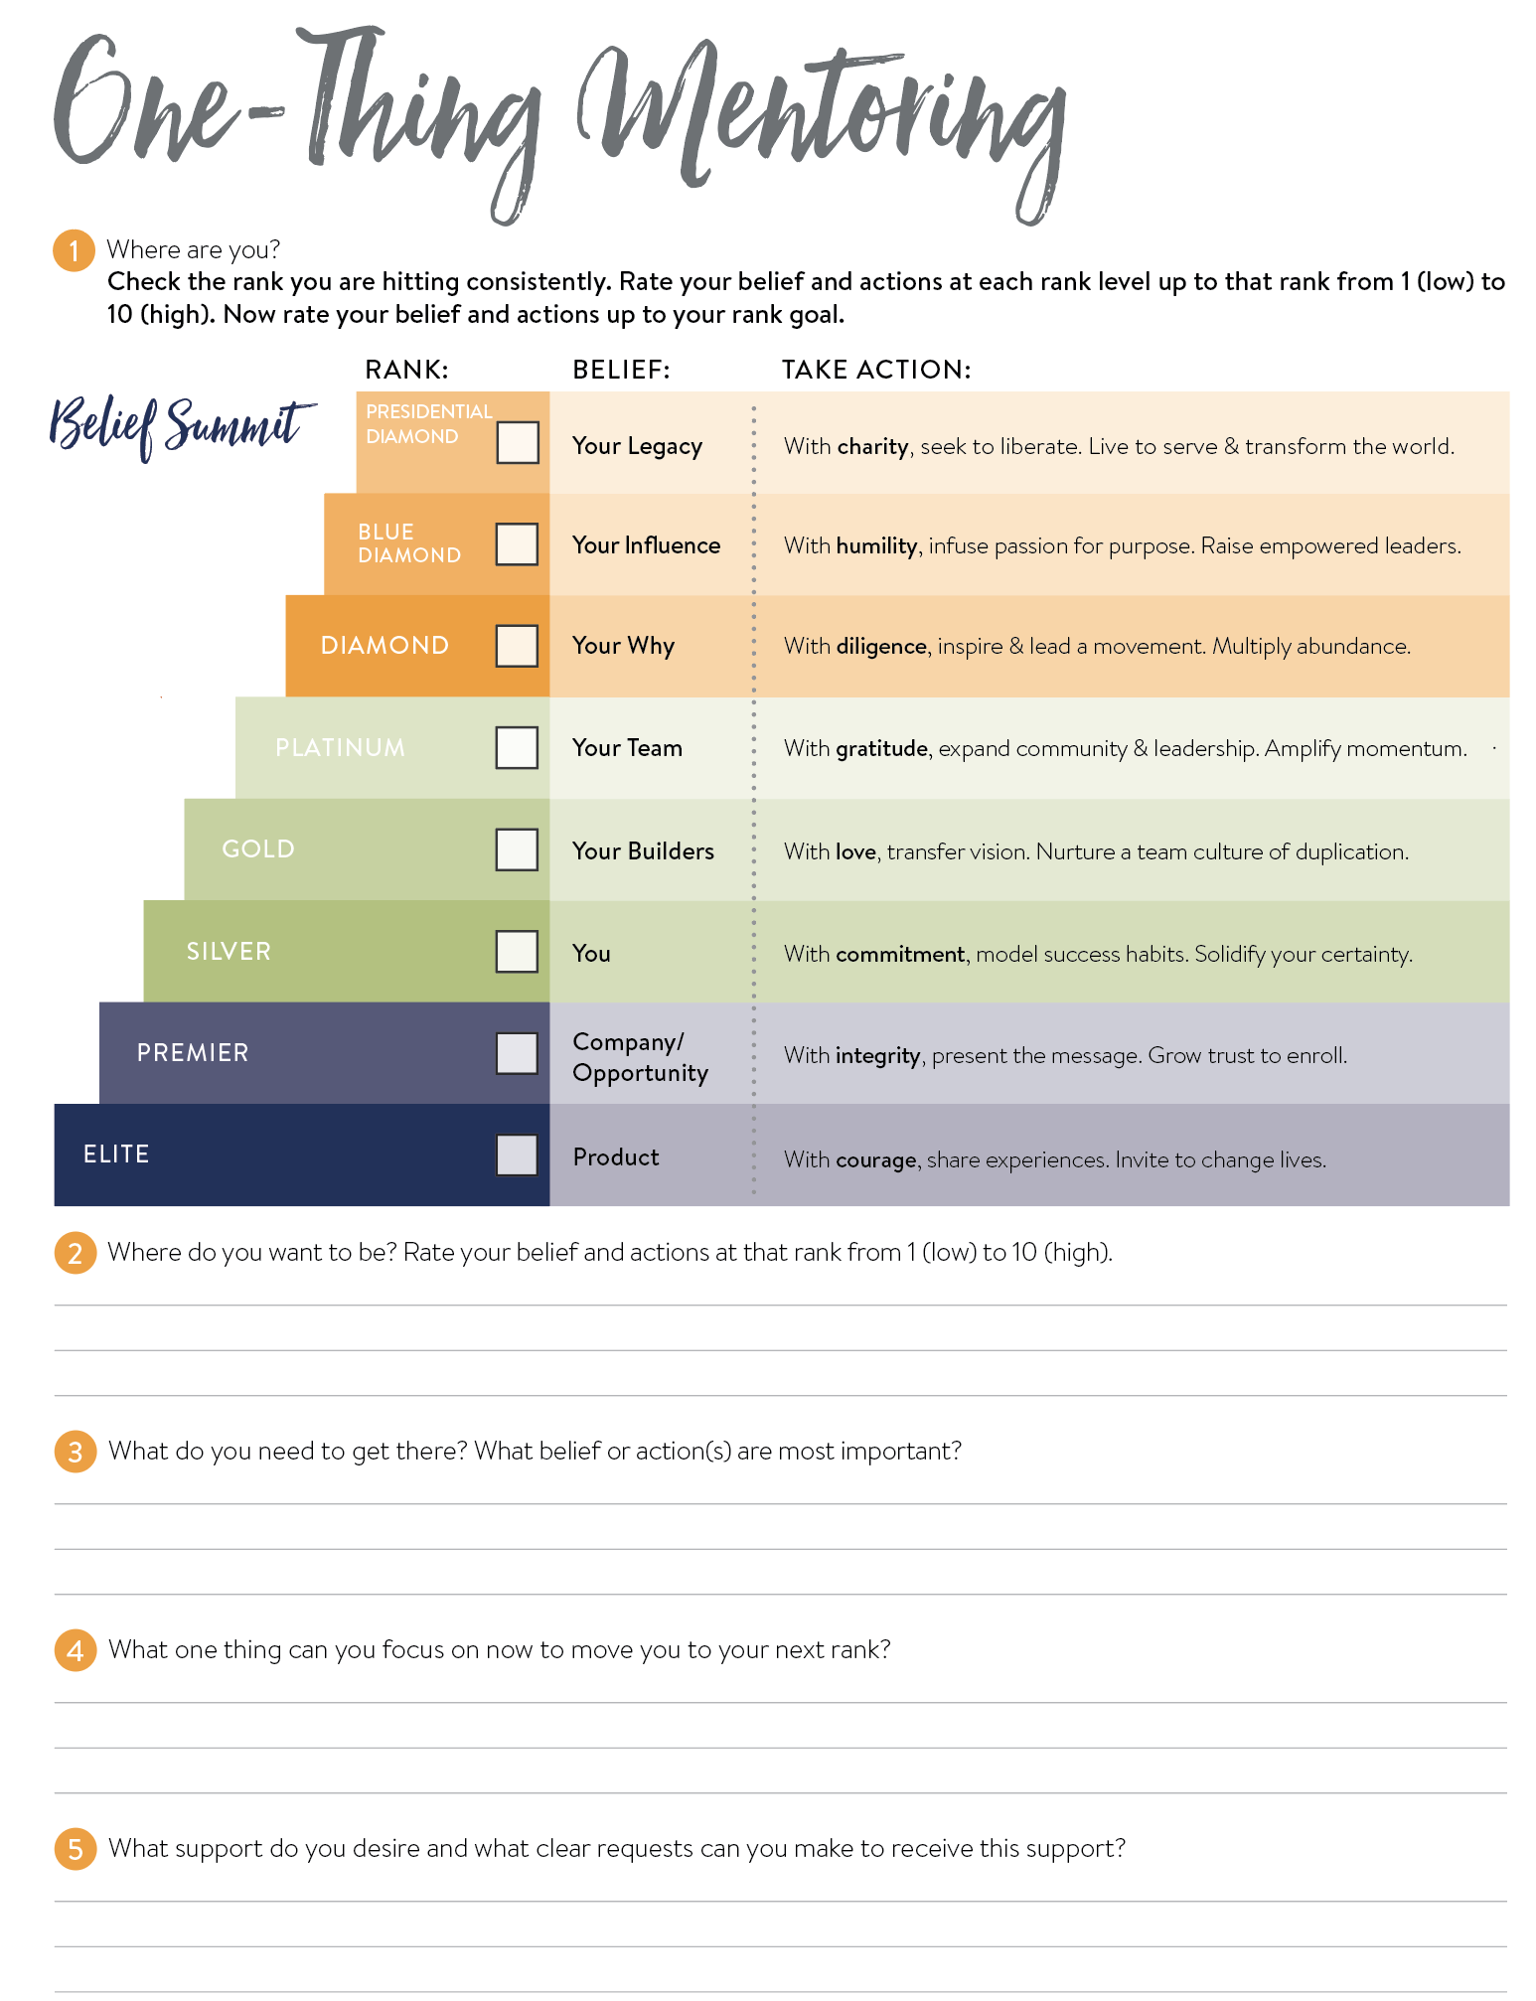

Slide 22
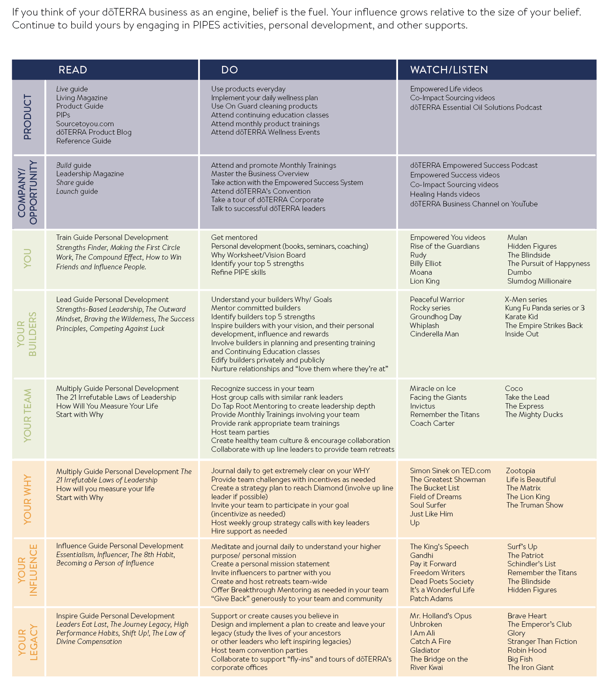

Slide 24
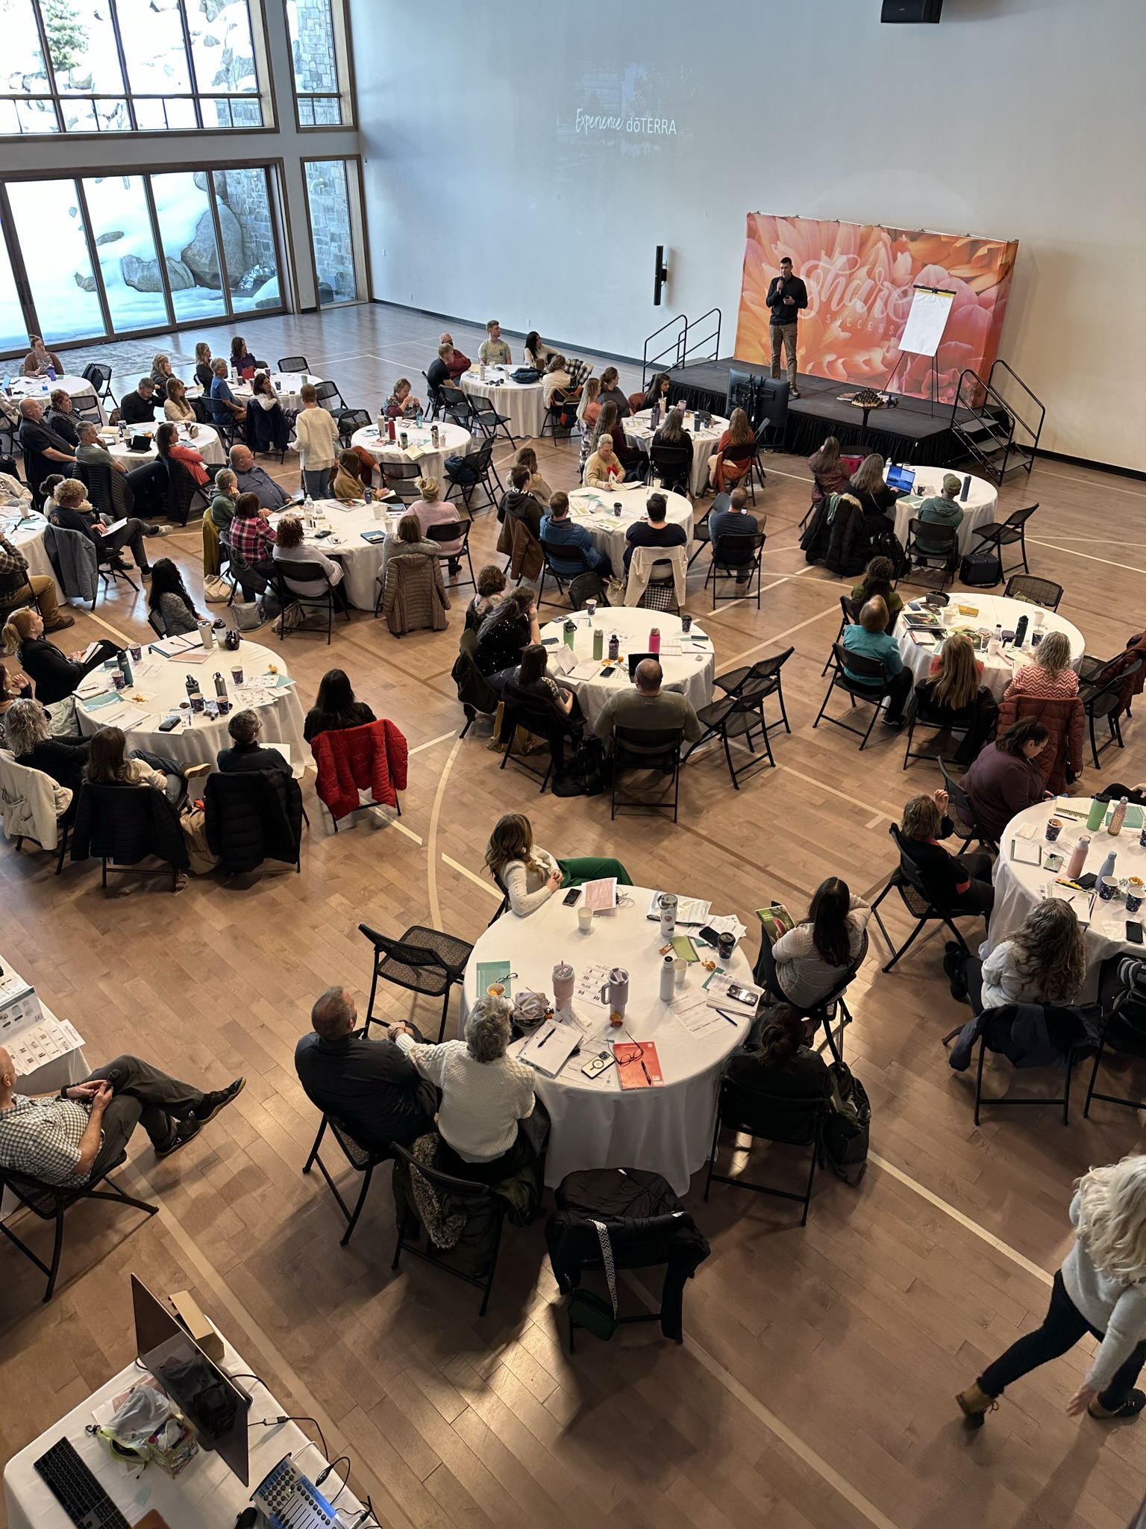

Slide 25
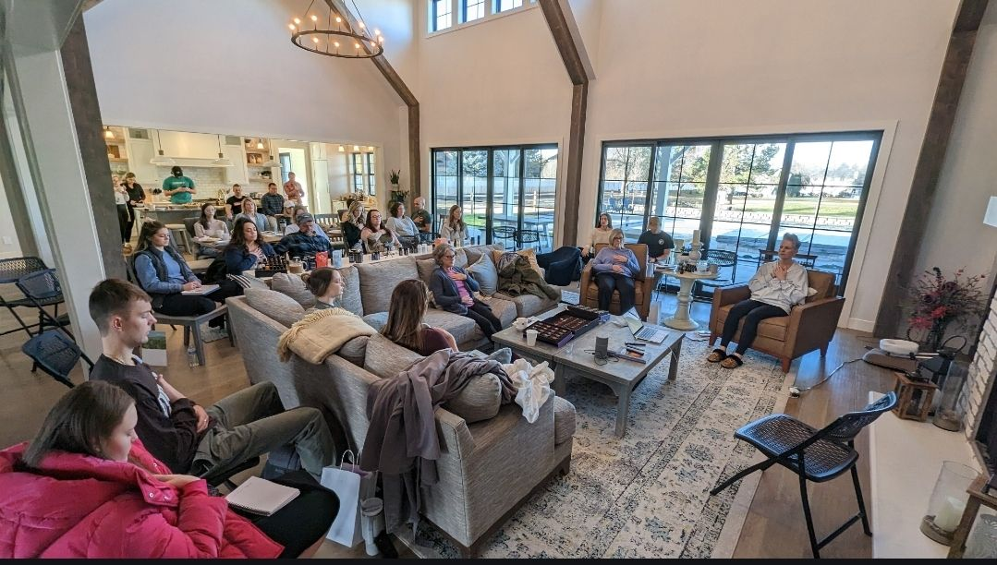

Slide 26
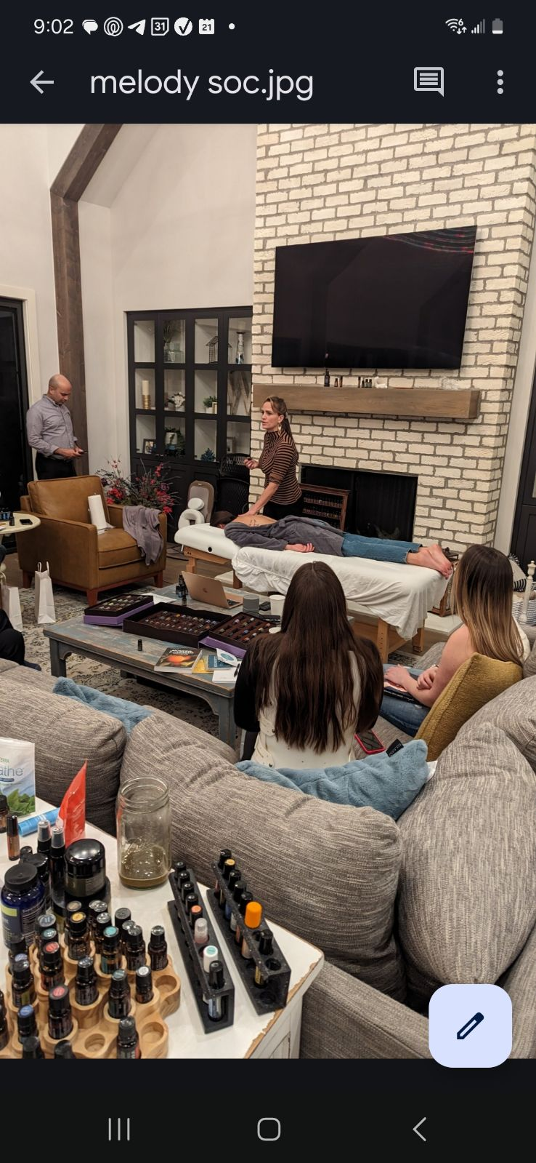

Slide 28
Same challenge every month
Coaches invite challengers
Coaches pay $30 to be able to invite 10 Challengers
Prize money for top 10 finishers
Use habit-stacking
Teams vs. Teams
Crucial Elements:
Challengers use product (consumable)
Challengers post progress pics
Didn’t win? No worries – I can show you how to earn!

