Slide 1
Authentically YOU!
Becoming the Leader You are Meant to Be

Slide 2
Once upon a time…..
Notes:
-loved to learn new things
-loved to teach others whatever she learned
-told she was bossy
-had life happen
-felt like her voice didn’t matter

Slide 3
And life continued….
Notes:
-Got lost in mommy-hood
-lost my voice
-lost my purpose
-lost my passion

Slide 4
And then I went to a class…

Slide 5
I gave in to the call

Slide 6
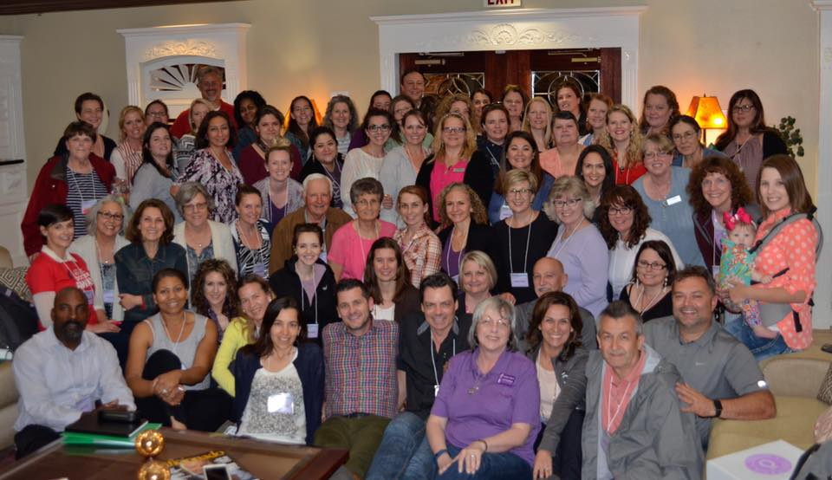
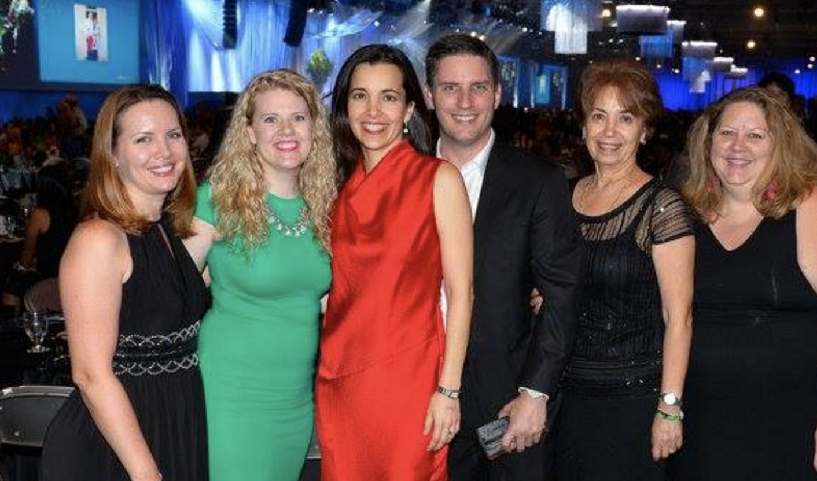
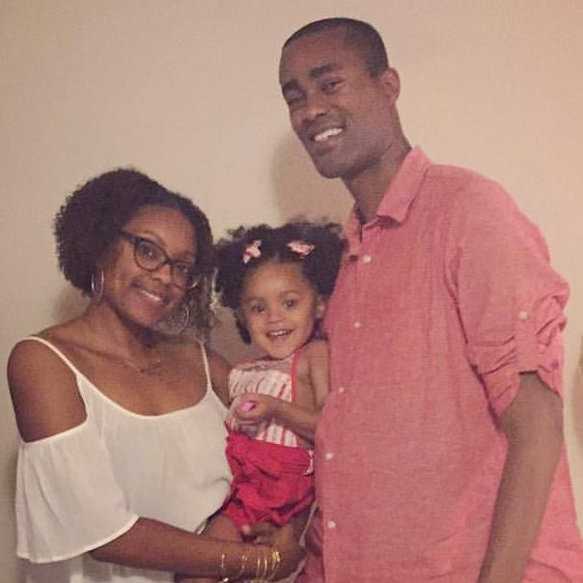
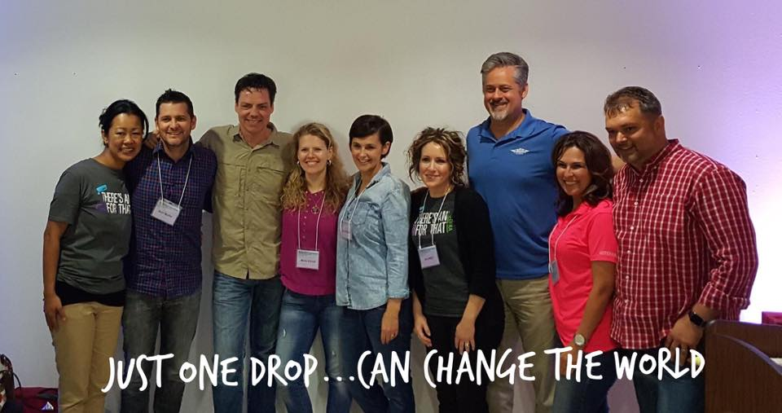
Joy in the Journey

Slide 7
What is authentic leadership?
The authentic self is the intelligence at the core of who we are. It is the wise part of us that can step back and choose the most appropriate course of action that serves the greatest good in the moment.
When leaders are rooted in authenticity, it creates enormous benefits for leaders, those they lead, and the organization.
Authentic leadership is the fullest expression of ME for the benefit of WE.
It is a moment-by-moment choice to lead adaptively from our core.

Slide 8
Why do we want to be authentic?
Human beings are wired to be authentic.
Inauthenticity causes stress in our bodies.
Authentic connections are good for our well-being & immune system.
Authenticity helps us build deeper connections with others.
Authenticity creates trust in teams.
Authentic leaders drive innovation.
Authentic leaders attract quality people.

Slide 9
7 Practices of Authentic Leadership

Slide 10
1. Befriend Your Body
Neuroscience shows us that changes in posture change brain chemistry and leadership impact.
Our state of being is connected to our body. It drives our attitude, our body language. 94% of communication is non-verbal.
Body awareness helps us know ourselves: what brings us joy, what triggers us, what we can do to overcome fears to be more impactful and authentic leaders.

Slide 11
2. Stay Curious
Curiosity opens the door to creativity, connection, compassion and to better decision making.
Curiosity helps us be more effective and adaptive as changes happen.
Get curious about your strengths, values, energizers, sense of purpose, weaknesses, negative thought patterns, etc.

Slide 12
3. Let Go
Some areas of letting go are:
Tension in the body
Shoulds & What-ifs
Limiting beliefs
Trapped emotions
Taking things personally
Resisting what is
Commitment to be right
Things we can’t control
Past hurts

Slide 13
4. Give Yourself an A
Giving ourselves an A is about appreciating our humanity and making peace with our “flaws.”
Accepting all parts of ourselves as we are gives us greater self- confidence.
When we accept ourselves we have access to a greater range of behaviors. We are able to be more effective and adaptive across a range of leadership situations.

Slide 14
5. Choose to BE Before DO
Leadership requires us to adapt quickly while maintaining the integrity of who we are.
Authentic leadership is leading adaptively from our core.
Choosing Be before Do allows us to adapt quickly by accessing the different parts of who we already are in order to be fully effective, adaptable and authentic.
Ask yourself “Who am I being right now? Am I operating from fear or from values and inspiration?”

Slide 15
6. Face the Dragon
We decide to stare all the imaginary fire-breathing dragons in the face, and be with our fear, rather than avoid it.
We decide to act despite that feeling in the pit of our stomachs.
We choose to tolerate and breathe through our discomfort rather than avoid it.
Then we realize that many of our fears are illusions we made up anyway.

Slide 16
7. Dance with the Dream
Our dream is the spark that makes us feel most alive, engaged, and energized. It’s linked to personal purpose.
The pursuit of the dream is a gateway to our self-actualization because we are more willing to push ourselves outside our comfort zone.

Slide 17
7 Practices of Authentic Leadership
Befriend your body
Stay curious
Let go
Give yourself an A
Choose to BE before DO
Face the dragon
Dance with the dream
www.transformleaders.tv/assessments

Slide 18
