Slide 1
Heather Patenaude
Blue Diamond Wellness Advocate

Slide 2
Are You Treating Your Business
Like a Business?

Slide 3
What’s the Worth of Your Business?
What’s your average organizational volume?
Multiply that by 12
That’s the worth of your business!

Slide 4
Does this number
surprise you?
Subtitle here

Slide 5
Let’s do three examples…
Your Average OV is 90,000
Multiply by 12
One Million Dollar Business

Slide 6
Your Average OV is 150,000
Multiply by 12
1.8 Million Dollar Business

Slide 7
Your Average OV is 320,000
Multiply by 12
3.8 Million Dollar Business

Slide 8
How does the CEO of a million + dollar business act, think, and respond?

Slide 9
Qualities of a Successful CEO
Set the vision for their company
Plan ahead and prepare based on vision
Work hard to execute the vision
Professional
Carry a lot of responsibility
Servant leaders
Willing to be uncomfortable
Take responsibility for the success or failure of their business

Slide 10
Leadership/CEO:
Moving Pieces

Slide 11
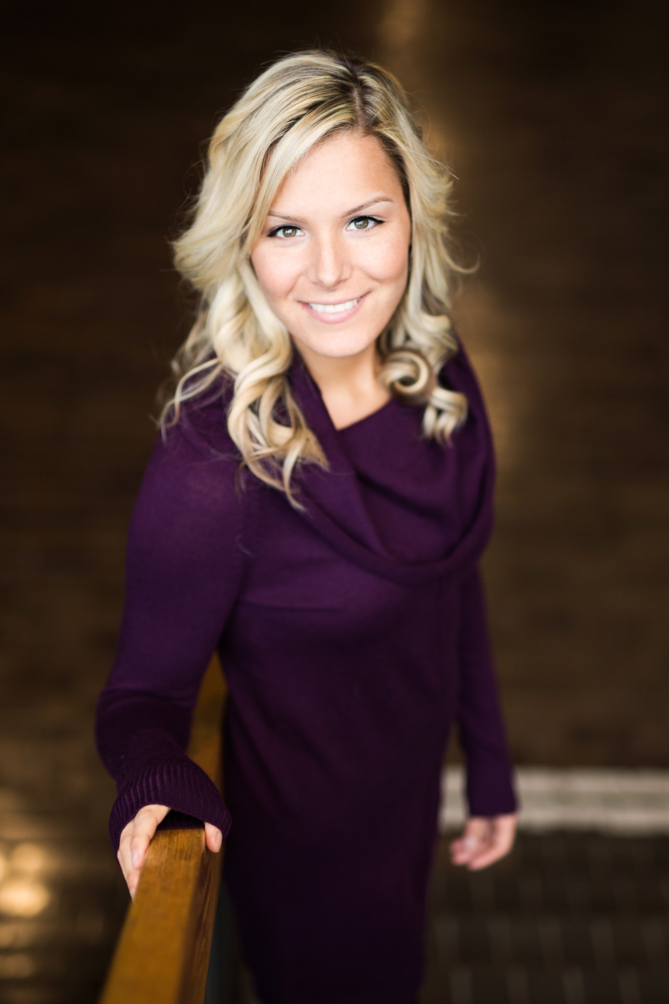
Would You Hire Yourself?
Consistent
Capable
Committed
Communicate
Community

Slide 12
Ways to Sharpen Mindset
Spend time with excellent people
Incorporate your Business (hire an accountant and lawyer if you need to)
Be Intentional
Business Budget (i.e. take a salary, taxes, budget, track expenses)
Know how to find solutions and answers
Set aside time to strategize and plan
Lead by example (if you run promotions, do them!)
Hire people to help you in areas that are not your strengths
Set the vision for their company
Plan ahead and prepare based on vision
Work hard to execute the vision
Professional
Carry a lot of responsibility
Servant leaders
Willing to be uncomfo

Slide 13
NOW IS THE TIME!
Be the CEO!

