Slide 1
EMPOWERED DUPLICATION
Heather Patenaude

Slide 2
The Power of:
Empowered Life
Empowered Success
Empowered You

Slide 3

What is your system to duplicate?
Users & Builders

Slide 4

Clear Path
Leads to duplication!

Slide 5
dōTERRA has made it as easy as 1, 2, 3!
Empowered Life for Users
Empowered Success for Builders
Empowered You for Leaders

Slide 6
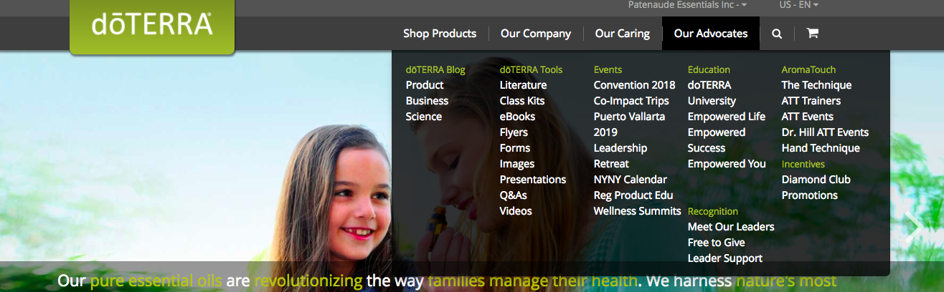
Empowered Duplication
On doTERRA.com

Slide 7
USER DUPLICATION

Slide 8

Empowered Life
Monthly Educational Trainings for Users

Slide 9
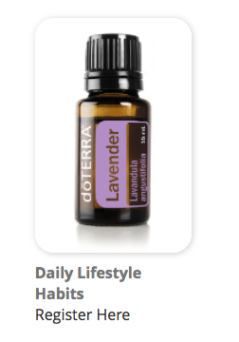
Register for Empowered Life
On dōTERRA.com
Our Advocate
Empowered Life

Slide 10
BUILDER DUPLICATION

Slide 11

Empowered Success Monthly Webinar
For Builders

Slide 12

Register:
Empowered Success Webinar Training
On doTERRA.com
Our Advocate
Empowered Success

Slide 13
Pathway from a sample to
Presidential Diamond

Slide 14

Healthy Can Be Simple
Sample Guide

Slide 15

Natural Solutions Class
Educate about the oils

Slide 16

Live Guide
Educate about their membership

Slide 17

Share Guide
Host Guide
Soft Launch

Slide 18

Build Guide
Educate on the Business

Slide 19

Launch Guide
Train to Elite

Slide 20

Train Guide
Train to Premier & Silver

Slide 21

Lead Guide
Train to Gold

Slide 22

Multiply Guide
Train to Platinum and Diamond

Slide 23

Influence Guide
Train to Blue Diamond

Slide 24

Inspire Guide
Train to Presidential and beyond

Slide 25

Empowered You
Strength Based Leadership Training

Slide 26
The Power of:
Empowered Life
Empowered Success
Empowered You
Empowered University

Slide 27
COMING SOON!!

Slide 28

Building Foundations
IS GETTING A FACELIFT!

Slide 29

Empowered University
Six Weeks of Launch Training to make your new builders successful!

Slide 30
A BRAND NEW LOOK!

Slide 31


