Slide 1
Empowered
University
Six Sessions to Launch YOUR Business
Session Two

Slide 2
Know your oils!
Product of the product
Using is the first step!

Slide 3
Have you had your “ah-ha” moment?
Belief: In Product
Do you think they work?
What if I said you can no longer have oils in your home?
Have they personally impacted you?

Slide 4
Job or Hobby?

Slide 5
Treating like a job
Make time for your business
You will make team calls
You will be engaged in good communication with upline/downline/mentor
You will be actively looking to have personal development
You will be consistent in classes, Membership Overviews, Business Overviews, educating users

Slide 6
Treating like a hobby
Will make time if it fits
Being on team Facebook page is not a priority
Communicates with upline/downline/mentor when convenient
Host classes when it’s convenient
Take huge chunks of time off
Expects others to grow your business

Slide 7
Decide, Communicate, Commit

Slide 8
Now that you have decided, let’s look at your schedule!!

Slide 9
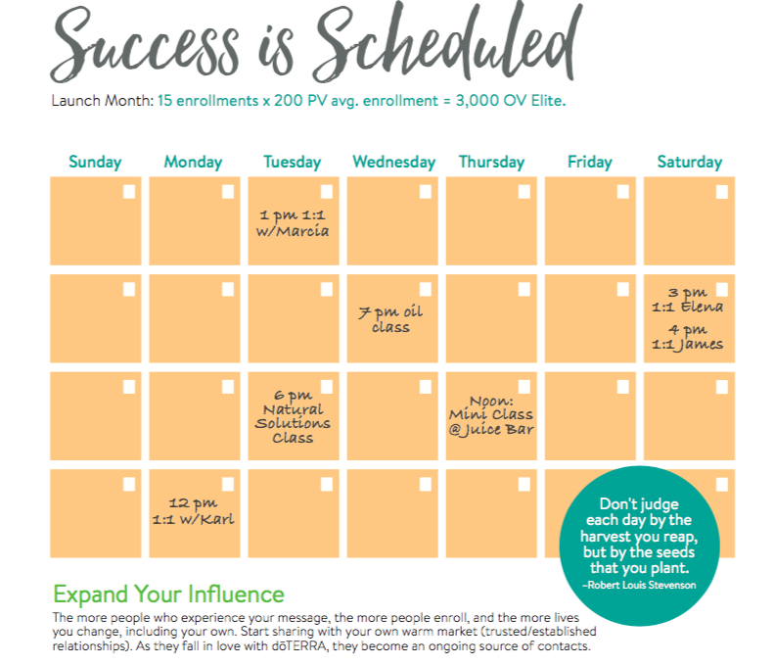
You have to make time for your business!

Slide 10
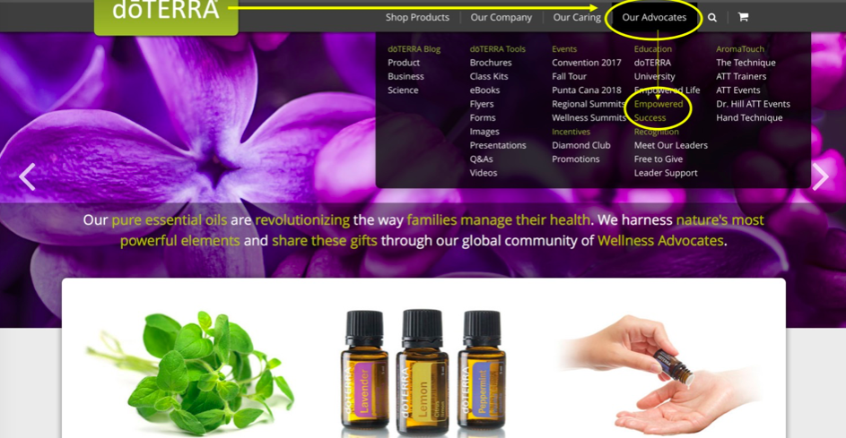
Where to find material?
doterra.com
“Our advocates”
“Empowered Success”

Slide 11
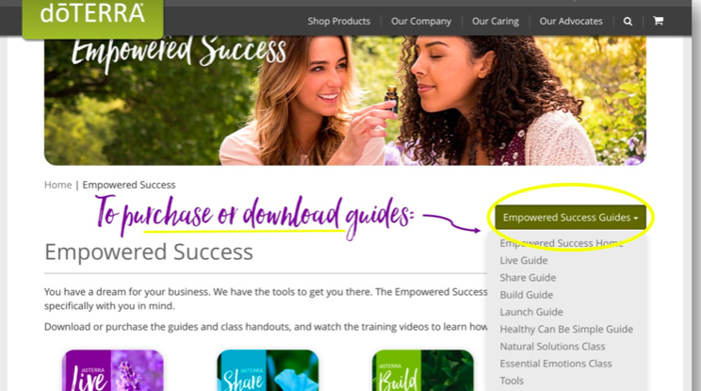
Download or Buy

Slide 12
Keys to Launch
Work with your upline and schedule 2-4 classes in the next 3 weeks.
Teach them yourself or your coach can teach 1 or 2 of them
We want quality not quantity
Getting qualified people there….how to do it?
What’s the best way to connect with your network?

Slide 13
Share Guide
Your tool for hosting a class!
Download and use to plan your first appointment or class!

Slide 14
Upline not close?
Use Class in a Box
Do a FaceTime/Zoom Chat with your mentor to learn how to do a class
Watching training videos and jump in!
Do a FaceTime/Zoom Chat class with your mentor!

Slide 15
Friends or Family Not Close
Invite to an on line class that you are teaching (zoom, google hangout, Skype)
Send samples and class material ahead of time
Teach just like a live class!

Slide 16
How to Invite!
Seek openness
Ask four questions:
Are you interested in learning about natural solutions?
What do you know about essential oils?
Are you interested in learning more?
Would it be okay if I invited you to an essential oil class?
Questions are from EDGE Success

Slide 17
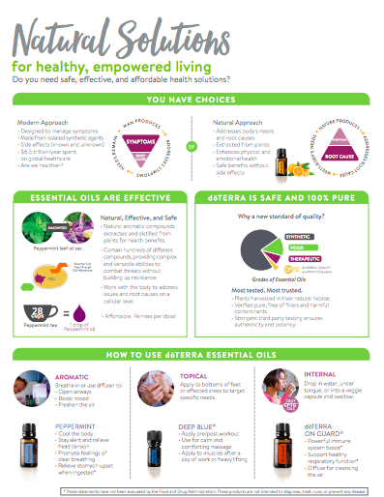
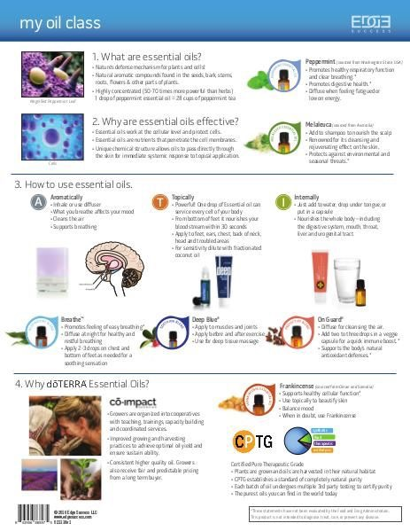
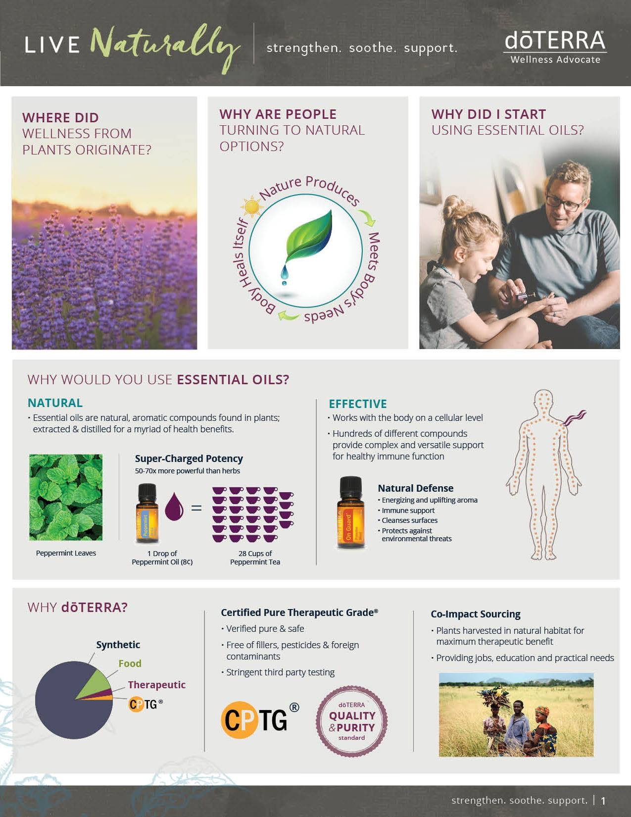
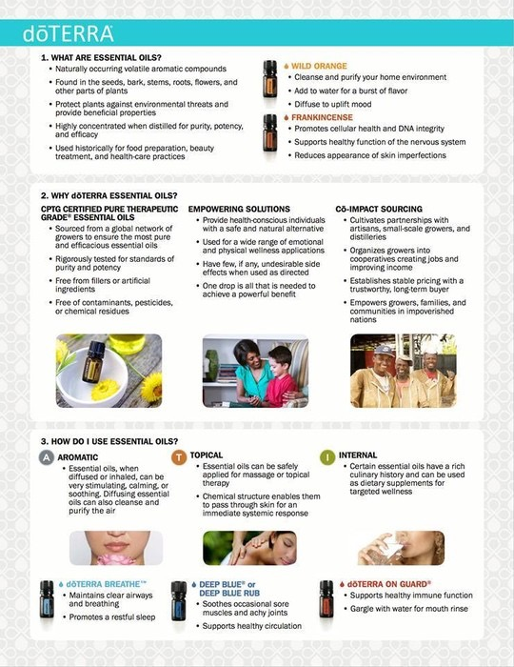
Class Material
Natural Solutions Class

Slide 18
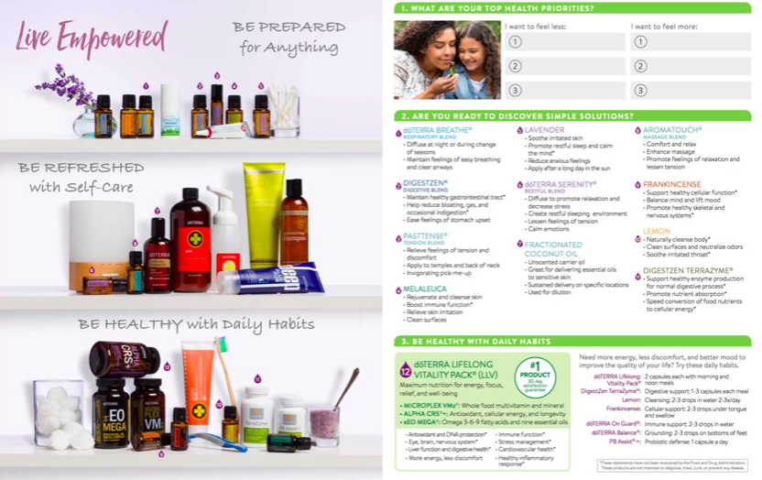

Slide 19
“Thank you so much for coming to my class! I love educating and empowering other on essential oils! If you would like to make dōTERRA part of your life, awesome, I’ll show you how to do that. If not, I am so glad I was the one to educate you on oils!”
–Good Close

Slide 20
Wholesale Customer vs.
Wellness Advocate

Slide 21
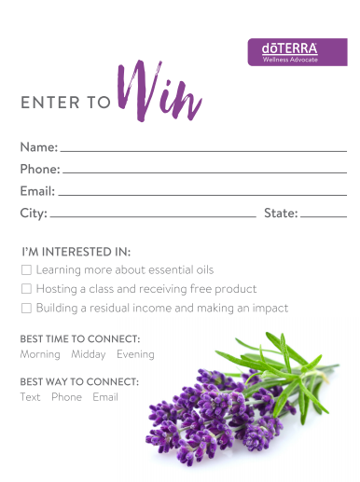
Book Classes from Classes
Hand out drawing form at the end of class
Anyone who books class that night you offer free oil (give to them at the night of the class)
Schedule Live at time of enrollment
Book classes at Live Guide Overview
Ask for referrals
Drawing form on doTERRA.com, Empowered Success tools

Slide 22
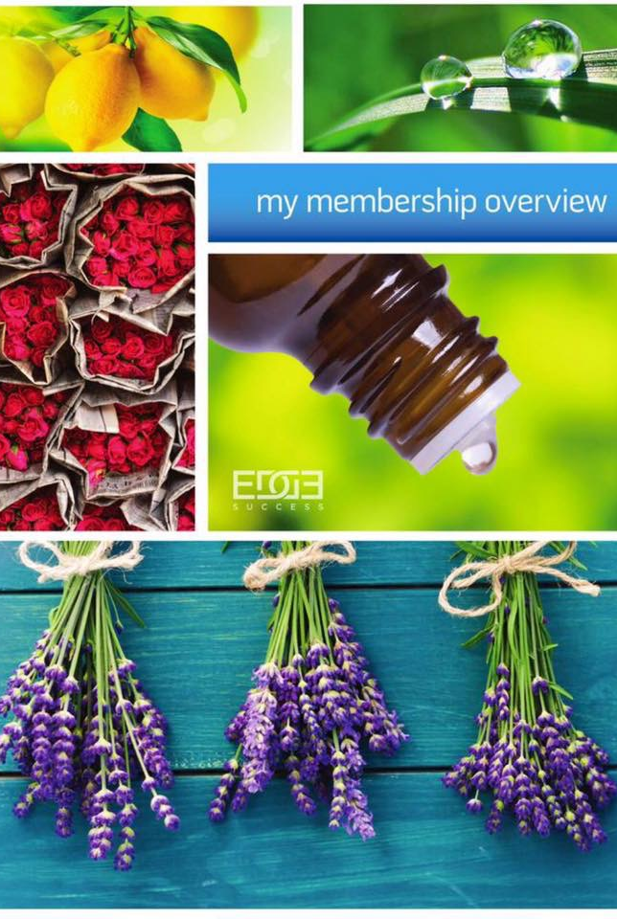
Lifestyle
Overviews
Success is in the follow up
Cultivates relationships
Teach about the products
Teach about the buying options
Teach them how to log into their office Schedule when they enroll

Slide 23
Be Consistent in teaching
No matter your level of commitment!
You’ll build a level of trust with your team the more consistent you are.

Slide 25
Plug into the team
Team Calls
Team Facebook page
Team Events

Slide 26
Homework:
Links in description of video
Pages 5-13 of Launch Guide
Watch a Natural Solutions Class for practice
How to do a Lifestyle overview
How to enroll a new Wellness Advocate/Wholesale Customer video
Difference between WA/WC

