Slide 1
Empowered University
Six Session to Launch YOUR Business
Session Three

Slide 2
Compensation & Rank
Understanding Compensation and Rank help you grow in a systematic manner!

Slide 3
Five ways to Earn

Slide 4
Must have 100 PV LRP to get paid
Key Info
Must be at 100 PV in your LRP all the time!

Slide 5
Follow along in Build Guide

Slide 6
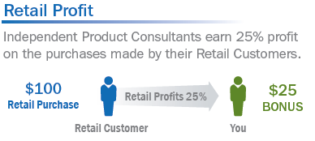
Retail Sales
Earn 25% of profits
Paid on the 15th of the month

Slide 7
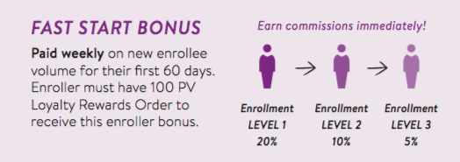
Fast Start
Paid Weekly (Wednesdays)
Paid based on enrollment
Paid on three levels of enrollment
Paid for 60 days of the NEW Wellness Advocate

Slide 8
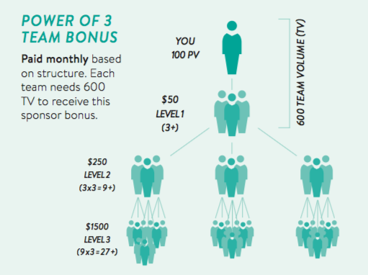
Power of Three
Help your top line get the $50 and teach them how to do it
Based on Sponsorship

Slide 9
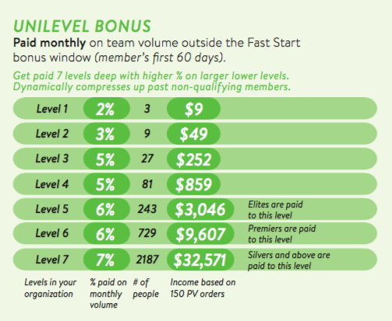
Unilevel Bonus
Residual Income
Grows over time
Based on Sponsorship

Slide 10
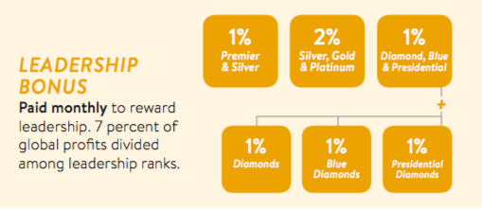
Leadership Pools
Long Term Income
Premier and above

Slide 11
Ranks
Pay for products to Multiply your income
When you understand ranks, you
understand placement and strategy!

Slide 12
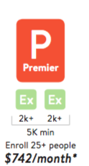
Elite, Premier, Silver
Get your oils paid for ranks

Slide 13
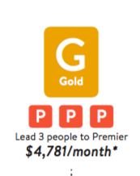
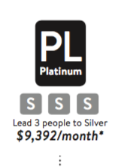
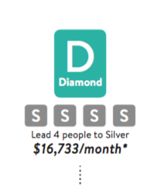
Gold, Platinum, Diamond
Supplement your income ranks

Slide 14
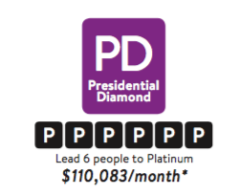
Blue and Presidential Diamond
Replace and Multiply your income

Slide 15
Homework
If you don’t understand the comp plan, re-watch this week until you have a good grasp of the plan! Knowing the plan will help you with placement and strategy!
Schedule your Lifestyle Overviews from any enrollments you’ve had!
Explain the comp plan to a team member!

