Slide 1
dōTERRA’s Compensation Plan Compared to Other Top MLM Companies

Slide 2
48 different companies were listed in the 182 comments!!!

Slide 3
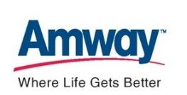
Notes:
Weight these logos by number of facebook comments about each company.

Slide 5
The Grass is Always Greener on the Other Side of the fence

Slide 6
Disclaimer: The research in this presentation is based upon public information for all companies discussed. It is not my fault that dōTERRA comes out as the best company….facts are facts.

Slide 7
The Rise & Fall of ViSalus
End of 2010: ViSalus made over $15 million a month.
ViSalus experienced rapid growth: Sales of $624 million in 2012: IPO Announced.
Sales peaked in 2012, then declined: Sales of $350 in 2013: IPO Cancelled.
Lawsuits: Recruited “mercenaries” (big leaders) who weren’t loyal consumers.
Last Report: September 2014 only 30,000 distributors and losing money.
Most importantly: Didn’t make our list of 48!!!!
2005: Purchased by Ryan Blair
2010: Record sales - $15 M per month
Sep. 2012: IPO cancelled; Distributors leave company
High debt levels lead to acquisition by Blyth, Inc.
Aug. 2012: Potential IPO – Sales exceed $600 million for the year.
2012: Co-founders “artificially inflate sales numbers”
Oct. 2013: Co-founders found guilty in Federal court of RICO Act violations
Mar. 2013: ViSalus investigated
2013: ViSalus operates at a continual loss
Sep. 2014: ViSalus becomes private, independent company & struggles today in obscurity.
Notes:
ViSalus Sciences was originally started in 1997 by Nick Sarnicola and Blake Mallen, two distributors with The Free Network, LLC, a telecommunications multi-level marketing (MLM) company based in Troy, Michigan.[2] After The Free Network folded in March 2005, ViSalus was purchased by wireless Internet developer Ryan Blair with investment from Ropart Asset Management, a private equity firm owned by Robert B. Goergen. Sarnicola and Mallen were retained as sales chief and CMO, respectively. The company was moved to the San Francisco Bay Area.[6]
The 2008 recession put ViSalus near bankruptcy, with the business $6 million in debt.[7] In 2008, ViSalus was acquired by Blyth, Inc., a multi-level marketing company that sells home decor which had been founded by Georgen.[6] In the first stage of the takeover – completed in 2008 – Blyth purchased a 43.6% equity interest for $14.0 million.[5][8] By 2010 the company had returned to profitability, and ViSalus was making over $15 million a month.[9] Blyth completed the second phase of the takeover in 2011, investing an additional $2.5 million and increasing their ownership share to 57.5%.[10]
In August 2012, Blyth – which then owned a 73% share of Visalus – planned to spin off the company in an initial public offering of shares worth up to $175 million. In September 2012, Moody's Investors Service downgraded Blyth's credit from "stable" to "negative,"[11] ViSalus reported extremely high growth rates in 2012, being audited at 450%, which made it one of the fastest growing companies of its size. Despite this, Blyth stated that the company's growth was not properly valued.[6] Blyth withdrew the Visalus IPO citing uncertain market conditions.[12] According to the Detroit Free Press, one reason why the Visalus IPO was cancelled was because the co-founders were artificially inflating sales numbers: "ViSalus has been criticized for allegedly puffing up its record sales in 2012 by recruiting top product distributors in the industry. Like mercenaries, these distributors were purportedly willing to switch company affiliation for a price, and after ViSalus peaked, they jumped to another direct sales company. Such a practice would be legal."[13]
In 2013, ViSalus launched in the United Kingdom.[14] On February 18, 2014, ViSalus announced its expansion to Germany and Austria.[15]
In September 2014, ViSalus announced that it had become a private, independent company. ViSalus arranged a transaction with Blyth to convert the company's stock to common stock, although Blyth remains an equity holder with 10% of ViSalus's stock.[16][4][17] The transaction eliminated Blyth's obligation to pay the co-founders $143.2 million as part of the 2008 acquisition. At the time of the transaction, ViSalus' earnings and revenue had declined from a high-point in 2012, and the company had been operating at a loss for 2013 and the first two quarters of 2014.[4]
According to the Detroit Free Press, Visalus was at a high of 114,000 distributors in the summer of 2012.[13] According to a report in Crain's Detroit Business, Visalus had 76,000 distributors in June 2013, which declined to 31,800 distributors in September 2014. The article also reported that Sarnicola is the largest distributor in Visalus, with his distributor team accounting for 74% of company revenue.[4]

Slide 8
Evaluating Direct Selling Companies
Product
People
Plan

Slide 9
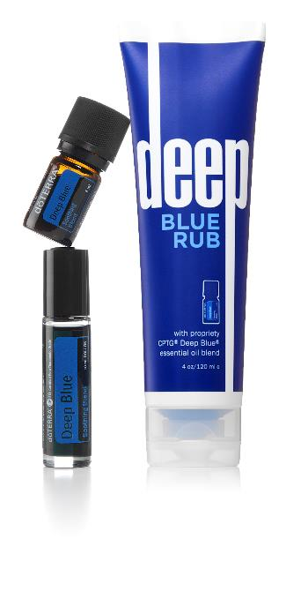
Products
Would you use these products? How do the products improve your life?
What are the ingredients in the products? Are they unique?
What does monthly volume look like month after month after month?
Is the marketing of the products FDA compliant?

Slide 10
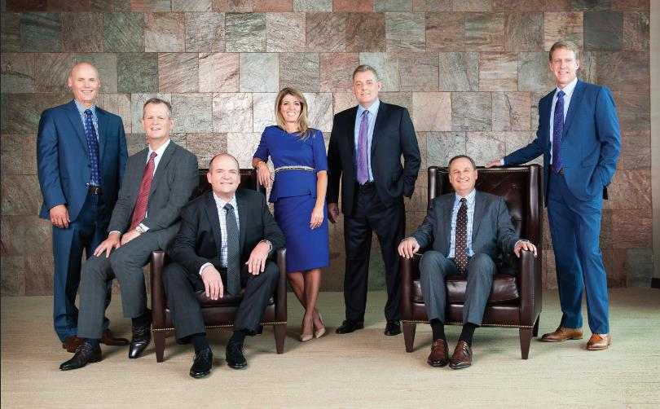
People
What experience does the management team have?
How many players are there to make decisions?
Are there past challenges with any of the founders?
What is the real vision of the ownership team?

Slide 11
Plan
Is the plan customer centered? (Retention)
What are the plan details?
How does the Earnings Disclosure Statement stack up?
How many people are breaking at new leadership ranks?

Slide 12
Three Basic Types of Compensation Plans
Binary Plans
Breakaway Plans
Unilevel Plans

Slide 13
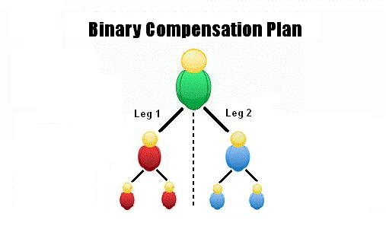
Binary Plans
(Isagenix, Beachbody, Zija, USANA, Mona Vie, Jeunesse)
How it works (in general):
Only 2 people on front line
Compensation based on group volume of each leg
Commissions usually paid on weaker leg
No depth limitations/not driven by levels. However, volume w/in organization is limited for payouts
If distributor doesn’t qualify, commissions return to the company
Notes:
http://www.workathomemomnow.com/understanding-mlm-compensation-binary-compen

Slide 14
Binary Plans
(Isagenix, Beachbody, Zija, USANA, Mona Vie, Jeunesse)
Pros
Cons
Easy to explain
Frequent payouts
(weekly/biweekly)
Good for single product companies
Not consumer friendly
Usually pays on an individuals weakest leg only, no reward for greatest effort
Manipulation in placements
2 Legs required to get a check
Volatile revenue – up and then down
Regulatory challenges – FTC and abroad.
Notes:
http://www.workathomemomnow.com/understanding-mlm-compensation-binary-compen

Slide 15
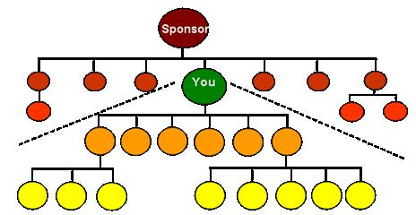
Breakaway Plans
(Amway, Nu Skin, Herbalife, Arbonne)
How it Works:
Team Volume Requirement is key.
Your business focused downline breaks away from your team volume when they start to build.
Monthly Team Volume maintenance requirements for all leaders.
When leaders breakaway, their volume goes with them – for the Team Volume requirement. This creates massive stress for inexperienced builders.
Leaders are then paid on number of generations of downline groups.
Notes:
http://www.workathomemomnow.com/stairstep-breakaway-compensation

Slide 16
Breakaway Plans
(Amway, Nu Skin, Herbalife, Arbonne)
Pros
Cons
Payout could potentially be very large
Good for distributors who have exceptional recruiting and selling skills
Difficult to understand
Distributors have a tendency to stockpile product
Pays the highest levels the most money, significantly less to the lower levels
Too many “dead bodies” – low retention
Creates competition within organization
Notes:
http://www.workathomemomnow.com/stairstep-breakaway-compensation

Slide 17
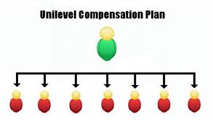
Unilevel Plans
(dōTERRA, Young Living, It Works, Nerium, Plexus, Le-Vel, Advocare, LifeVantage, Rodan & Fields)
How it Works:
Simple to explain
Paid on each individual level.
Structure is important – Placement key.
Requirements based on OV and Width.
No limit on width or depth, but only paid a limited number of levels.
Notes:
http://www.workathomemomnow.com/understanding-mlm-compensation-unilevel-compensation

Slide 18
Unilevel Plans
(dōTERRA, Young Living, It Works, Nerium, Plexus, Le-Vel, Advocare, LifeVantage, Rodan & Fields)
Pros
Cons
Easy to explain
Good for part-time distributors
Supplemental bonuses
Offers large payouts
No limits on distributor frontline
Residual income is most secure
Limited levels of pay
Requires time and hard work to build
Usually slower to build
Smaller checks initially
Notes:
http://www.workathomemomnow.com/stairstep-breakaway-compensation

Slide 19
Unilevel Summary – Things to Look For
Payment percentage by level
Fast Money vs. Residual Income
Rank Requirements
# of Legs
Size of Legs
OV Requirements
Other Factors
Fast Start Bonuses
Pools/Depth
Income Disclosures
Notes:
http://www.workathomemomnow.com/stairstep-breakaway-compensation

Slide 20
doTERRA’s Compensation Plan “Unilevel Plus”
Fast Start
Power of 3
Unilevel
Plus
Other benefits:
- Loyalty Rewards
- Dynamic Compression
- Payout increase w/depth
- Minimal leg requirements
- No changes!!!
Pools
Founders Club

Slide 22
Plexus Plan
 |  |  | Total
Level | People | Points | Awarded
1 | 3 | 5 | 15
2 | 9 | 5 | 45
3 | 27 | 5 | 135
4 | 81 | 4 | 324
5 | 243 | 3 | 729
6 | 729 | 2 | 1,458
7 | 2,187 | 1 | 2,187
 |  |  | 4,893
Payment per point |  |  | $ 3.25
Monthly Payment |  |  | $ 15,902

Slide 23
Plexus Plan
(If they valued depth)
Plexus Plan
 |  |  | Total
Level | People | Points | Awarded
1 | 3 | 5 | 15
2 | 9 | 5 | 45
3 | 27 | 5 | 135
4 | 81 | 4 | 324
5 | 243 | 3 | 729
6 | 729 | 2 | 1,458
7 | 2,187 | 1 | 2,187
 |  |  | 4,893
Payment per point |  |  | $ 3.25
Monthly Payment |  |  | $ 15,902
 |  |  | Total
Level | People | Points | Awarded
1 | 3 | 1 | 3
2 | 9 | 2 | 18
3 | 27 | 3 | 81
4 | 81 | 4 | 324
5 | 243 | 5 | 1,215
6 | 729 | 5 | 3,645
7 | 2,187 | 5 | 10,935
 |  |  | 16,221
Payment per point |  |  | $ 3.25
Monthly Payment |  |  | $ 52,718

Slide 24
dōTERRA Plan
(if the percentages were inverted)
dōTERRA Plan
Level | Volume | % | Amount
1 | 1,430 | 2 | $ 28.60
2 | 5,608 | 3 | $ 168.23
3 | 24,207 | 5 | $ 1,210.35
4 | 80,661 | 5 | $ 4,033.03
5 | 213,484 | 6 | $ 12,809.04
6 | 437,133 | 6 | $ 26,227.98
7 | 786,839 | 7 | $ 55,078.73
 |  |  | $ 99,555.95
Level | Volume | % | Amount
1 | 1,430 | 7 | $ 100.10
2 | 5,608 | 6 | $ 336.45
3 | 24,207 | 6 | $ 1,452.42
4 | 80,661 | 5 | $ 4,033.03
5 | 213,484 | 5 | $ 10,674.20
6 | 437,133 | 3 | $ 13,113.99
7 | 786,839 | 2 | $ 15,736.78
 |  |  | $ 45,446.97

Slide 25
Competing Unilevels - % pay by Rank
It Works: L1 – 10%, L6 – 2%
Nerium: L1 – 5%, L7 – 2%
Rodan and Fields: L1 – 5%, L5 – 5%
LeVel : L1 – 4%, L8 – 4%
LifeVantage: L1- 2%, L5 – 5%, L9 – 2%
Nerium: L1 – 5%, L8 – 2%

Slide 26
Rank Requirements - Examples
Life Vantage: Top rank requires 1 million OV
Young Living: Diamond rank 250,000 OV
Top rank requires 1.5 million OV
Nerium: Diamond-type rank 150,000 OV
Top rank requires 1.65 million OV

Slide 27
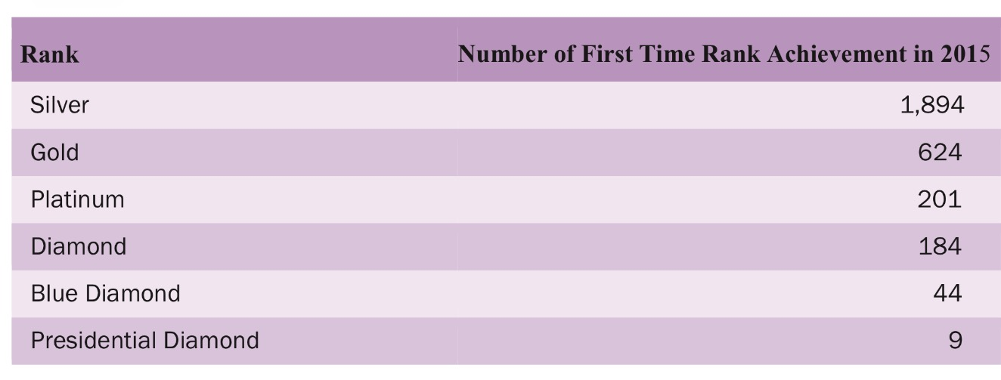
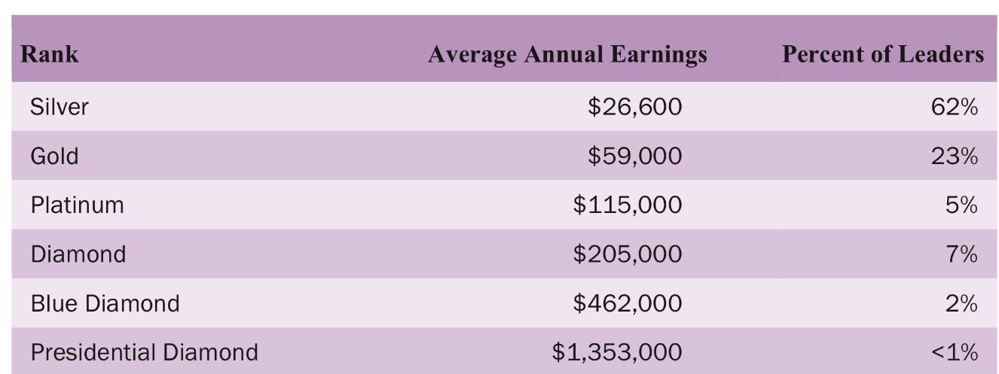
Income Disclosures
Read the fine print.
No disclosure is a red flag
LeVel has no disclosure
Be sure to compare like ranks
Compare Leg/OV requirements
Look for or compute numbers at each level.

Slide 28
Income Disclosures - Top Ranks

Slide 29
Income Disclosures - Read the Fine Print
Herbalife Income Disclosure:
“The majority of those Distributors who earned in excess of $100,000 in 2012 had reached the level of Herbalife’s President’s Team. During 2012, 47 U.S. Distributors joined the level of President’s Team. They averaged 9 years as an Herbalife Distributor before reaching President’s Team, with the longest being 20 years and the shortest being less than three years.”
dōTERRA Facts:
Platinum Ranks average $115,000 in annual earnings
During 2015, 438 people hit new ranks at Platinum level or higher (versus 47 for Herbalife)
dōTERRA is not even 9 years old!!!

Slide 30
12 Month Retention
Industry Standard
10-20%
70+%
doTERRA
Notes:
This is assumed industry standard. I was not able to find a true number for this. doTERRA’s actual 12 month retention rate is 70.5%.

Slide 31
Back Office vs Corporate Retention Rate
65%
Distributors who’ve placed an order in past 3 months
Distributors still listed as “D” in the system
Back Office:
70+%
Distributors who’ve placed an order in past 12 months
Distributors who have ever signed up
Corporate:

Slide 32
Evaluating Direct Selling
vs.

Slide 33
Evaluating Direct Selling
In stock
Out of Stock

Slide 34
Plan Comparison
Fast Start Bonuses 35%, 3 Levels no cap 30%, 2 Levels w/cap
Power of Three Bonus $50/$250/$1,500 Nothing
Unilevel 7 Levels 5 Levels
L1 (2%), L7 (7%) L1 (8%), L5 (4%)
Pool/Depth Bonuses Yes Yes

Slide 35
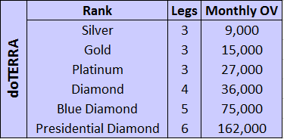
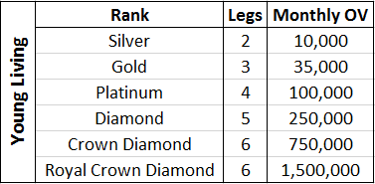
Top Rank Level OV Requirements

Slide 36
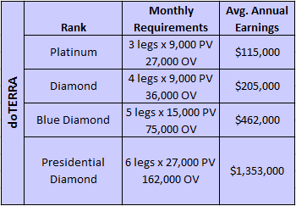
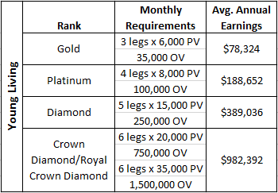
Paid Rank Earnings Comparison

Slide 37
The Grass is NOT Always Greener on the Other Side of the fence!

Slide 38
Summary
People, Products & Plan
You don’t want to rebuild again, and again and again
Remember the value of retention
Be sure to compare all of the details

