Slide 1
Hayley Hobson
Double Presidential Diamond

Slide 2
Share a reel on social media
Notes:
Honestly, for the first five years, I had NO idea what I was doing.
I think it’s called being unconsciously competent.
And it worked. So I put my head down and kept doing it.
And for a long time I grinded.
I worked way harder than I admitted. (Although some of you probably suspected).
Which put my marriage and my family life on the rocks.
And I kind of “faked” being happy.
And then kept grinding away so I didn’t lose my “position” or my rank in the company.

Slide 3
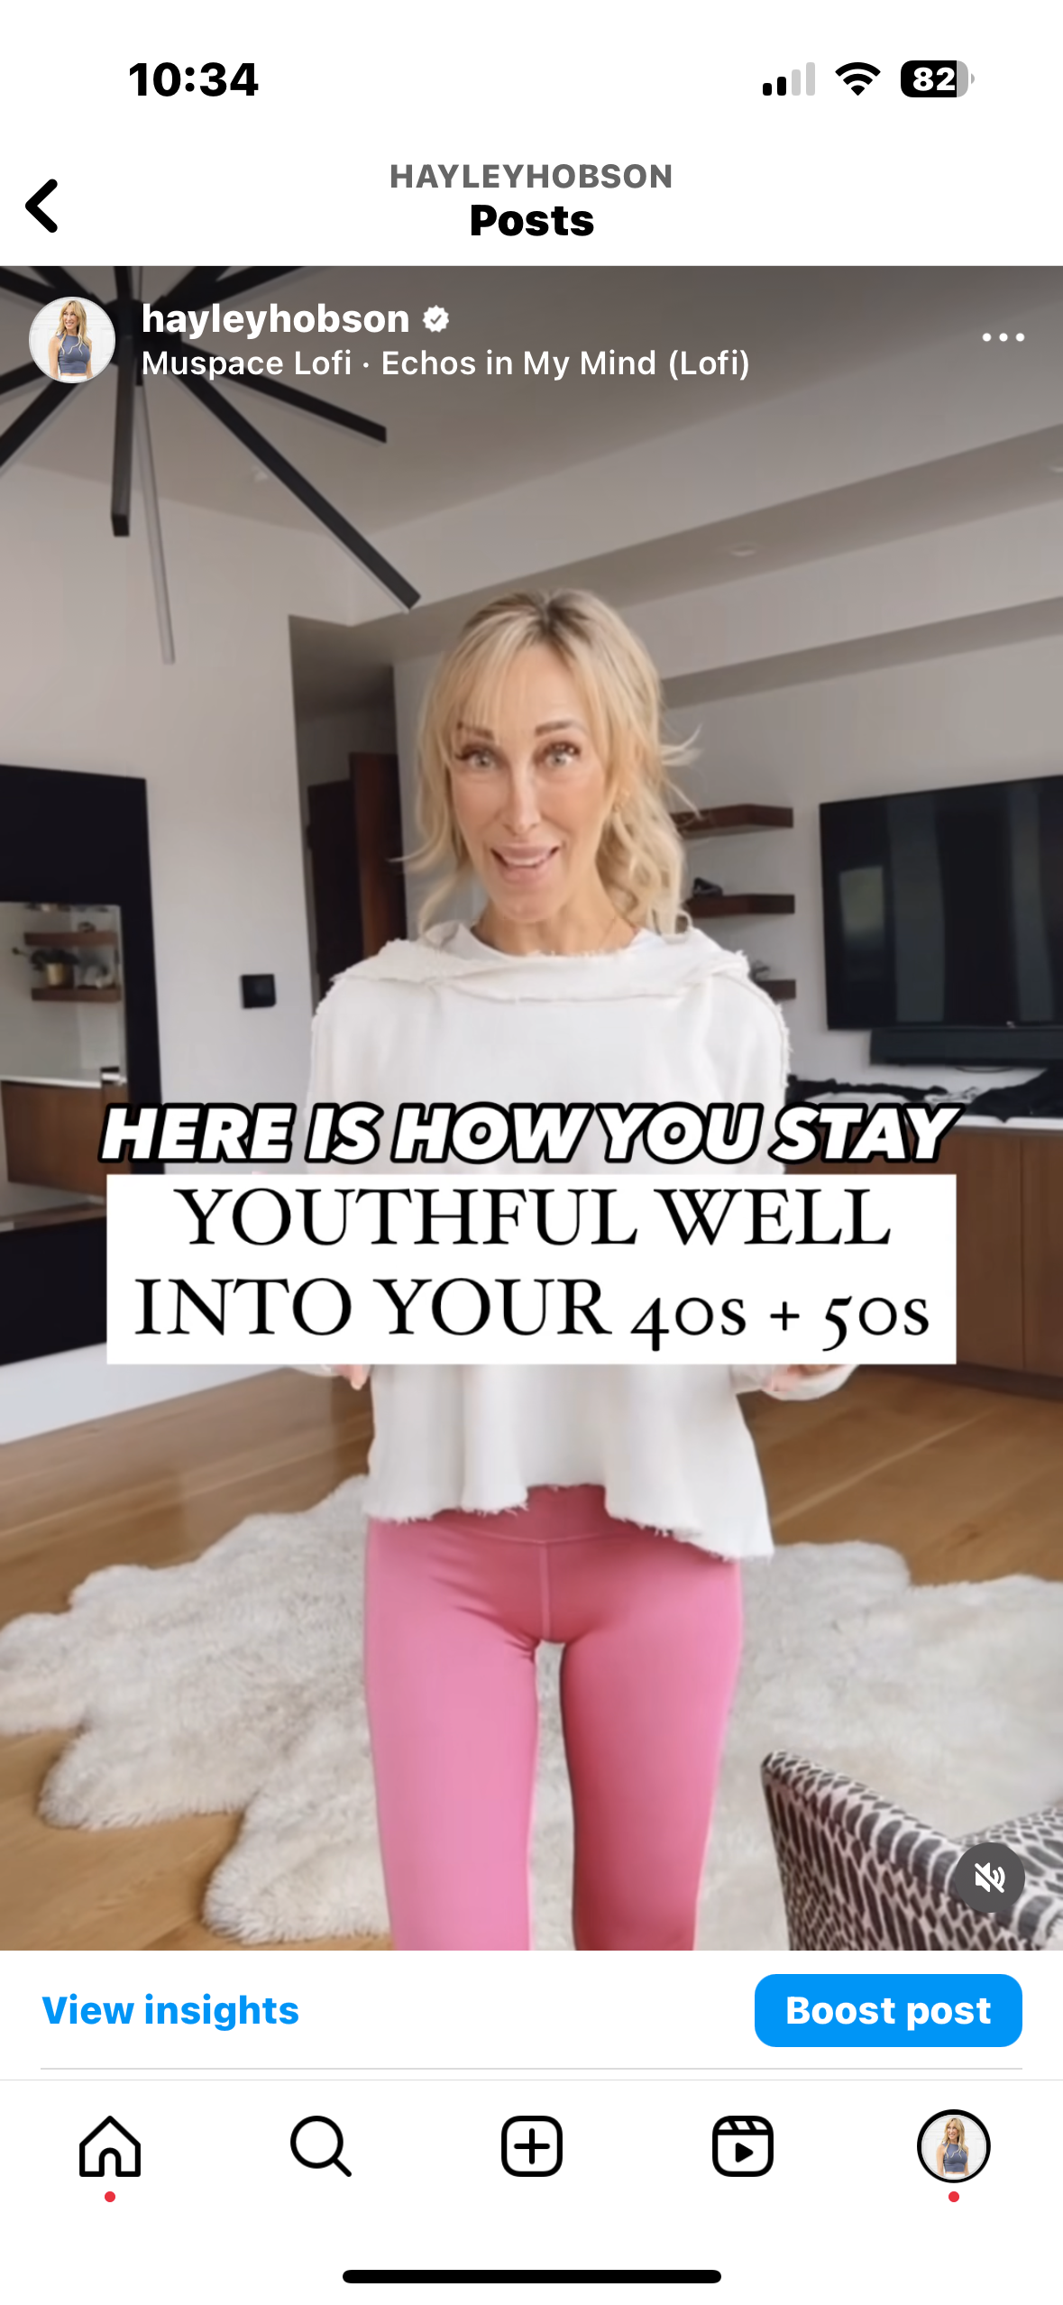
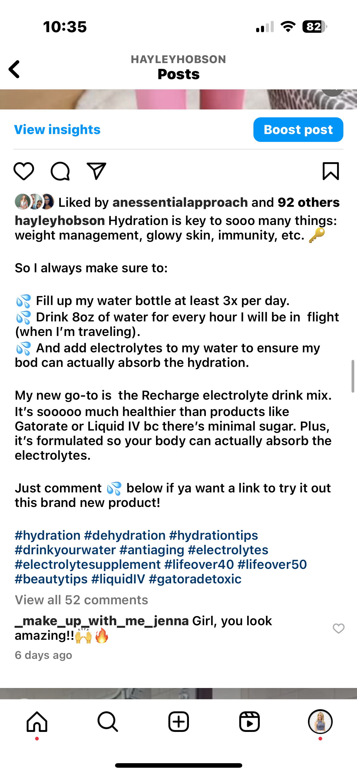
Notes:
Honestly, for the first five years, I had NO idea what I was doing.
I think it’s called being unconsciously competent.
And it worked. So I put my head down and kept doing it.
And for a long time I grinded.
I worked way harder than I admitted. (Although some of you probably suspected).
Which put my marriage and my family life on the rocks.
And I kind of “faked” being happy.
And then kept grinding away so I didn’t lose my “position” or my rank in the company.

Slide 4
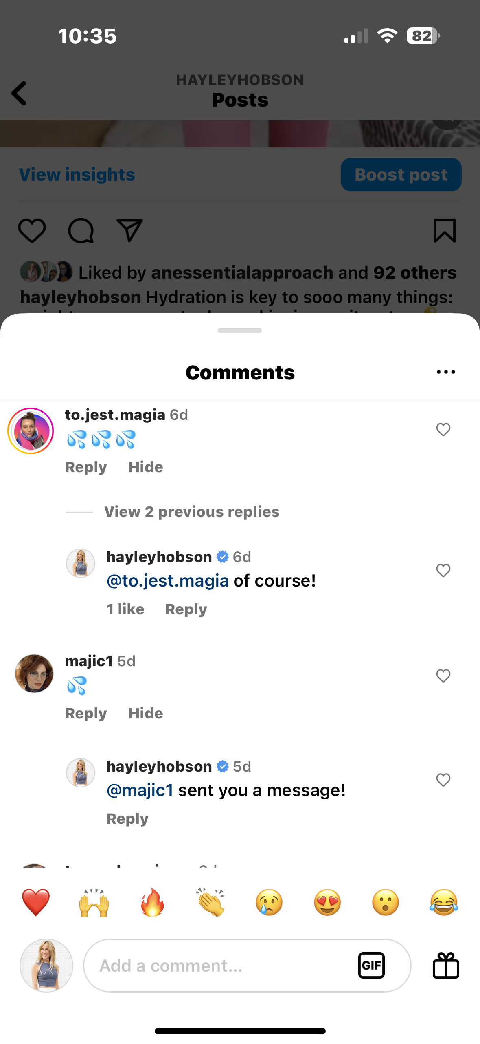
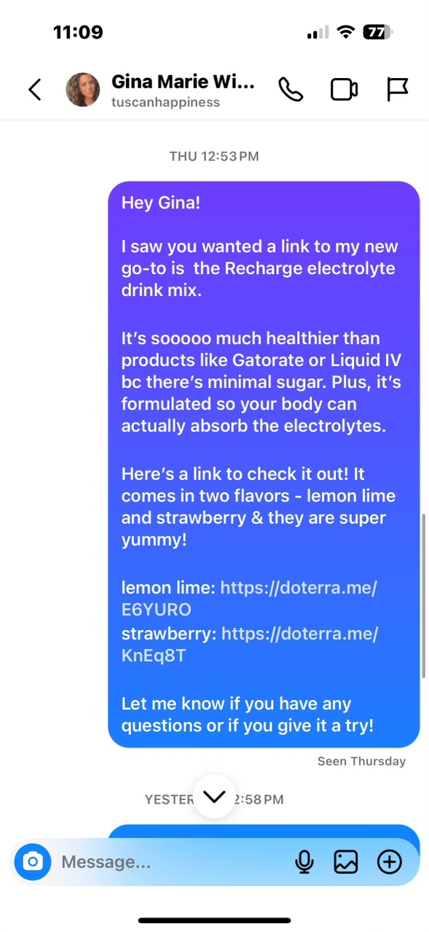
Notes:
Honestly, for the first five years, I had NO idea what I was doing.
I think it’s called being unconsciously competent.
And it worked. So I put my head down and kept doing it.
And for a long time I grinded.
I worked way harder than I admitted. (Although some of you probably suspected).
Which put my marriage and my family life on the rocks.
And I kind of “faked” being happy.
And then kept grinding away so I didn’t lose my “position” or my rank in the company.

Slide 5
Share a reel on social media
Notes:
Honestly, for the first five years, I had NO idea what I was doing.
I think it’s called being unconsciously competent.
And it worked. So I put my head down and kept doing it.
And for a long time I grinded.
I worked way harder than I admitted. (Although some of you probably suspected).
Which put my marriage and my family life on the rocks.
And I kind of “faked” being happy.
And then kept grinding away so I didn’t lose my “position” or my rank in the company.

Slide 6
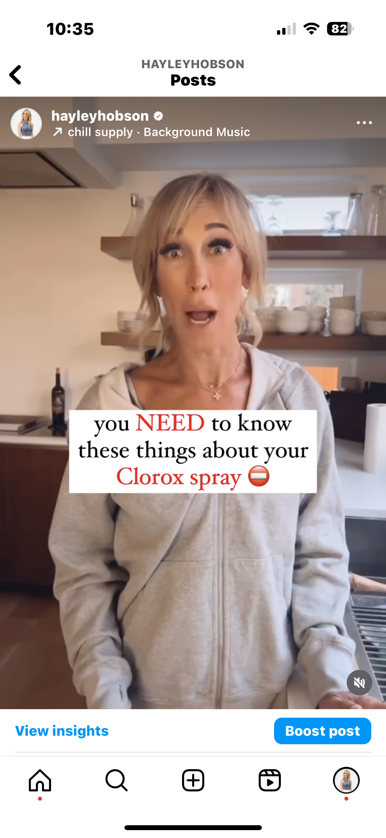
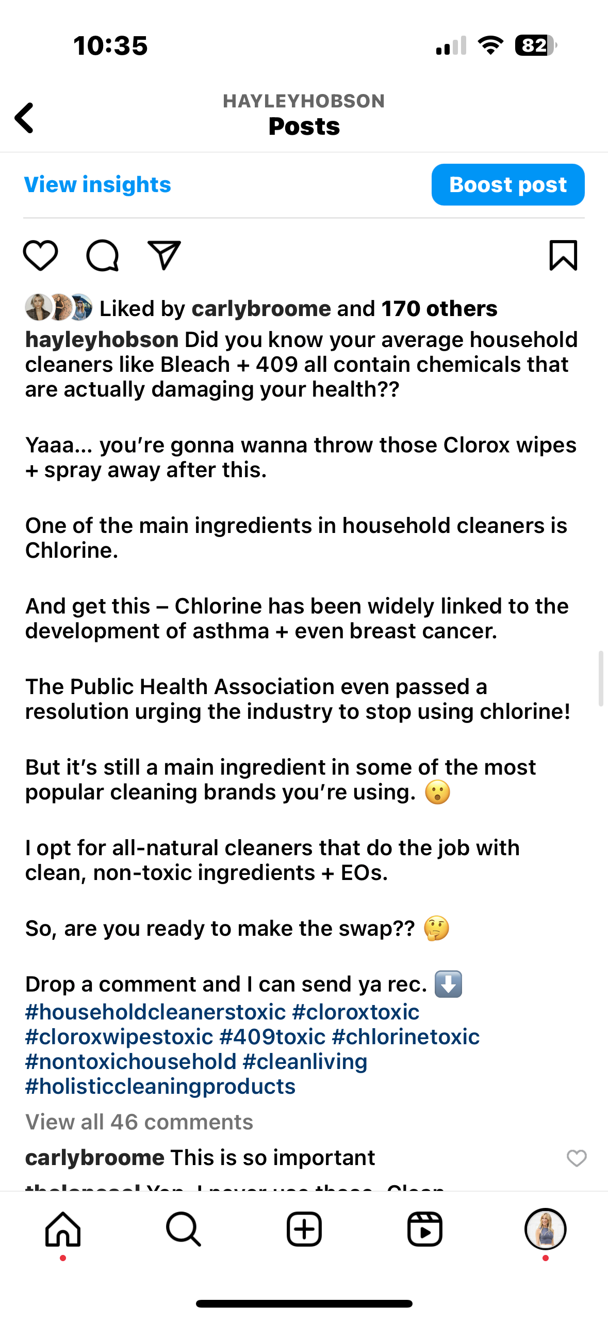
Notes:
Honestly, for the first five years, I had NO idea what I was doing.
I think it’s called being unconsciously competent.
And it worked. So I put my head down and kept doing it.
And for a long time I grinded.
I worked way harder than I admitted. (Although some of you probably suspected).
Which put my marriage and my family life on the rocks.
And I kind of “faked” being happy.
And then kept grinding away so I didn’t lose my “position” or my rank in the company.

Slide 7
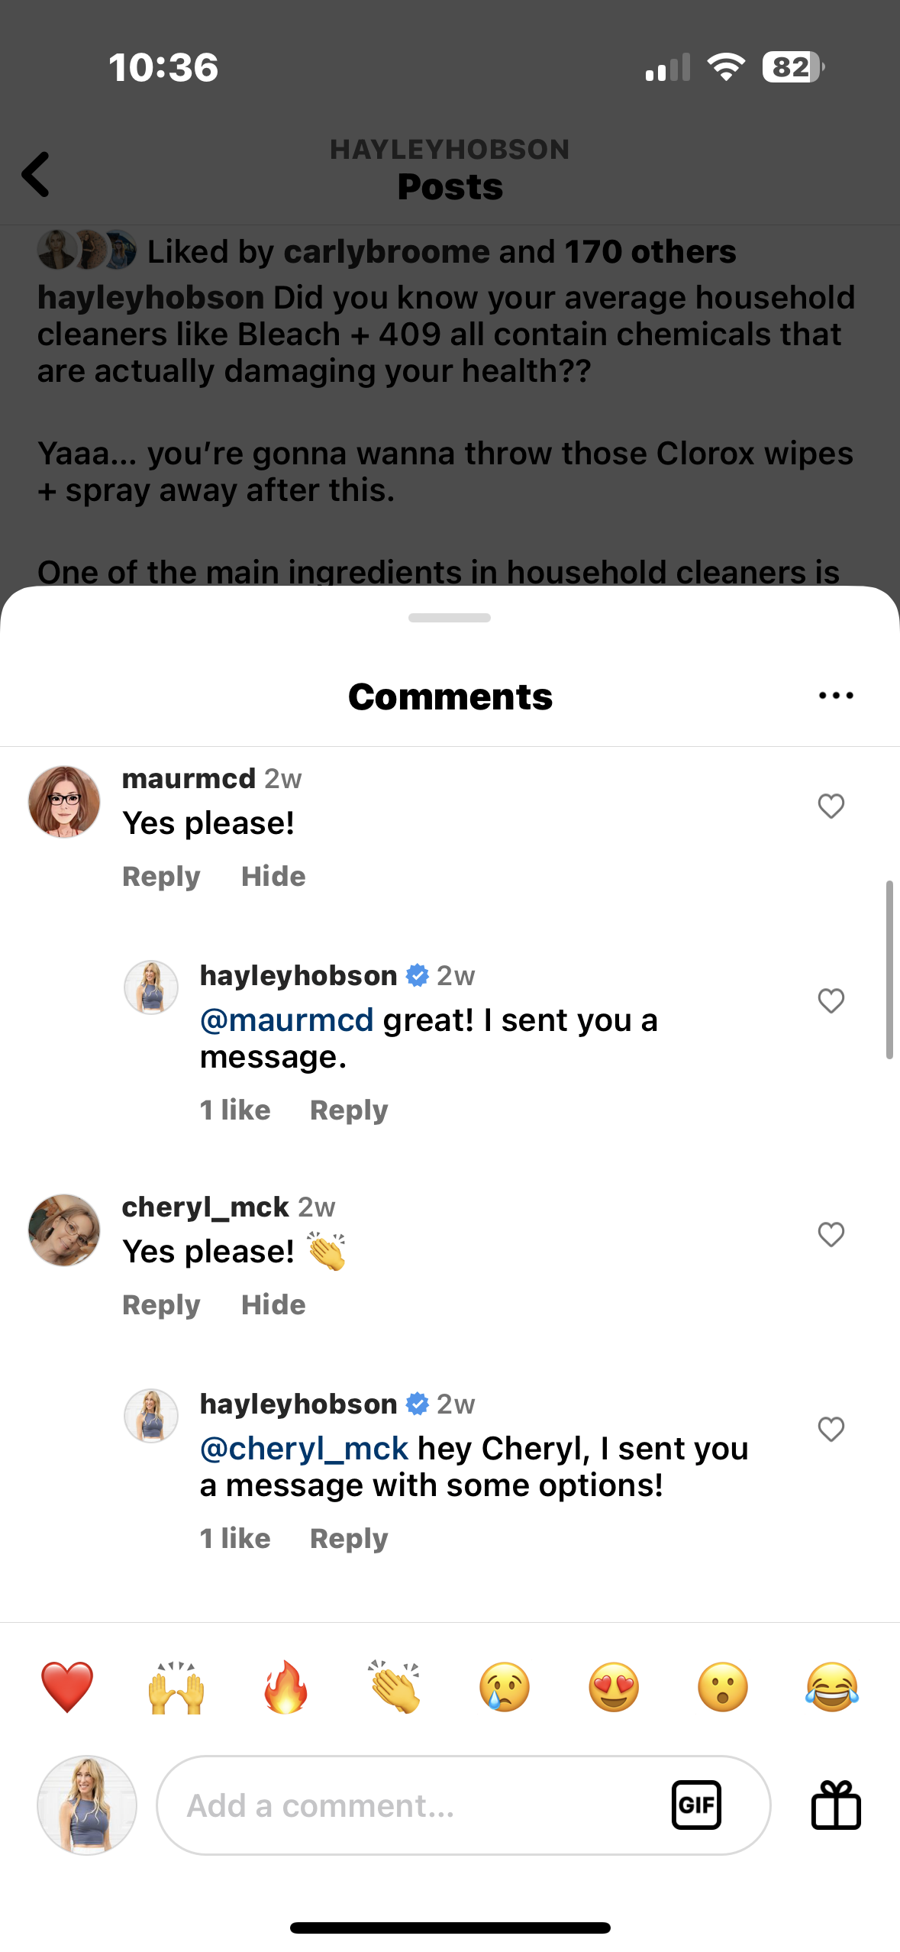
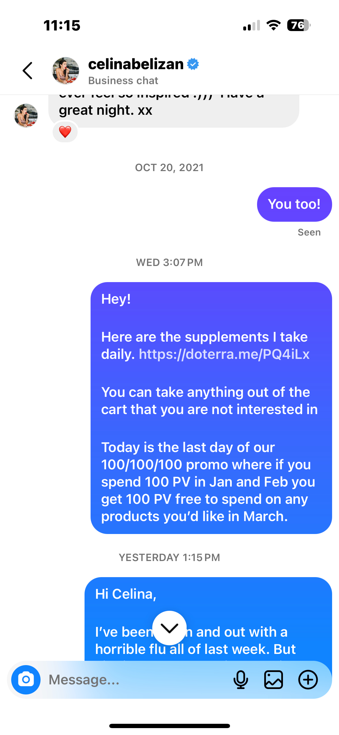
Notes:
Honestly, for the first five years, I had NO idea what I was doing.
I think it’s called being unconsciously competent.
And it worked. So I put my head down and kept doing it.
And for a long time I grinded.
I worked way harder than I admitted. (Although some of you probably suspected).
Which put my marriage and my family life on the rocks.
And I kind of “faked” being happy.
And then kept grinding away so I didn’t lose my “position” or my rank in the company.

Slide 8
How to create a custom cart link
Notes:
And I realize now that working was so much easier for me than getting intimate.
In every area of my life.
Not just at home. With my husband… With my kids… With my family…
But also with you.
In all of my relationships.
They were surface level compared to what I now know is possible.
And here’s how I figured it out.

Slide 9
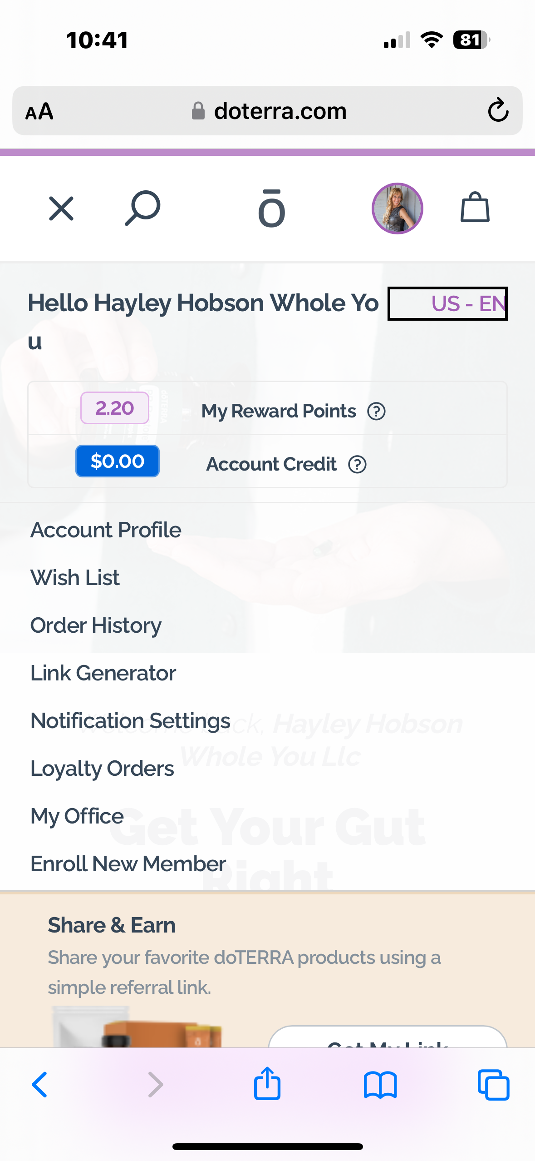
Notes:
And I realize now that working was so much easier for me than getting intimate.
In every area of my life.
Not just at home. With my husband… With my kids… With my family…
But also with you.
In all of my relationships.
They were surface level compared to what I now know is possible.
And here’s how I figured it out.

Slide 10
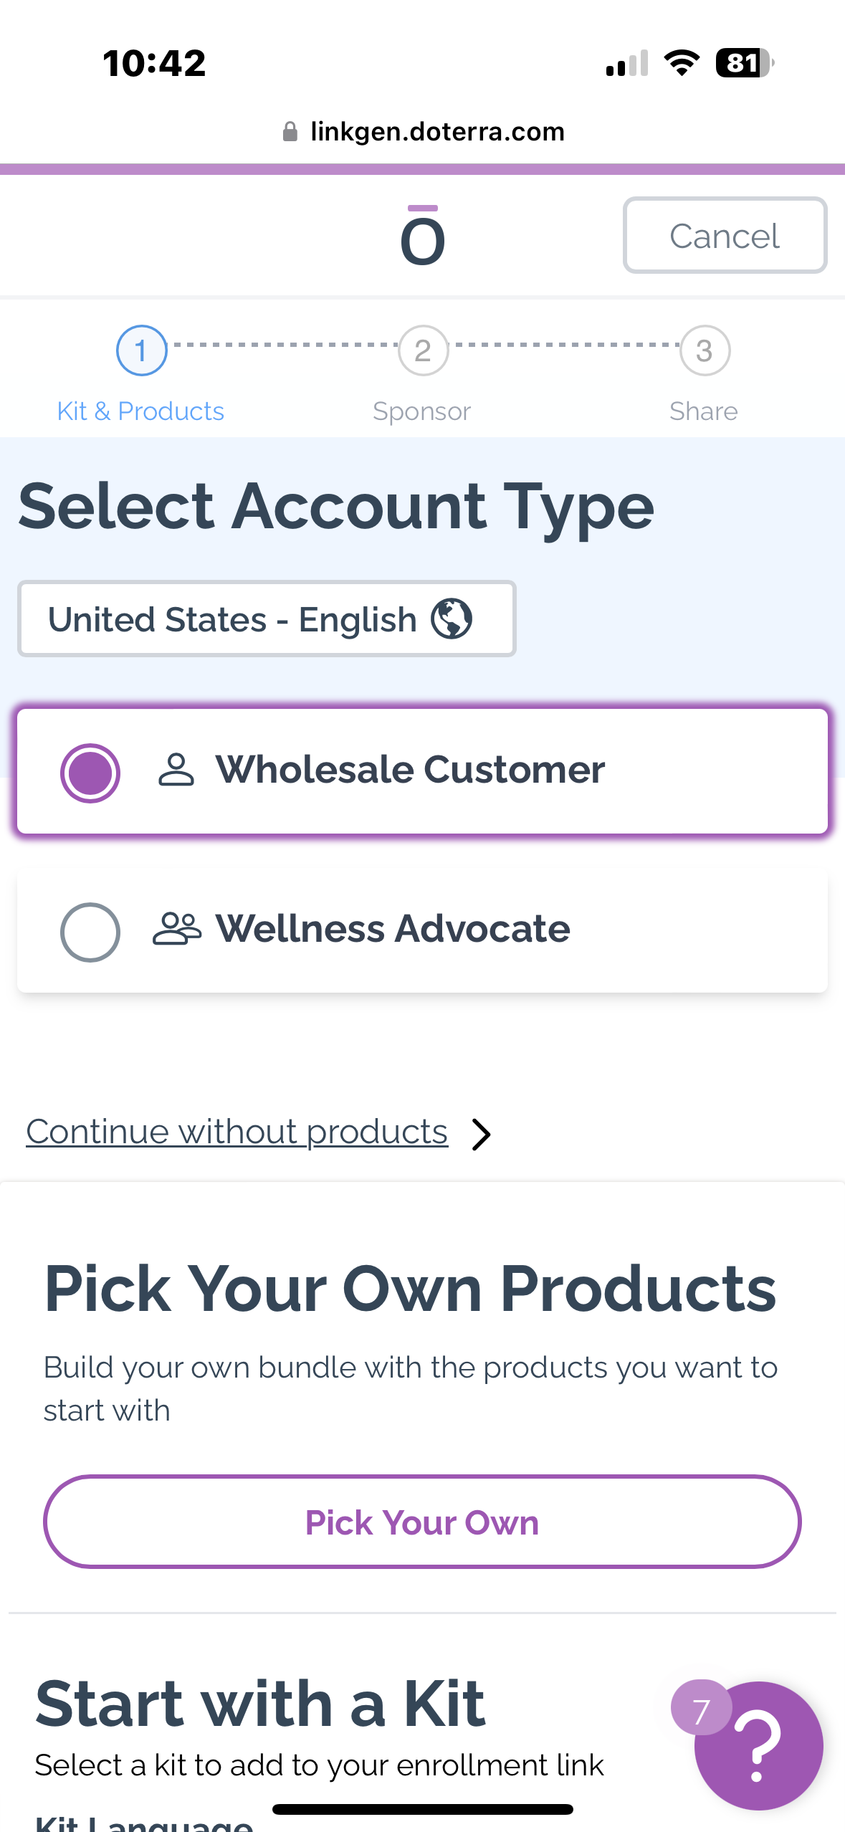
Notes:
And I realize now that working was so much easier for me than getting intimate.
In every area of my life.
Not just at home. With my husband… With my kids… With my family…
But also with you.
In all of my relationships.
They were surface level compared to what I now know is possible.
And here’s how I figured it out.

Slide 11
Notes:
And I realize now that working was so much easier for me than getting intimate.
In every area of my life.
Not just at home. With my husband… With my kids… With my family…
But also with you.
In all of my relationships.
They were surface level compared to what I now know is possible.
And here’s how I figured it out.

Slide 12
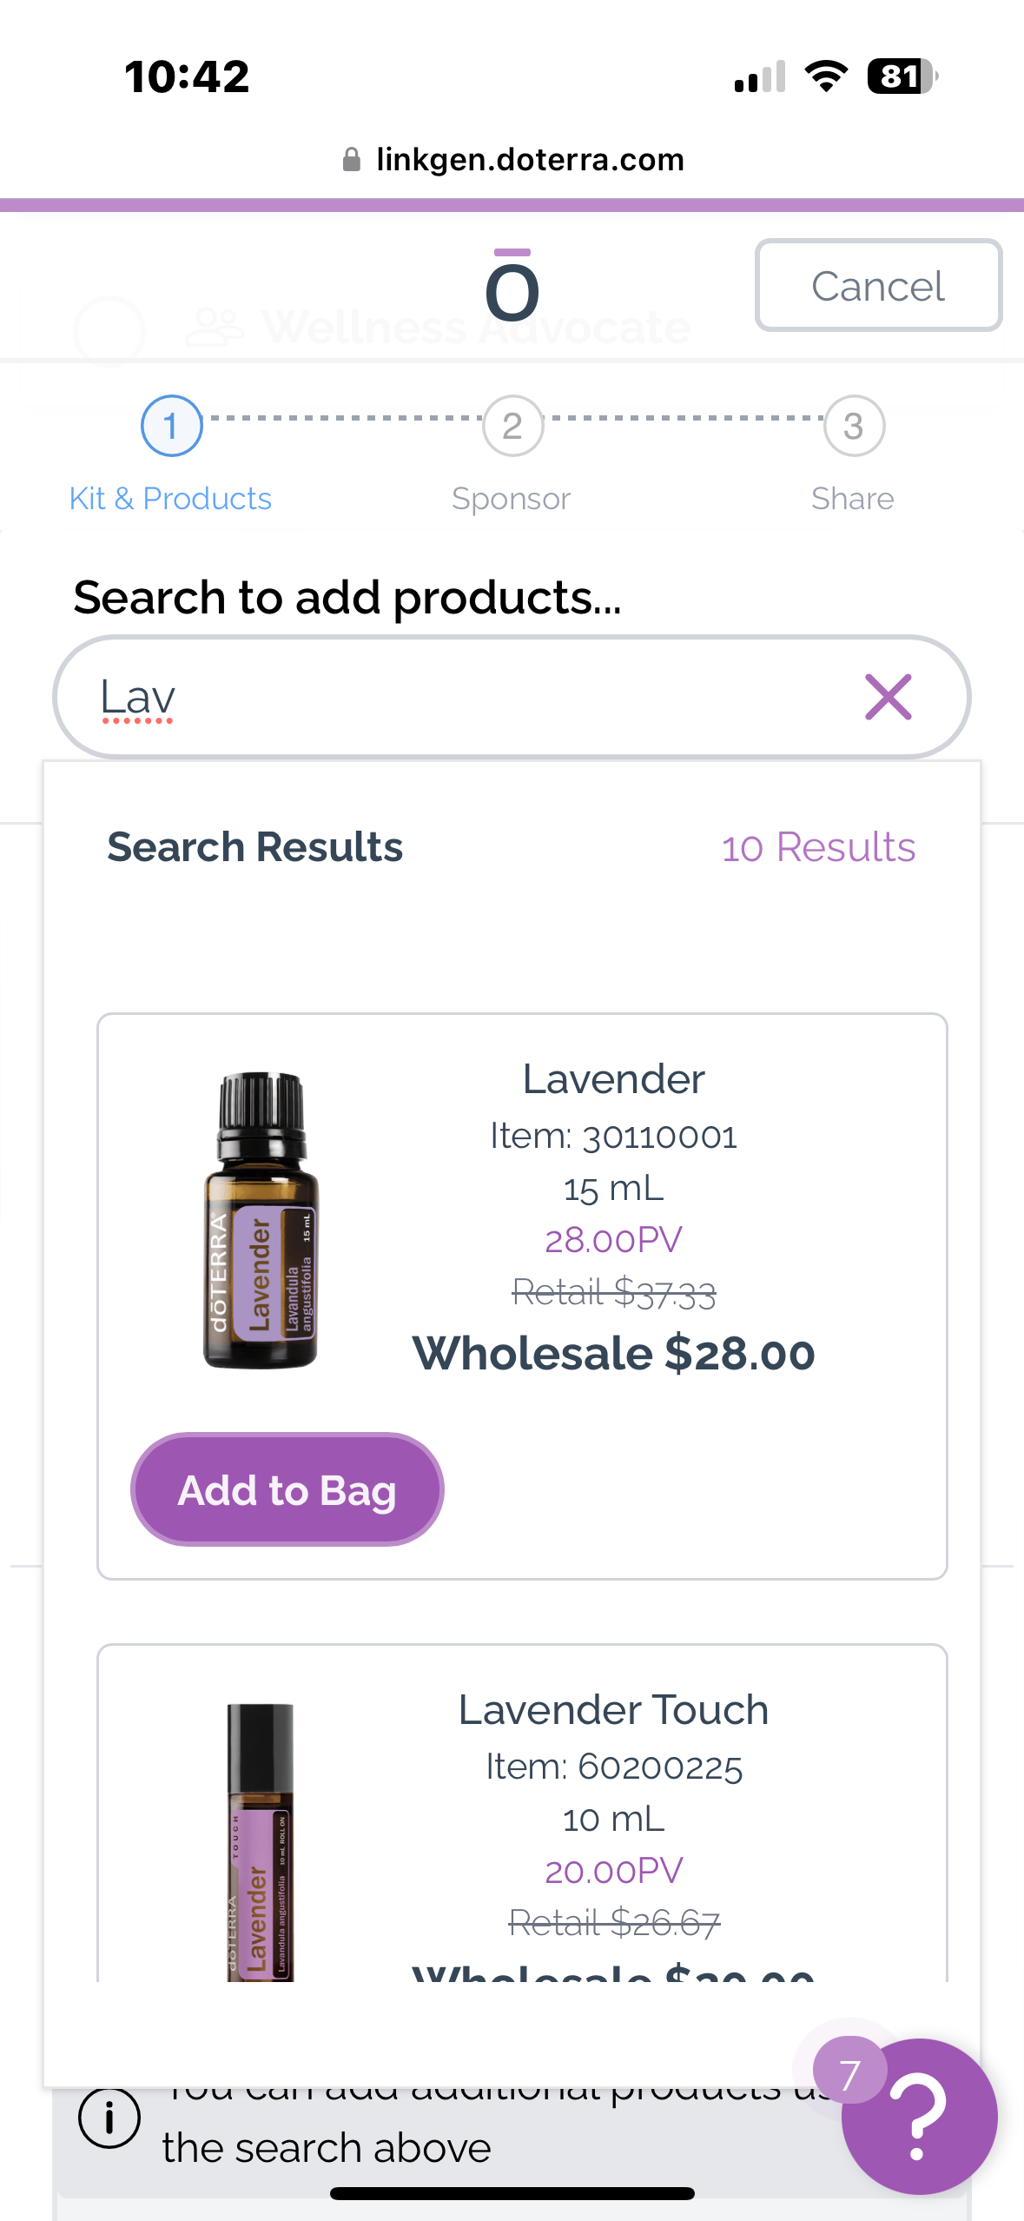
Notes:
And I realize now that working was so much easier for me than getting intimate.
In every area of my life.
Not just at home. With my husband… With my kids… With my family…
But also with you.
In all of my relationships.
They were surface level compared to what I now know is possible.
And here’s how I figured it out.

Slide 13
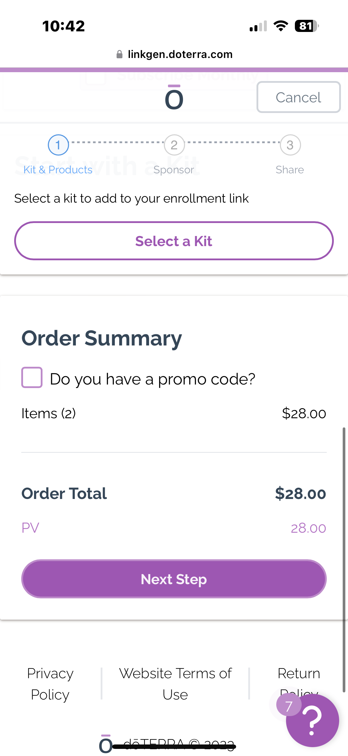
Notes:
And I realize now that working was so much easier for me than getting intimate.
In every area of my life.
Not just at home. With my husband… With my kids… With my family…
But also with you.
In all of my relationships.
They were surface level compared to what I now know is possible.
And here’s how I figured it out.

Slide 14
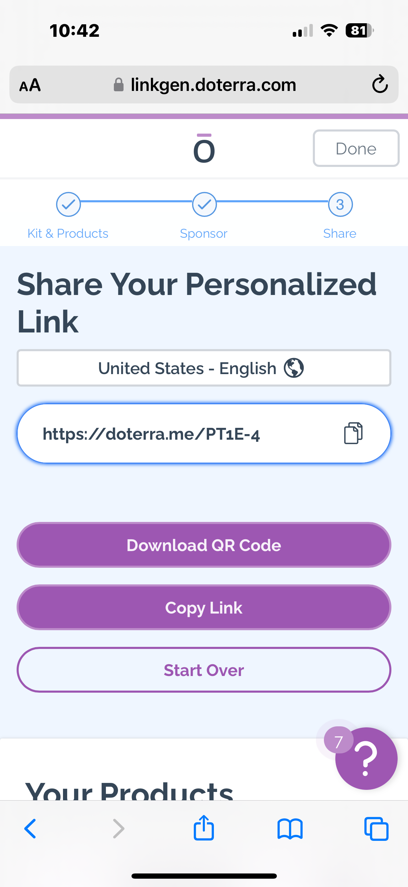
Notes:
And I realize now that working was so much easier for me than getting intimate.
In every area of my life.
Not just at home. With my husband… With my kids… With my family…
But also with you.
In all of my relationships.
They were surface level compared to what I now know is possible.
And here’s how I figured it out.

Slide 15
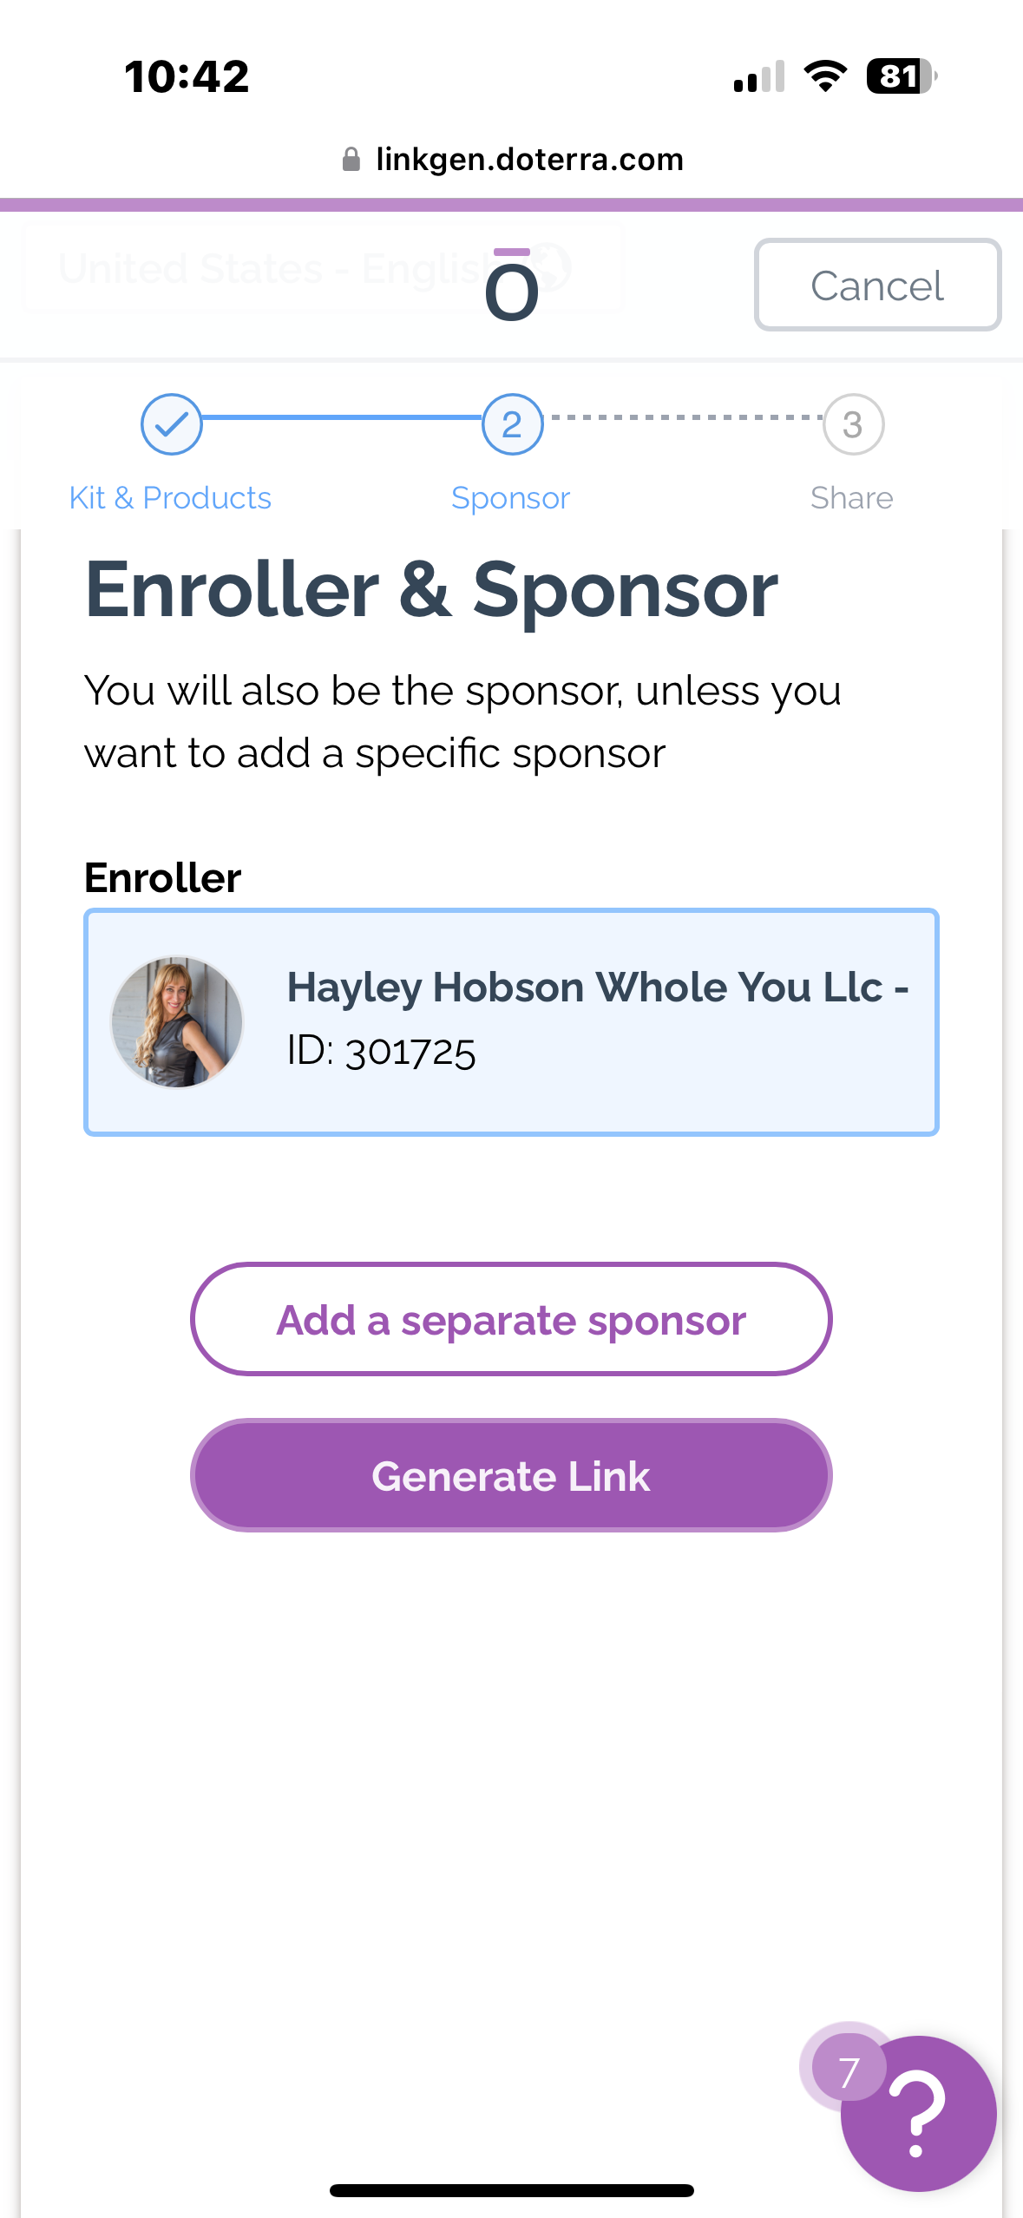
Notes:
And I realize now that working was so much easier for me than getting intimate.
In every area of my life.
Not just at home. With my husband… With my kids… With my family…
But also with you.
In all of my relationships.
They were surface level compared to what I now know is possible.
And here’s how I figured it out.

Slide 16
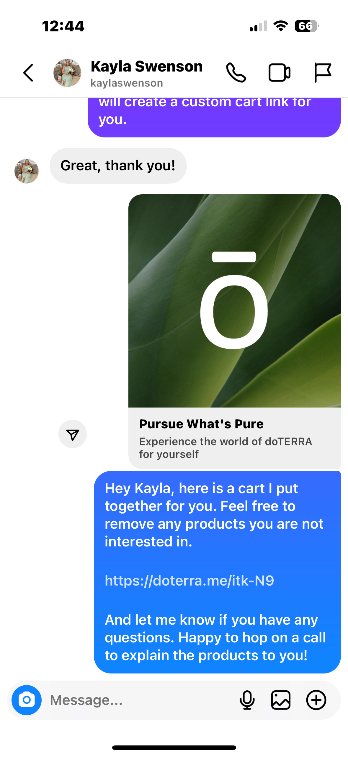
Notes:
And I realize now that working was so much easier for me than getting intimate.
In every area of my life.
Not just at home. With my husband… With my kids… With my family…
But also with you.
In all of my relationships.
They were surface level compared to what I now know is possible.
And here’s how I figured it out.

Slide 17
Let’s Connect:
instagram.com/hayleyhobson
facebook.com/hayleyhobsonwholeyou
Podcast: hayleyhobson.com/news
tiktok.com/@iamhayleyhobson.com
Notes:
Vision + committed action = extraordinary results program

