Slide 2
In this class, you will learn:
The science behind emotion & essential oils
Tools & habits for healthy body chemistry
Practical emotional wellness steps you can take NOW

Slide 3
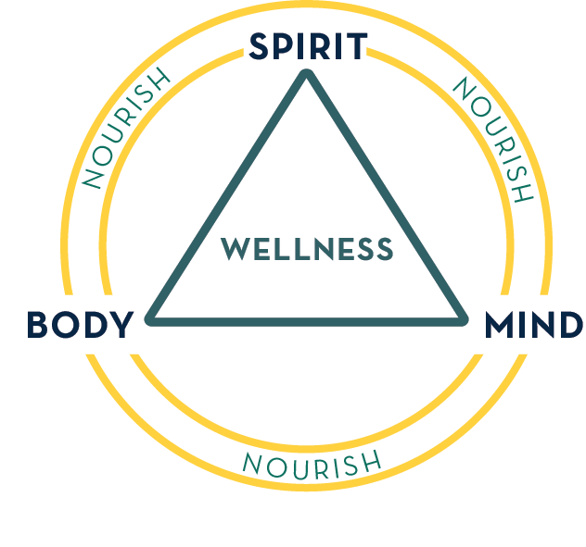
You are created to function as a whole.

Slide 4
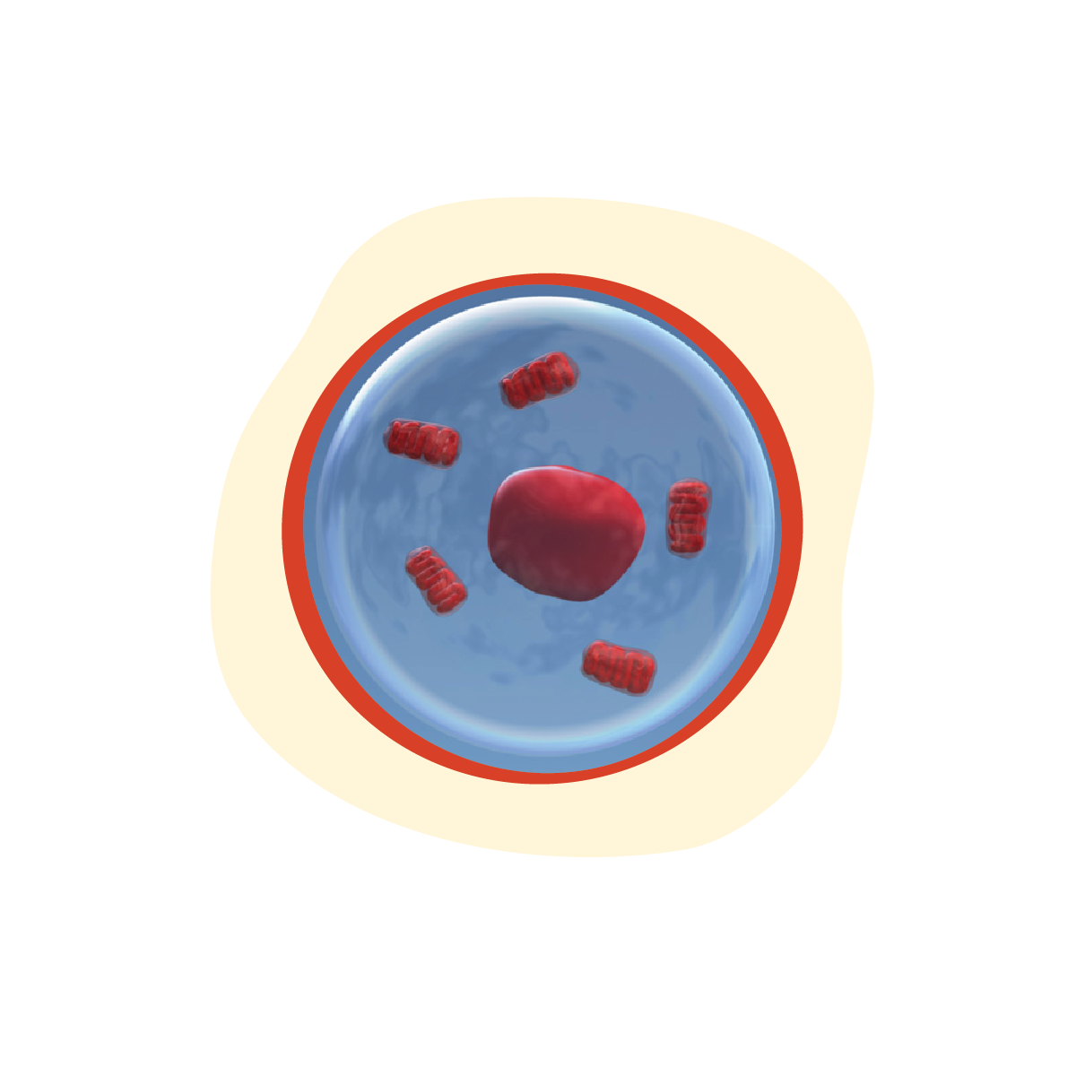
Your body is made up of intelligent cells, wired to restore health.

Slide 5
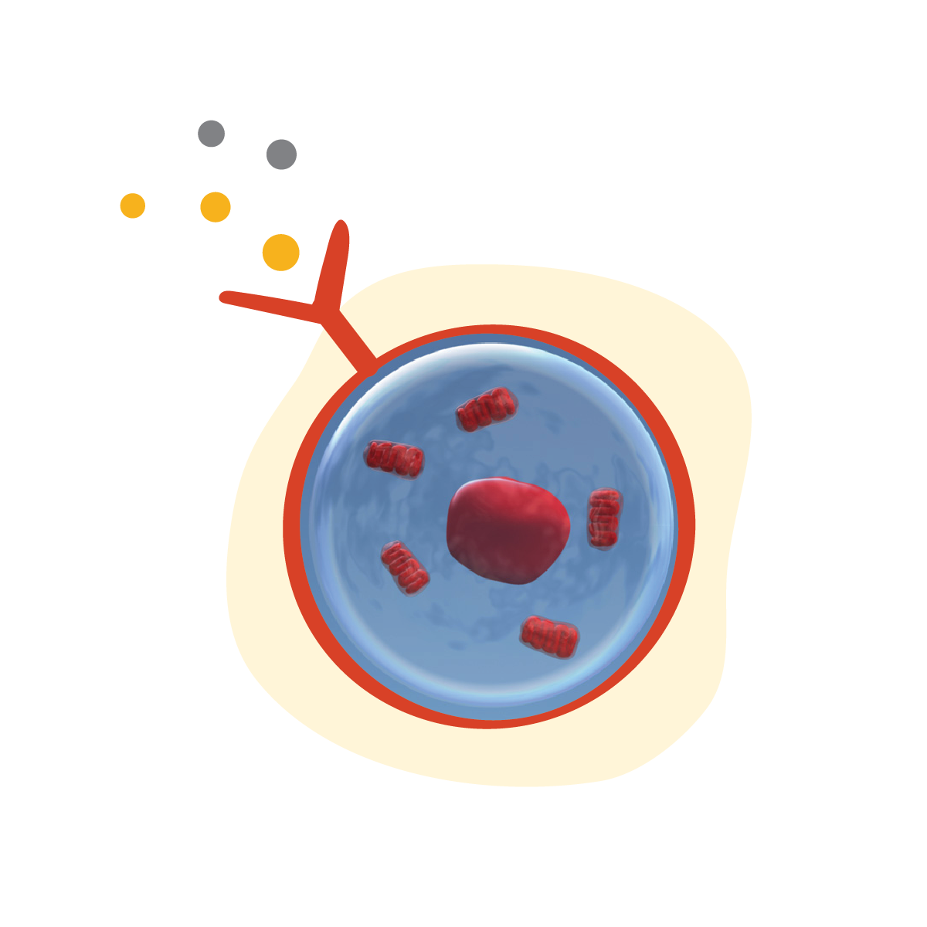
EMOTIONS are information-carrying molecules that:
1) Bind to -and react with- cell receptors 2) Get into cells
3) Impact cellular function & behavior.

Slide 6
Emotions are processed throughout the body.

Slide 7
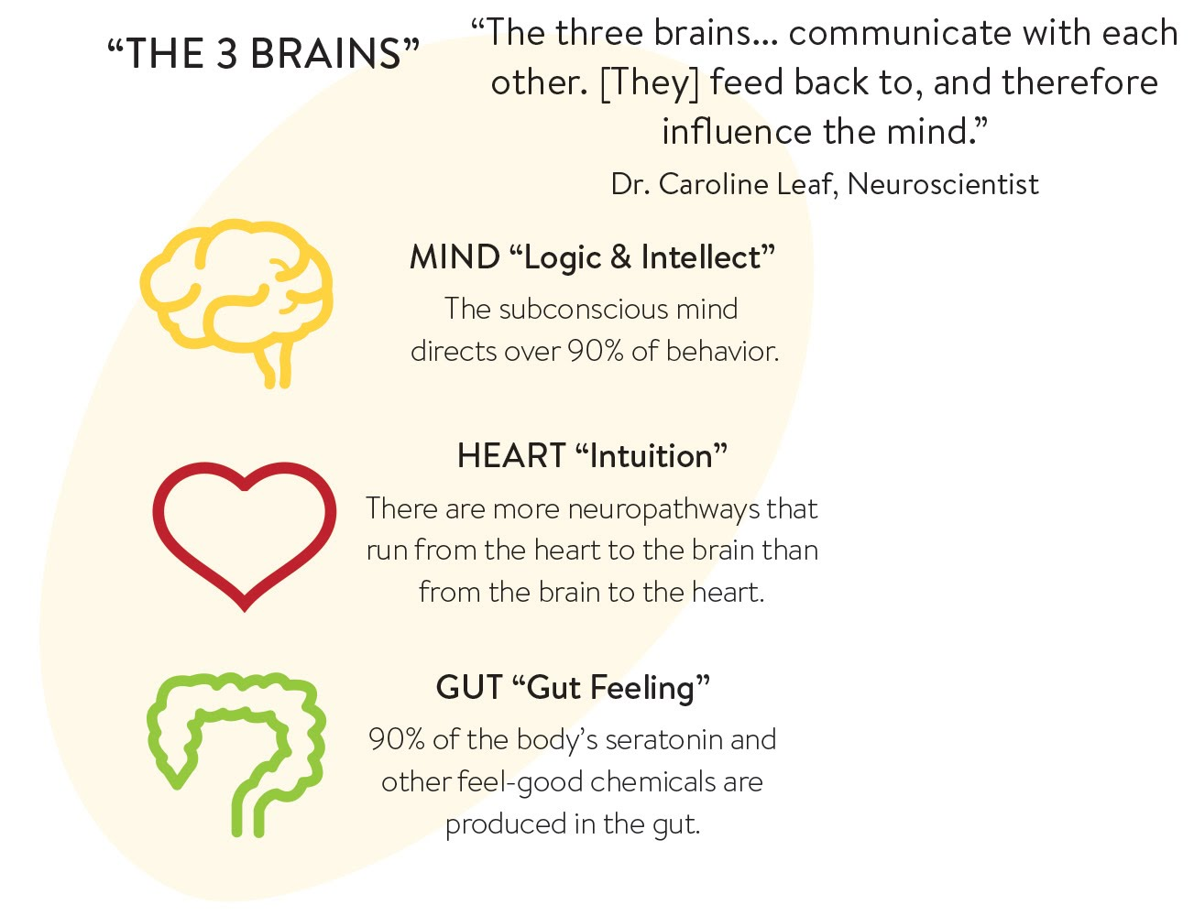

Slide 8
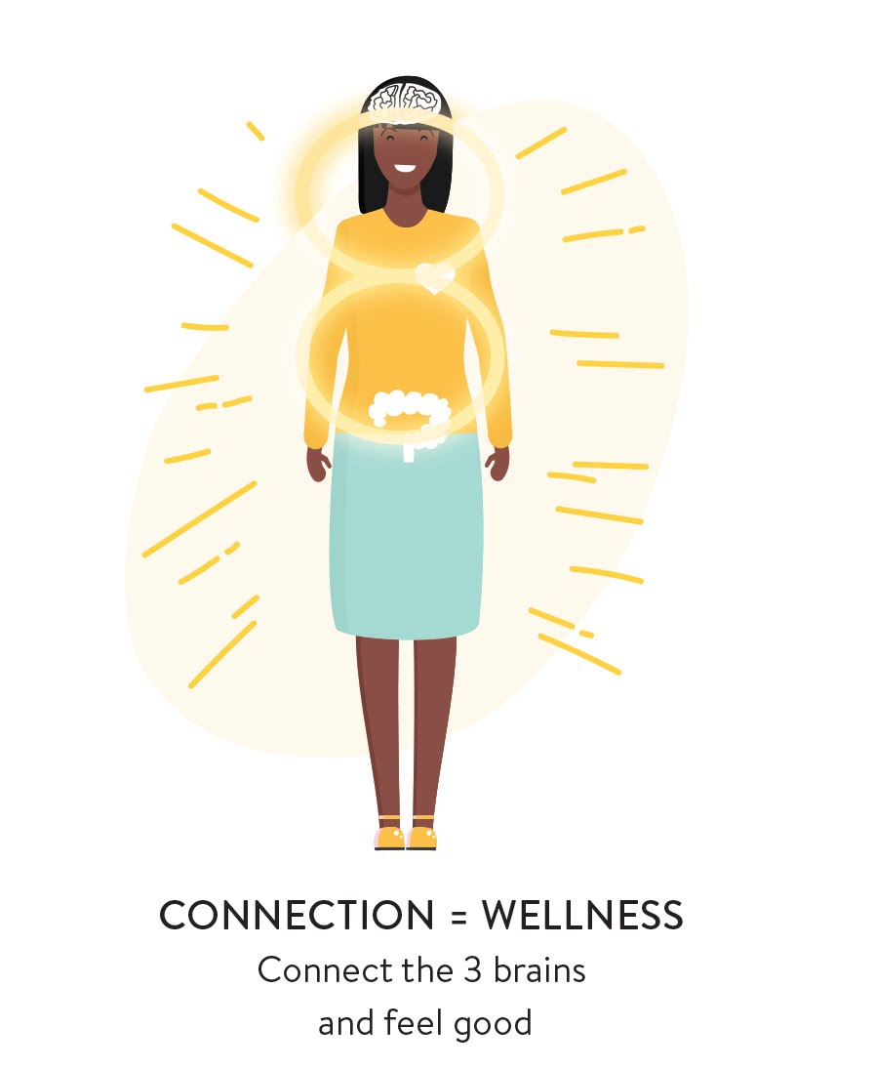

Slide 9
Emotions &
Your Beliefs

Slide 10
Your “3 Brains” instinctively process every life experience.

Slide 16
Essential Oils Support
Healthy Emotions

Slide 17
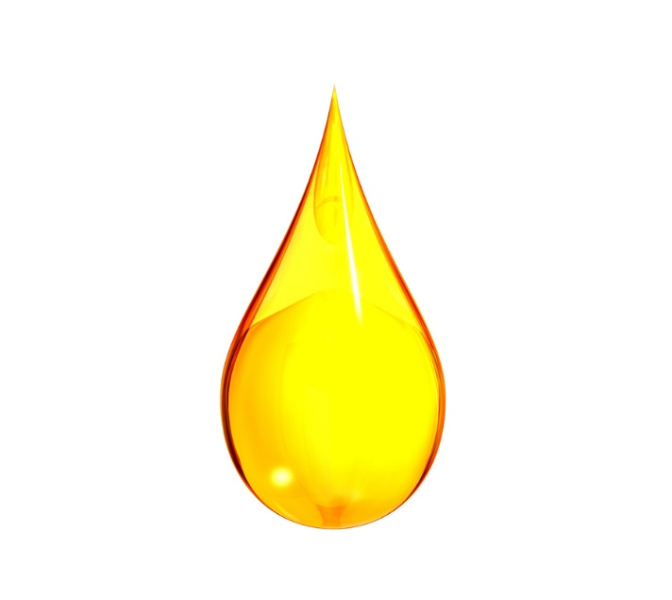
Emotions & Essential Oils interact chemically.

Slide 18
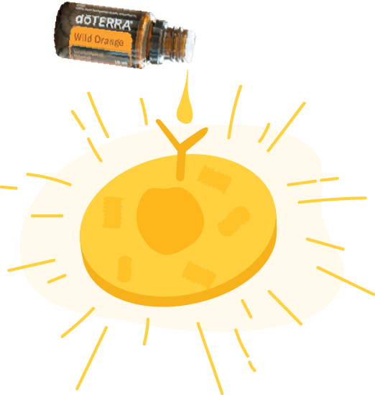
Anchor in healthy biochemistry
Support healthy cellular function
Promote physical and emotional detox

Slide 19
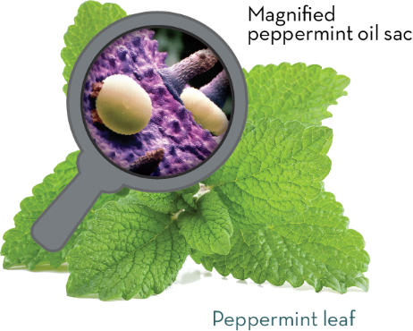

Slide 20
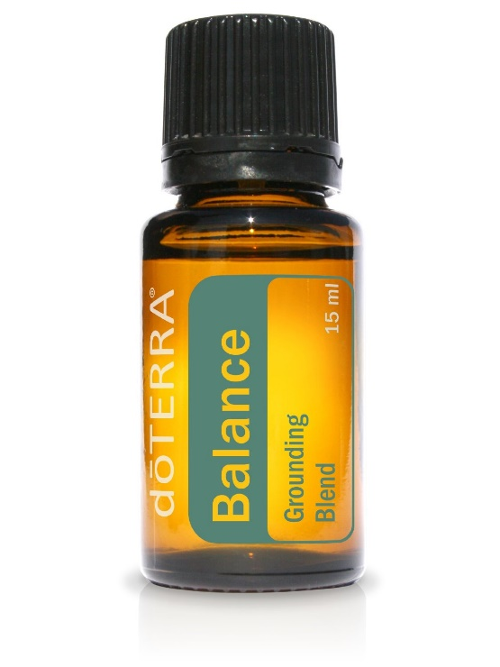

Slide 21
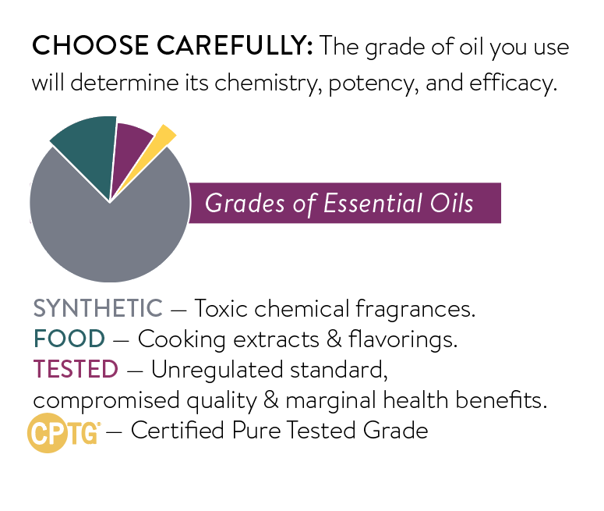

Slide 22
How to Use Essential Oils
for Emotional Wellness

Slide 23
Essential Oils are dynamic… supplying targeted support for your healthy emotions and physical body.

Slide 31
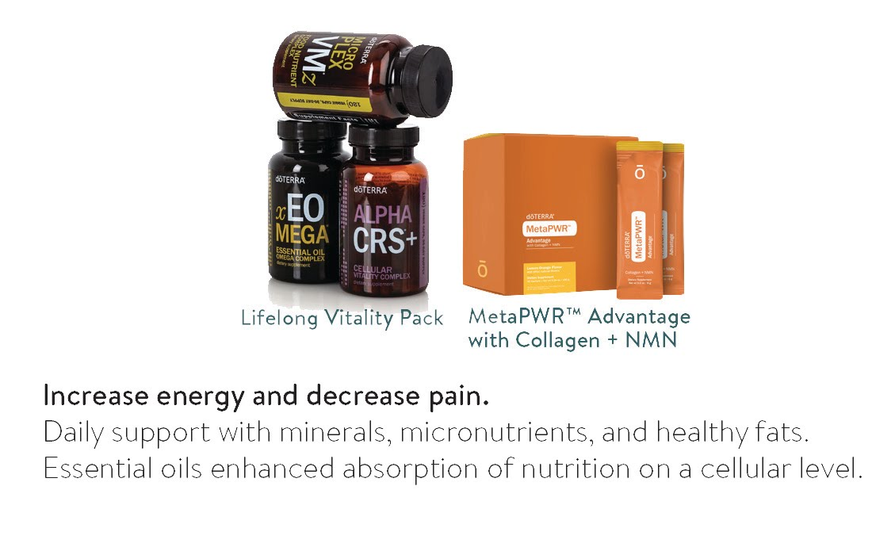
Foundational, cellular support for the “3 brains”

Slide 32
Gut cleansing restores clear thinking and improves mood.

Slide 33
Manage the effects of stress & anxious feelings to ease body & mind.

Slide 34
Moment-by-Moment
Support

Slide 35
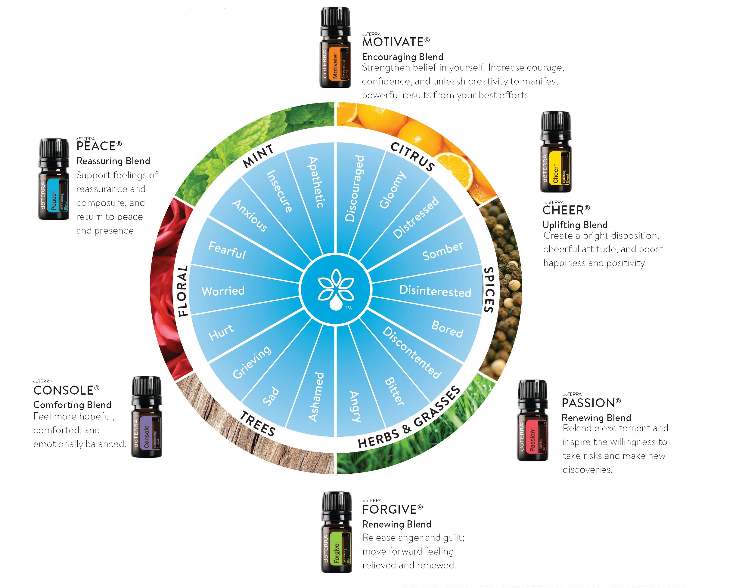

Slide 36
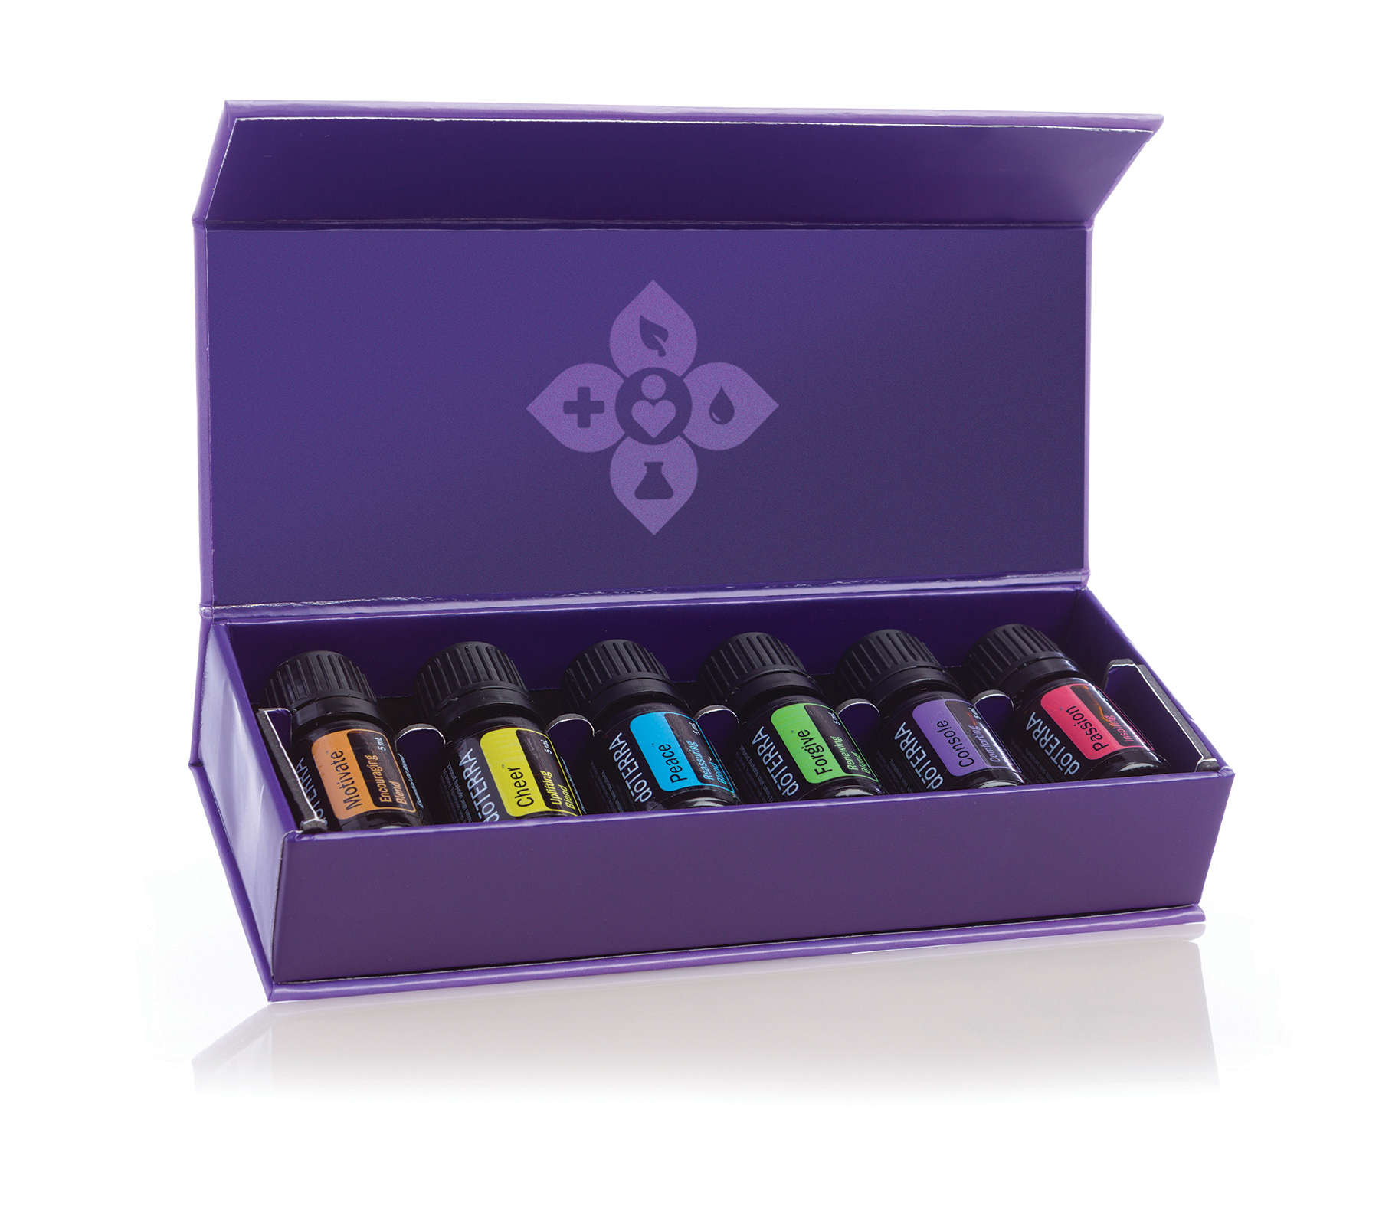

Slide 37
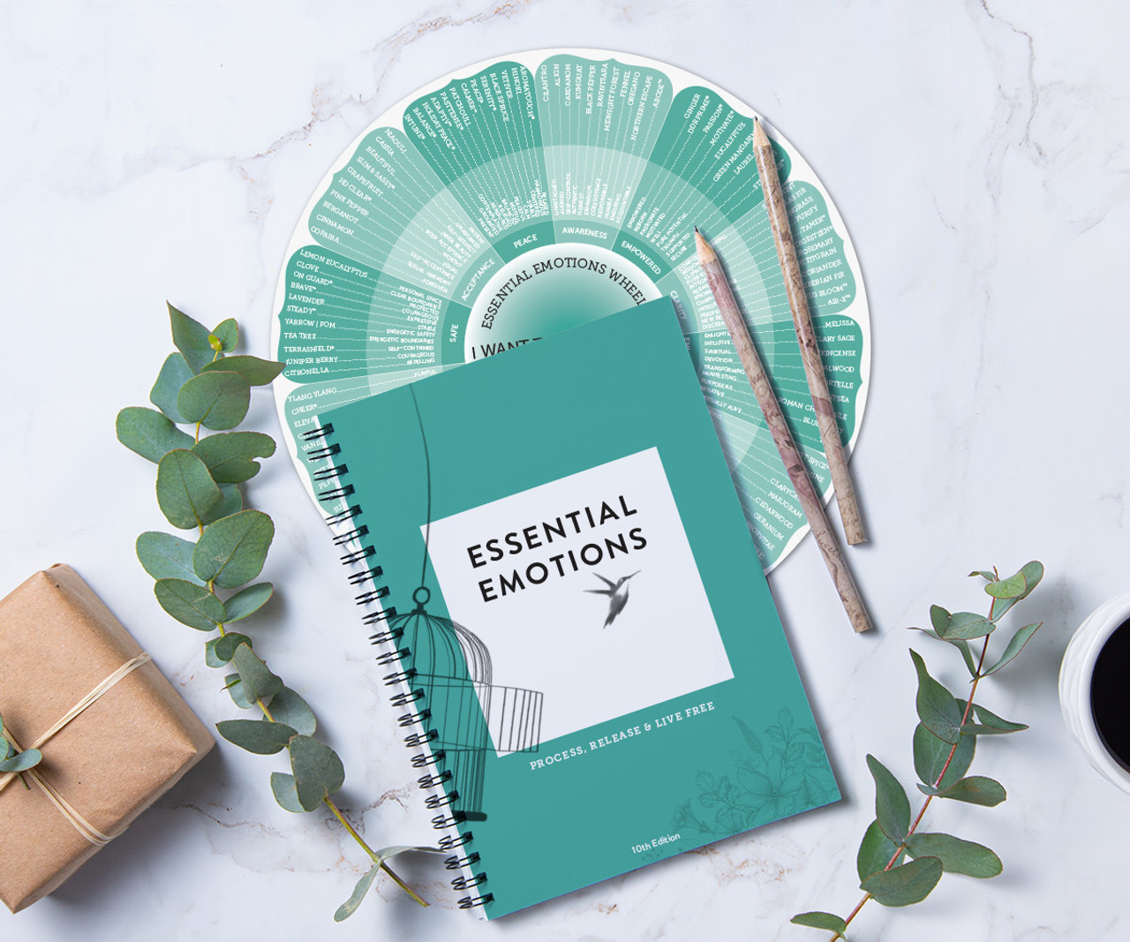
www.essentialemotions.com

Slide 38
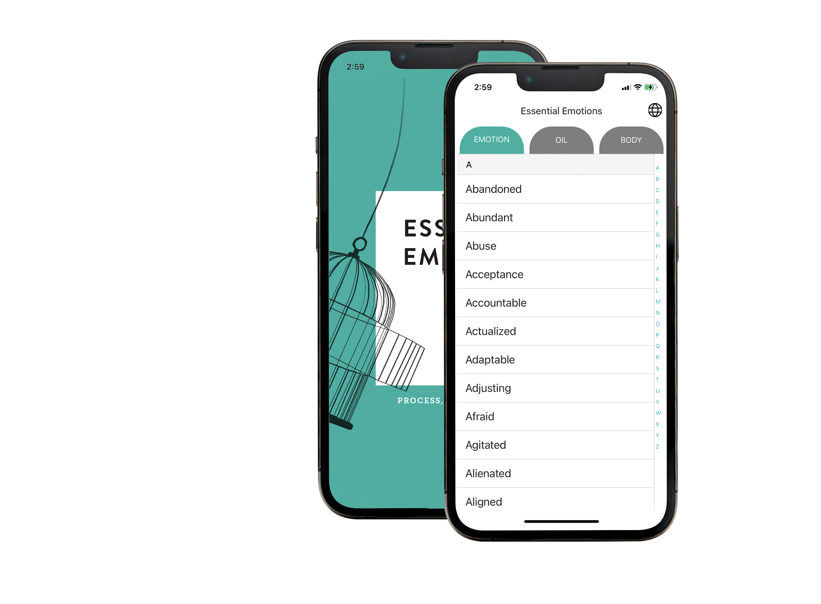
Reference app

Slide 39
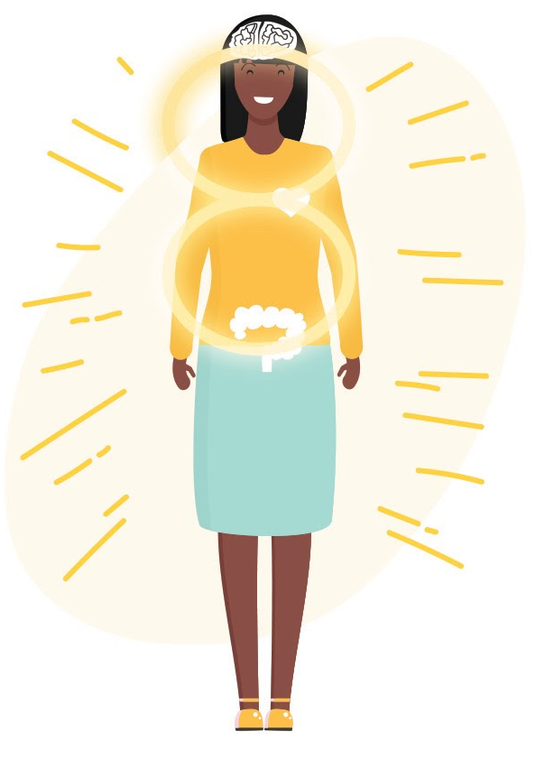
Increase Water Intake
Increase Exercise & Movement
Rest & Meditate
Improve Diet

