Slide 1
dōTERRA for Dudes
Notes:
Welcome everyone – explain that this class is not just about oils that smell manly but it’s for specific health concerns that address all men.

Slide 3
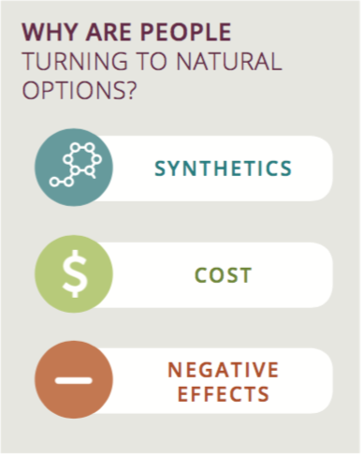

Slide 5
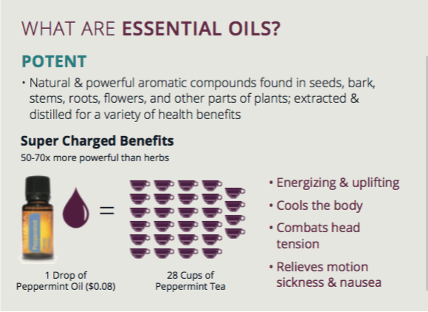
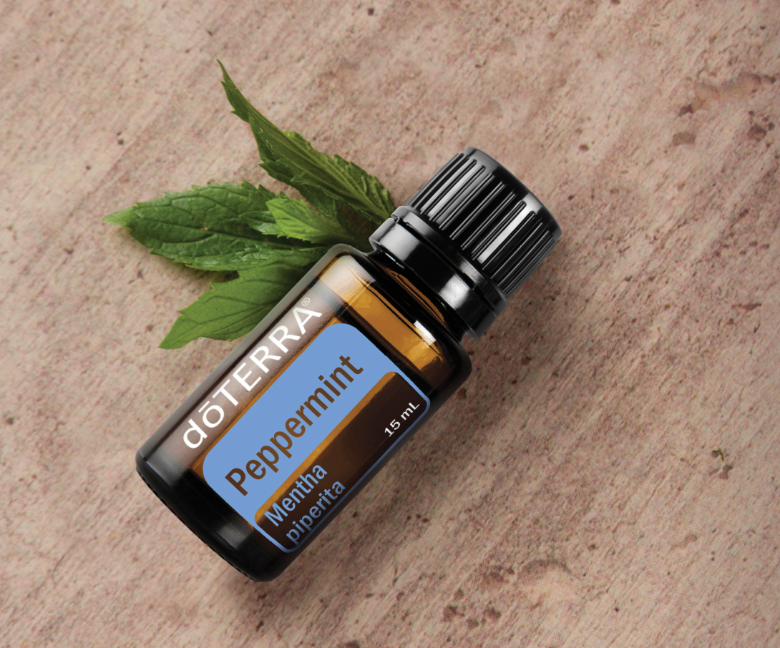

Slide 6
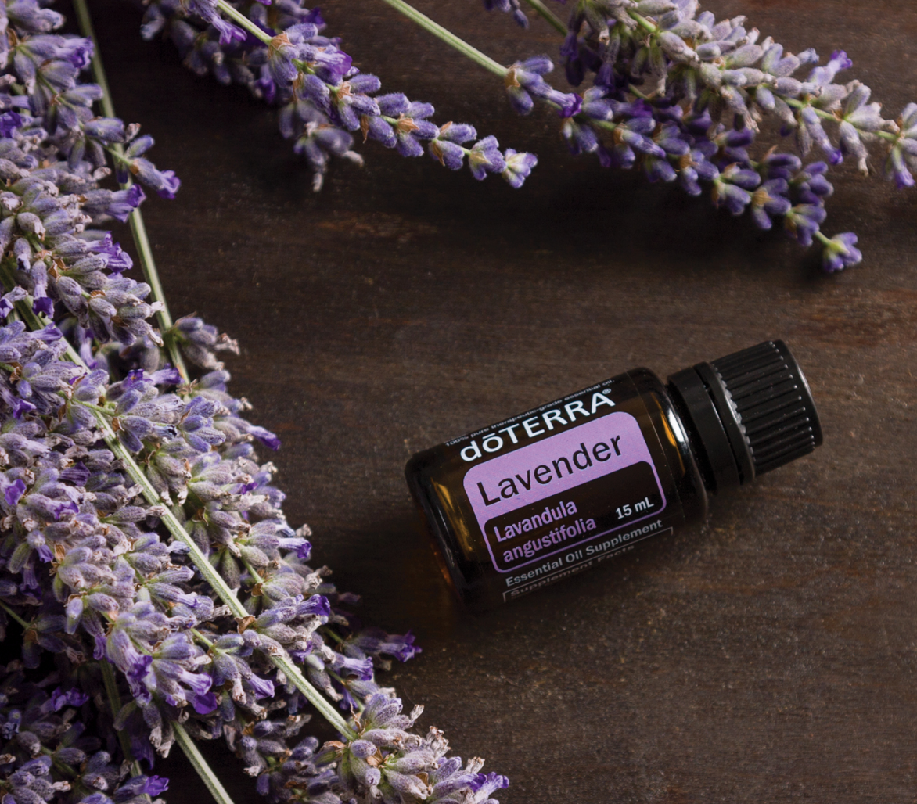

Slide 7
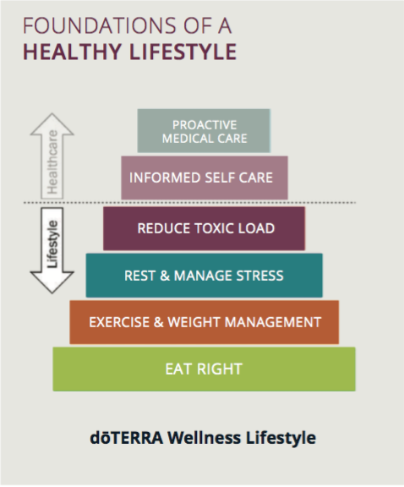

Slide 8
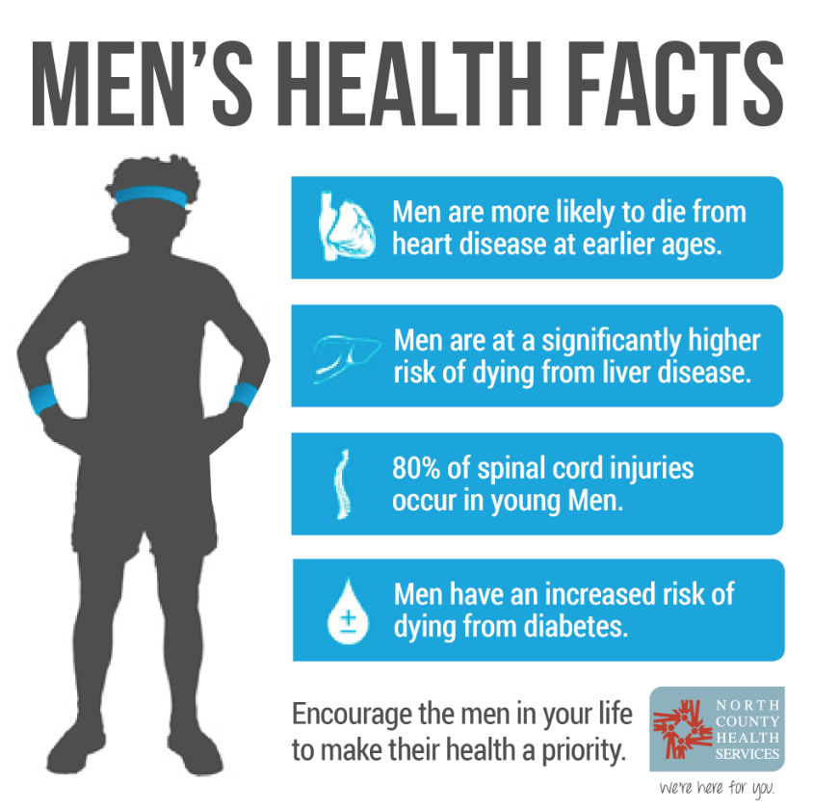
Notes:
Men and women are DIFFERENT! Which means that we need to take care of our bodies and the specific concerns for aging in different ways

Slide 9
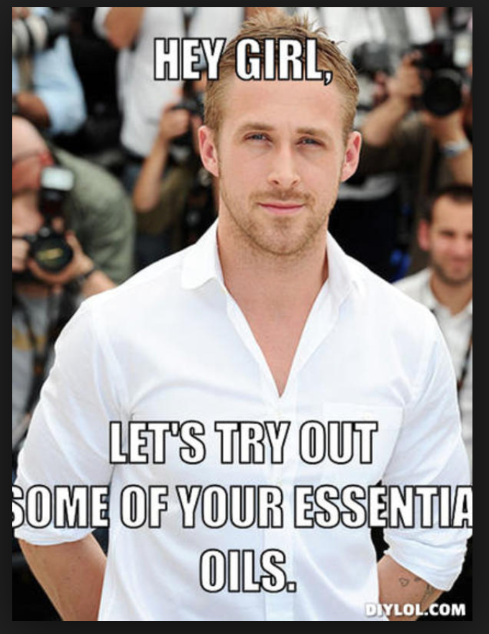
Notes:
Trust me – one of the sexiest things you can do is be open to improving your health! I promise you men, if you go home and ask about oils your wife will we thrilled and that happiness can have a ripple effect….(wink)

Slide 10
B
Notes:
Let’s focus first on heart health – because in doterra we educate you on preventative models of wellness – we don’t wait until we are at risk for a heart attack – we’ve already established that if you are a man, you are at greater risk! So let’s do things today, to improve our future and avoid the bad news or the life threatening proceedures down the road

Slide 11
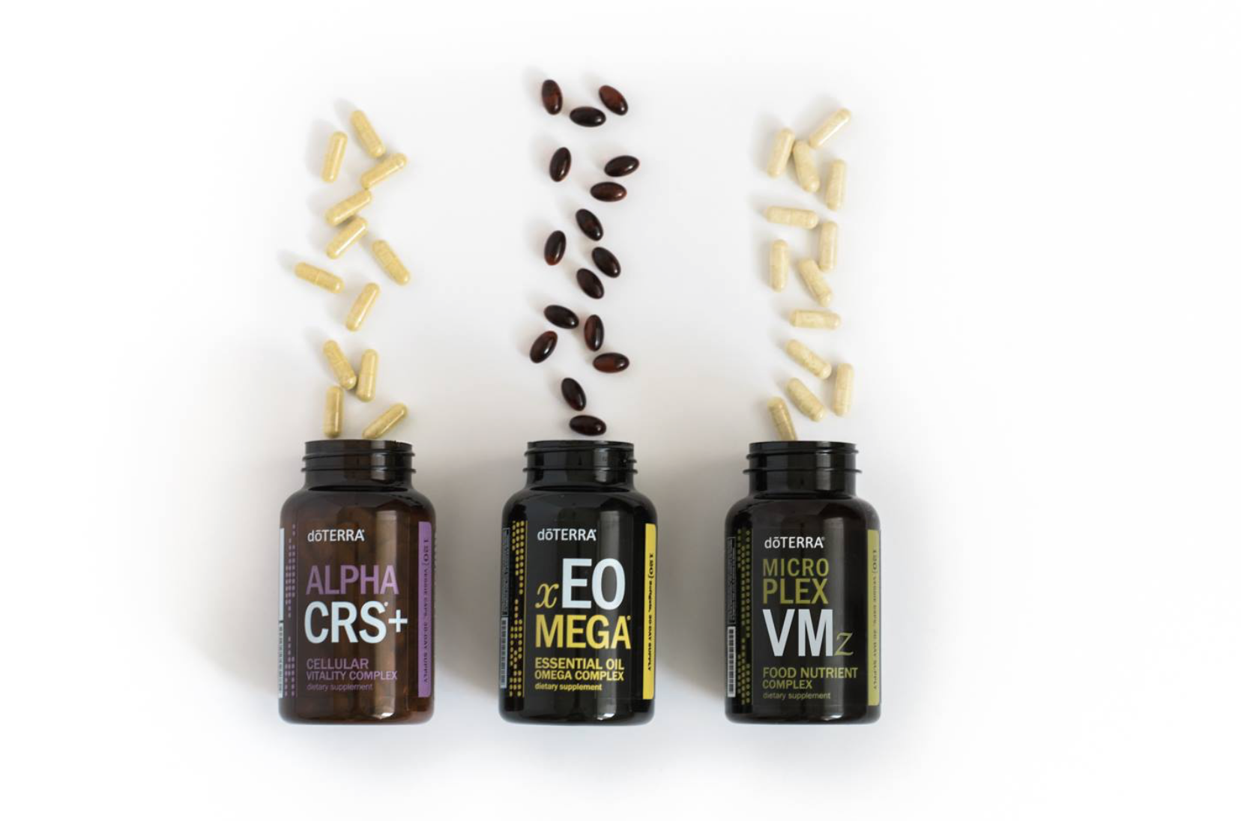
Life Long Vitalty
Notes:
Ask for testimonies from the audience. It’s called LIFE LONG VITALITY For a reason! (tell personal testimony) Highlight: Alpha CRS – powerful antioxidant support for supporting a healthy prostate. Also incredible for daily energy and stamina xEO Mega - This is the ticket for Heart health! We need omega’s to support a healthy cholesterol level, decrease the risk of stroke, reduce blood clotting, reduced inflamation AND reduces the risk the of heart disease, particular sudden cardiac death!
VMz- whole food source of vitamins and minerals our body needs to thrive!

Slide 12
B

Slide 13
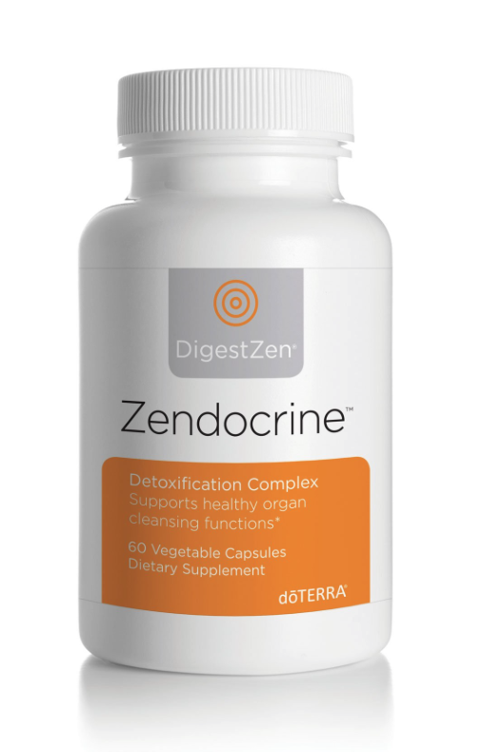
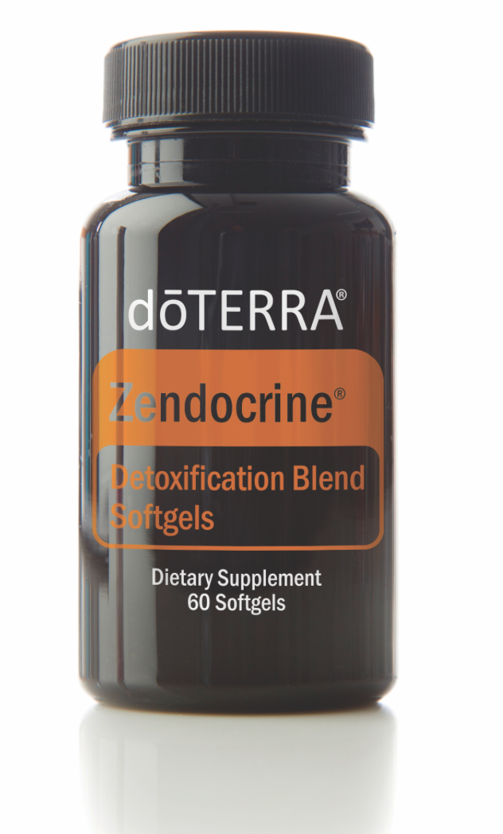
Supports Healthy Organ Cleansing (Liver, Lungs, Kidneys, Bladder)
Helps Cleanse from Free Radicals and Toxins
Notes:
Key add-on supplements for daily health – ideal after a less than desirable weekend of manly food and drink – If you drink at all or even just smoke an occassional cigar– you need to help support your cleansing organs!

Slide 14
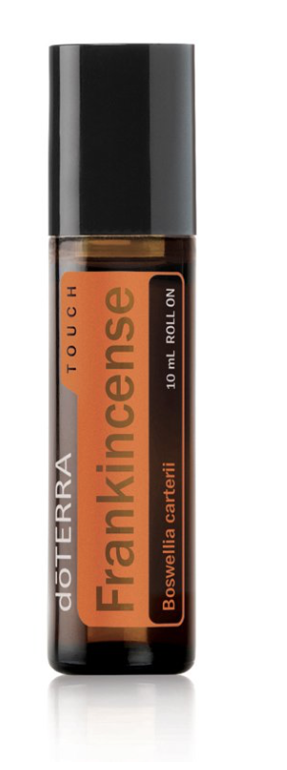
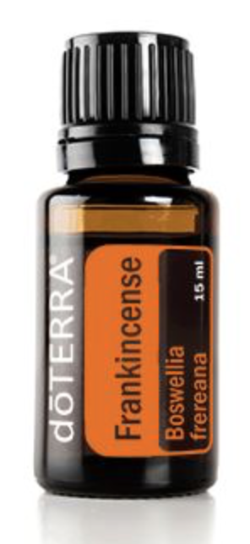
Notes:
Frank is king – this oil will do so much for men’s health! We are featuring it now because of it’s role in live support – but it is ideal to take a few drops under the tongue everyday to support the body

Slide 15
B

Slide 16
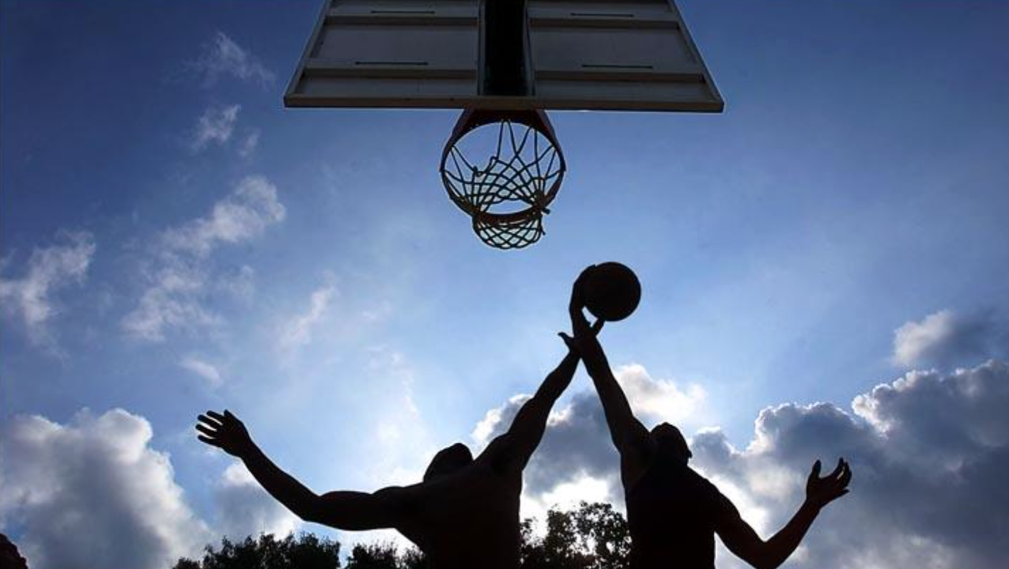
Notes:
Young men often jump right into sports without proper conditioning or warm ups – or they push their performance and cause permanent injury

Slide 17
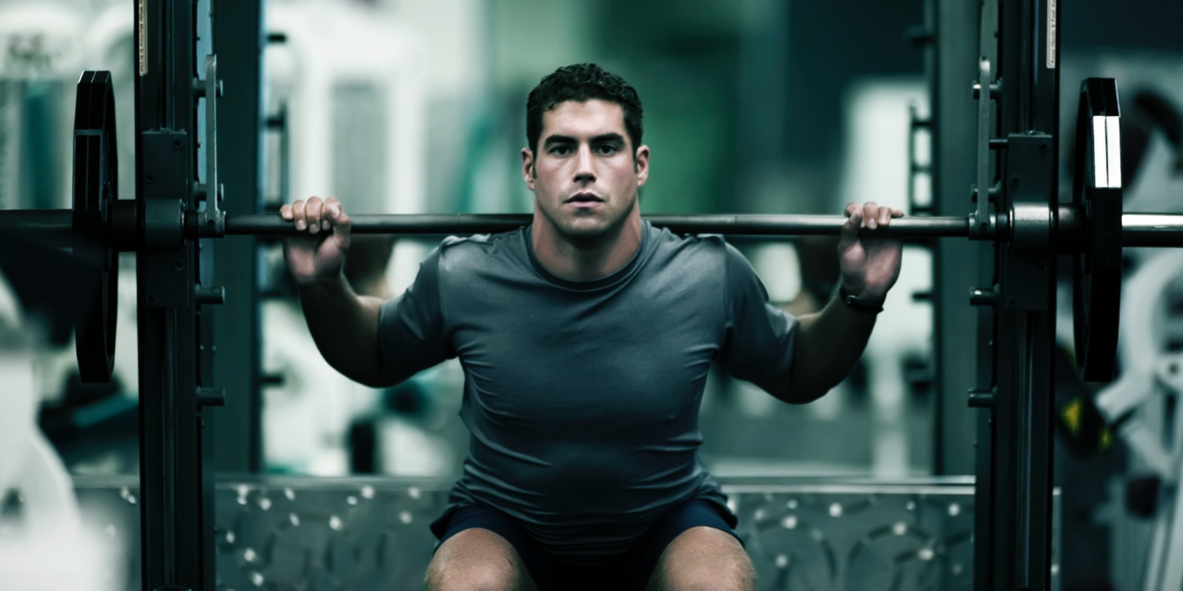
Notes:
Lifting too much with poor form can make certain muscles dominate leaving other muscles weak – which could be an injury waiting to happen.

Slide 18
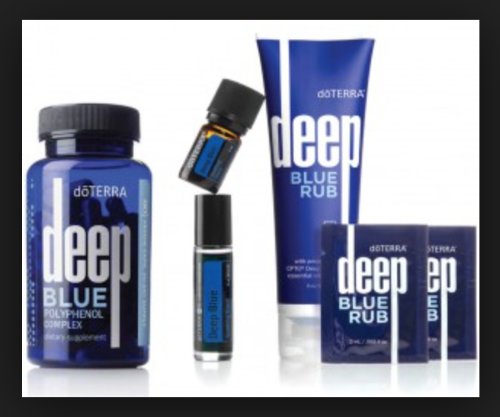
Notes:
Heavy favs for men – these products are designed to help ease discomfort in muscles and joints from a taxing job, working-out, tension, and discomfort associated with aging. Take deep blue polyphenol complex daily – apply the deep blue products as needed to areas of concern. DO not apply just before using the restroom.

Slide 19
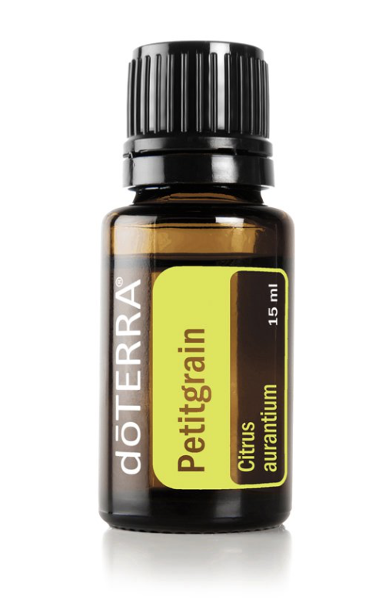
Notes:
Petitgrain is extremely calming and reduces excitability in the nervous system – apply topically to areas that need extra support (ideally make a roller, dilute with FCO and roll up and down the spine) *often called men’s lavender – very similar properties but without the feminine aroma

Slide 20
B
Notes:
LLV and slim and sassy – metabolic support!

Slide 21
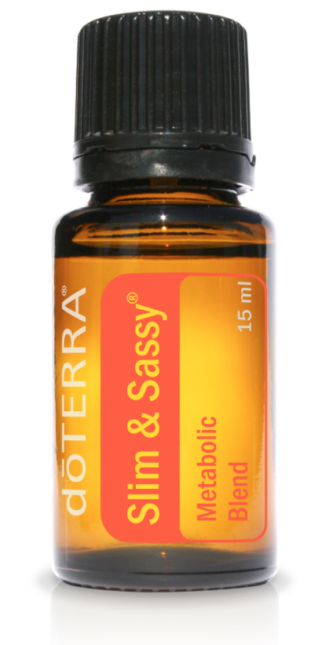
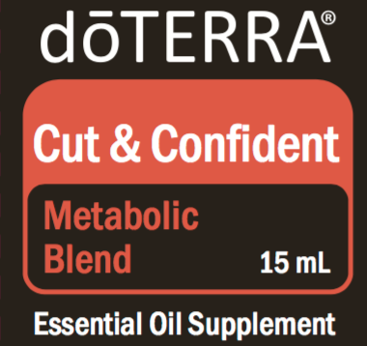
Notes:
Bottom line – sugar, processed foods, late night snacking, etc – sets you up to fail – using this product can help balance a healthy blood sugar, cut cravings, and balance your metabolism

Slide 22
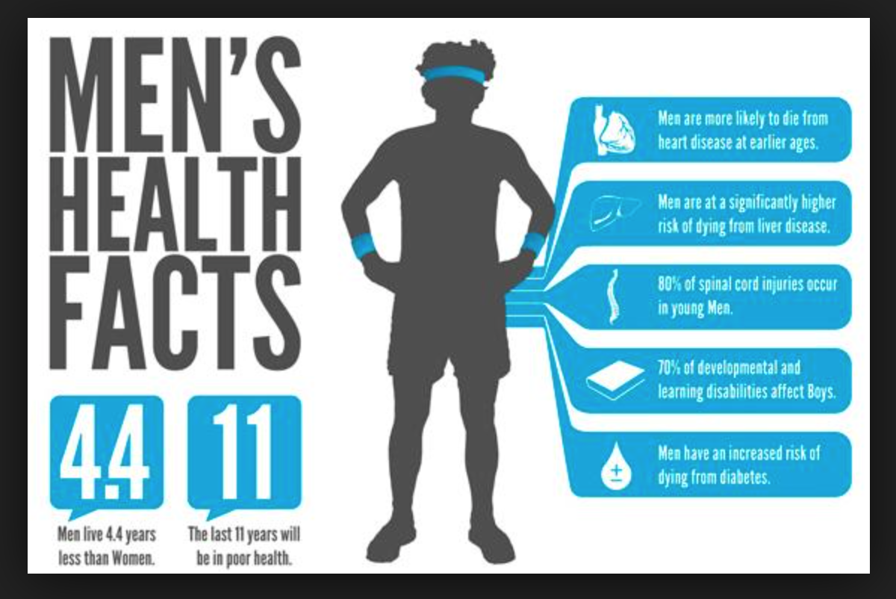
B
Notes:
Men live 4.4 years less than women Most spend the last 11 years of their life in poor health – the time to do something is now!

Slide 23
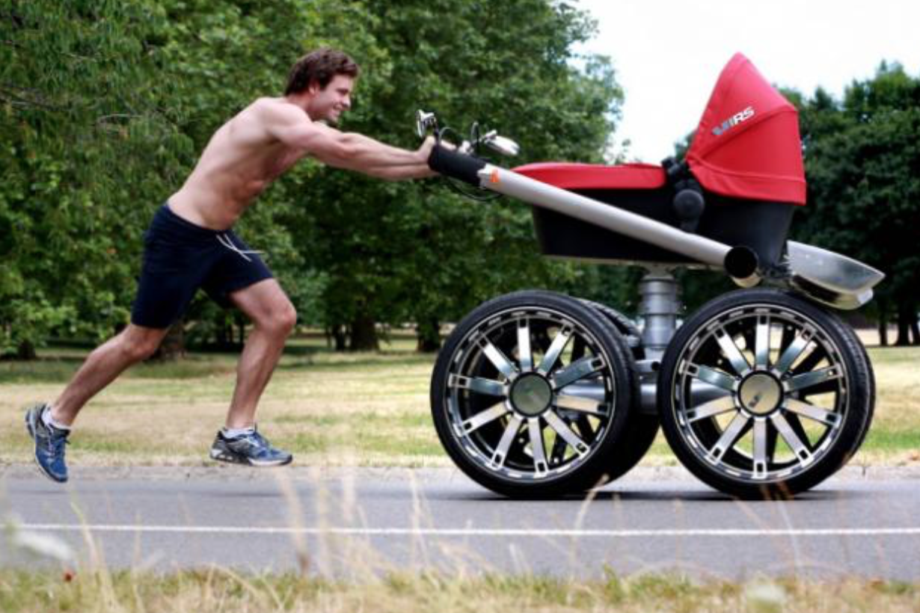
Notes:
We’d be remiss not to talk about daily life – and how oils enhance and bring a new quality to our day to day! We want you to feel amazing daily!

Slide 24
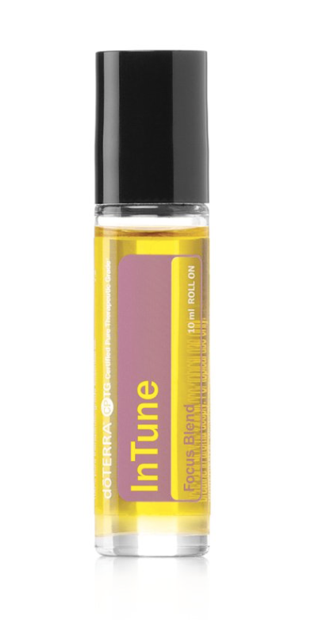
Nate’s Top Picks
Notes:
Ask if anyone sits at a desk, has trouble focusing or staying on task, etc…. Also works as a cologne.

Slide 25
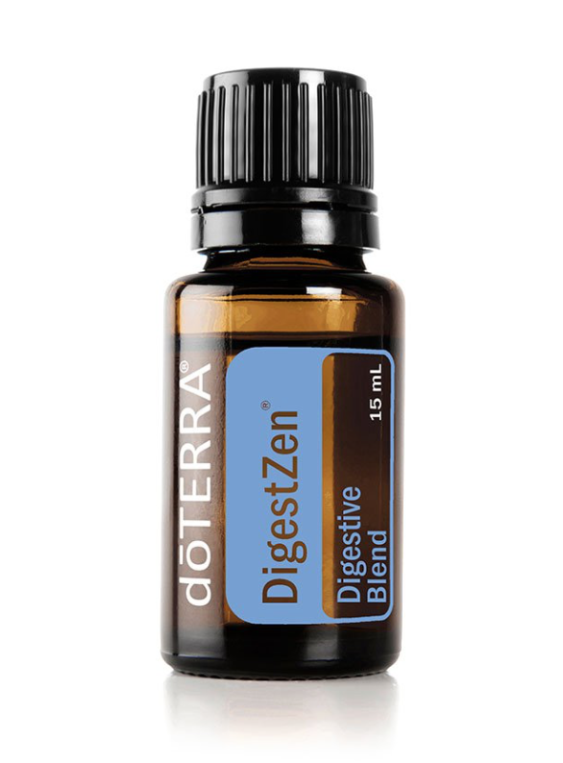
Notes:
Gas, bloating, indigestion, heart burn, reflux, etc! life saver. Marriage saver.

Slide 26
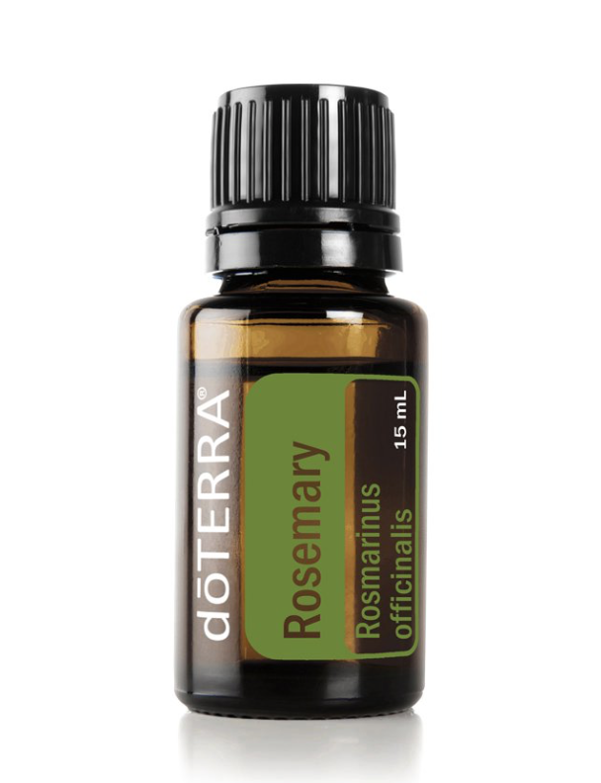
Notes:
Memory and hair loss – as well as relaxation, stress and sleep

Slide 27
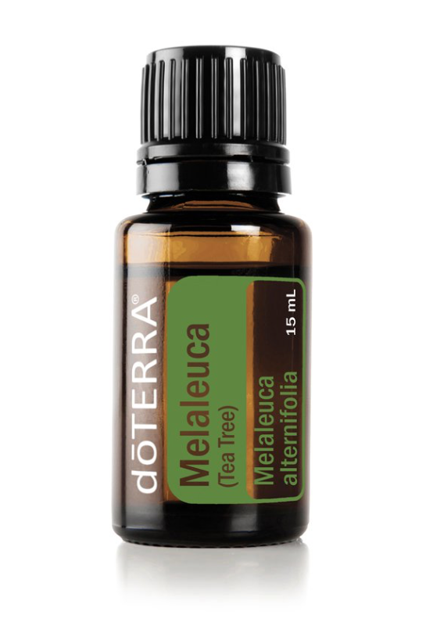
Notes:
Soothing and gentle – great for toe nail fungus and athletes foot – also razor burn

Slide 28
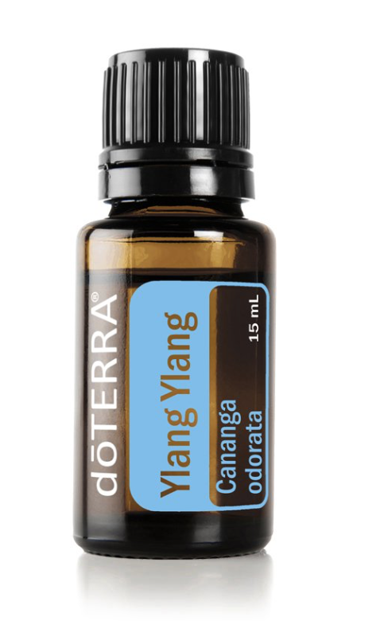
Notes:
Ylang ylang has very calming restful
Aphrodisiac & Helps with low libido and impotence
Assists with hormone imbalance

Slide 29
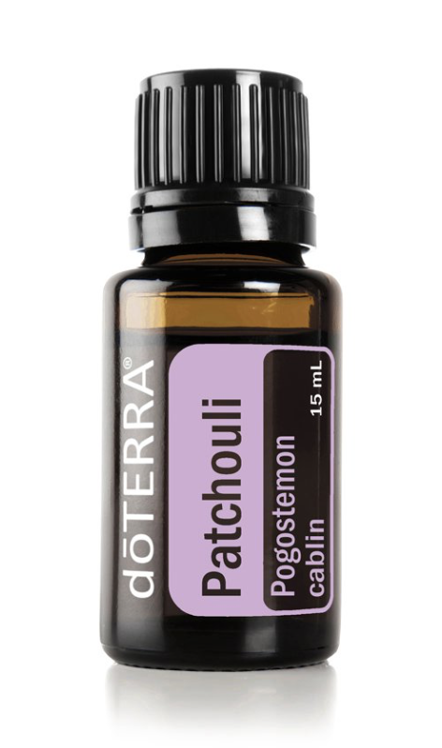
Notes:
Emotionally calming and stablzing. Degraded – enhanced
Insect Repellent
Deoderant

Slide 30
Notes:
We want the men in our lives to Thrive – not merely survive! To be the hero’s of their own stories. To be less stressed, more rested, more present, engaged and full of energy.

Slide 31
What to do next?
1. Be like Ryan Gosling – Go home and ask to talk to your significant other about oils! 2. Take your LLV daily. 3. Grab your favorite oils and put them in practical places – your night stand, by your toothbrush, at your office 4. Use them! Oils will 100% be completely ineffective if unused. 5. Save money! Order on the loyalty program and earn free stuff. It’s just smart.

Slide 32
Don’t have oils in your home?
Join today! 1. Pick a Kit (it saves you the most money!)
or
2. Pay $35 Membership and Pick Oils A La Carte

Slide 33
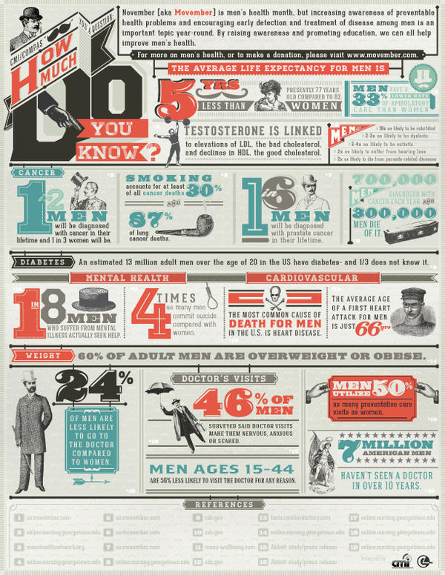
Notes:
I printed this image and handed it out at the beginning of class since our class kicked off November

