Slide 1
YEAR

Slide 6
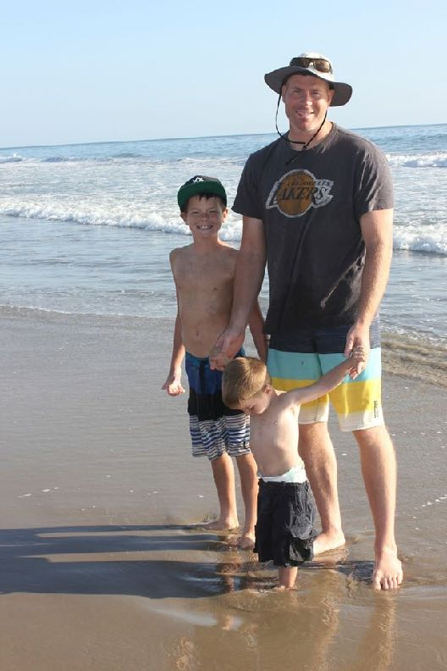
My Story
Notes:
A few years ago, I was hugely in debt. Was not leveraged at all……….meaning I was trading hours for dollars at a job. I was living paycheck to paycheck. I definitely had dreams that were going unfulfilled. I want to share with you how all of that changed, and how I was able to escape the Rat Race. And, how we can help you do it too. So, I want to show you how to not only be your own boss, but how to also harness the power of leverage.

Slide 8
Buckets…………..Or ………………….Pipeline?
Notes:
A few years ago, I was hugely in debt. Was not leveraged at all……….meaning I was trading hours for dollars at a job. I was living paycheck to paycheck. I definitely had dreams that were going unfulfilled. I want to share with you how all of that changed, and how I was able to escape the Rat Race. And, how we can help you do it too. So, I want to show you how to not only be your own boss, but how to also harness the power of leverage.

Slide 9
The 4 Ways We Make Money In America ~Robert Kiyosaki
Employee:
Trade time for money
Making other people money
EE
B
Business Owner:
Operates if you’re there, operates if you’re not
Self Employed:
A job you own and a job that owns you
If you stop, the income stops
Investor:
Take all your money and put it out in the world and it comes back as interest.
An asset that creates money.
A Residual Income
SE
I

Slide 10
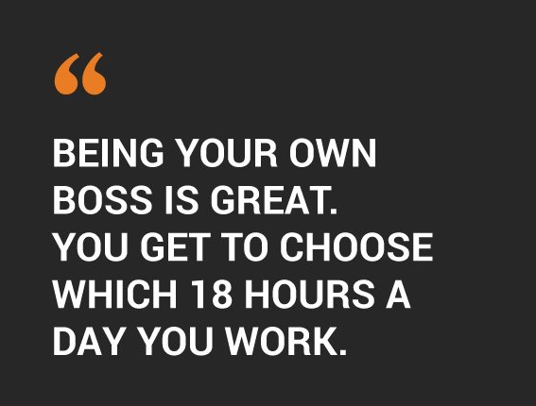
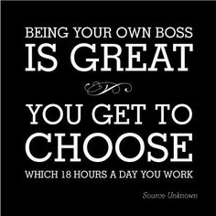

Slide 13
80% of Americans between the ages of 30 and 54 believe they will not have enough saved for retirement.
45% of Americans have saved nothing for retirement, including 40% of Baby Boomers.

Slide 17
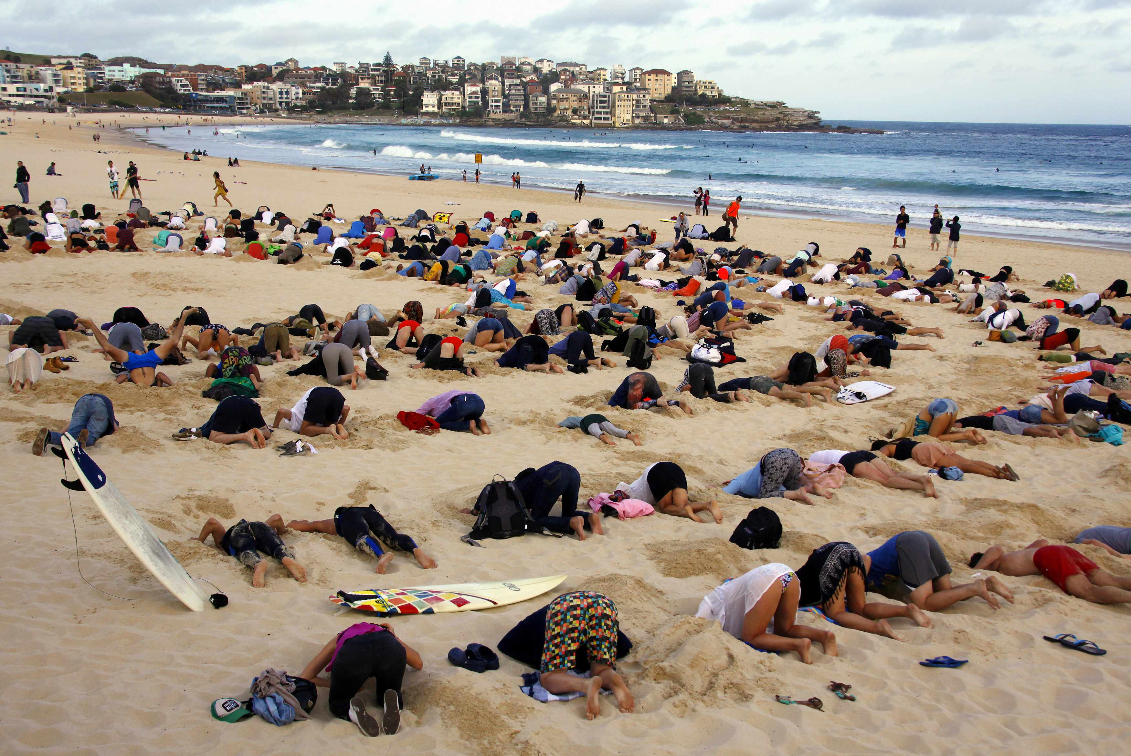

Slide 20
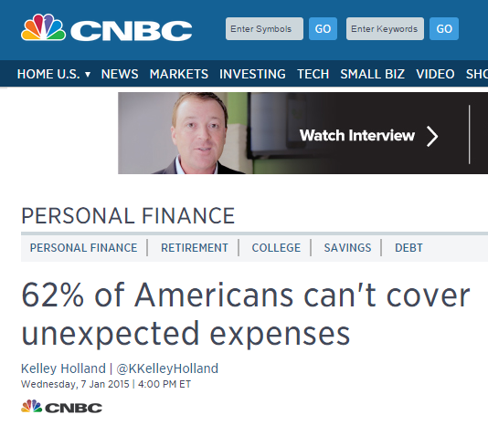

Slide 22
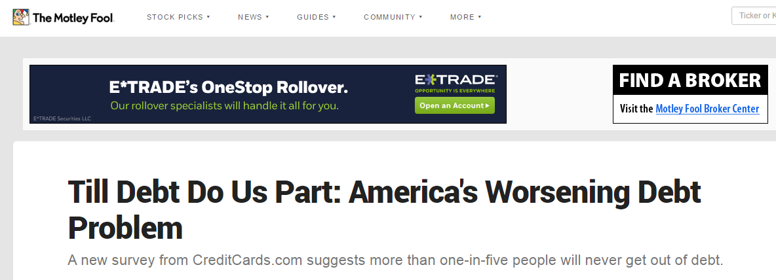

Slide 23
Did You Know?
77% of Americans live their lives paycheck to paycheck.

Slide 24
Did You Know?
40% of Americans say only $500 of extra monthly income could dramatically improve their financial situation.

Slide 25
Did You Know?
About 55 percent of Americans say their income is falling behind the cost of living, a poll from Pew Research found earlier this month.
Only 6 percent said their income is going up faster than the cost of living.

Slide 26
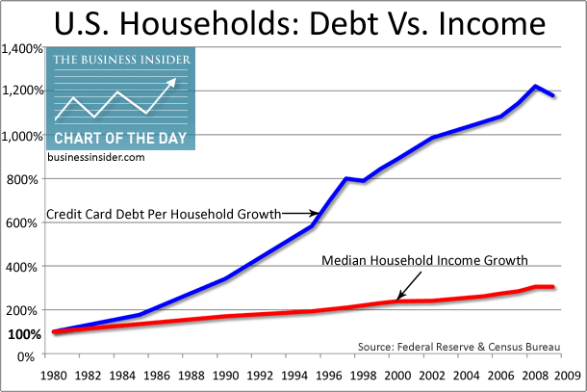
Did You Know?
$1.22 – Average amount spent by Americans for every $1 they earn.

Slide 27
Sound Familiar?
Do you know someone that has been laid off in the last 3 years?
Know anyone who has maxed out their credit cards?
Know anyone that is having a hard time paying their bills?

Slide 28
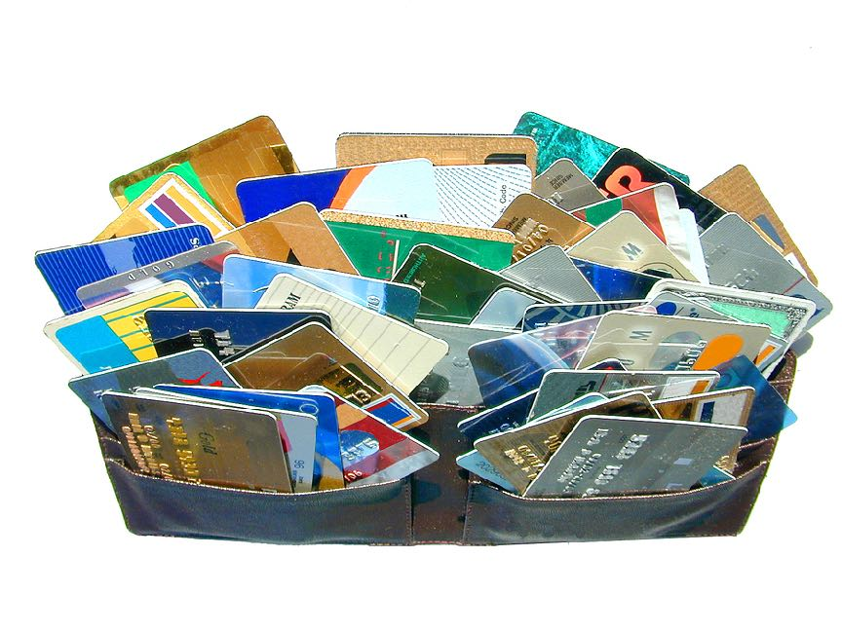
Did You Know?
The average American has $15,950 in credit card debt.
Notes:
Q: Do you know how long it would take to pay off $16,000 in credit card debt making the minimum payment, and having the interest rate at only 18%?
A: 58 years

Slide 29
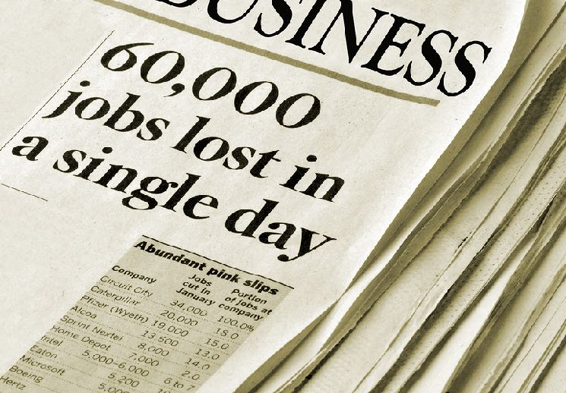
Did You Know?
500,000 jobs are being eliminated each year due to technology.
(These are jobs that are never coming back.)

Slide 30
Did You Know?
The average American has $15,950 in credit card debt.
Notes:
Q: Do you know how long it would take to pay off $8,000 in credit card debt making the minimum payment, and having the interest rate at only 18%?
A: 47 years

Slide 31
Did You Know?
The average college graduate will work 11 different jobs in 5 different careers during his life.

Slide 32
Did You Know?
62% of Americans will retire with a yearly income of less than $10,000.

Slide 33
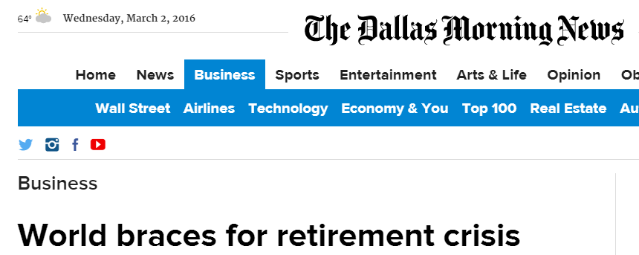
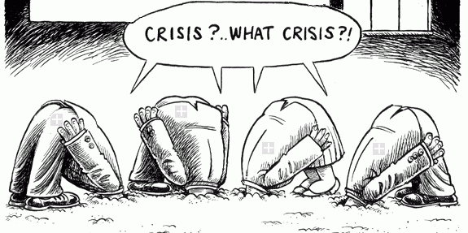

Slide 34
Retirement????
56% of Americans in a 2016 study said their checking and savings amounted to less than $1,000 combined. (Source: Forbes)

Slide 35
Did You Know?
At age 50 - 75% of population has less than $5,000 in the bank for retirement.
At age 65 – 45% of Americans depend on relatives.
30% depend on charities.
23% are still working (most can’t afford to quit).
Only 2% are self-sustaining.

Slide 36
Did You Know?
Retirement planners say anyone under the age of 40 will need at least 2 million saved up for a comfortable middle class retirement.
Do you have $2 million sitting around?
Notes:
- If you don’t have $2 million dollars saved up, and if you don’t have a “Plan B”, then what I’m about to show you is a REALLY good “Plan B”. So, pay close attention….and see if it’s right for you too.

Slide 37
Think about your own life……….
Is everything in your life exactly how you’d like it?
If money was out of the equation, would you still be working at your current job?
Would you change anything about your job, financial situation, or home life?
What financial goals are you wanting to accomplish?
Notes:
- If you don’t have $2 million dollars saved up, and if you don’t have a “Plan B”, then what I’m about to show you is a REALLY good “Plan B”. So, pay close attention….and see if it’s right for you too.

Slide 38
Think about your own life……….
How long have you been trying to “get ahead”?
What are the consequences of not solving those issues?
Notes:
- If you don’t have $2 million dollars saved up, and if you don’t have a “Plan B”, then what I’m about to show you is a REALLY good “Plan B”. So, pay close attention….and see if it’s right for you too.

Slide 39
Notes:
- If you don’t have $2 million dollars saved up, and if you don’t have a “Plan B”, then what I’m about to show you is a REALLY good “Plan B”. So, pay close attention….and see if it’s right for you too.

Slide 40
Notes:
- If you don’t have $2 million dollars saved up, and if you don’t have a “Plan B”, then what I’m about to show you is a REALLY good “Plan B”. So, pay close attention….and see if it’s right for you too.

Slide 42
The 2 Secrets To Getting Out of the Rat Race:
#1: You have to be your own boss. You aren’t going to get rich working for other people.
#2: You’ve got to employ the concept of Leverage. Working hard once and getting paid in the future for that effort.

Slide 43
Why doTERRA?
Executives have 180 years combines experience.
Debt-Free
They Will Never Go Public (This is good!)
They Will Never Sell (This is even better!)
Highest Retention Rate
One of the Fastest Growing Companies in the Industry!
The Largest Essential Oil Company in the World!
Timing!
Notes:
160 Years Combined Experience is more than any other executive team in the direct sales or network marketing industry.
They’re completely Debt-Free
Never sell – don’t have to worry about being sold to a different company with different goals
Never go public – don’t have to answer to shareholders, won’t cut corners, etc
Highest Retention Rates in the Industry
Timing of what’s been happening, and what’s happening right now, is extremely important, and very exciting.

Slide 44
Why doTERRA - Timing
There have been approximately 40,000+ Direct Sales/Network Marketing Companies.
There are only about 9 “Billion Dollar” companies (U.S.)
The fastest company to ever hit a Billion Dollars did it in 14 years.
We’re became a billion dollar company over twice as fast (only 7 years) as the fastest company that has ever done it!
Notes:
That volume and revenue is going to be there, and doTERRA will be a Billion Dollar company whether I decide to do the business or not, whether YOU decide to do the business or not. There’s no stopping it.
There are a lot of different ways to make money in this world. Some much harder to succeed in than others.
Doesn’t it make more sense to be part of something that the guess-work and risk is taken out of the equation?
Doesn’t it make sense to choose a business that your odds of success are much higher?
You don’t want to spin your wheels faster than you have to.
When analyzing, or choosing a company, or business opportunity, you absolutely need to look at this factor…..and momentum.

Slide 45
Put It In Perspective……
We’ve grown faster than Apple!
Can you imagine investing in gold when it was $40/oz?
Notes:
That volume and revenue is going to be there, and doTERRA will be a Billion Dollar company whether I decide to do the business or not, whether YOU decide to do the business or not. There’s no stopping it.
There are a lot of different ways to make money in this world. Some much harder to succeed in than others.
Doesn’t it make more sense to be part of something that the guess-work and risk is taken out of the equation?
Doesn’t it make sense to choose a business that your odds of success are much higher?
You don’t want to spin your wheels faster than you have to.
When analyzing, or choosing a company, or business opportunity, you absolutely need to look at this factor…..and momentum.

Slide 46
Why dōTERRA? - Retention
Retention Rates
Notes:
Let’s talk about one of the biggest factors to doTERRA’s growth and success.
In the direct sales and network marketing industry, Retention is calculated on a 12-month cycle. It’s how many people that are still active 12-months after they’ve joined.
The average retention in the industry is 10%. This means that if you referred 10 people……….that you would have only 1 out of those 10 that would be active after 12 months. You’re losing 90% of your customers.
With doTERRA, we have approximately 85% retention. Which means that if you referred 10 people, instead of having only 1 left after 12 months, you’d have 8 ½ instead. Remember, I said earlier you should choose an opportunity or business based on your odds of success? Well, we have the highest retention in the industry. You’re not spinning your wheels ………..having to replace people and customers faster than they’re dropping out.
This allows you to focus on your team, and to help them grow.
The #1 reason that our retention is as high as it is………..is because of the essential oils. They’re life-changing. And, we don’t even try to sell. We educate people on the benefits enough to where they want to try the oils. Then, the oils sell themselves………because the person trying the oils will have an experience. After that…………85% retention. Pretty cool.

Slide 47
What High Retention Means To You?
You Don’t Have To Be “Salesy”
The Oils Sell Themselves – You Share & Educate
You Don’t Have To Spin Your Wheels
It Allows You To Focus On Your Team
The Average Person Can Succeed! (Almost *ALL of our most successful people are NOT network marketers)
You Earn More $$$ …….Faster!

Slide 48
*Age of 50 - has $42,000 in savings
America spends $1.22 for every dollar we make
75% of those 50 & older have less than $5,000
40 Years
Go to work for someone
98%
Retiring today are dependent on SS, family, charities, or they’re still working (or dead)
G
65
2%
It’s working for
R
The Golden Years
You spend all your money to get your health back
WHEN do you plan to retire?
B
How much do you HAVE?
D
80
How much do you NEED?
You save and save your entire life.
I need $4,500/month
That’s $54,000 a year that has to be residual
Divided by interest rate of 5%
=
$1,080,000 saved up

Slide 49
So you’re working for 40 years for a 2% chance of success…
What if we can show you how to retire in 2-4 years and turn that 40 years into 4?
This quadrant is a 1:1 relationship:
1 hour for $x
It’s time for money.
Effort Based
Effort and time.
EE
B
This quadrant produces an income by creating an asset
SE
I

Slide 50
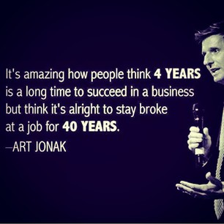
So you’re working for 40 years for a 2% chance of success…

Slide 51
doTERRA creates an asset that produces income – residual income.
We teach people how to improve their lives and their health
2 hours to invite
If those 3 do an LRP of 100 pv or more- Po3
$50
2 hours to teach
2 hours to follow up
6 hours of work
$50 a month
X 12 months
= $600
Enroll 3 people with a FPK and make $22.50 Fast Start x 3
Divided by 5%
= $12,000
That ONE class is worth $12,000!
$67.50
Now how many classes do you want to teach??

Slide 52
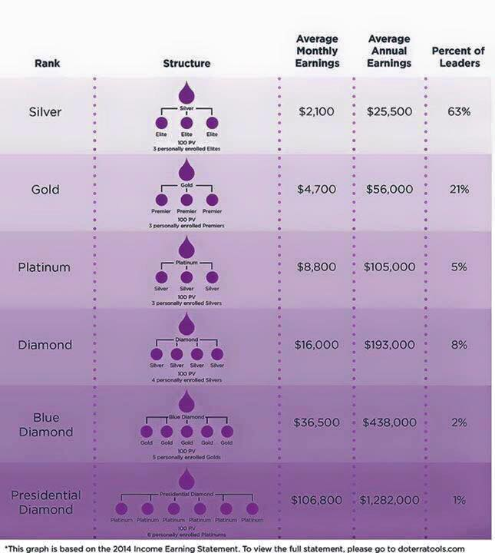
On this scale, how much would you like to earn a month?
2014
Most people will choose Gold because that is where their belief level is at.
Gold = $4,500 a month x 12 months = $54,000
Divided by .05% = $1,080,000
If it takes 30 months (2 ½ years) to get there
=
$36,000 a month that you have been investing to create that residual return

Slide 53
40 Years
98%
Retiring today are dependent on SS, family, charities, or they’re still working
G
65
Same number most people are targeting for retirement!
2%
It’s working for
R
The Golden Years
You spend all your money to get your health back
WHEN do you plan to retire?
B
How much do you HAVE?
D
80
How much do you NEED?
You save and save
I need $4,500 a month
That’s $54,000 a year that has to be residual
Divided by interest rate of 5%
=
$1,080,000 saved up

Slide 54
How much do you need to put into your retirement account each month?
2014
Annual income
$25,500 ÷ 5% = $510,000
By hitting gold in 30 months, you have just created over a million dollar asset that will pay you for the rest of your life
$56,000 ÷ 5% = $1,120,000
$105,000 ÷ 5% = $2,100,000
$193,000 ÷ 5% = $3,860,000
$438,000 ÷ 5% = $8,760,000
$1,282,000 ÷ 5% = $25,640,000

Slide 55
When you hit Gold in 30 months ($4,500 a month income), that’s equivalent to Doterra putting $36,000 a MONTH into your retirement count for 30 months!!............... and then turning on an income stream for how long?
Let’s dream a little bit….. Maybe to Blue Diamond, and you’re on the lower scale of $30,000 a month x 12 months = $360,000 ÷ .05% = 7,200,000 ÷ 48 months to get to Blue Diamond
=
$150,000/month
That you would have to save up…..for 48 straight months!!

Slide 58
Spend time with your kids
Bring your spouse home
Have peace of mind
Build a legacy
Share your success with others
Build long term financial security
Be able to quit your job
Help people find a whole new way of life
Get out of debt
Be able to retire
Own your home free and clear
Travel the World
Have true freedom in your life
Do what you want when you want

Slide 61
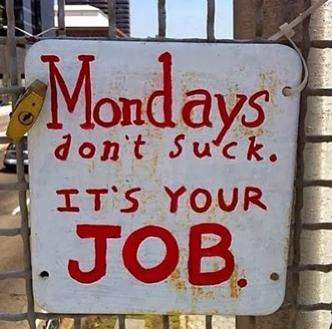

Slide 63
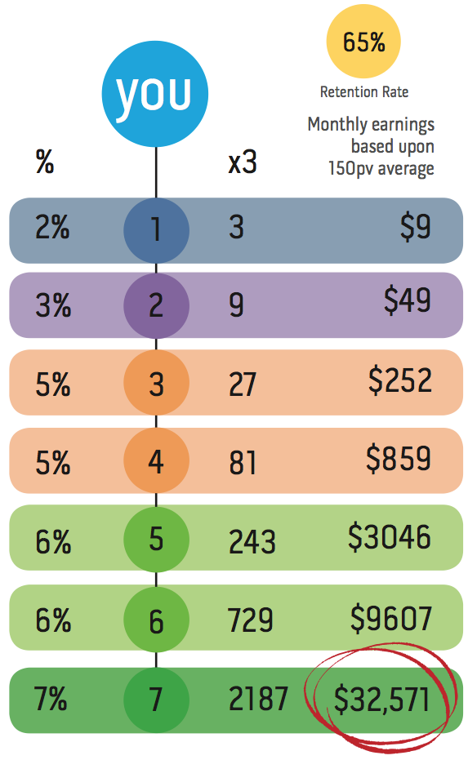
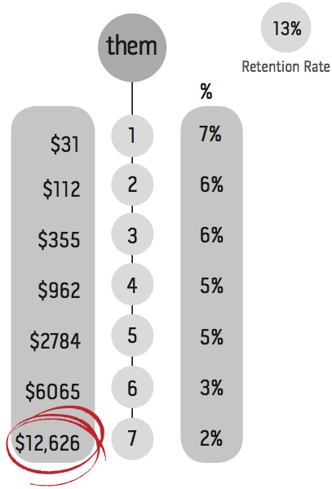

Slide 64
Corporate World (J.O.B.) VS. doTERRA
Instead of Stepping on Each Other, We Get Rewarded for Helping Others Succeed!
Instead of Only 1 Person at the Top, We Can Have Unlimited People at the Highest Rank.
No Commute
Don’t Need to Ask For Time-Off or Vacation
Leverage – Not Trading “Hours for Dollars”
You Get Constant Pay Raises!

Slide 65
Starting Your Own Biz VS. doTERRA
Low Overhead/Expenses
Risk is Taken Out of the Equation (doTERRA is Proven)
Return on Investment
No Employees to Pay
No Products/Inventory to Stock
You Don’t Have to Wear All the Hats
Leverage – Not Trading “Hours for Dollars”

Slide 66
2015 Average Earnings (annual)
Silver
Gold
Platinum
Diamond
Blue Diamond
Presidential Diamond
$26,600
$59,000
$115,000
$205,000
$462,000
$1,353,000

Slide 67
Value = $12,000 invested in an account earning 5%.
Time it took to build = 3 Months
$4000 per month

Slide 68
Value = $60,000 invested in an account earning 5%.
Time it took to build = 6 Months
$10,000 per month

Slide 69
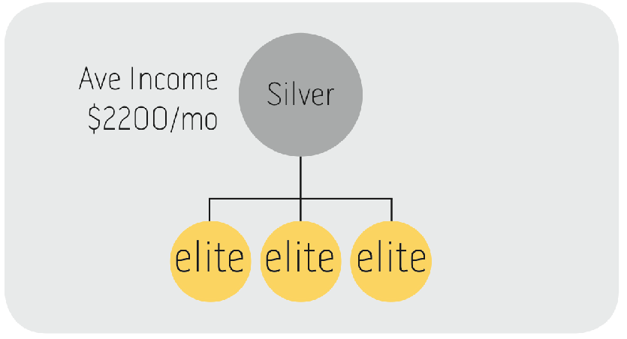
Value = $528,000 invested in an account earning 5%.
Time it took to build = 1 Year
$44,000 per month

Slide 70
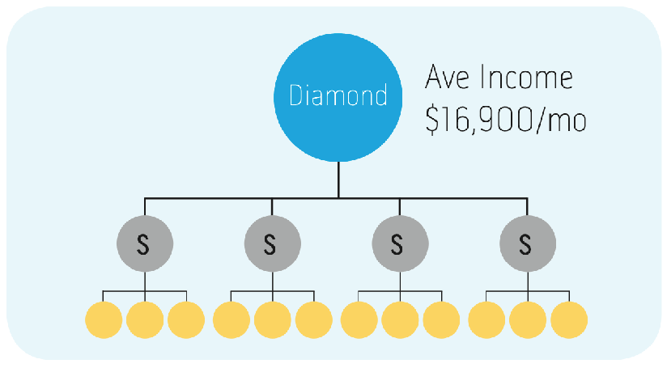
Value = $4,056,000 invested in an account earning 5%.
Time it took to build = 4 Year
$84,000 per month

Slide 71
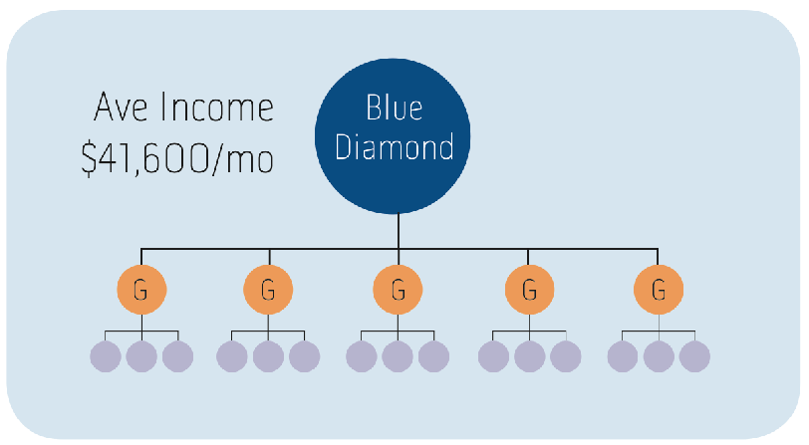
Value = $9,984,000 invested in an account earning 5%.
Time it took to build = 6 Year
$138,000 per month

Slide 72
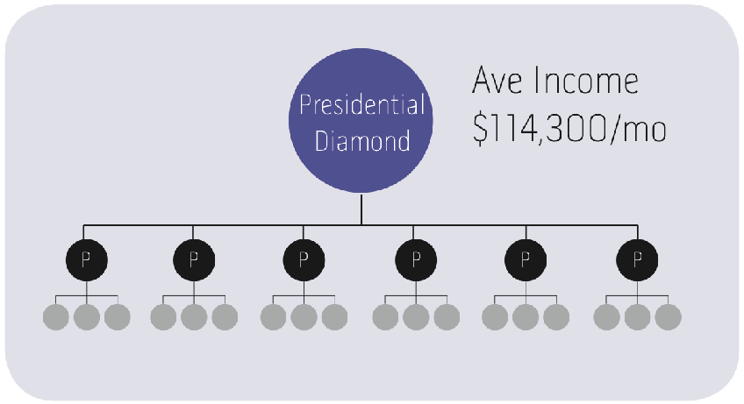
Value = $27,432,000 invested in an account earning 5%.
Time it took to build = 10 Year
$229,000 per month

Slide 73
What Are My Options?
Some people just want to earn free essential oils.
$200-$500/mo
A lot of people want to supplement their income.
$1,000-$3,000/mo
Most people want to completely replace their income
$4,000-10,000+/mo
You decide which option………if any. If you still have more questions, get them answered first, so you can make an educated decision.

Slide 74
Get Your Oils for Free
If you just want your oils paid for:
Commit to about 1-2 hours a week.
100 pv/mo = approx $100/mo
Refer just a handful of people, and in a short period of time, you’ll usually earn enough to cover the cost of your oils every month.
Have the “Modern Essentials” book

Slide 75
Supplement Your Income $1k-3k/mo
Order Enrollment Kit (lots of options)
Have the “Modern Essentials” book
Commit to about 4-5 hours a week.
150 pv/mo = approx $150/mo
Written Goals
Order Business Cards
Events/Training
Commit for at least 6 months

Slide 76
Replace Your Income $4k-10k+/mo
Order Enrollment Kit (lots of options)
Have the “Modern Essentials” book
Commit to 7-10 hours a week.
150 pv/mo = approx $150/mo
Written Goals
Order Business Cards
Events/Training
Commit for at least 12 months

Slide 77
Why Others Fail!
Products That Don’t Work
Retention is Low
No System
Lack of Training/Tools
Not Following Proven, Successful Leaders
No Team Concept
Too Many Qualifications
Takes Too Long to Make $$$
Other Companies Require HUGE Time Commitment

Slide 78
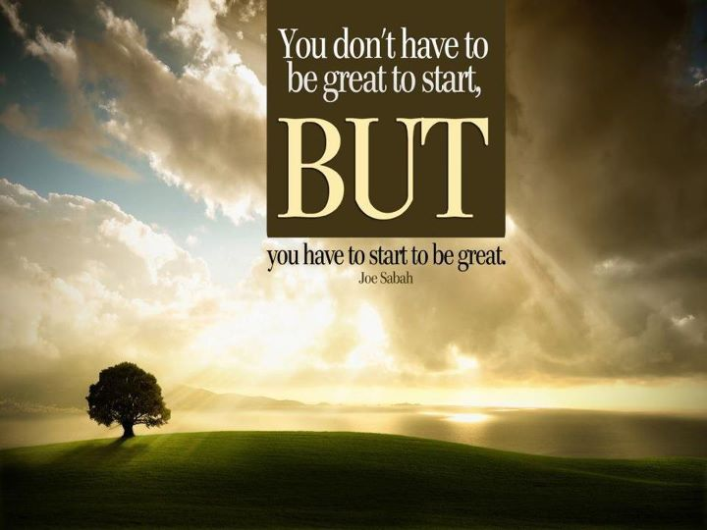
Notes:
Products that don’t work – Our products work!

Slide 79
Notes:
Products that don’t work – Our products work!

