Slide 1
Empowered
Natural Living

Slide 2
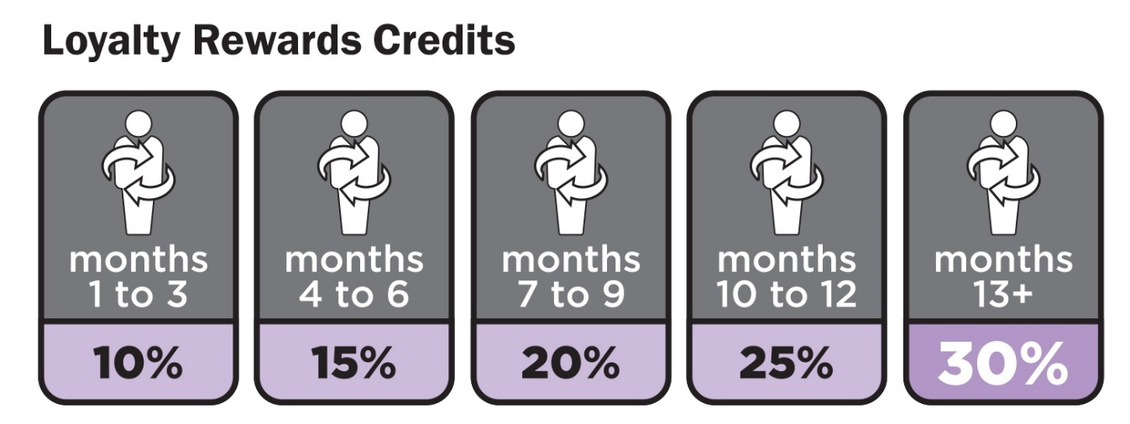
Loyalty Rewards Program
Do you like free product?
dōTERRA rewards you for ordering regularly
Loyalty Rewards is similar to a frequent flyer program
Choose different products each month
Cancel anytime by contacting member services
Notes:
dōTERRA has a loyalty program that rewards individuals for ordering regularly. It’s similar to a frequent flyer or cash back program where you earn points for purchases that can then be redeemed for free product. The percentage of points you receive is based on the months you’ve consecutively ordered. Individuals usually begin at 10% and work their way up to 30% although there is a way to fast-track your percentage. You may choose different products each month for your loyalty order, and you can cancel at anytime without penalty by contacting dōTERRA member services.

Slide 3
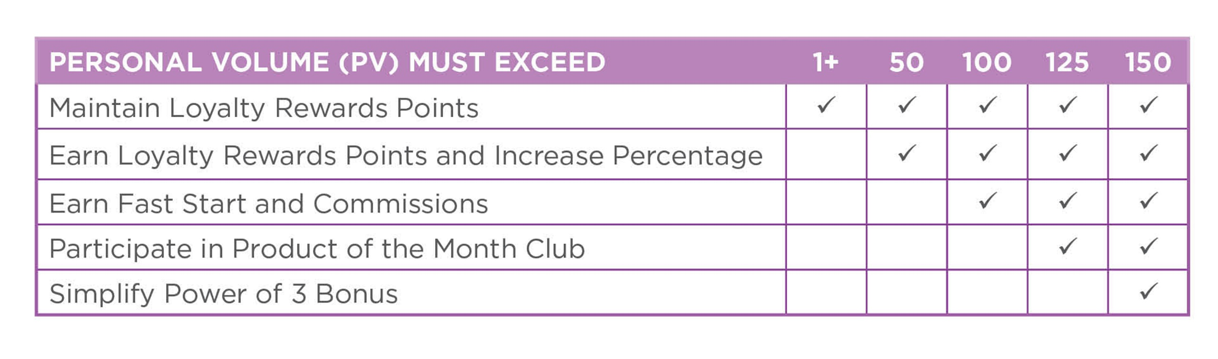
Loyalty Rewards Program Tips
Notes:
Each product is assigned a PV amount. When looking at oils this is usually equal to the price of the item, however, wellness products usually have a PV that is slightly lower. The PV can be found in the column next to the price as you place your order or below the price on the product page.
To maintain your loyalty points, your monthly order simply needs to be 1PV or higher.
To earn points and increase your percentage, your loyalty order must be 50PV.
To earn Fast Start and Commission, your order must be 100PV.
To join the Product of the Month Club, your order must be 125PV.
To simplify your Power of 3 Bonus, your order should be 150PV.

Slide 4
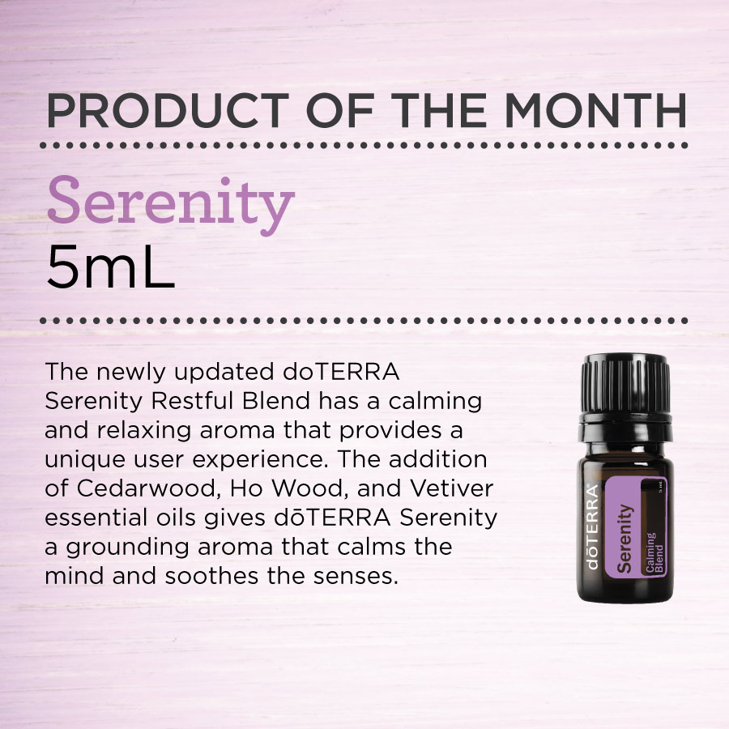
Product of the Month
How do I qualify?
Loyalty Rewards order must be 125PV or higher
Loyalty Rewards order placed before the 15th of the month.
Notes:
Each month dōTERRA will announce a new product of the month. To receive the product of the month individuals need to have a 125PV loyalty order that processes before the 15th of the month.

Slide 5
Little Shifts = Big Impact
Month 1 Menu
Notes:
A small shift in how you order will allow you to focus on your families wellness while creating a big impact in the rewards you earn.

Slide 6
Month 1 Overview
125Pv LRP Recommendation
Lavender
Lemon
Peppermint
Lemongrass
DigestZen TerraZyme®
PB Assist+®
Product of the Month
5mL dōTERRA Serenity®

Slide 7
Month 1 Overview
200Pv LRP Recommendation
Lavender
Lemon
Peppermint
Lemongrass
DigestZen TerraZyme®
PB Assist+®
Zendocrine®
DDR Prime®
Product of the Month
5mL dōTERRA Serenity®

Slide 8
Lavender
A must-have oil to keep on hand at all times due to its versatile uses, including calming and relaxing properties that promote peaceful sleep and ease feelings of tension.*
Primary Benefits
Soothes occasional skin irritations
Taken internally, Lavender reduces anxious feelings and promotes peaceful sleep*
Helps ease feelings of tension.*
*These statements have not been evaluated by the Food and Drug Administration. This product is not intended to diagnose, treat, cure, or prevent any disease.
Notes:
Lavender has been used and cherished for centuries for its unmistakable aroma and myriad benefits. In ancient times, the Egyptians and Romans used Lavender for bathing, relaxation, cooking, and as a perfume; it is widely used for its calming and relaxing qualities which continue to be Lavender’s most notable qualities. Lavender is frequently used to reduce the appearance of skin imperfections. Add to bath water to soak away stress or apply to the temples and the back of the neck. Add a few drops of Lavender to pillows, bedding, or bottoms of feet to promote a restful night’s sleep. Due to Lavender’s versatile properties, it is considered the must-have oil to have on hand at all times.
Uses:
Add a few drops of Lavender to pillows, bedding, or bottoms of feet at bedtime.
Keep a bottle of Lavender on hand to soothe occasional skin irritations.
Freshen your linen closet, mattress, car, or the air by combining Lavender with water in a spray bottle.
Take internally to reduce anxious feelings.*
Use in cooking to soften citrus flavors and add a flavorful twist to marinades, baked goods, and desserts.
*These statements have not been evaluated by the Food and Drug Administration. This product is not intended to diagnose, treat, cure, or prevent any disease.

Slide 9
Lemon
The cleansing, purifying, and invigorating properties of Lemon make it one of the most versatile oils, not to mention the top-selling essential oil that dōTERRA® offers.
Primary Benefits
Cleanses and purifies the air and surfaces
Naturally cleanses the body and aids in digestion*
Supports healthy respiratory function*
Promotes a positive mood
*These statements have not been evaluated by the Food and Drug Administration. This product is not intended to diagnose, treat, cure, or prevent any disease.
Notes:
The top-selling doTERRA essential oil, Lemon has multiple benefits and uses. Lemon is a powerful cleansing agent that purifies the air and surfaces, and can be used as a non-toxic cleaner throughout the home. When added to water, Lemon provides a refreshing and healthy boost throughout the day. Lemon is frequently added to food to enhance the flavor of desserts and main dishes. Taken internally, Lemon provides cleansing and digestive benefits and supports healthy respiratory function.* When diffused, Lemon is very uplifting and energizing and has been shown to help improve mood.
Uses:
Take internally to assist with seasonal respiratory discomfort.*
Add Lemon oil to a spray bottle of water to clean tables, countertops, and other surfaces. Lemon oil also makes a great furniture polish; simply add a few drops to olive oil to clean, protect, and shine wood finishes.
Use a cloth soaked in Lemon oil to preserve and protect your leather furniture and other leather surfaces or garments.
Lemon oil is a great remedy for the early stages of tarnish on silver and other metals.
Diffuse to create an uplifting environment.
Directions for Use:
Diffusion: Use three to four drops in the diffuser of your choice.
Internal use: Dilute one drop in 4 fl. oz. of liquid.
Topical use: Apply one to two drops to desired area. Dilute with doTERRA Fractionated Coconut Oil to minimize any skin sensitivity.
Cautions:
Possible skin sensitivity. Keep out of reach of children. If you are pregnant, nursing, or under a doctor’s care, consult your physician. Avoid contact with eyes, inner ears, and sensitive areas. Avoid sunlight or UV rays for up to 12 hours after applying product.
Statements with asterisks refer to internal use. All others refer to aromatic or topical use.

Slide 10
Peppermint
The high menthol content of the dōTERRA® Peppermint essential oil sets it apart from others when it comes to quality—making it one of the best-selling favorites among dōTERRA® essential oils.
Primary Benefits
Promotes healthy respiratory function and clear breathing*
Promotes digestive health*
Repels bugs naturally
*These statements have not been evaluated by the Food and Drug Administration. This product is not intended to diagnose, treat, cure, or prevent any disease.
Notes:
The peppermint plant is a hybrid of watermint and spearmint and was first described by Carl Linneaus in 1753. A high menthol content—like that found in the doTERRA Peppermint essential oil—distinguishes the best quality Peppermint from other products. Frequently used in toothpaste and chewing gum for oral hygiene, Peppermint also helps alleviate occasional stomach upset and promotes healthy respiratory function.* Peppermint continues to be one of the best-selling favorites among doTERRA essential oils.
Uses:
Use a drop of Peppermint with Lemon in water for a healthy, refreshing mouth rinse.
Take one to two drops in a Veggie Capsule to alleviate occasional stomach upset.*
Add two to three drops to your favorite smoothie recipe for a refreshing twist.
Place one drop in palm of hand with one drop Wild Orange and one drop Frankincense and inhale for a mid-day pick-me-up.
Directions for Use:
Diffusion: Use three to four drops in the diffuser of your choice.
Internal use: Dilute one drop in 4 fl. oz. of liquid.
Topical use: Apply one to two drops to desired area. Dilute with doTERRA Fractionated Coconut Oil to minimize any skin sensitivity
Cautions:
Possible skin sensitivity. Keep out of reach of children. If you are pregnant, nursing, or under a doctor’s care, consult your physician. Avoid contact with eyes, inner ears, and sensitive areas.
Statements with asterisks refer to internal use. All others refer to aromatic or topical use.

Slide 11
Lemongrass
A favorite oil for massages, Lemongrass provides a pungent, smoky aroma, and offers purifying and toning benefits for the skin.
Primary Benefits
Supports healthy digestion when taken in a capsule*
Combine with a carrier oil for soothing massage
Apply diluted after a long run for a refreshing feeling
*These statements have not been evaluated by the Food and Drug Administration. This product is not intended to diagnose, treat, cure, or prevent any disease.
Notes:
A tall, perennial plant, Lemongrass has a subtle citrus flavor and is used in Asian cuisine in soups, teas, and curries as well as with fish, poultry, beef, and seafood. In addition to its unique flavor, Lemongrass essential oil promotes healthy digestion and acts as an overall tonic to the body’s systems.* It’s also purifying and toning to the skin, and is frequently used in skin care products for these benefits. Lemongrass is an ideal oil to use in massage therapy. Lemongrass has a pungent, herbaceous aroma that can heighten awareness and promote a positive outlook.
Uses
Combine equal parts Fractionated Coconut Oil and Lemongrass oil for a massage after a hard workout.
Use to flavor entrées and meat dishes while promoting healthy digestion.*
Blends well with Basil, Cardamom, or Spearmint.
Dilute oil, then rub or spritz on skin before going outside.
Lemongrass essential oil naturally repels insects.
Directions for Use
Diffusion: Use three to four drops in the diffuser of your choice.
Internal use: Dilute one drop in 4 fl. oz. of liquid.
Topical use: Apply one to two drops to desired area. Dilute with doTERRA Fractionated Coconut Oil to minimize any skin sensitivity.
Cautions:
Possible skin sensitivity. Keep out of reach of children. If you are pregnant, nursing, or under a doctor’s care, consult your physician. Avoid contact with eyes, inner ears, and sensitive areas.

Slide 12
Zendocrine®
Zendocrine® essential oil blend supports the body’s natural ability to rid itself of unwanted substances.*
Primary Benefits
Supports the body’s natural ability to rid itself of unwanted substances*
Supports healthy liver function*
Purifying and detoxifying to the body’s systems*
*These statements have not been evaluated by the Food and Drug Administration. This product is not intended to diagnose, treat, cure, or prevent any disease.
Notes:
Zendocrine essential oil blend supports the body’s natural ability to rid itself of unwanted substances.* It supports the healthy cleansing and filtering functions of the liver, kidneys, colon, lungs, and skin.* This powerful blend combines Rosemary, Cilantro, and Juniper Berry, known for their detoxifying properties and ability to support healthy liver function, while Tangerine and Geranium have purifying effects against unhealthy substances.* Zendocrine helps cleanse the body of toxins and free radicals that can slow the body’s systems down, leaving a heavy, weighted feeling.*
Uses:
Add 1–2 drops to citrus drinks, teas, or water to support healthy liver function.*
Take one drop daily for one week as part of an internal cleansing regimen or to kick-start a New Year’s Resolution.*
Directions for Use:
Diffusion: Use three to four drops in the diffuser of your choice.
Internal use: Dilute one drop in 4 fl. oz. of liquid.
Topical use: Apply one to two drops to desired area. Dilute with doTERRA Fractionated Coconut Oil to minimize any skin sensitivity.
Cautions:
Possible skin sensitivity. Keep out of reach of children. If you are pregnant, nursing, or under a doctor’s care, consult your physician. Avoid contact with eyes, inner ears, and sensitive areas.

Slide 13
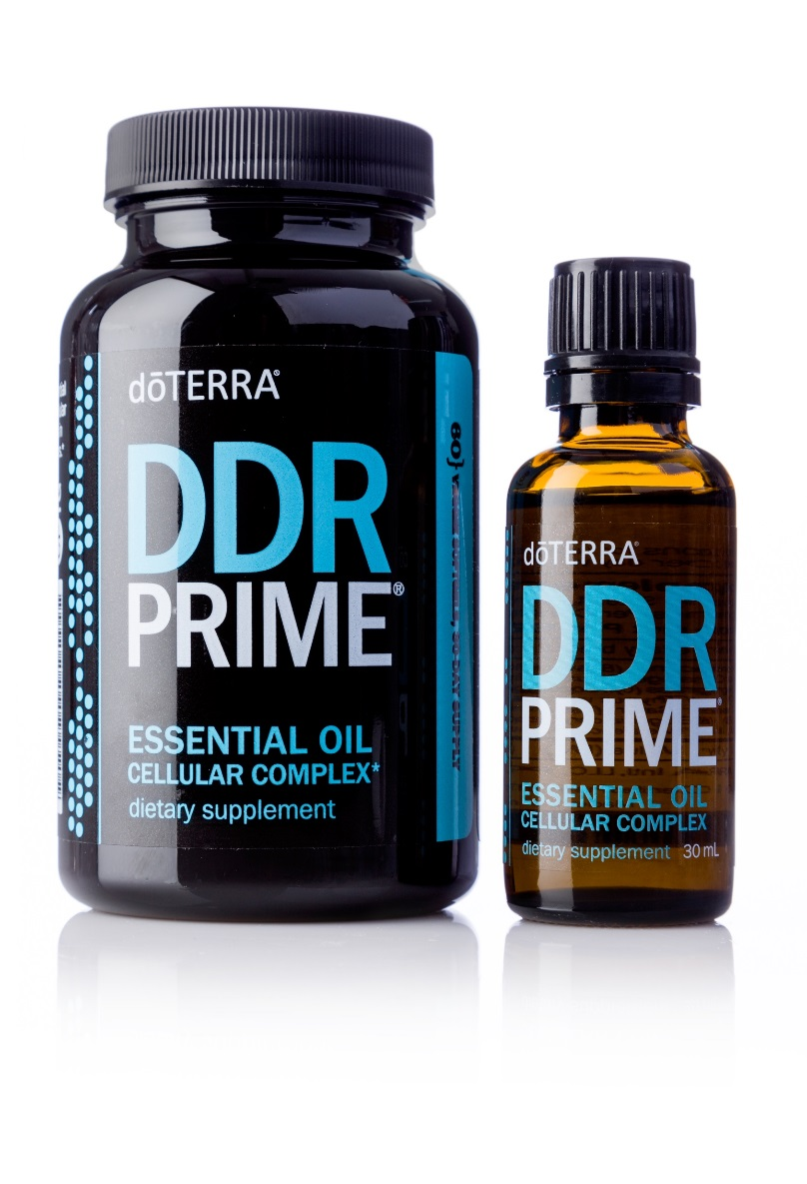
DDR Prime®
DDR Prime is a proprietary blend of Certified Pure Therapeutic Grade® essential oils that help protect the body against oxidative stress to cellular DNA.* The essential oils in DDR Prime provide antioxidant protection and support a healthy response to cellular stressors.*
Primary Benefits
May help ease indigestion and maintain overall gastrointestinal health*
Supports healthy cellular integrity.*
Pairs well with Fractionated Coconut Oil for a soothing topical massage.
Add one to two drops to citrus drinks, tea, or water and consume daily to protect the body and cells from oxidative stress.*
Provides important antioxidant benefits.*
*These statements have not been evaluated by the Food and Drug Administration. This product is not intended to diagnose, treat, cure, or prevent any disease.
Notes:
DDR Prime Essential Oil Cellular Complex is a proprietary blend of essential oils that supports healthy cellular integrity.* The blend includes Clove, Thyme, and Wild Orange essential oils providing powerful antioxidants that help protect against oxidative stress. It also includes essential oils from Frankincense, Lemongrass, Summer Savory, and Niaouli.
Uses:
Add 1–2 drops to citrus drinks, teas, or water and consume daily to protect the body and cells from oxidative stress.
Combine with Fractionated Coconut Oil for a soothing topical massage.
DDR Prime Softgels Essential Oil Cellular Complex is a proprietary blend of essential oils combined to support cellular health, function, and renewal.* DDR Prime includes Frankincense, Wild Orange, Lemongrass, Thyme, Summer Savory, Clove, and Niaouli essential oils, shown in studies to promote a healthy response to free-radicals while supporting healthy cellular function.* DDR Prime Softgels are easy to swallow and provide an easy and convenient method for consuming DDR Prime essential oil blend, anytime, anywhere.
Uses:
Take two softgels daily with meal (may be taken one each, morning and evening).
Cautions:
Keep out of reach of children. If you are pregnant, nursing, or under a doctor’s care, consult your physician. Store in a cool, dry place.
Key Ingredients and Benefits:
Frankincense: Promotes a healthy response to free radicals*
Wild Orange: Supports a healthy cellular response*
Lemongrass: Protects against environmental threats*
Thyme: Broad-spectrum activity in supporting the immune system and cellular health*
Summer Savory: Supports healthy response to oxidative stress*
Clove: Powerful antioxidant properties*

Slide 14
TerraZyme®
TerraZyme® Digestive Enzyme Complex is a blend of whole-food enzymes and supporting cofactors that help strengthen the body's production of enzymes which is important in the process of healthy digestion of food nutrients and cellular metabolism of nutrients to energy.*
Primary Benefits
Supports healthy digestion and metabolism of enzyme-deficient, processed foods*
Supports conversion of food nutrients to cellular energy*
Promotes gastrointestinal comfort and food tolerance*
Supports healthy production of metabolic enzymes*
Proprietary blend of 10 active whole-food enzymes
Contains the dōTERRA tummy tamer blend of Peppermint, Ginger, and Caraway Seed
Sodium lauryl sulfate-free HPMC vegetable capsules
Safe and effective
*These statements have not been evaluated by the Food and Drug Administration. This product is not intended to diagnose, treat, cure, or prevent any disease.
Notes:
DigestZen TerraZyme Digestive Enzyme Complex is a proprietary blend of active whole-food enzymes and supporting cofactors that are often deficient in cooked, processed, and preservative-laden foods. The powerful combination of digestive enzymes found in DigestZen TerraZyme supports the body’s constant production of enzymes critical for healthy biochemical functions, including healthy digestion of food nutrients and cellular metabolism of nutrients to energy.* DigestZen TerraZyme includes a variety of whole-food enzymes that help with the digestion of proteins, fats, complex carbohydrates, sugars, and fiber.
Uses:
Take one to three vegetable capsules with meals throughout the day. If your meal includes lots of fresh, raw foods, take one capsule. If your meal includes highly processed, cooked foods or food products known to cause specific GI discomfort, take two to three capsules with meal.
Cautions:
Some people may experience an initial change to digestive schedule and function when they begin using enzyme supplements. For most people, these symptoms are mild and should disappear after a few days. Pregnant or nursing women and people with known medical conditions should consult a physician before using. Does not contain wheat or milk products. Does not contain ingredients made from animal products.

Slide 15
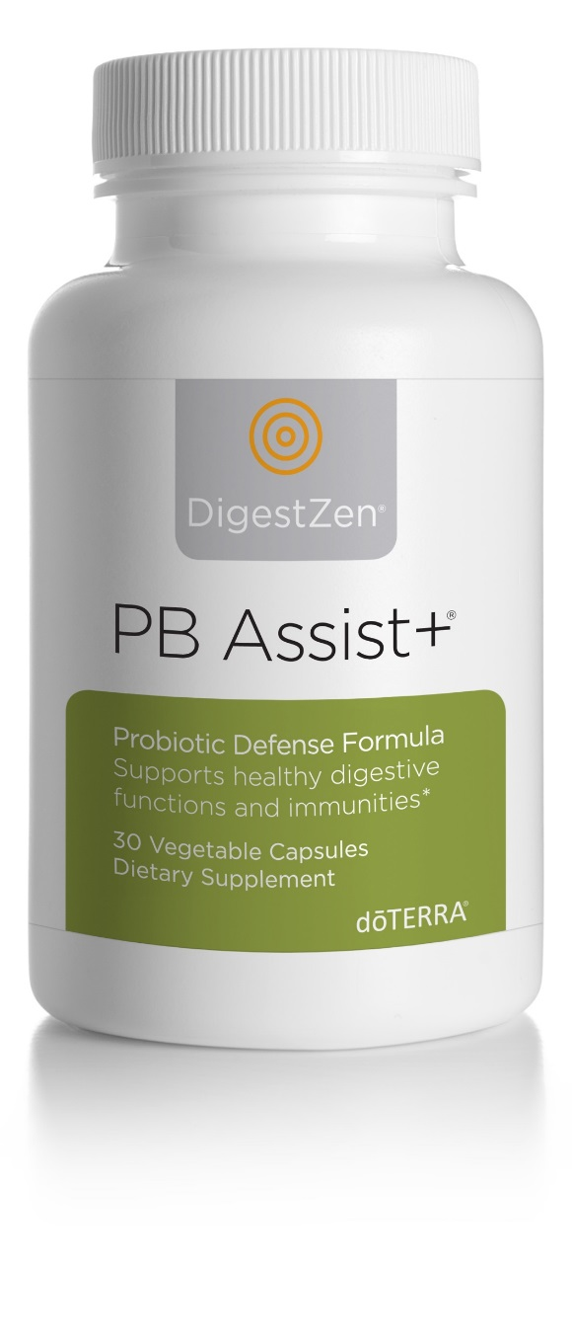
PB Assist+®
PB Assist+® is a proprietary formula of pre-biotic fiber and probiotic microorganisms in a double-layer vegetable capsule. It delivers 6 billion CFUs of active probiotic cultures and soluble pre-biotic FOS (fructo-oligosaccharides) that encourage friendly bacterial growth.*
Primary Benefits
Promotes a positive balance and proliferation of beneficial bacteria*
Maintains healthy intestinal microflora balance*
Supports healthy functioning of the digestive and immune systems*
Supports the health of the GI tract, particularly the intestines and colon*
Helps support optimal metabolism and absorption of food*
*These statements have not been evaluated by the Food and Drug Administration. This product is not intended to diagnose, treat, cure, or prevent any disease.
Notes:
PB Assist+ is a proprietary formula of pre-biotic fiber and six strains of probiotic microorganisms in a unique double-layer vegetable capsule. It delivers 6 billion CFUs of active probiotic cultures and soluble pre-biotic FOS (fructo-oligosaccharides) that encourage friendly bacterial growth*. The time-release, double-capsule delivery system is designed to help protect the sensitive probiotic cultures from stomach acid. PB Assist+ offers a unique, safe, and effective way to deliver the well-recognized digestive and immune system support benefits of probiotics.*
Uses:
Take one double-layer capsule three times daily with food for 10 days each month to promote colonization of friendly digestive flora.* Can be used more frequently and for extended periods of time when digestive flora has been compromised by digestive stressors. PB Assist+ also may be used when traveling to boost digestive immunities, or once a day as an ongoing maintenance program for people with occasional digestive discomfort.*
*These statements have not been evaluated by the Food and Drug Administration. This product is not intended to diagnose, treat, cure, or prevent any disease

Slide 16
Immortelle
With a blend of powerful oils in every drop, Immortelle Anti-Aging Blend is formulated to protect and nourish skin while helping to reduce contributing factors to the appearance of aging skin.
Primary Benefits
Helps to reduce the appearance of fine lines and wrinkles
Helps reduce contributing factors to the appearance of aging skin
Helps sustain smoother, more radiant, and youthful-looking skin
*These statements have not been evaluated by the Food and Drug Administration. This product is not intended to diagnose, treat, cure, or prevent any disease.
Notes:
A proprietary blend of powerfully renewing, rare essential oils used throughout history for their beautifying benefits, Immortelle Anti-Aging Blend is formulated to protect and nourish skin while helping to reduce contributing factors to the appearance of aging skin. These powerful essential oils help sustain smoother, more radiant, and youthful-looking skin. Immortelle easily absorbs into the skin and can be used on the face, neck, and décolletage to reduce the appearance of fine lines, wrinkles, and aging skin.
Uses:
Apply a thin layer of Immortelle to the face, neck, and décolletage, then repeat application to targeted areas of concern. Follow with the doTERRA moisturizer of your choice.
Apply to reduce the appearance of blemishes.
Use as part of your morning and night facial routine.
Directions for Use
Topical use: Apply one to two drops to desired area. Dilute with doTERRA Fractionated Coconut Oil to minimize any skin sensitivity.
Cautions
Possible skin sensitivity. Keep out of reach of children. If you are pregnant, nursing, or under a doctor’s care, consult your physician. Avoid contact with eyes, inner ears, and sensitive areas.

Slide 17
Product of the Month
dōTERRA Serenity® calms emotions while creating a sense of peace and well-being.
Primary Benefits
Promotes relaxation and a restful sleeping environment
Lessens feelings of tension and calms emotions
Calms the mind and soothes the senses
When accompanied with dōTERRA Serenity® Restful Complex Softgels, provides a natural solution for a restful night’s sleep*
*These statements have not been evaluated by the Food and Drug Administration. This product is not intended to diagnose, treat, cure, or prevent any disease.
Notes:
The newly updated doTERRA Serenity Restful Blend has a calming and relaxing aroma that provides a unique user experience. This perfectly balanced, tranquil blend can be felt immediately, transporting the user to a state of blissful repose. doTERRA Serenity combines essential oils renowned for their ability to lessen feelings of tension and calm emotions, and support a restful sleep when used aromatically. Apply one to two drops to the hands and inhale throughout the day to help reduce worry from life’s daily stressors, or diffuse at night to help quiet a restless baby or child. The addition of Cedarwood, Ho Wood, and Vetiver essential oils gives doTERRA Serenity a grounding aroma that calms the mind and soothes the senses. doTERRA Serenity can be used in conjunction with doTERRA Serenity Restful Complex Softgels. The doTERRA Serenity essential oil blend creates a relaxing environment while the softgels promote a restful night’s sleep.*
Uses:
Diffuse at night to calm a restless baby or child.
Apply to bottoms of feet at bedtime to help unwind before going to sleep. Use in conjunction with doTERRA Serenity Restful Complex Softgels for an enhanced effect.
Inhale directly from hands or diffuse throughout the day to help lesson tension.
Add 2–3 drops into a warm bath with Epsom salts to create a relaxing, renewing experience.
Apply 2–3 drops to the back of the neck or on the heart for feelings of calmness and peace.
Directions for Use
Diffusion: Use three to four drops in the diffuser of choice.
Topical use: Apply one to two drops to desired area. Dilute with a carrier oil to minimize any skin sensitivity. See additional precautions below.
Cautions
Possible skin sensitivity. Keep out of reach of children. If you are pregnant, nursing, or under a doctor’s care, consult your physician. Avoid contact with eyes, inner ears, and sensitive areas.
*These statements have not been evaluated by the Food and Drug Administration. This product is not intended to diagnose, treat, cure, or prevent any disease.

