Slide 3
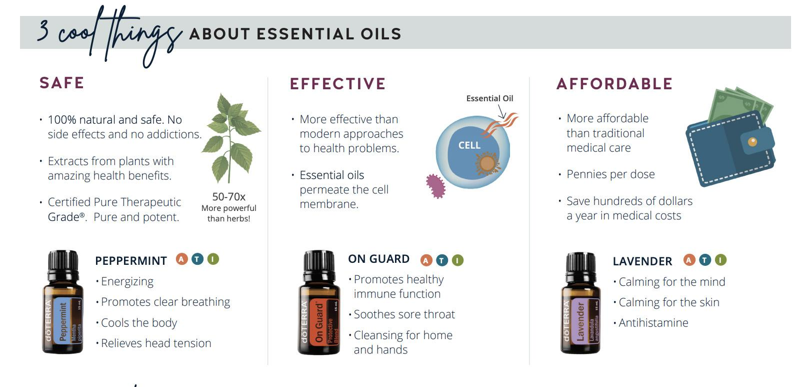

Slide 5
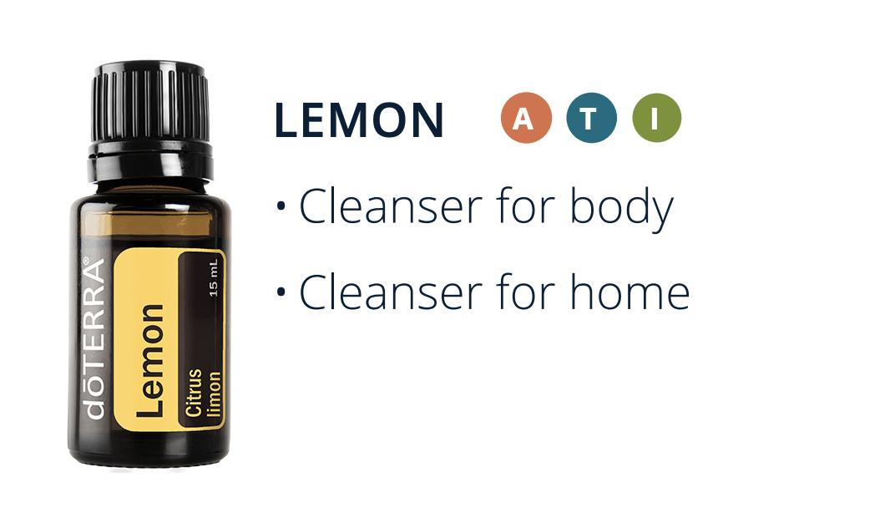

Slide 10
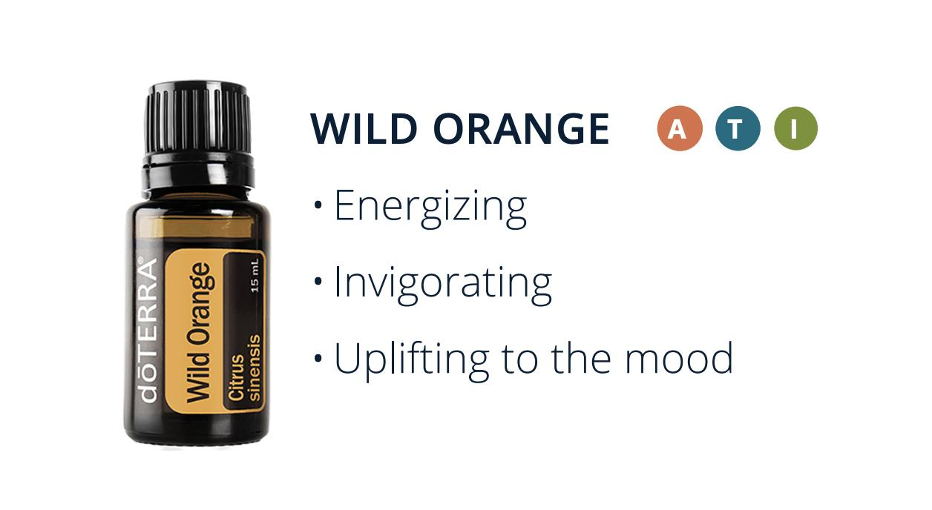

Slide 16
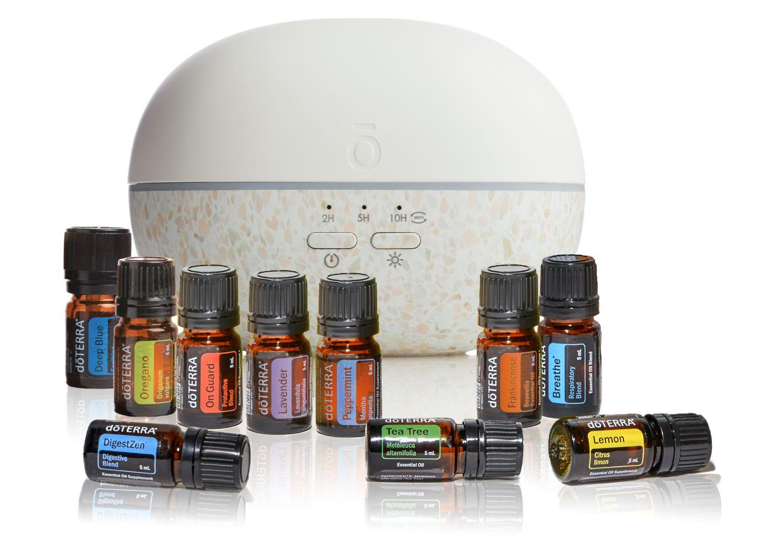
Healthy Start Kit
Transform your mind, body, and home

Slide 17
Home Essentials Kit
Your toolbox to create a happy, healthy home

Slide 18
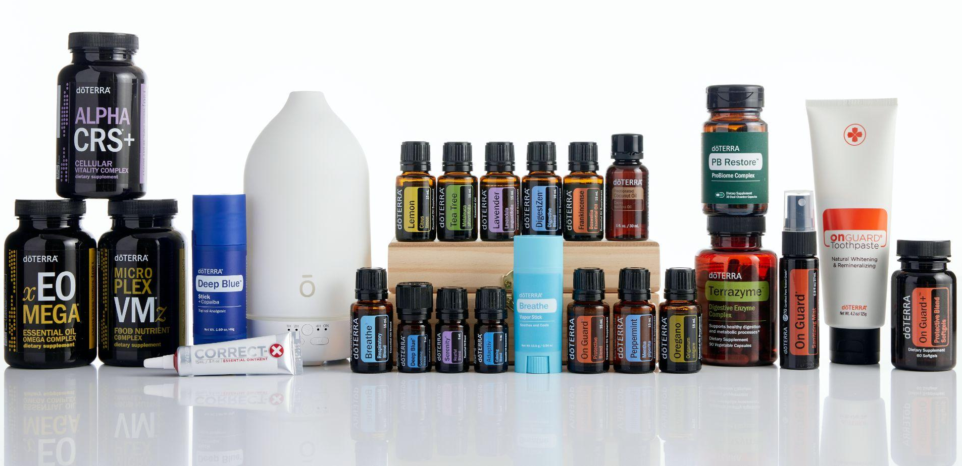
Natural Solutions Kit
A collection of the best doTERRA products meant to help you live a natural life, free of harmful toxin

