Slide 1


Slide 2
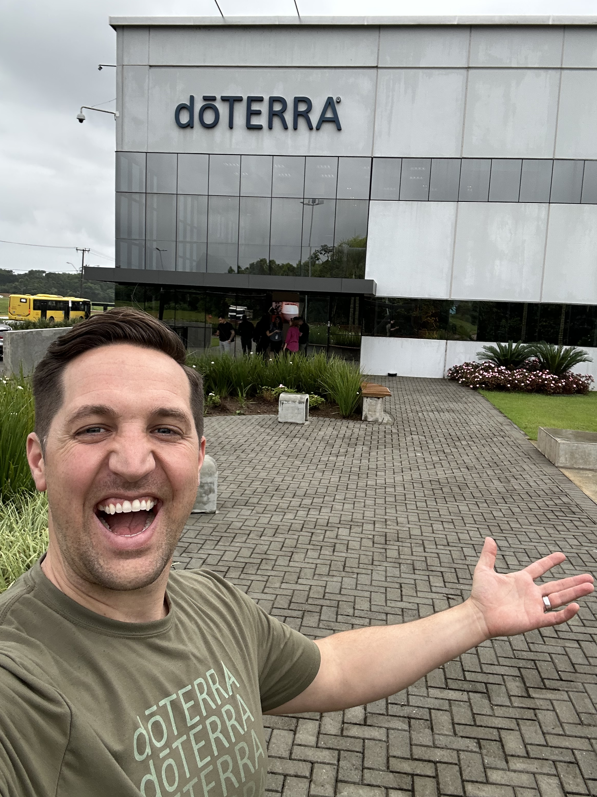
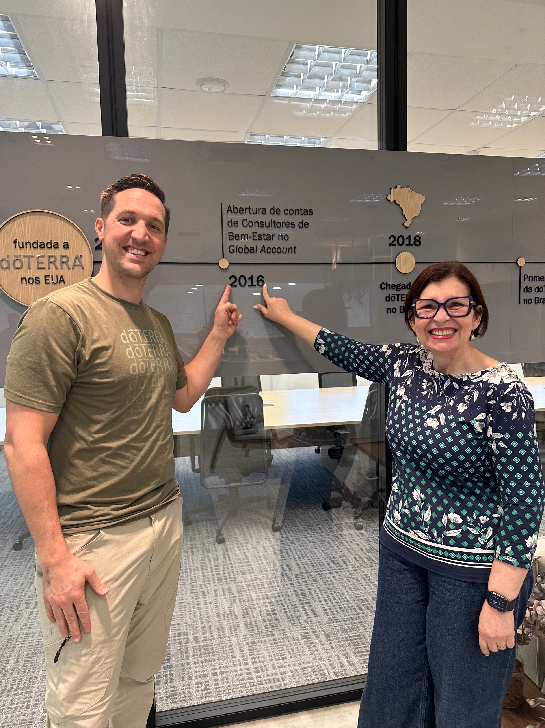
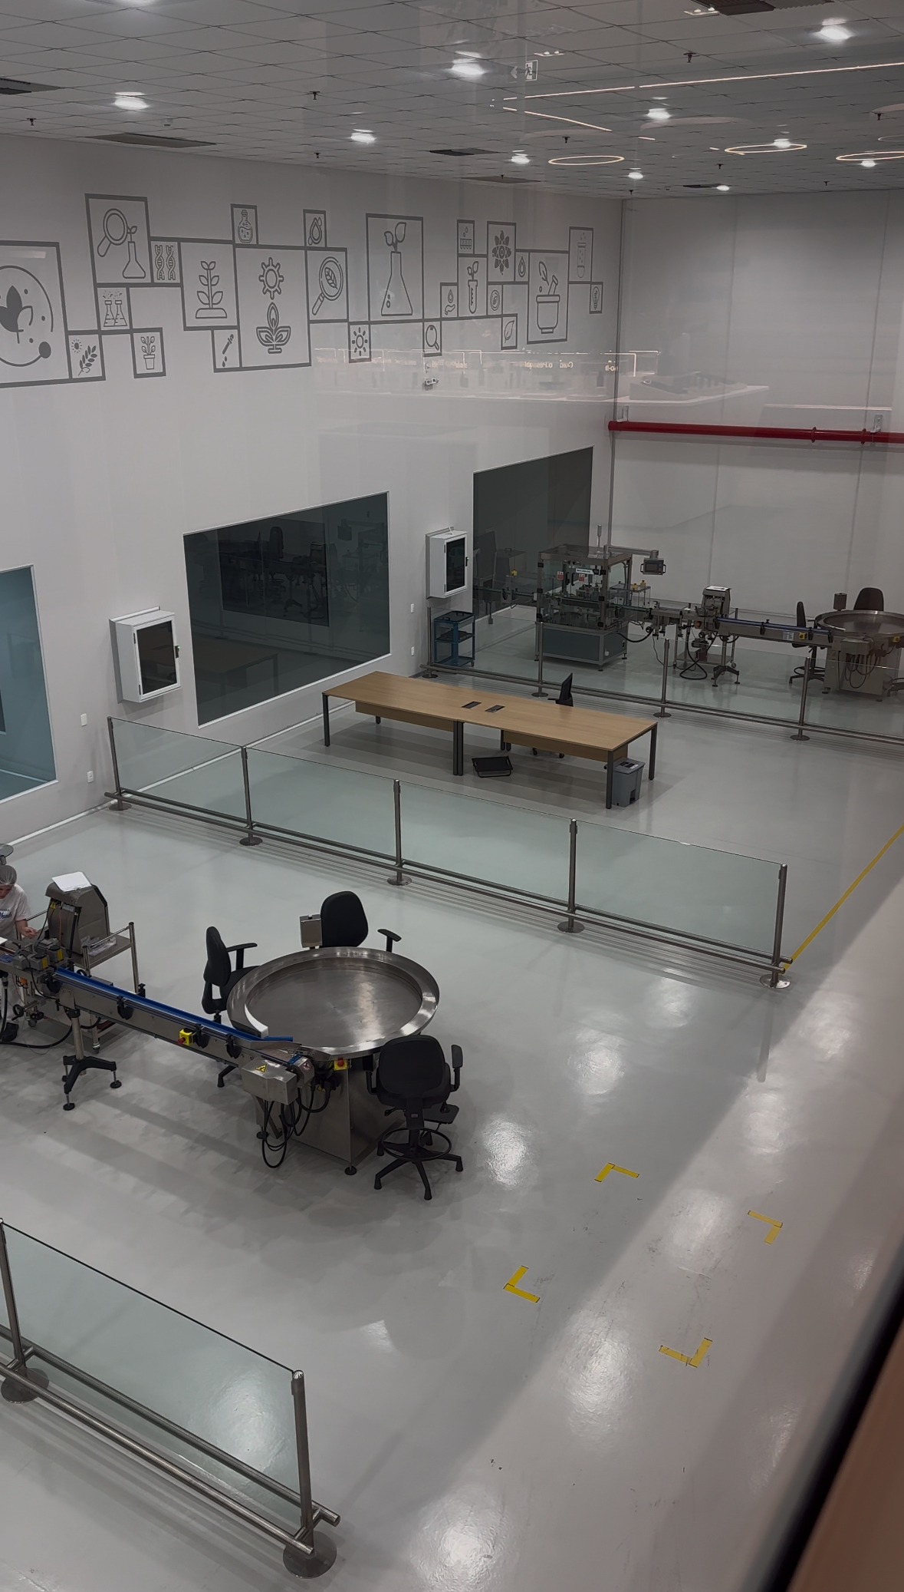
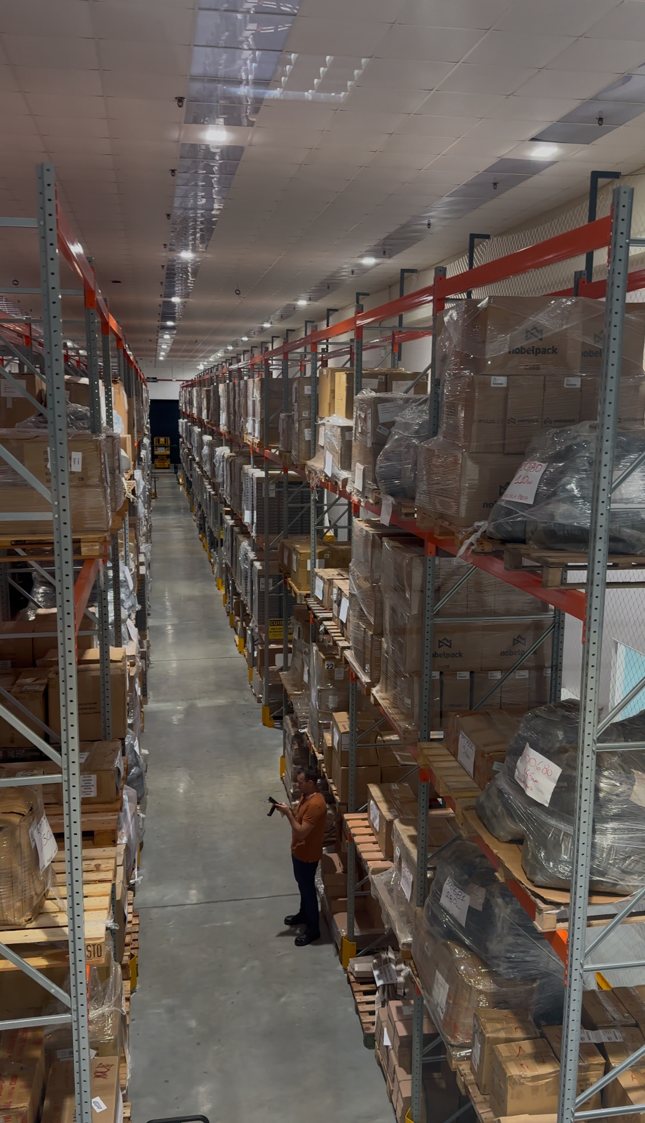
Fabrica dōTERRA

Slide 3
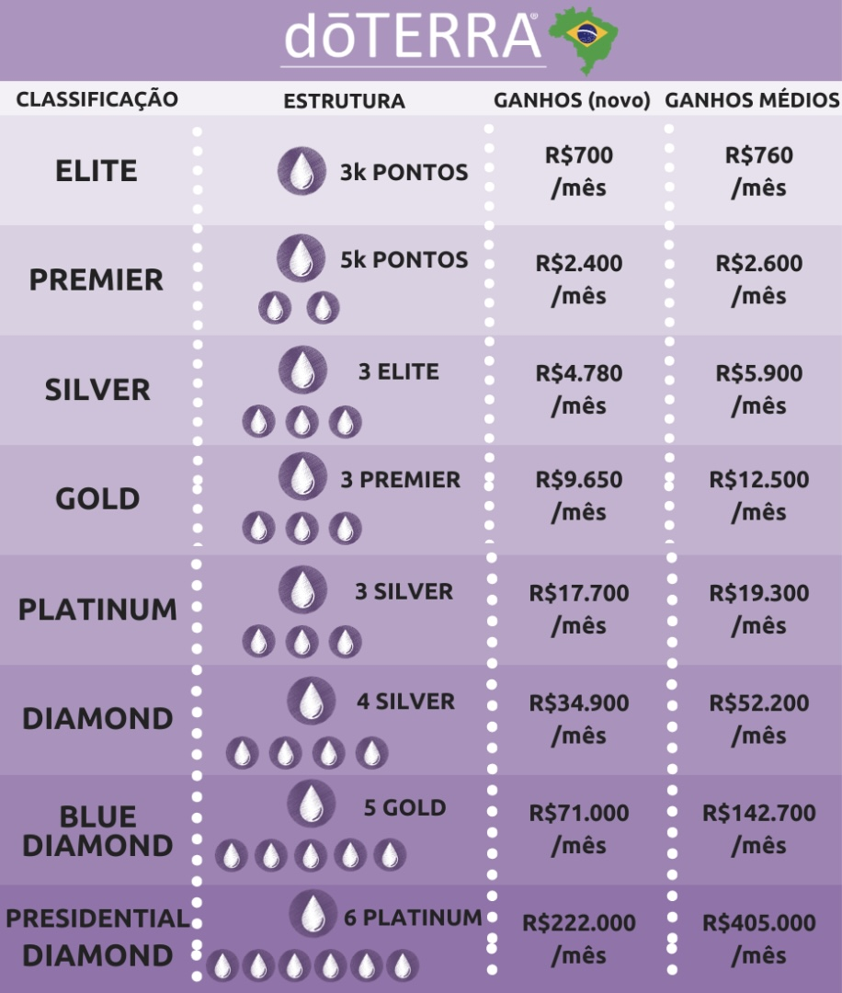
Fabrica de Elites
Silver
3
Diamond
12
Presidential Diamond
54

Slide 4
Como eu posso impactar
MAIS PESSOAS em um nivel
MAIS PROFUNDO
MAIS RAPIDO?

Slide 5
Aquisição
Retenção
Duplicação

Slide 6
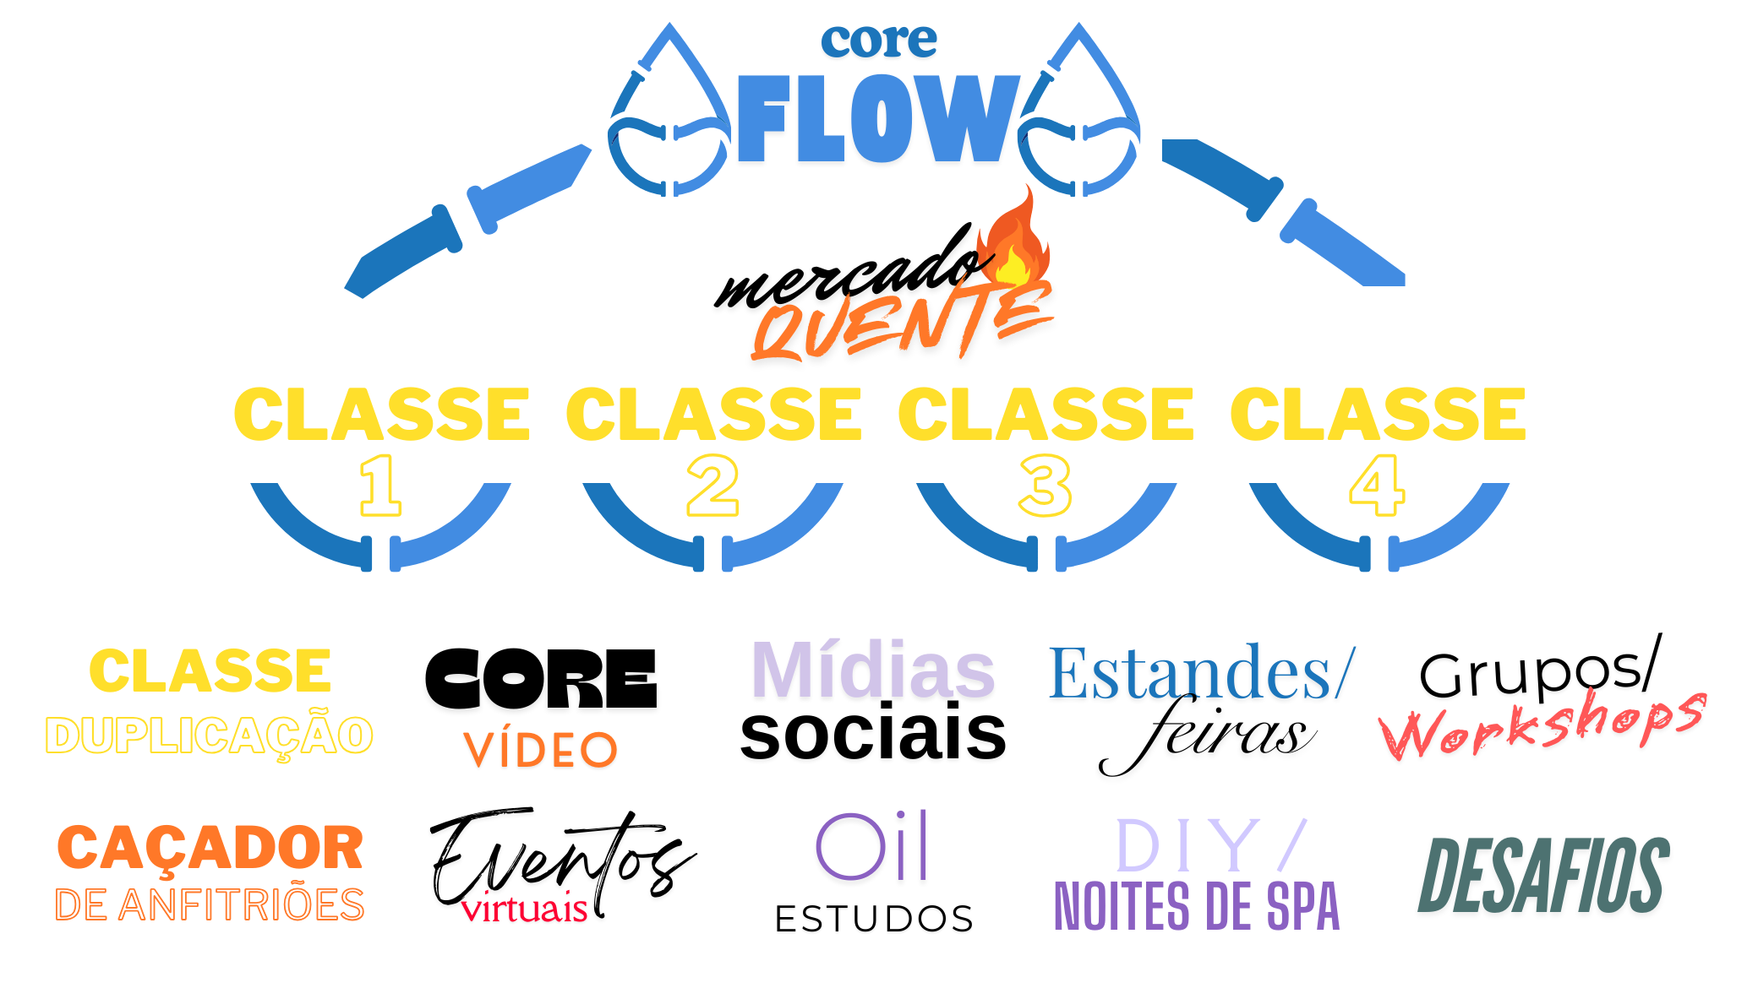

Slide 7
Mês 1

Slide 8
Mês 1 – 1000 ov
Cadastra 10 pessoas pessoalmente
Inicio Rapido: R$700

Slide 9
Mês 2 – 2500 ov
Cadastra 5 pessoas pessoalmente
Recompra de 5 pessoas do mes anterior.
Inicio Rapido: R$700
3 Diretos cadastrando 5 pessoas
Inicio Rapido: R$525
Poder de 3 N1 + Boost: R$500
Total: R$1,725

Slide 10
Mês 3 – Elite (3000pv)
Cadastra 5 pessoas pessoalmente 500pv
Recompra de 5 pessoas do mês anterior 500pv
Inicio Rapido: R$700
3 Diretos cadastrando 5 pessoas 1500 pv
Inicio Rapido: R$525
Poder de 3 N2 + Boost: R$1,875
Pessoas comprando 500 pv
Unilevel: R$88
Total: R$3,188

Slide 11
Fabrica de Elites
Silver
3 ganhando R$3,188
Diamond
12 ganhando R$3,188
Presidential Diamond
54 ganhando R$3,188

Slide 12
é sua
Fabrica de Elites

Slide 13

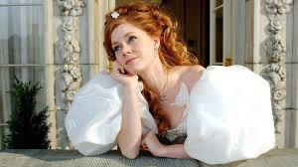

Slide 14
Imersão
(eventos de destino)

Slide 16
Evento de 4 passos
1. Experiência
2. Inspiração
3. Resolver Preocupações
4. O lançamento

Slide 17
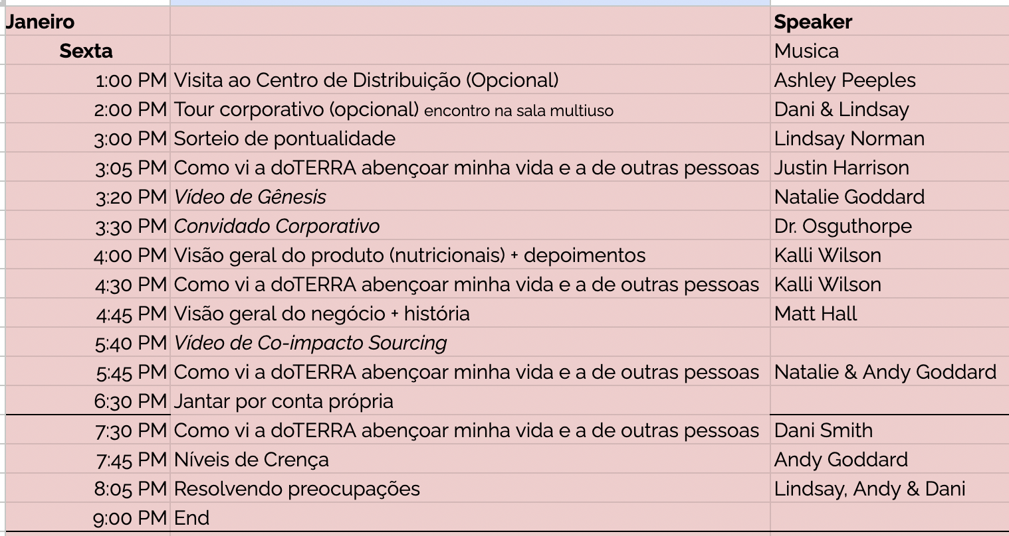

Slide 18
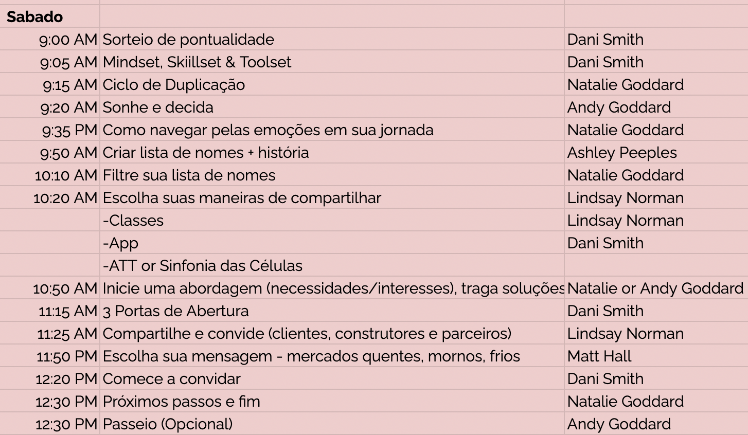

Slide 19
O que você mais gostou do tour?

Slide 20
Conheça os Donos

Slide 21
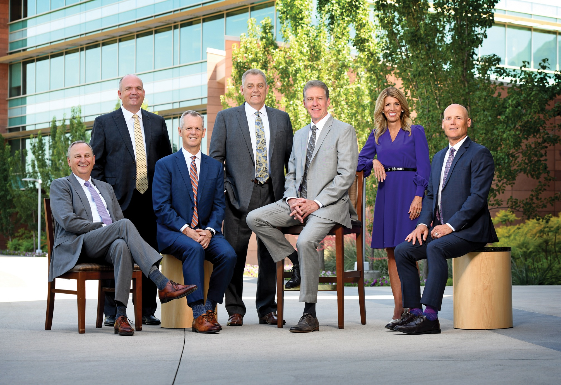
Notes:
VIDEO: Genesis Story

Slide 22
Convidado Corporativo

Slide 23
Visão geral do produto (nutricionais + depoimentos)

Slide 24
História: Como vi a doTERRA abençoar outras pessoas e minha vida

Slide 25
Por que fazer parceria com a dōTERRA

Slide 26
Visão geral do negócio

Slide 27
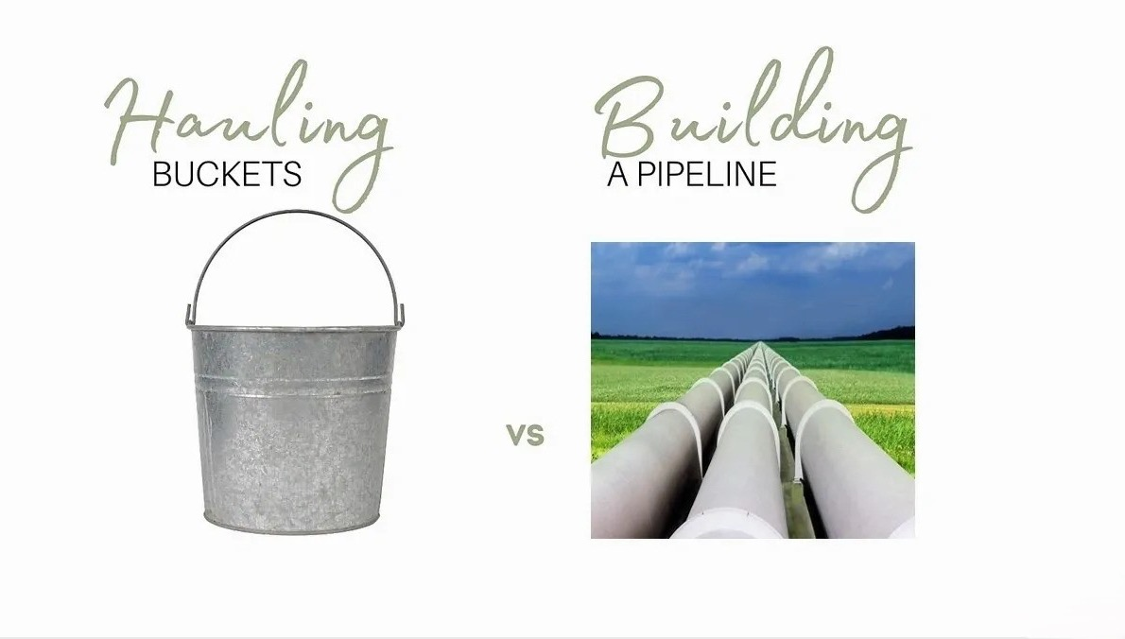

Slide 28
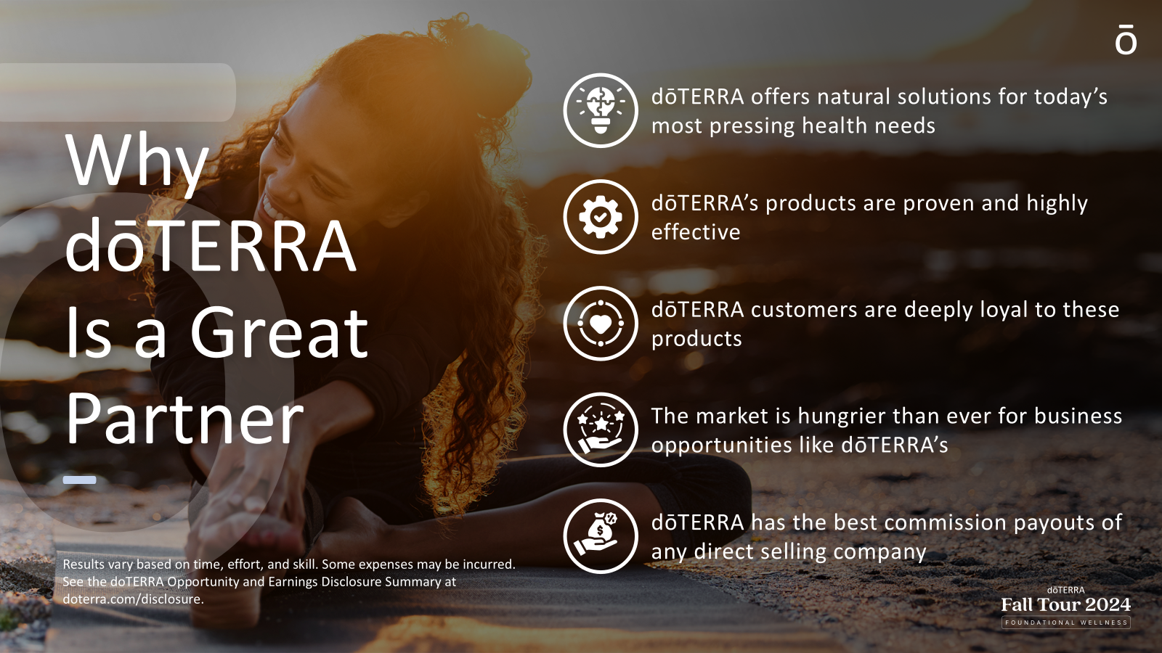

Slide 29
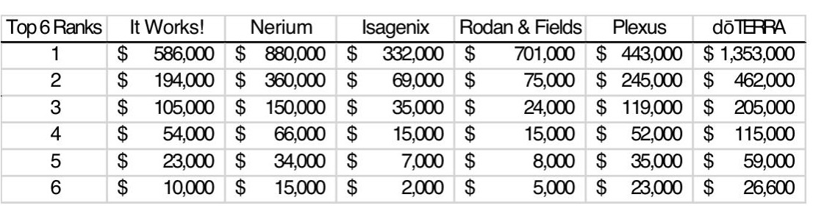
Income Disclosures – Top Ranks

Slide 30
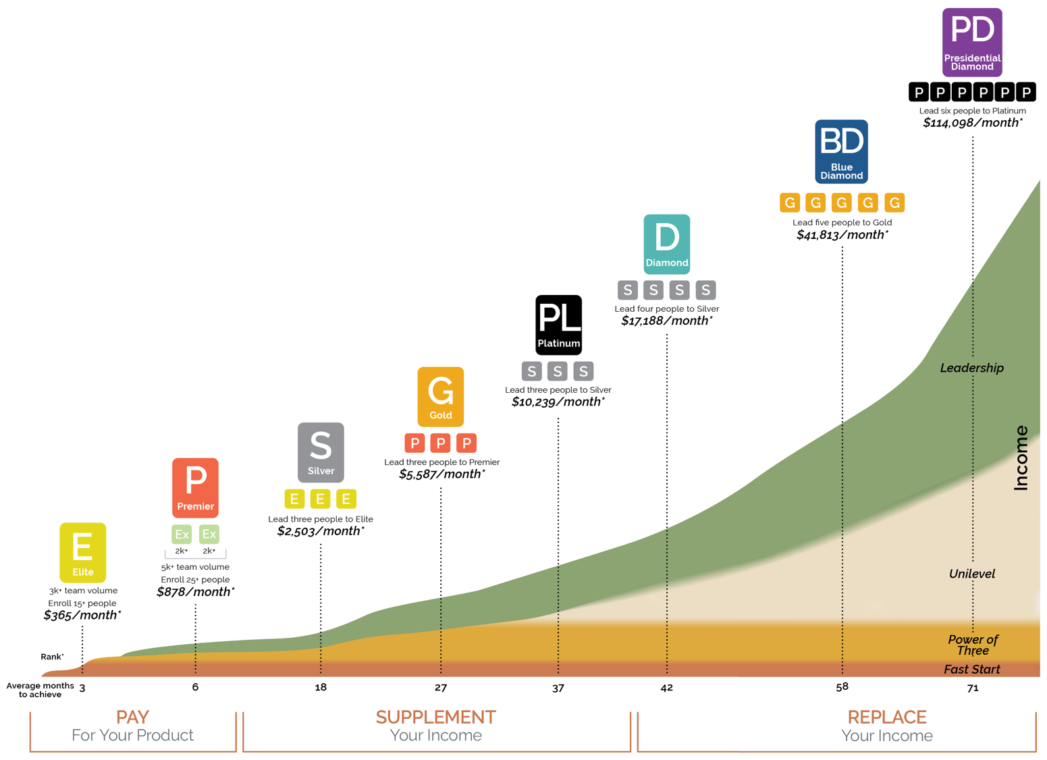
Income Potential
3
3
17
Share Success promotions!
35
77
192
357
1193

Slide 31
Impacto

Slide 32
O poder do produto

Slide 33
Nossa história

Slide 34
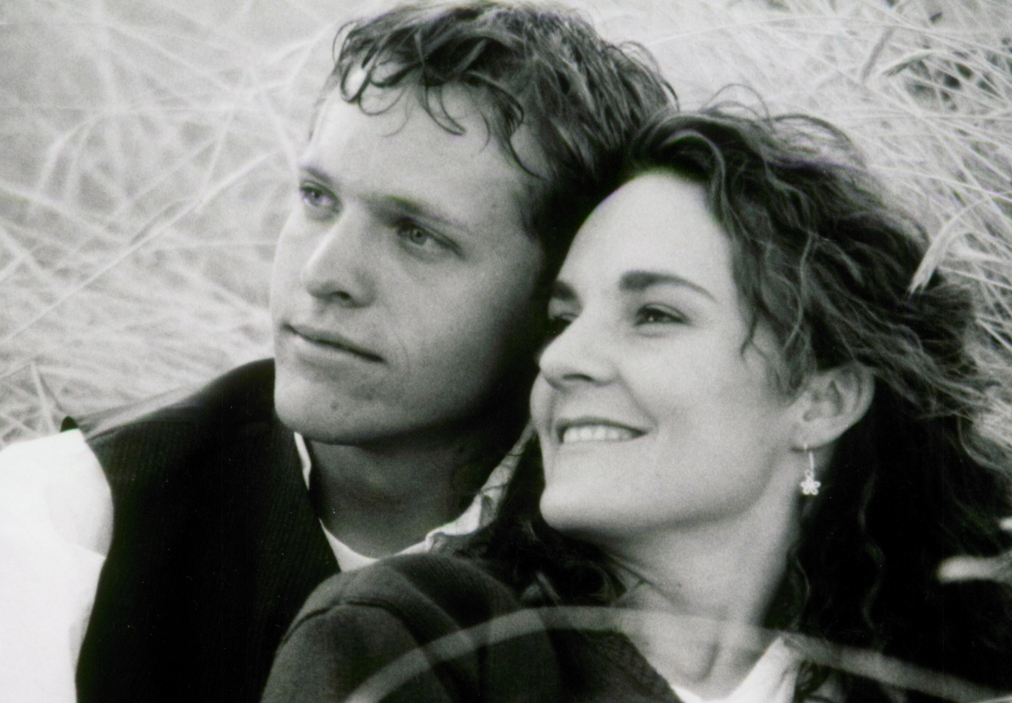
Notes:
I’d like to honor Natalie

Slide 35
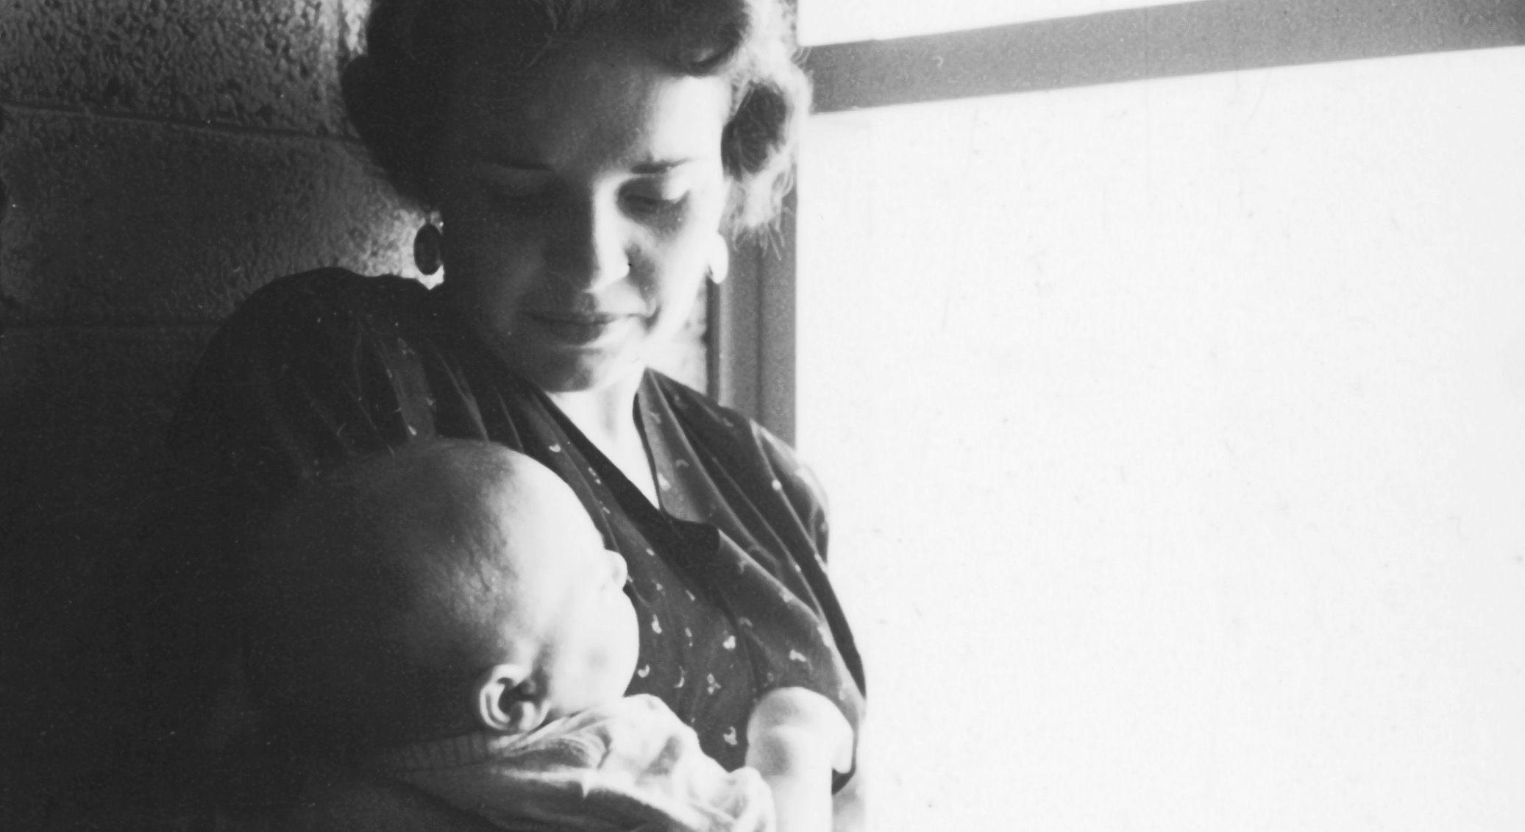
Notes:
She was raised by a mother who struggled with health issues all her life. She turned to western medicine, but didn’t find any relief. She turned to holistic medicine and found solutions. When she started living healthier, she did something very important: She shared. Natalie learned about natural wellness from her mother. But when Natalie was 19, her mother suddenly died – left a hole. Natalie struggled with depression.

Slide 36
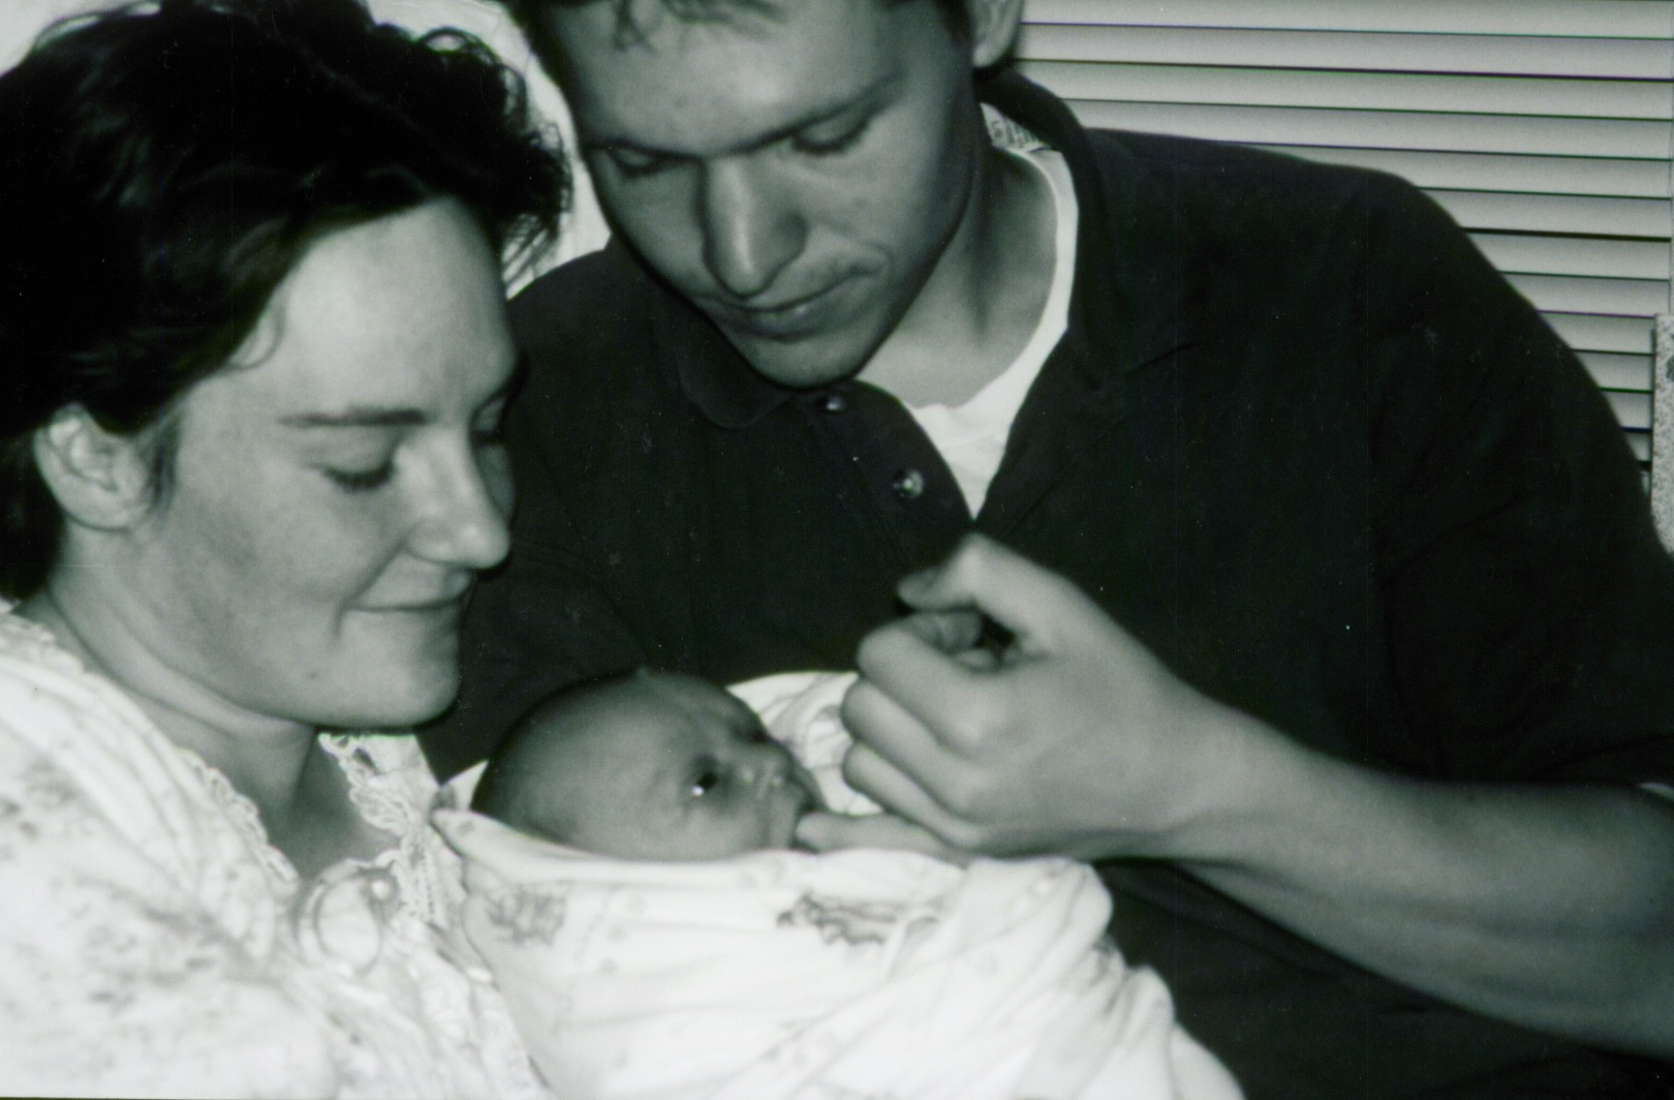
Notes:
Natalie was raised to believe that having a family was the key to happiness, but she was still depressed.

Slide 37
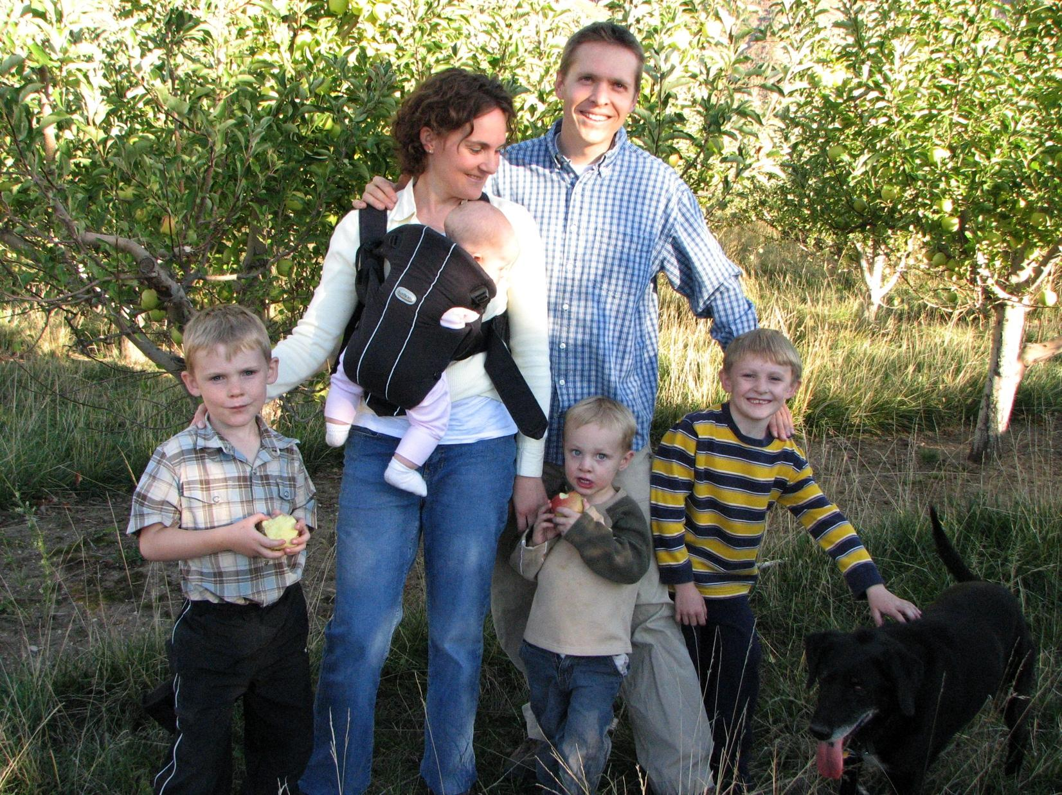
Notes:
So we had 3 more. You can guess how that worked out.

Slide 38
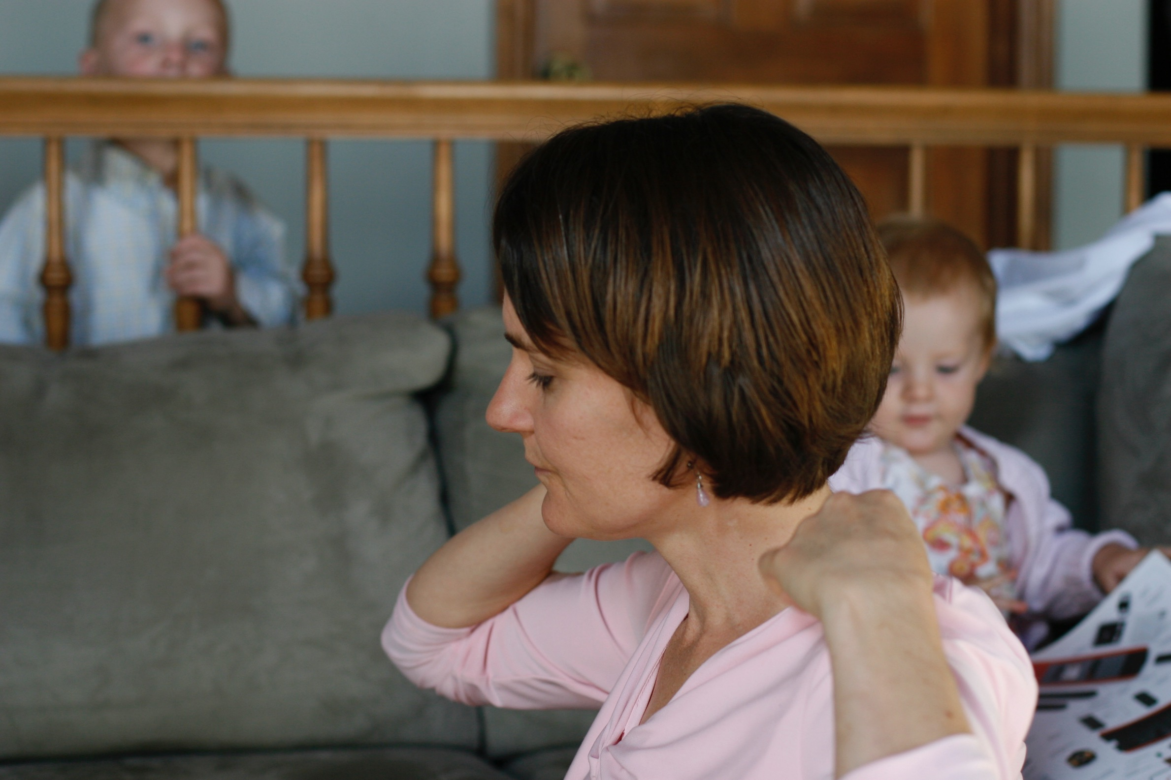
Notes:
She asked, “Is there more to life than changing diapers and wiping noses?”

Slide 39
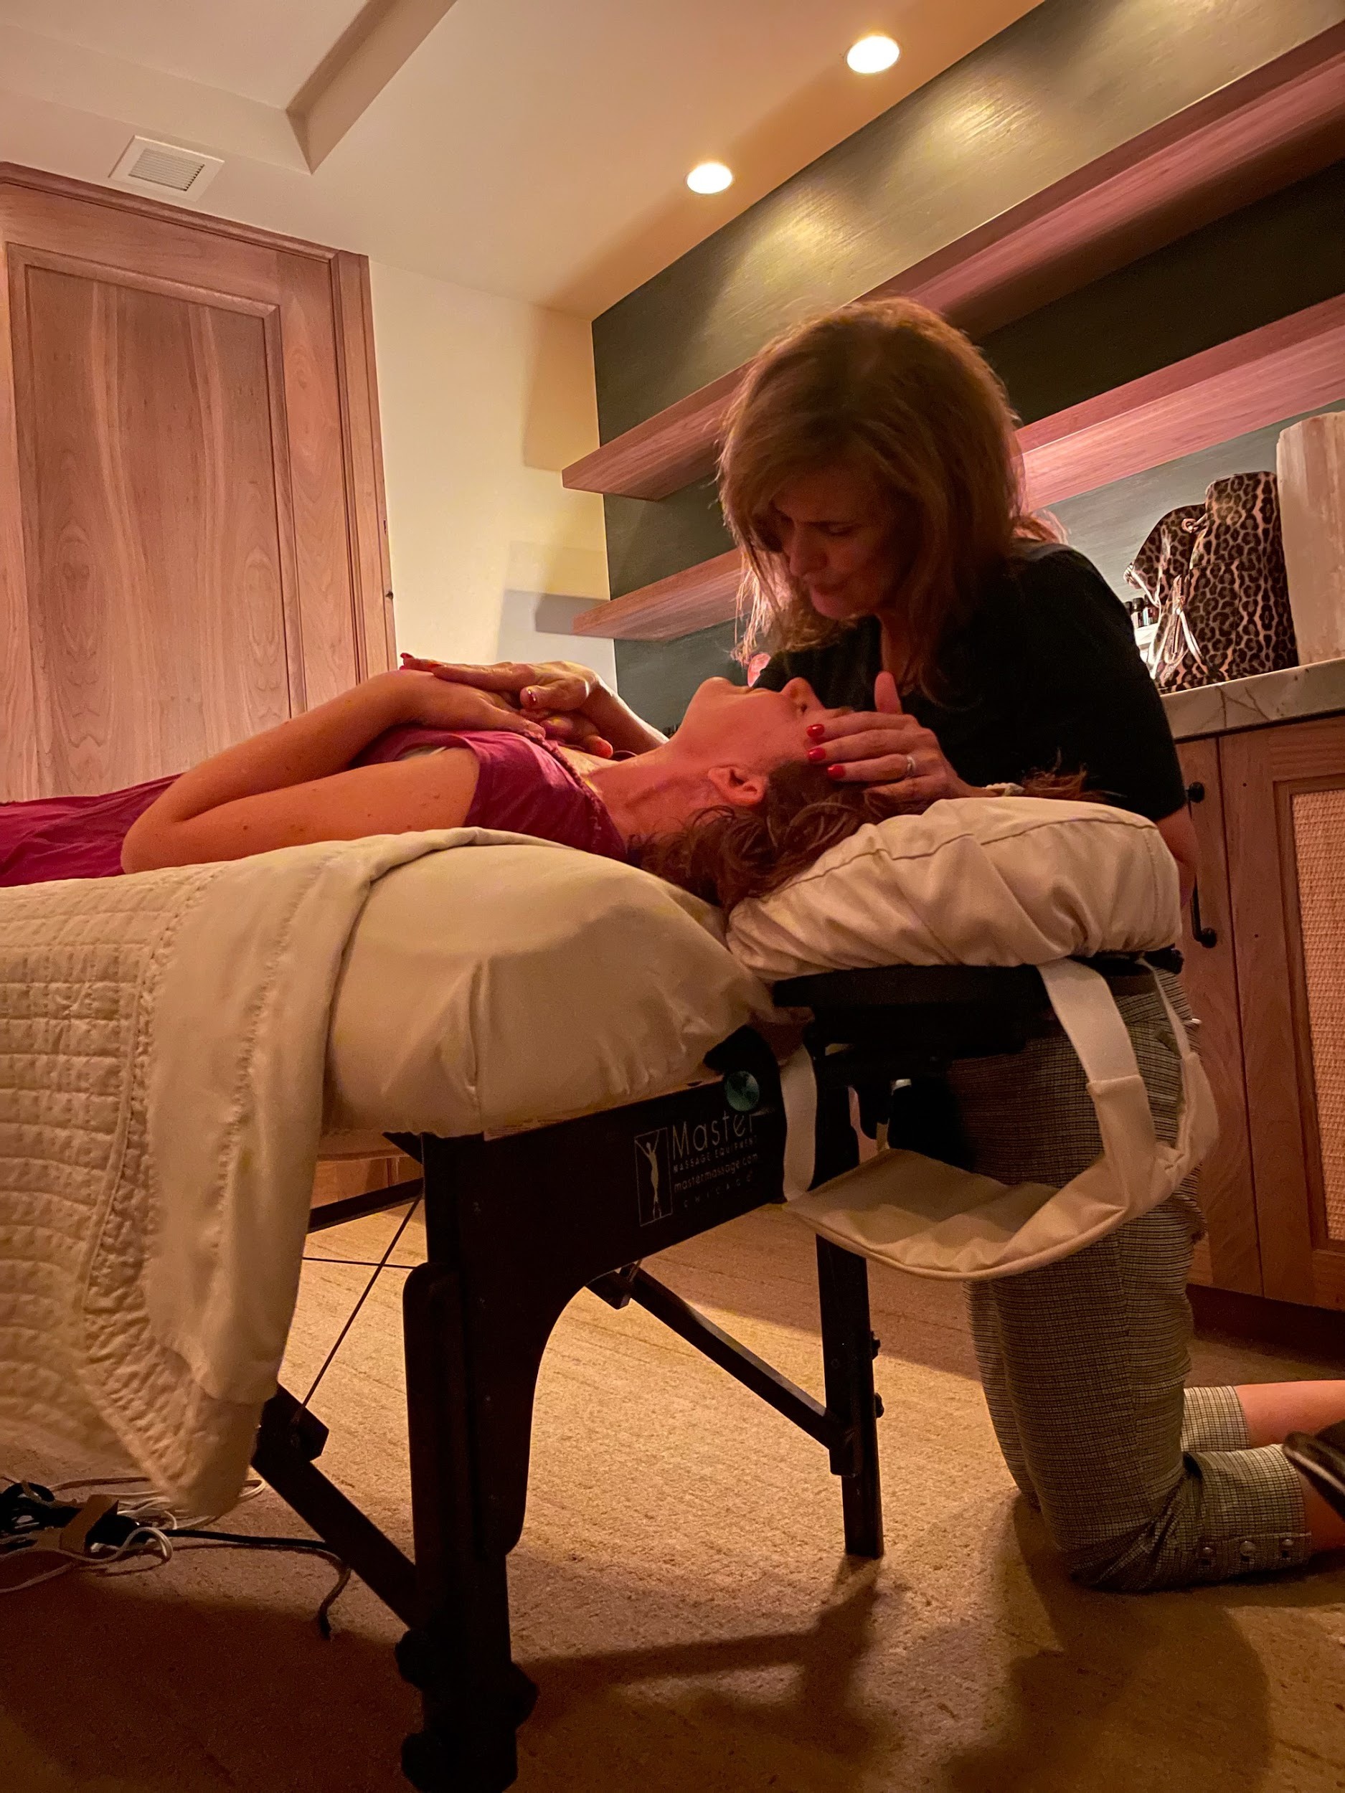
Notes:
I bought her a massage for her birthday, but it was a different kind of treatment. The woman used essential oils, music, and massage. Natalie experienced more healing in that 1 hour than she had in the previous 9 years. The fog of her depression was lifted. She finally felt free. She bought oils from this woman (this was before doTERRA) and came home swiping them on me and all the children. The mood in our home was better, and we started having positive emotional breakthroughs.

Slide 40
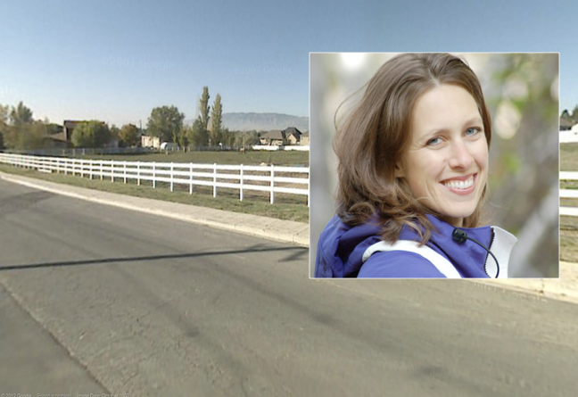
Notes:
Several years later, Natalie was driving down the street and saw this woman feeding horses with her children. A little voice told Natalie to stop and talk to her, so she did. Several weeks later, the woman invited Natalie to a class on essential oils. Because Natalie had been using essential oils, she thought she was already an expert.

Slide 41
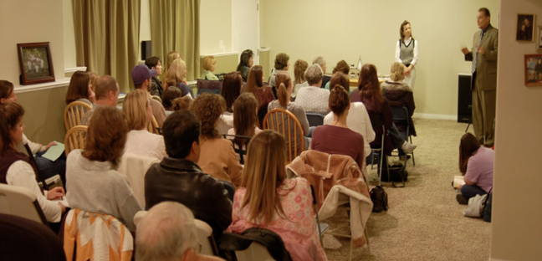
Notes:
After 3 invitations, Natalie said, “I’ll be back in 30 minutes. Then this woman will leave me alone!” She sat on the back row.

Slide 42
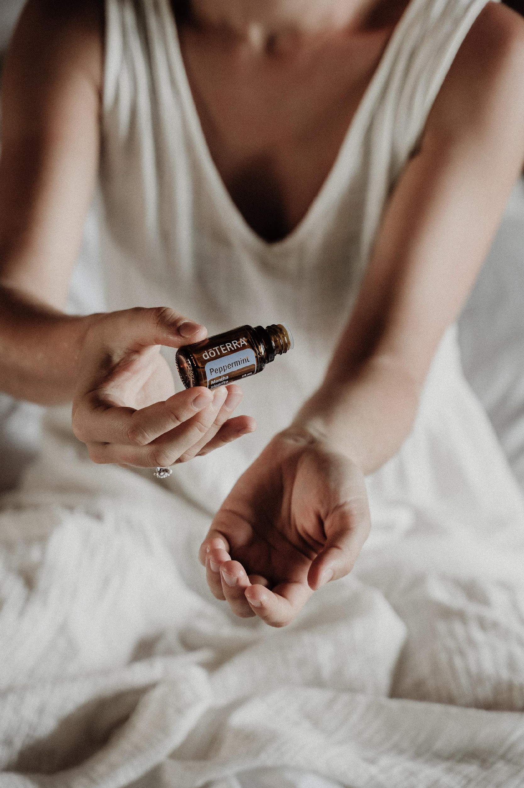
Notes:
First, they passed around the peppermint. It knocked her socks off.

Slide 43
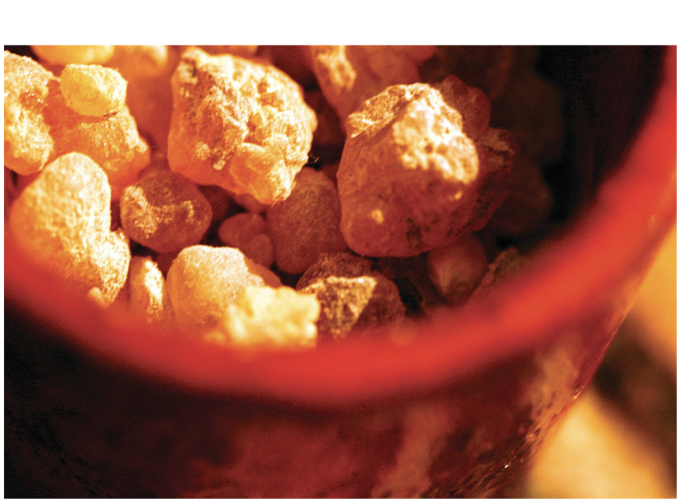
Notes:
Then they passed the Frankincense around. A little voice told her to pay attention.

Slide 44
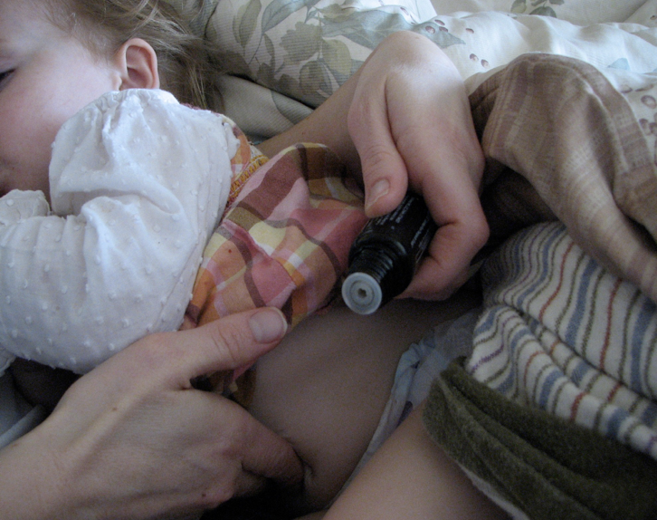
Notes:
She bought the biggest kit and came home and started using the oils. We couldn’t believe the results! Everyone was healthier and happier.

Slide 45
Com estes óleos, nós somos as
pessoas mais ricas do mundo.
Notes:
After using the oils for 3 weeks, Natalie turned to me and said, ”With these oils, we are the richest people on earth.”

Slide 46

Notes:
Natalie loved to do Yoga. She was in her front yard in Savasana, and she had impressions of people she should share the oils with. She said, If I did that, I would be doing network marketing, and I don’t do network marketing.” The message came back, “I wanted this for you. But if you don’t want it, I can give it to someone else.”

Slide 47
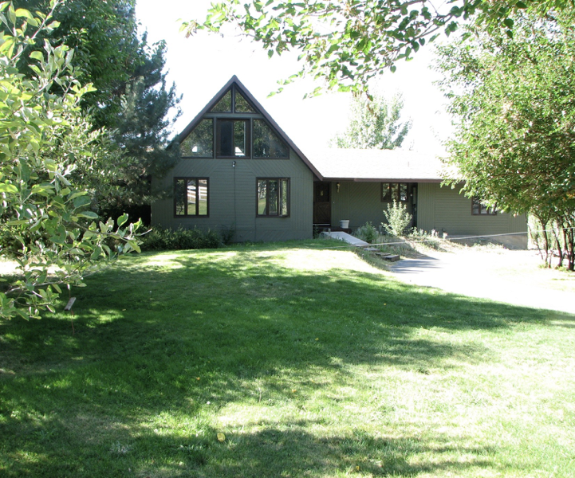

Slide 48
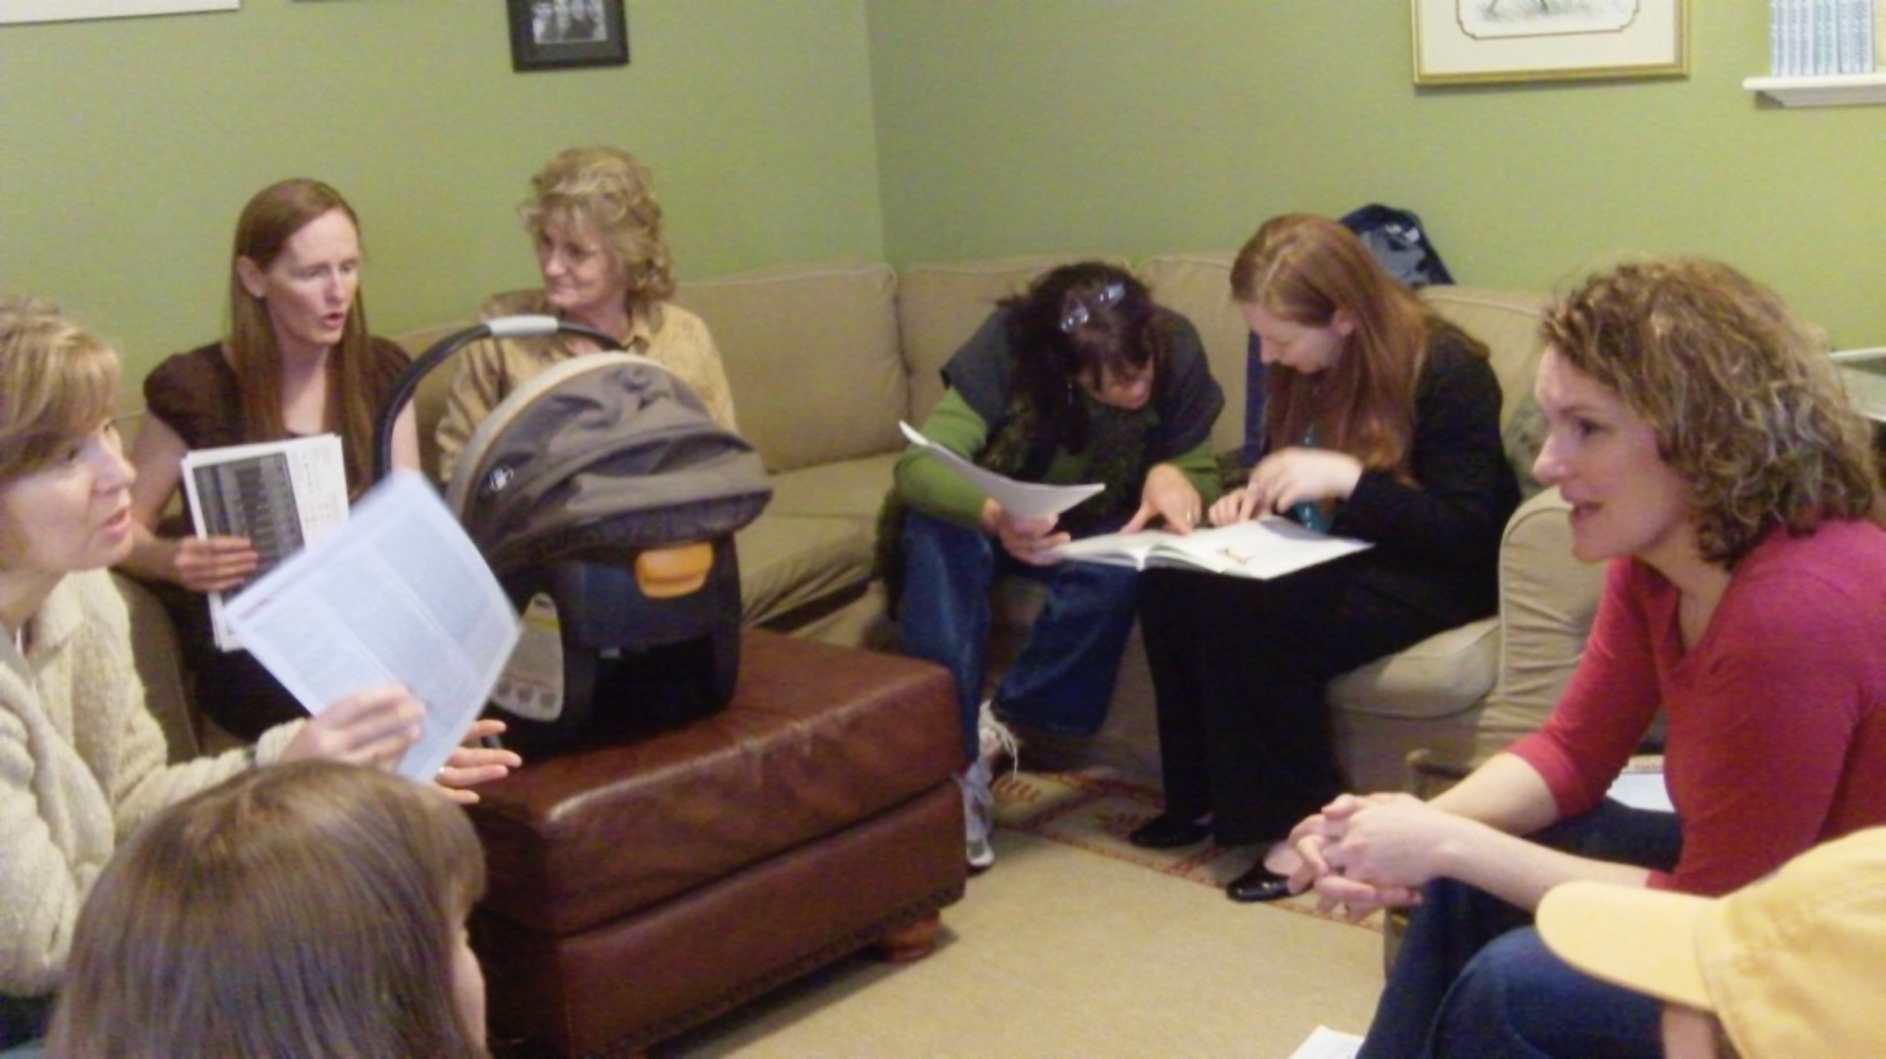
Notes:
Natalie became addicted to empowering women and setting them free to take control of their own health

Slide 49
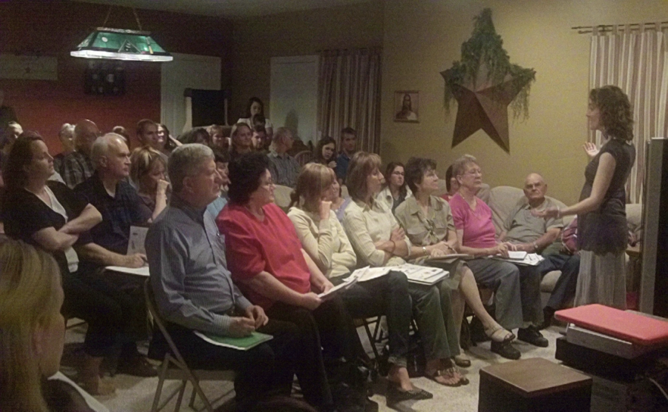
Notes:
She started teaching more people how to be free (physically, financially, and emotionally)

Slide 50
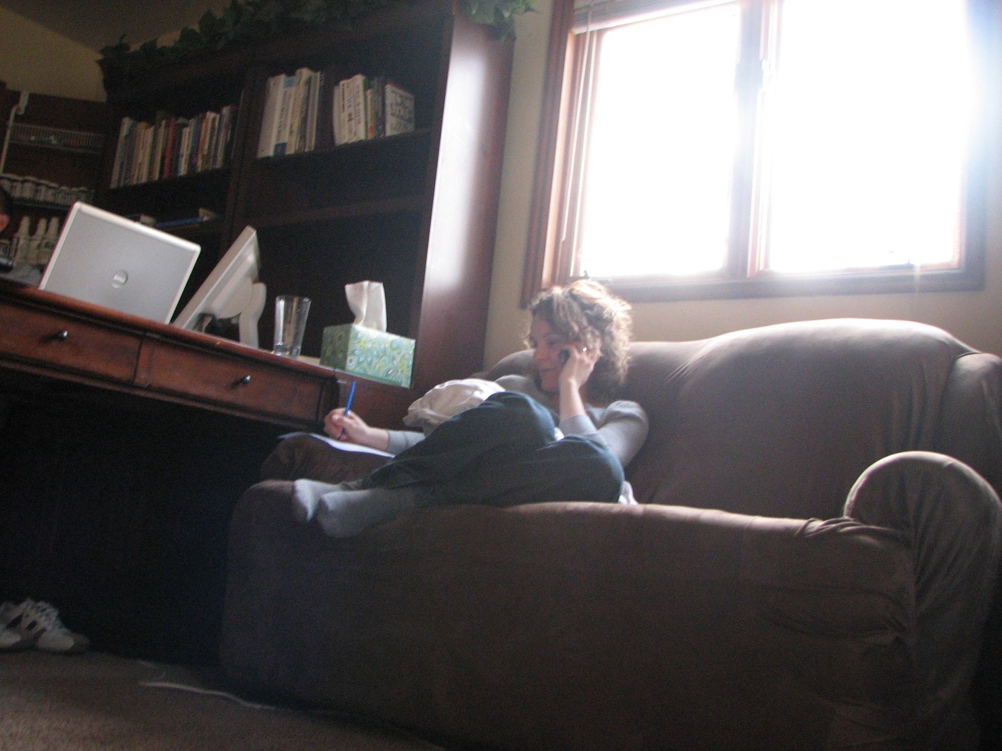
Notes:
She started teaching more people how to be free (physically, financially, and emotionally)

Slide 51
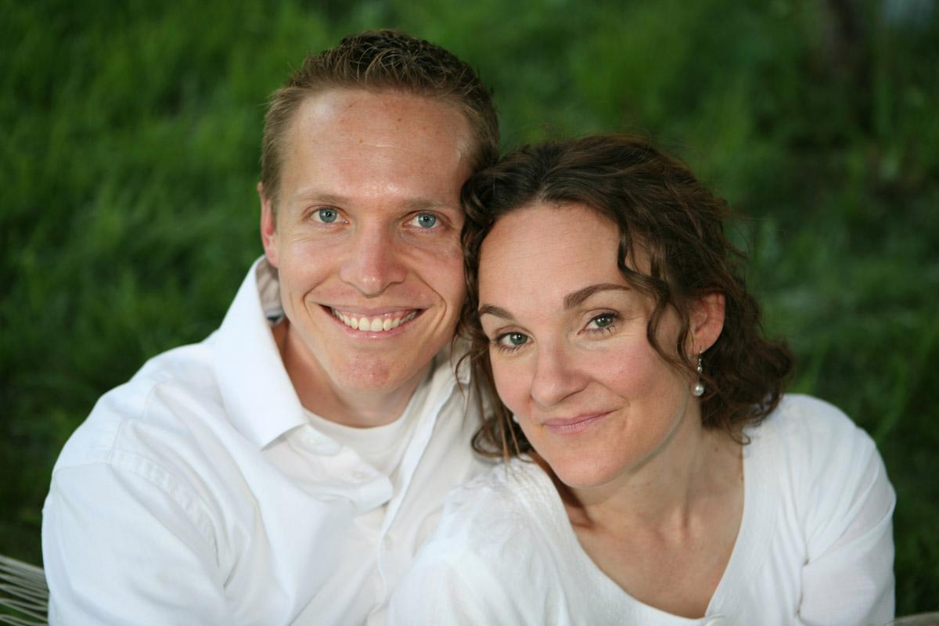
Notes:
And we felt hope

Slide 52
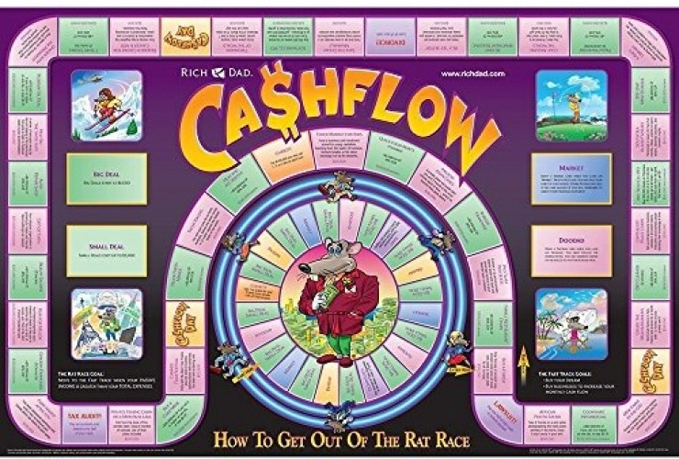

Slide 53
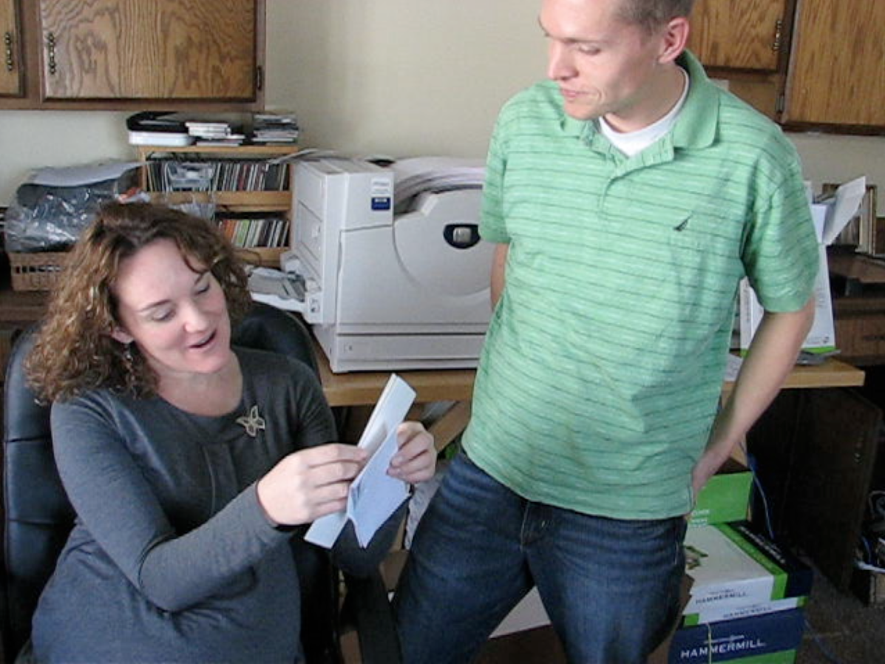
Notes:
We were free.

Slide 54
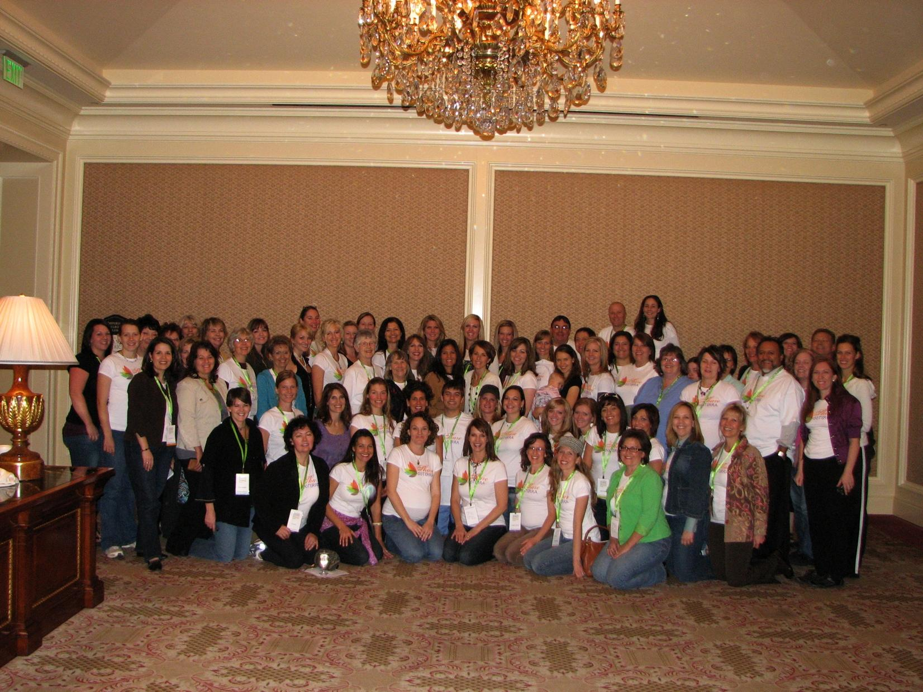

Slide 55
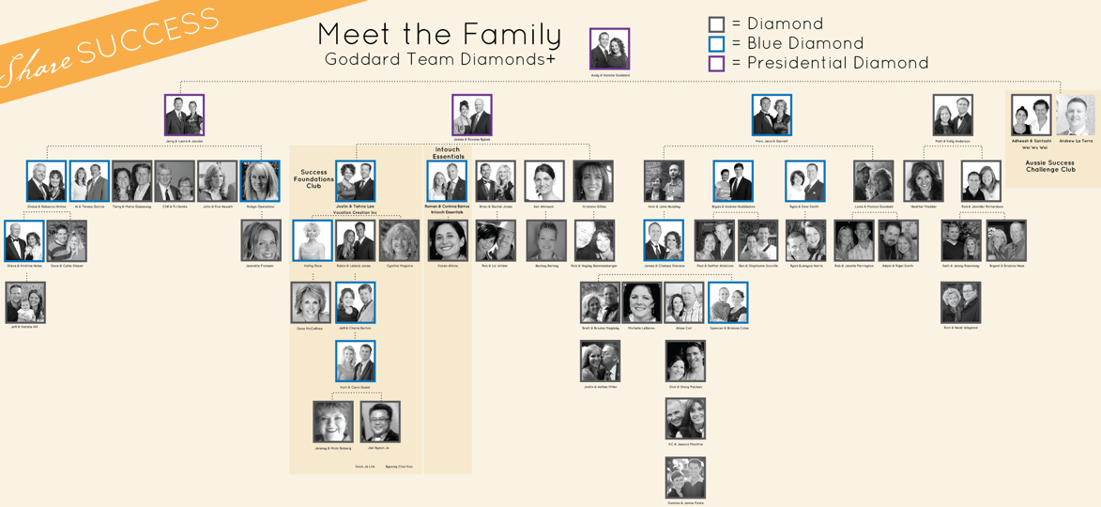

Slide 56
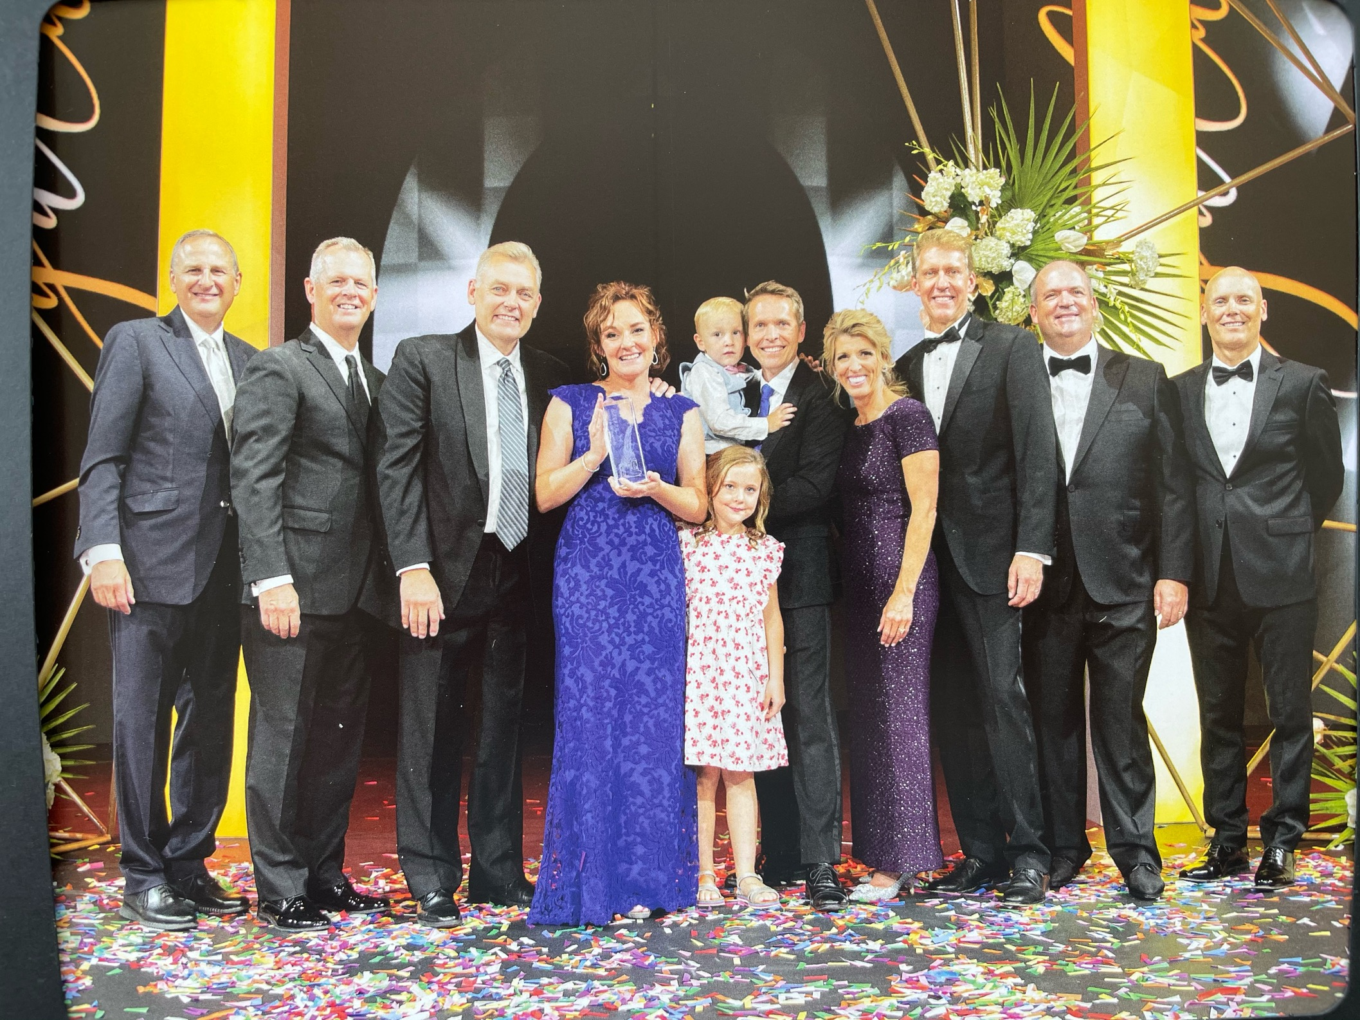
Notes:
When we walked the carpet, we felt free. But the next year, something even more life-changing happened.

Slide 57
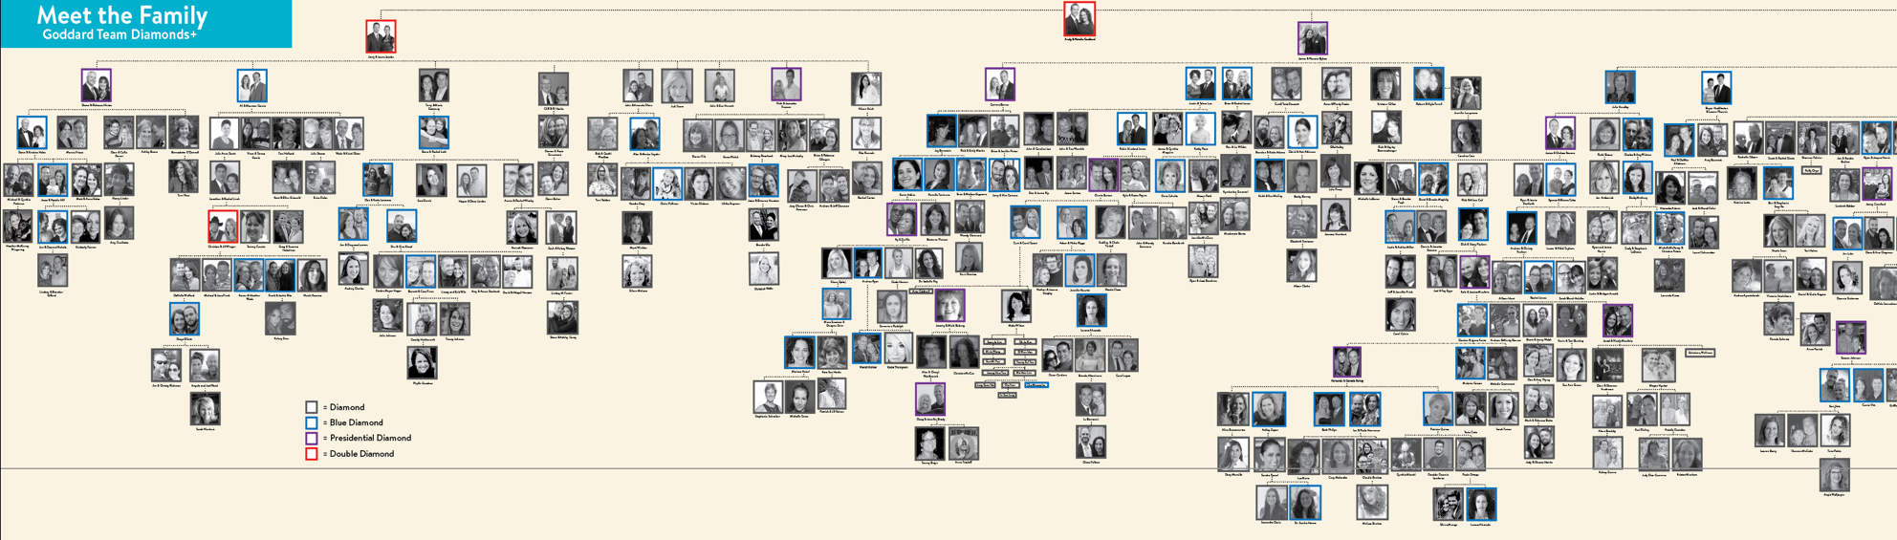
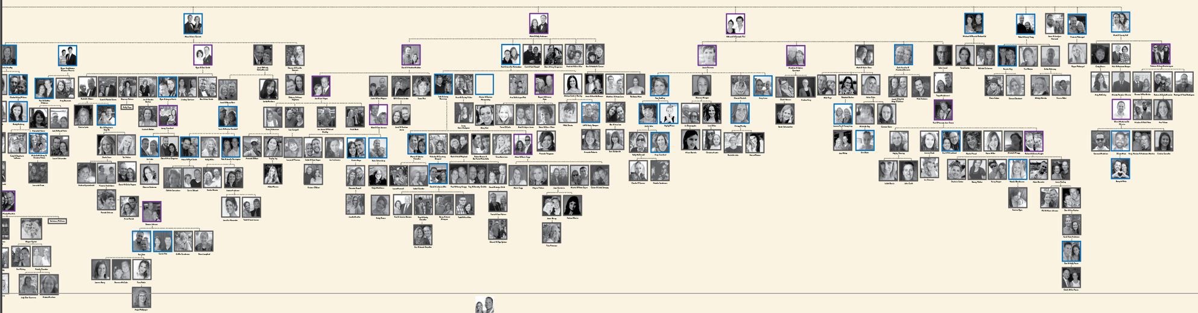

Slide 58

Um curador em cada lar

Slide 59

2,2 milhões de lares

Slide 60
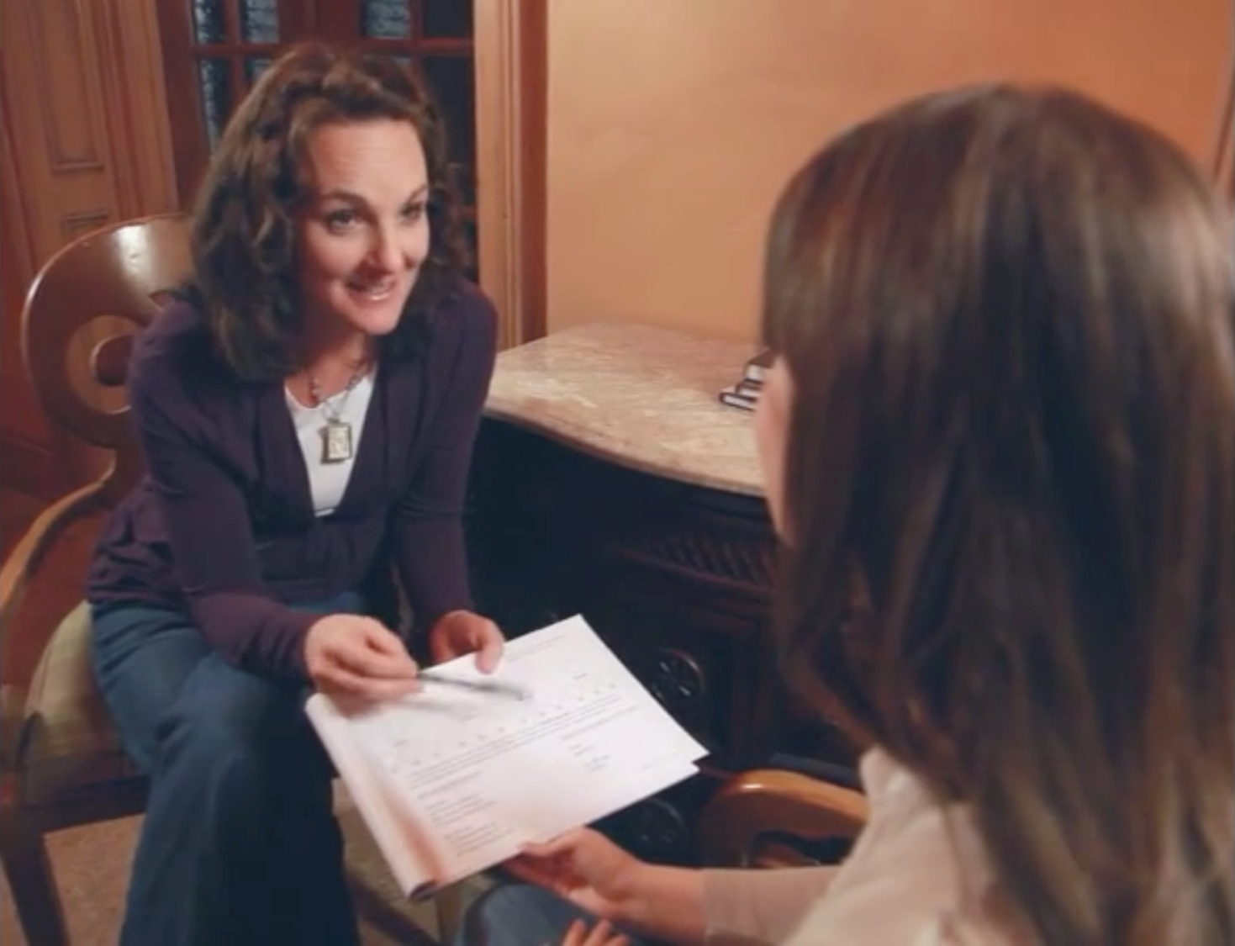
Notes:
Then oils came into our lives and Natalie found emotional health. Then doTERRA came into our lives and we found physical AND emotional health. Then Natalie did what her mom did for her – SHE SHARED IT. Living and sharing turned into building and for the first time in our lives…

Slide 61
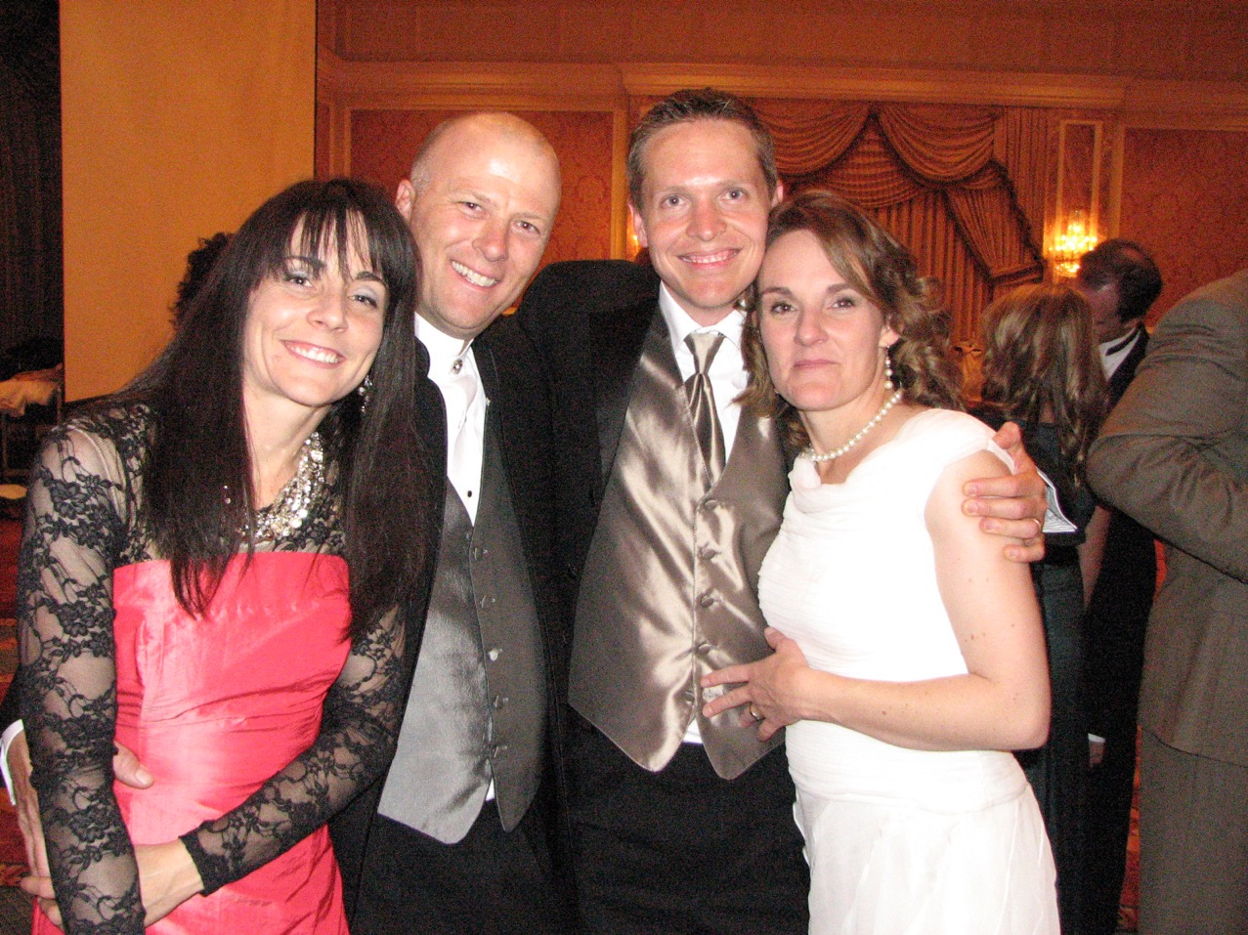
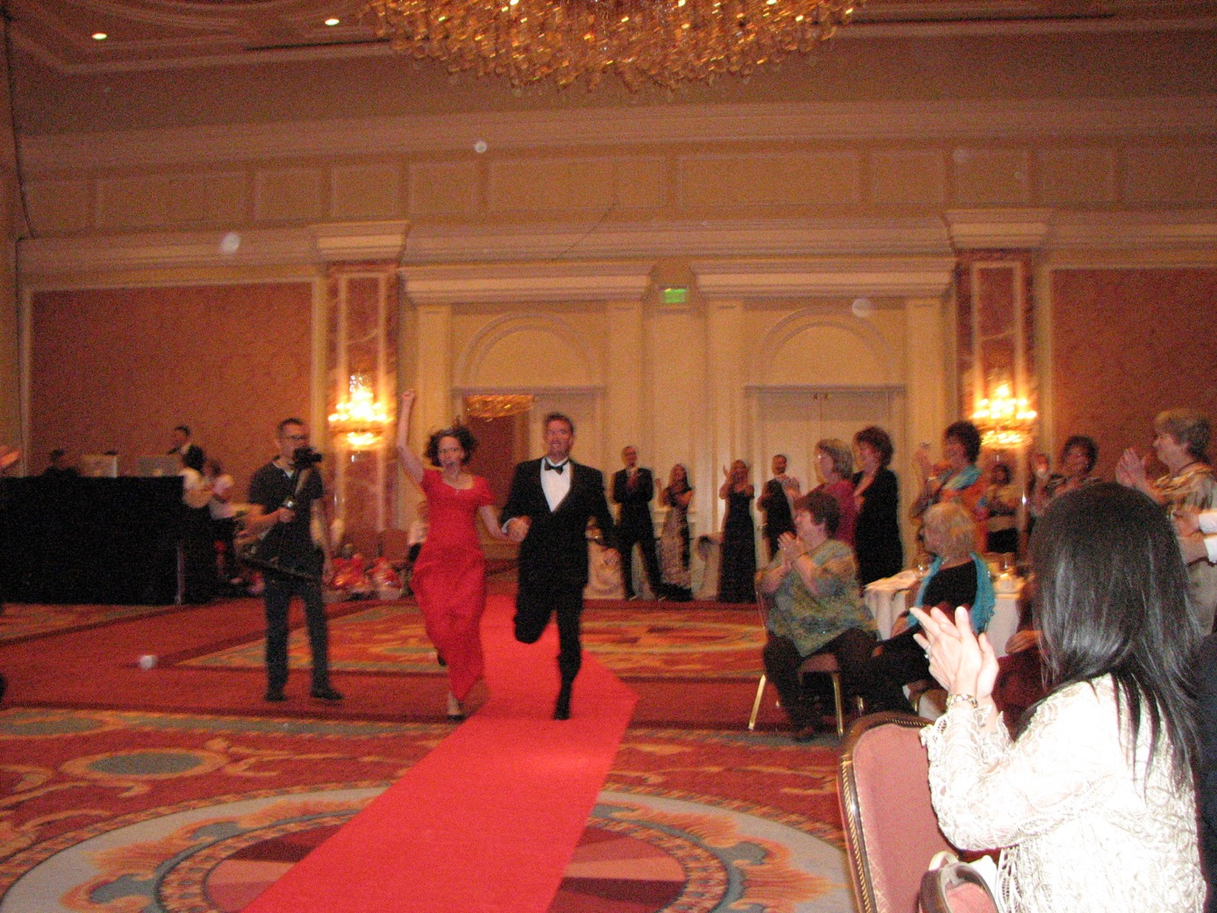
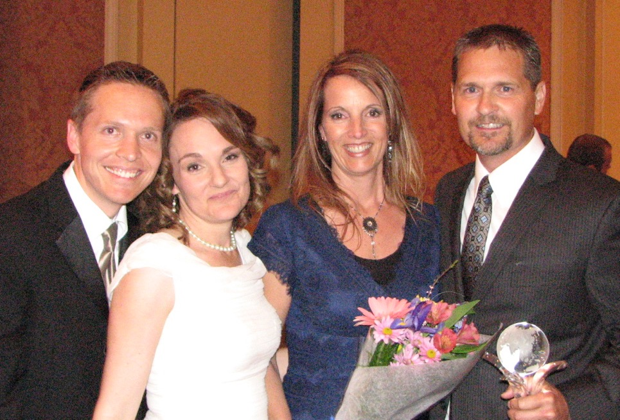
Us crying
Notes:
We hugged our 3 frontlines as they walked as diamonds. We cried ugly tears. We became addicted to setting people free.

Slide 62
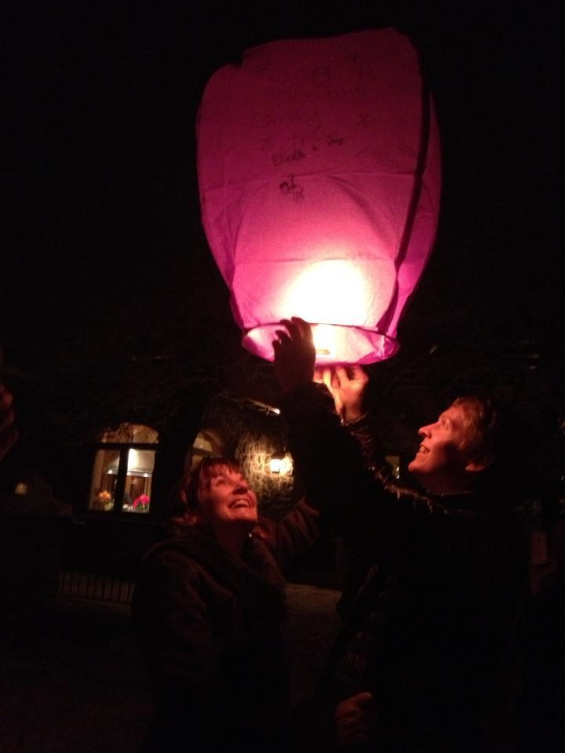
Notes:
And dreaming of helping other’s dreams come true

Slide 63
Você vai conseguir tudo o que quer na vida,
se você ajudar outras pessoas o suficiente a conseguirem o que querem.
- Zig Ziglar

Slide 64
64 Presidential Diamonds
190 Blue Diamonds
672 Diamonds

Slide 65
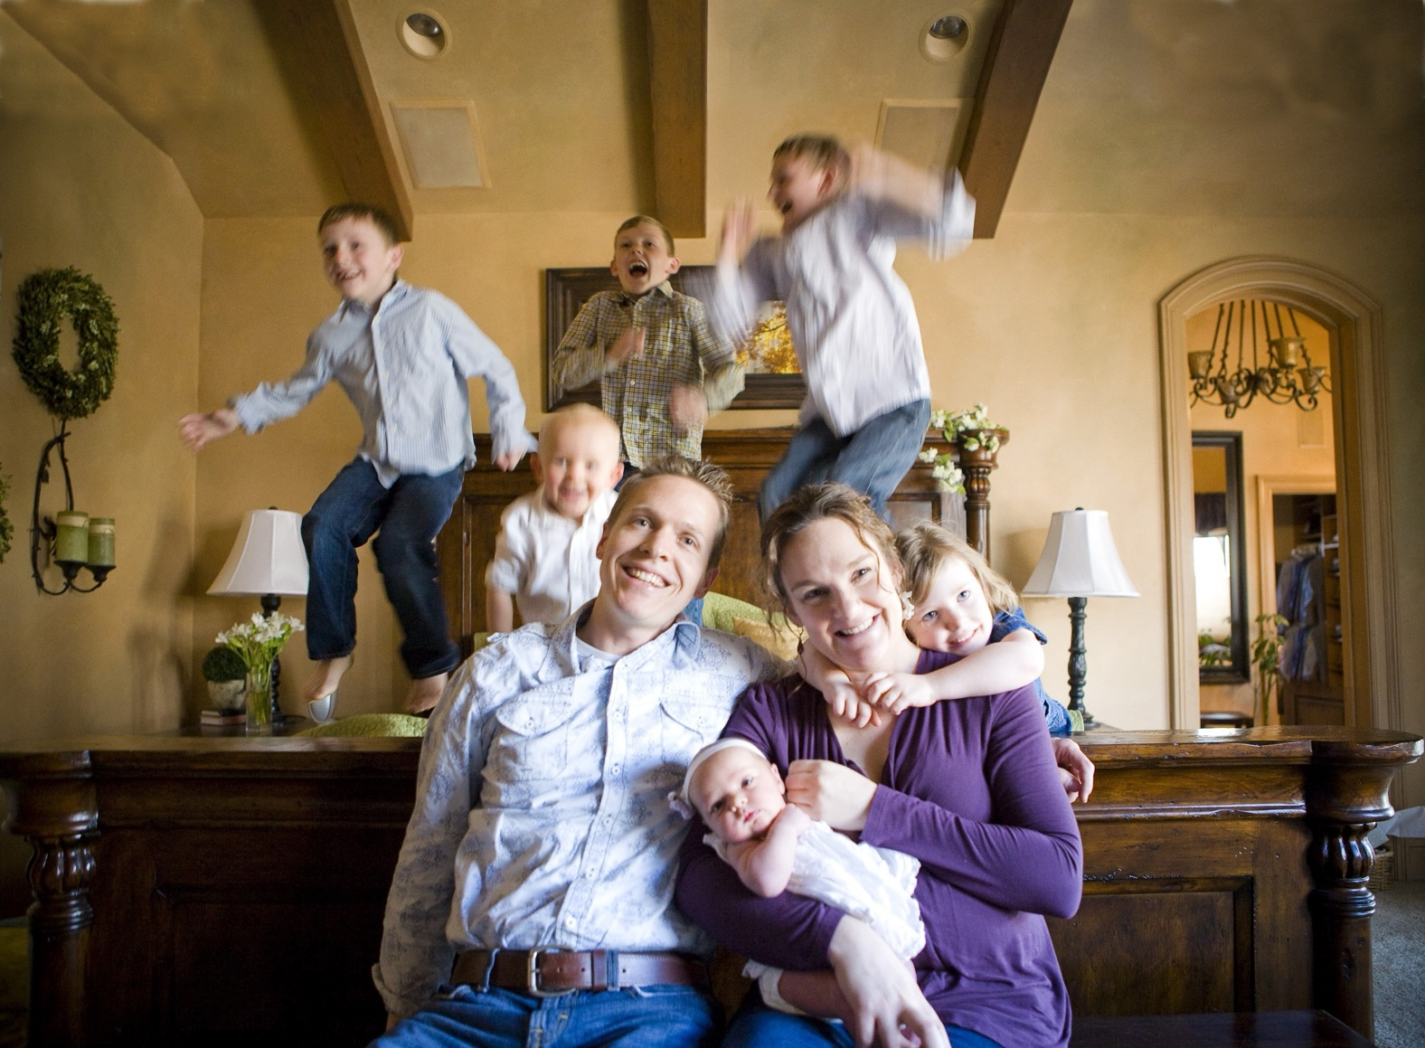
Notes:
And so many of our dreams came true

Slide 66
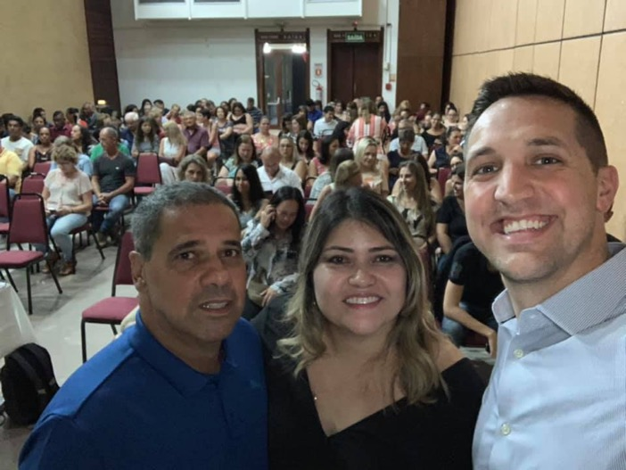
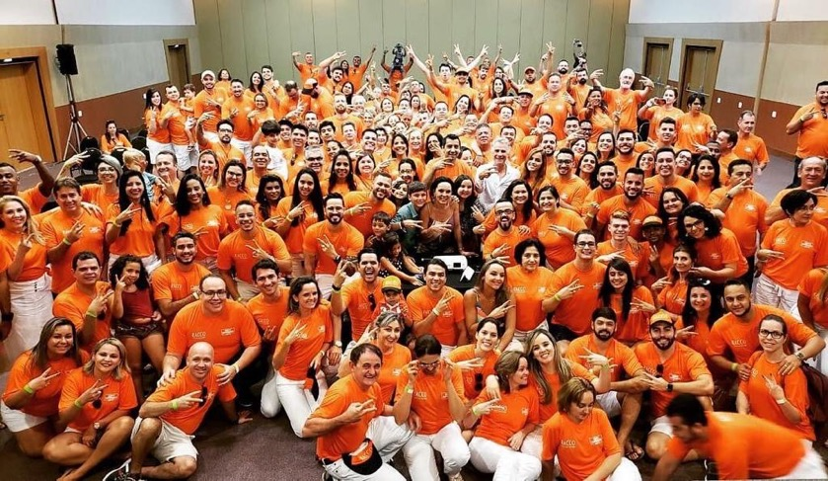
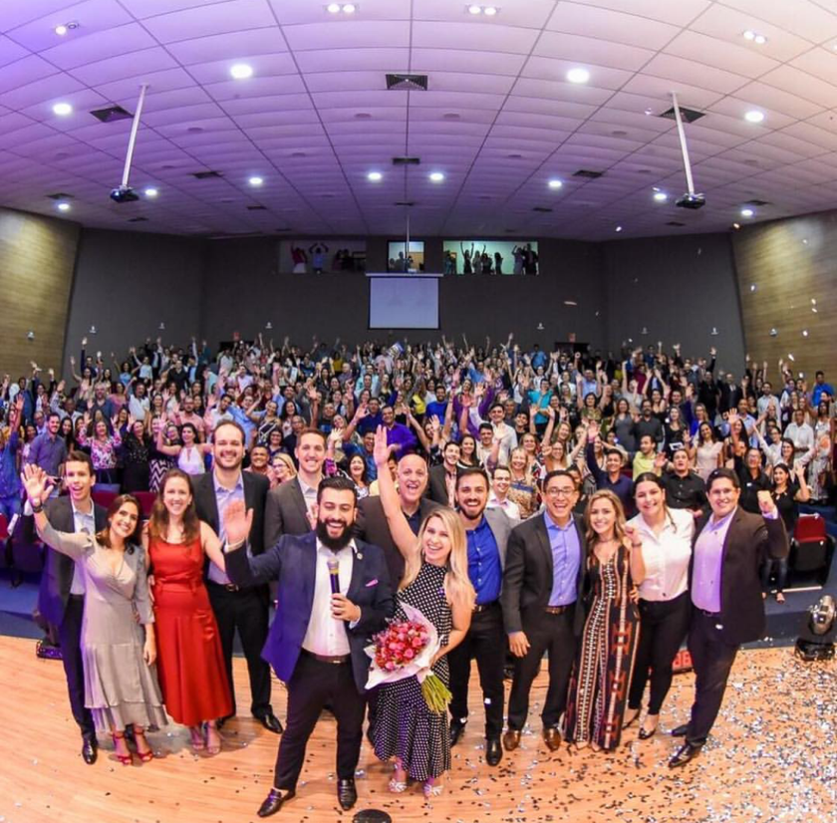
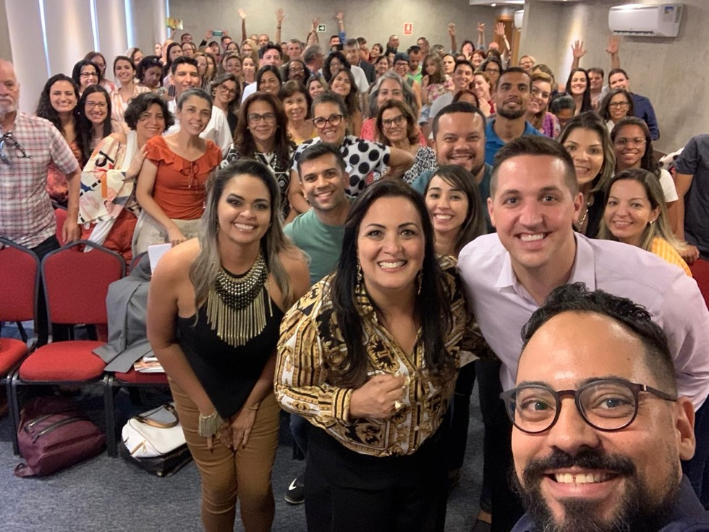

Slide 67


Slide 68


Slide 69
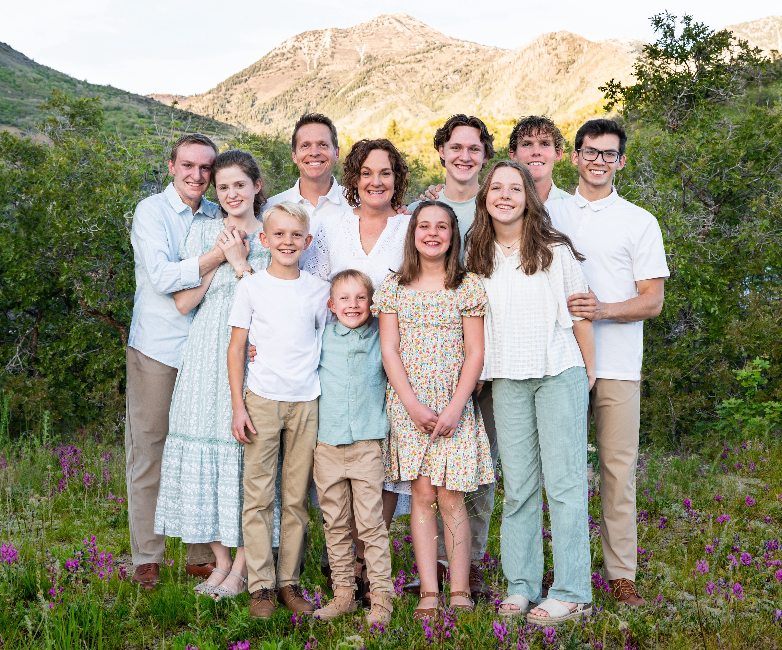

www.doterra.com/empowered-success
Notes:
I want you to think of the most successful brands in the world. What do they have in common? They strongly focus on their customers. So it’s no coincidence that they lead in their respective markets.

Slide 70
O Poder da Oportunidade

Slide 71
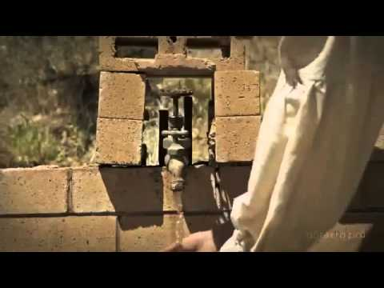

Slide 72
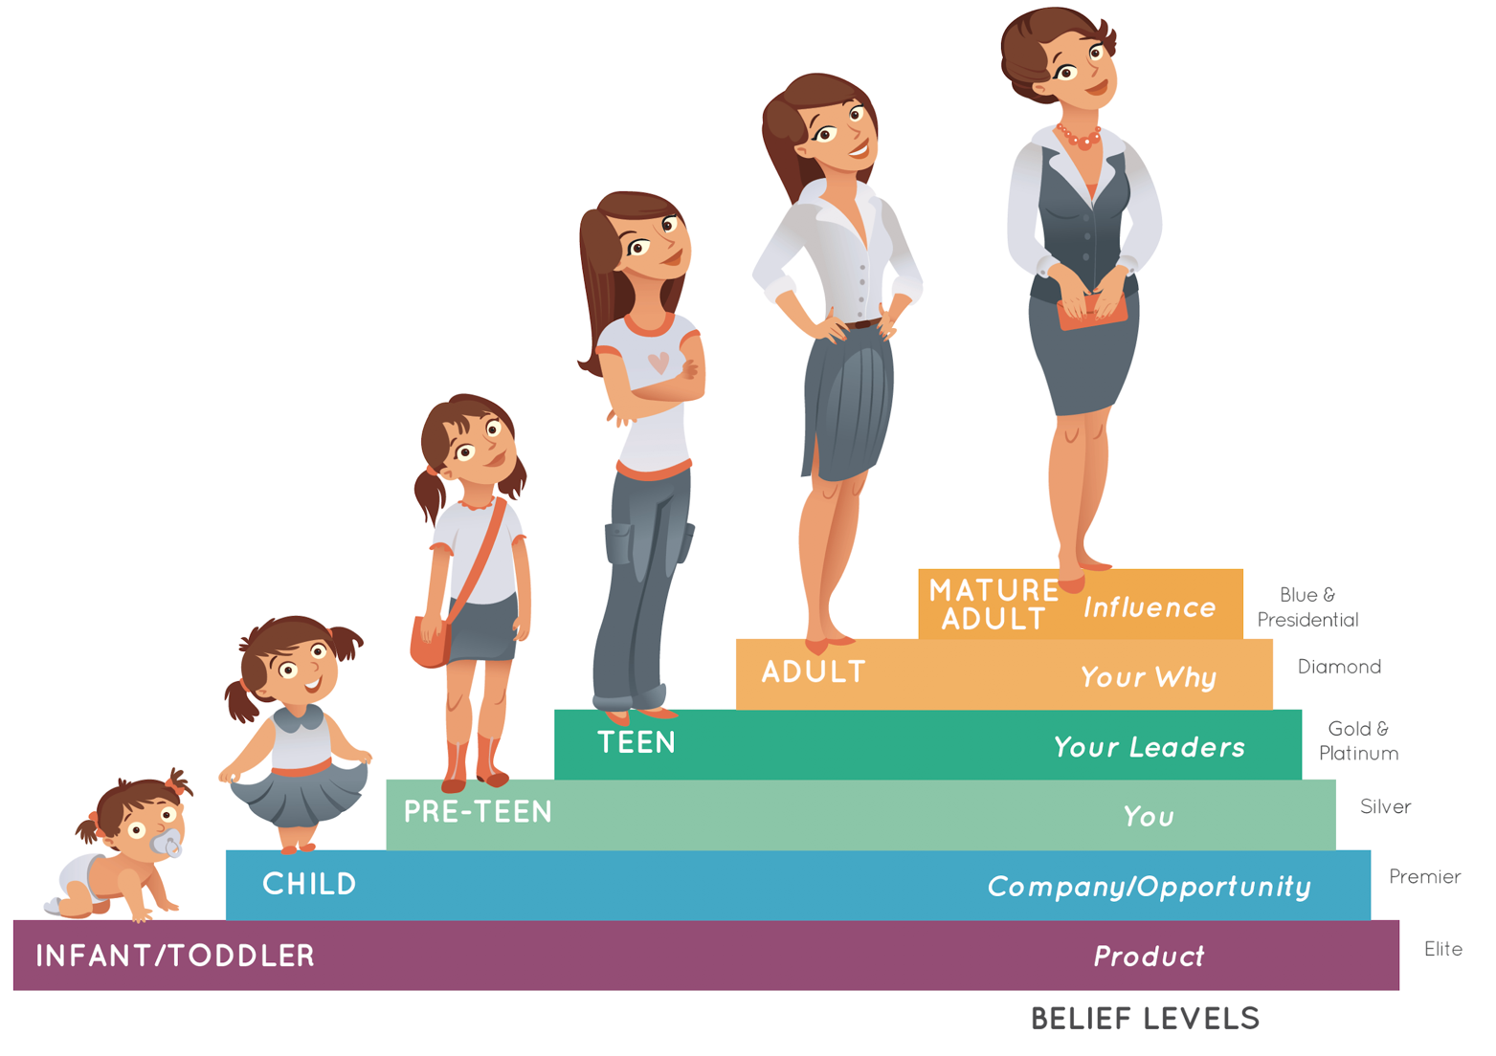

Slide 74


Slide 76

6

Slide 77

Melhores óleos essenciais!

Slide 78
Melhor Plano de Compensação
$114,100
$41,800
Renda média mensal!
$17,200
$10,200
$5,600
$2,500
$900
$400

Slide 79

Notes:
Help them see themselves in it

Slide 80

Live
Notes:
And then there is you…

Slide 81

Share

Slide 82

Build

Slide 83

Notes:
What we do- PIPES creates a financial pipeline as well… so in training builders you’ll often see it this way

Slide 84
Foco no UM

Slide 85
Trabalhe de forma mais inteligente

Slide 86
Resolvendo Preocupações

Slide 87
Duplique

Slide 88


Slide 89

The Big Questions From Every New Builder

Slide 90


Slide 91

Notes:
But what activity actually gets the results you want?

Slide 92


Slide 93

MÉTODO DAS TRÊS PORTAS
(uma abordagem filosófica para sua lista de nomes)

Slide 94



Slide 95


Slide 96










Share & Invite
Enroll
Prospects
GOALS FOR
Enroll
In LRP
Commit
to Build
Commit
to Host
Notes:
If you master these 5 conversations, you can achieve any rank. Always be listening for the Unmet needs

Slide 97


Slide 98

Notes:
The intention is to learn this class both educated and empowered

Slide 99
Criar lista de nomes

Slide 100



Slide 101


Slide 102


Slide 103
Filtrar a sua lista de nomes

Slide 104


Slide 105


Slide 106
Scripts

Slide 107
Escolha suas maneiras de compartilhar

Slide 108

19-20

Slide 109
Aprimorando sua mensagem

Slide 110


Slide 111


Slide 112




Slide 113



Slide 114



Slide 115
Escolha 2 nomes
(quente e morno)
Aperfeiçoe seus scripts
Enviar uma mensagem de texto

Slide 116
Você vai conseguir tudo o que quer na vida,
se você ajudar outras pessoas o suficiente a conseguirem o que querem.
- Zig Ziglar

Slide 117
SATURDAY:
2525 N. Three Falls Dr.
Alpine, UT
9am-3pm
EXPERIENCE
doTERRA

Slide 118

Next Events:
  January 24-25
  February 21-22

Slide 119

BELIEF
STUCK
Partner not on board
Burnout
Not duplicating
RESULT
ACTION

