Slide 2
What did you like about the tours?

Slide 3
Meet the Owners

Slide 4
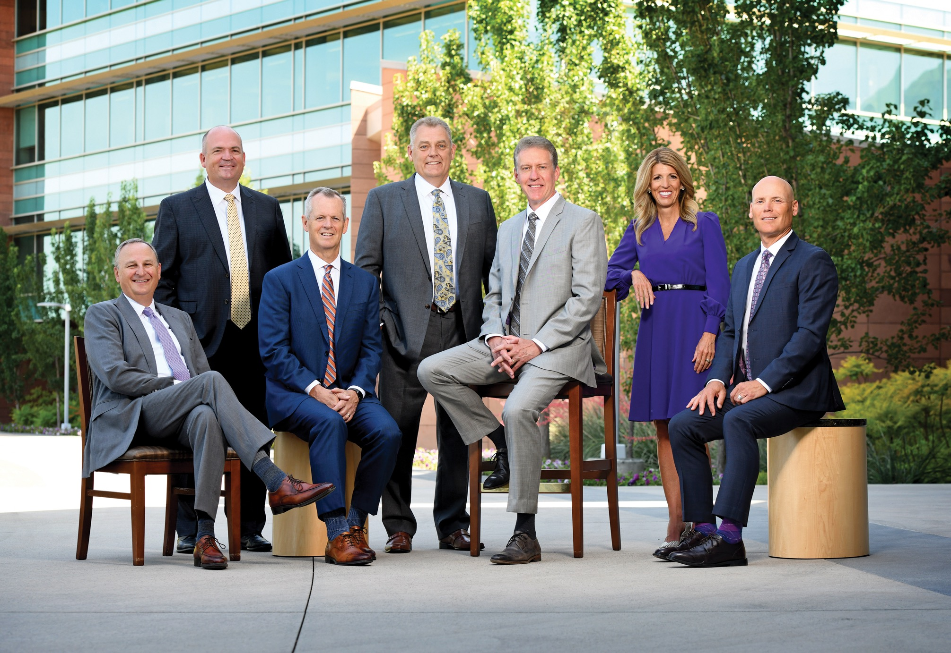
Notes:
VIDEO: Genesis Story

Slide 5
Corporate Guest

Slide 6
Product overview (nutritionals + testimonials)

Slide 7
Story: How I’ve seen doTERRA bless others and my life

Slide 8
Why Partner with doTERRA

Slide 9
Business Overview

Slide 12
Income Disclosures – Top Ranks

Slide 13
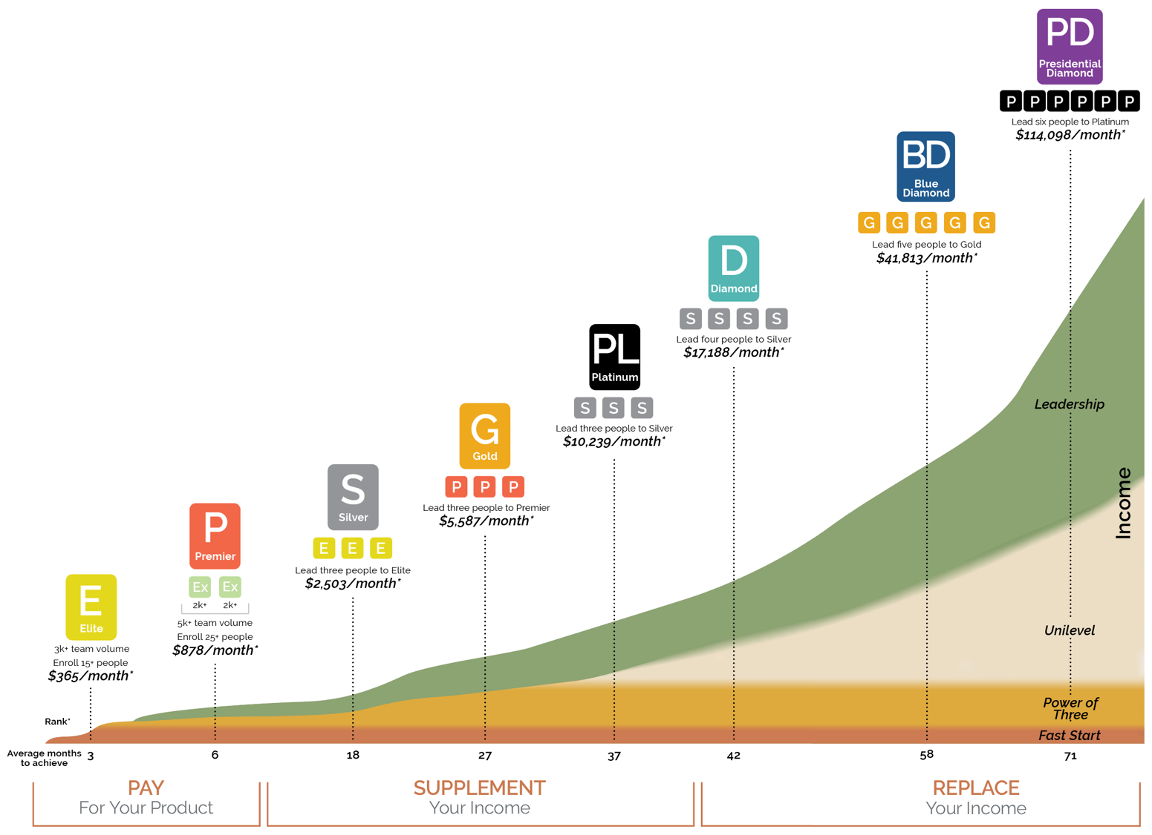
Income Potential
3
3
17
Share Success promotions!
35
77
192
357
1193

Slide 14
Impact

Slide 15
The Power of the Product

Slide 16
Our Story

Slide 17
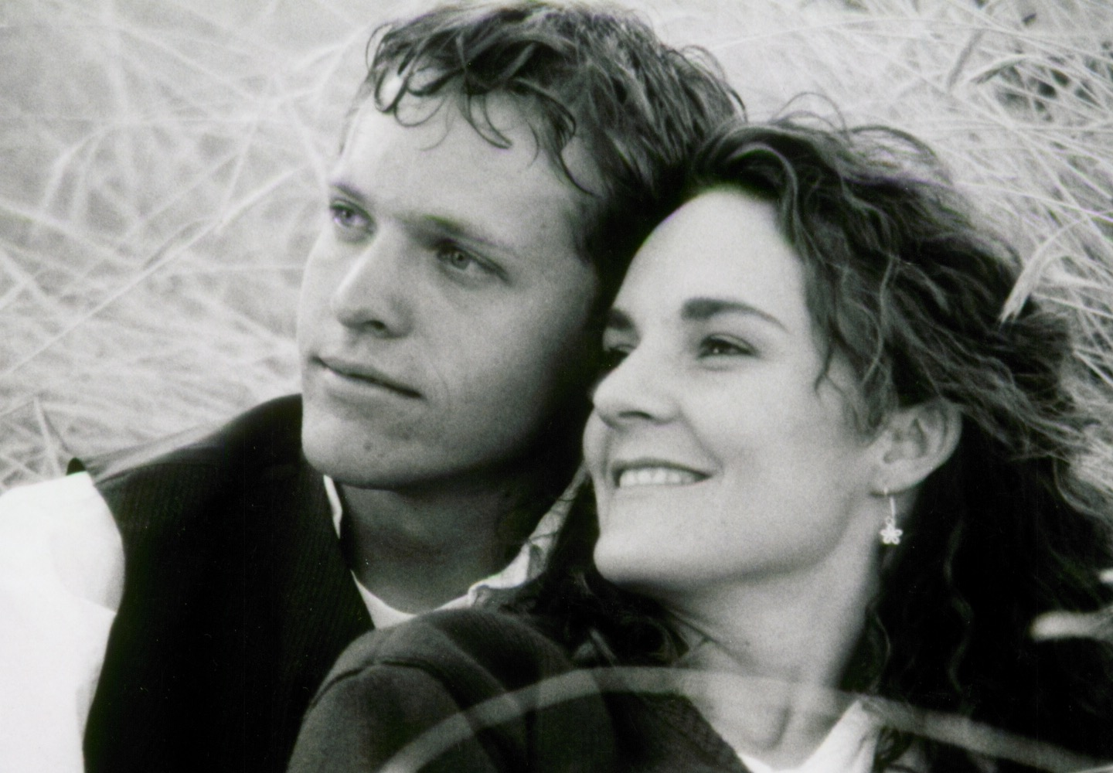
Notes:
I’d like to honor Natalie

Slide 18
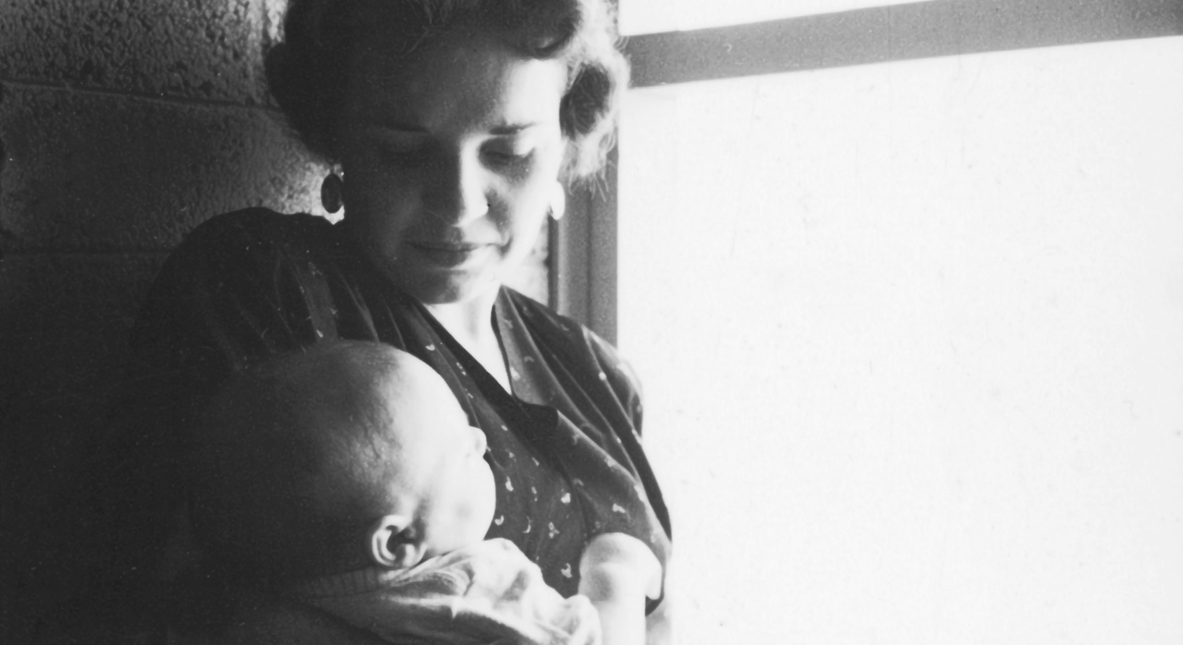
Notes:
She was raised by a mother who struggled with health issues all her life. She turned to western medicine, but didn’t find any relief. She turned to holistic medicine and found solutions. When she started living healthier, she did something very important: She shared. Natalie learned about natural wellness from her mother. But when Natalie was 19, her mother suddenly died – left a hole. Natalie struggled with depression.

Slide 19
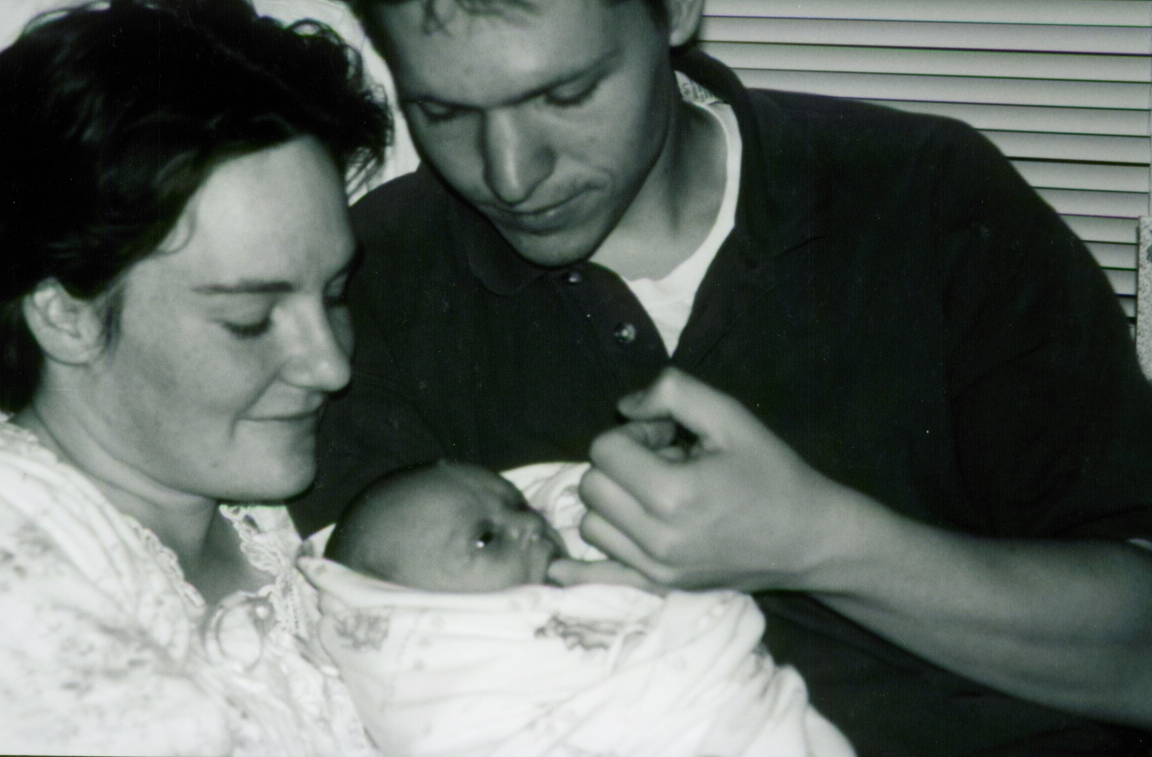
Notes:
Natalie was raised to believe that having a family was the key to happiness, but she was still depressed.

Slide 20
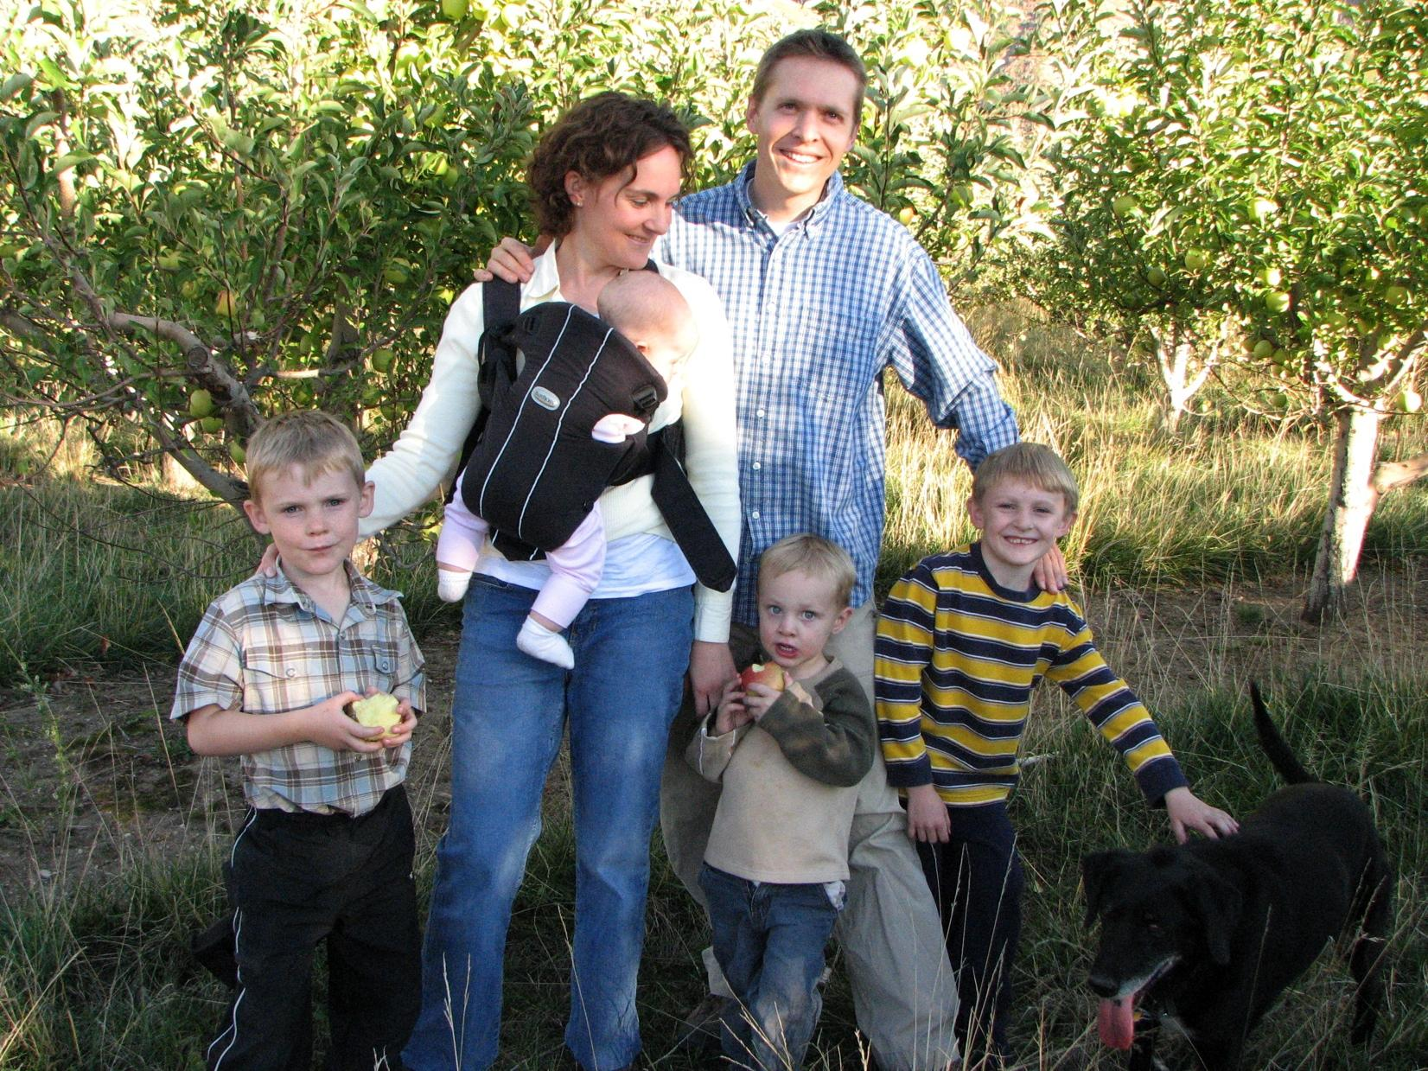
Notes:
So we had 3 more. You can guess how that worked out.

Slide 21
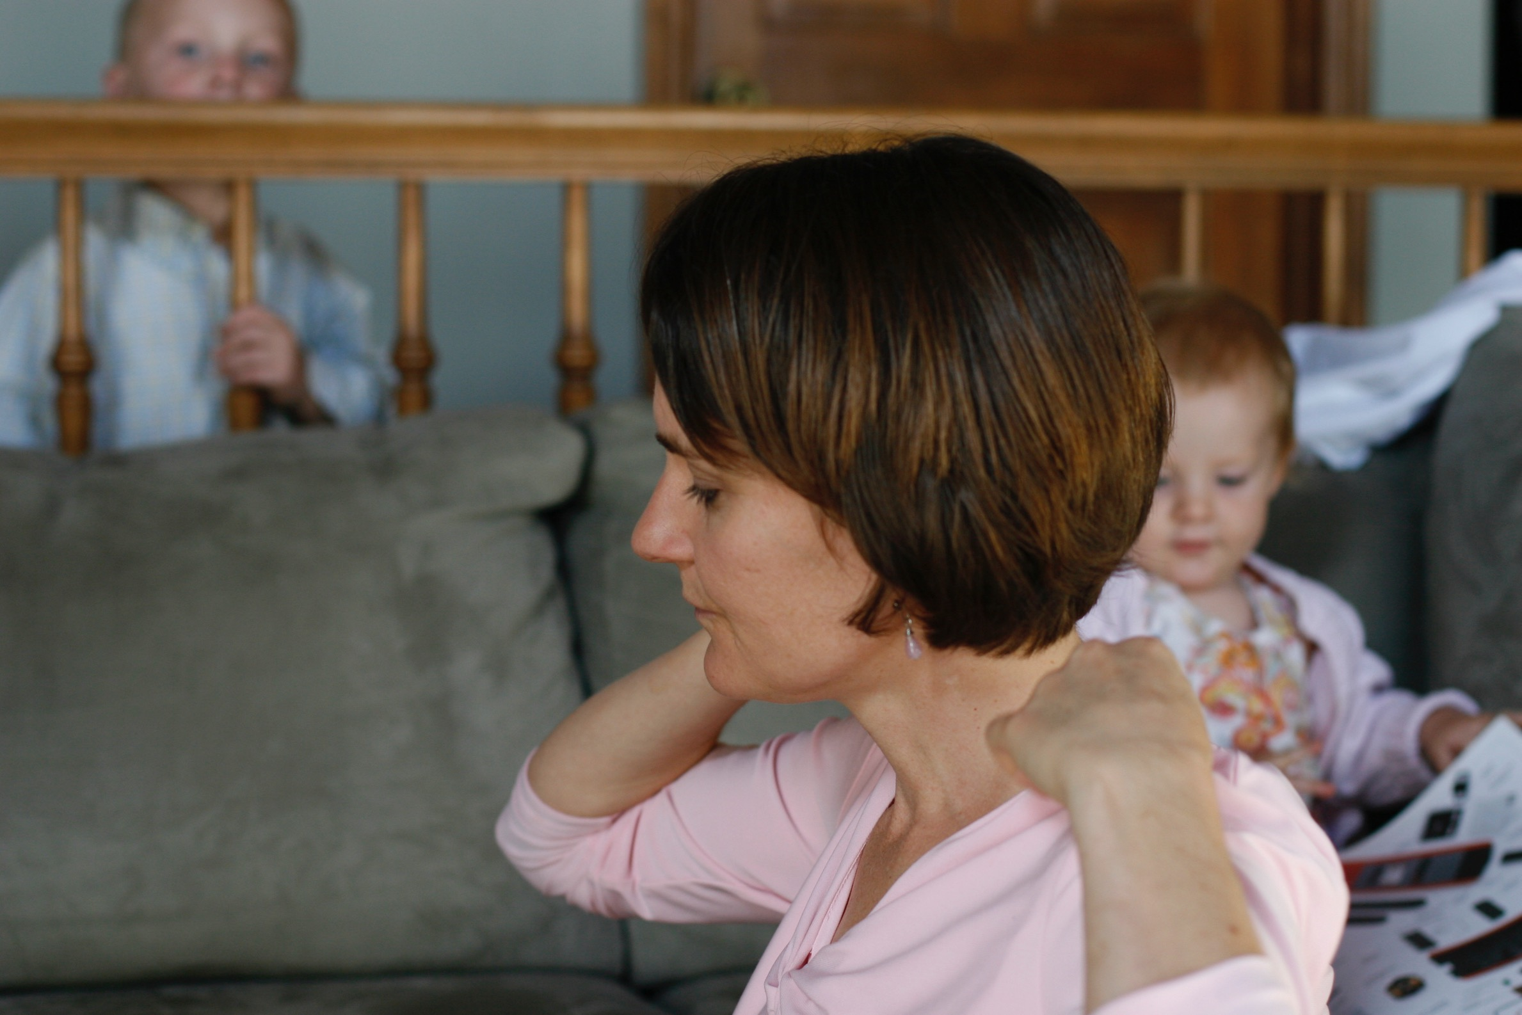
Notes:
She asked, “Is there more to life than changing diapers and wiping noses?”

Slide 22
Notes:
I bought her a massage for her birthday, but it was a different kind of treatment. The woman used essential oils, music, and massage. Natalie experienced more healing in that 1 hour than she had in the previous 9 years. The fog of her depression was lifted. She finally felt free. She bought oils from this woman (this was before doTERRA) and came home swiping them on me and all the children. The mood in our home was better, and we started having positive emotional breakthroughs.

Slide 23
Notes:
Several years later, Natalie was driving down the street and saw this woman feeding horses with her children. A little voice told Natalie to stop and talk to her, so she did. Several weeks later, the woman invited Natalie to a class on essential oils. Because Natalie had been using essential oils, she thought she was already an expert.

Slide 24
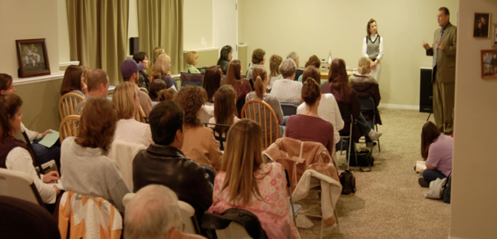
Notes:
After 3 invitations, Natalie said, “I’ll be back in 30 minutes. Then this woman will leave me alone!” She sat on the back row.

Slide 25
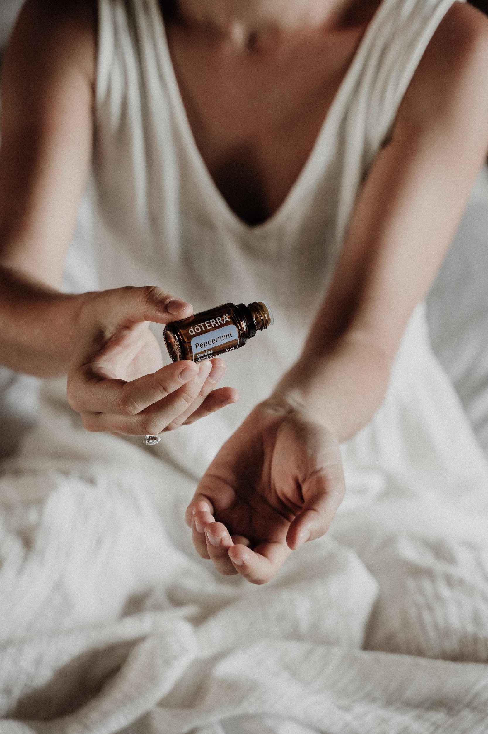
Notes:
First, they passed around the peppermint. It knocked her socks off.

Slide 26
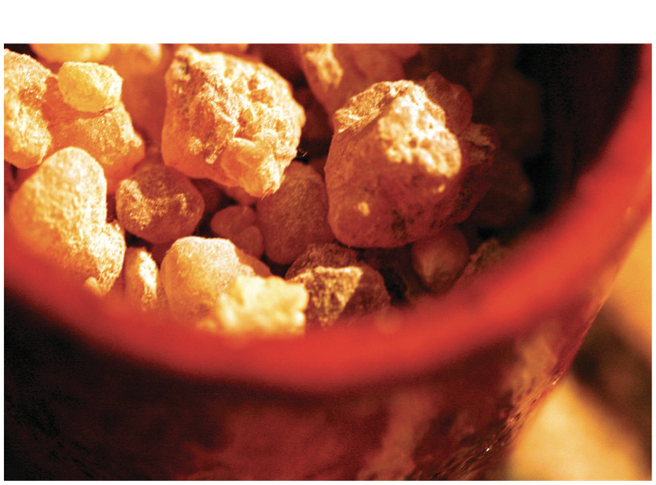
Notes:
Then they passed the Frankincense around. A little voice told her to pay attention.

Slide 27
Notes:
She bought the biggest kit and came home and started using the oils. We couldn’t believe the results! Everyone was healthier and happier.

Slide 28
With these oils, we are the
richest people on earth.
Notes:
After using the oils for 3 weeks, Natalie turned to me and said, ”With these oils, we are the richest people on earth.”

Slide 29
Notes:
Natalie loved to do Yoga. She was in her front yard in Savasana, and she had impressions of people she should share the oils with. She said, If I did that, I would be doing network marketing, and I don’t do network marketing.” The message came back, “I wanted this for you. But if you don’t want it, I can give it to someone else.”

Slide 30
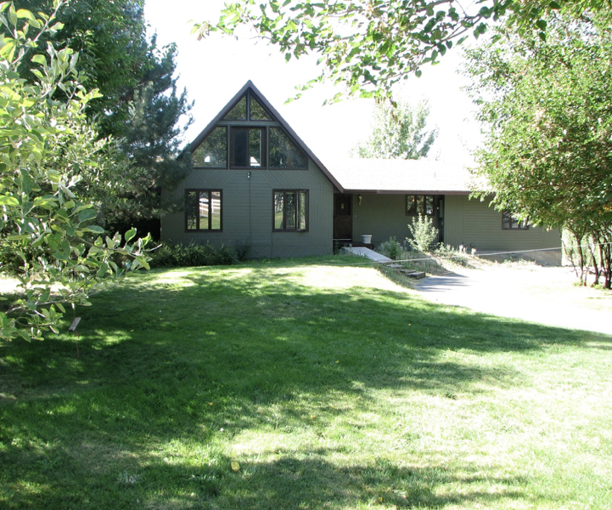

Slide 31
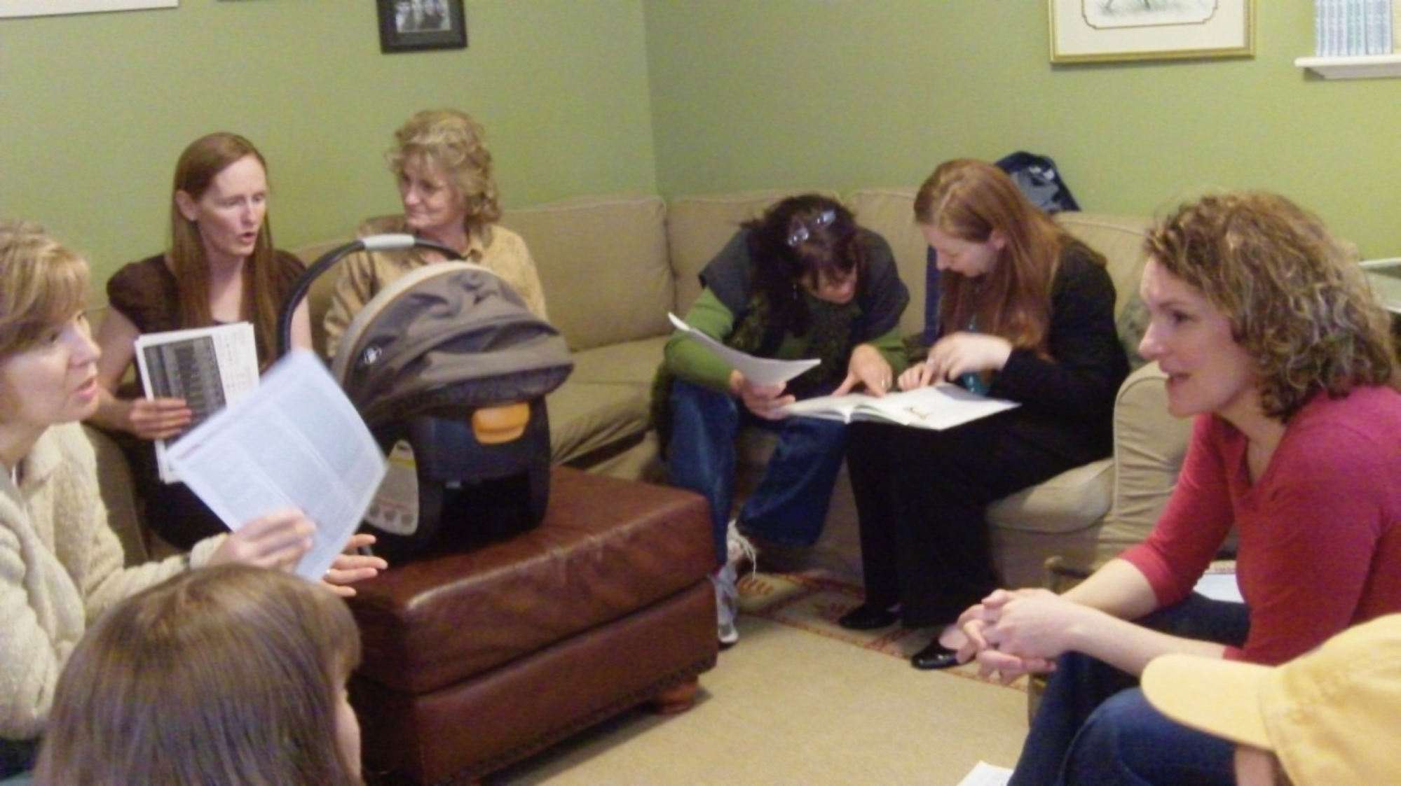
Notes:
Natalie became addicted to empowering women and setting them free to take control of their own health

Slide 32
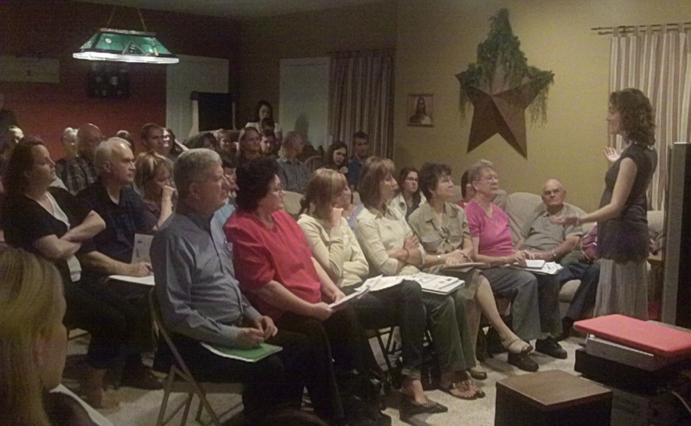
Notes:
She started teaching more people how to be free (physically, financially, and emotionally)

Slide 33
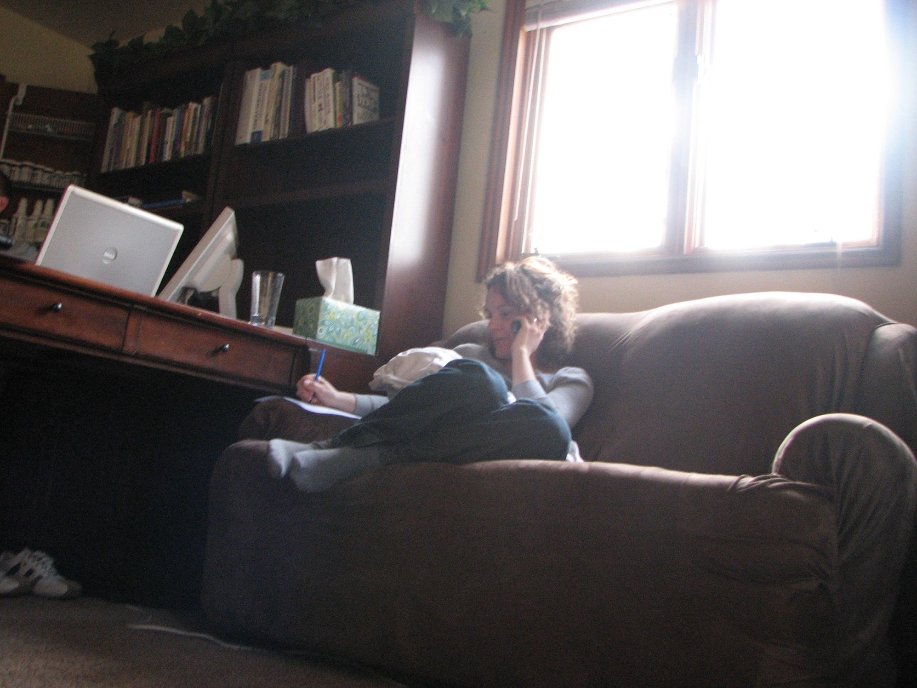
Notes:
She started teaching more people how to be free (physically, financially, and emotionally)

Slide 34
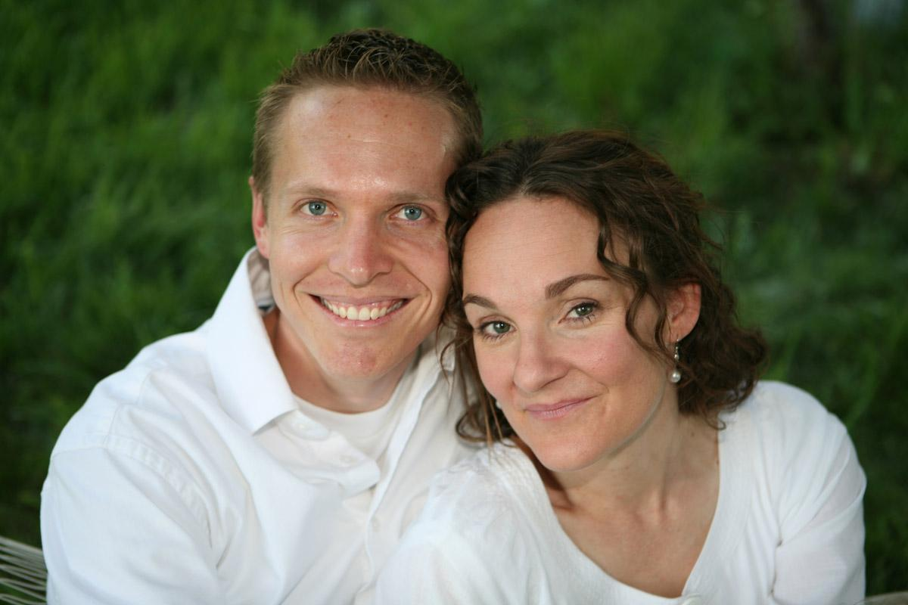
Notes:
And we felt hope

Slide 35
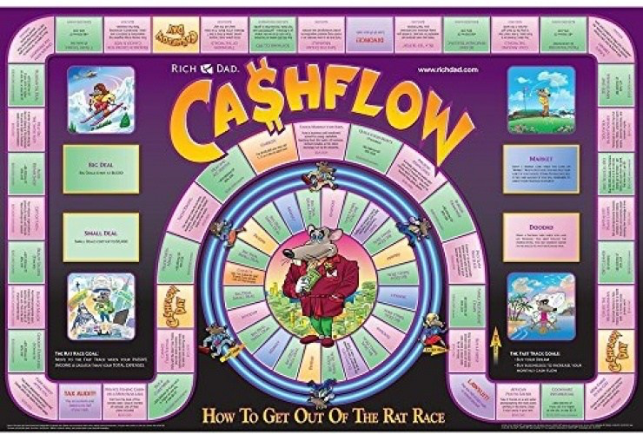

Slide 36
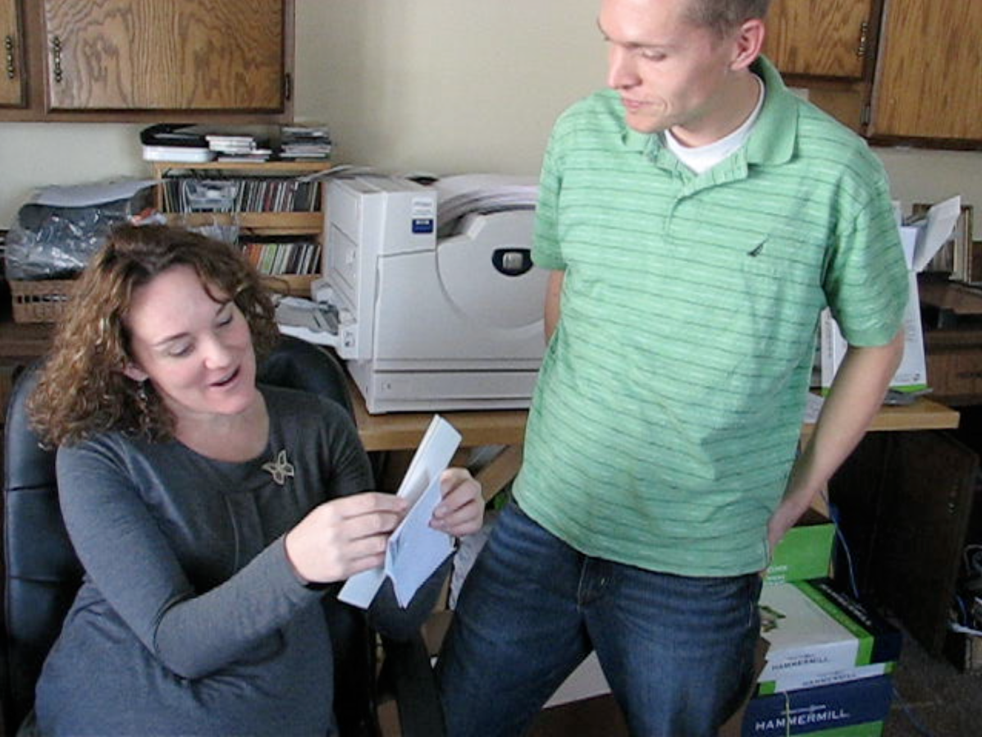
Notes:
We were free.

Slide 37
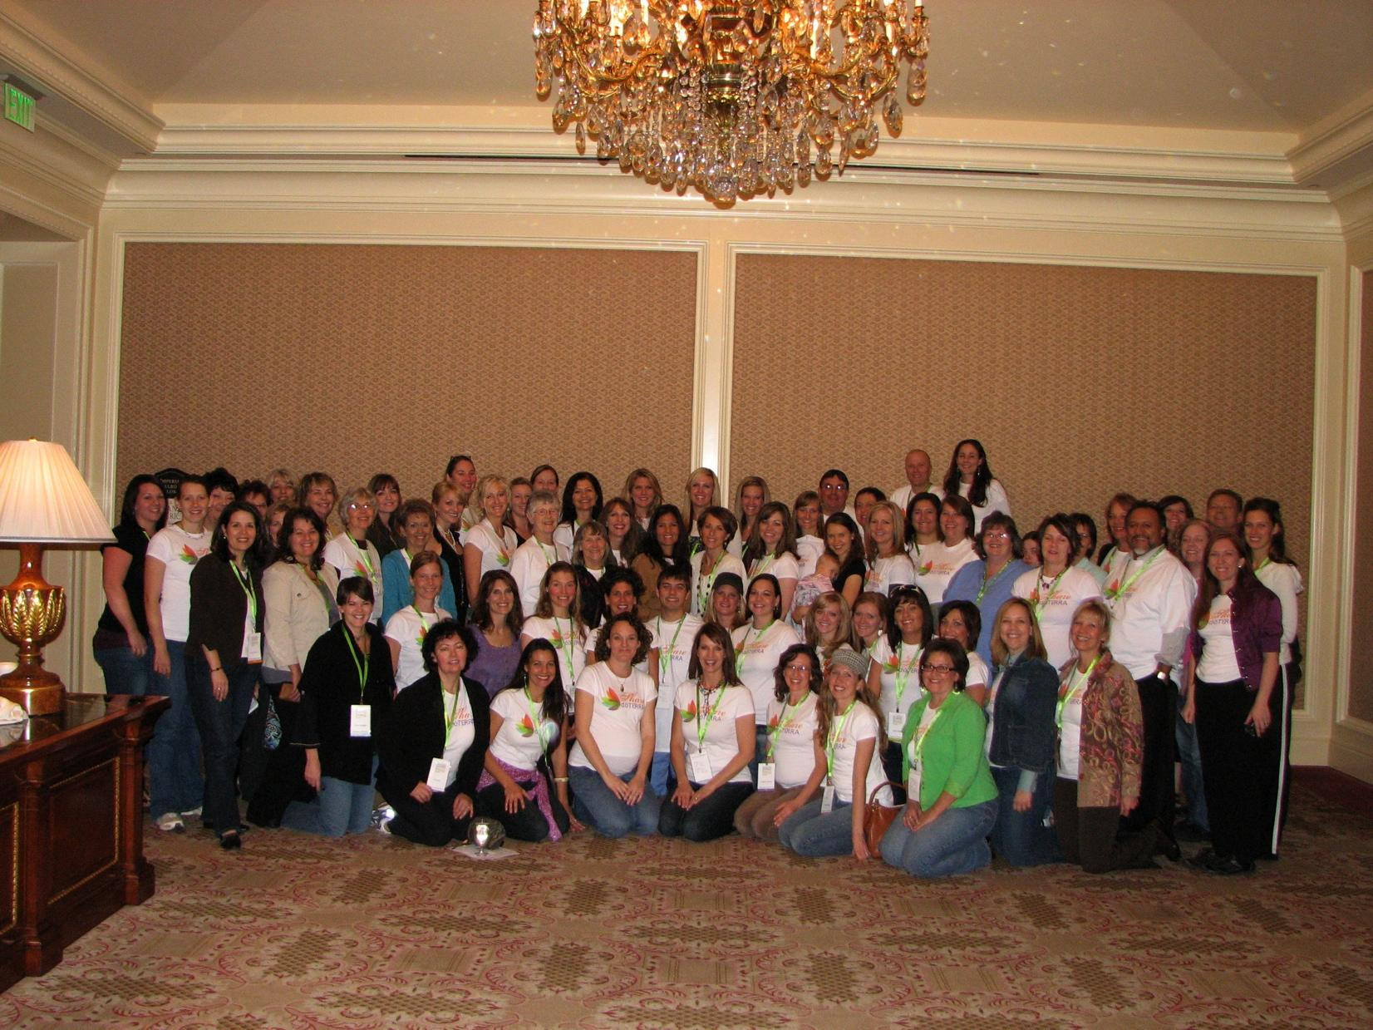

Slide 38
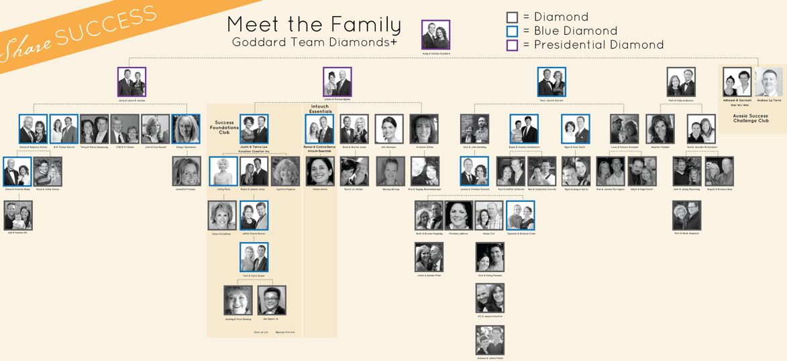

Slide 39
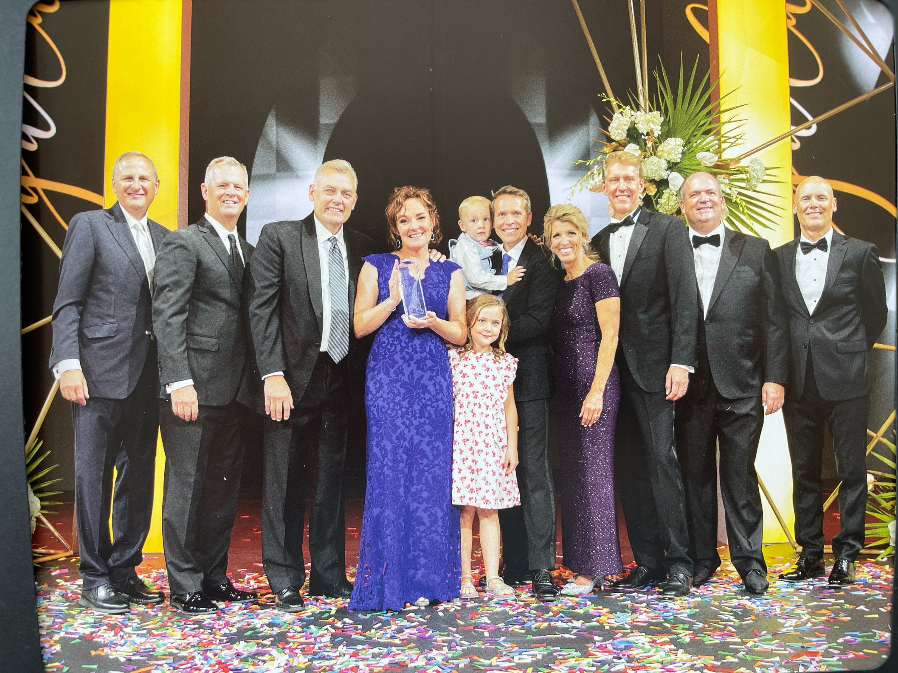
Notes:
When we walked the carpet, we felt free. But the next year, something even more life-changing happened.

Slide 41
A Healer in Every Home

Slide 42
2.2 Million Homes

Slide 43
Notes:
Then oils came into our lives and Natalie found emotional health. Then doTERRA came into our lives and we found physical AND emotional health. Then Natalie did what her mom did for her – SHE SHARED IT. Living and sharing turned into building and for the first time in our lives…

Slide 44
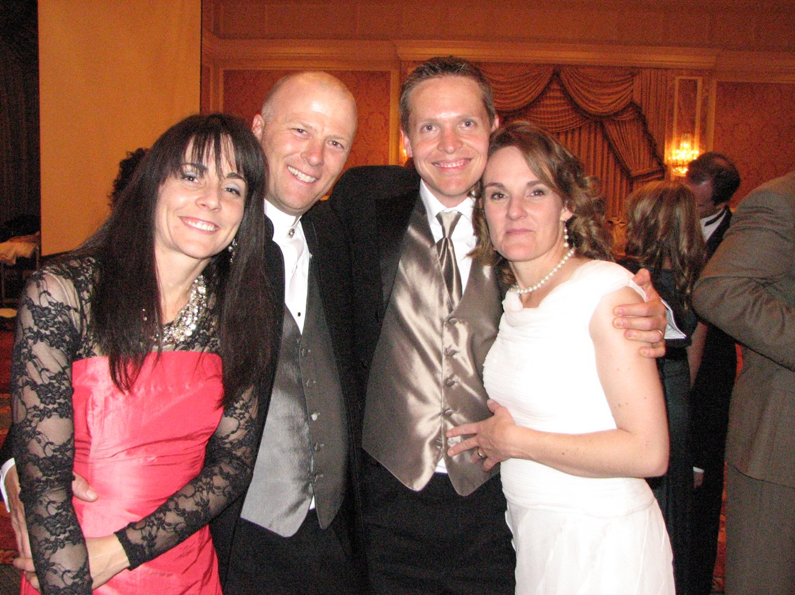
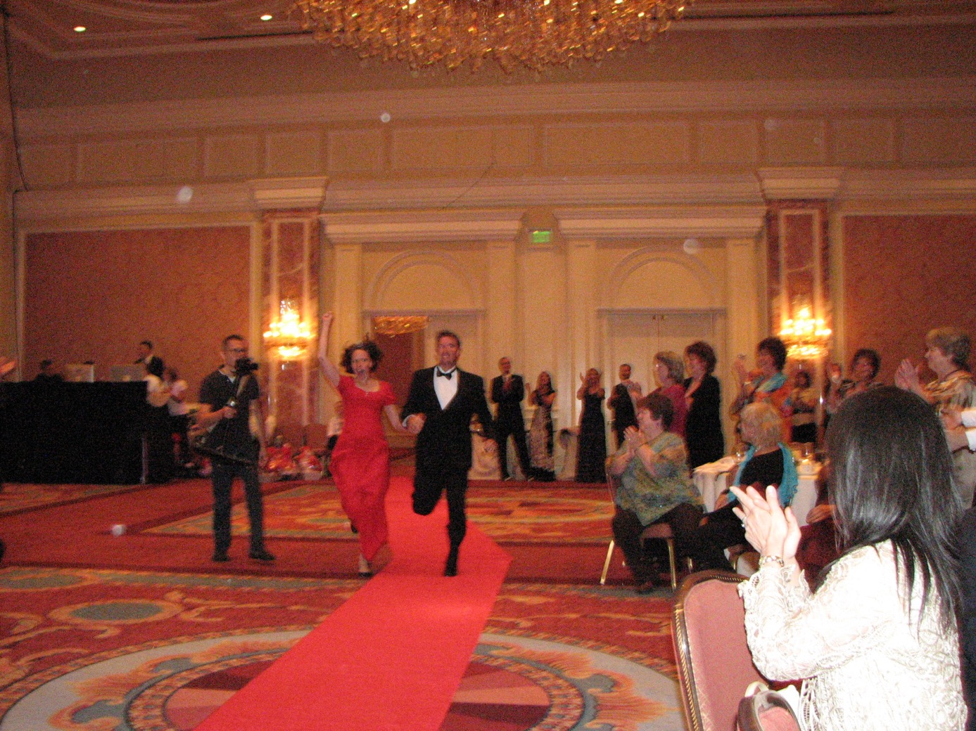
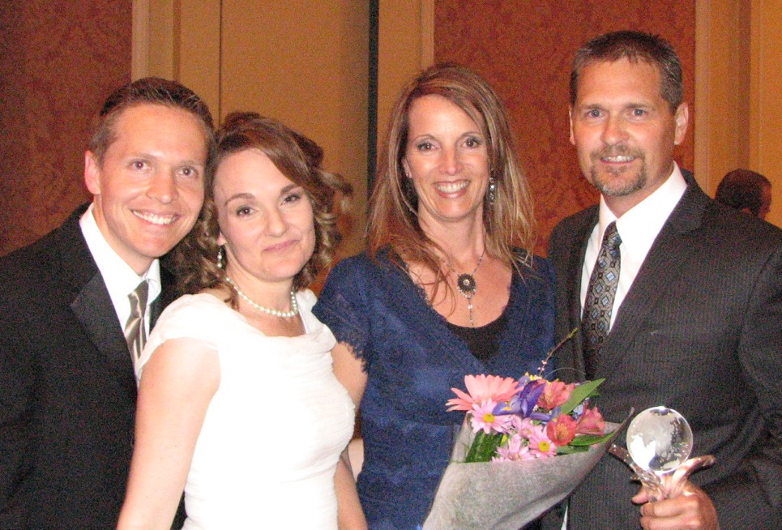
Us crying
Notes:
We hugged our 3 frontlines as they walked as diamonds. We cried ugly tears. We became addicted to setting people free.

Slide 45
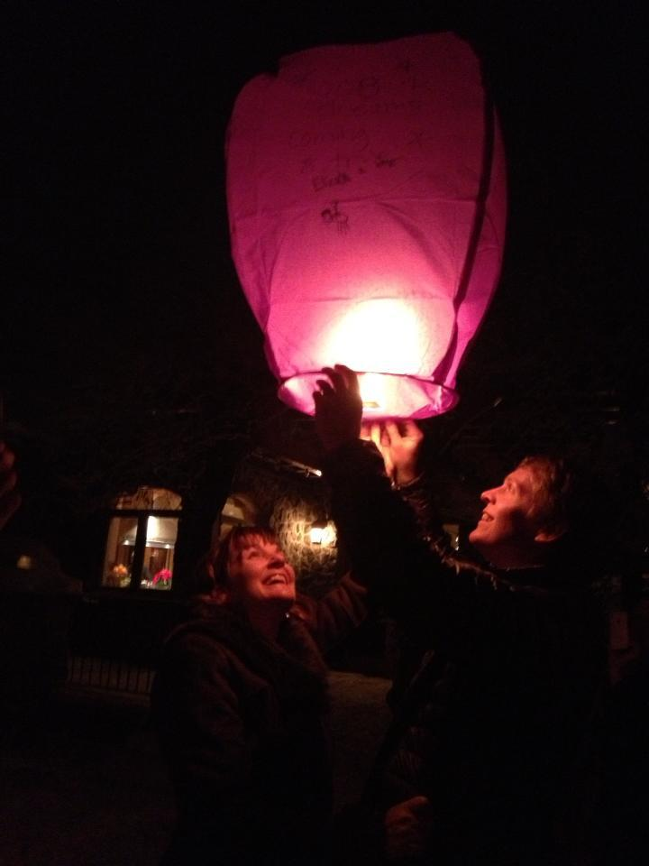
Notes:
And dreaming of helping other’s dreams come true

Slide 46
You will get all you want in life,
if you help enough other people get what they want.
- Zig Ziglar

Slide 47
64 Presidential Diamonds 196 Blue Diamonds 684 Diamonds

Slide 48
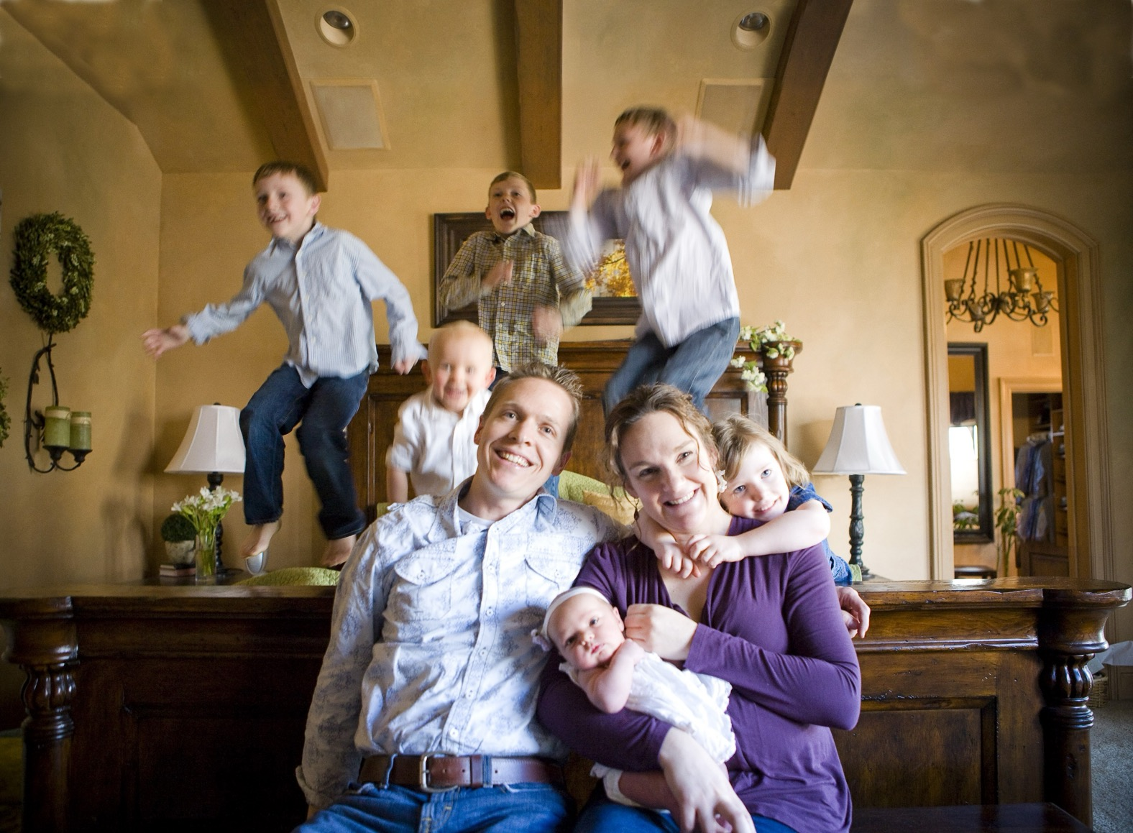
Notes:
And so many of our dreams came true

Slide 49
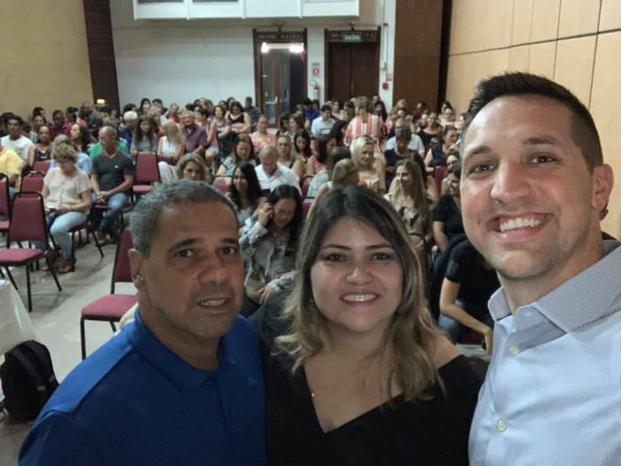
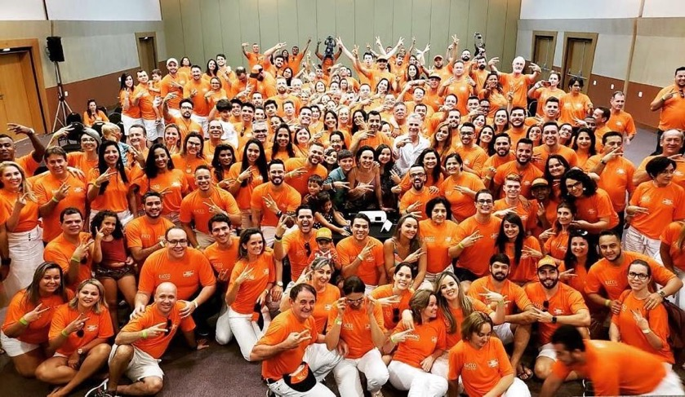
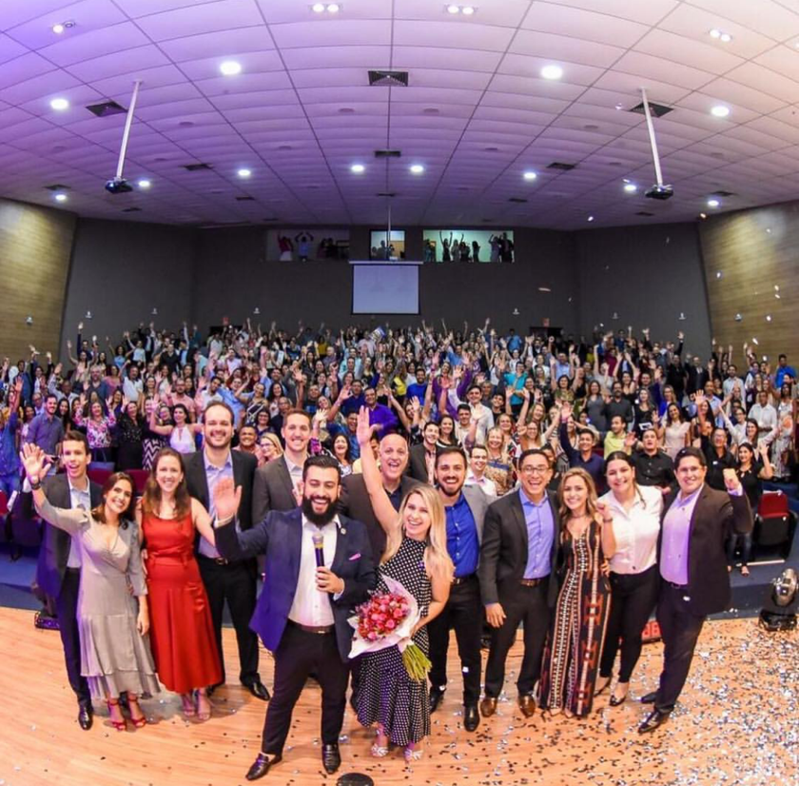
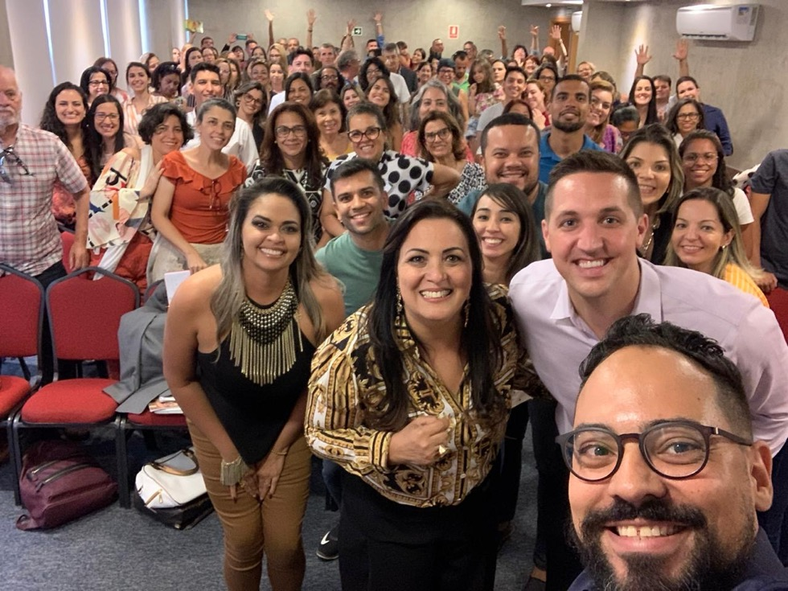

Slide 52
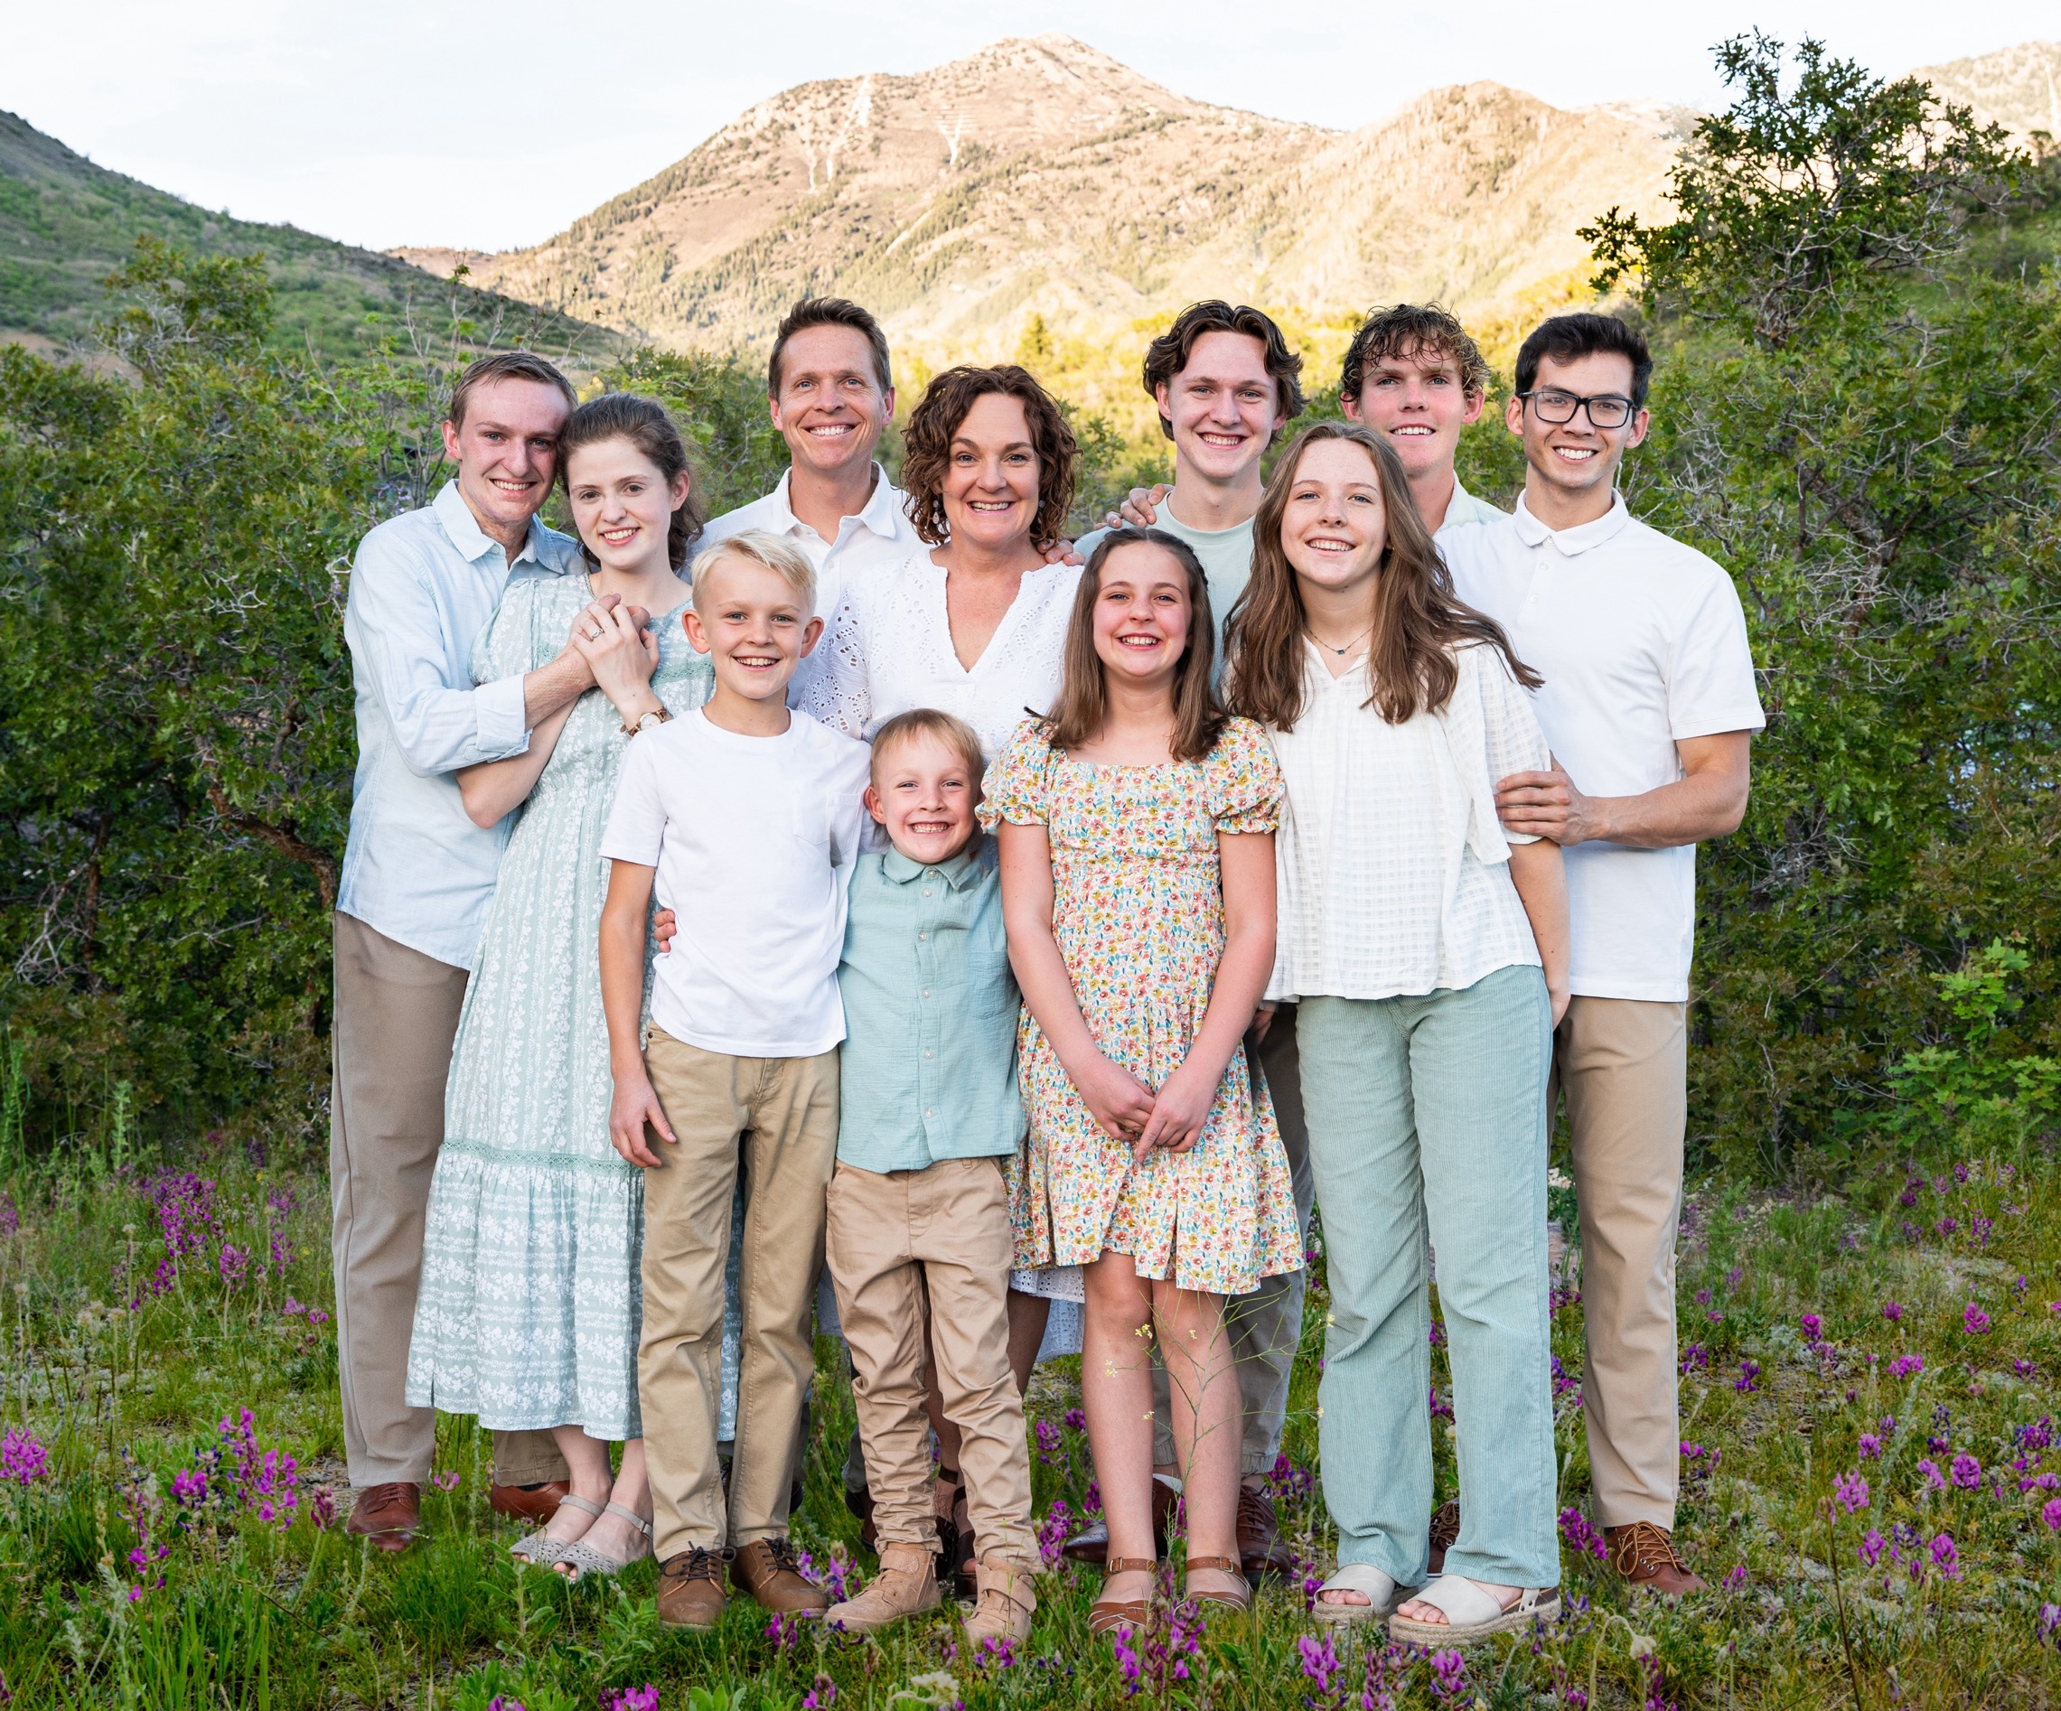
www.doterra.com/empowered-success
Notes:
I want you to think of the most successful brands in the world. What do they have in common? They strongly focus on their customers. So it’s no coincidence that they lead in their respective markets.

Slide 53
The Power of the Opportunity

Slide 54
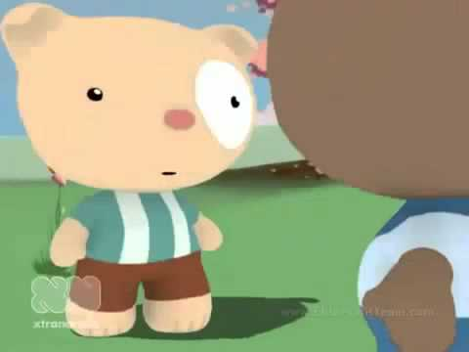

Slide 55
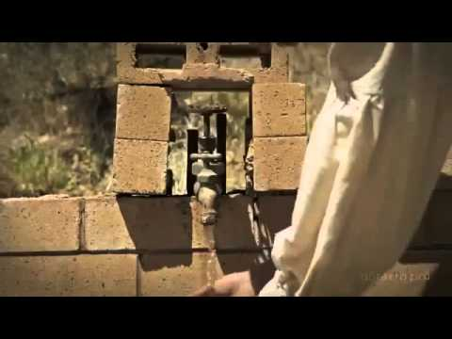

Slide 56
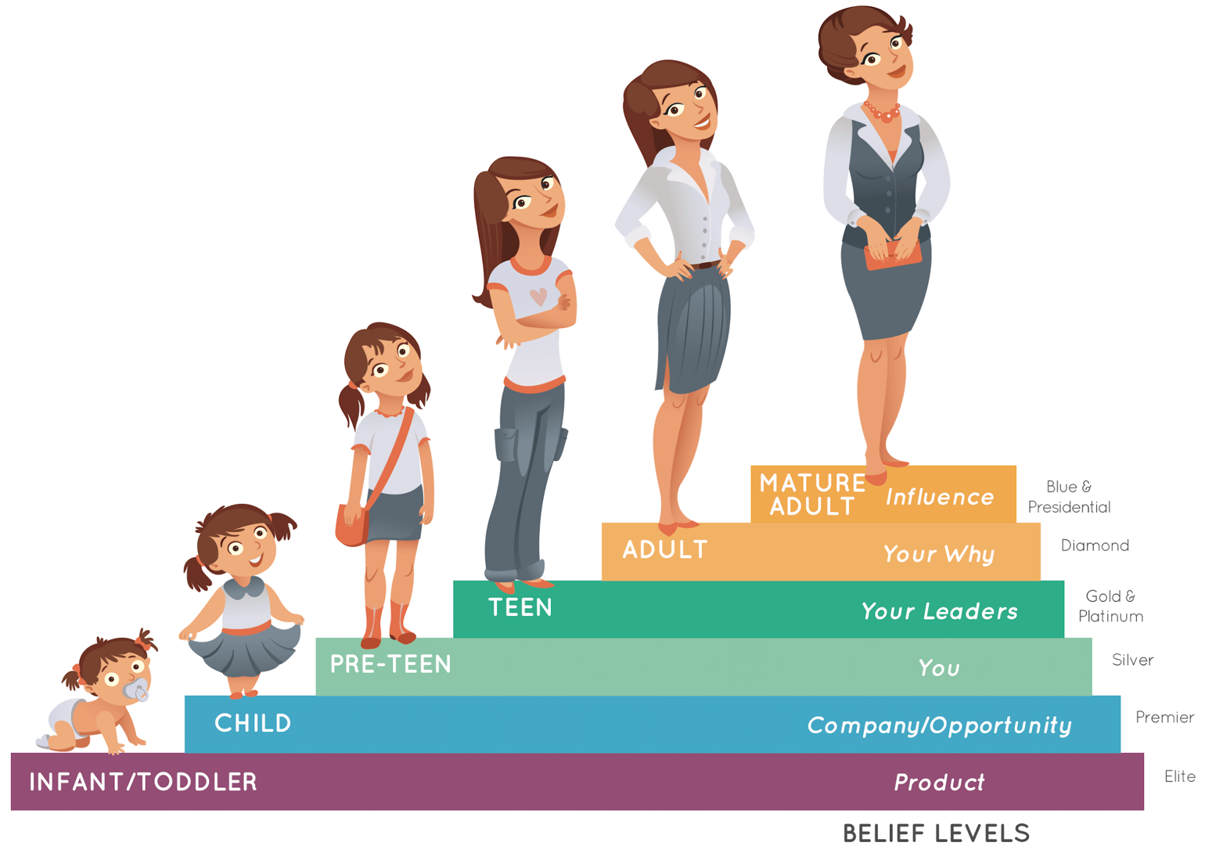

Slide 60
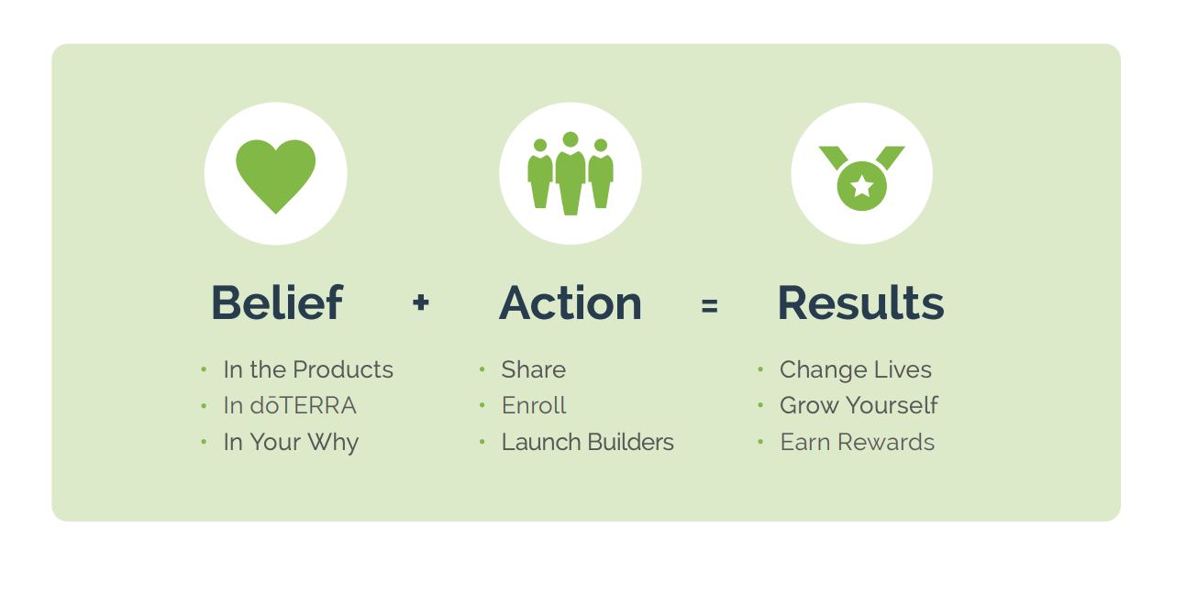
6

Slide 61
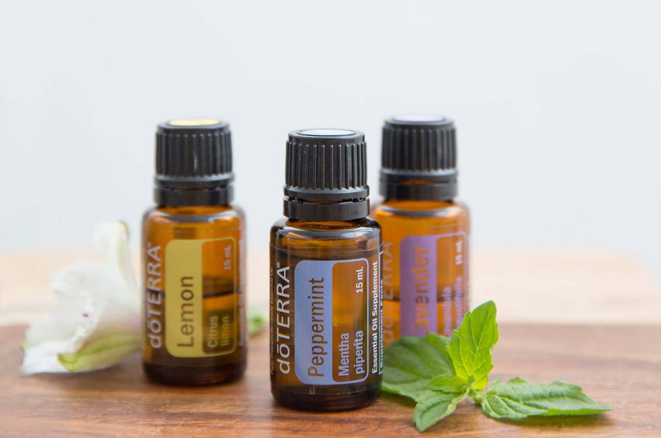
Best Essential Oils!

Slide 62
Best Compensation Plan
$114,100
$41,800
Average Monthly Income!
$17,200
$10,200
$5,600
$2,500
$900
$400

Slide 63
Notes:
Help them see themselves in it

Slide 64
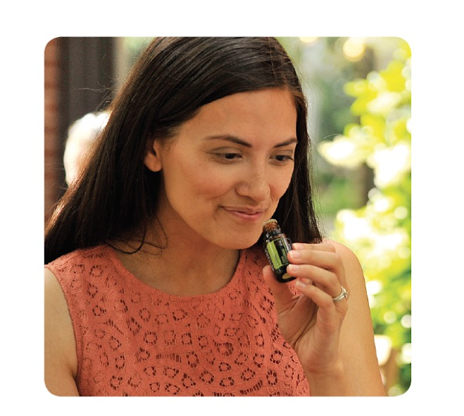
Live
Notes:
And then there is you…

Slide 65
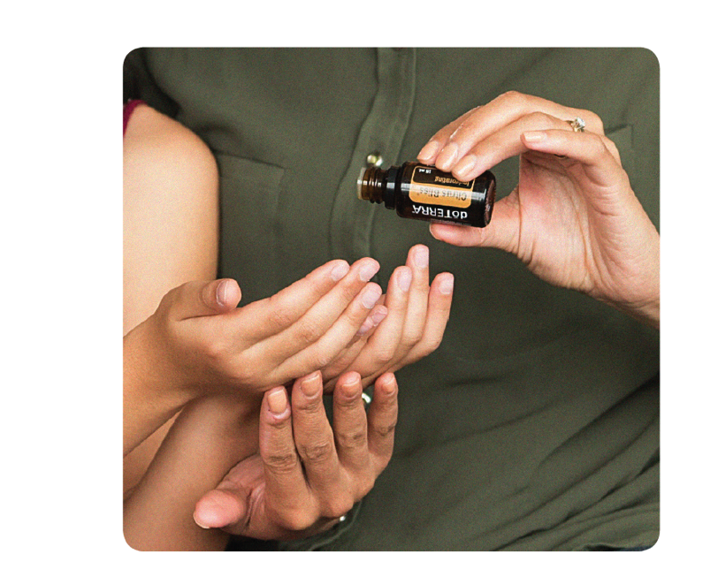
Share

Slide 66
Build

Slide 67
Notes:
What we do- PIPES creates a financial pipeline as well… so in training builders you’ll often see it this way

Slide 68
Focus in on the ONE

Slide 69
Work Smarter

Slide 70
Resolving Concerns

Slide 71
Duplicate

Slide 73
The Big Questions From Every New Builder

Slide 75
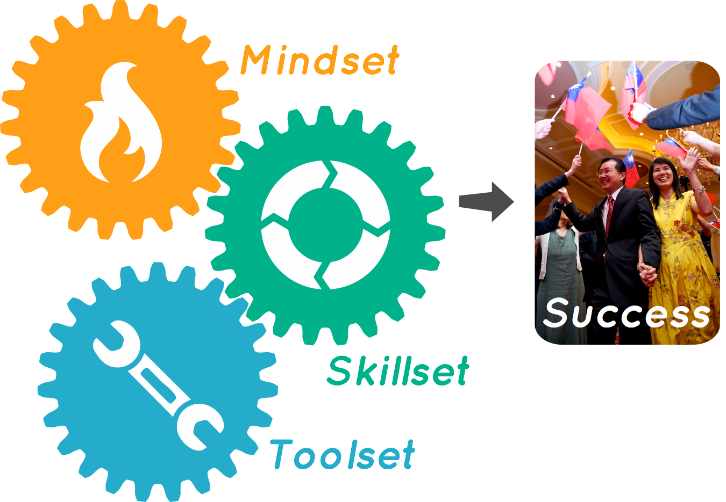
Notes:
But what activity actually gets the results you want?

Slide 76
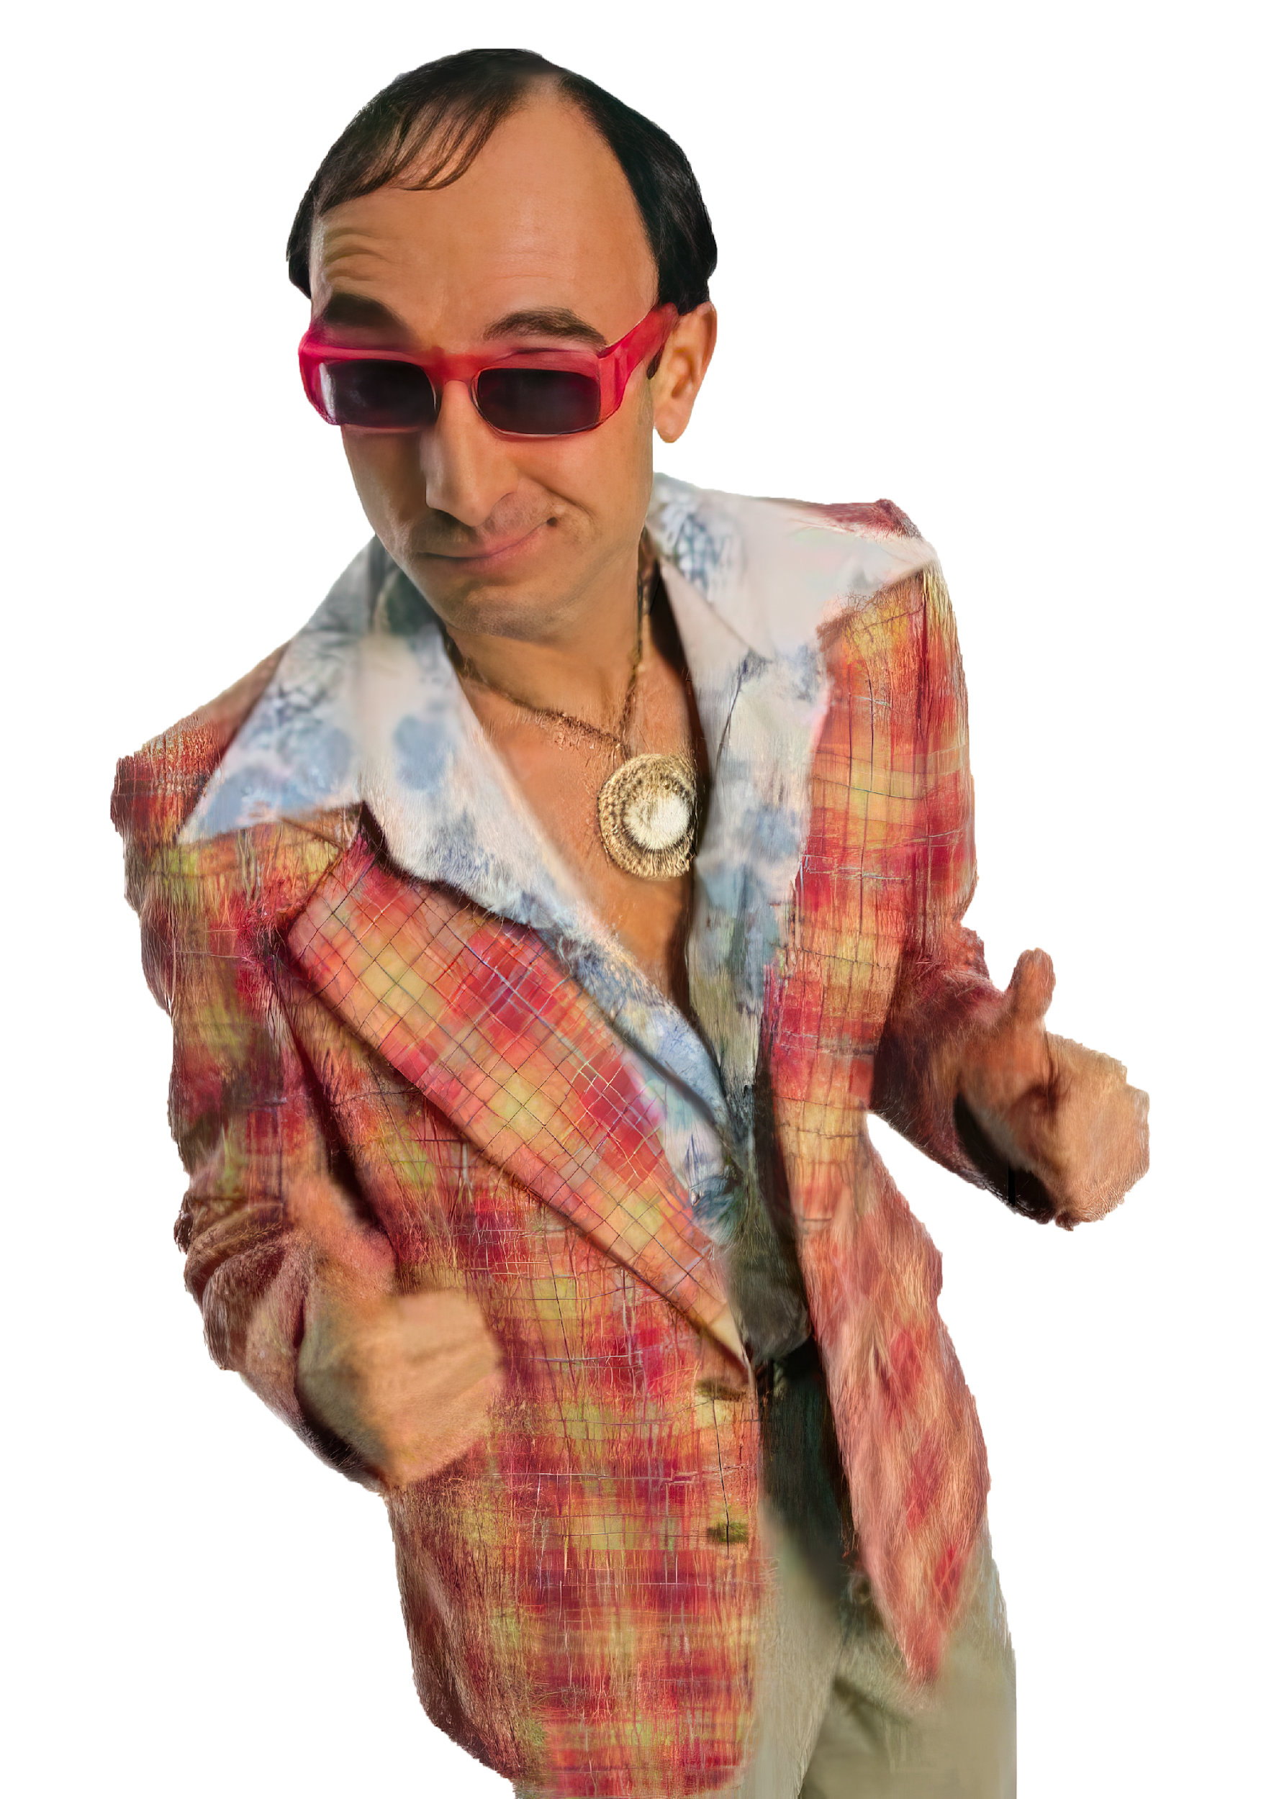

Slide 77
THREE DOOR METHOD
(a philosophical approach to your names list)

Slide 80
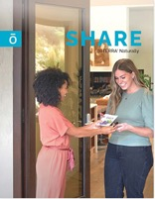
Share & Invite
Enroll
Prospects
GOALS FOR
Enroll
In LRP
Commit
to Build
Commit
to Host
Notes:
If you master these 5 conversations, you can achieve any rank. Always be listening for the Unmet needs

Slide 82
Notes:
The intention is to learn this class both educated and empowered

Slide 83
Create Names List

Slide 84
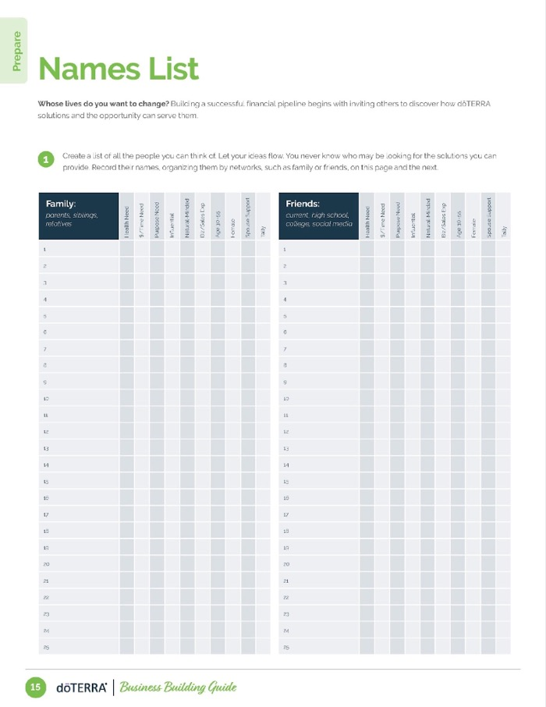
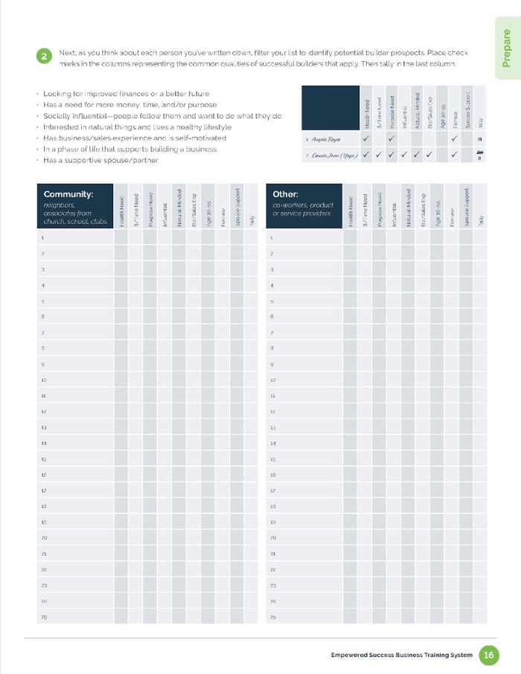

Slide 86
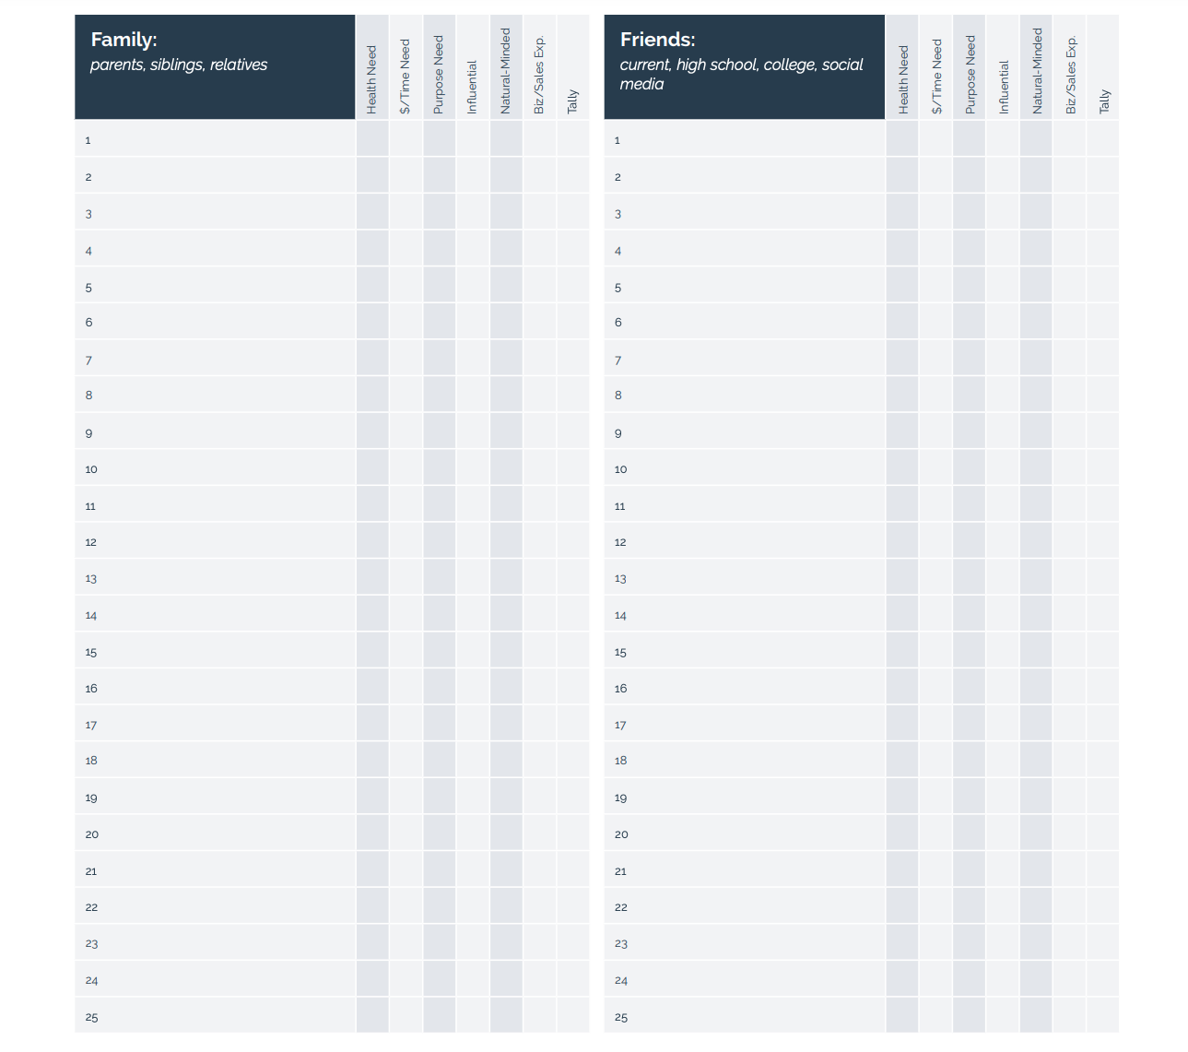

Slide 87
Filter Names List

Slide 89
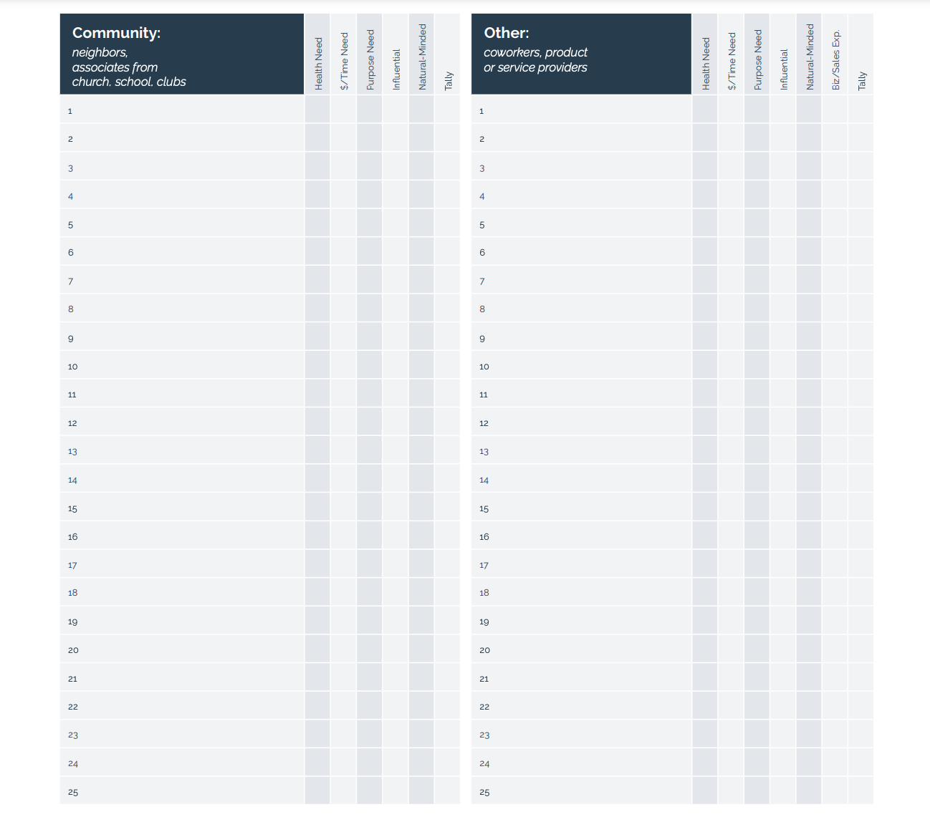

Slide 90
Scripts

Slide 91
Choose Your Ways to Share

Slide 92
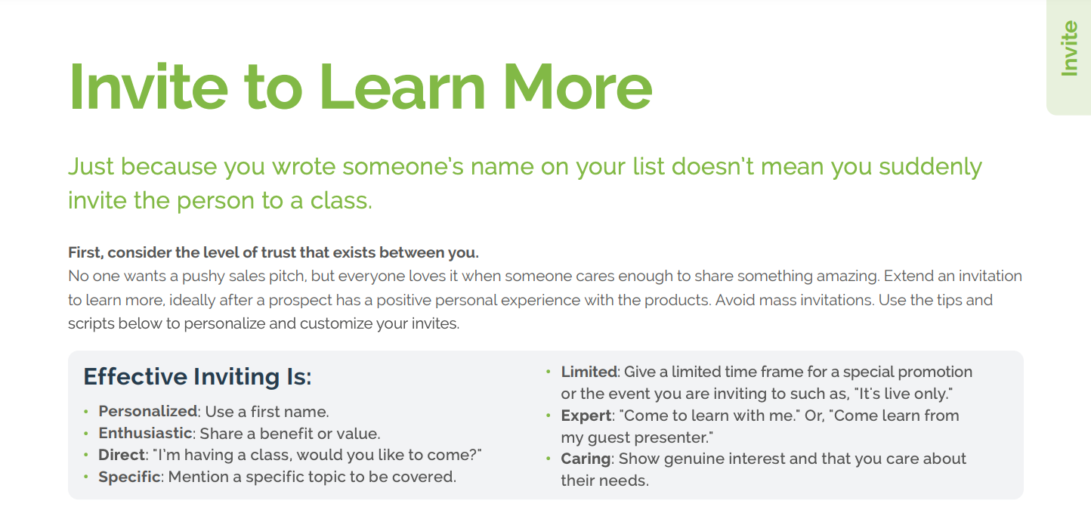
42

Slide 93
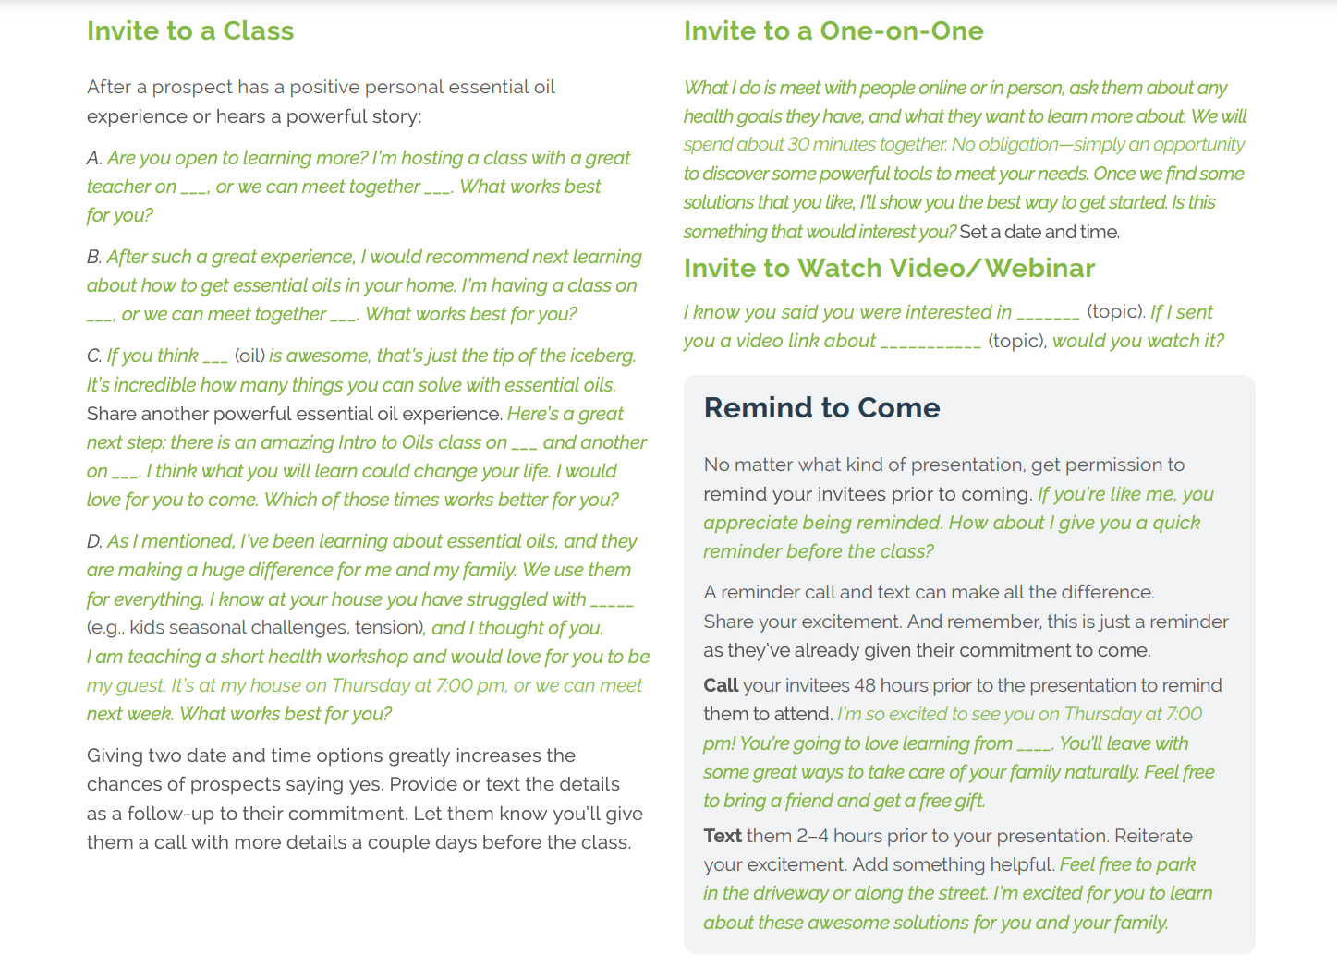
42

Slide 94
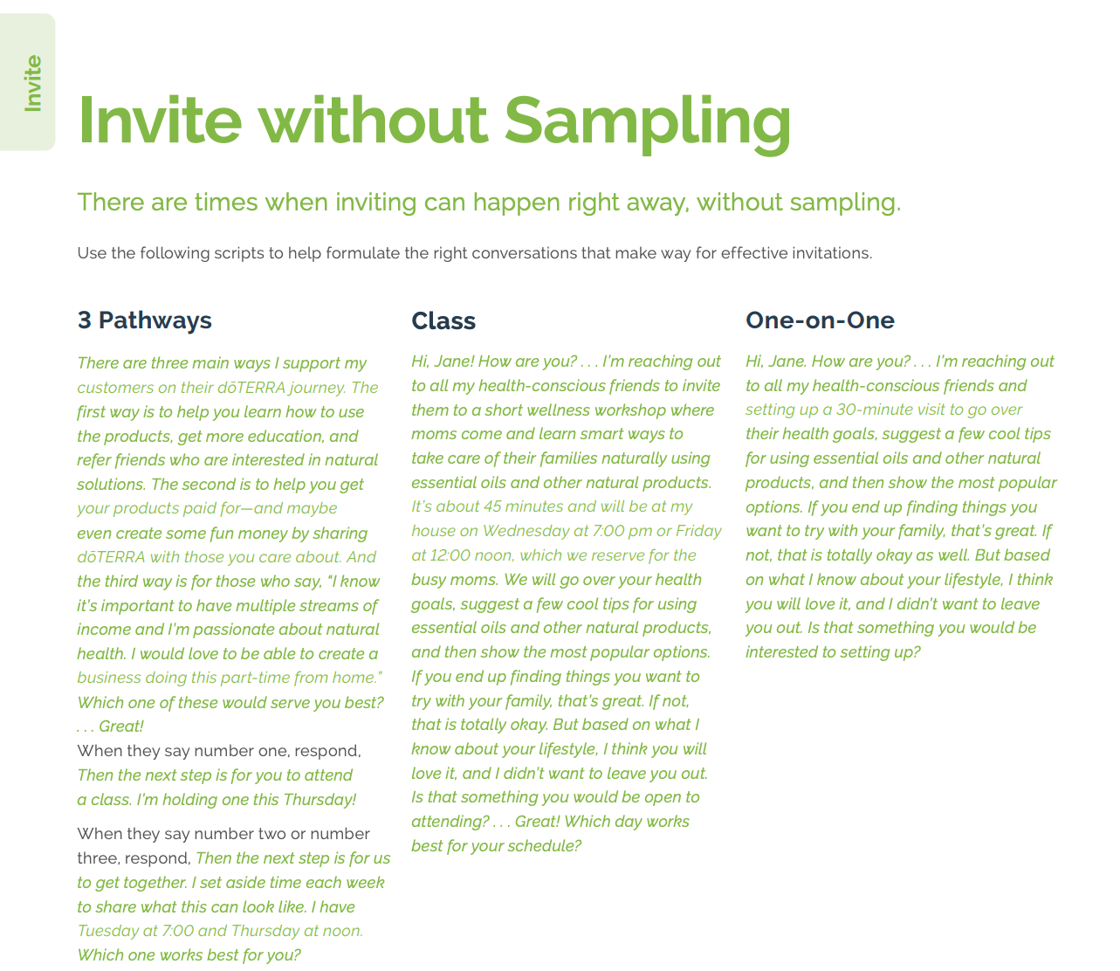
43

Slide 95
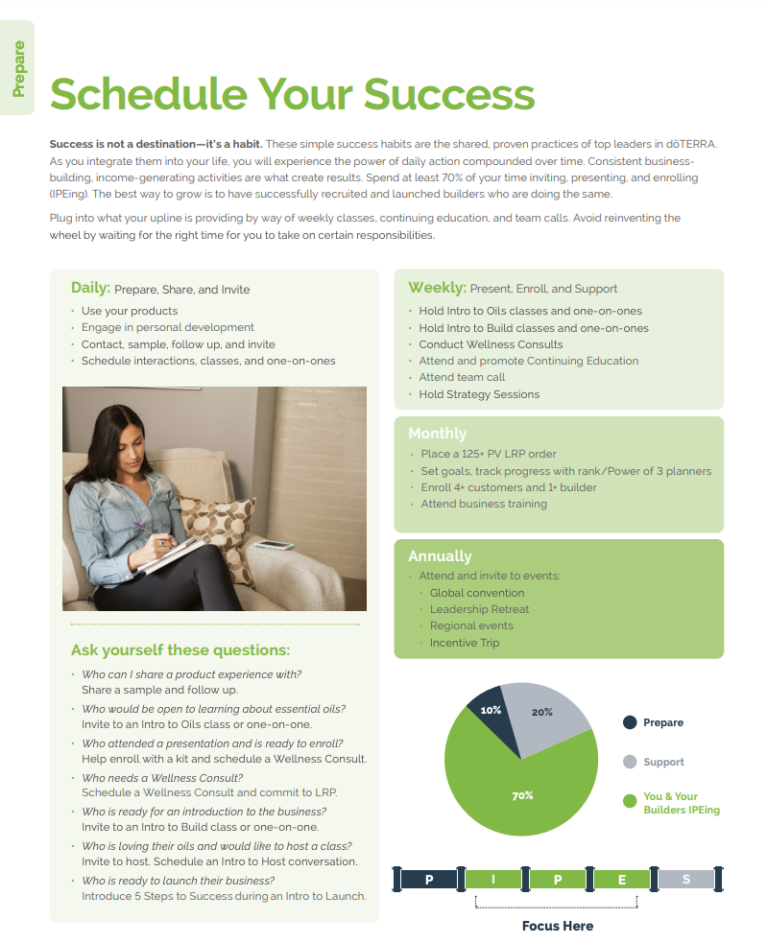
19-20

Slide 96
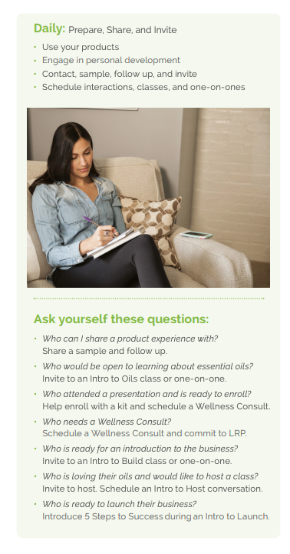
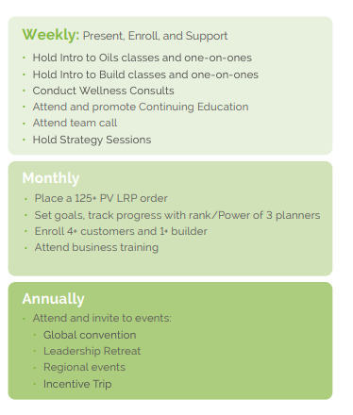
19-20

Slide 97
19-20

Slide 98
Dialing in Your Message

Slide 104
Scripts

Slide 105
Pick 2 Names
(hot and warm)
Perfect Your Scripts
Send a Text

Slide 106
You will get all you want in life,
if you help enough other people get what they want.
- Zig Ziglar

Slide 107
SATURDAY: 2525 N. Three Falls Dr. Alpine, UT 9am-3pm
EXPERIENCE
doTERRA

Slide 108
Next Events:
January 24-25
February 21-22

Slide 109
BELIEF
STUCK
Partner not on board
Burnout
Not duplicating
RESULT
ACTION

