Slide 1
Notes:
Slide #1: Introductions and Welcome
**START ZOOM RECORDING**
Introduce yourself. Welcome to our foundational health workshop. Our desire in this class is two fold. We want to first educate you on a wellness lifestyle, looking at research and our current wellness landscape. Second, we want to share some solutions that can help you walk down this road of wellness, giving you hope for your health.
Let’s tackle some housekeeping items:
It’s helpful to have a pen and paper ready to take notes and write down questions.
This class is 30-40 min. There will be a product giveaway at the end that I think you’ll love.
We will also be using the chat feature throughout this workshop.
We’re going to start with an exercise. Try to settle your mind for a minute and think about what your life would look like if you were in perfect health. How would this impact your family and relationships? How would this impact your work? How would this impact you? Take a moment to think about this, and then share in the chat. What would your life look like if you were in perfect health?
**NEXT SLIDE**

Slide 2
Notes:
Slide #2: We’re going to start with a brief health assessment for you. What areas of your health would you like help with?
Comment in the chat the numbers representing the areas you or someone in your household struggles with.
#1 digestive issues
#2 Headaches, pain and inflammation
#3 Immunity issues
#4 Stress and Anxiety
#5 Energy and Stamina
#6 Sleep Issues
#7 Blood Sugar Regulation
**NEXT SLIDE**

Slide 3
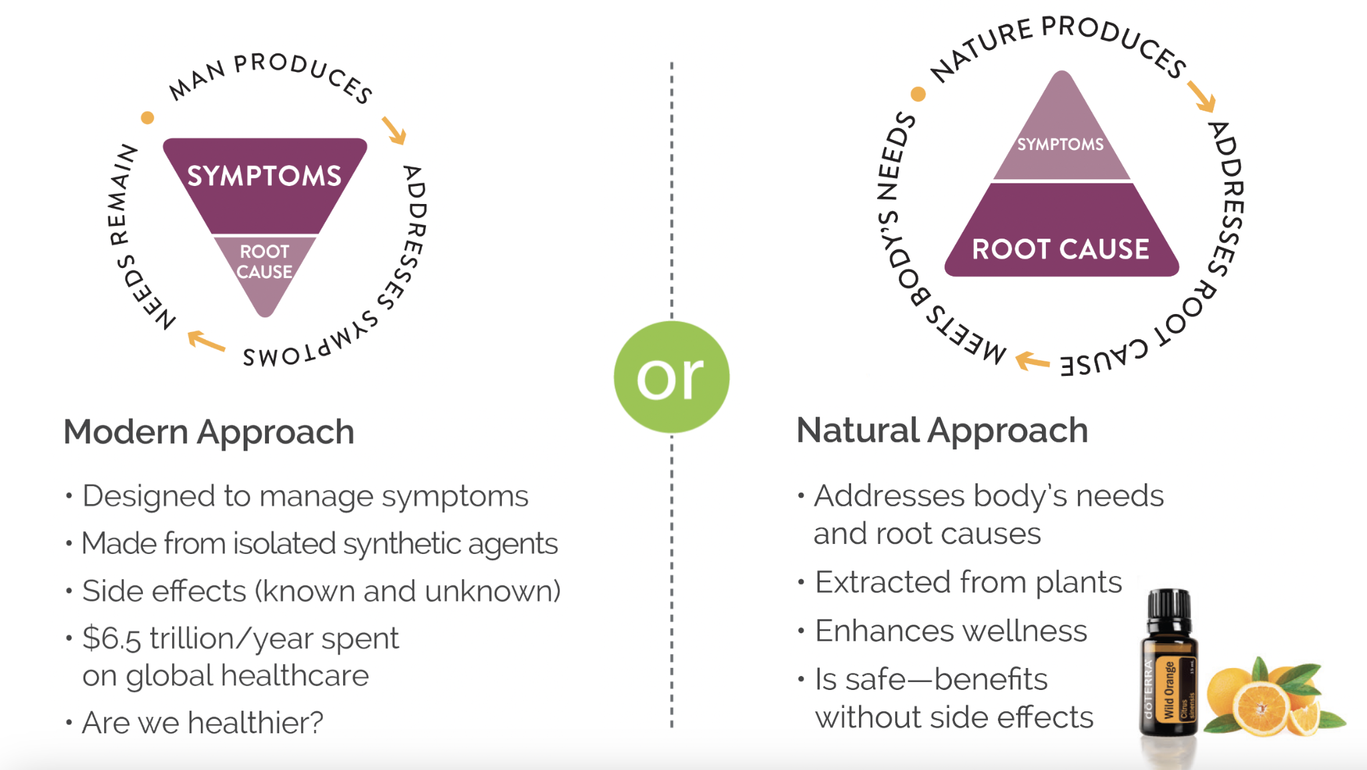
Notes:
Modern Approach vs Natural Approach
Before we go deeper, we need context. Most people function within the modern approach to medicine, although we are starting to see that shift! In the modern approach to health care, symptoms are most often addressed, not root causes. Solutions for those symptoms often come from over the counter and prescription pharmaceuticals that can be filled with synthetic and toxic ingredients. Many of these have known and unknown side effects. This is a 6.5 trillion dollar industry. The question is, are we healthier?
Let’s take a look at one study. The FDA estimates that 200,000 Americans are hospitalized every year because of overdoses and side effects of NSAIDs (Nonsteroidal Anti-inflammatory drugs) such as Advil, ibuprofen, and aspirin. They are also the cause of THOUSANDS of deaths per year. Even Tylenol (acetaminophen) is known to cause liver damage if used to excess.
(Here’s a link to the article we took this from.
https://www.google.com/amp/s/abcnews.go.com/amp/Health/PainManagement/story%3fid=2739177&page=1)
Let’s contrast that to The Natural Approach to wellness which focuses on root causes and aims to work with the body to support healing major body systems so that multiple symptoms can subside. This is often a plant-based approach, which is great, because our body RECOGNIZES plant based sources and uses them! We’re going to focus on this soon!
**NEXT SLIDE**

Slide 4
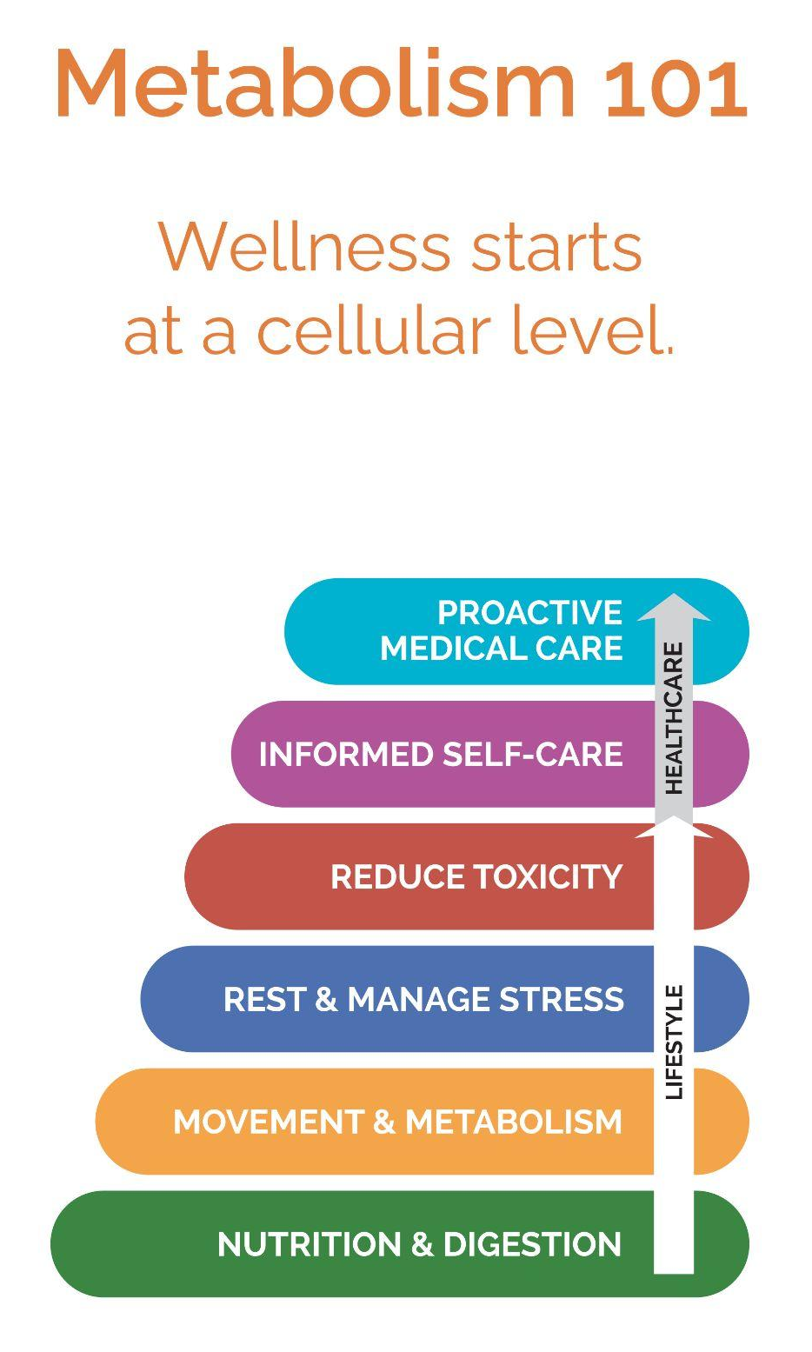
Why Foundational Wellness?
For the body to heal itself, organs must be functioning optimally. You need vitamins, minerals, nutrients, probiotics, and enzymes for comprehensive organ support. This organ support is the foundation to healing in the body. We refer to this as foundational wellness.
Notes:
So what is foundational wellness? Let’s talk about that. For the body to heal itself, organs must be functioning optimally. You need vitamins, minerals, nutrients, probiotics, and enzymes for comprehensive organ support. Supporting your organs is the foundation to healing in the body. We refer to this as foundational wellness.
Let’s look at the wellness pyramid. To address foundational wellness, you want to focus on the bottom of the pyramid. You will see nutrition and digestion, and then movement and metabolism, are the primary areas that create a bedrock for your health. Everything else is built on those.
There are various reasons your body is not functioning optimally. We’ll explore a few today. However, if you have any issues we referenced at the beginning of this class your body is letting you know that your organs need more adequate support.
DoTERRA works closely with several doctors and scientists. Dr Watts is our lead nutritional advisor who had his own practice for several years. He always had the goal of getting to the root problems for his patients. After studying the blood work of several patients, he decided to take a new approach to his care. Before addressing root issues, he wanted to first address foundational health in all of his patients. He knew they needed the proper nutrition and support for their organs to be functioning optimally. What he found is that 70% of his patients had their issues go away when focusing on nutrition and digestion. While the other 30% had their root causes more easily identified because their foundational wellness had been addressed. This is why we are PASSIONATE about coming alongside you with the most innovative, top quality, comprehensive foundational wellness product on the market.

Slide 5
Notes:
What Creates Disease in the Body?
In order to understand foundational health, we need to look more closely at root causes for disease.
3 main causes for disease in the body:
Nutrient Deficiency
Inflammation
Toxic Overload
**NEXT SLIDE**

Slide 6
Notes:
Nutrition
Nutrition is at the core of our immune function. When the major organs of our body are well supported and function optimally, we have energy, clarity of thinking, good mood, great sleep, and little to no inflammation.
Most of us do not have optimal organ function, however, and that’s because our body is not getting what it needs from food sources and proper movement of the body. Our food supply, which used to be our main source of vitamins and minerals, has been heavily compromised due to pesticide use, soil depletion, the use of artificial sweeteners and seed oils, and shifts in farming practices. According to the Environmental Working Group: (Share chart)
95% of US adults are deficient in Vitamin D
94% are deficient in Vitamin E
61% are deficient in Magnesium
The results of nutrient deficiency vary by body, but I’ll list a few for you:
Inflammation
Headaches
Lack of sleep
Foggy thinking
Lack of energy
Digestive issues
Hormone imbalance
If you only remember one thing today, remember this. Poor nutrition is the #1 cause of poor health.
**NEXT SLIDE**

Slide 7
Notes:
Research from Harvard Medical School:
We’re almost to solutions, but we need to explore one more topic. Who here uses a supplement? Think vitamin D, C, B…maybe you take a multivitamin or an omega. If you take any kind of supplement, comment “yes” in the chat box. Feel free to say no too.
Let’s take a quick peek at the supplement industry:
A study by the FDA from 2007 to 2016 detected contaminants in 776 dietary supplements, produced by 146 companies. (https://www.health.harvard.edu/staying-healthy/whats-in-that-supplement-sometimes-more-than-you-bargain-for)
A study of 3 leading memory supplements found that 2 of them didn’t contain the active ingredient listed on the label.
The Supplement industry is not heavily regulated. They can contain lots of fillers and not much of the actual ingredient. This creates a struggle: our diet is often deficient in nutrients so we need supplements, but it’s hard to know what supplements to trust. This is a primary reason why people turn to doTERRA. DoTERRA has a commitment to purity and consistency in their products. They are backed by research and science to show transparency with consumers.
A 2023 Consumer Survey on Dietary Supplements confirms 74 percent of U.S. adults take dietary supplements, and 55 percent qualify as “regular users.”
**NEXT SLIDE**

Slide 8
Notes:
Because of the high use of supplements, I’m going to teach you two crucial elements about supplements:
Bioavailability refers to how much of the supplement is available for your body to use. As we just heard, many supplements are filled with synthetics and fillers, ingredients that your body cannot use and ingredients that can be more harmful to you in the long run.The average supplement on the market is 20-40% bioavailable. When a supplement is not absorbed, it simply passes through the body and results in bright yellow urine.
Bioretention refers to the amount of time the supplement stays in your bloodstream for the body to experience continued support. If your body is simply passing the supplement through, you won’t experience benefits from the supplement throughout the day.
Your goal should be to have a supplement that is high in both of these areas.

Slide 9
Comprehensive Foundational Wellness
Step #1: Nutrition (vitamins & minerals)
Vitamins, Minerals,
Greens plus essential
oils and more
Highlights of VMG
90+ Key Ingredients
Whole Food Product (highly bioavailable!)
Best technology for highest absorption
91% Bioretention after 8 hrs
Vegan and Gluten Free
Doesn’t spike blood sugar (woo hoo!!)
1 sachet / day for adults
Perfect for habit stacking
TASTES AMAZING!!! (Pineapple & Mango)
Benefits include energy, immunity, gut health, digestion. Also supports liver, brain, and hormones.
Notes:
Are you ready to press the easy button on your foundational wellness?! Let’s start with nutrition. You might not know this, but for the last decade, doTERRA’s number one selling product has been for foundational wellness. Yes, we are the largest essential oil company in the world. It speaks volumes that while we hold that title, our number one seller is a supplement for foundational health. VMG+ just came onto the market with the purpose of addressing nutrient deficiency. People are raving about its taste, simplicity and benefits! The name stands for Vitamins, Minerals, Greens, plus essential oils and more.
Let’s look at its highlights:
It has 90+ Key Ingredients including vitamins, minerals and nutrients from fruits and vegetables that taste delicious (like pineapple and mango).
This is a Whole Food Product that uses Liposomal Technology. This makes it 5x more bioavailable and 10x more absorbable than our direct competitors.
A test showed that 91% of the supplement remained in the body 8 hours after it was taken! This means the body can draw on its benefits ALL day!
It is Vegan and Gluten Free
If you are watching your glucose spikes and dips, you’ll be happy to know this product does NOT spike your blood sugar.
Adults only need 1 sachet / day. It is sooo easy and fast.
While it shouldn’t be used with children under 4, kids ages 4 to 12 can take a ½ sachet a day.
This product is Perfect for habit stacking. My favorite products to stack it with are the doTERRA electrolytes and the doterra collagen
TASTES AMAZING!!! (Pineapple & Mango)
So what does that translate to for benefits? That means benefits include energy, immunity, gut health, digestion. Also supports liver, brain, and hormones. Preliminary studies showed VMG+ reduced biological age by an average of nearly 2 years after just 6 wks of use.
This is the perfect product to include in your daily routine for foundational health. It is designed to support the 5 major organs of the body so the body can focus on healing.
We’d love to hear some of the testimonials you have on this product.

Slide 10
Notes:
We know that supplements can be expensive and it can feel like taking supplements is extra. I consider this part of my food budget because it fills in the nutritional gaps my food doesn’t fill. This product will also replace many supplements you might currently be taking. So instead of adding this into your supplement regimen, work with your advocate to see what you can replace with this product!
Now if you look at this graph, you can see that getting many of the products included in VMG+ individually would prove to be much more expensive than getting them all in one with the VMG. We know that cost is a factor in your health, so at $3 a day, and with a 30-day money-back guarantee,. VMG+ is the best bang for your buck.

Slide 11
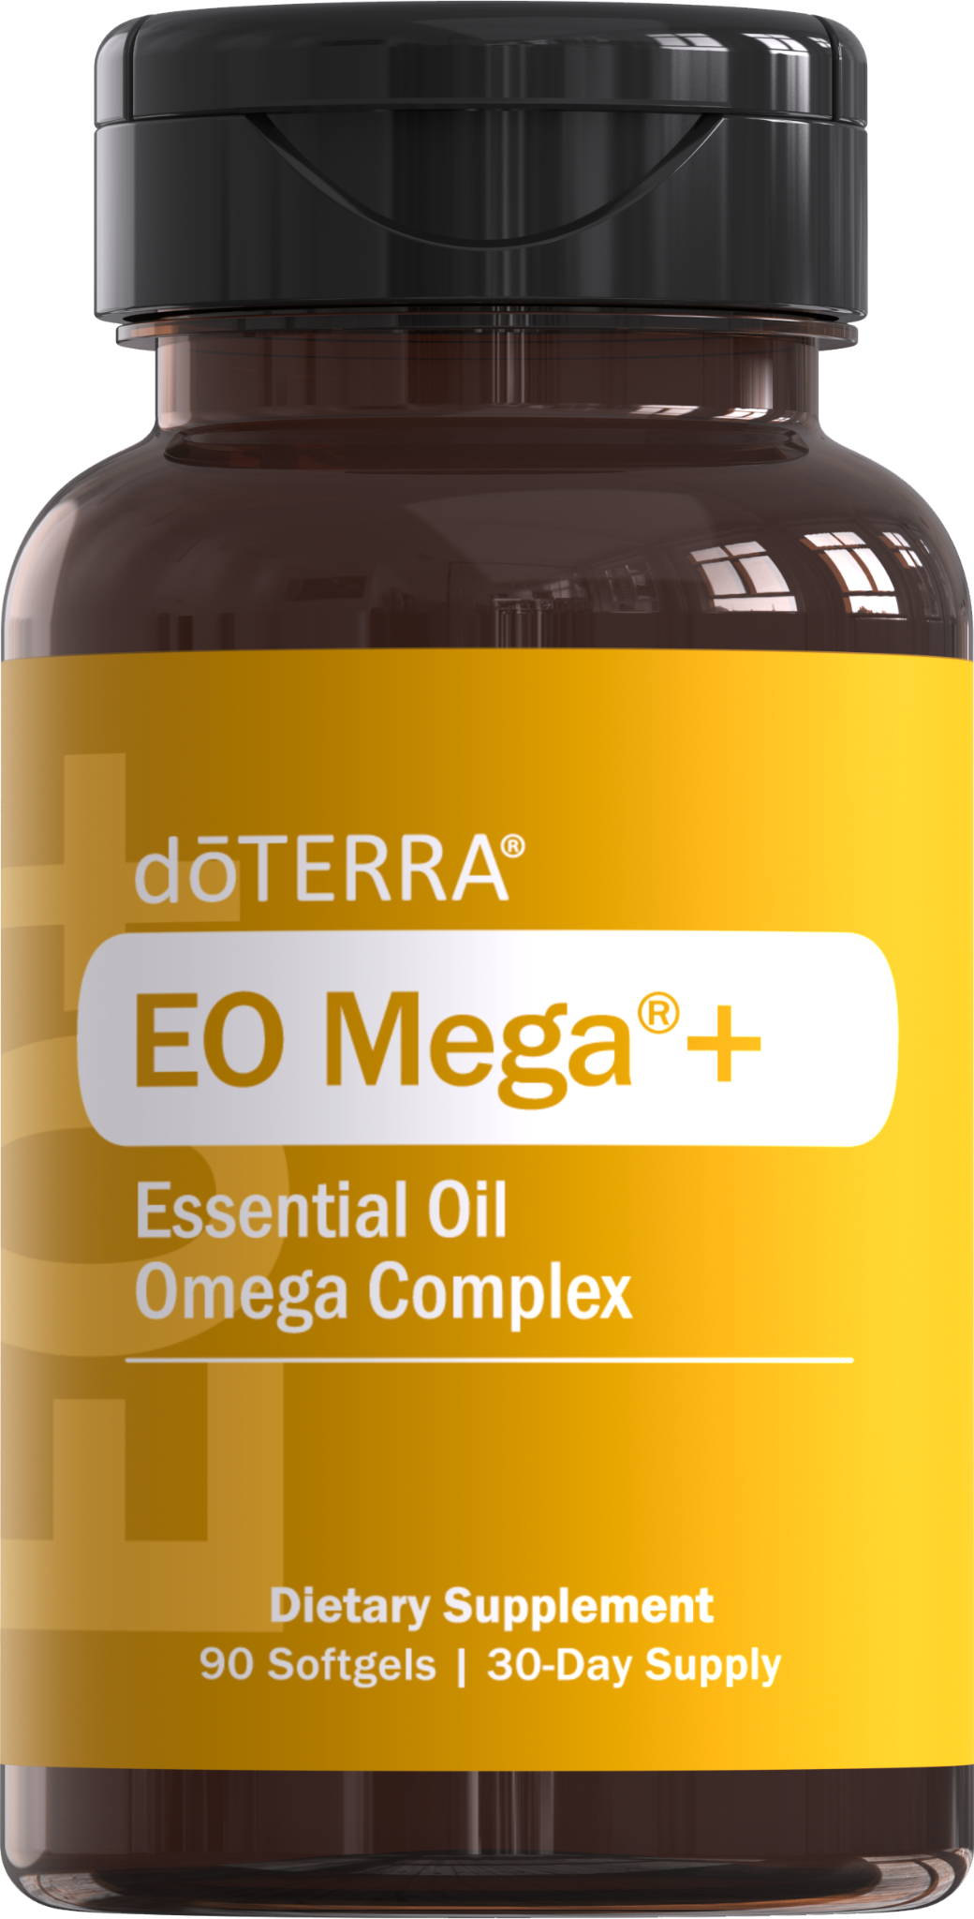
Comprehensive Foundational Wellness
Step #2: Omegas/Fatty Acids
Cardiovascular System (Blood Pressure, Cholesterol)
Blood Pressure decreased by 42.2%
Resting heart rate decreased by 16.2%
Risk of Coronary Heart Disease decreased by 35%
Brain (Cognition, Memory, Mental Clarity)
Eyes
Many other benefits including Joints, Hair, Skin, Nails, Digestion, Immunity, Hormones, etc.
Notes:
Let’s move to Step #2 in our comprehensive foundational wellness approach - fatty acids.
So let’s look at why daily omegas are so helpful. 25% of US deaths are from heart disease. 90% of heart health issues can be changed with lifestyle changes, including adding omegas to your daily routine.
doTERRA’s EOmega+ has 2000 mg of fish oil that contains 900 mg of fatty acids, including 800 mg of EPA and DHA! To get your required daily Omega 3 fatty acids, you would need to eat at least 2 cans of tuna each day. EO Mega+ is also a great choice because it has wild orange essential oil included for additional absorption and power. The limonene content from this essential oil also provides extra support to decrease cholesterol. This makes doTERRA’s EO Mega+ unlike anything else on the market.
EPA and DHA Omega 3s have SO many health benefits, but I will highlight a few.
Cardiovascular System
reduced blood pressure and risk of getting hypertension. Several tests have shown how great they are for your Cardiovascular system. One study showed that the resting heart rate of the participants went down 16.2%. Another study showed that participants’ blood pressure went down 42.2%)! That is huge!
In addition to circulation, Omega 3s help reduce your risk of Coronary heart disease
Brain and Nervous System
Cognitive Performance
Memory
Mental Clarity
Eyes (Vision and Retinal function)
Many other functions- Hair, Skin, Nails, Digestion, Immune System, Respiratory System, Hormones, Joints, and longevity
It’s not an overstatement to say that Every Cell needs fatty acids to function properly, because it plays a role in cell wall creation
Omegas are the oil for your body, like the oil for your car engine. The quality is crucial to ensure good performance.
The last thing I’d like to add is these omegas actually taste GOOD! Because of the wild orange in them, you get very little fishy taste. In fact, many people have started chewing them before they are swallowed.

Slide 12
Comprehensive Foundational Wellness
Step #3: Probiotics
Less than $5/day
Notes:
Let’s finish our three step comprehensive wellness approach with our best selling PB RESTORE. The gut plays a vital role in our overall health and well-being. It’s often called the second brain and houses 80% of our immunity. dōTERRA’s PB restore is designed to work with VMG+ and EO Mega+:
PB Restore is doTERRA’s pre, pro and postbiotic. It has a double encapsulation delivery system that releases billions of healthy intestinal flora into your digestive system. Other probiotics dissolve in the harsh stomach acid and don’t make it to your intestines- doTERRA’s dissolves partly in the stomach, and partly in the intestines, where you need different flora and additional support of healthy bacteria.
Remember Dr Watts? He says if he could recommend everyone he knows to be on one product, it would be PB Restore.
These three products come in the Foundational Wellness bundle with doTERRA. It would cost you less than $5 per day to address your foundational health. Now, if you want to uplevel your foundational wellness, we have one additional product we want to share.
**NEXT SLIDE**

Slide 13
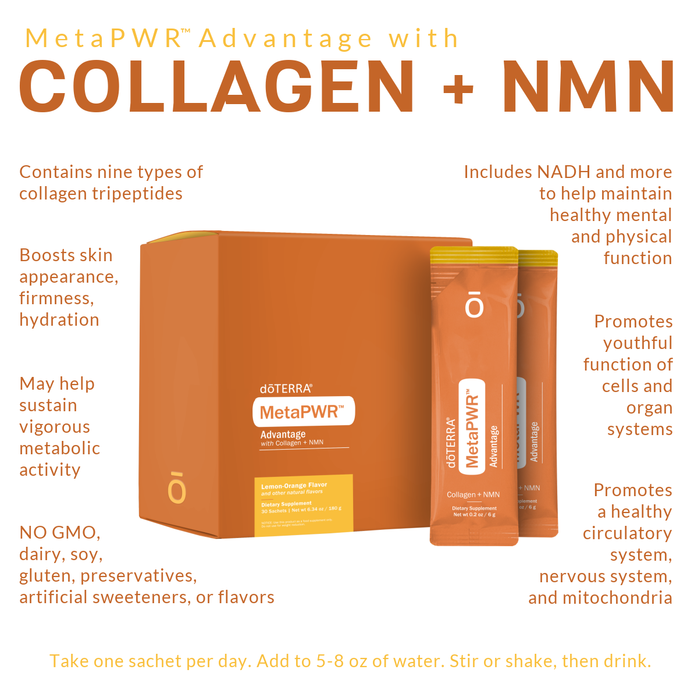
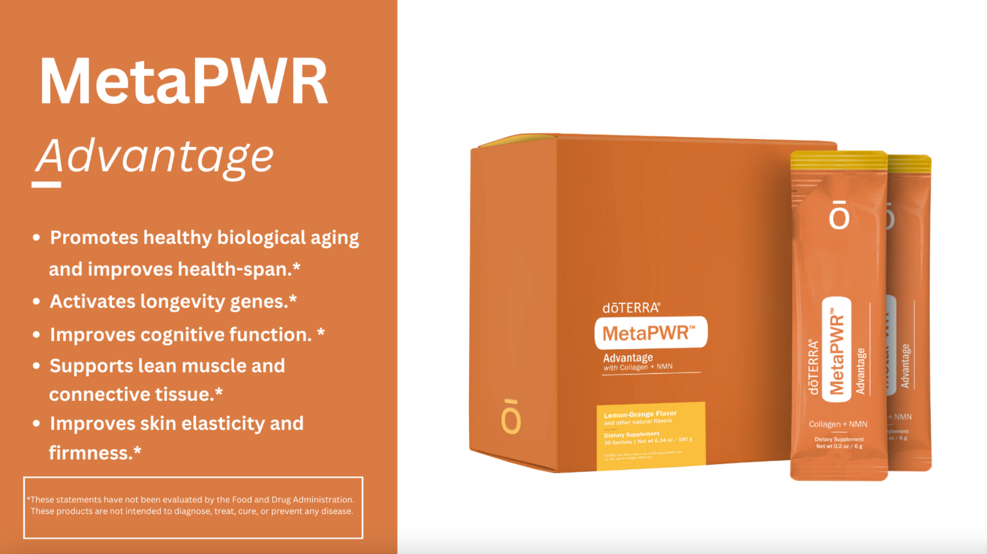
Notes:
Slide #13: MetaPWR Advantage
Regardless of your age, collagen is a hot topic in our society.
Collagen is a protein responsible for healthy joints and skin elasticity which helps you feel good AND look good. But collagen has other benefits too.
While most collagen products only offer 1 or 2 types of collagen, dōTERRA’s award winning collagen -MetaPWR advantage contains 9 different types of marine collagen and is 12 x more absorbable than other collagen products. All of this makes it the perfect “uplevel” to your foundational wellness routine.
It not only supports hair, skin and nails but also joints, connective tissue, gut lining, and helps with mental clarity. It even helps with cardiometabolic factors like A1C, blood pressure and cholesterol.
MetaPWR advantage comes in a freeze dried powder and is packaged for individual use. By freeze drying the collagen, it allows the collagen to remain potent unlike many powders and liquids on the market.
Let’s take a moment to talk about aging. You’ve probably heard people say, "It’s just part of getting older." But what if I told you that’s only partly true? Our chronological age is simply the number of years we've been alive, but our biochemical age tells a different story—it's all about how well our cells are actually functioning.
Our bodies produce NAD+, a vital molecule for both cell repair and slowing down aging, but NAD+ levels decline after age 25. Think of your body like a scratched DVD—the information is still there, but the scratches make it hard to read. Similarly, when our cells can’t access the information they need, they stop functioning properly.
Without enough NAD+, cells struggle to repair, leading to aging issues like joint pain, graying hair, and wrinkles. NMN, a precursor to NAD+, can boost these levels, improving metabolism, cellular repair, and slowing signs of aging. If you want to take your foundational wellness up a level, this is our next recommendation! You can also habit stack by adding your collagen to your VMG in the mornings! Take them together!

Slide 14
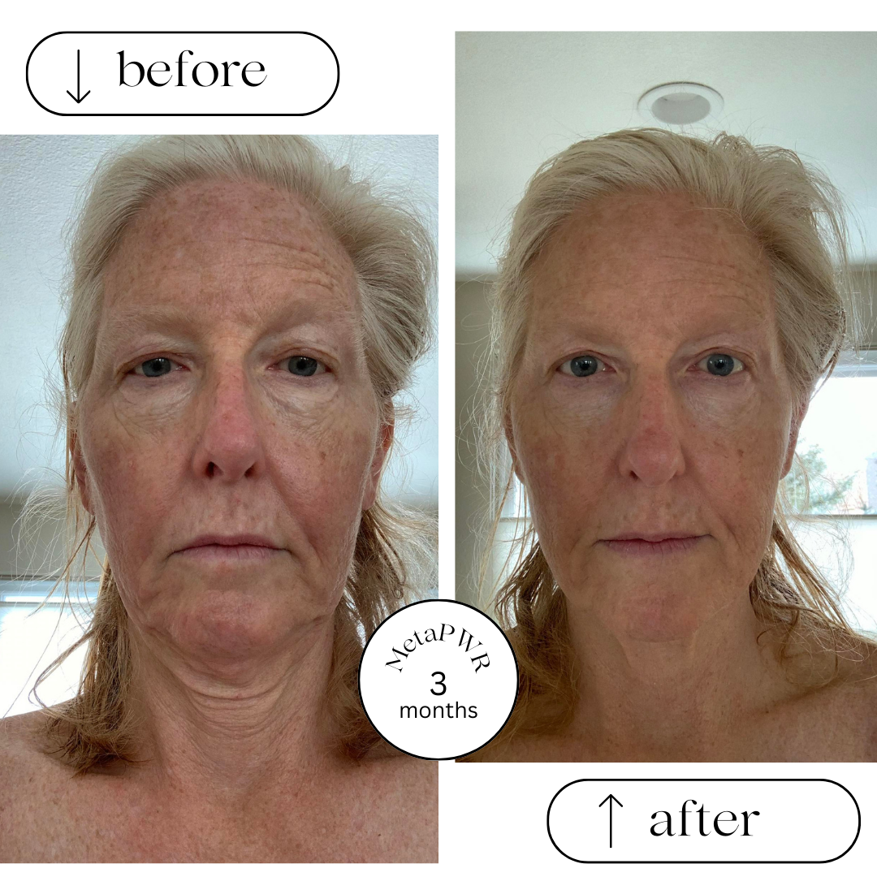
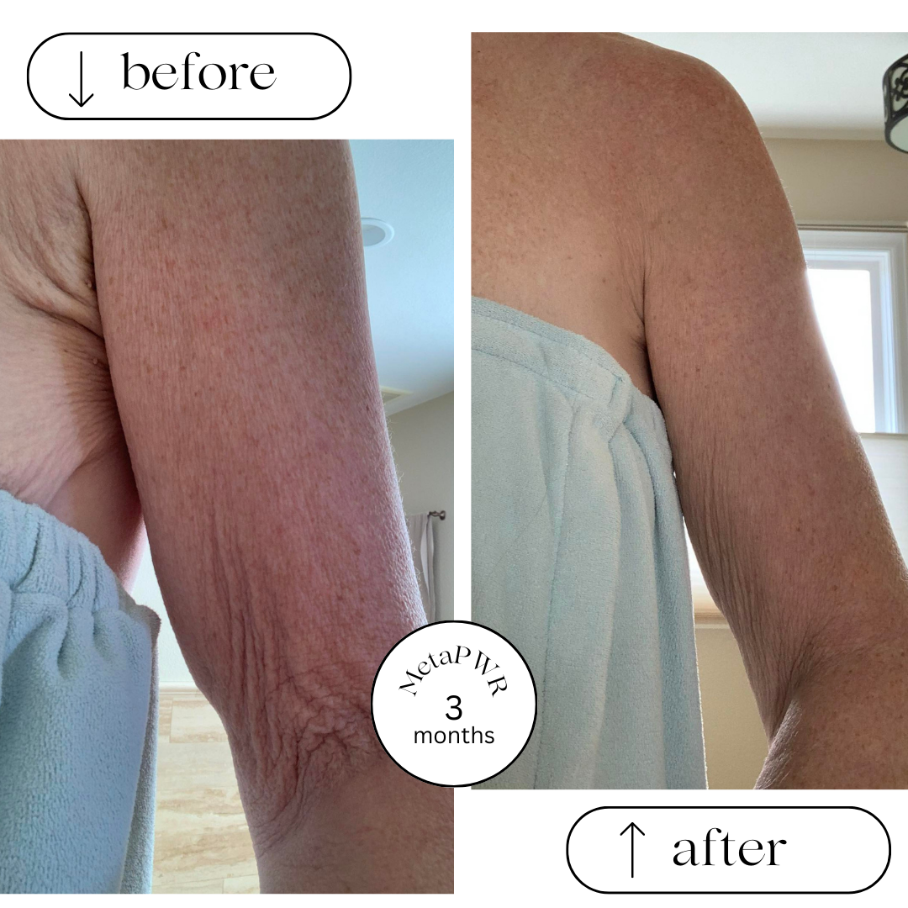
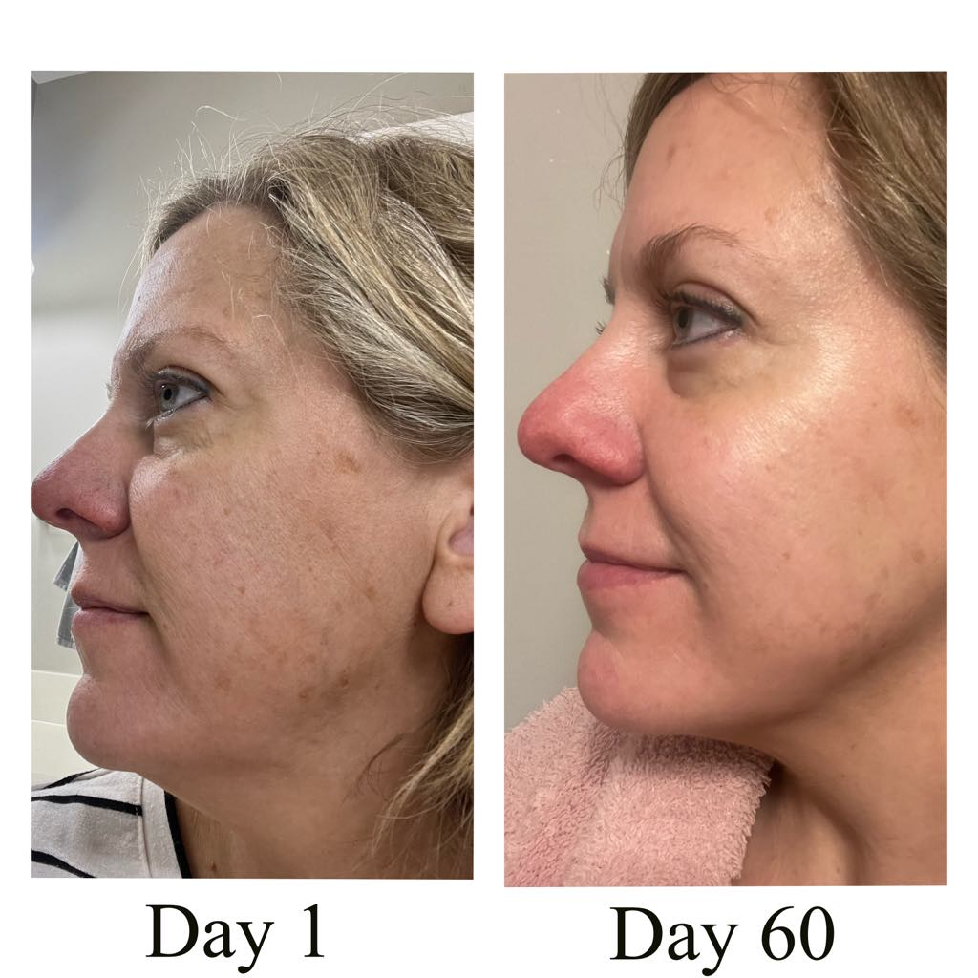
Check out these
MetaPWR
Results!
Notes:
Slide #14: Before and Afters
Sarah is in the middle and on the right are the same person. She had a dramatic weight loss that left her skin loose and saggy. She took the metapwr advantage for 3 months and saw a significant improvement in her skin.
Amy is on the left. She saw significant improvements in her skin tone and with shrinking pores.
Each of these women saw distinct improvement on the outside, but also saw dramatic improvement internally as well. Many times, outward improvement is a sign that there’s an inward improvement as well.
**NEXT SLIDE**

Slide 15
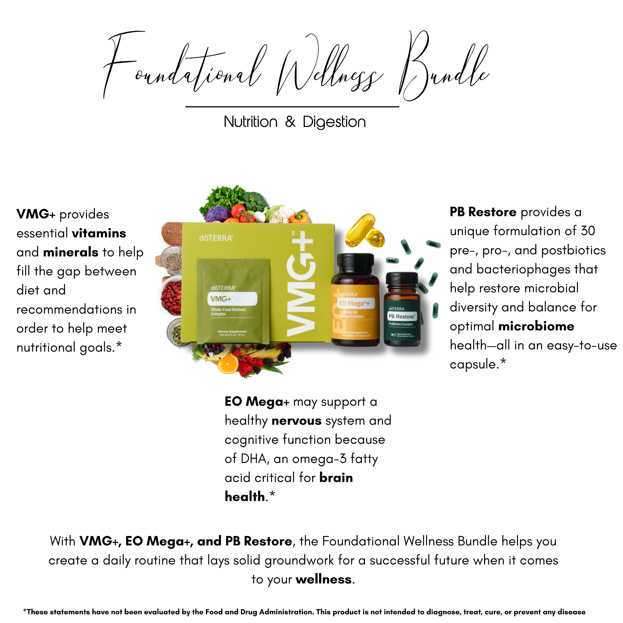
Less than $5/day
$149.50
PV: 125
Notes:
If you would like a comprehensive foundational health system, this is what we recommend: VMG, EO Mega, and PB restore. If you want to uplevel the benefits, consider adding on the metapwr advantage!
This shift should allow you the following benefits:
Redirect where you are spending for your current supplements
Ease of knowing your major organs are being well supported so your body can work on healing
Assurance that this will help fill the nutritional gap between what our food provides and what our body needs for optimal functioning

Slide 16
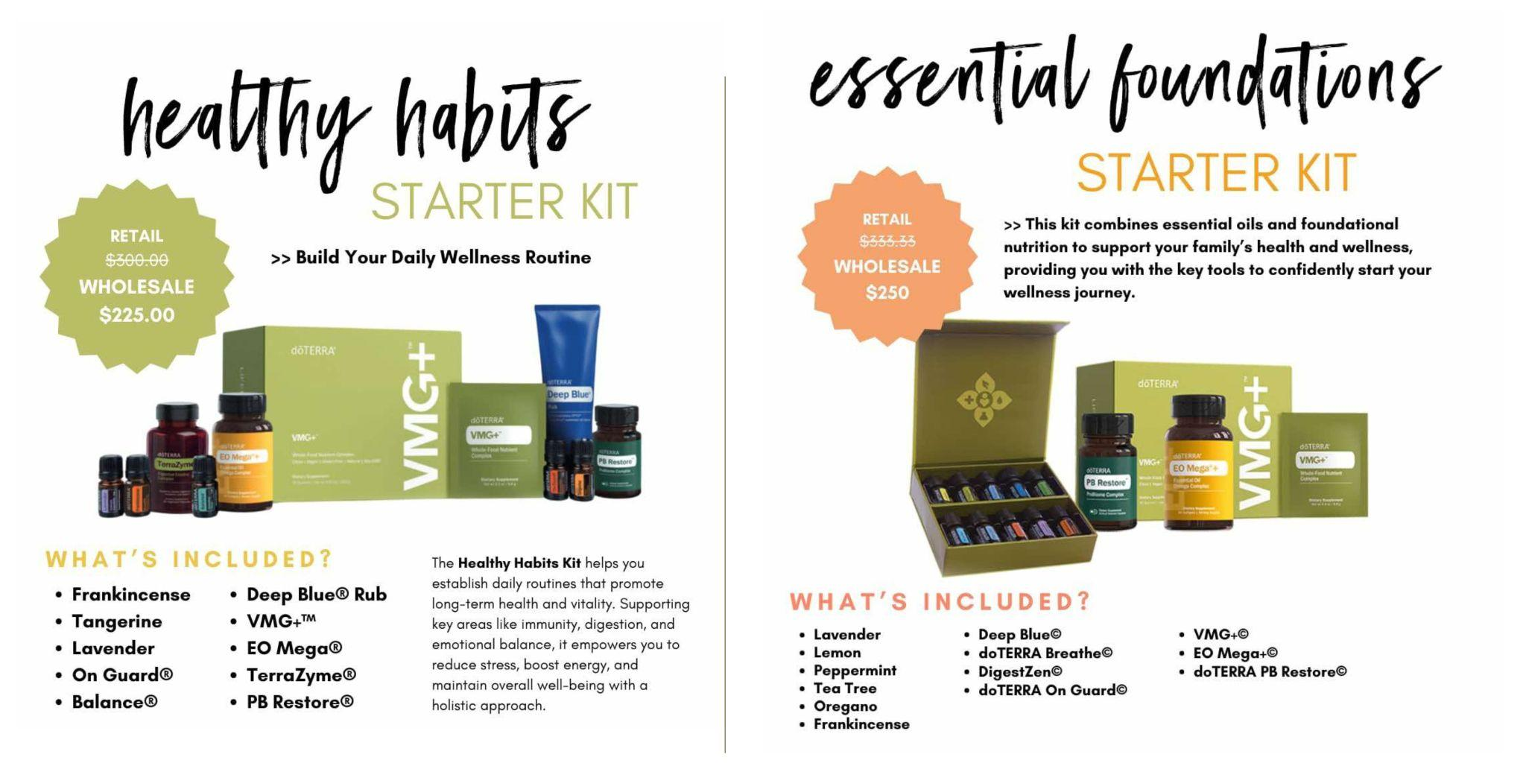
Notes:
We also have some beautiful bundles that include both supplements and our top selling oils. Connect with your advocate for the best place to start!

Slide 17
Notes:
We’re excited to share more about doTERRA’s business model. Let’s first look at how the comp plan and business model are set up. Essentially, this business is designed to create a pipeline for you. What exactly do I mean by that?
Let me give you an example. There was a woman who hauled buckets of water for a living. Every day, she hauled water from the nearest source to her distant village. If she needed more money, she’d simply work longer hours and haul more buckets. After many years, she grew tired of hauling buckets. Then inspiration came. If she used her spare time to build a pipeline, she could eventually create a new kind of financial opportunity and be free from hauling buckets. She labored diligently for a few years to build her pipeline. The day she turned on the spigot, everything changed. She successfully created an unlimited supply of water, improved her villagers’ lifestyles, and secured her own financial future. Her entire life changed.
Essentially, when you’re hauling buckets, you’re exchanging dollars for hours. This is most jobs out there, including direct sales companies who have a front loaded compensation plan where the majority of their payout is for sales. This ensures you continue to haul buckets. It’s hours worked in exchange for dollars paid.
Contrast that to doTERRA’s compensation plan and business model, which allows you to build your financial pipeline as you build your business.

Slide 18
Notes:
DoTERRA offers natural solutions for today’s most pressing health needs: Did you know that 70% of American have a metabolic disorder? Over 50% of children are obese or overweight. 70% of young people do not qualify for the military because of their health. This is staggering and should be a huge cause for concern for every single one of us. DoTERRA has solutions to address our health epidemic!
DoTERRA’s products are proven and highly effective. You heard about that tonight at our class.
Our customers are exceedingly loyal! Our customer retention rate is 75%! That’s almost unheard of in this industry. The industry average for retention is 13-18%. This lets us know our customers need the product, love the product and also find the product affordable.
With inflation impacting families and expenses continuing to rise, families are being faced with pressure to find additional streams of income. I love that doTERRA offers you flexibility to fit this into your life, allow your family to live the wellness lifestyle that so many desire, and that allows you to partner with a team like ours that has incredible resources and support so you’re never alone in figuring out this business.
Last but not least, doTERRA has the best commissions payout of any direct selling company. Most companies payout 40% or less of their revenue. DoTERRA pays out 48%. This is one thing that drew me to doTERRA…they were very transparent about income.

Slide 19
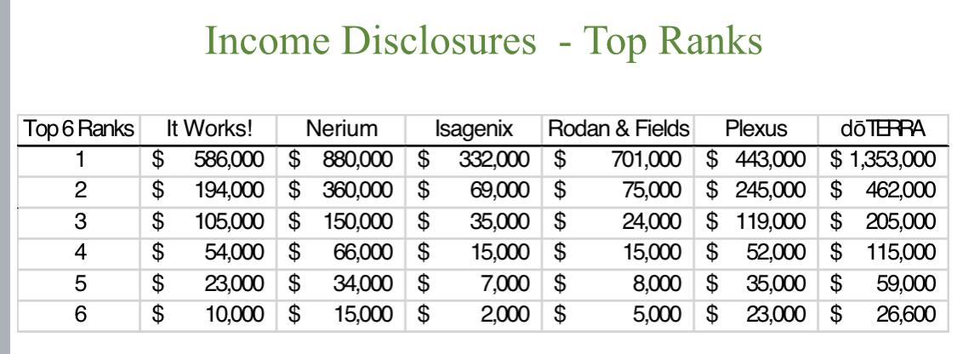
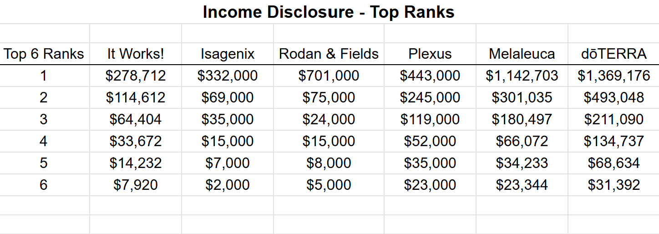
Notes:
You can see what that looks like here. This graphic is a little outdated because a couple of these companies are no longer in business. But we want you to see visually how doTERRA compares.
We know not everyone is driven by income, but it is necessary to live our daily lives. That’s why we highlight it. The questions we often get asked are, “Is this real?” “Can this happen for me?” “Can I be successful?” So we want a few people to share how the doTERRA business has impacted them.
SHARE TESTIMONIALS

Slide 20
Notes:
Slide #: Thank You and Close
If you’d like to learn even more about what our team offers, about doTERRA and more about how this business could fit into your life, I’d love to invite you to our next Learn More call. [Announce the date] That’s where you can, of course, Learn More :).
Thank you all for joining us. Once again, the wellness advocate that invited you will be reaching out in the next day or 2 to help you find solutions for your health.
Between now and then, be sure to jot down anything else that pops in your head so you can share with your wellness advocate when you connect with them. Thanks again for choosing to spend your evening with us. We look forward to seeing you in our community group soon!

Slide 21
Notes:
Slide #19: Introductions and Welcome
**START ZOOM RECORDING**
Hello and welcome to our workshop. We’re so excited to chat with you about the power of essential oils. Our goal today is to show you health options for your home that will empower you for you and your family’s health. The Modern medicine world can mostly be characterized by sick care. We want to teach you how to focus on well care!
But first, there are a few housekeeping items:
It’s helpful to have a pen and paper ready to take notes and write down questions.
Stay until the end because there will be a giveaway.
We will be using the chat feature throughout this workshop.
We’re going to start with you thinking about a world where, when you have a health issue and go to the doctor for diagnosis, you are then able to address the issue with tools and products available in your own home. In this world, you have the resources, the knowledge and the answers to address your health. Our desire is to help you move into the direction of this becoming a reality for you and your family.
Let’s start in the chat. Have you ever used an essential oil? If so, for what purposes have you used them?
Ok let’s learn why doTERRA is the industry leader in size and in purity in the essential oils world!
**NEXT SLIDE**

Slide 22
Notes:
Slide #20: Research: Roseman University of Health Sciences
We’re going to start with some research.
doTERRA prides itself on being a company who values research. Roseman University did an independent study on essential oils from a number of prominent essential oil companies. Results found doTERRA’s oils were the only ones to be:
therapeutically-relevant in cell growth and rejuvenation (this is referring to how the body responds to the oil)
metabolic health
and healthy inflammatory responses
doTERRA oils were also the only oils found to contain no traces of contaminants, synthetics and no form of dilution. Essential oils from competitors had minimal effects. The study concluded that the therapeutic potential of essential oils is highly dependent on the complete composition of the oil, making sourcing, processing and characterization critical to their benefits.
https://www.roseman.edu/student-experience/news/roseman-university-researchers-study-doterra-essential-oils/?fbclid=IwAR3YbwzWw06dPks6rOPcYW_Bx4V7P-R0ptm7vmqMNR7-EuOCQ9GGBucm2Sg
**NEXT SLIDE**

Slide 23
Notes:
Slide #21: DoTERRA Difference
DoTERRA’s oils are pure – There are no fillers, synthetic ingredients, or dilution.
Independent lab tests show that the majority of brands available to consumers aren't pure. In addition to the Roseman University Study, I’ll put another one in the comments: https://www.consumersadvocate.org/essential-oils
We source from plants grown in their ideal environments- this makes all the difference in the chemical profile and therapeutic effectiveness of the oil.
Every batch of oil is tested for ideal chemistry and consistency
Over 54 tests done on each batch of doTERRA oils – from the farmer to the consumer.
doTERRA oils can be used topically, aromatically, and internally
People use doTERRA because they want safe, affordable and effective solutions for their family’s health.
**NEXT SLIDE**

Slide 24
Notes:
Slide #22: Safety and Risk
DoTERRA recognized that the essential oil industry didn’t have a standard for purity to ensure safety. So they created the CPTG standard that can be used throughout the essential oils industry. CPTG stands for Certified Pure Tested Grade. This standard is beyond organic and includes significant testing that isn’t cheap. Oils safe to ingest will have a food grade label.
doTERRA oils are safe to use at any age from newborn babies to great grandparents. Brand matters for SAFETY! When you are ingesting oils, please make sure they have a food grade label on the bottle. If they do, you can take essential oils in a veggie cap, put them under the tongue or in a glass of water. There are lots of ways to ingest them safely. There are times that I want the internal benefits without the taste, so the veggie caps are my favorite way to go.
**NEXT SLIDE*

Slide 25
Notes:
Slide #23: Our Essential Oils are Effective
Our body is made up of cells. Each cell is surrounded by an oily membrane. Its function is to keep the good in and the bad out. When you have a bacterial-infection (see that green blob?), Doctors often prescribe an antibiotic to kill it, and the antibiotics often work to get rid of the symptom because bacteria grows on the outside of a cell.
However, you may have noticed that when you have a virus, your doctor tells you to go home, relax, and drink honey and lemon because they can’t treat it. That’s because unlike bacteria, viruses proliferate on the inside of a cell and most antibiotics can’t penetrate our body’s oily cell membrane and attack the virus.
But guess what can easily penetrate that same oily membrane.... essential oils! Unlike most modern medicines, pure essential oils can penetrate our cell membranes and help stop viral replication. This means, true essential oils allow you to support the healing of your body immediately instead of paying a copay or waiting to see a doctor.
OPTIONAL to SHARE: To illustrate the power of essential oils, listen to this…
One of the biggest fears of our aging population is dementia and memory loss. Check out this study recently published by UC Irvine. Participants in the study diffused a variety of essential oils for 2 hours a night every night for 6 months. 226% increase in cognitive capacity!!!!! Just from diffusing Essential Oils on their nightstand! The scientists noticed a direct link between the sense of smell and the brain’s memory circuits. You can check out the UC Irvine study here: https://www.frontiersin.org/articles/10.3389/fnins.2023.1200448/full
**NEXT SLIDE**

Slide 26
Notes:
Slide #24: Affordable
Now let’s look at how much it costs to use essential oils for wellness. Did you know essential oils are 50-70 times more potent than herbs. This means a little goes a LONG way! Did you also know that one bottle of PURE oil is more affordable than one bottle of diluted or adulterated oil?
Using the chat feature, I want you to make a guess. A recent test of Costco peppermint oil showed that it was not 100% peppermint oil. How much peppermint is in the Costco Peppermint oil bottle? (ANSWER: 10%).
When you use a DoTERRA oil, you get 100% of the oil making it much cheaper compared to other company’s oils where it is diluted.
Each 15ml bottle has 250 drops of essential oil in it
1 dose = 1 -2 drops
On average, it costs about $1 to $2 to treat an acute issue with pure essential oils
Here’s an essential oil tip…When you are treating any kind of infection, disease or ailment, use less oil more frequently throughout the day. Using 8 drops of oil on a wound at one time will not be more effective than using 1 drop of oil on a wound every 2-3 hours throughout the day.
**NEXT SLIDE**

Slide 27
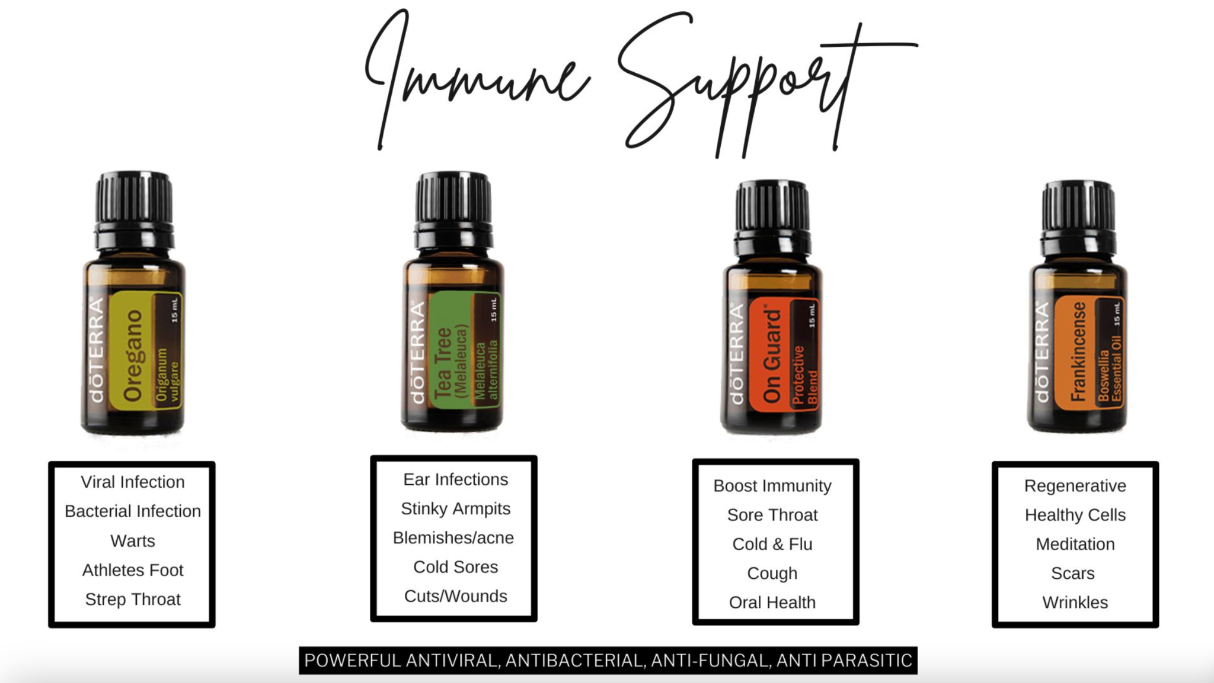
Notes:
Slide #25: Immune Support
PICK 1-2 TO HIGHLIGHT ON THIS SLIDE
Let’s move into some specific oils now! Consider these to be options you grab from your medicine cabinet!
Did you know that research shows that essential oils, when diffused, can kill most airborne microorganisms? A french study colonized 210 different microbes; within 30 minutes of diffusing a mixture of essential oils, only 4 colonies remained alive! https://www.huffpost.com/entry/essential-oils-health_b_868303
Use your key chain as you talk about the oils.
Oregano - A powerhouse antibacterial
Use for skin tags and warts
Canker sores
Tea Tree - Great for all things fungal or any kind of infection.
great for acne
Use after you shave to prevent razor burn
Good for cold sores
Use for wounds/cuts
Amazing if you struggle with smelly armpits even when using deodorant
OnGuard - (show in keychain) The protector. Natural immune defense. Everyone should have On Guard.
Stops the growth of viruses and bacteria.
Diffused it cleans the air of airborne pathogens.
Soothes sore throats and can help knock it out.
The key is to use it frequently right away. So worth it to avoid getting sick for a week!
Frankincense - Considered the KING of oils - When in doubt use Frankincense. Renewing, beautifying, rejuvenating, grounding.
Reduces inflammation
Relieves headaches (wonderful with peppermint and lavender)
Supports immune function
Apply topically to help reduce the appearance of skin imperfections
Strengthens the effects of other oils when used together
Diffuse during meditation for a sense of relaxation and balance
**NEXT SLIDE**

Slide 28
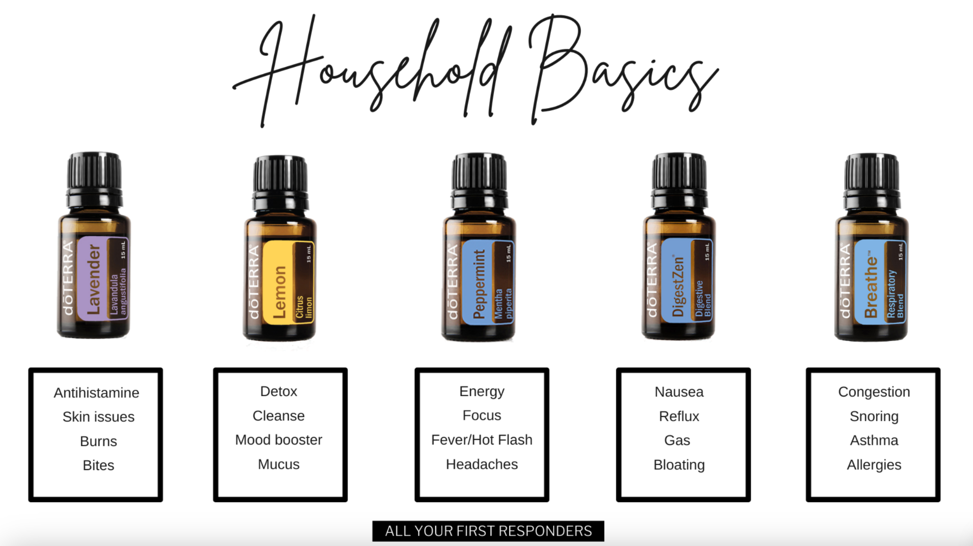
Notes:
Slide #26: Household Basics
PICK 1-2 TO HIGHLIGHT ON THIS SLIDE
Lavender: (show keychain) the Swiss army knife of oils! Every first aid kit needs lavender in it!
Good for calming the mind and skin
Great for bug bites and bee stings. Pain goes away almost immediately and the itching stops right away.
Soothes and heals burns and skin irritations. Takes burning away immediately and doesn’t scar.
Good if you struggle with sleep or just unwinding
Relieves stress and anxiety
Are you an allergy sufferer? If so, this is a must have. It’s a natural antihistamine. Increases the body's serotonin levels.
Lemon: (show keychain) cleansing. A drop or two in water is amazing for escorting toxins out of your body
The clean fresh scent uplifts your mood.
Use it to clean your fruits and vegetables
Awesome with anything sticky like residue and chewing gum
ASK: How many lemons does it take to make a bottle of doTERRA’s Lemon Oil? 60
Peppermint: (show keychain) everything cooling and energizing
Increase energy. In the afternoon when you need to wake up and focus. It oxygenates your cells.
Great to diffuse when studying or working where you need to be alert
Use this when your sinuses are stuffed up and you need to open your airways
Wonderful relief for tension headaches - can knock it out before it really sets in
When you eat something spicy or eat too late at night - peppermint can help prevent acid reflux
When overheating on a summer day or kids have a fever, you’ll be glad you have oils to cool down. Can cool your body 1 degree. Also great for hot flashes.
TRIVIA: Let’s go back to the chat feature! Take a wild guess. How many cups of peppermint tea would be equal to one drop of doTERRA peppermint oil?
DigestZen: (show keychain) might not use this one every single day, but it’s going to be one you are glad you have on hand when you need it. We call this the oil of repentance. It’s definitely a “purse oil”. You’ll never want to be without it (even when traveling).
Useful for acid reflux, bloating, gas, indigestion, bloating, diarrhea.
Can be used for nausea - settles your stomach
Can even be used for food poisoning
Breathe: (show keychain) you will use this for everything respiratory
sinus infections, asthma, snoring, congestion
with that nagging cough and difficulty breathing it will help clear the congestion so you can breathe better
those with asthma find it’s a must have
diffuse at night for a more restful sleep and to help reduce snoring
use before a workout to open airways and increase your stamina
**NEXT SLIDE**

Slide 29
Notes:
Slide #27: Pain and Inflammation
Deep Blue - must have for muscle and joint health
Not only does it relieve pain and tension, the amazing oils in it support muscle, joint and bone healing.
Alleviates back pain
When you have a nasty bruise forming, grab your deep blue to stop it in its tracks.
Stick has copaiba in it and is easy to apply without it getting on your hands.
Copaiba – another oil used for pain and inflammation; a super anti-inflammatory
Layered with another oil, it increases the effectiveness
When you really need to boost pain relief, this is what you’re going to use with your Deep Blue.
If you ever suffer from any emotional strain such as anxiety or depression, this oil can calm and soothe.
Supports all major body systems: heart, nerves, respiratory, immune and skin
Can really be helpful for ADHD
A CBD replacement
**NEXT SLIDE**

Slide 30
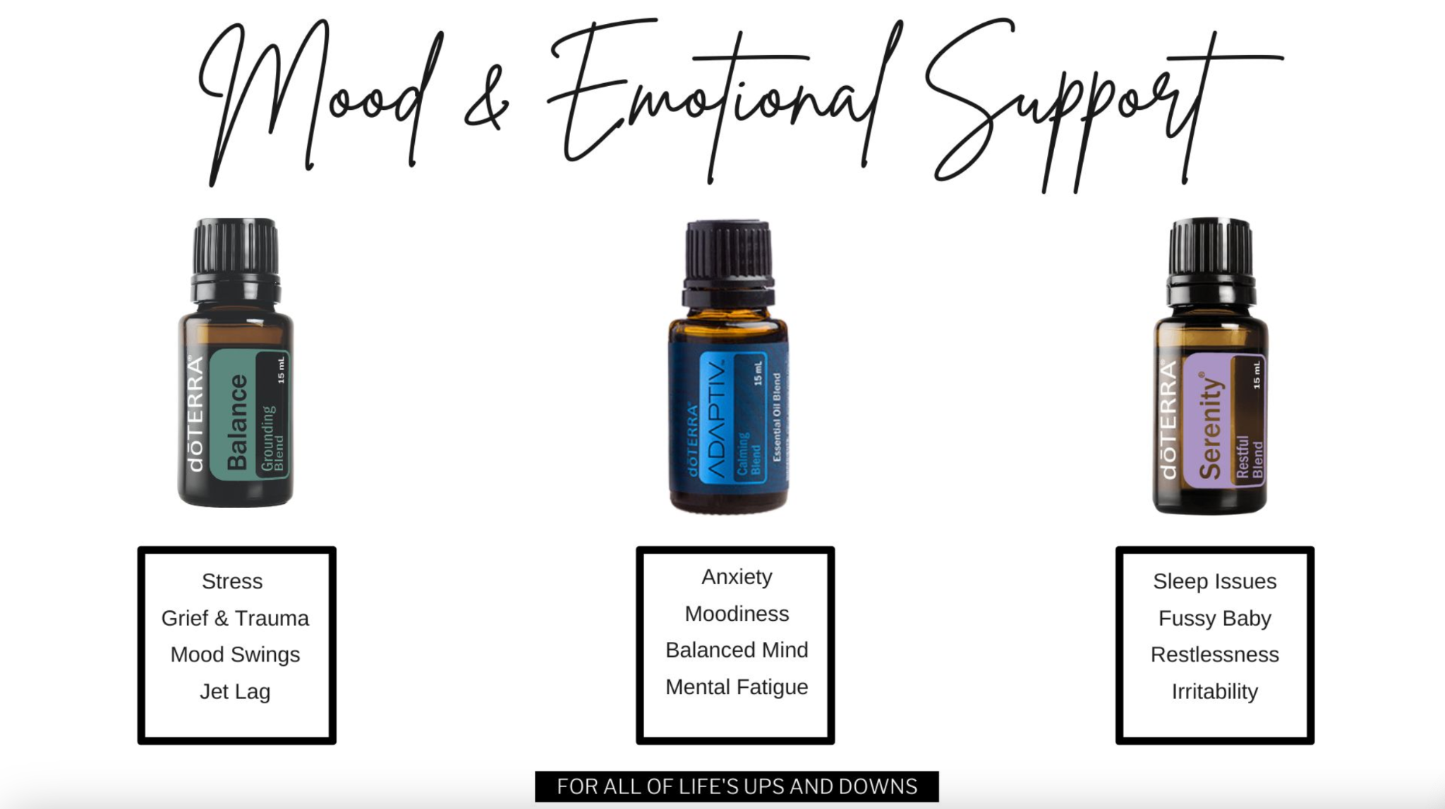
Notes:
Slide #28: Mood and Emotional Support
Let’s wrap up our oils section with mood and emotional support oils. Talk with your wellness advocate about additional oil options available for wellness!
PICK 1 TO HIGHLIGHT ON THIS SLIDE
Lastly – let’s talk about our mood and emotional support blends. For those of you who indicated you or someone in your family deals with anxiety, these are great options to consider.
These oils are 3 of the powerful blends for emotional & mood support
Adaptive – Show how you apply it with one drop in your hands, rub it around and then breathe in through nose and mouth
Helps the brain stay in executive functioning in the frontal cortex instead of going into fight or flight
Brings a calming effect over your body
Diffuse it in a room or use it topically
Balance - smells like a forest
wonderful to diffuse
very grounding emotionally and helpful with grief, sadness, overwhelm, heaviness, or just getting through the day feeling more emotionally strong and grounded
Serenity - calming and helpful for sleep
May help you fall asleep more easily and sleep more deeply
So many people swear by it
Also, helpful for anxiety and stress
**NEXT SLIDE**

Slide 31
Notes:
doTERRA has several great bundles to choose from when you start as a wholesale customer. They have bundles with just essential oils, bundles with just supplements, and then bundles with a combination of both. Connect with your advocate to see the best place to start for you.

Slide 32
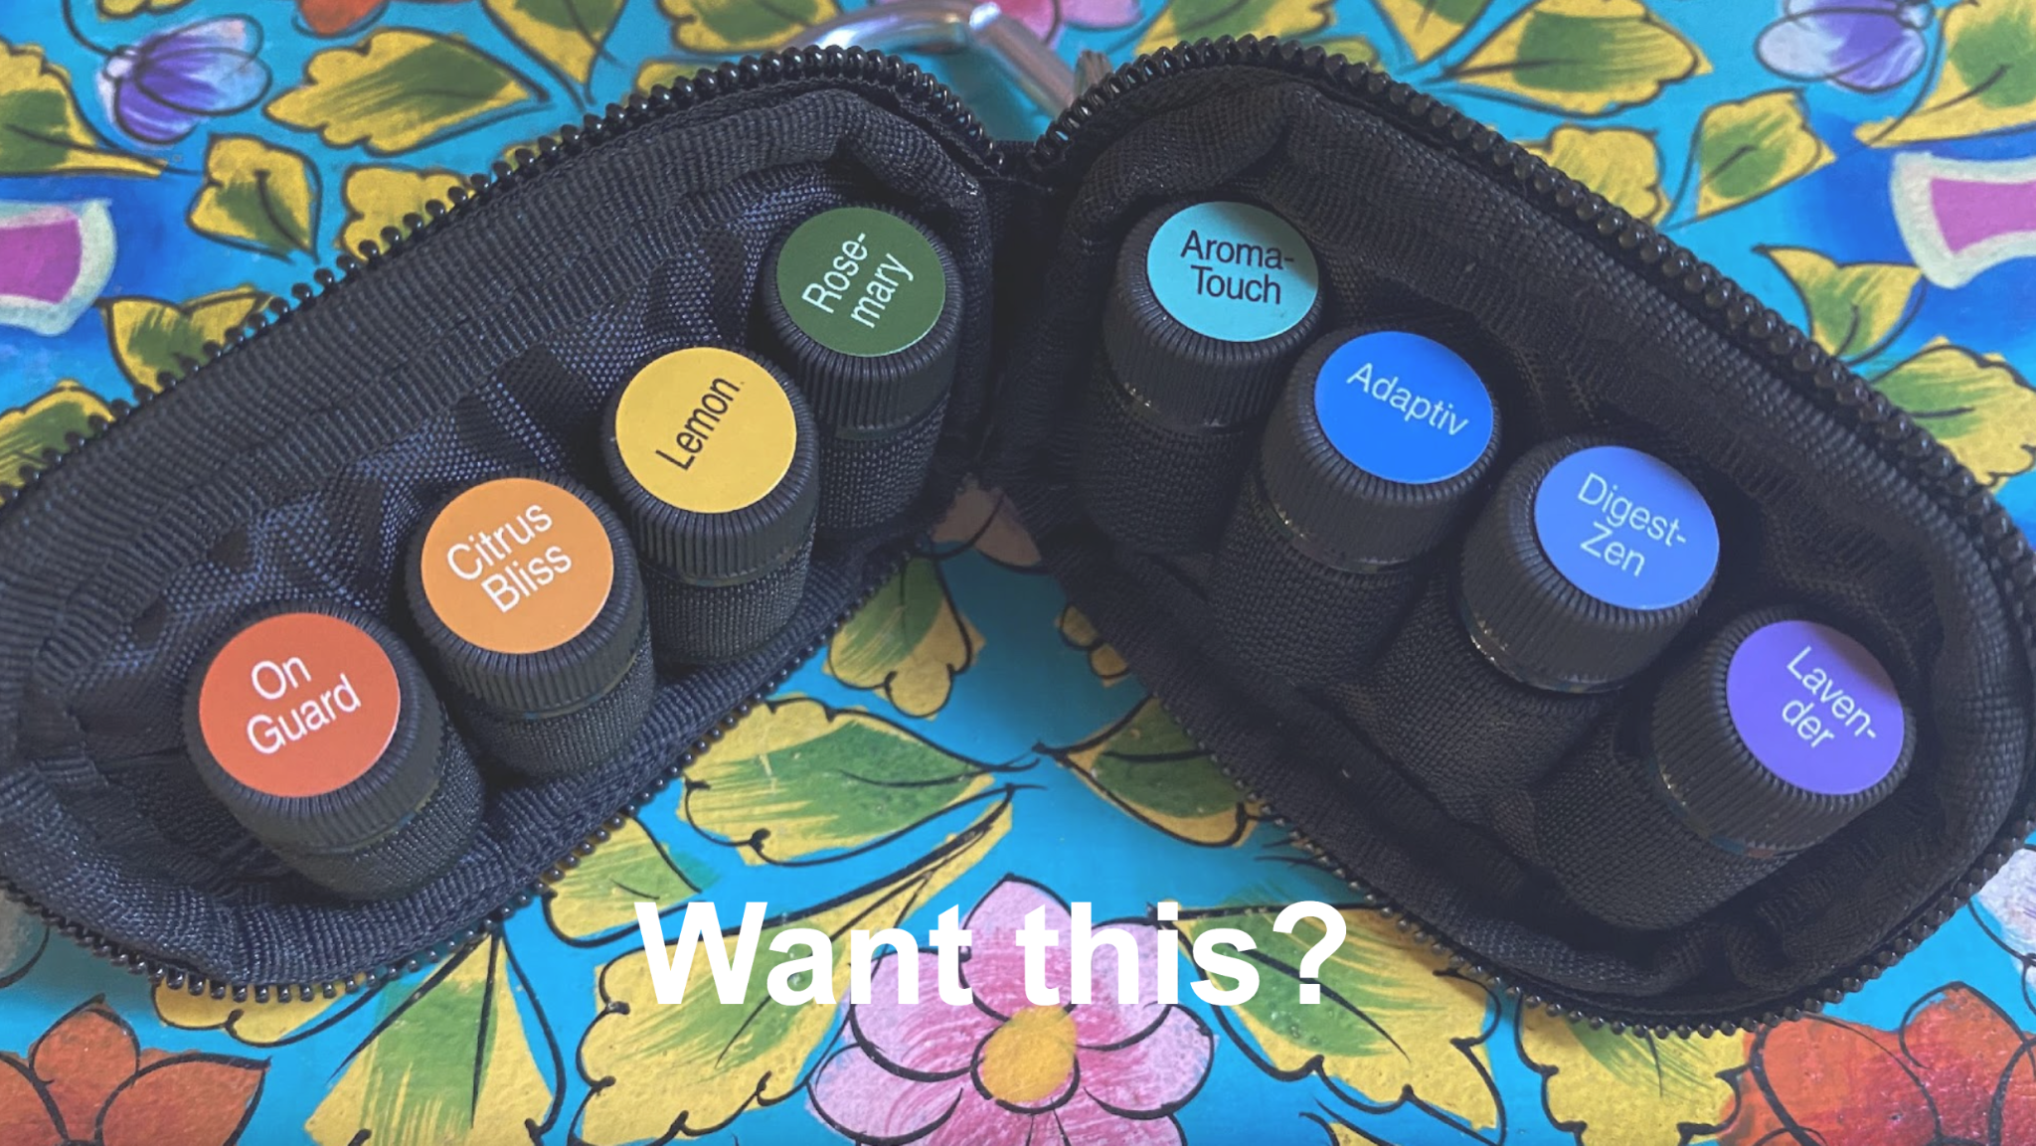
Notes:
Slide #: Host a Workshop/Class Online
This has been one of the most valuable items to have with me on the go! There is a way you can get it for free. We host a workshop every week that you can join in on at any time. However, if you have thought of your own friends or family who might enjoy a workshop geared specifically to them, you will get this as a gift when you host.
When you schedule your wellness workshop, you will receive this keychain! This is the only way to get one!
You can invite your friends that live outside your community or even in a different country. The ideal workshop size is 5 people. That’s doable, yes? You will get 5 oils for hosting. For every guest you have there up to 5, I will add another free oil to your keychain as a gift!
Talk to your wellness advocate about that option if you’re interested.
**NEXT SLIDE**

Slide 33
Notes:
Slide #: Google Form and Giveaway
**NEXT SLIDE**

Slide 34
Notes:
We’re excited to share more about doTERRA’s business model. Let’s first look at how the comp plan and business model are set up. Essentially, this business is designed to create a pipeline for you. What exactly do I mean by that?
Let me give you an example. There was a woman who hauled buckets of water for a living. Every day, she hauled water from the nearest source to her distant village. If she needed more money, she’d simply work longer hours and haul more buckets. After many years, she grew tired of hauling buckets. Then inspiration came. If she used her spare time to build a pipeline, she could eventually create a new kind of financial opportunity and be free from hauling buckets. She labored diligently for a few years to build her pipeline. The day she turned on the spigot, everything changed. She successfully created an unlimited supply of water, improved her villagers’ lifestyles, and secured her own financial future. Her entire life changed.
Essentially, when you’re hauling buckets, you’re exchanging dollars for hours. This is most jobs out there, including direct sales companies who have a front loaded compensation plan where the majority of their payout is for sales. This ensures you continue to haul buckets. It’s hours worked in exchange for dollars paid.
Contrast that to doTERRA’s compensation plan and business model, which allows you to build your financial pipeline as you build your business.

Slide 35
Notes:
DoTERRA offers natural solutions for today’s most pressing health needs: Did you know that 70% of American have a metabolic disorder? Over 50% of children are obese or overweight. 70% of young people do not qualify for the military because of their health. This is staggering and should be a huge cause for concern for every single one of us. DoTERRA has solutions to address our health epidemic!
DoTERRA’s products are proven and highly effective. You heard about that tonight at our class.
Our customers are exceedingly loyal! Our customer retention rate is 75%! That’s almost unheard of in this industry. The industry average for retention is 13-18%. This lets us know our customers need the product, love the product and also find the product affordable.
With inflation impacting families and expenses continuing to rise, families are being faced with pressure to find additional streams of income. I love that doTERRA offers you flexibility to fit this into your life, allow your family to live the wellness lifestyle that so many desire, and that allows you to partner with a team like ours that has incredible resources and support so you’re never alone in figuring out this business.
Last but not least, doTERRA has the best commissions payout of any direct selling company. Most companies payout 40% or less of their revenue. DoTERRA pays out 48%. This is one thing that drew me to doTERRA…they were very transparent about income.

Slide 36
Notes:
You can see what that looks like here. This graphic is a little outdated because a couple of these companies are no longer in business. But we want you to see visually how doTERRA compares.
We know not everyone is driven by income, but it is necessary to live our daily lives. That’s why we highlight it. The questions we often get asked are, “Is this real?” “Can this happen for me?” “Can I be successful?” So we want a few people to share how the doTERRA business has impacted them.
SHARE TESTIMONIALS

Slide 37
Notes:
Slide #: Thank You and Close
If you’d like to learn even more about what our team offers, about doTERRA and more about how this business could fit into your life, I’d love to invite you to our next Learn More call. [Announce the date] That’s where you can, of course, Learn More :).
Thank you all for joining us. Once again, the wellness advocate that invited you will be reaching out in the next day or 2 to help you find solutions for your health.
Between now and then, be sure to jot down anything else that pops in your head so you can share with your wellness advocate when you connect with them. Thanks again for choosing to spend your evening with us. We look forward to seeing you in our community group soon!

