Slide 1
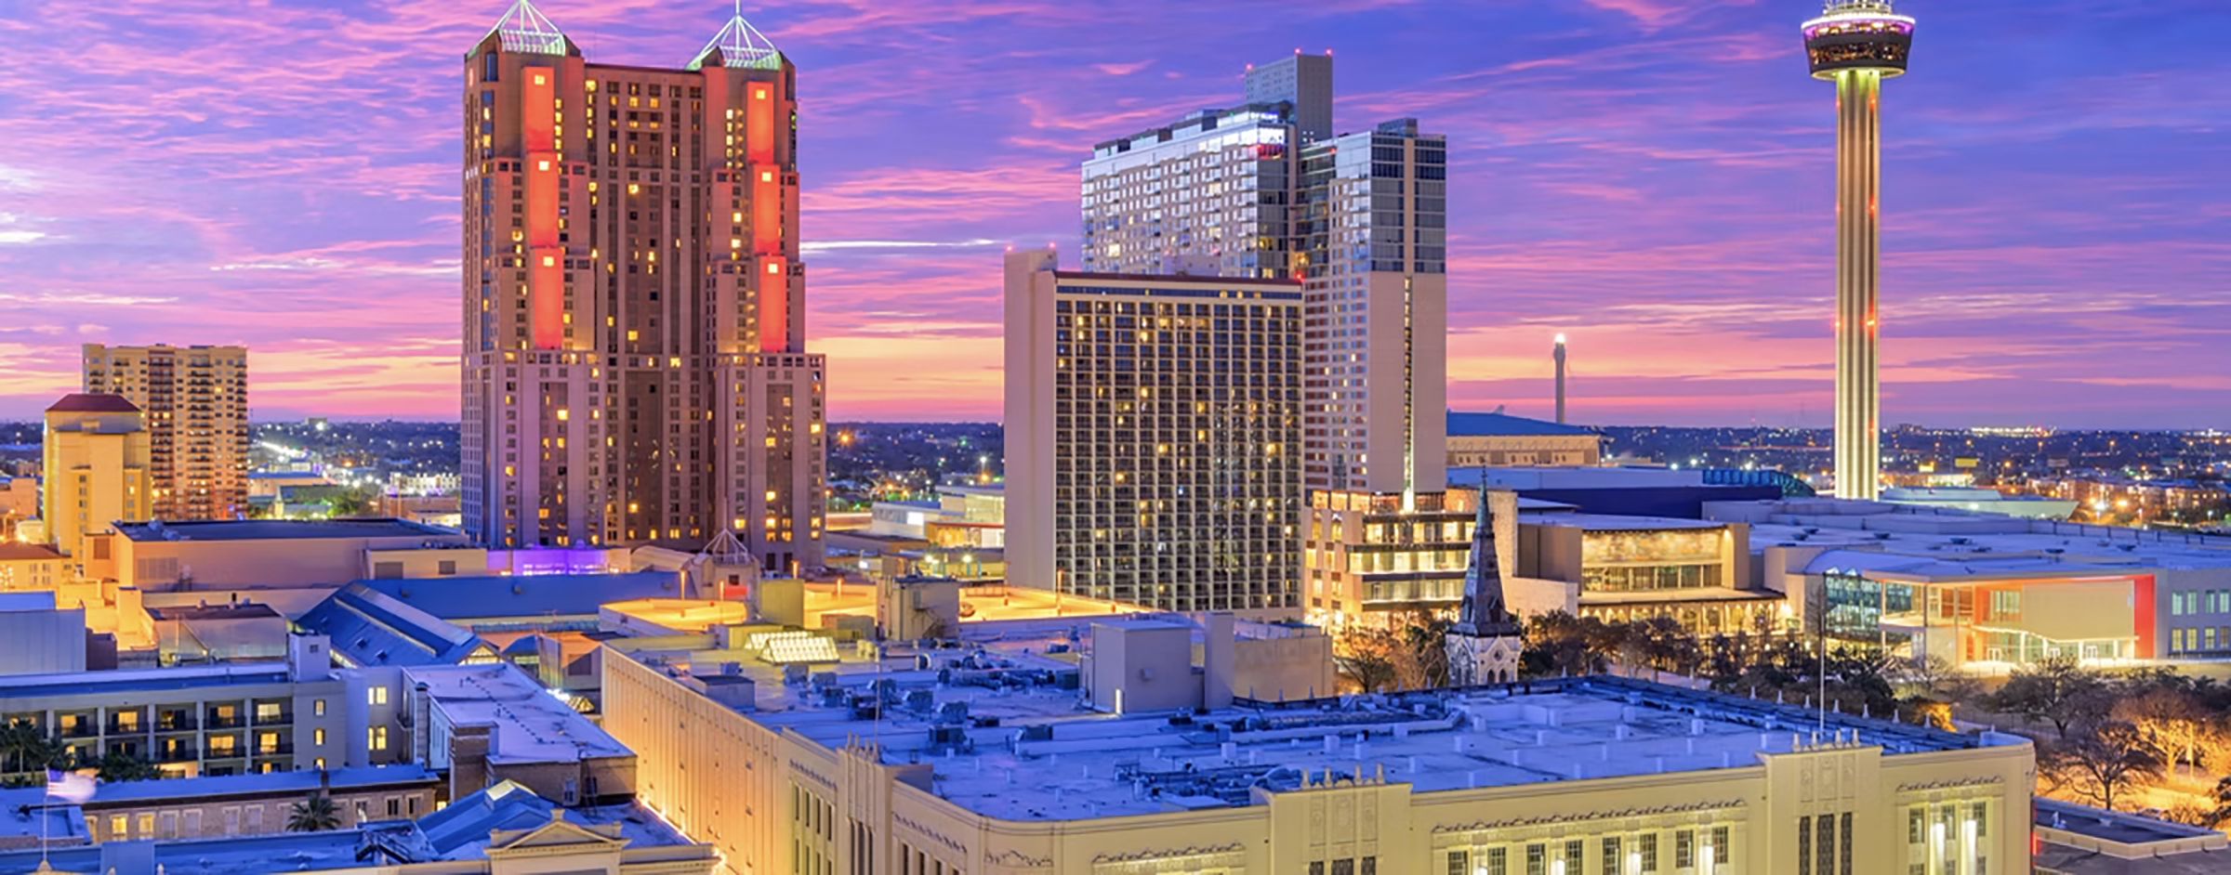

Slide 2
BREAKTHROUGH
An Aromatherapeutic Process for Emotional Release & Expansion

Slide 3
Gratitude
Notes:
Conclude the breakthrough process with a gratitude slide, inviting you to appreciate the growth and clarity achieved.

Slide 4
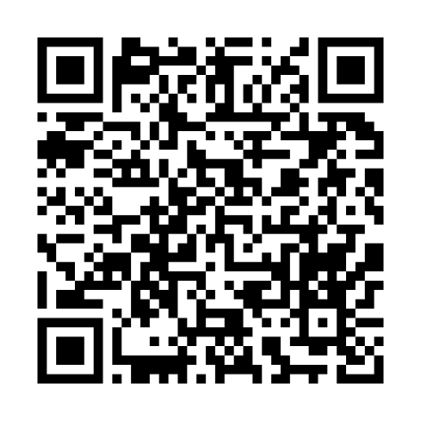
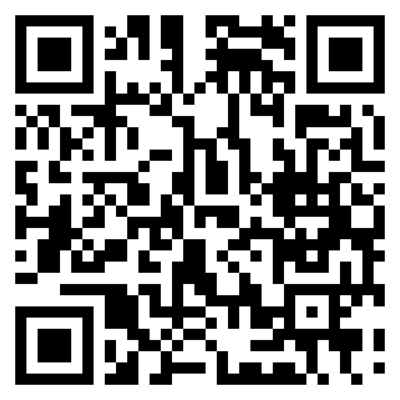
Leader Toolkit
Access Tools & the FREE Breakthrough Worksheet!
Share Breakthrough with your teams!
Learn how to help your teams breakthrough
Download the Breakthrough Worksheet
Save $50 with Coupon Code: LEAD
Notes:
Remember, you have access to the complete Breakthrough Worksheet and an online program that teaches you how to use these tools. They are invaluable resources you can pass on to your teams to help them experience similar breakthroughs.

Slide 6
BREAKTHROUGH PROCESS
Robin Jones & Cherie Burton

Slide 7
WHAT’S WORKING PANEL
Moderator: James Bybee
Sarah Schumaker, Rachel Lynch, Nicole Gibson, Elena Starkey

Slide 8
ENGAGING BUILDERS WITH THE COMP PLAN
Rod Richardson & Seth Risenmay

Slide 9
Burnout?
Notes:
How many of you have experienced burnout while building doTERRA? Me too.
Why is that? We’re out there healing the world – how could we get burned out on that?
I have a theory...

Slide 10
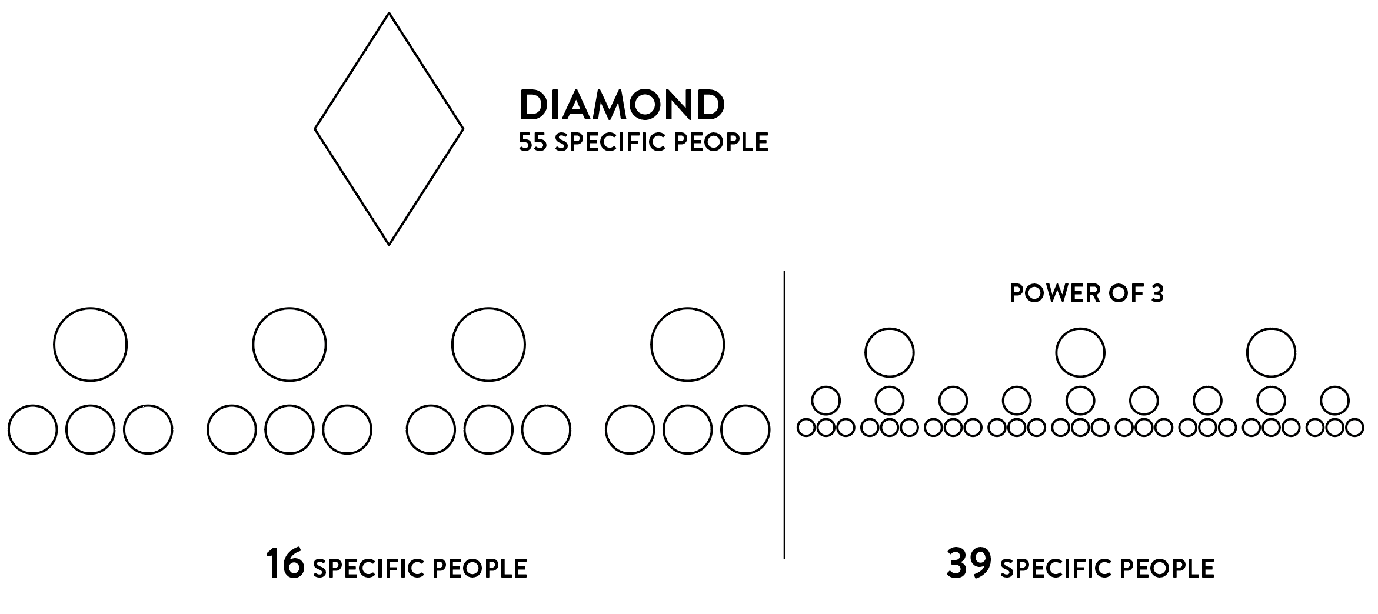

Slide 11
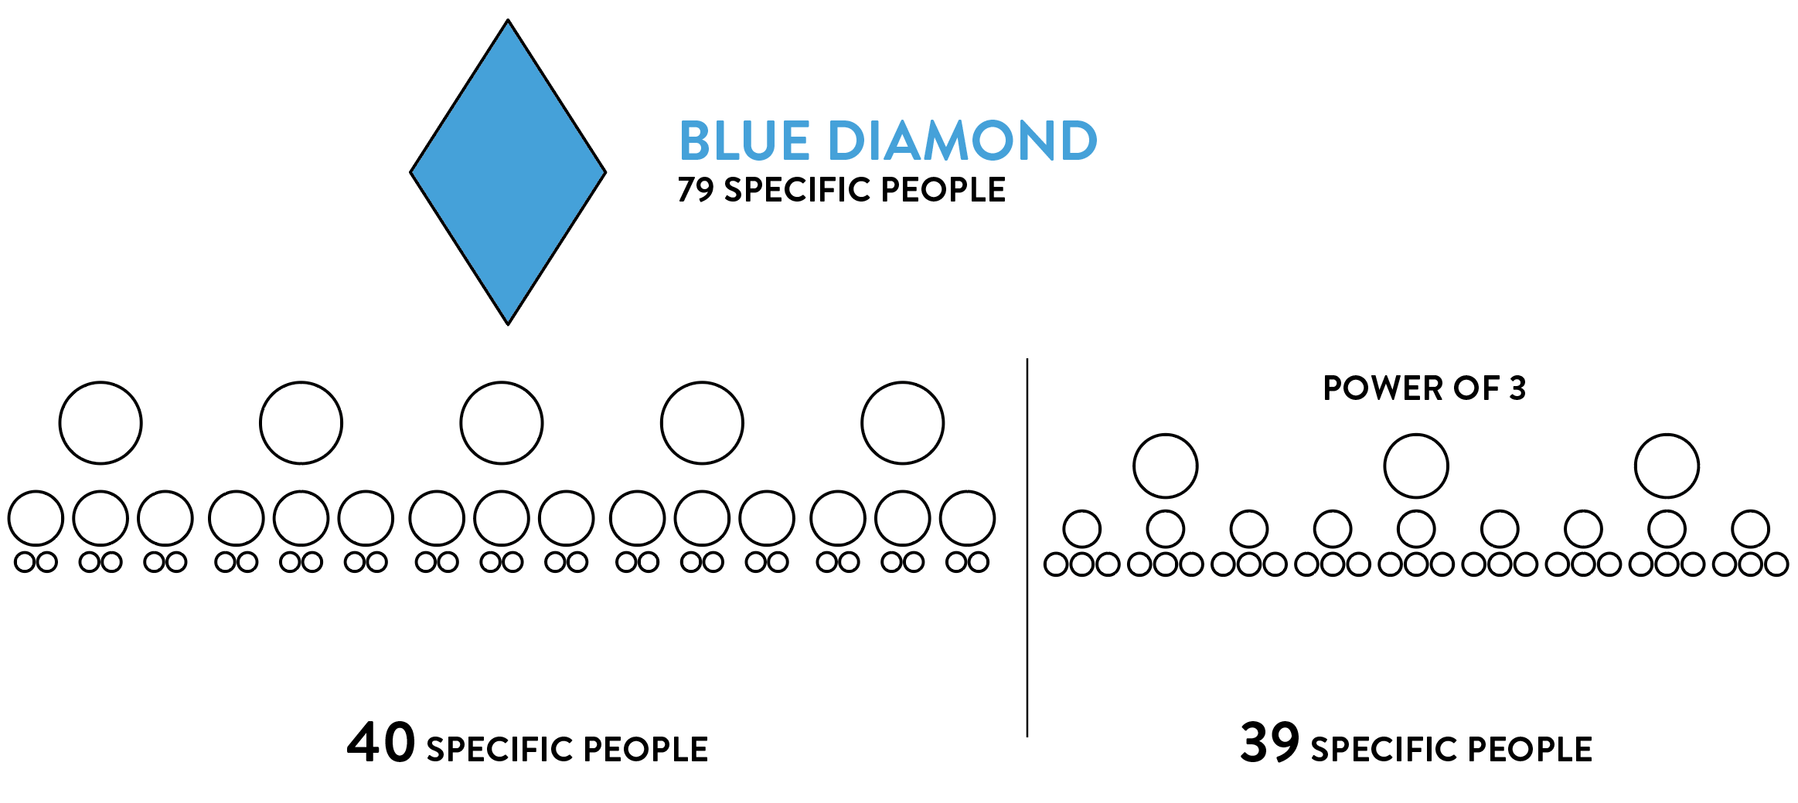
Notes:
Have you ever gotten to the end of the month and there’s this SAME specific person who’s still specifically not doing that same specific thing? For us it’s this woman named Norma. And you’re thinking you need to call this person and have the same specific conversation that you’ve had for years! Screw it – I’m just gonna buy in.
Just to avoid that conversation with the same freaking person – Who’s done $500? $1000? Be honest. $2000
Corporate, you have no idea. You’ve been up here on this stage speaking going why can't we get them off of their butts and have them clap? You know why? Cuz we have those same specific people that are still not doing that same specific thing

Slide 12
Notes:
Now you go to presidential - that's six Platinums, 18 Silvers, 54 Elites - 78 SPECIFIC people for rank and 78 specific people for Po3 (2) that have to do a certain thing - I wonder why we're burned out? Just doesn't make sense!
How many of you know Seth Risenmay? He shared these thoughts at US BDPD summit. He went into corporate 1 year ago and he’s like, you guys could get up on stage and you can announce that our product will grow back your arm, but it won't matter because you know why? Because we're sitting there thinking about Norma. We're in our chairs and we're thinking, you know this should normally really excite me that I can grow a person's arm back but Norma is not going to do that same thing and we keep thinking about the Norma! Who has the Norma? All of us have that freaking Norma and we don't know what to do with her!
Corporate – I want tell you why you pissed us off. Cause if you call your account manager and tell them about Norma and how she’s hijacked that leg, what do they usually say? Just go build a new leg. Burnout?
I don't want to throw our comp plan under the bus because I think that actually it's a massive reason why we're as big as we are, so I want to thank Greg and others who came up with that because it’s a fantastic thing.

Slide 13
Rigidity & Fragility
Notes:
However, it does it does have rigidity and it has fragility built into it. What I mean by fragility is that if you were to take the 78 people that make you go presidential plus another 78 people for your 2 powers of three (and some of those overlap and some don't) but if two of those 156 people made a 99 PV order instead of 100 PV order $2 would take our paycheck and shift it over $20,000. Especially if one of those people are mad at you and they do that on purpose? Who here has had someone who knows that they're a specific person that has to do a specific thing and they know that you need them to do that, and they would just rather you buy the product than them? And who still gets paid? They do. It's just enmity. That's the problem. So, what's the solution?

Slide 14
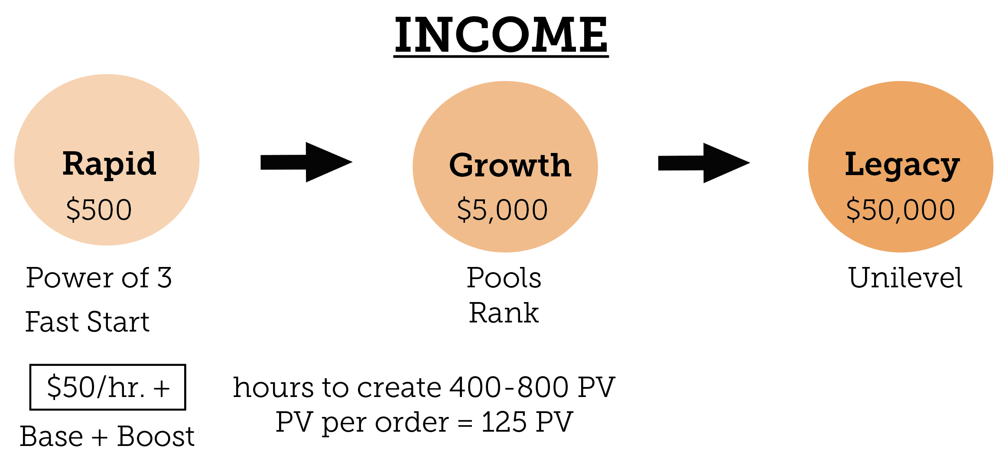

Slide 15
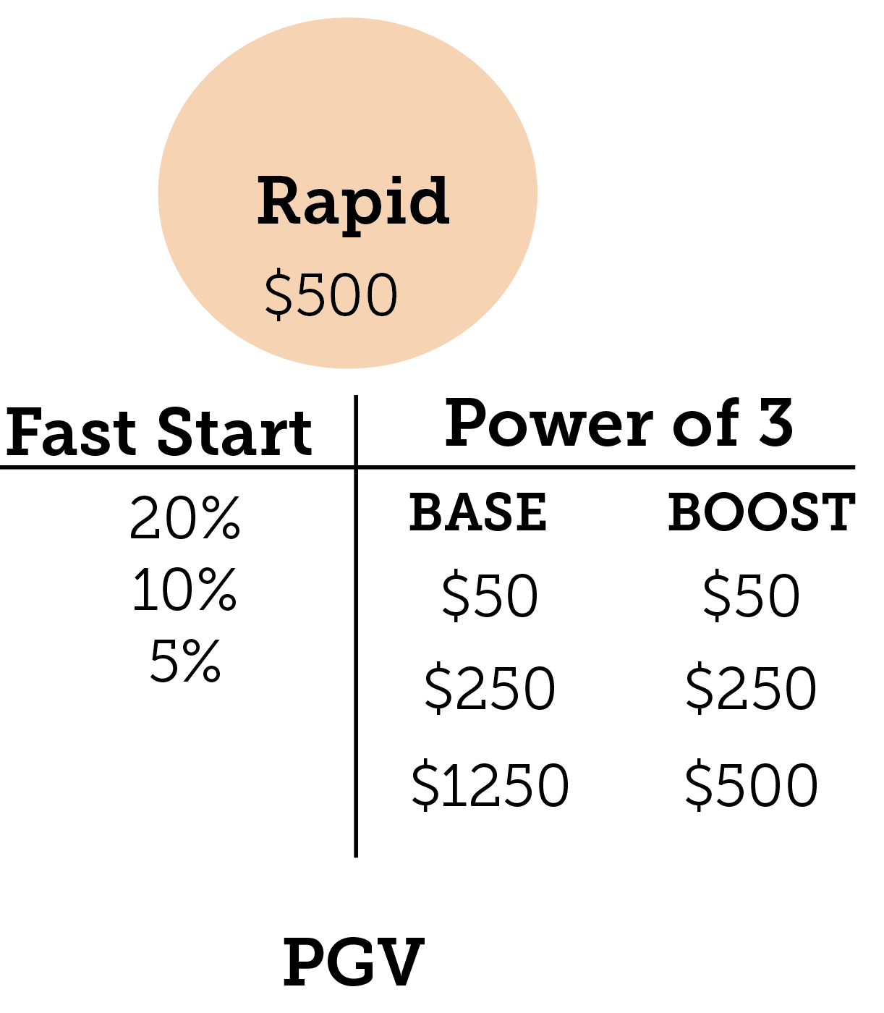

Slide 16
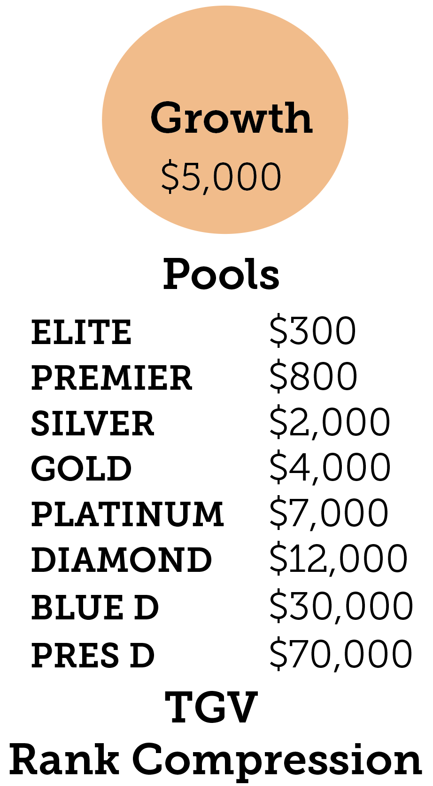
Average Income

Slide 17
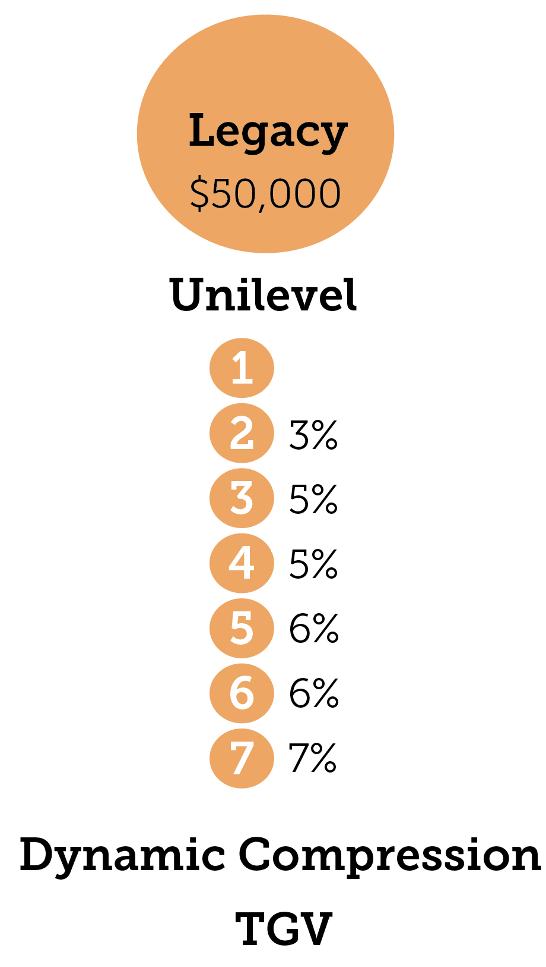

Slide 18
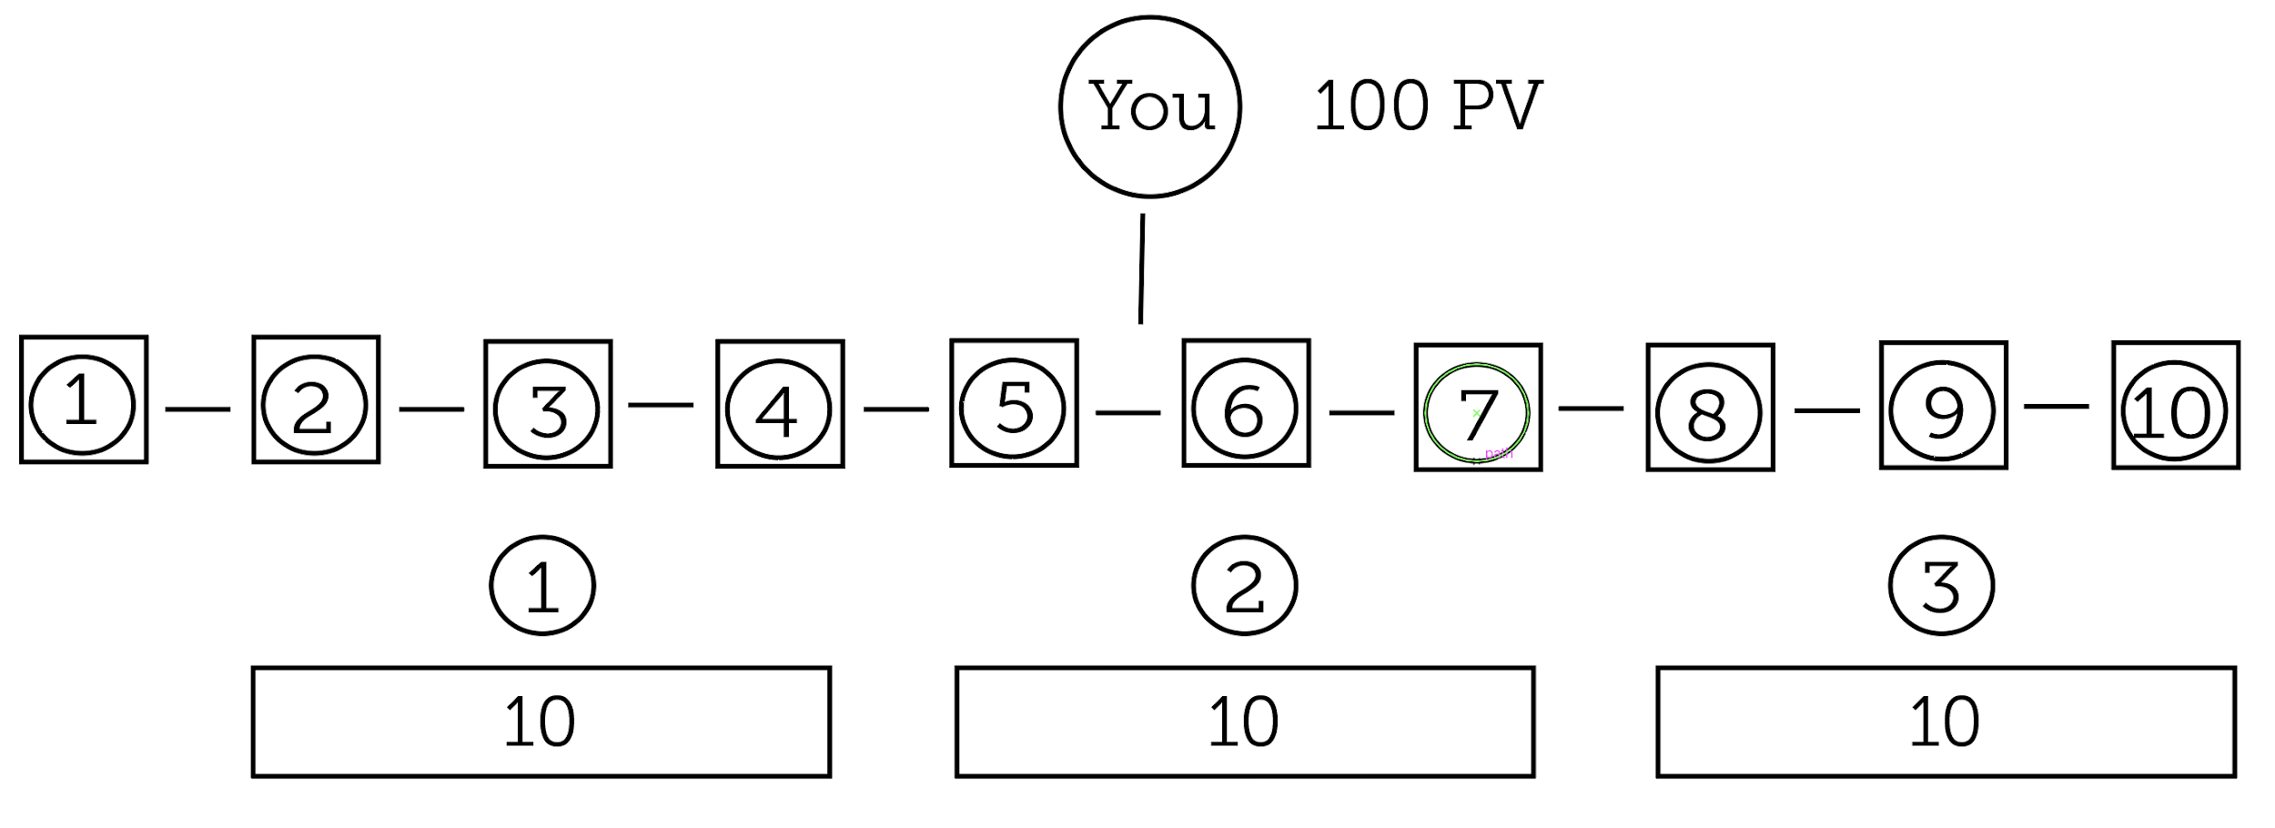

Slide 19
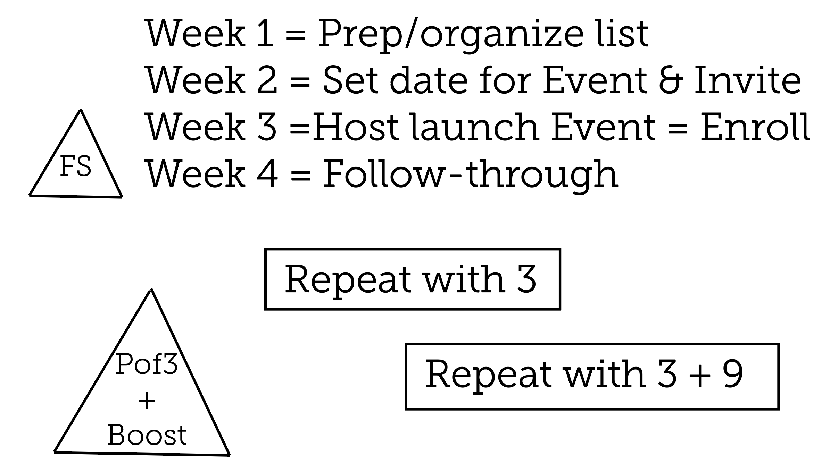

Slide 20
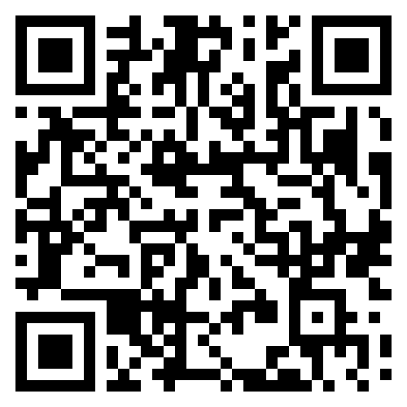
RESOURCES
sharesuccess.com/leadership

