Slide 1
Empowered University
Six Sessions to Launch YOUR Business
Session Four

Slide 2
Placement and Strategy

Slide 3
Knowing Ranks Helps!

Slide 4
Wholesale Customer VS
Wellness Advocate

Slide 5
Wholesale Customer
$35 enrollment fee
$25 renewal fee (and free oil)
Access to all specials, LRP increased %, shipping points, and 25% off products
Can have no one placed under them in structure
Can impact rank and power of three
Can earn zero commission from dōTERRA

Slide 6
Wellness Advocate
Must give social security number
$35 enrollment
$25 renewal fee (with free oil)
Access to all specials, LRP increased %, shipping points, and 25% off products
Can build a team and earn commissions
Expanded back office
Receives a mydoterra.com/yourname site

Slide 7
Enroller and Sponsor

Slide 8
YOU
You sponsor is anyone on your top line
WA
WC
Enrollment
Sponsor
Enrollment but NOT Sponsor
WA/WC
You enroll but can SPONSOR under any Wellness Advocate
Fast Start is paid on ENROLLMENT not SPONSORSHIP!
All other compensation is based on sponsorship!

Slide 9
Pitfalls to Placement
We all make mistakes!

Slide 10
Dividing Family and Friends
Just creates chaos!

Slide 11
Plugging Holes
Think long term, not short term

Slide 12
Living in the past!
“If only!”

Slide 13
Focusing only on leaders/builders
Focus on solid users, who become sharers, who become builders, who become leaders!

Slide 14
SUCCESSFUL PLACEMENTS!
What are the keys?

Slide 15
Engage in good conversations
Meet people where they are!
Only build with and under people you can have good communication with!
Set expectations with anyone you place your personal enrollments under! Wellness Advocates: sharers or builders

Slide 16
Make sure you move in 14 days!
Set an alarm!
Don’t FORGET!

Slide 17
Sponsor right away….and you can still move within 14 days!

Slide 18
Keep rank worksheet before you!
It helps to have your goals before you to know where you need to place!

Slide 19
Focusing on this structure will get you to Silver
and power of three faster!

Slide 20
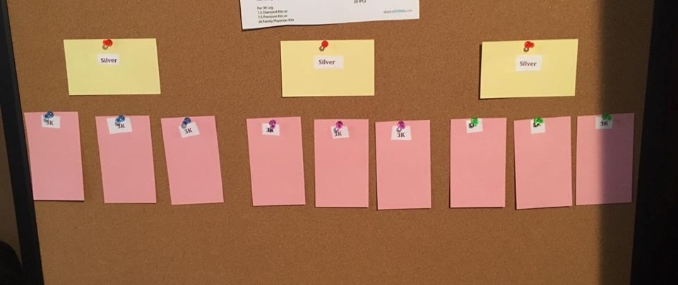
Map out WA & place WC only under committed WA
Key conversation with BUILDERS!
LRP
Referrals
Use oils
Share with others
After a year evaluate if it is a fit
This KEY conversation
sets a vision!

Slide 21
Think 2 or 3 ranks ahead
Do you know what rank is 2 or 3 ahead of you?
Knowing the ranks helps you strategize!

Slide 22
Mock Layout

Slide 23
Build Three Legs
Keep Volume Together

Slide 24
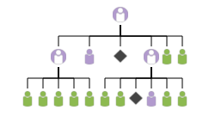
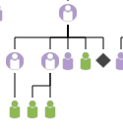
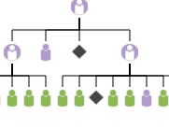
New Builder
Have key conversations early on to identify 2 to 3 legs to work with
Place WC under those who are committed with you
Place in Power of Three spots
What if no one commits? * Placeholder

Slide 25
Use upgraded Wholesale Customer
They have to be a wholesale customer for 90 days to have the second move.
Do you have a wholesale customer interested in the business?
Up grade and move!
Up grade and account transfer!

Slide 26
Homework
Page 14 and 15 of the Launch Guide
If you still don’t understand ranks or comp plan…review!
Make sure you have 4 classes planned for the next 2-3 weeks!
Sample, Invite, Teach, Enroll, and follow up with names list!!

