Slide 1
Empowered University
Six Sessions to Launch Your Business
Session Six

Slide 2
Moving Forward and
Growing a Duplicatable Team

Slide 3
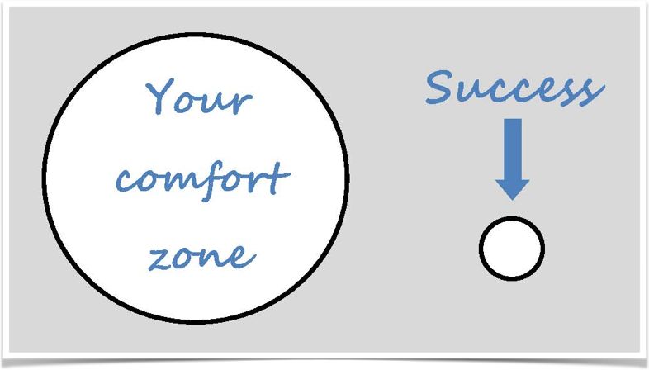
Jump outside of your comfort zone!
A MUST!
Do this daily!

Slide 4
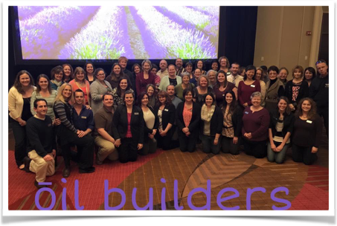

People Centered
Product Centered

Slide 5

Loyal users are the foundation!!
  Users need attention

Slide 6

Business or Hobby?
The big question
This is a question you have to answer?
Knowing the answer will help you overcome challenges and push through on hard days!
You are only allowed to quit on a day when you get 5 enrollments!

Slide 7

Master THREE Presentations
Natural Solutions Class
Lifestyle Overview
Business Overview
Natural Solutions Class
Lifestyle Overview
Business Overview

Slide 8
How to break down your time?
80% of your time is doing the “daily power hour” questions!
10% Oil & Business Education
10% Back office & administrative activities

Slide 9
Daily Power Hour
Who do I need to share oils with?
Who have I shared oils with that need an invite to a class?
Who needs a Lifestyle Overview?
Who needs a Business Overview?
Do I have new builders going through Empowered University?
Do I have seasoned builders needing any guidance?
What classes to I need to prepare for?

Slide 10
Learn the steps for a:
Customer
Builder

Slide 11

Cycle for a Customer
Natural Solutions Class
Enroll
Lifestyle overview
Empowered Life
User Group on Facebook

Slide 12
Cycle for a new builder
Complete the cycle of a customer
Business Overview
Add to builder group
Direct them to pinned post
Empowered University
Empowered Success Monthly Webinars (doterra.com)

Slide 13
How to use Empowered University
Encourage your new builder to watch session 1 video
Do the Homework for session 1
Then they need to call you!
Answer any questions/troubleshoot….move on to session 2!
Repeat till you do all 6 sessions!

Slide 14
When you feel stuck ask….
Am I hosting classes/appointment consistently?
Am I introducing people to essential oils?
Am I using essential oils?
Am I giving my dōTERRA Business 3 to 10 hours a week?
Am I getting on team trainings?

Slide 15

Create MASSIVE action!
Commit to 6-12 months!

Slide 16
THIS IS THE TIME!!!
THIS IS YOUR BUSINESS!!
LET'S GO CREATE SOME MAGIC!!!

Slide 17

Empowered You ….Beyond Elite

Slide 18
Homework
Watch: How to have a power hour!
Make sure you are familiar with doterra.com “our advocate” tab! SO much info!
Be familiar with the policy manual

