Slide 1
Betty Torres
Blue Diamond
Notes:
Introduce myself
Briefly tell story of where I came from
College business teacher
Started in Direct Sales 21 years ago because of health issues & home based aspect
Roller coaster ride
I got into doTERRA for the products, especially the LLV
After experiencing product results and being extremely impressed with ownership, I decided to build doTERRA.
I was determined to build it RIGHT…one person at a time and focus on helping them improve their health (the right reasons).

Slide 2
Converting Your Members to Lifelong Vitality
Notes:
We need to become effective teachers
Our job is to EMPOWER others
Lead them to the BIG PICTURE OF WELLNESS
CONVERTING???
What are we converting them from?
From thinking about just the essential oils and symptomatic relief
Shift their focus to the BIG PICTURE OF WELLNESS
Lifelong Vitality…not just LLV, but LIFELONG VITALITY in every since of the word!

Slide 3
Notes:
PRESENTING
Thankful for the opportunity to share what has worked for me. After 7 ½ years, I have an organically grown business of 40,000 members and almost $2 million in monthly sales. Our retention is among the highest in the company.
Today, I’ve been asked to FOCUS on on PRESENTING
Keep things SIMPLE and DUPLICABLE
Personally, I only teach one class…Intro Class to NEW PEOPLE all the time.
Old people keep coming back with their GUESTS to hear the powerful message. They learn something every time, too!
It’s the same class, but it’s NEVER the same class because of new facts and focus on different products.
Use doTERRA materials
During classes, I only use handouts – NO POWERPOINTS
Same if 5 people or 250 people
Our job is to share…not to re-invent the wheel
Great teachers take a lot of information and MAKE IT SIMPLE!

Slide 4
“CLASS” OBJECTIVES
#1 - TAKE RESPONSIBILITY for our own health.
#2 - EXPLORE NATURAL SOLUTIONS as a first line of defense.
#3 - Educate ourselves on the BIG PICTURE OF WELLNESS.
Notes:
Teacher Tricks:
Wriite this down!
Three things…
Important to define the class objectives…lay out the expectations

Slide 5
Symptoms vs. Root Cause What are Essential Oils? The doTERRA Difference 3 Ways to Use Them
Notes:
The doTERRA Difference (CPTG) – Sourcing and Testing
3 Ways to Use them
Aromatically
Topically
Internally

Slide 6
DECISION POINT
Small bottles or
Large bottles?
Notes:
We’ve covered a lot of oils tonight
You might be wondering where to start
doTERRA has put together a kit with the oils that every household needs
These are the MOST POPULAR oils
SMALL BOTTLES – Family Essentials Kit ($150)
LARGE BOTTLES - Home Essentials Kit
3x the oil and a diffuser
How much do you think this would cost?
Not even twice as much…$275!!!

Slide 7
Let’s talk about the real reason we’re here… THE BIG PICTURE OF WELLNESS
Notes:
EVERY CONVERSATION LEADS TO THIS…
We’ve come a long way tonight…we’ve talked about the fact our healthcare system is in crisis.
We’ve discussed using ESSENTIAL OILS as a natural first line of defense.
Are you ready to go BEYOND the SYMPTOMS?
Are you ready to address the ROOT CAUSES
Let’s talk about the REAL REASON we’re here…

Slide 8
NOTHING CAN REPLACE…

Notes:
We don’t want people to think all they need to do is take a capsule. Make it clear we are not saying that.
You can beat your genetic predispositions by living a healthy lifestyle
SLEEP (REST & MANAGE STRESS) – 7 to 8 hours every night…your body needs this time to REST and REPAIR
WATER – drink half your body weight in ounces of water per day…proper hydration is essential for every bodily process (Grapefruit – 15 drops/day can increase body’s own production of glutathione by 30%)
FOOD (DIET) – Fewer animal products and cooked and processed foods and MORE raw whole foods, especially green leafy vegetables…smaller meals; eat when hungry. Eat local and in season.
PHYSICAL ACTIVITY – Just move! I use a FitBit and walk 10,000 steps each day.

Slide 9
How Can doTERRA
Support a Healthy Lifestyle?
Proper Nutrition
Cleansing & Digestion
Limit Toxins

Notes:
Write this down!

Slide 10
Proper Nutrition
Comprehensive whole food nutritional supplements with the right balance for optimum health.
30 DAYS TO CHANGE YOUR LIFE!

Notes:
UNIQUELY INFUSED WITH ESSENTIAL OILS…help clean out the cell receptors so your cells can communicate better with each other
30-day guarantee…but give it 120 days (red blood cell cycle)

Slide 11
MicroPlex VMz
Vitamins & minerals from whole food sources
72 trace minerals – tell vitamins what to do
xEOmega
Food for your brain – brain is 80% fat
Critical for cardiovascular health
Provides lubrication for regular elimination
Provides clean fuel for your body to burn for improved energy and stamina
CRS+
Super Antioxidant – cell protection
Free radical scavenger
Notes:
Less is more as far as information
We have lots of resources…an entire pamphlet, online resources for the LLV
In this presentation, we KEEP IT SIMPLE!
MicroPlex VMz – from whole food sources, vitamins and 72 trace minerals (minerals tell the vitamins what to do)
xEOmega – nourishment for your brain (80% fat), supports cardiovascular system, supports digestive system, clean fuel for your body to burn
Alpha CRS+ - grape seed extract, pine bark extract, resveratrol, tumeric, gingko biloba, CoEnzyme Q10…and more!

Slide 12
Lifelong Vitality Pack
$79.50
Wholesale Price

Notes:
ADDRESS PRICING
My friend…scientist: At least $650
Buy separately at Retail: Approx $200
Buy separately at Wholesale: Approx $150
Buy as a Pack: $79.50!
One month’s supply for a 150-pound adult
30-day money back guarantee
My suggestion is to give it at least 120 days (4 months) – the red blood cell cycle is 120 days!
Wellness Inventory – write down everything you have going on inside/outside and physical/emotional
OR Wellness Consult from Live Guide
Expectations of person who is inviting
2-day shipping
Change your lifestyle and give your body the resources it needs to do the job it is designed to do.

Slide 13
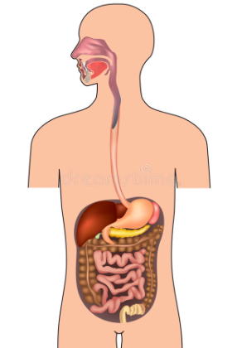
Cleansing & Digestion
60 to 85% of your immune system is based on your digestive system
There are more neurotransmitters in the digestive system than in the brain.
Lack of nutrient absorption compromises immune system, mood, and brain function.
How will you be healthy with a poorly functioning digestive system?
Notes:
2 to 3 health bowel movements a day
Average person in our country has 2 to 3 a week

Slide 14
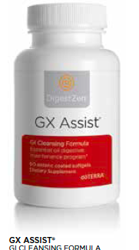
Cleansing & Digestion

Notes:
We have an entire line of digestive products, but today we are going to focus on two of these that everyone should be taking

Slide 15
Terrazyme – digestive enzymes
Take with cooked or processed meals to assist digestion
10 different types of enzymes
PB Assist+ - probiotic
Repopulates good flora in intestines (essential for proper digestion)
Double encapsulation gets probiotics through digestive process

Notes:
Start with these digestive products

Slide 16

Notes:
PRODUCT GUIDE
LRP – The Smartest Way to Buy
LRP – Additional special pricing

Slide 17
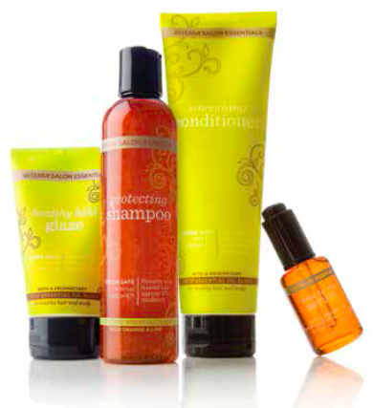
Limit Toxins

Notes:
REDUCE TOXIC LOAD
Products we use every day…from a company we can trust!
Reallocate your purchases from the stores to your own wholesale account.
GET THEM THINKING!
ASK QUESTIONS:
Do you brush your teeth? Check the label…”Do not ingest. Keep away from children. Call Poison Control if ingested.” WHY ARE YOU PUTTING THIS IN YOUR MOUTH?
Do you wash your hair? Check the label…sodium laurel sulfate? One of the most toxic, proven-to-cause-cancer chemicals known to mankind.
Do you use skincare? doTERRA’s skincare does not have any of the 10 “DO NOT TOUCH” INGREDIENTS.
Do you wash your clothes? doTERRA Laundry Detergent was compared against all major brands on different types of stains. Will not break down fibers and will not put harmful chemicals into your body and into the environment.
Foaming Hand Wash – no triclosan (banned in Minnesota…because it was breeding antiobiotic-resistant bacteria in people’s bodies)
Do you clean your house? (John Travolta & Kelly Preston’s son’s story)

Slide 18
Notes:
We’ve covered a lot of informaiton tonight
Now…let’s talk about getting these products in your home
It’s time for you to select the kit that best meets your needs
BEST – Diamond Kit
IF ONLY ESSENTIAL OIS -
If starting with Essential Oils – Small Bottles or Big Bottles
Big picture next month – set up their LRP!
MOST POPULAR KIT AND MY FAVORITE
Natural Solutions – products from different categories including LLV, digestive products, large bottles of oils and more!
LRP – THE SMARTEST WAY TO BUY!
No one does the BIG PICTURE for one month!

Slide 19
Set Up Their LRP
+
FOUNDATION: LLV, Terrazyme, PB Assist+, Mito2Max, Grapefruit…
PLUS a product or two of choice
Notes:
Set up the LRP the same for everybody…makes it easy.
They get PARALYZED by too many choices.
Most people like to be told what to order. They can be paralyzed by too much information and too many choices.
Grapefruit – 15 drops/day help increase your body’s production of it’s own GLUTATHIONE by up to 30%

Slide 20
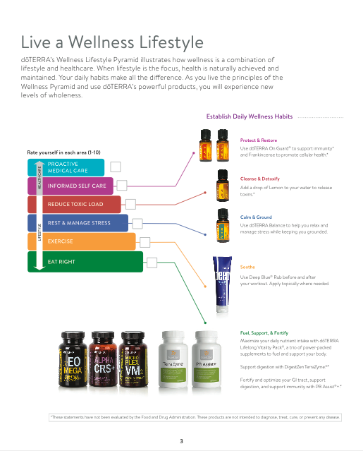
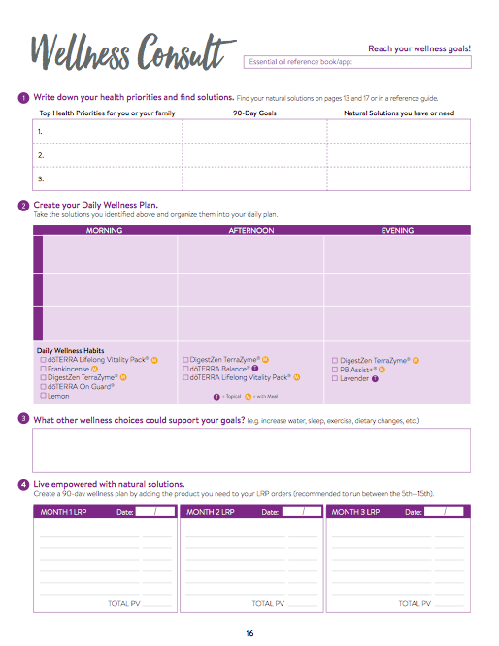
Notes:
doTERRA has given us EVERYTHING we need to EDUCATE and SUPPORT our team members!
Use this to educate yourself on the BIG PICTURE discussion.
Sit down with your new team members when they received their products. Work up their wellness plan using the WELLNESS CONSULT.
Take care of their LRP orders for first 3 months. Months 4 to 6, you remind and they set up, but you check their back office to make sure set up correctly. Months 7 to 9, you watch closely through Detailed Report .

Slide 21
Keys to Success
Robust Unilevel & High Retention
#1 – Keep Things SIMPLE
#2 – Build Momentum with the EVENTS CYCLE
#3 – Understand the POWER OF ONE
#4 – ALWAYS Lead to BIG PICTURE OF WELLNESS
Notes:
Keys to a ROBUST UNILEVEL & HIGH RETENTION
#1 – SIMPLICITY – Using doTERRA’s materials, only doing with is duplicable, teaching one class (special topics taught by subject matter expert or people with interests in that area; no technology…just handouts)
#2 – EVENTS CYLCE – Build to classes and larger events with a foundation of Initial Contacts, Follow-Up, One-on-One’s, and In-Homes. Much can be done online, but face-to-face is the way I have primarily built.
#3 – POWER OF ONE – (DUPLICATION!) Take the time to get people started right. Most solid and successful leaders in doTERRA average around 1 person per month. Explain briefly…1st 3 months, 2nd 3 months, 3rd 3 months
#4 – Lead them to the BIG PICTURE OF WELLNESS starting from the first day. Plant the seeds! ALL ROADS LEAD TO THE BIG PICTURE OF WELLNESS!!!

Slide 22
Notes:
MY GOAL is to have people leave the class saying…WOW, THIS IS SO MUCH BIGGER THAN I THOUGHT.
If I had known how big this is, I would have invited 10 people.
I want them to feel EMPOWERED to take responsibility for their own wellness.
I want them to feel EMPOWERED through the EDUCATION they received tonight.
EMPOWERED is what it’s all about…
We EMPOWER people through education
We become great communicators and teachers, so we can relay this important message
BE EMPOWERED SO YOU CAN EMPOWER OTHERS!

