Slide 1
Simply Natural Solutions
Terri Pace
Simply Natural Solutions
Holistic Health Coach
I’ve Got My Oils…Now What?
Notes:
Announce: There will be a segment of the meeting where we invite participants to ask a question or tell about an experience they have had (general topics). However, this call is not intended to review any one specific protocol or health objective.
Use the approved claims list to provide great wording.
Send this link to all participants: https://doterra.com/US/en/flyers-approved-claims-list

Slide 2
I’ve Got My Oils…Now What?
Notes:
Welcome all to this forum.
This meeting is to welcome new members and connect them to the resources they need to increase their confidence in living a natural solutions lifestyle.
This meeting is also to offer suggestions for product use for both new and existing team members.
This meeting is to share success stories, big and small; I love sharing the creative ways I have discovered to more fully benefit from the amazing tools we have in our homes!
We will review daily protocols to support health and wellness, as well as essential oil usage and safety tips.
Welcome by Name
Welcome by name those who pre-registered; make it a personal invitation and warm welcome; thank them for being on the call.
Welcome all other participants just joining dōTERRA® or members for a longer period of time. Invite all to send a chat message with their name and how long they have been a member.
We are here to help EVERYONE get started right - to feel comfortable and confident as you open up to using these amazing oils!
Want to receive follow up links? Please register on the Eventbrite site!

Slide 3
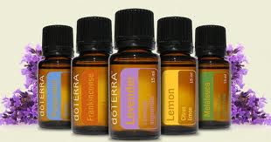
I’ve Got My Oils…Now What?
What’s Your Story?
Notes:
Get out your favorite oil right now and queue it up in your diffuser, apply it to your hands and breathe in deeply, or simply apply topically. We will smell them, learn about them, and encourage you to PLAY!
I also invite you to get your Welcome Packet from your first order!
Share Successes
Unmute all participants.
New members first: Successes can come quickly with these essential oils. Is there anyone new who has already had a success (large or small)?
Invite other attendees to share a way they used their oils this week.
If no response, bring in a prepared team member who has also volunteered to speak on the call. Call them out by name.

Slide 4
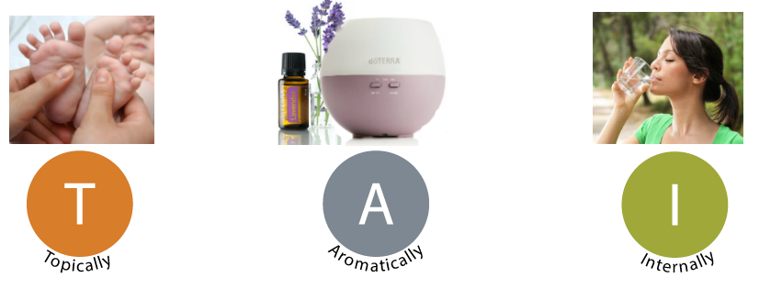
Three Ways to Use Essential Oils
Apply directly to skin for targeted support
Diffuse in a room to purify the air or to change mood, emotion
Consume as dietary supplement for targeted wellness
Notes:
Aromatically-
Breathe in or use to clean the air, open airways and affect mood. Diffusing lets the entire family reap the benefits of the oils, so it is actually very cost effective as well. I love diffusing when I want to quickly change the mood in the room!
Topically-
Well founded, well studied method of applying essential oils. We apply essential oils to the skin for targeted support.
Applying to the bottom of the feet is a good application, but there are other great application points that people use such as neck, wrist, abdomen, etc. Applying heat or massaging the oil in will increase blood flow and absorption.
Why the bottom of the feet?
Largest and highest number of pores are in your feet
Access to all the systems of the body. (~reflexology)
Why the back of the neck?
There is a concentration of neurotransmitter receptor sites on either side of the spine. When applying to ourselves, we can reach base of spine and back of neck easily.
Internally-
Consuming essential oils is the third way we make them part of our wellness plan. When choosing this method, it is very important to use a Certified Pure Therapeutic Grade oil; inferior products have possible effects of synthetic or highly concentrated contaminants or pesticides in an essential oil. Notice the FDA label as GRAS (generally regarded as safe for internal use).
Actually, this commitment to purity is important no matter which way you choose…Remember, if it is on you, it is in you.
What’s the best way? Work within the limits of your own knowledge (education or experiential). Use the method you feel most comfortable with!

Slide 5
Three Ways to Use Essential Oils
Internal Usage
Dr. Hill:
Dr. Yorgason: Safe to Ingest!
Tips on Taking Oils Internally
8 Reasons to Use Oils Internally
Topical Usage
https://doterra.com/US/en/brochures-magazines-living-spring-2015-topical-use-of-essential-oils

Slide 6
Peppermint - Invigorating
Daily Use
Wellness Support
Promotes digestive health
Promotes healthy respiratory function and clear breathing
Rub on temples after you wake up for a morning energy boost.
Diffuse when feeling fatigued or low on energy
Helps reduce bloating, gas and occasional indigestion
Add to cold water compress or foot bath to cool off when overheated.
Apply topically to relieve feelings of tension

Slide 7
Lemon ALL THINGS Cleansing
Daily Use
Wellness Support
Cleanses and purifies the air and surfaces
Diffuse to promote a positive mood and cognitive ability
Supports healthy respiratory function
Take internally to assist with seasonal respiratory discomfort
Naturally cleanses the body and aids in digestion

Slide 8
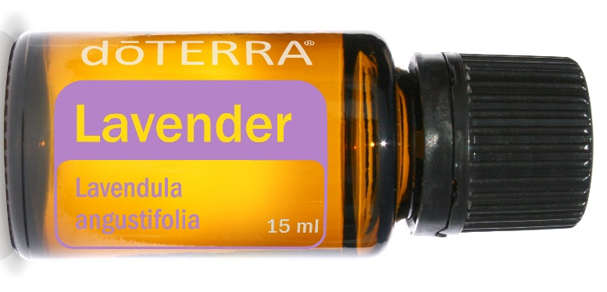
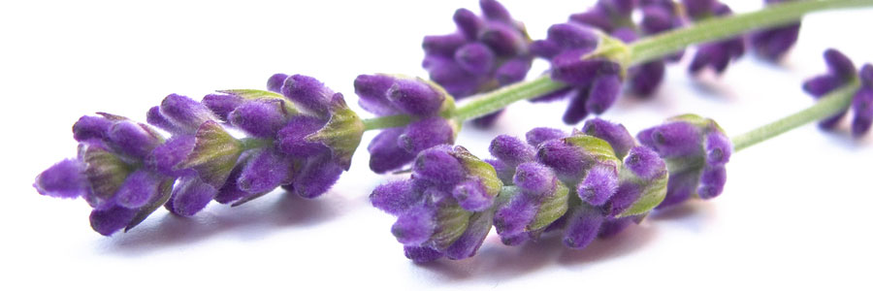
LAVENDER All Things Calming
Daily Use
Wellness Support
Widely used for its calming and relaxing qualities
Reduces appearance of skin imperfections
Add to bath water to soak away stress or apply to the temples and the back of the neck
Soothes occasional skin irritations
Helps to ease feelings of tension
Take internally to reduce anxious feelings
Take internally for a peaceful sleep

Slide 9
Frankincense – Modern Uses
As the king of oils, Frankincense is known to
Helps build and maintain a healthy immune system
Promote cellular health
Supports normal Brain Function
Reduces the appearance of scars and stretch marks
When inhaled or diffused, Frankincense induces feelings of peace, relaxation, satisfaction,
and overall wellness.

Slide 10
Secret of Success
Notes:
Our success lies in the daily routines…what will you do each and every day to support the goals you desire?
We walk towards our health…or away from it…one step at a time. Evaluate every choice in its ability to bring us closer to our goals or not! Do the things that support your goals every day!!

Slide 11
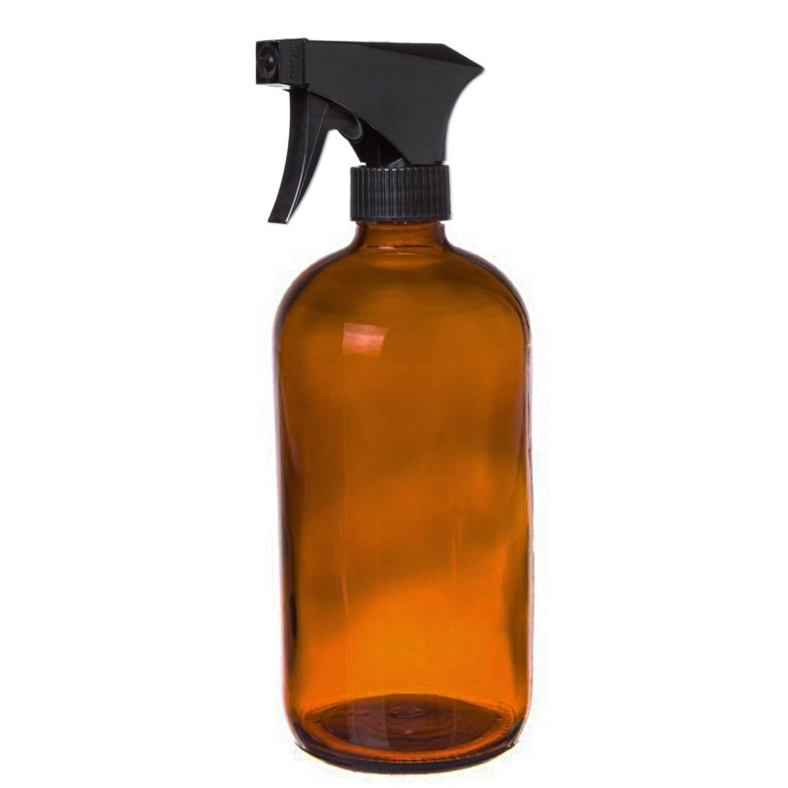
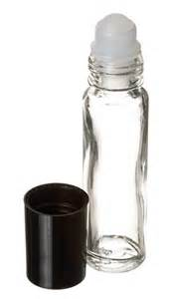
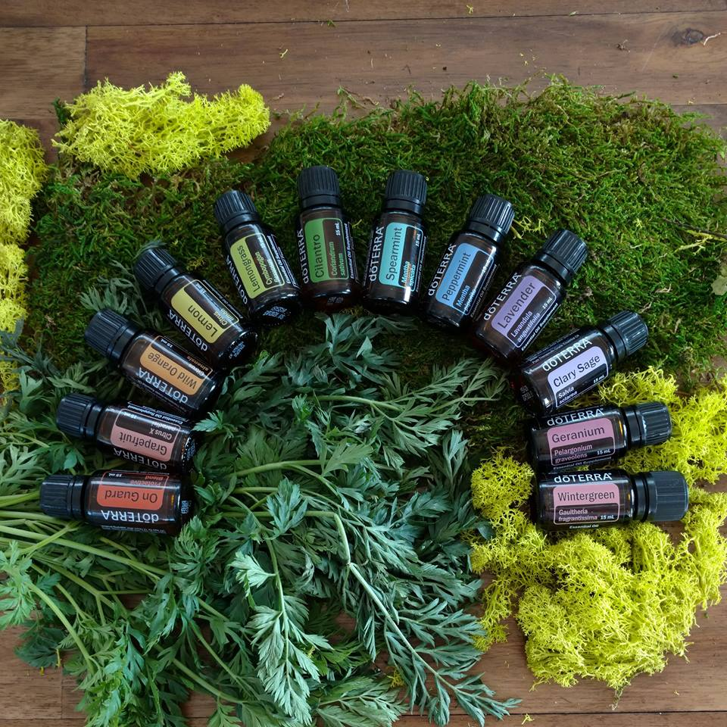
Daily Routines
Notes:
Take essential oils every day…infused already in Lifelong Vitality!

Slide 12
Daily Routines
Notes:
LRP is your shopping list for next month!!
What will you use daily that will need to be replenished?
What new product do you want to experience?
Lifestyle Overview concept!
Announce: Product Promotions this month

Slide 13
What Topics Are Important to You?

Slide 14
How Do I Learn More?
Resources
Approved Claims List
dōTERRA Facebook Page
dōTERRA YouTube Channel
dōTERRA Product Blog
dōTERRA Science Blog
Aromatic Science
Notes:
dōTERRA Product Tips Blog – an excellent place to learn about product promotions, product features or product success stories. https://doterra.com/US/en/blog-products
dōTERRA Facebook Page – the best place to connect with dōTERRA on Facebook, get product information, and to connect with dōTERRA product fans, friends and more. https://www.facebook.com/doterra
dōTERRA YouTube Channel When dōTERRA creates a new “official” video, this is often the first place it is made available. https://www.youtube.com/user/doTERRAcorp?ob=0
dōTERRA Pinterest Page See how dōTERRA is being shared on Pinterest--get ideas on how to share dōTERRA, products, product uses and more! https://www.pinterest.com/doTERRA/
dōTERRA® Science Blog: https://doterra.com/US/en/blog-science
dōTERRA® Everyday: https://doterra.com/US/en/university/living
Aromatic Science: http://www.aromaticscience.com/

Slide 15
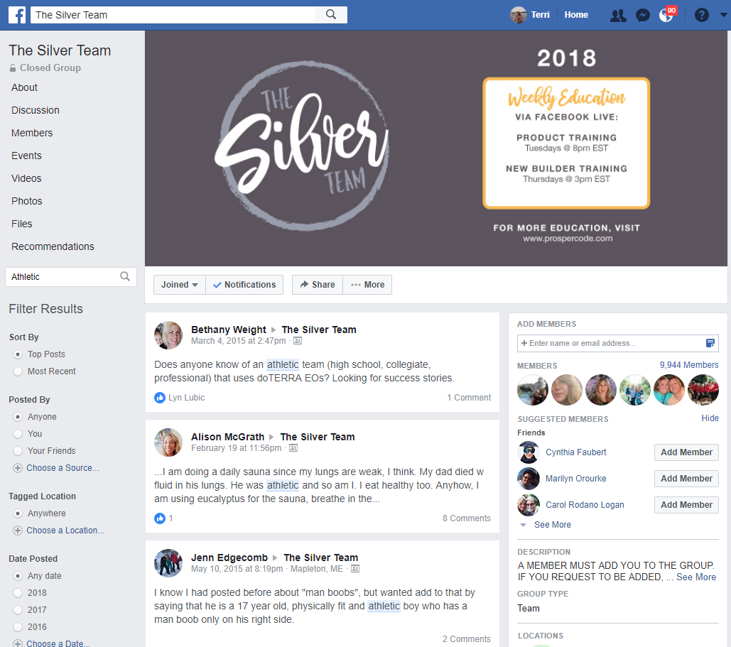
Benefits of Membership
Thriving Wellness Community of Likeminded, Like-hearted People
Solutions at Your Fingertips!
Access to Scientific Studies and Peer-Reviewed Research
FREE Weekly Trainings Programs

Slide 16
Benefits of Membership
http://drdaveandcallie.com/blog/
http://discoverbrilliantsolutions.com/
http://www.rebeccahintze.com/
https://www.youtube.com/playlist?list=PL5NTp5_GgKNsVFVLPdd9Qt_nzjQd7-Ekt

Slide 17
Visit my Eventbrite Site for Full Class Listing: http://simplynaturalseminars.eventbrite.com/
Mailing list for event and class notifications:
http://eepurl.com/K4uQf
Facebook Page: Simply Natural Solutions with TERRI PACE
https://www.facebook.com/simplynaturalnews/
YouTube Channel:
https://www.youtube.com/c/TerriPaceSNS
Instagram: Terri.Pace
https://www.instagram.com/terri.pace/
Email: simply.natural@optimum.net

Slide 18
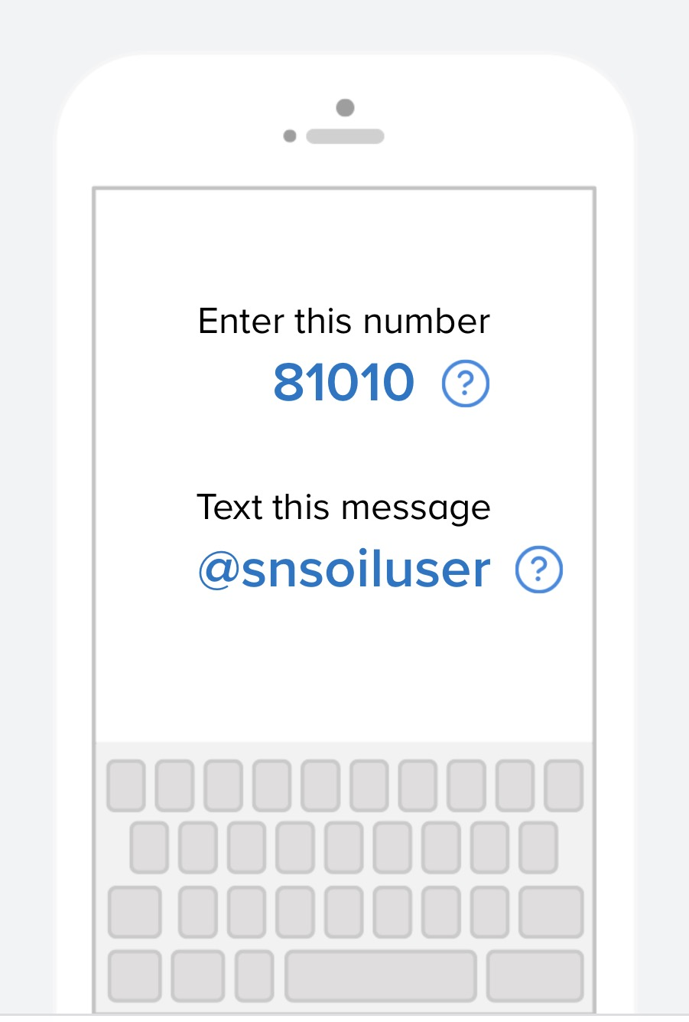
Get Connected
Remind Notifications for Product Usage and Happenings
www.remind.com/join/snsoiluser

Slide 19
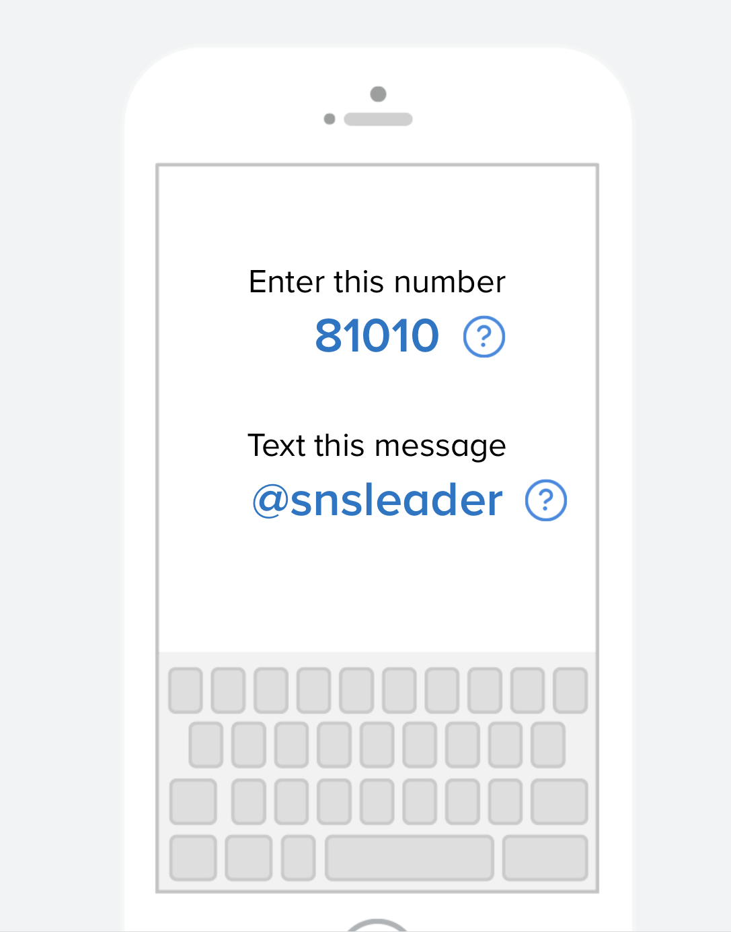
Get Connected
Remind Notifications for
Business & Leadership Trainings
and Personal Development Opportunities
www.remind.com/join/snsleader

Slide 20
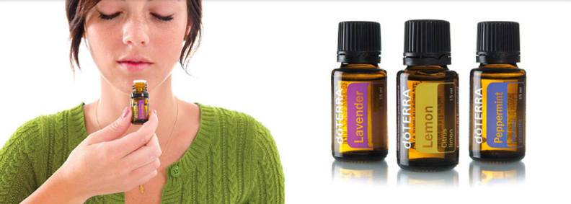
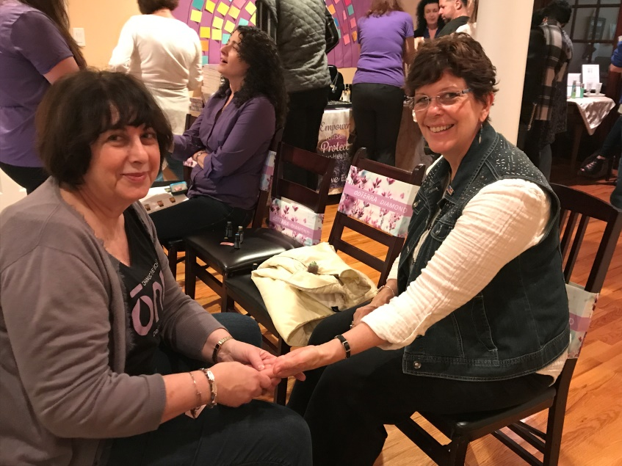
How Do I Learn More?
Use
Repeat
Share

Slide 21
Simply Natural Solutions
Terri Pace
Simply Natural Solutions
Holistic Health Coach
I’ve Got My Oils…Now What?
Notes:
If, perchance you are on the call and have not yet opened your own wholesale account, please call the person that told you about this meeting. You will need to get a number from them to make the proper connections to open your own wholesale account.
So if you want to start having some of your own experiences, get out your oils, put them in a convenient place so you remember you have new options to try.
If you do not have your oils yet, talk to your friend that asked you to listen in tonight. Be sure to connect with them. You will need their doTERRA number to connect yourself in so you can always get the best prices for the oils.
Special Guest Stories
Share a success story - 1 minute advise them of brief timing
My mess is my message
What was your mess?
What oil did you choose and how did you choose it?
How exactly did you use it?
What happened?

