Slide 1
Sharing Made Easy
With Nicole Vincent

Slide 2
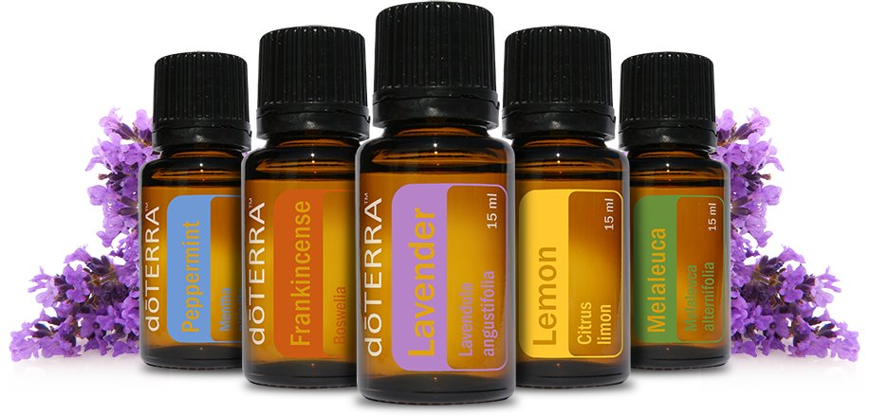
How do you feel about your oils?
How do you feel about the person who helped you get oils?

Slide 3

How would you feel if you didn’t have your oils?

Slide 4

I don’t know enough

Slide 5

You are the expert
*with your tools & resources

Slide 6
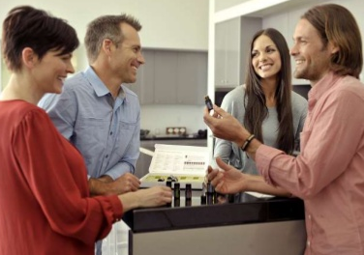
Sharing isn’t scary!
Bring your oils
Bring your reference book or app
Bring your passion
Use this page to guide you: sharesuccess.com/class
Bring Kit options page: media.doterra.com/us/en/flyers/enrollment-kits.pdf

Slide 7
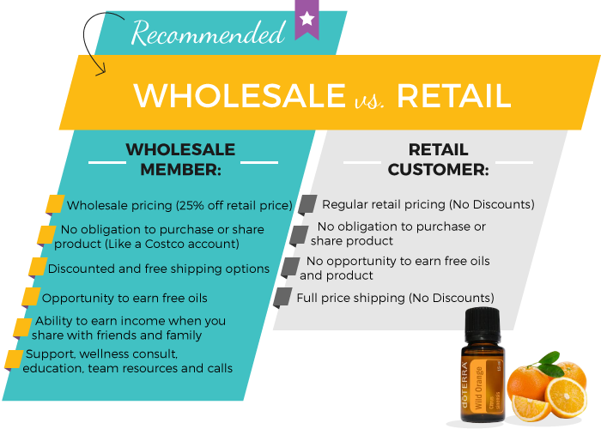
Benefits of having their own account

Slide 8

Extra benefits in May
50 points is the same as $50 in oils
Automatically added to both accounts
Unlimited on how many times you can do the deal
You must upgrade to a Wellness Advocate to receive your points

Slide 9
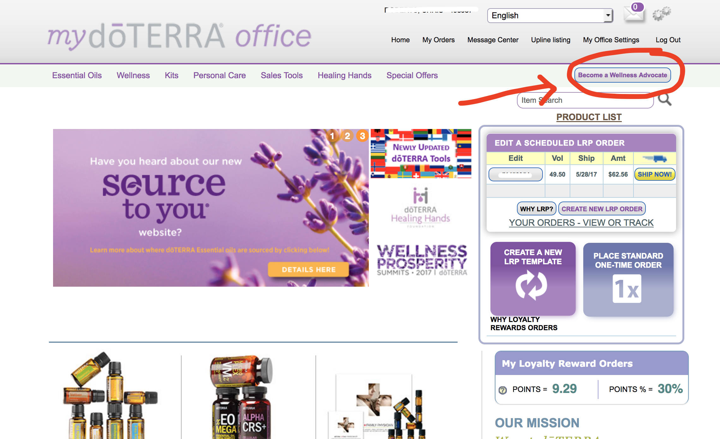
How to upgrade to Wellness Advocate
It’s FREE & easy!
Log in at mydoterra.com
Top right, click “Become a Wellness Advocate”
Enter your SSN or Tax ID
Click “Continue”
Boom! You’re ready to go!

Slide 10
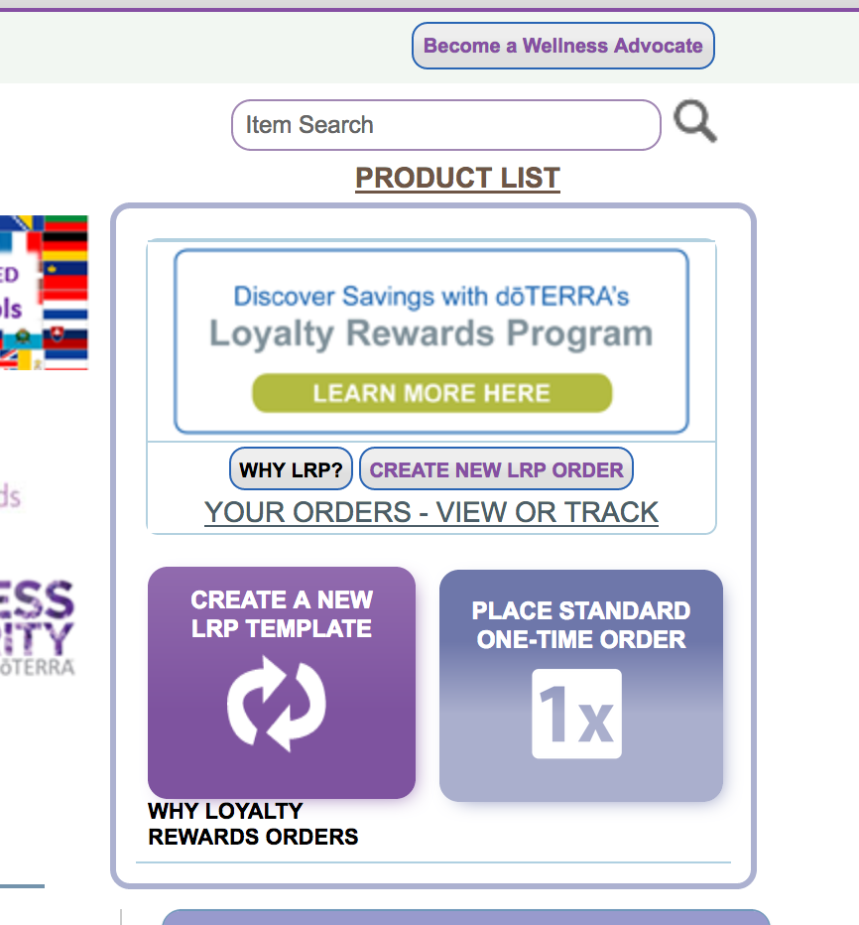
If you’d like to receive commissions….
Optional!
You must have a Loyalty Rewards Order (LRP) set up
It must be 100pv and run in May
This will give you 20% commission in a check on every person you sign up
Can adjust the LRP order in June

Slide 11
What does this really look like?
Friend’s Sign up | Points You Receive | Commission You Receive* | Points Your Friend Receives*
Aroma Diffused Kit | 50 | $20 | 50
Family Essentials Kit | 50 | $21 | 50
Emotional Aromatherapy Kit | 50 | $29 | 50
Cleanse & Restore Kit | 50 | $35 | 50
Home Essentials Kit | 50 | $45 | 50
Family Wellness Kit | 50 | $45 | 50
Natural Solutions | 50 | $80 | 150
Oil Sharing Kit | 50 | $140 | 150
Every Oil Kit | 50 | $285 | 250
Diamond Kit | 50 | $400 | 450

Slide 12
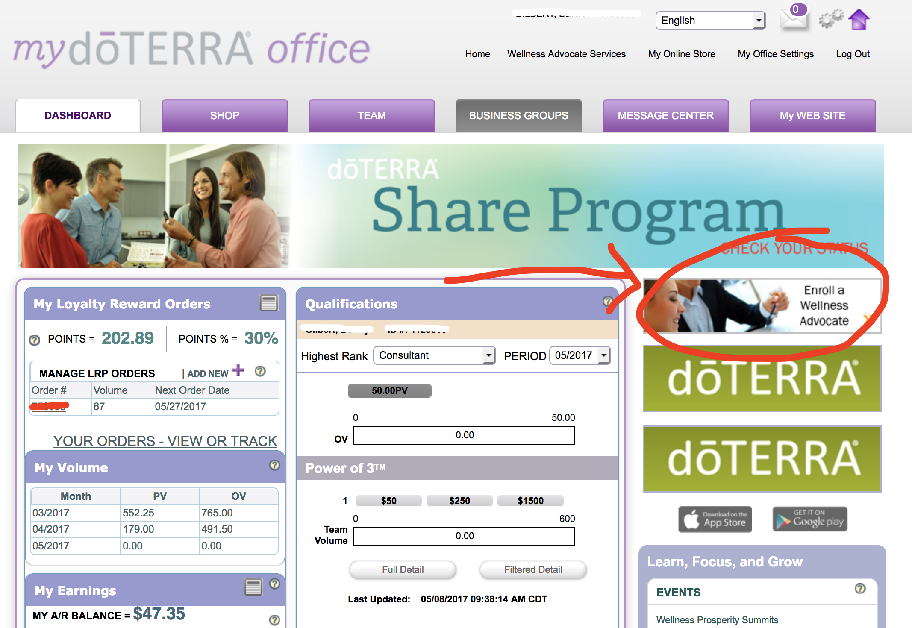
Time to sign them up!
Go to DASHBOARD tab
Click on “Enroll a Wellness Advocate”
Choose language and country

Slide 13
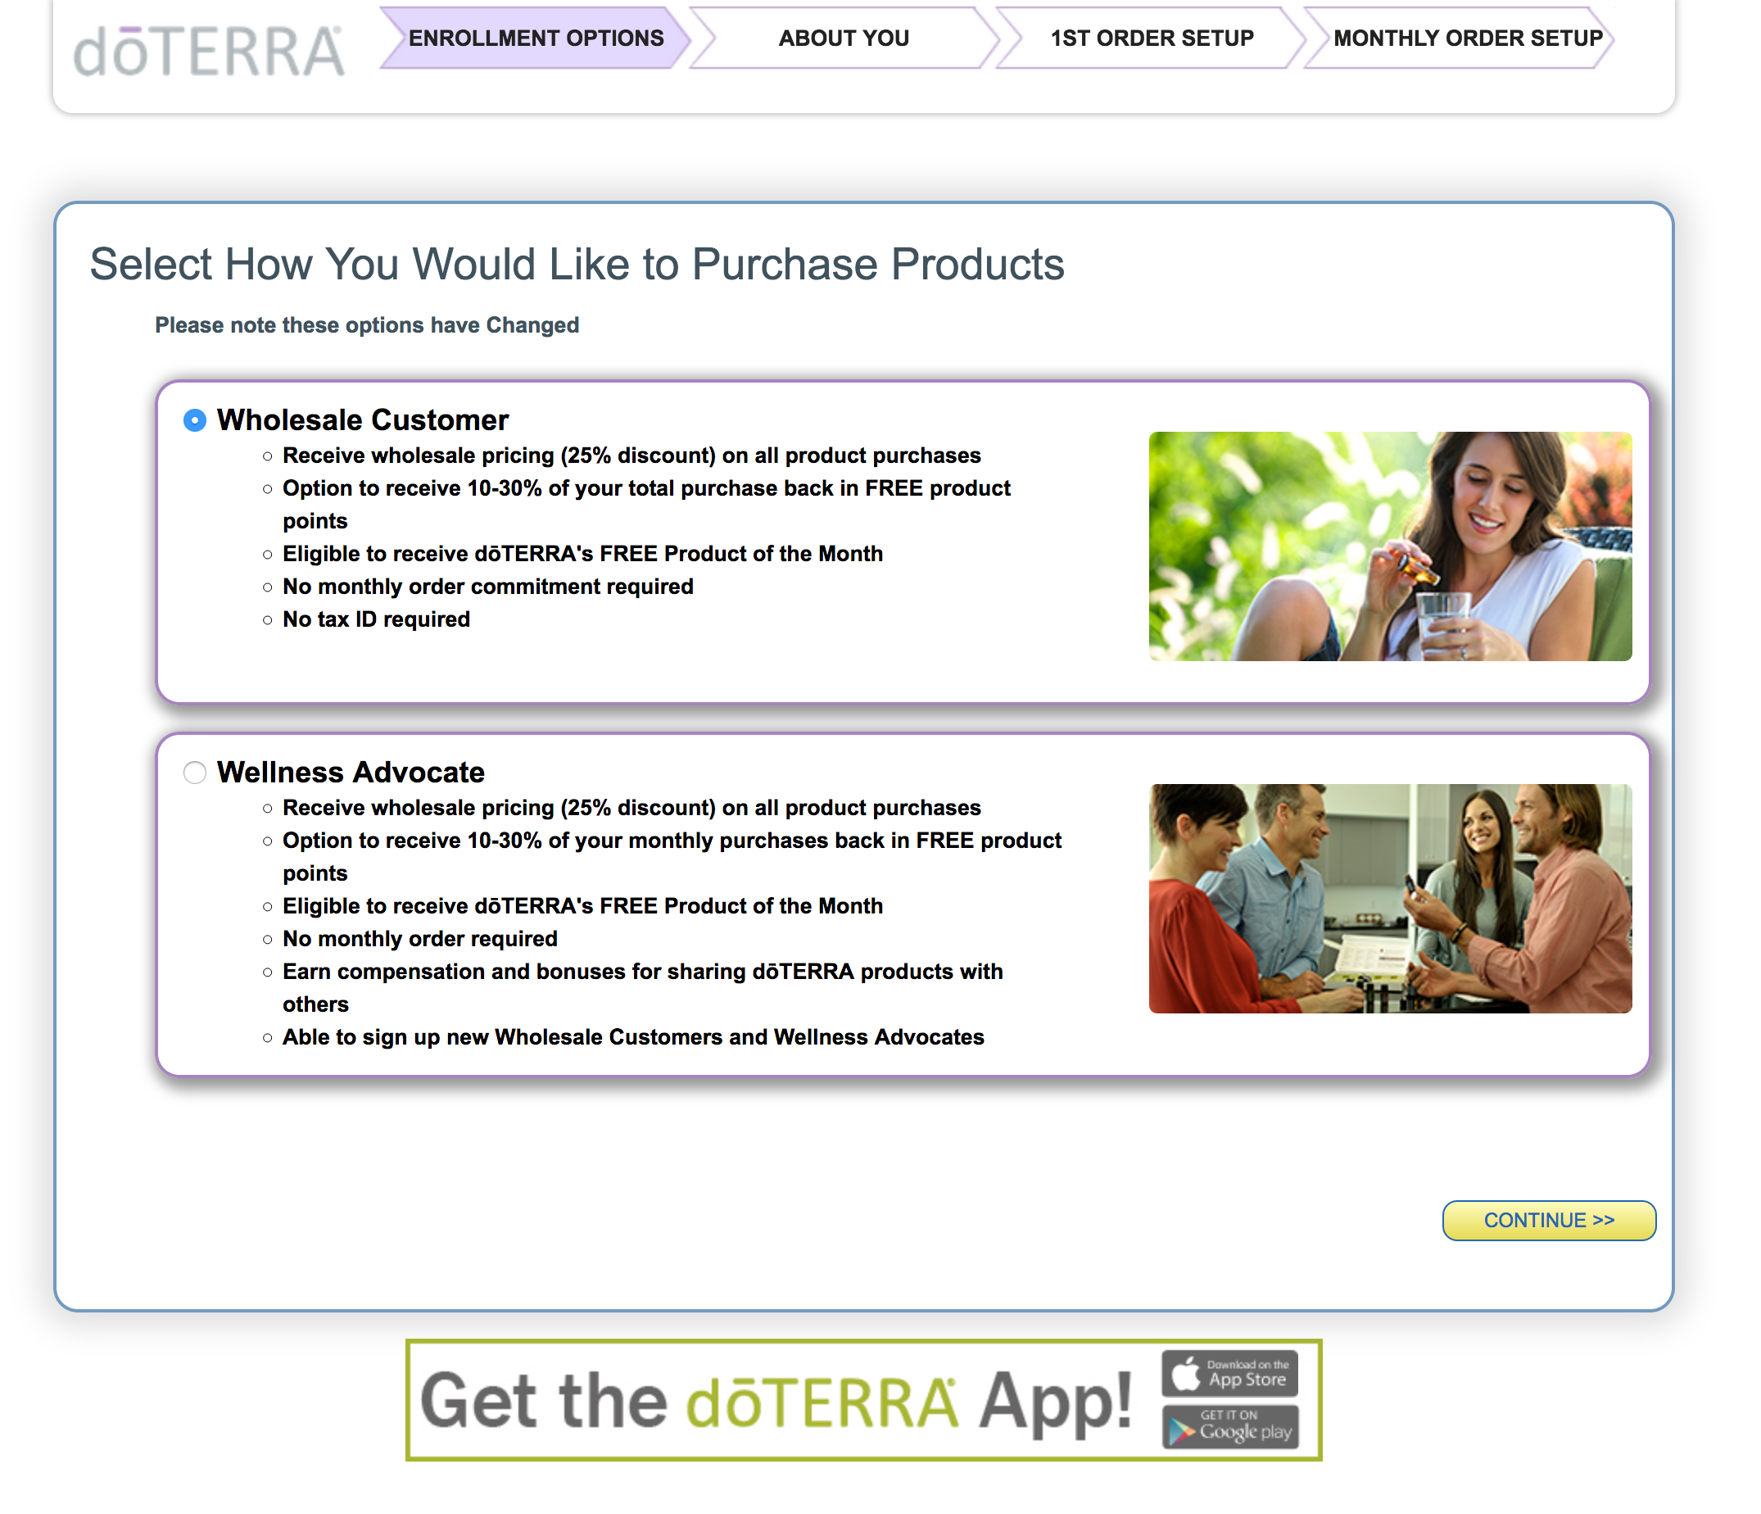
Next step
Most will choose “Wholesale customer”
Choose “Wellness Advocate” if they would like to share doTERRA
Click CONTINUE

Slide 14
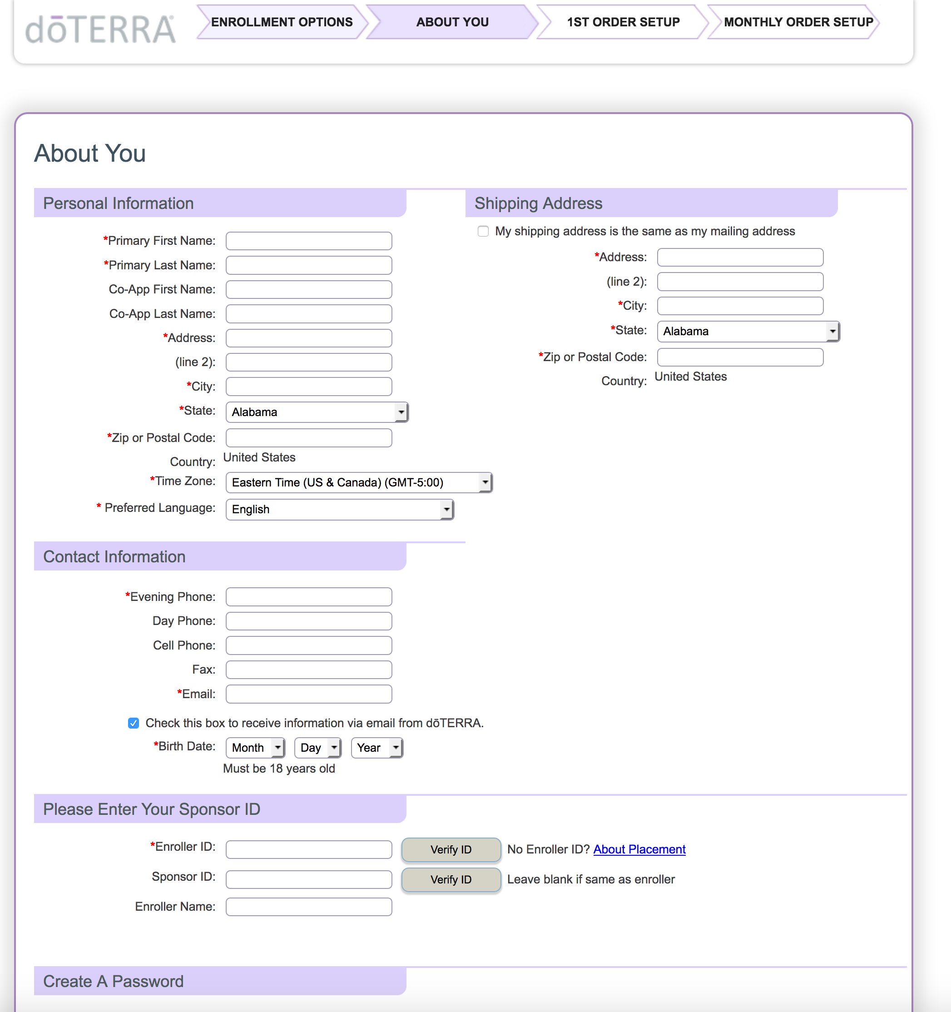
Fill in Information
Fill in their information for setting up their account
SSN or Tax ID is only needed on Wellness Advocate account
Make sure to enter your Member ID number as the Enroller ID & Sponsor ID

Slide 15
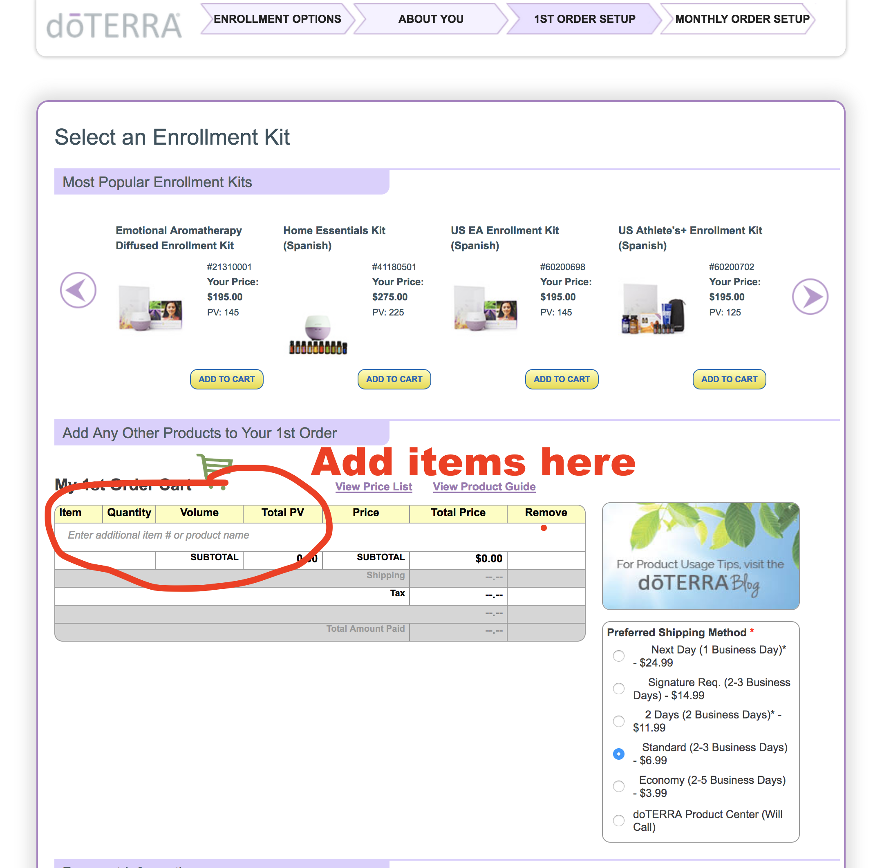
Choose the Kit
Use the arrows to find the chosen kit in the correct language
If they want to create their own kit, choose “Introductory Packet” for $35 and then add items to cart
Choose shipping preference
Click “View Totals”
Enter credit card info on next page

Slide 16
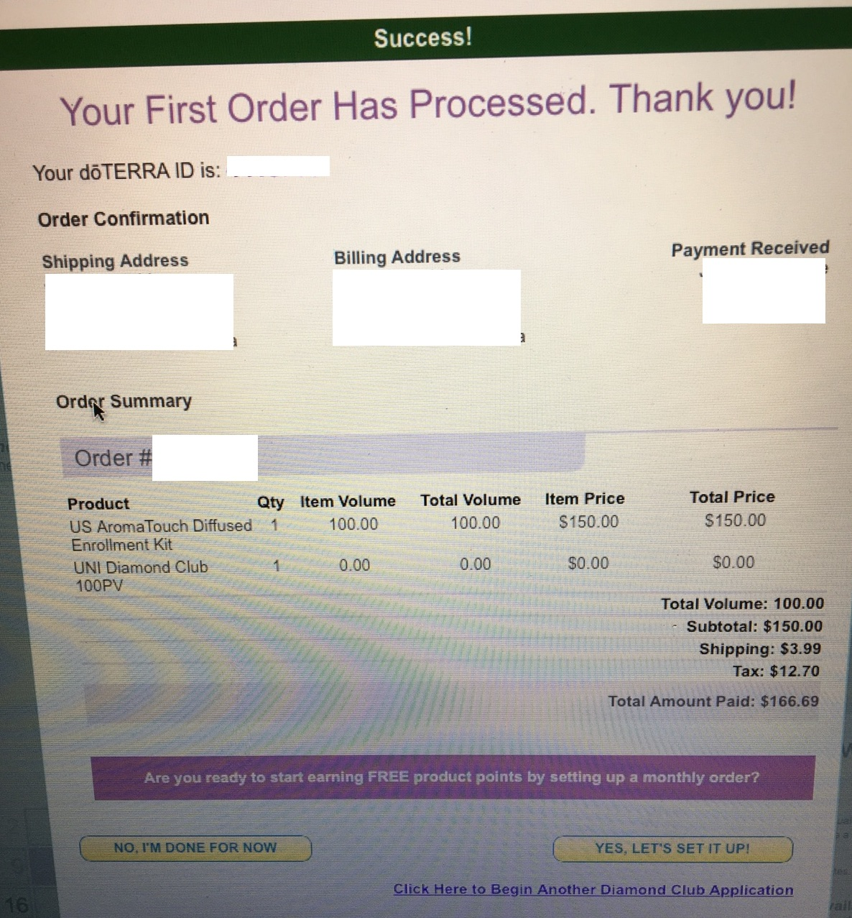
That’s it!
They will have their doTERRA ID and can log in at mydoterra.com in the future and to redeem their points
They can also set up an LRP order if they want to participate

Slide 17

Connect them with resources
Help them get a book or the app
Add them to Facebook support group(s)
Ask the person who signed you up for help

Slide 18

Connect with our team!
Essential oil users & education - Essential Oilers with Nicole Vincent facebook.com/groups/essentialoilers/
Essential oil sharing and business – Essential Oiler Leaders
facebook.com/groups/eoleaders/
Connect with Nicole Vincent: nicolervincent.com

