Slide 1
New to Sales?
Learn to Sell with Confidence
Learn what it takes to become a top-producing salesperson! As you start your sales journey, use the Sales Guide and its accompanying videos as a guide to develop the traits and skills of a top leader. Selling the doTERRA way is all about serving others by reaching out, listening, and connecting people to the solutions they need. When your primary goal is to help others experience life-changing products, selling feels natural.

Slide 2
Sales Guide
Learn to Sell the doTERRA Way
Embrace Sales—You Are a Salesperson
Sales Essentials—Discover the Secret to Selling
Master the Fundamentals of Success
The doTERRA Sales Cycle
Step 1: Connect Authentically
Step 2: Invite to a Class
Step 3: Introduce the Need for Solutions
Step 4: Educate About doTERRA Products
Step 5: Close with Confidence
Step 6: Enroll in a Total Wellness Lifestyle
Step 7: Answer Objections
Step 8: Gather Referrals and Book Classes
Step 9: Follow Up to Build Residual Income
Unlock Your Potential and Track Progress

Slide 3
Know What You Are Selling
When you share doTERRA products, you are selling a total wellness lifestyle—one of hope, empowerment, and healing. You are helping people eat better, exercise more, improve their sleep, lower stress, and eliminate toxic products from their lives. You are not just selling essential oils; you are helping people live happier and healthier lives.
In order to help others realize the potential of living this wellness lifestyle, you need to be a product of the product. The more you incorporate the products into your lifestyle and change your own life, the more confident you will be when selling doTERRA products to others.

Slide 5
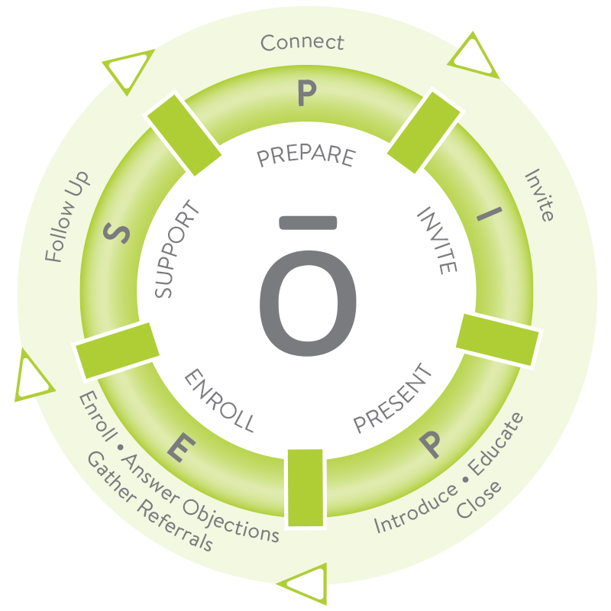
Know How to Sell
Following a sales process, or a series of repeatable steps, is critical to succeeding in sales. The doTERRA Sales Cycle guides you through each step you need to take with new and existing prospects, from introducing essential oils to enrolling them in the doTERRA wellness lifestyle.
Remember that when relationships are your number one focus, the sale will naturally follow. Keep a service mindset at every stage. You have the opportunity to empower people with doTERRA natural solutions, so listen and seek to understand their needs.

Slide 6
You Have Always Been A Salesperson
From the time you were a child, you have been selling with great success. On the playground you created a compelling pitch to convince your friends which game to play. Just yesterday, you may have sold your friends on a good hair salon, new restaurant, or vacation destination because you were passionate about it and couldn't resist sharing. You have been a salesperson your entire life.
The Professional Salesperson
As a professional salesperson, your job is to create value for people and help them make the decision to move forward or not. Done right, selling will feel natural, fulfilling, and fun. When you have a professional attitude, you create a comfortable experience for your customers and yourself. Your goal is to create a positive experience during each interaction. Much of this depends on the level of knowledge and professionalism you display.
Use the chart below to identify which traits of the professional salesperson you would like to improve in yourself.
"Good sales is all about educating the customer so they are empowered to make the best decision based on their individual needs."—Betty Torres

Slide 7
AMATEUR |  | PROFESSIONAL
Does not care what is being sold | > | Knows and believes in the product
Creates pressure | > | Creates a sharing environment
Is frustrated by rejections | > | Builds relationships with people who say "no"
Leaves people feeling conflicted | > | Leaves everyone in a good mood
Pessimistic | > | Positive
Has no "Why" | > | Has a vision for their life and business
Finds excuses | > | Finds a way

Slide 10
Listen Before You Sell
Successful salespeople understand that listening is a critical part of selling. Do not let the pressure of trying to make a sale distract you from learning about your customer. Remember this is a relationship-building process. Listening enables you to understand the needs of others so you can offer a solution that helps them solve their challenge.
No matter how persuasive you are or how confident you feel about the product, not everyone will be ready to buy right away. Marketing research indicates most sales happen between the fifth and twelfth contact,¹ so keep planting seeds and nurturing the relationship. You will often find that allowing a person to say “no” today will result in them saying “yes” in the future. Listen to what your customer is saying and be respectful, whether they are interested in buying a product or not.
Use the doTERRA Wellness Pyramid to help each person you work with identify their needs and then provide solutions through doTERRA products.

Slide 14
3 Keys to Success:
Successful Wellness Advocates build key habits within a framework of three main elements: mindset—the way you think, skillset—the actions you take, and toolset—the systems and tools you use. Top-producing salespeople achieve success by focusing on these fundamentals.
Cultivate the Fundamentals of Success yourself and accelerate your business growth. As you establish a positive mindset, professional skillset, and proven toolset, you will see key habits form. Developing these critical habits takes time, so stay with it.

Slide 15
Mindset
Selling is a mindset and requires confidence—in yourself and the product. At the beginning of this guide you did the exercise “Know Why You Are Selling.” Review this often to remember the difference that you can make in other people’s lives and why you want to offer that change. A positive and confident mindset naturally leads to more successful sales and helps strengthen key habits.
Self-motivation is a key element of correct mindset. Find ways to keep yourself motivated when things get difficult or your confidence has been shaken. For example, call your mentor, review your vision board, or watch an inspirational video—whatever helps. Feelings of discouragement are unavoidable in sales, so it is important to have strategies in place to keep your spirits high and yourself focused when challenges inevitably arise.

Slide 17
TOTAL SKILLS
MASTERED:
_____________

Slide 22
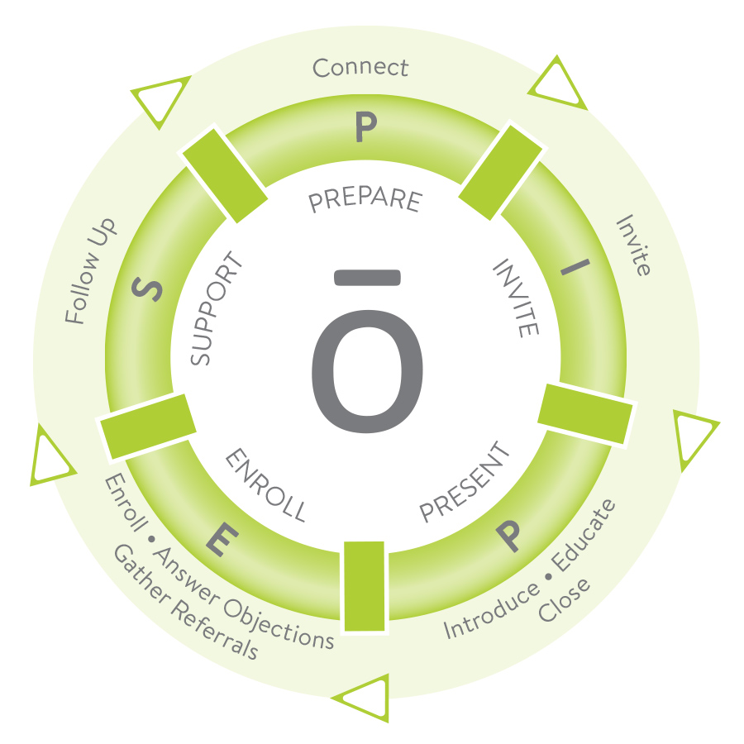
The doTERRA Sales Cycle is a series of repeatable steps; from introducing to enrolling, it acts as your guide as you share the doTERRA wellness lifestyle.
Nine Simple Steps
1. Connect
2. Invite
3. Introduce
4. Educate
5. Close
6. Enroll
7. Answer Objections
8. Gather Referrals
9. Follow Up
These steps fit neatly into the PIPES framework you are already familiar with, giving you a clear roadmap and ensuring you do not skip important steps in presenting your message and enrolling new customers. Trust the process to experience success.

Slide 23
Implement the doTERRA Sales Cycle
The following pages give you a deep dive of the nine steps in the doTERRA Sales Cycle.
For each step, you will:
Learn the definition.
Read about practical ways to develop the skill.
Practice sample scripts.
Rate yourself on how confident you are.
To further develop your sales ability, put skill-building ideas into practice so you can become the polished, professional Wellness Advocate you desire to be.

Slide 24
How to find new customers:
Build authentic relationships with people everywhere you go. Get their contact information so you can continue building the friendship. doTERRA is a relationship business. Whether with an existing relationship or someone new, build trust in every interaction. Seek to change lives by sharing what you love—no matter where you are or who you are with.

Slide 26
How to get people to say YES:
Reach out to the people on your Names List or Success Tracker and invite them to attend a class or presentation. Great invitations are personalized, passionate, relay value, and show genuine care for the one you are inviting. As you discover what's most important to each person by taking a genuine interest in who they are and building connections about what they are experiencing, your invitation to come to a class will feel natural.

Slide 28
Introduce the need for your products:
The Introduce phase in the doTERRA Sales Cycle is where prospective customers realize they have a need. This creates a buying environment. At the beginning of the presentation, help people identify the gap between their current overall wellness and desired wellness goals. One way to do this is by having them rate themselves on the doTERRA Wellness Lifestyle Pyramid in the Live guide. Be clear that you are going to show them something that will change their lives and let them know there will be an opportunity to buy at the end of the presentation.

Slide 30
How to teach people about essential oils:
The Educate phase in the doTERRA Sales Cycle connects the need created in the Introduce phase with the specific doTERRA products that will help them. Create experiences with essential oils throughout the class so they can recognize the power themselves. Demonstrate how doTERRA products can help achieve their wellness goals. Explain why natural solutions are effective and show them how to use them. Remember the first introduction to essential oils can be overwhelming, so keep the presentation simple.

Slide 32
How to close the sale:
The Close phase of the doTERRA Sales Cycle is where you summarize the main points of the presentation, review membership and kit options, and introduce the option to enroll. Closing is a service you provide to help people make the decision that is best for them. Remind class attendees that with “a book and a box” they are prepared to address 80 percent of health priorities at home. Craft a close that feels authentic to you and practice it until you become effective using it.

Slide 35
Prepare to enroll new customers:
Instruct customers to fill out the shaded areas on the order form so they can get these oils into their home. Walk around the room and offer to answer individual questions. Share what you love about the kit that you feel is best for them. Connect everything back to their health priorities and how this kit is designed to meet their needs. Point out that purchasing a kit is important so they have multiple products on hand, not just one or two things.

Slide 37
Answering Customer Objections:
Answering customer objections is an important service you offer during the Sales Cycle. Ask engaging questions and let them share their experiences and concerns. Talk less and listen more. You will overcome objections by discovering what it is they really want and helping them find ways to get it. Ask if they are open to the next step of getting oils in their home.

Slide 38
Use the steps below as a framework for answering objections.
Acknowledge that their concern is valid. People have a psychological need to be heard and understood. "I can understand why that would be a concern for you."
Summarize the concern in your own words and express empathy. It is important to understand the problem accurately and observe the emotions behind their words. Make sure you are on the same page and respond to their emotions. “If I’m hearing you right, you feel like the price of buying a kit is more than you want to invest right now. Is that right? I totally get it. It's frustrating to be on a tight budget.”
Ask permission to explore options and brainstorm solutions together. This gives the customer ownership in the conversation and helps them feel invested in finding a solution. “I think we can come up with a solution that works for you. Can we brainstorm options to figure this out?”
Reference a third party’s experience and explain how they solved the same challenge. Sharing real stories from real people further validates the customer and reassures them that you have helped others overcome the challenge. “Last week, Susan had the same concern, so she hosted a class where she invited ten people and earned enough to purchase the kit she wanted. She was so excited!”
Issue an invitation. Capitalize on the momentum you created in the brainstorming session and help them progress in the enrollment process. “Are you open to inviting your friends over for a class so we can get you the kit you want?”

Slide 42
Gathering Referrals:
Leverage the excitement from the class to gather referrals and book future classes with class members. You can expect that people will want to help their friends and family. You may find that people go blank if you just ask, “Who do you know?” Help jog their memory by suggesting categories of people—friends, family, coworkers, etc.

Slide 43
Skill Building:
Invite attendees to host a class for their friends. Always keep at least two time slots available on your calendar for them to choose from.
Offer an incentive for those that book a new class at the event. Use LRP points to purchase inexpensive incentive gifts.
Avoid using the word “referral.” Ask instead who came to mind during the class that they thought would have enjoyed being there.

Slide 45
Sales Tip – Following Up:
Get a next step on your calendar. Schedule a Lifestyle Overview for every person who enrolls. For those interested in discussing the business opportunity, schedule a Business Overview. Inevitably you will find some people who are not yet ready to enroll. Continue to nurture the relationship. Strong relationships are the most valuable resource in your business.

Slide 47
Your potential as a Salesperson:
Throughout this guide, you have learned principles that will help you unlock your potential as a doTERRA Wellness Advocate. You know that selling the doTERRA way means serving others and building relationships. After clarifying why you are selling doTERRA products and letting go of misconceptions, you have embraced your identity as a salesperson.
You have learned essential skills, identified the fundamentals of success—mindset, skillset, and toolset—and studied the doTERRA Sales Cycle. Continue applying these sales principles and honing your skills so you can achieve your goals.

Slide 48
Tally Your Sales Score
Transfer your scores from the previous pages and tally them in the first column to create a comprehensive review of your current Sales Score. This Sales Score makes your progress quantifiable and allows you to easily identify your strongest and weakest areas.
Coach Your Team
This guide is a great tool for coaching your team and developing their sales ability. Encourage your team members to fill out the guide and record their scores. As you coach them, start by asking what their current sales score is and help them improve in the areas where they need help.
Plan and Track Your Success
Examine your two strongest areas of the Sales Cycle. Analyze what unique skills and talents you use to succeed at those steps, then find ways to use those same talents to improve your two weakest areas. For example, if you feel confident inviting but struggle with closing, deconstruct which strengths you use to invite and see how they can be used to help you close. Create an action plan for increasing your scores below. Consider implementing the skill-building suggestions in this guide, role-playing to gain confidence, or working with an upline leader.

