Slide 1
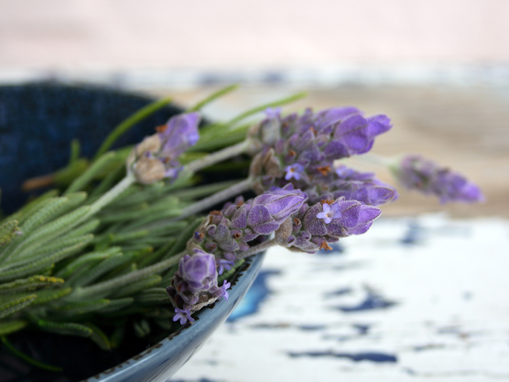
Winter Wellness with Essential Oils
Essential Wellness

Slide 2
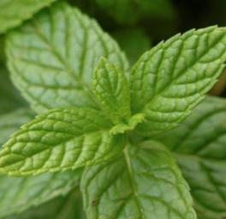
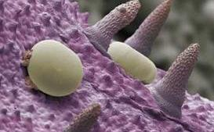
WHAT IS AN ESSENTIAL OIL?
Natural aromatic compounds found in plants
Steam distilled or cold pressed extraction
Powerful, safe benefits without side effects
50 to 70x more powerful than herbs
(Oil sacs on peppermint leaf)

Slide 3
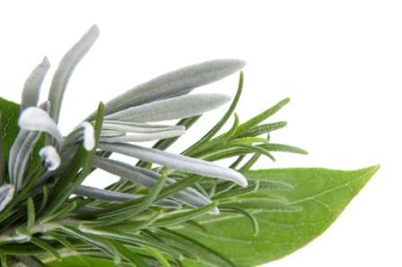
=
ONE drop of peppermint essential oil is equivalent to 28 cups of peppermint tea!
Notes:
Essential oils are concentrated volatile compounds from plants.

Slide 4
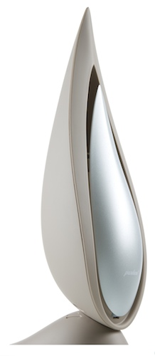
ESSENTIAL OIL USES
Aromatic
Diffuse in a room to:
Impact mood
Open airways
Cleanse environment
©2009 dōTERRA INTERNATIONAL,LLC

Slide 5
ESSENTIAL OIL USES
Topical
Apply directly to skin for systemic or localized effects

Slide 6
ESSENTIAL OIL USES
INTERNAL
In an Empty Capsule
Under your tongue
In a glass of water or juice
In a teaspoon with honey

Slide 7
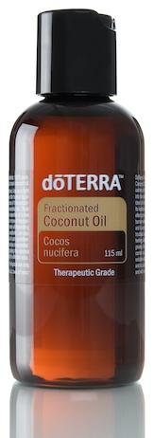
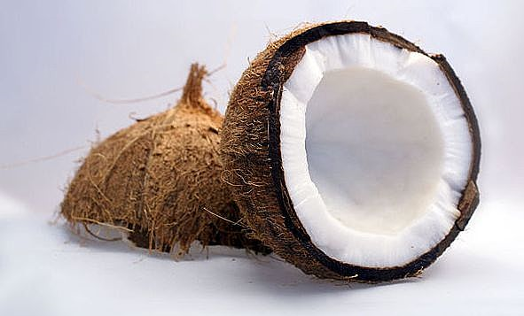
ESSENTIAL OIL SAFETY
Very safe and gentle with few side effects
Keep out of eyes, ears, and nose
Dilute with carrier oil, not water
Skin sensitivity primary safety issue
Follow all label directions

Slide 8
Why choose dōTERRA essential oils?
©2009 dōTERRA INTERNATIONAL,LLC

Slide 9
CERTIFIED PURE THERAPEUTIC GRADE®
PURE—100% natural, no artificial ingredients, fragrances, or fillers
SAFE—Certified to be free of pesticides and other chemical residues
POTENT—Standardized active compounds
©2009 dōTERRA INTERNATIONAL,LLC

Slide 10
Sources
Birch
Rose
Juniper
Lavender
White Fir
Thyme
Melissa
Lemongrass
Peppermint
Clary Sage
Marjoram
Sandalwood
Helichrysum
Oregano
Cassia
Basil
Cedarwood
Frankincense
Fennel
Grapefruit
Wintergreen
Coriander
Rosemary
Cypress
Geranium
Patchouli
Vetiver
Lemon
Hawaiian Sandalwood
Wild Orange
Myrrh
Black Pepper
Roman Chamomile
Ginger
Bergamot
Cilantro
Cinnamon
Lime
Ylang Ylang
Clove
Eucalyptus
Melaleuca
Notes:
Emily explained how the quality of dōTERRA’s CPTG Certified Pure Therapeutic Grade essential oils actually begins with the careful selection and nurturing of source plant materials. dōTERRA works with skilled growers from around the world to carefully select the right plant species, grown in the right environmental conditions, and harvested at the right time to ensure consistent quality and potency of each essential oil. Building close relationships with agricultural artisans around the globe is key to maintaining a supply of quality oils.

Slide 11
Why do we get run down?

Slide 12
Top 10 Reasons
Not washing hands
Not getting enough sleep
Working too much
Not drinking enough fluids
Not cleaning things well
Cleaning too much
Too much Stress
Poor Diet
Not enough exercise
Exposure to Germs and Toxins

Slide 13
How can we stay HEALTHY all Year long?

Slide 14
Proper Nutrition
dōTERRA Lifelong Vitality Pack
Anti-inflammatory, Essential Oils, Anti-Oxidants,
Vitamins & Minerals
© 2008 dōTERRA Holdings, LLC, Unauthorized duplication prohibited

Slide 15
Top 10 Benefits
Soothes inflammation
Supports healthy immune function
Supports healthy cells
Enhances energy, vitality and wellness
Supports brain function & memory
Supports digestion & metabolism
Revitalizes appearance of skin
Eases stress in body
Encourages Emotional Stability

Slide 16
Drinking Enough Water
“Drinking plenty of water will keep you well hydrated. Proper hydration is essential to a strong immune system and will help you feel better as well.”
-- Kristina Duda, R.N., “ How To Maintain Your Health and Prevent Colds and the Flu”
Drink at least 64 ounces of water a day
Add 1-2 drops essential oil to your water for taste and for added immune support.
Lemon
Wild Orange
Lime
Peppermint
Grapefruit
Slim & Sassy

Slide 17
Managing Stress
Lavender
Serenity
Elevation
Balance
Ylang Ylang

Slide 18
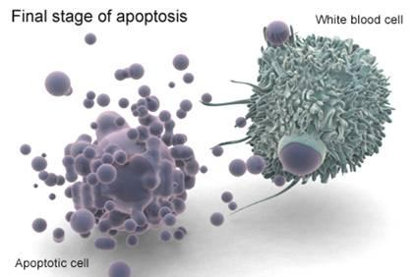
Cleansing your Body
Why does this matter?

Slide 19
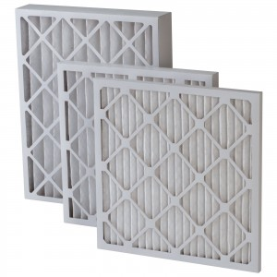
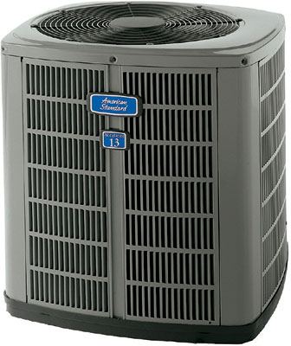
What is This?

Slide 20
Cleansing your Body
Essential Oils
Lemon, and other Citrus Oils
Supports the body with flushing toxins and petrochemicals from body

Slide 21
Cleansing your Organs
Zendocrine Complex
Promotes healthy functioning of endocrine system
Cleanses liver, kidneys, colon, lungs, and skin
Zendocrine Essential Oil Blend
Can Help supports and repair liver, kidneys, colon, lungs, and skin

Slide 22
Cleansing your Body
GX Assist – Cleansing your Digestive tract
Take 1-3 soft gels with meals for 10 days per month as needed.
PB Assist– Helps support and replenish healthy micro flora in the digestive Tract
Take 1 three times a day with food for 5 days each month

Slide 23
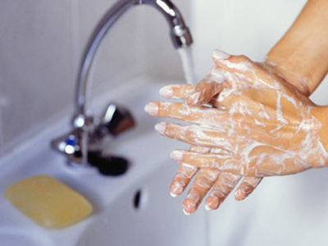
Wellness = Keeping Germs Away
Hand Washing
"Washing your hands is the best way to fight viruses and germs — if you do it properly,"
--- Philip Tierno, PhD, director of clinical microbiology and immunology at New York University

Slide 24
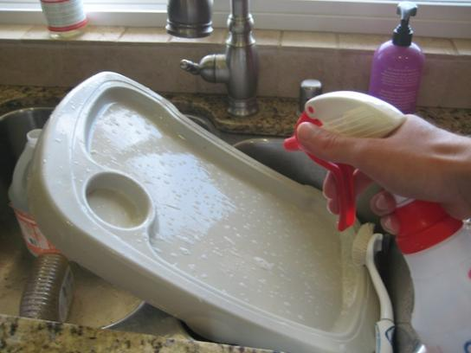
Keeping Germs Away
Sanitizing Surfaces
Lemon
Lime
Wild Orange
Purify
On Guard

Slide 25
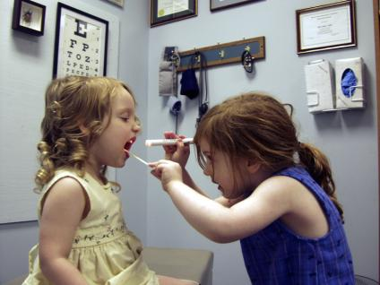
Building Immunity
“Our immune systems are the first line of defense against diseases and viruses” --Dr. David Hill
Prevention
On Guard
Cinnamon
Frankincense
Oregano
Thyme
Life Long Vitality Pack
On Guard Throat Drops

Slide 26
Common Winter Season Remedies
Lemon
Dries up Mucus, Soothes Throat, Eases Cough, Slows down Runny/Stuffy Nose
Breathe
Supports all types of Respiratory Functions
Head tension, Tempurature balance, Eases Cough and Congestion, Opens up Airways, Digestive Support, Cooling and Soothing to Throat
Peppermint

Slide 27
Winter Season Remedies
DigestZen
Soothes Stomach, Intestinal Support, Eases Acid Buildup
Lavender
Ear Support, Calms Angry Skin, Soothes burns
Frankincense
Calms bumps and scrapes, Supports Cognition and Energy Levels

Slide 28
Watch out for the Cuddies!
Oils to use for Immune Support
On Guard
Cinnamon
Frankincense
On Guard Throat Drops
Lemon
Oregano
Thyme

Slide 29
With dōTERRA,
you are in control!
©2009 dōTERRA INTERNATIONAL,LLC

Slide 30
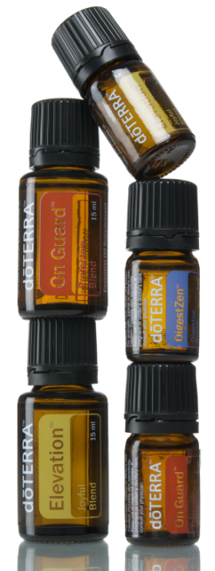
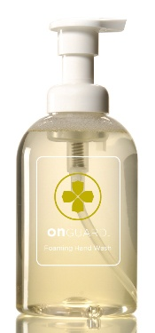
dōTERRA Product Categories
Essential Oils
Wellness
Spa
Living

Slide 31
How do you become an oil user?
If you know the alphabet, you can be an essential oils user.
This book will help you become an essential oil expert
www.AromaTools.com
www.Doterra.com
www.SourceToYou.com

Slide 32
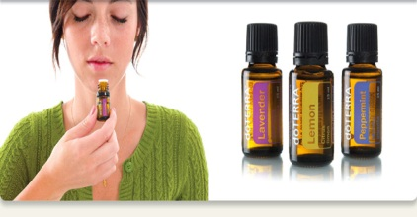
How to Purchase
Wholesale Customer
$35 Membership or Enrollment Kit
Loyalty Rewards Program
Wellness Advocate
Same as customer, plus
Earn commissions on sales
Get all your shipping costs back in product points
Earn 10-30% of your purchase back in credits
Deeper discounts on popular items
25% discount off retail
Notes:
You have three choices as to how you will buy from doTERRA. You can just buy the product retail; or for a $35 fee you can become an Independent Product Consultant (IPC) and get 25% off every order and have the option to earn commissions on any product purchased through you.

Slide 34
Now Is The Time

